Slide 1
Food labels

Slide 2
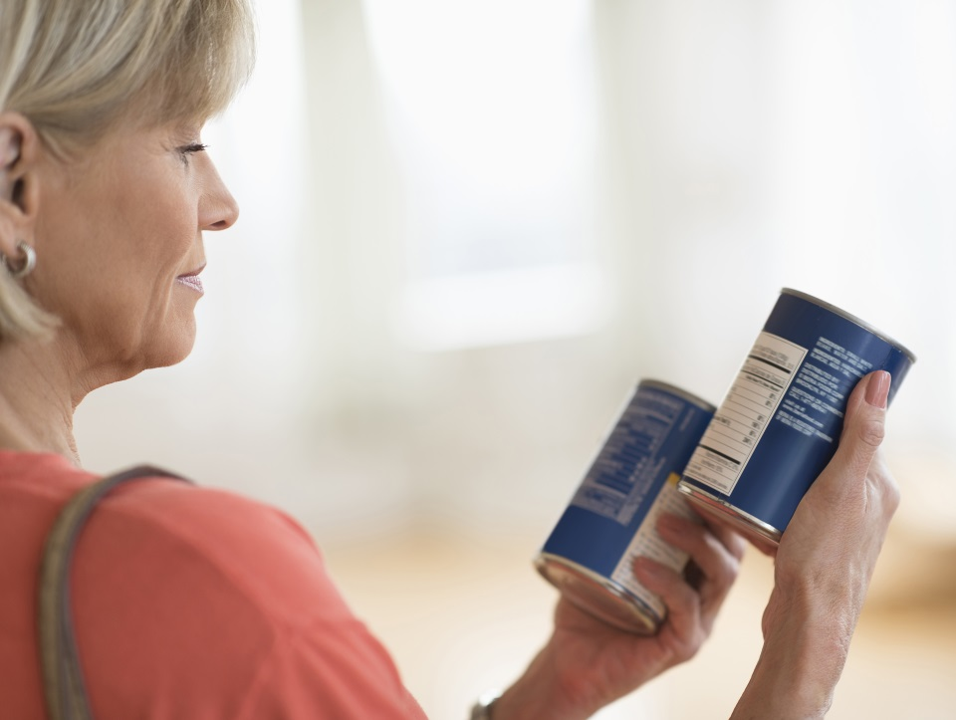
Labels
Food labels provide information which helps people to know when to eat food, and how to store it safely.

Slide 3
Date marks
Date marks show by when food should be eaten. There are two types:
‘use by’
‘best before’

Slide 4
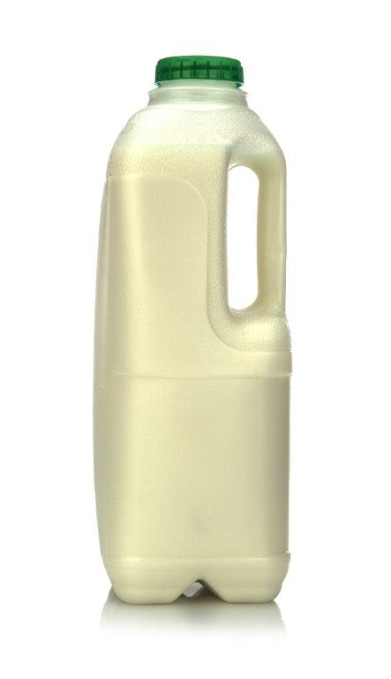
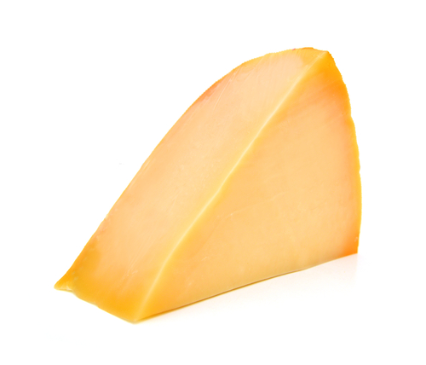
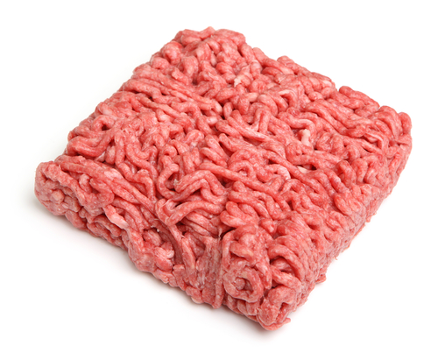
‘Use by’
This is used on foods such as milk, cheese, meat and ready-made pizzas.
It shows the day/month, e.g. 8 Feb.
After this date, the food is not safe to eat.

Slide 5
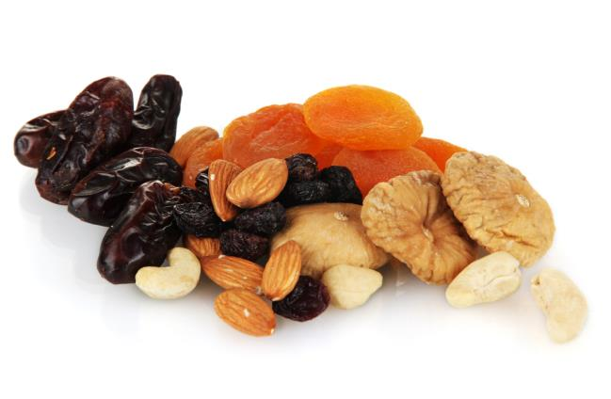
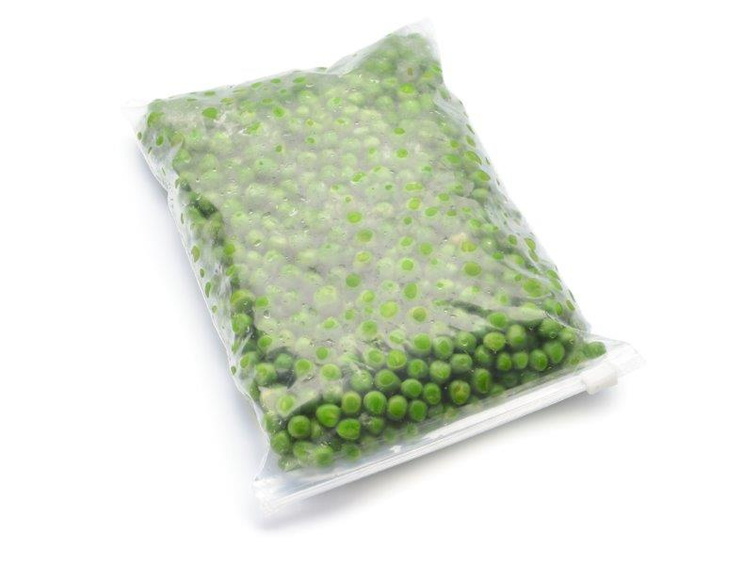
‘Best before’
This is used on foods such as canned beans, dried fruit, breakfast cereals and frozen peas.
It shows the month/year, e.g. Feb ’08.
After this date, the food will probably be safe to eat, but may not look or taste as good.

Slide 6
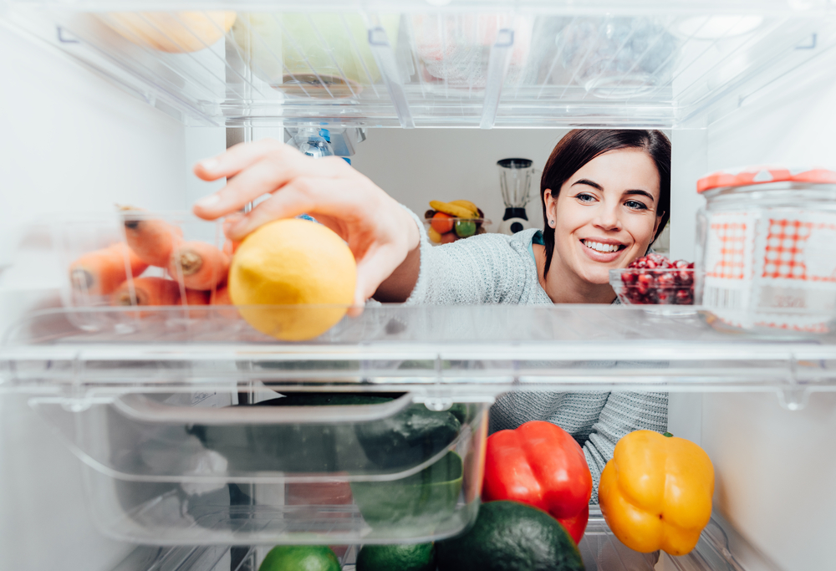
Storage instructions
Labels show how best to store the food to keep it safe.
For example:
cool, dry place (cupboard);
refrigerated (in the fridge);
frozen (in the freezer).

Slide 7
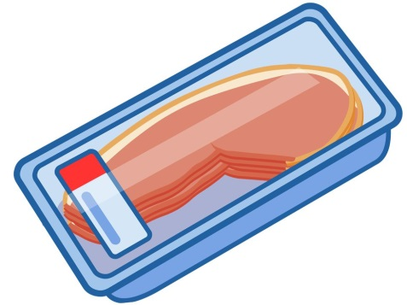
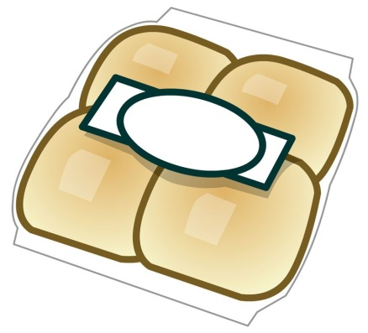
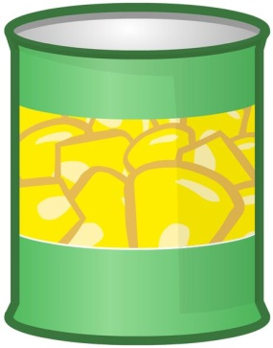
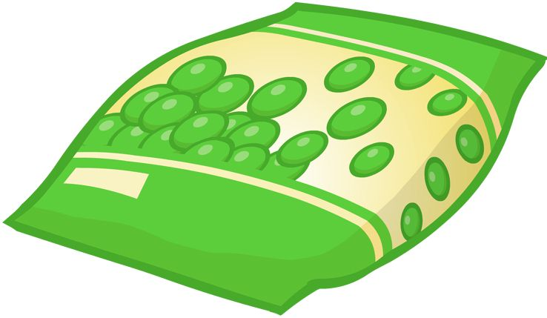
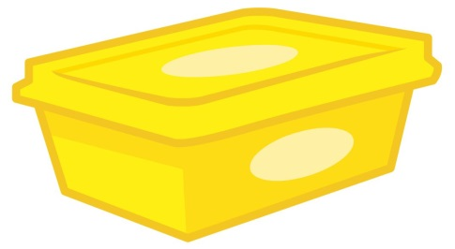
Where should these foods be stored?
cupboard
freezer
fridge

Slide 8
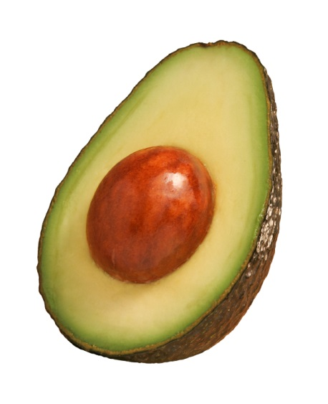
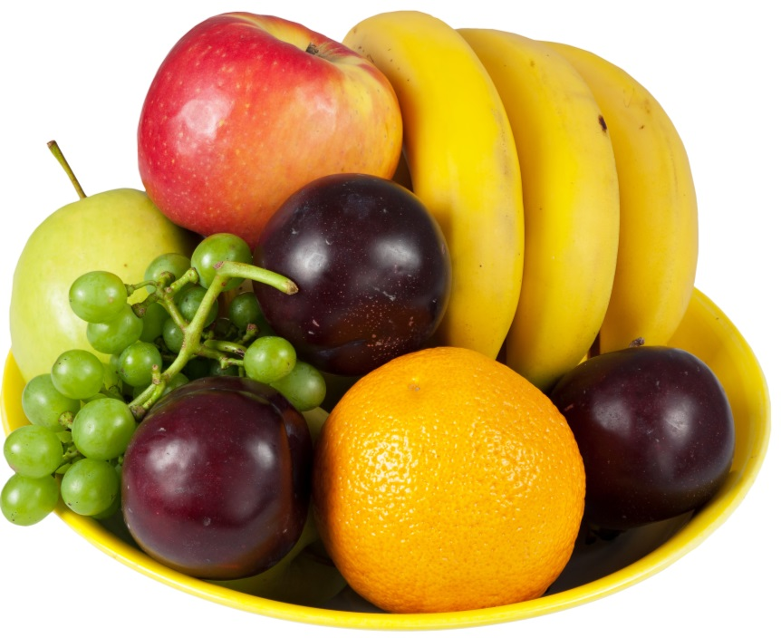
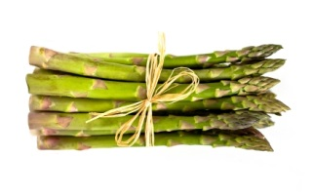
Foods that do not have labels
Lots of the food we buy (or grow) does not have labels.
Examples include:

Slide 9
Foods that do not have labels
Name other examples.

Slide 10
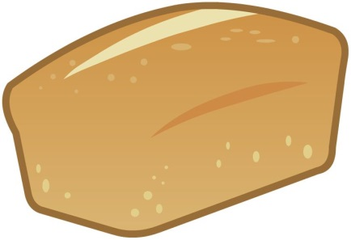

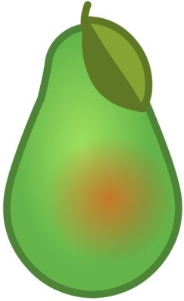
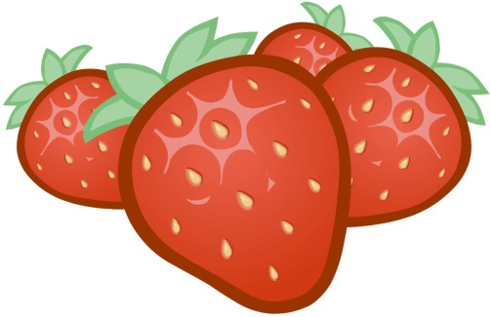
Where could these foods be stored?
cupboard
freezer
fridge

Slide 11
Food labels
For further information, go to:
www.foodafactoflife.org.uk
This resource meets the Guidelines for producers and users of school education resources about food.

