Slide 1
Selecting ingredients

Slide 2


Selecting ingredients
Ingredients are chosen for a number of reasons, such as:
to add flavour, colour or texture;
to provide a particular function, e.g. to thicken;
to provide nutrients or change the nutritional profile of a dish, e.g. to increase the fibre content;
to extend the shelf life, e.g. vinegar for pickling or chemical preservatives;
cost and availability, e.g. fruit in season;
to satisfy a need to buy food with a certain provenance, e.g. Red Tractor.

Slide 3
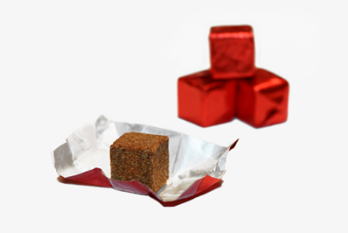
Adding flavour
Fresh and dried herbs and spices can be added to dishes to provide flavour, e.g. curry powder or garlic.
Herbs and spices can also be used to replace the salt in some dishes.
Food processing, packaging and storing can impact the flavour of food so manufacturers may add additives such as flavour enhancers to over come this.

Slide 4
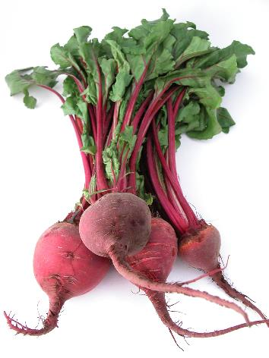
Adding colour
Fruit, vegetables, herbs and spices can all be used in recipes to add colour.
Food processing can impact the colour of food so manufacturers may use additives to improve this.
For example, canned mushy peas contain the colours E101 (yellow-orange) and E133 (brilliant blue) to provide the bright green colour expected of peas.

Slide 5

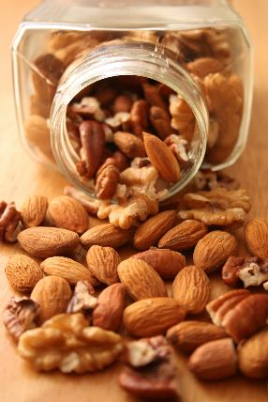
Adding texture
Nuts, seeds, grains, fruit and vegetables can all be added to recipes to provide texture, e.g. poppy seeds on a bread roll.
The cooking method and cooking time can also impact the texture, e.g. steaming or microwaving vegetables quickly can retain their colour, flavour and firm texture.
Equipment used to process the food can also impact the texture, e.g. using a food processor to blend soup for a smoother texture.

Slide 6
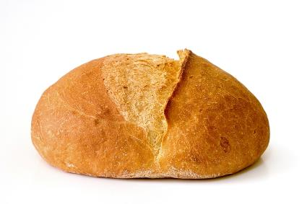

To provide a particular function
Ingredients provide a variety of functions in recipes, such as:
thickening, e.g. flour in a roux sauce (gelatinisation);
setting, e.g. eggs in quiche (coagulation);
browning, e.g. flour in a bread roll (dextrinisation);
raising, e.g. baking powder in a Victoria sponge.

Slide 7
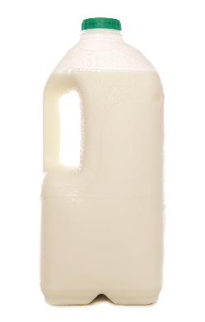
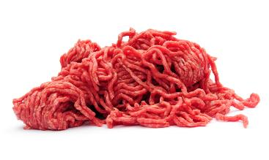
To provide nutrients or change the nutritional profile of a dish
All ingredients provide nutrients and/or energy, e.g. fish (protein) and potatoes (starchy carbohydrates) in a fish pie.
Some ingredients can be changed or modified to improve the nutritional profile of a dish, e.g. wholemeal flour for added fibre, reduced fat cheese, lean beef mince.
The quantity of ingredients can also be reduced, or ingredients substituted, e.g. using a smaller amount of a strong flavoured mature cheese can reduce the fat content of a dish whilst retaining the flavour.

Slide 8
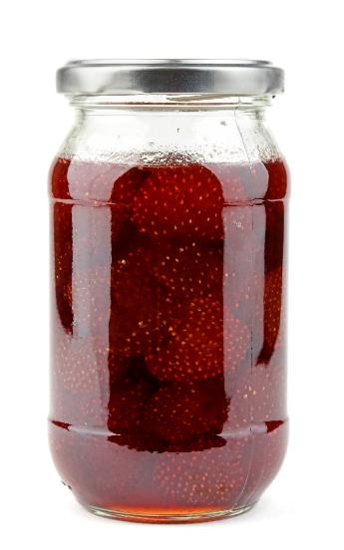
Extending the shelf life
Once slaughtered, picked or harvested food begins to deteriorate. Ingredients can be chosen to extend the shelf life of foods and dishes, such as vinegar for pickling and sugar for jamming.
Manufacturers also use ingredients such as preservatives to extend the shelf life of foods, for example sodium benzoate is used to protect food from bacteria, yeast or fungi growth.

Slide 9

Cost and availability of ingredients
The amount of money available may impact the type and quantity of ingredients bought and selected. If buying for a special occasion or celebratory meal, consumers may wish to spend more on ingredients or buy something required for a particular recipe.
The availability of food can also influence the ingredients selected, e.g. fresh vegetables from a local market or frozen vegetables from a supermarket. Many people wish to eat local produce, but this can cost them more.

Slide 10

Eating local produce
Consuming seasonal produce that is locally grown food means people can eat food that does not have to travel long distances to reach your plate.
This practice also supports local farmers and the regional economy, helping to sustain agricultural livelihoods and reduce the carbon footprint associated with food transportation.
Ensuring that the carbon footprint of the produce is reduced is another key consideration for shoppers.

Slide 11




Food provenance
Some consumers want to know that their food has been reared, grown or produced following high standards of hygiene, welfare and care of the environment.
Therefore, they may choose to buy foods that display the logo of organisations. The logo shows that adhere to these high standards.

Slide 12

Fair trading
Some consumers wish to support farmers, growers and producers and ensure they receive a fair wage, live in acceptable housing and receive good support and education.
Fair trading is important across the world, in developing countries and locally in the UK.

Slide 13
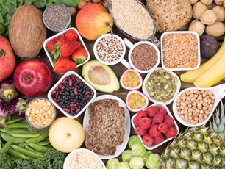
Food waste
Another consideration people have when selecting ingredients is ensuring food is not wasted in the production or processing of food.
It is estimated that the 10.4-13mn tons of food waste produced annually costs the UK £19 billion a year.
Addressing food waste requires concerted efforts across the supply chain, from producers to consumers, to implement more efficient practices and encourage behavioural changes towards more sustainable consumption.
Food Foundation 2024

Slide 14
Selecting ingredients
For further information, go to:
www.foodafactoflife.org.uk
This resource meets the Guidelines for producers and users of school education resources about food.

