Slide 1
Meals and snacks

Slide 2
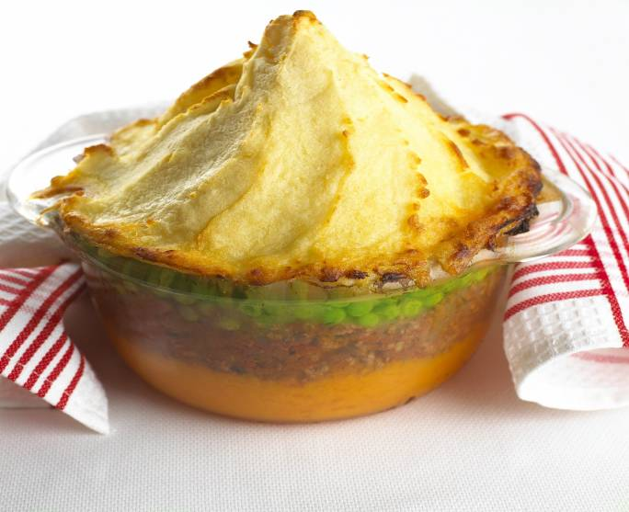
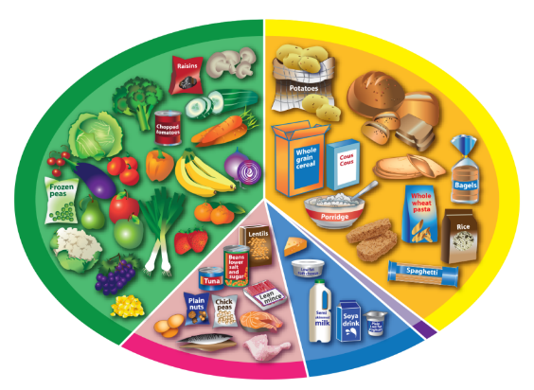
Meals and snacks
Meals and snacks are made with food from different food groups.
What food can you see in this dish?
Where would they belong on the Eatwell Guide?
Potato
Minced lamb
Peas

Slide 3
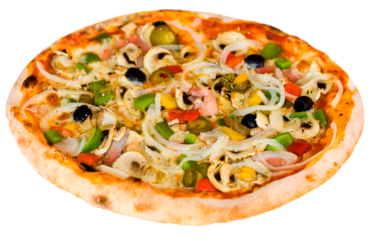
Pizza
Where does the food belong on the Eatwell Guide?
What food can you see in this dish?
Bread
Tomato sauce
Chicken
Cheese
Vegetables

Slide 4
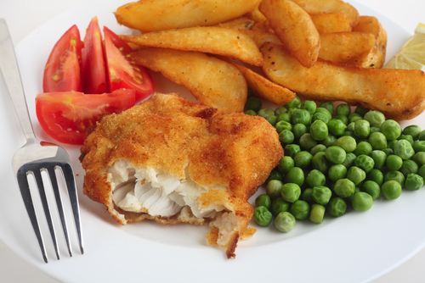
Fish, wedges and peas
Where does the food belong on the Eatwell Guide?
What food can you see in this dish?
Potatoes
Fish
Peas
Tomatoes

Slide 5
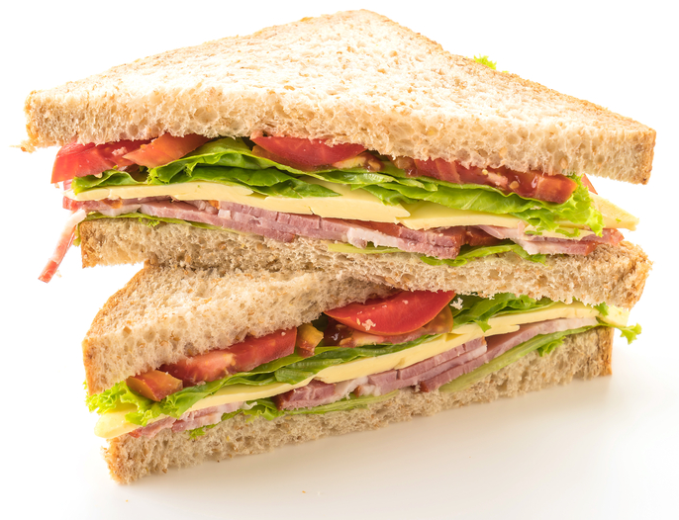
Sandwich
Where does the food belong on the Eatwell Guide?
What food can you see in this dish?
Bread
Spread
Cheese
Salad

Slide 6
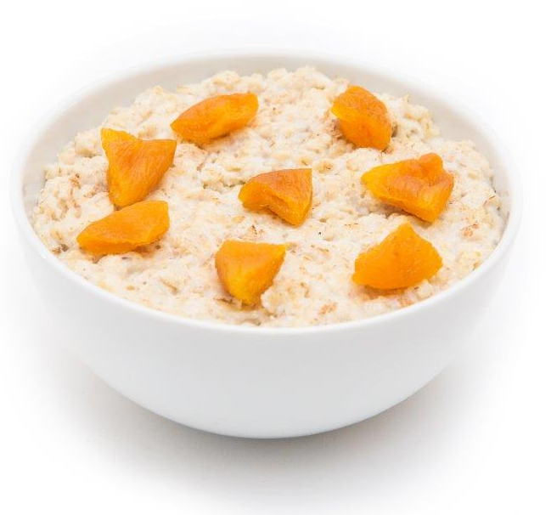
Porridge with apricots
Where does the food belong on the Eatwell Guide?
What food can you see in this dish?
Oats
Milk
Apricots

Slide 7
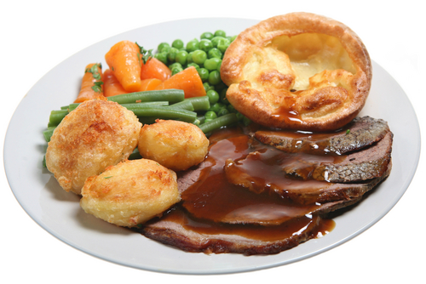
Roast dinner
Where does the food belong on the Eatwell Guide?
What food can you see in this dish?
Beef
Potatoes
Peas
Carrots

Slide 8
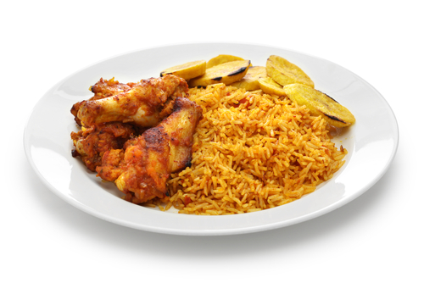
Jollof rice, chicken and plantain
Where does the food belong on the Eatwell Guide?
What food can you see in this dish?
Chicken
Rice
Plantain

Slide 9
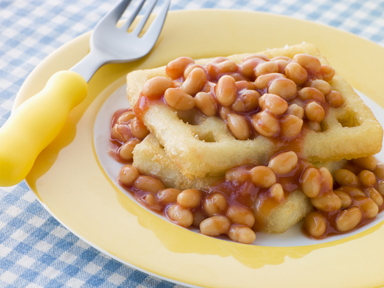
Potato waffle and baked beans
Where does the food belong on the Eatwell Guide?
What food can you see in this dish?
Potato
Beans

Slide 10
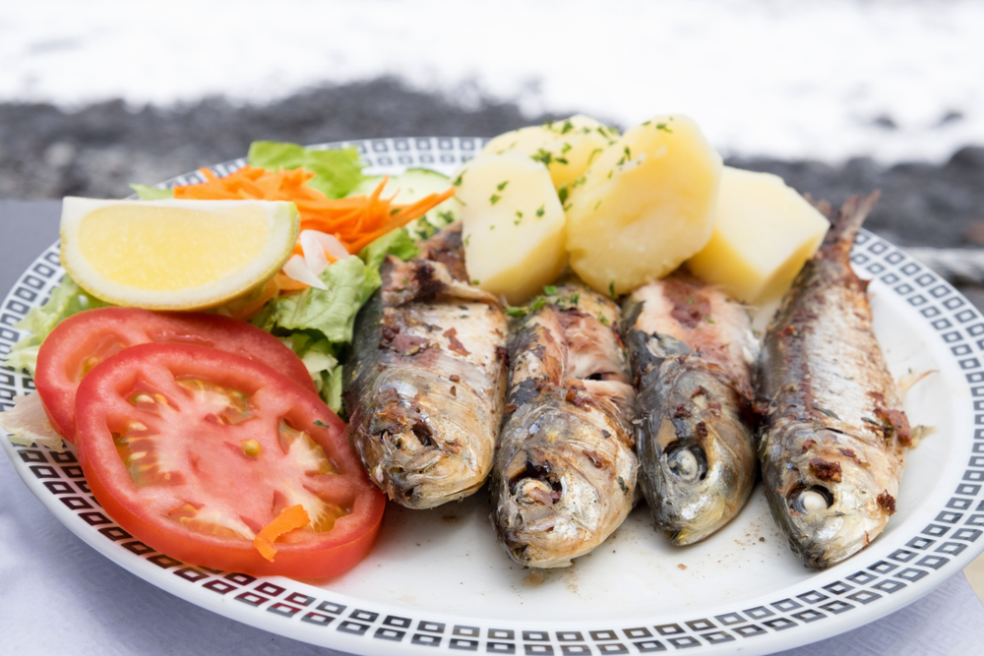
Grilled fish, potatoes and salad
Where does the food belong on the Eatwell Guide?
What food can you see in this dish?
Fish
Potatoes
Tomatoes

Slide 11
Meals and snacks
For further information, go to:
www.foodafactoflife.org.uk
This resource meets the Guidelines for producers and users of school education resources about food.

