Slide 1
Unhealthy diets

Slide 2
Starter
What can happen to the body if we don’t eat enough food?
What can happen to the body if we eat too much food?
Name four diseases associated with poor diet and lack of exercise.
Extension:
Suggest how can diet and exercise affect your risk of developing disease?

Slide 3
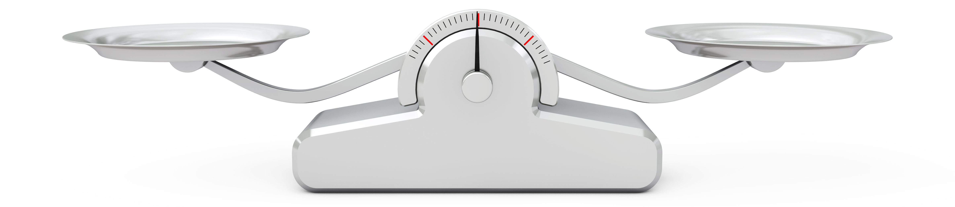
Demo – scales and energy balance
To maintain body weight it is necessary to balance energy intake (from food and drink) with energy expenditure (from activity).

Slide 4
Positive energy balance
A person is said to be in positive energy balance when the diet provides more energy than is needed to meet energy demands of the body. Energy is stored as fat and the person puts on weight over time.
People who achieve a positive energy balance over an extended period of time are likely to become overweight or obese.
Energy out: activity
Energy in: food and drinks
Energy in > Energy out = Weight gain

Slide 5
Negative energy balance
A person is said to be in negative energy balance when there is insufficient energy from the diet to meet energy demands of the body. Energy is derived from energy stores and the person loses weight.
People who achieve a negative energy balance over an extended period of time are likely to become underweight.
Energy in: food and drinks
Energy out: activity
Energy out > Energy in = Weight loss

Slide 6
Energy balance
Energy balance can be maintained by:
regulating energy intake through the diet;
adjusting physical activity levels;
a combination of both.

Slide 7
Fill in the gaps
Risk factors are linked to an _______ rate of a disease. They can be aspects of a person’s lifestyle, ________ in the person’s body or the _____________.
A ______ mechanism has been proven for some risk factors, but not in others.
Your weight and the amount of _______ you take affects your ______ of developing various _________.
increased
substances
environment
causal
exercise
risk
diseases

Slide 8
Energy and nutrients
It is not just important to balance our energy intake. It is also important to make sure we have the right amount of nutrients.
Food is eaten and digested in the body to allow the absorption of energy and nutrients.
There are two different types of nutrients:
macronutrients (carbohydrate, protein, fat);
micronutrients (vitamins and minerals).

Slide 9
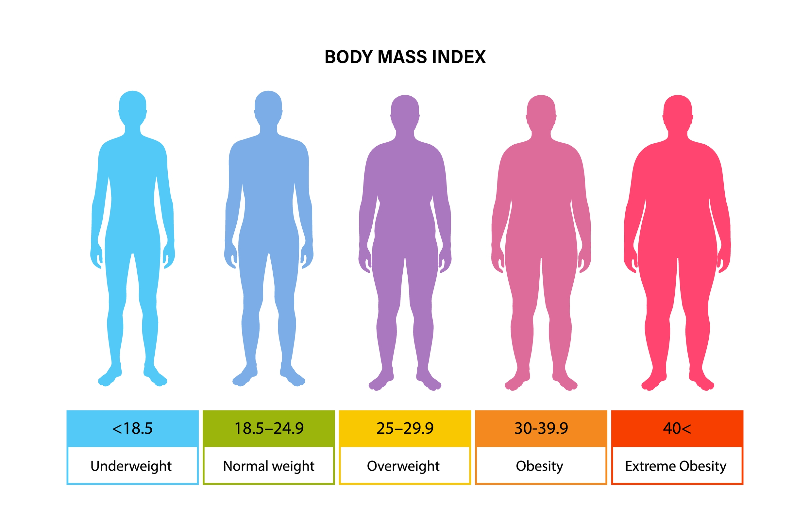
Undernutrition
If the energy in the food you eat is less energy than you use in the day, you will lose body mass.
You can become underweight and in extreme cases, this is known as starvation.
Underweight people often suffer from:
poor immune system and other health problems;
lack of energy, often tired;
lack of vitamins and minerals.

Slide 10
Undernutrition
Worldwide, Kwashiorkor and marasmus are two common diseases caused by a lack of protein and energy.
Fat soluble vitamins (A, D, E and K) and minerals are stored in the body so it takes time for deficiency diseases to develop. For example, vitamin A deficiency can lead to ‘night blindness’.
Water soluble vitamins are not stored in the body so low intakes usually lead to signs of deficiency relatively quickly.

Slide 11
Over nutrition
If the energy in the food you eat is more than the energy you use in the day, you will gain body mass. This is stored as fat under the skin
You can become overweight. This can lead to obesity in extreme cases
Overweight people can have an increased risk of:
heart disease;
stroke;
diabetes;
some cancers

Slide 12
Over nutrition
Over nutrition is a problem usually associated with developed countries, such as the United Kingdom.
The most common over nutrition problem is obesity caused by too much energy being consumed, or high levels of inactivity.

Slide 13
Undernutrition or overnutrition
Complete the following table with information on overnutrition and undernutrition.
 | Overnutrition | Undernutrition
Definition
Explanation
Risks
Examples

Slide 14
Body Mass Index (BMI)
Body Mass Index (BMI) can be used to identify if an adult is a correct weight for height.
BMI can be calculated as follows:
BMI = weight (kg)
(height in m)²
Recommended BMI range (adults)
Less than 18.5 Underweight 18.5 to 25 Desirable or healthy
range 25-30 Overweight 30-35 Obese (Class I) 35-40 Obese (Class II) Over 40 Morbidly or severely
obese (Class III)

Slide 15
Calculating BMI – worked example
William
Height: 1.75m
Weight: 80kg
BMI =
Jane
Height: 1.56m
Weight: 48kg
Recommended BMI range
Underweight less than 18.5
Normal 18.5 - less than 25
Overweight 25 - less than 30
Obese 30 - 40
Very obese over 40
weight (kg)
height (m) x height (m)
= 26.1 = 19.7
(overweight) (normal)

Slide 16
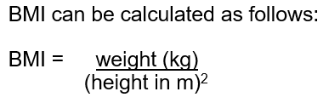
BMI calculation
Calculate the BMI. Click the colour blocks to reveal the answers.
51kg 82kg 78kg
1.7m x 1.7m 1.95m x 1.95m 1.63m x 1.63m
= 17.6 BMI = 21.6 BMI = 29.4 BMI
Underweight healthy weight overweight
Samantha
Height: 1.70m
Weight: 51kg
2. Rashid
Height: 1.95m
Weight: 82kg
3. Ahmad
Height: 1.63m
Weight: 78kg

Slide 17
Healthy food leaflet
Create a leaflet to go in a doctor’s waiting area which describes the importance of a healthy balanced diet. Include:
What a healthy balanced diet is
How you can balance energy intake
What the dangers of an unhealthy diet are
What BMI is
How doctors can use BMI
Make sure to include both overnutrition and undernutrition.

Slide 18

Healthy food leaflet – peer marking
Did it include…
A description of what a healthy balanced diet is
A description of energy balance
Definition of overnutrition and undernutrition

Slide 19
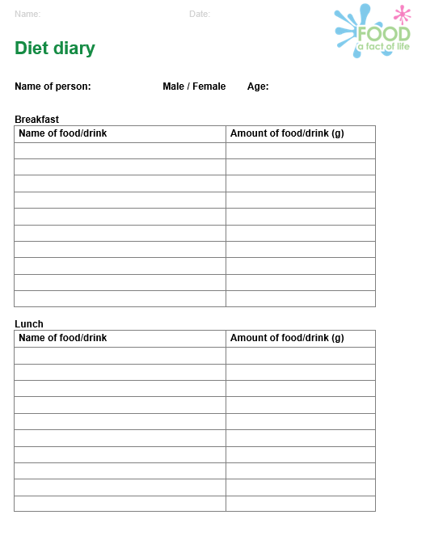
Homework - Diet diary
Keep a diary of what you eat for one day.
Use the worksheet to record what food you eat and use Explore food (a nutritional analysis programme) to calculate the amount of energy and nutrients you have had over the day.
https://explorefood.foodafactoflife.org.uk/

Slide 20
Homework
What food group did you eat most of?
What food group did you eat the least of?
Do you need to eat more of a food group?
Do you need to eat less of a food group?
Overall, do you think that you have a balanced diet?

Slide 21
Key words
Key word​ | Meaning​
Kwashiorkor | A severe type of protein-energy malnutrition.
Malnutrition | A condition that occurs when the diet does not contain the right amount of nutrients, either not enough or more than is needed.
Marasmus | A severe type of protein-energy malnutrition.
Obesity | A high, unhealthy amount of body fat. Usually defined as a body mass index (BMI) of 30 or higher. Having obesity can lead to many health problems.
Overnutrition | When the energy or nutrients in the food you eat is more than required.
Undernutrition | When the energy or nutrients in the food you eat is less than required.

Slide 22
Teachers’ guide

Slide 23
Teaching about unhealthy diets:
Compare healthier and unhealthier food habits.
Understand that too little or too much food can cause disease.
Describe the components of a healthy diet.
Explain health issues that can occur when not eating a healthy diet.
Calculate the BMI of different people.

Slide 24
Unhealthy diets lesson
Common misconceptions:
Energy balance - energy is balanced when it is the same between exercise and food intake (ignoring Basal Metabolic Rate (BMR)). Ensure that it is clear the amount of energy expended does not need to equal the amount that is taken in through food intake.
Energy stores – one of the changes in the way energy is taught in Physics is moving towards talking about ‘energy stores’. Make sure to use this terminology when teaching all topics on energy.
There are ‘bad’ foods – we should be teaching about unhealthy dietary patterns rather than ‘unhealthy’ or ‘bad’ foods or nutrients. Talking about undernutrition as well as overnutrition should support this (you can have too much or too little of a nutrient).

Slide 25
Progressing the learning
The topic of unhealthy diets is also covered at GCSE (14-16 years).
The healthy diet is also covered when looking at topics such as heart disease and type 2 diabetes at GCSE.

Slide 26
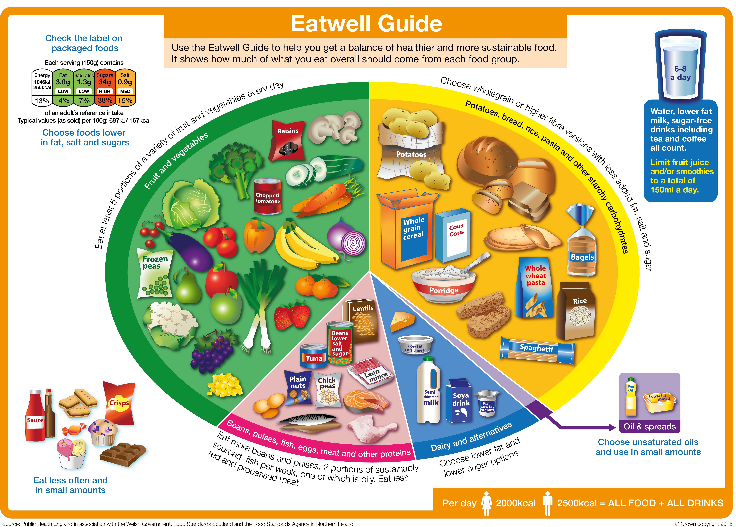
Talking about unhealthy diets
Make sure to focus on the idea of healthier dietary patterns and avoid sorting foods into ‘good’ or ‘bad’.

Slide 27
Extra information for teachers
The following slides contain extra information for teachers to support the teaching and learning around this topic area.
This may be useful as background reading, or you may wish to extend the learning for students by using this information in the lesson.

Slide 28
Malnutrition
Having intakes of energy and/or nutrients below or in excess of needs for long periods of time can affect health. This is called malnutrition.
Severe under nutrition (having an intake of energy and/or nutrients below what is needed) is rare in the United Kingdom, but can be common in some developing countries. However, under nutrition does occur in the UK, e.g. micronutrient deficiencies.
Children suffer the effects of starvation (not enough food) more quickly than adults.

Slide 29
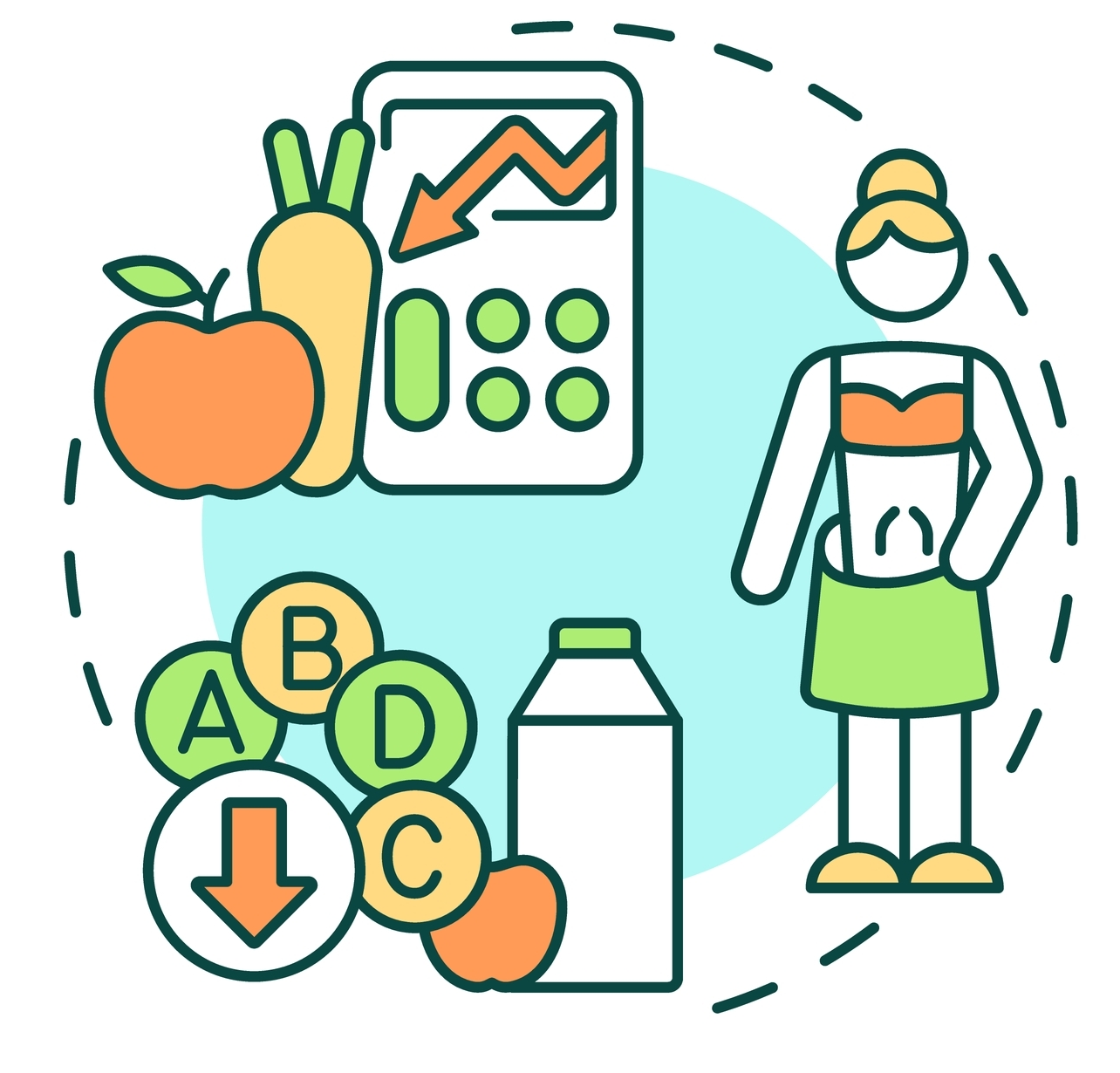
Malnutrition
The risk of malnutrition is increased by:
increased requirements for some nutrients;
restricted range of foods;
reduction in available income;
very low income;
medical conditions;
psychological conditions.

Slide 30

Cancer
Cancer is a complex disease which can take a long time to develop.
A wide variety of factors are involved in the development of cancer, including:
age;
genetics;
environment;
hormones;
infections.

Slide 31
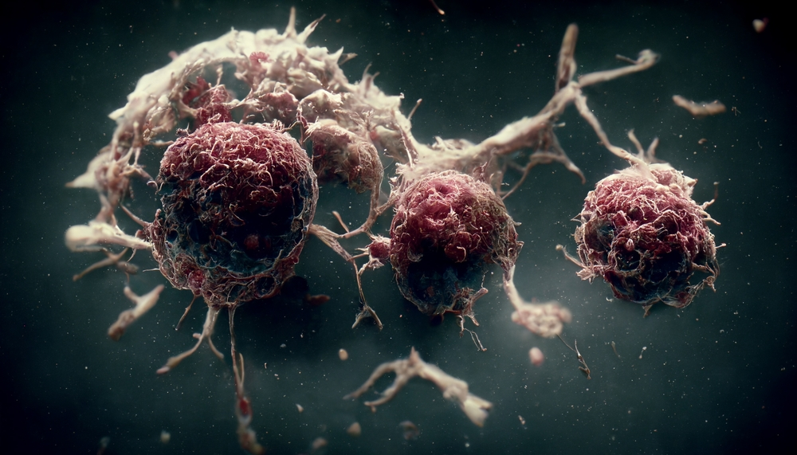
Cancer
Cancer occurs when abnormal cells in the body develop and increase rapidly. The abnormal cells can also spread to other parts of the body and multiply.
Cancer can occur in different parts of the body.
In the UK, the most common cancers in men are lung, prostate or bowel cancer. The most common cancers in women are lung, breast or bowel cancer.

Slide 32

Cancer prevention
The World Cancer Research Fund
has released nine cancer prevention
recommendations:
Be a healthy weight.
Move more.
Avoid high-calorie foods and drinks.
Enjoy more grains, veg, fruit and barley.
Limit intake of red meat and avoid processed meat.
Don’t drink alcohol.
Eat less salt.
Don’t rely on supplements.
Breastfeed your baby.

Slide 33
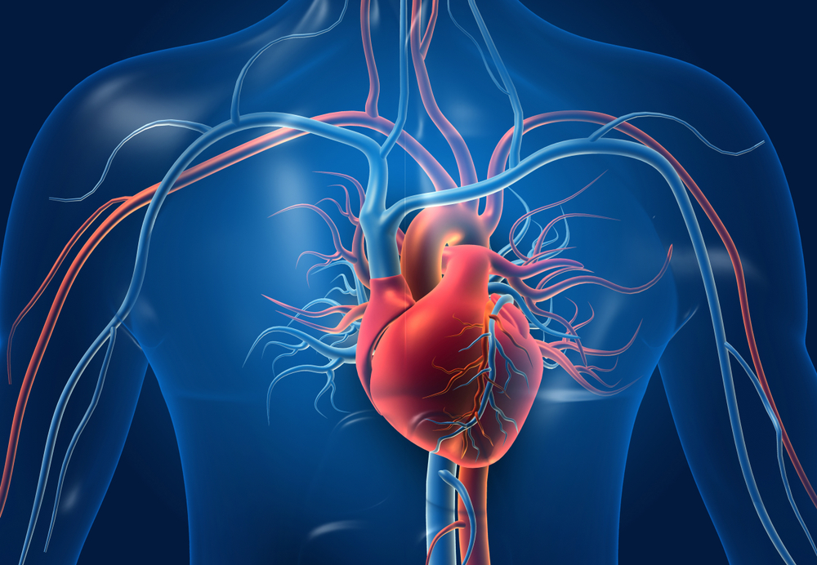
Coronary heart disease
Coronary heart disease (CHD) is caused by a narrowing of the blood vessels to the heart. This reduces the flow of blood to the heart.
If one of the blood vessels becomes completely blocked, the blood supply to part of the heart stops and that part is damaged. This is called a heart attack.

Slide 34

Coronary heart disease
It is estimated 7 million people in the UK are living with Coronary heart disease (CHD), which costs the NHS £6.8 billion a year. CHD is the leading cause of death in the UK, with around 1 person dying from CHD every 8 minutes.
However, it is believed 80% of CHD and strokes could be prevented by changes to lifestyle factors, such as diet, physical activity and smoking.
www.nutrition.org.uk

Slide 35
CHD
The chance of suffering from CHD is affected by many factors. These are called risk factors.
Factors that increase the risk of CHD include being:
male;
older;
a cigarette smoker;
overweight;
inactive;
stressed.
Factors that increase the risk of CHD also include having:
a family history of CHD;
high blood cholesterol level;
high blood pressure;
high intake of saturated fats;
diabetes.

Slide 36
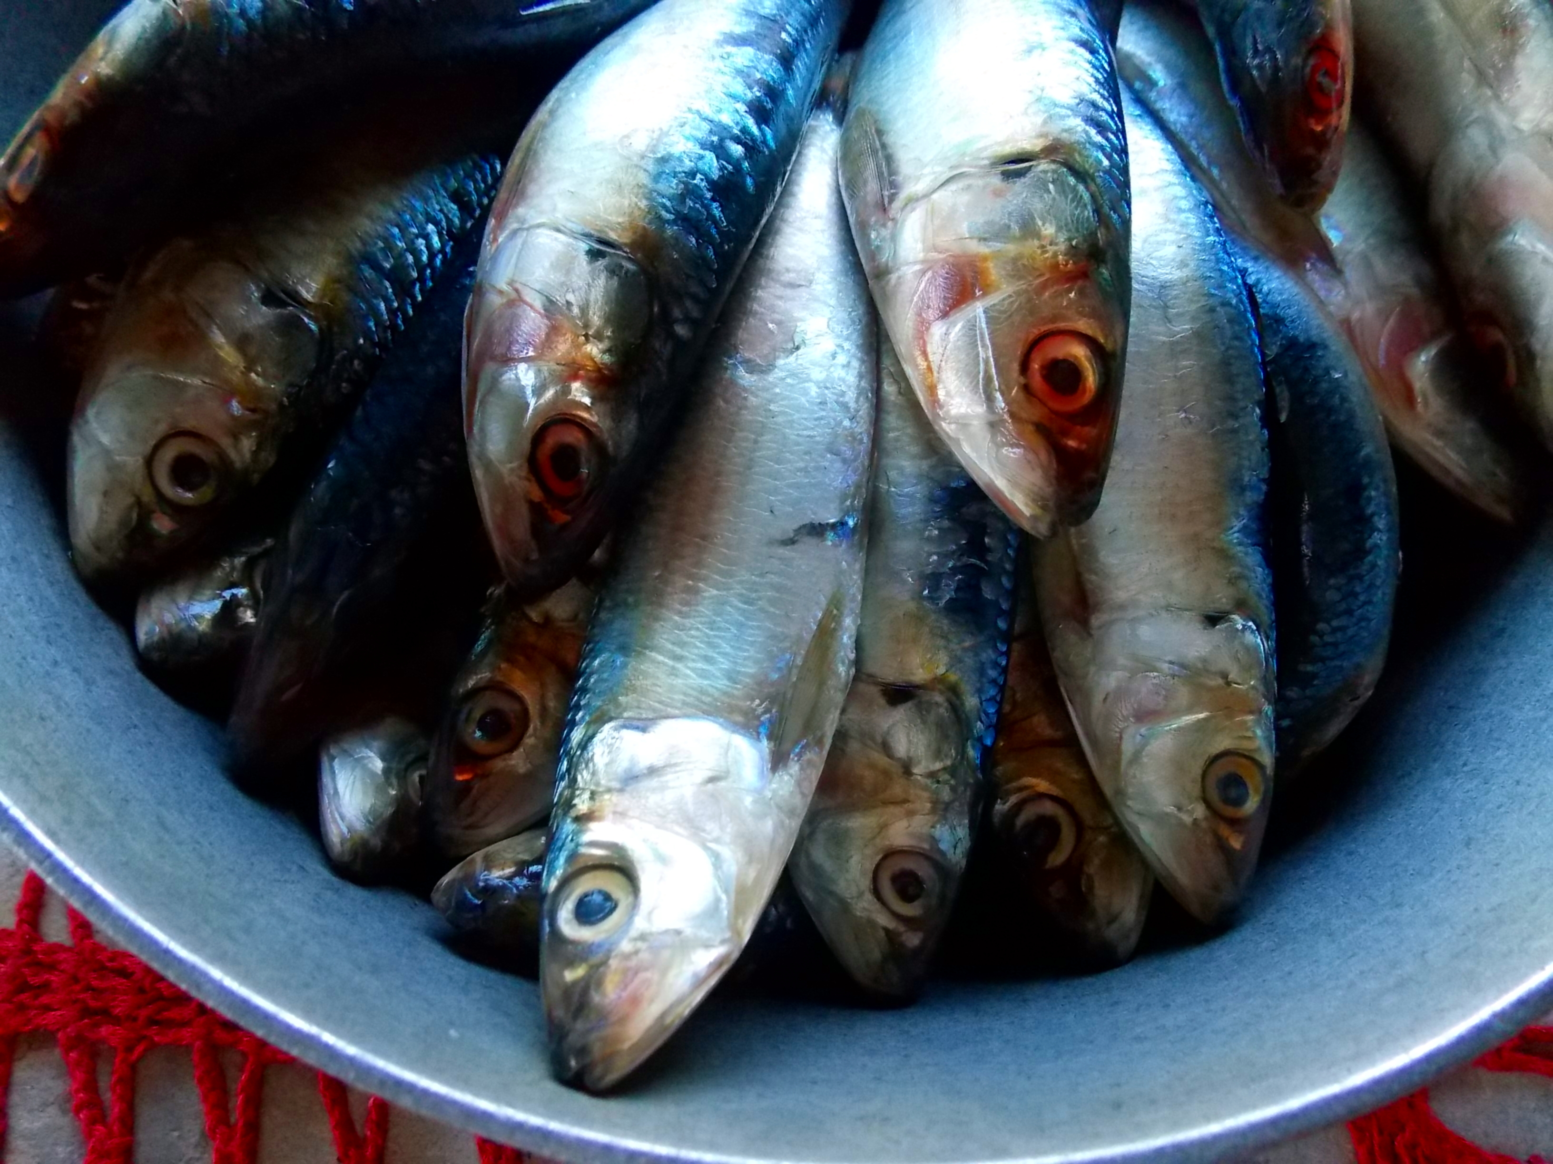
Coronary heart disease
Changes to the diet to reduce the risk of CHD include:
increasing oily fish intake;
reducing salt intake;
increase fruit and vegetables;
decreasing alcohol consumption.

Slide 37
BMI
If a person regularly consumes more energy from food and drink than they need, they will start to gain weight, eventually becoming overweight. For example, energy in > energy out.
Extra energy from food and drink is stored in the body as fat. There are a range of weights which are considered healthy for a given height. These can be calculated by calculating BMI (Body Mass Index).
BMI =
Recommended BMI range
Underweight less than 18.5
Normal 18.5 - less than 25
Overweight 25 - less than 30
Obese 30 - 40
Very obese over 40
weight (kg)
height (m) x height (m)

Slide 38
Obesity
People who are obese are more likely to suffer from:
• coronary heart disease;
• type 2 diabetes;
• gall stones;
• arthritis;
• high blood pressure;
• some types of cancers, i.e. colon, breast, kidney and stomach.

Slide 39
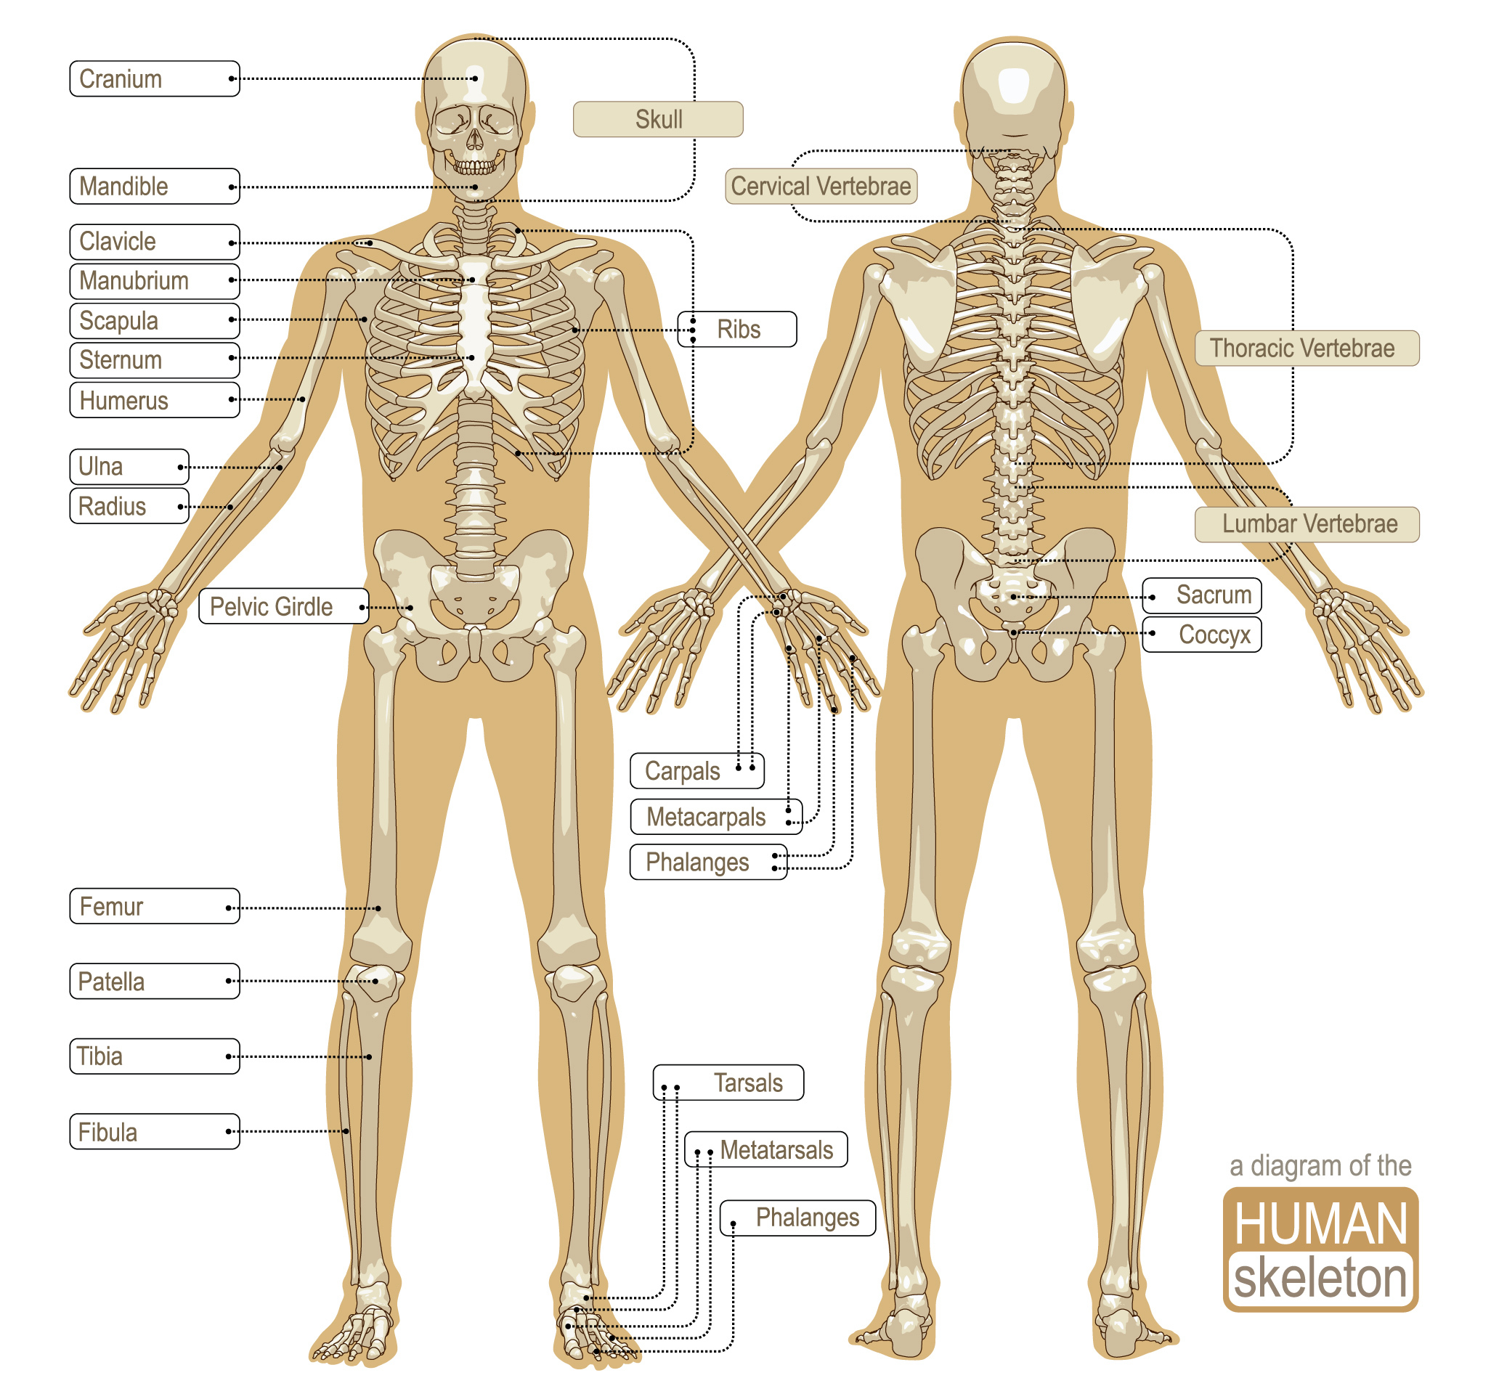
Bone health
Calcium is important for strong bones. Vitamin D is needed for calcium to be absorbed from food.
Osteoporosis is a disease where bones become weak, brittle and break easily. It is caused by severe losses of calcium.
During childhood, adolescence and early adulthood, calcium and other substances are added to the bone. This makes it stronger.
After the age of 30-35, bone loss begins. After the menopause women lose bone at an increased rate.

Slide 40
Bone health
Strong bones contain plenty of calcium and their strength is affected by:
genetics;
sex;
diet;
exercise;
body weight;
hormones.
Consuming adequate amounts of calcium and vitamin D throughout life will help with bone health and strength.

Slide 41
Anaemia
The mineral iron is vital for making red blood cells. Iron from the diet forms haemoglobin, which carries oxygen in the blood.
If the body’s store of iron is low and there is too little iron in the diet, the symptoms of iron deficiency anaemia will start to develop. This is particularly common in young women who have higher iron requirements due to their menstrual cycle.
Iron from animal sources is generally more easily absorbed than iron from plant sources. Vitamin C increases absorption of iron from plant sources.

Slide 42
Unhealthy diets
For further information, go to:
www.foodafactoflife.org.uk
This science pack is one of a series of resources produced for the pHood Futures project, supported by the Royal Society of Chemistry.
This resource meets the Guidelines for producers and users of school education resources about food.

