Slide 1
Vegetable soup
Complexity: medium

Slide 2
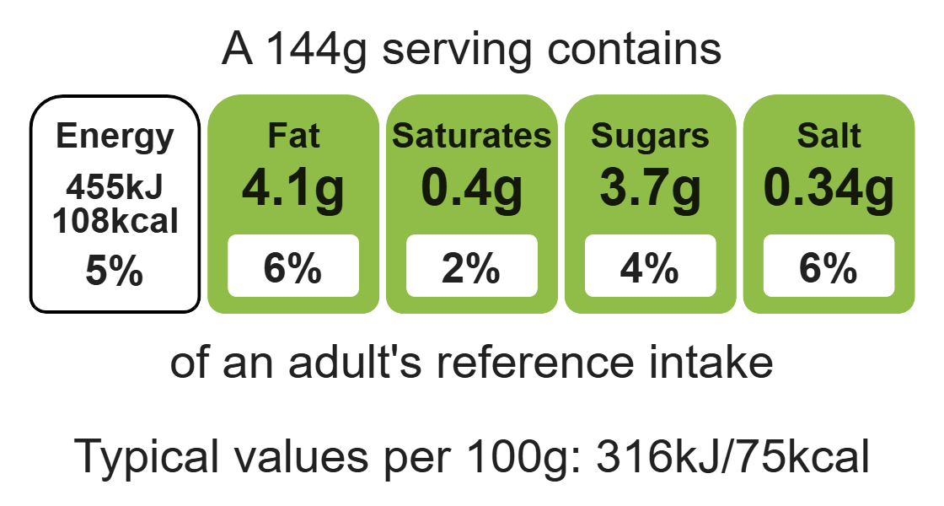
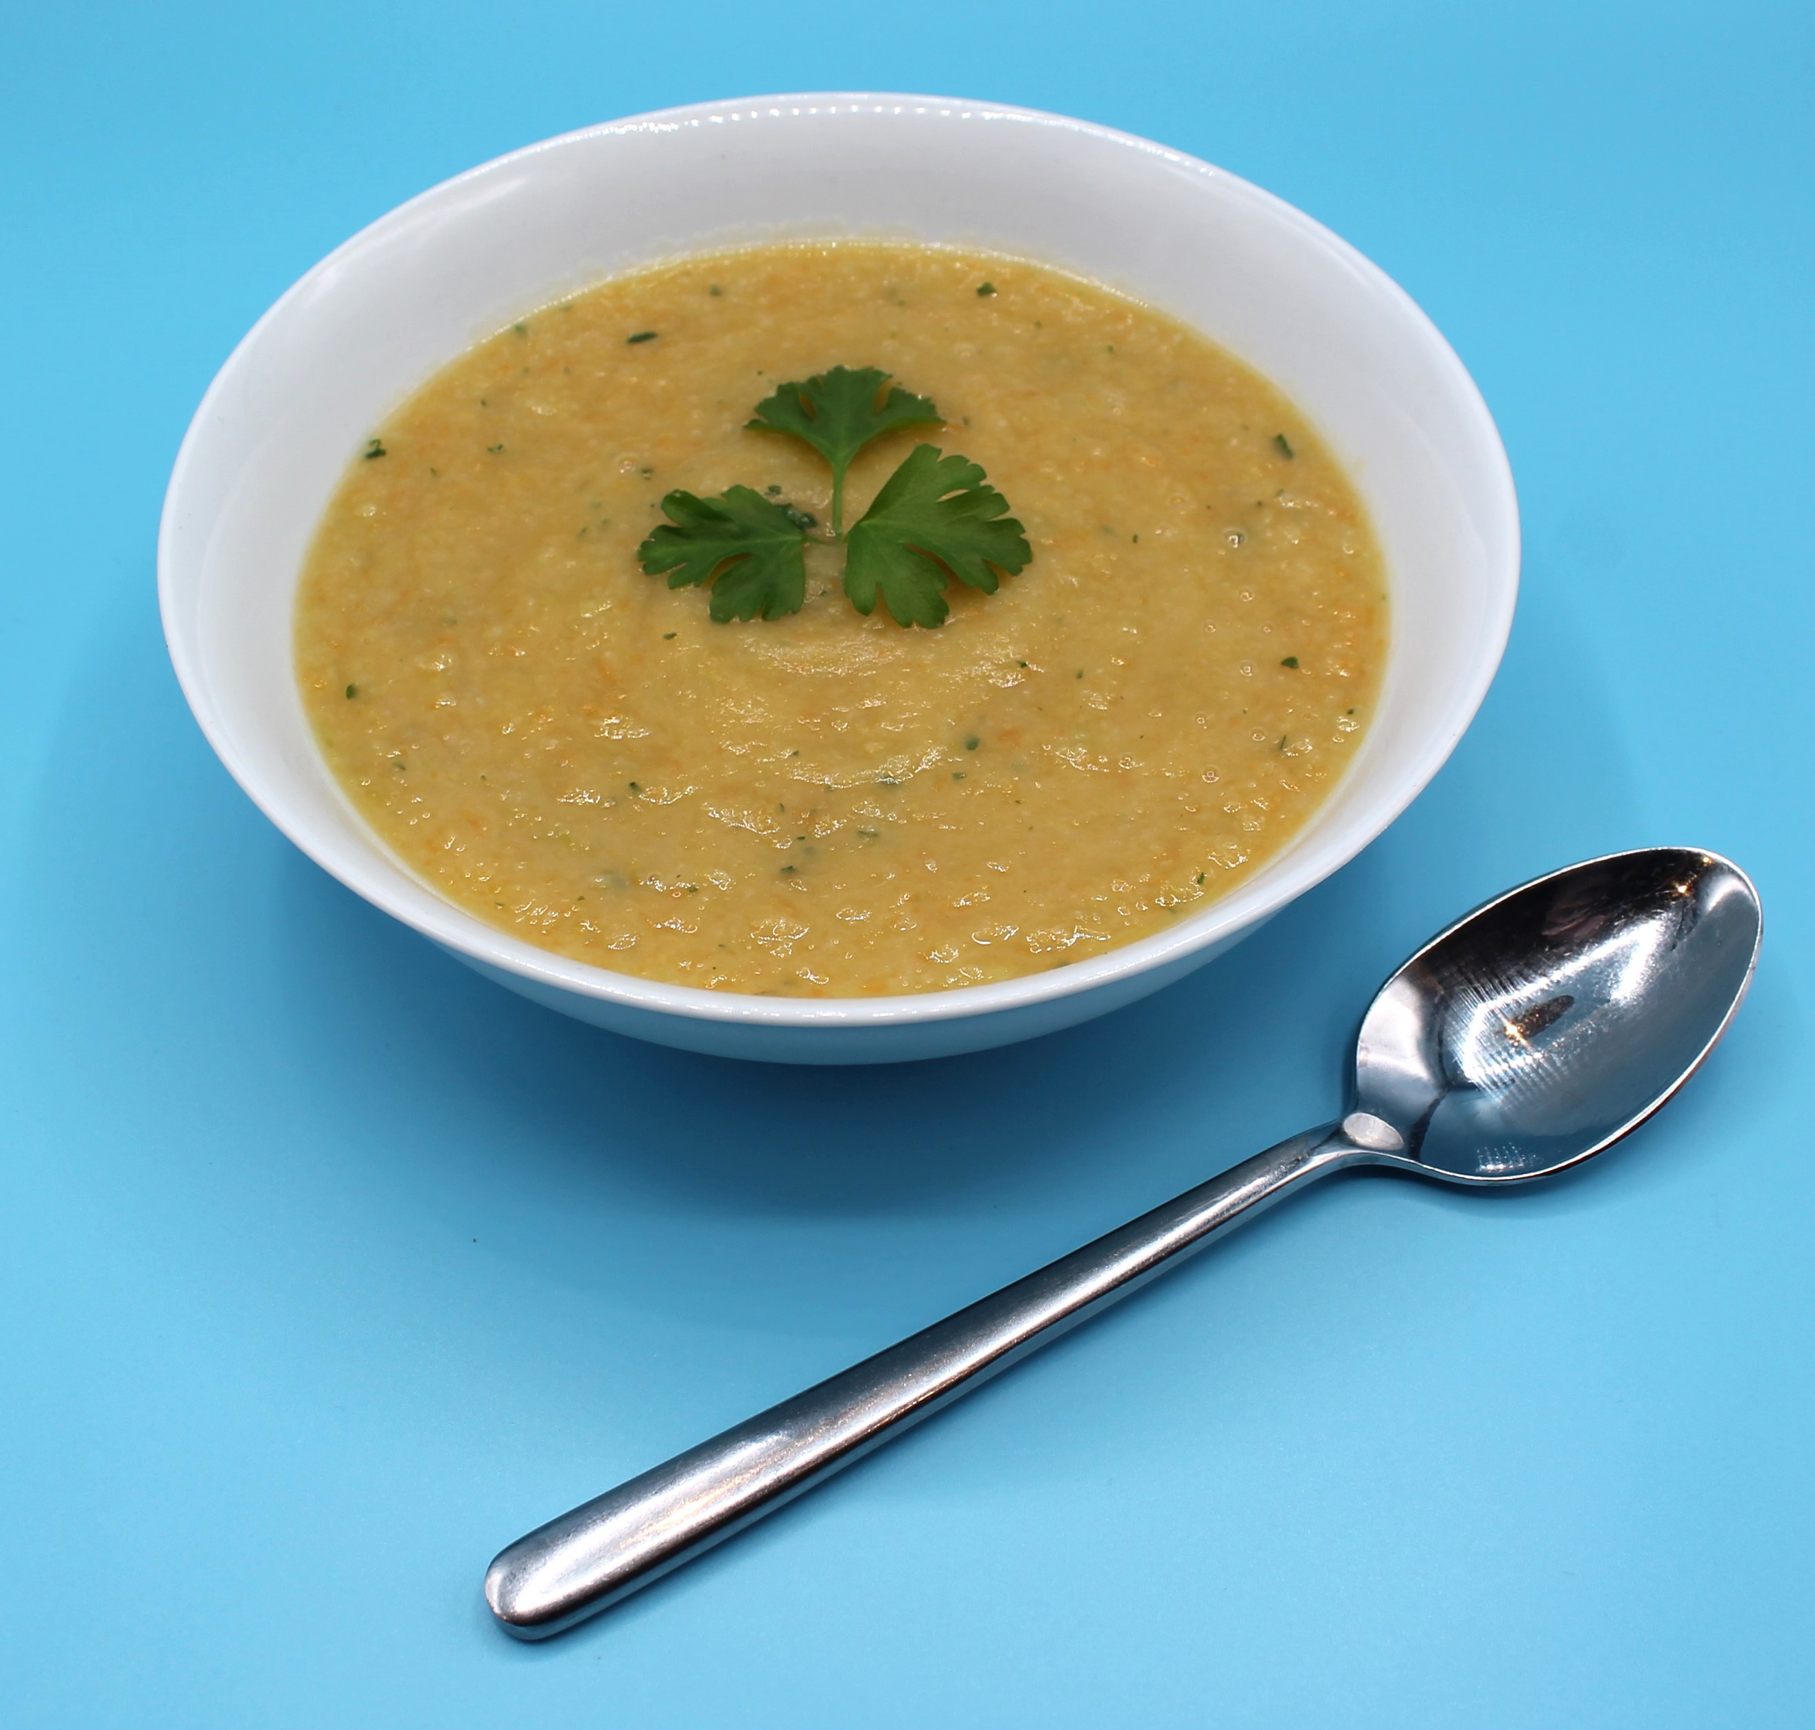
Nutritional analysis
Serves 3

Slide 3
Starter activity
Name three different flavours of soup.
How many portions of fruit and vegetables should we have per day?
Name a piece of equipment we could use to make the soup smooth.

Slide 4
Example responses
Name three different flavours of soup.
Tomato, vegetable, minestrone, creamy chicken
2. How many portions of fruit and veg should we have per day?
At least 5 A Day
3. Name a piece of equipment we could use to make the soup smooth
Blender, stick blender

Slide 5
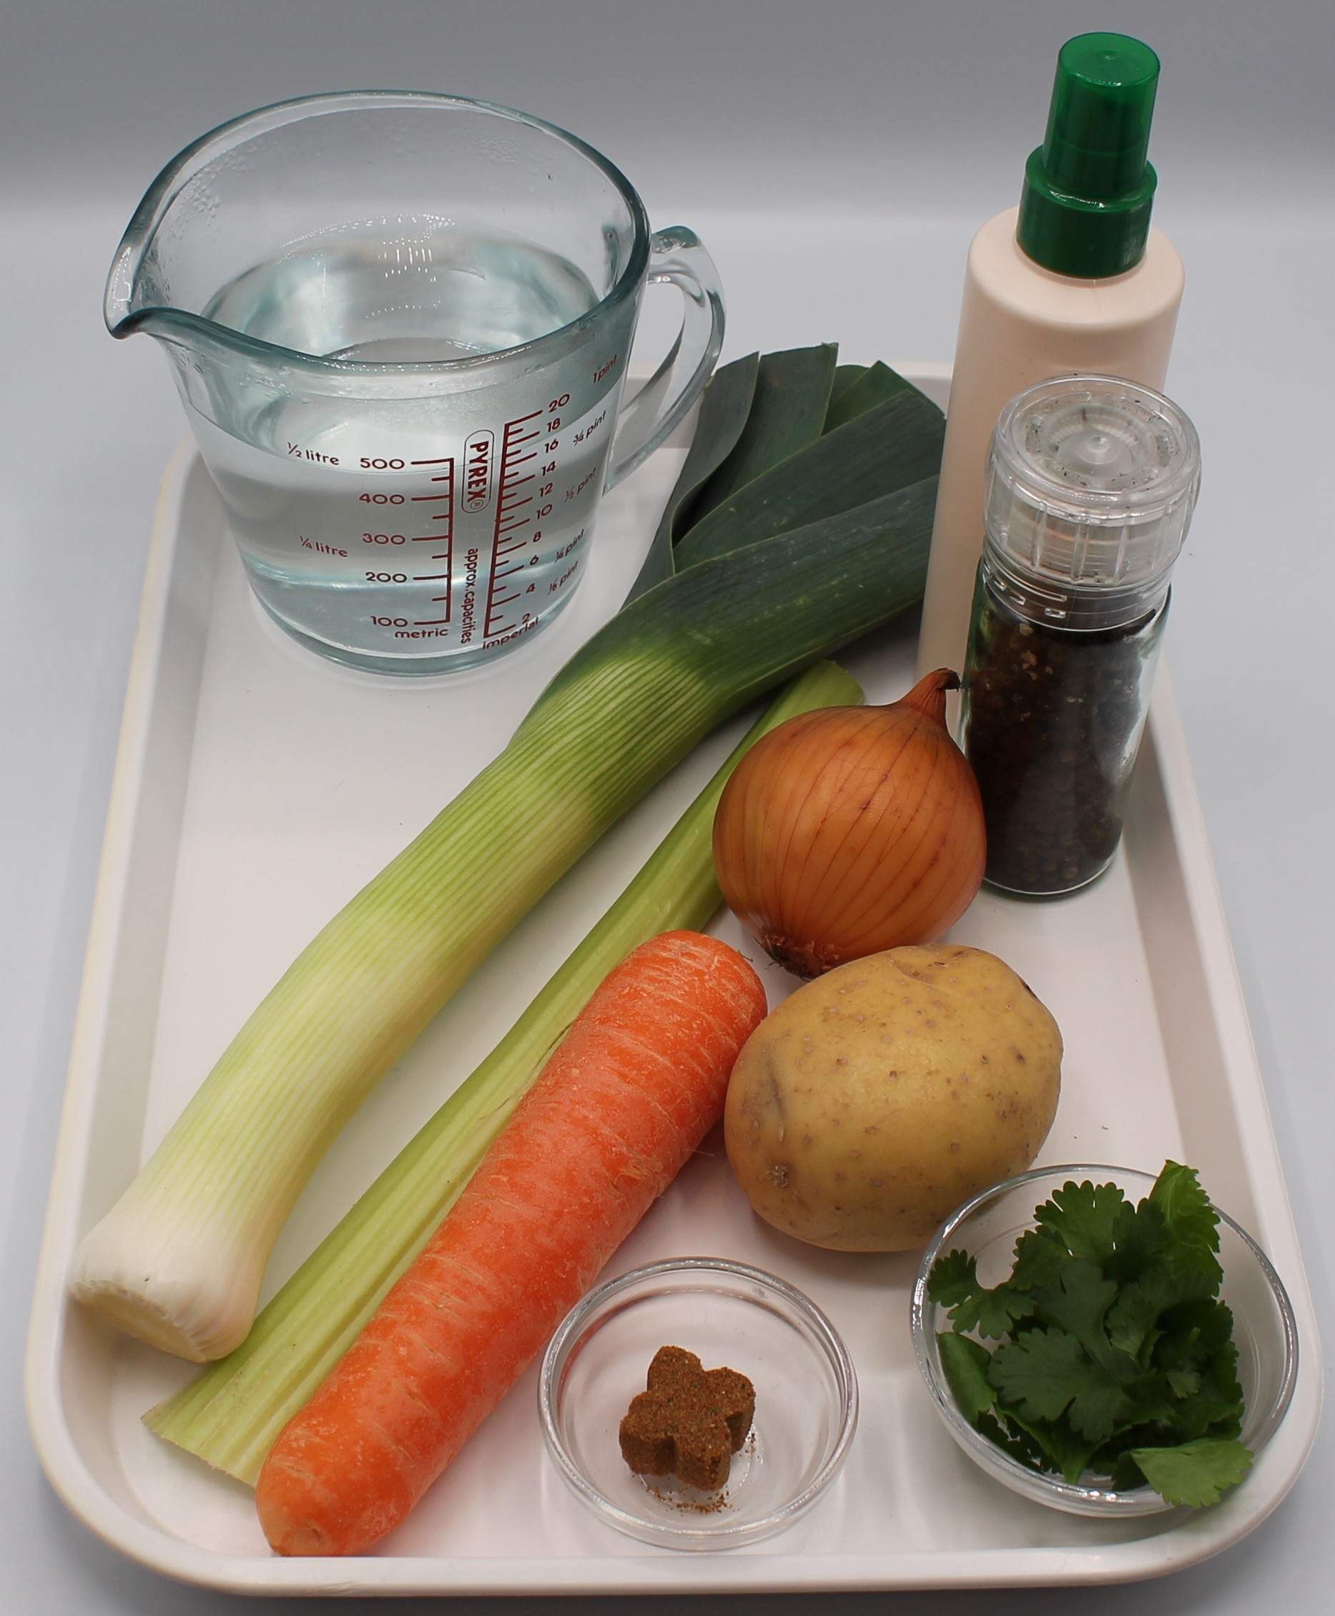

Ingredients (serves 3)
1 onion
1 carrot
1 leek
1 potato
1 celery stick
1x 15ml spoon oil or spray oil
1 reduced-salt stock cube
600ml water
1 x 15ml spoon coriander
Black pepper
Check for any food allergy, intolerance, special dietary requirement or religious/cultural reasons for not handling or eating the ingredients in this recipe.

Slide 6
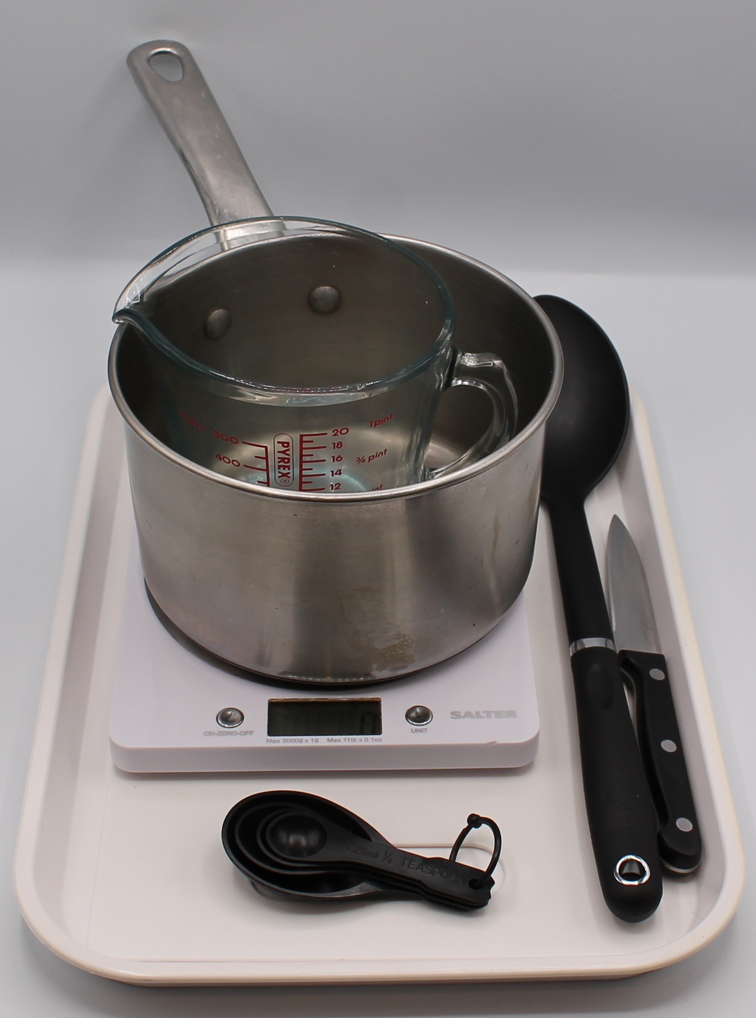
Equipment
Chopping board
Sharp knife
Vegetable peeler
Measuring spoons
Saucepan
Measuring jug
Blender (optional)

Slide 7
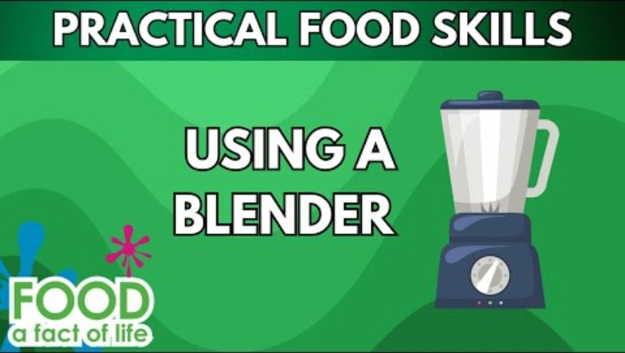
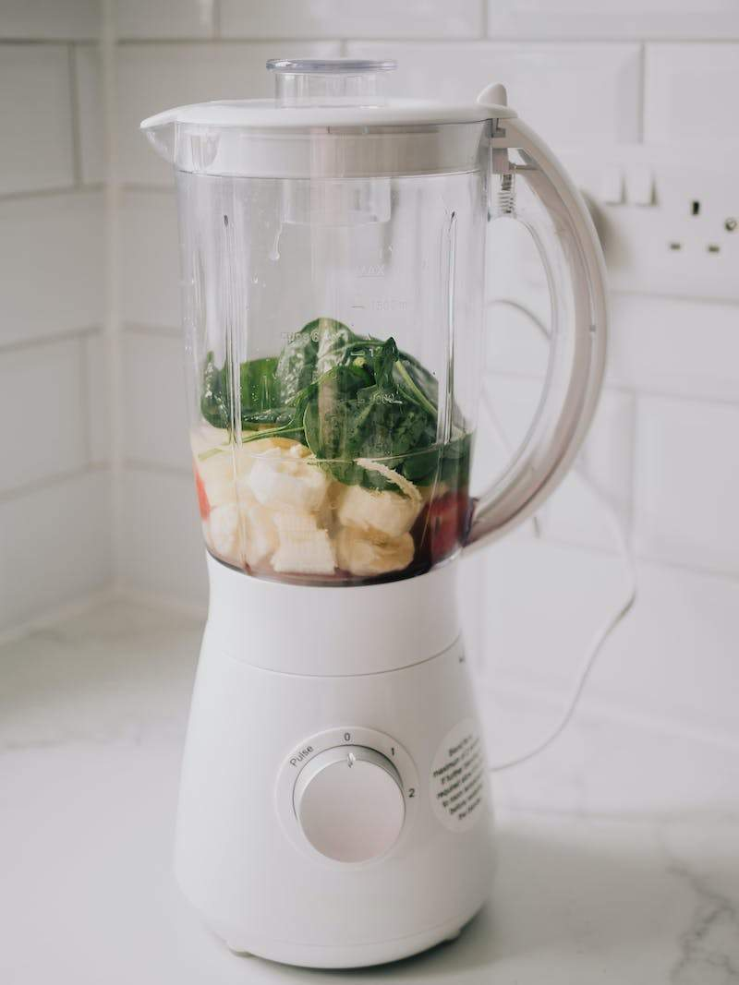
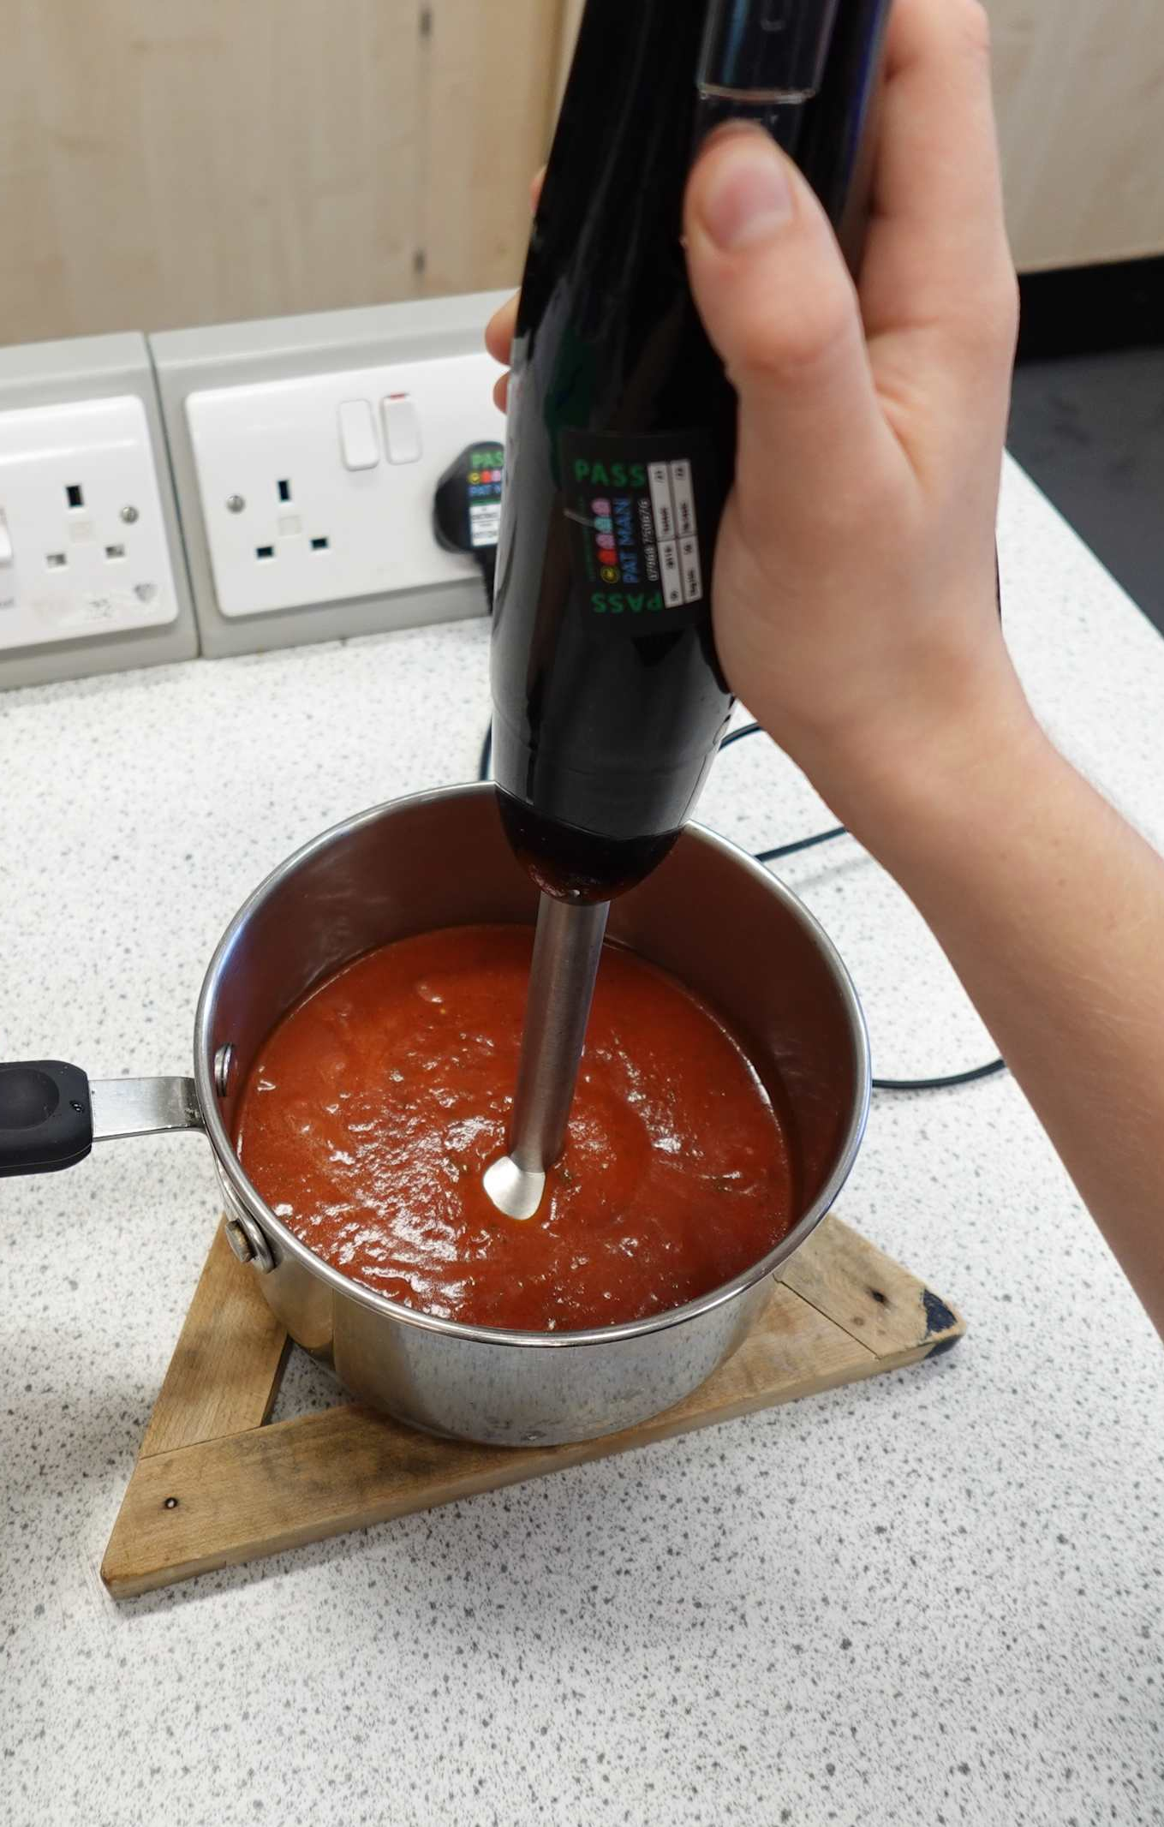
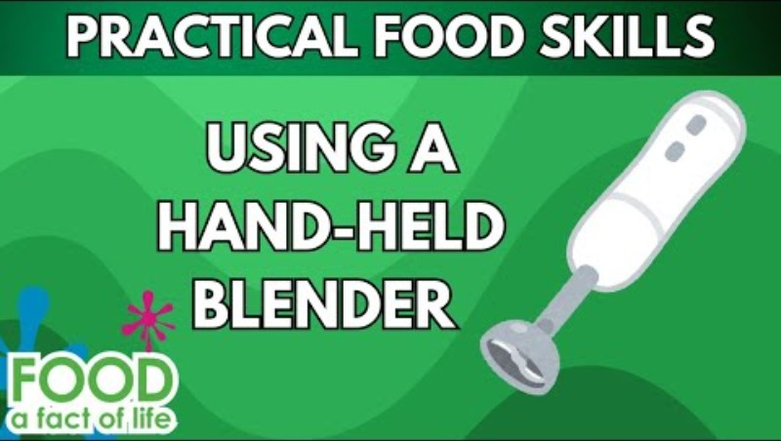
Food skills
Click below to watch how to use a blender safely
Weigh and measure
Peel
Cut
Chop
Slice
Dice and trim
Fry and sauté
Simmer and boil
Puree and blend
Click below to watch how to use a hand blender safely

Slide 8
Method
Prepare the vegetables:
peel and chop the onion;
top and tail, peel and dice the carrot;
top and tail, and slice the leek;
peel and cube the potato;
slice the celery;
chop the coriander.
Fry the onion, carrot, leek and celery in the oil until soft, about 5 minutes.
Add the potatoes.
Add the water and stock cube to the saucepan and bring to the boil.
Simmer for 20 minutes until all vegetables are soft.
Stir in the chopped coriander and serve.

Slide 9
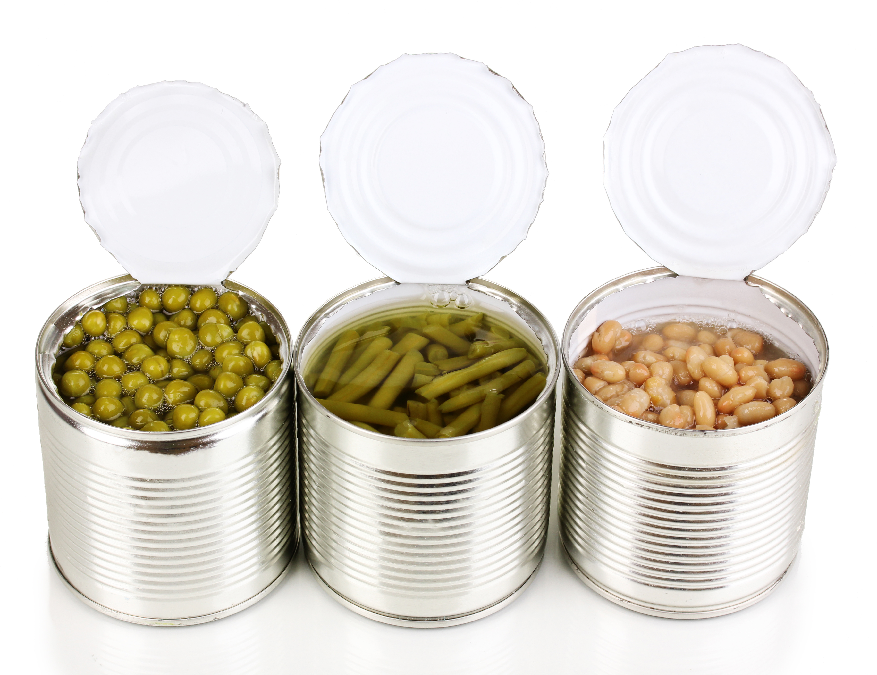
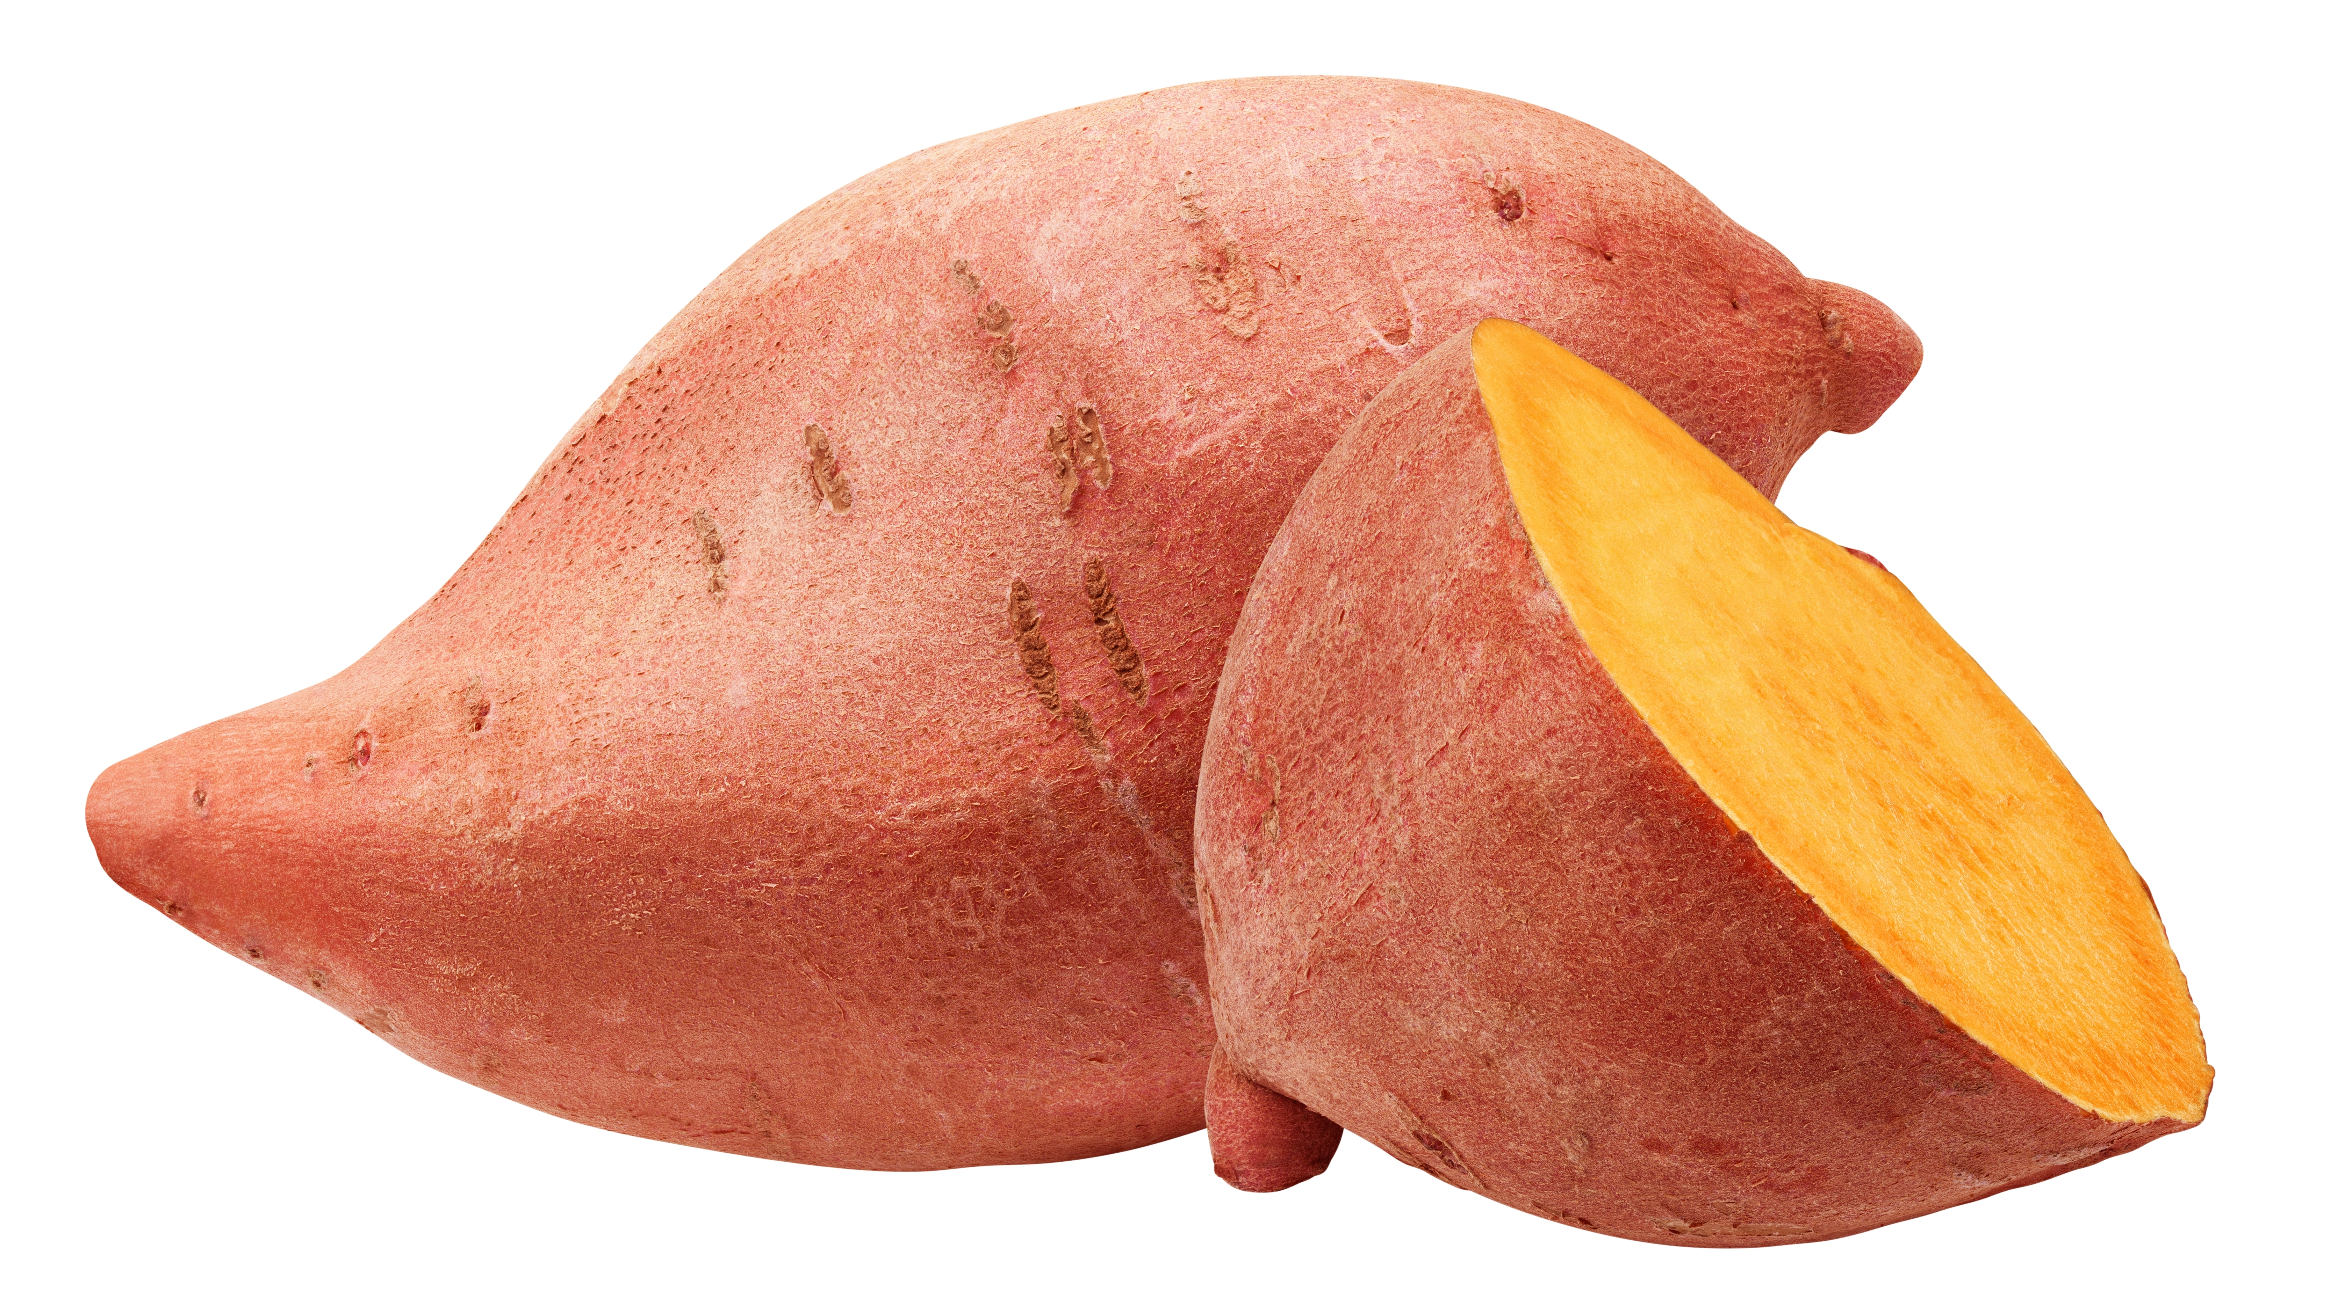
Top tips
Turn up the flavour: Swap the white potato for a sweet potato.
Beat the budget: Use seasonal frozen or canned vegetables to reduce the cost.
Focus on fibre: Add a can of beans, peas or lentils to increase the fibre content.
Reduce food waste: Add any vegetables which need using up.
If you have a blender, blend the soup to a smooth consistency

Slide 10
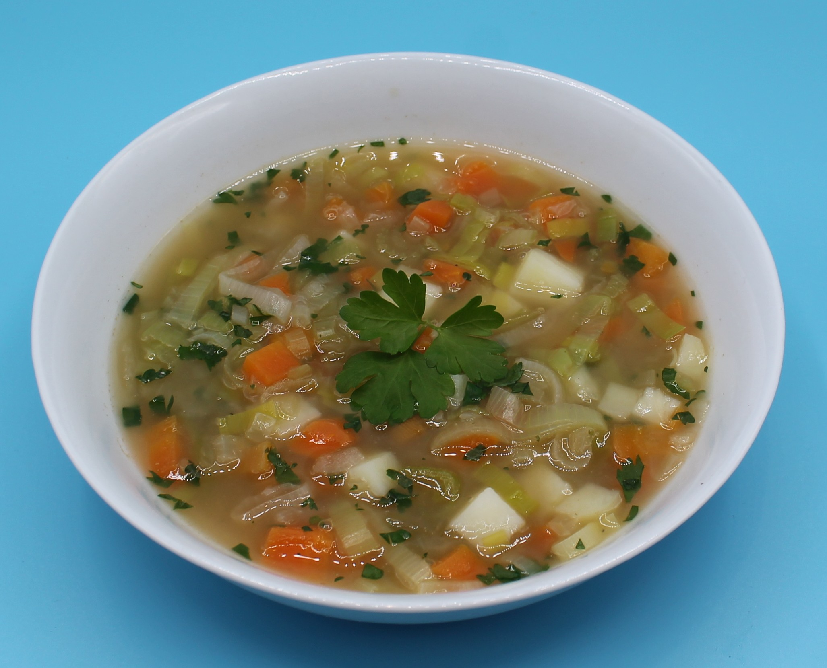
Food science
Gelatinisation
When starch (found in root vegetables such as potatoes) is mixed with water and heated, the starch granules swell and eventually rupture, absorbing liquid, which thickens the mixture.

Slide 11



Plenary
Evaluate your dish.
Ask five people to assess the dish that you made.
 |  |  |  | Comments
Appearance
Odour
Taste
Texture/mouthfeel

Slide 12

Example responses
Evaluate your dish.
Ask five people to assess the dish that you made.
 |  |  |  | Comments
Appearance
Odour
Taste
Texture/mouthfeel
What is the overall opinion of your dish?

Slide 13
Example responses
What is the overall opinion of your dish?
 | Comments
Appearance | Looks a good colour. Can see the fresh herbs.
Odour | Smells lovely and fresh. I can smell the coriander.
Taste | Lots of flavour. I like the combination of carrot and coriander.
Texture/mouthfeel | The soup was quite chunky, most people prefer smooth soup.

Slide 14
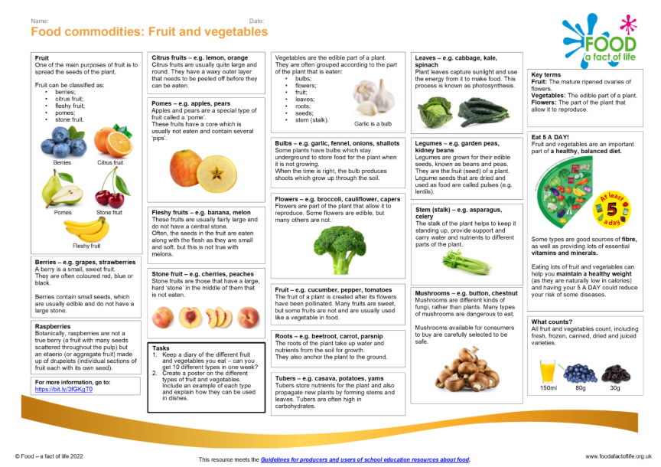
Looking for more…
Continue the learning and explore fruit and vegetables with our knowledge organisers!
Why not conduct a sensory evaluation looking at commercially made soups using this activity? This could be followed with an investigation into different ingredients that could be used to thicken soup.

Slide 15
Vegetable soup
For further information, go to:
www.foodafactoflife.org.uk
This resource meets the Guidelines for producers and users of school education resources about food.

