Slide 1
Party time!

Slide 2

The challenge
Create a burger to be served at a party.

Slide 3

Party time!
Create a mind map to identify what you need to consider, for example:
The occasion, e.g. birthday, anniversary, fun with friends, exam celebration.
The age of the party guests, e.g. children, teenagers, adults.
The time of the party, e.g. lunchtime, afternoon or evening.
How the burger will be served, e.g. will it be handheld or eaten with cutlery?
The season, celebration or festival.

Slide 4
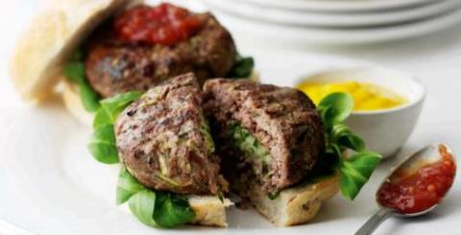
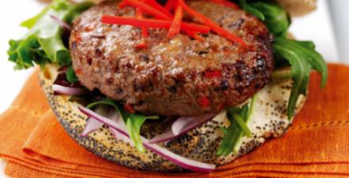
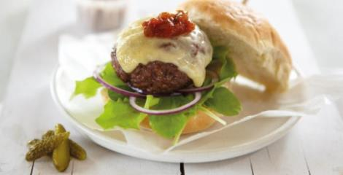
Inspiration

Slide 5
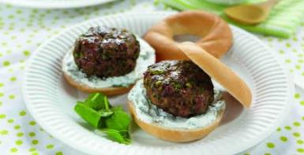
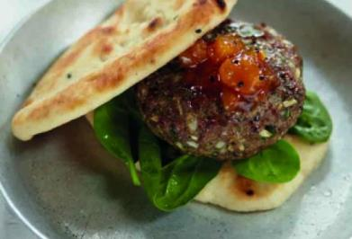
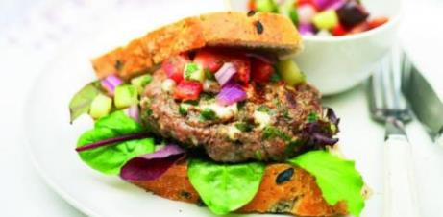
Inspiration

Slide 6
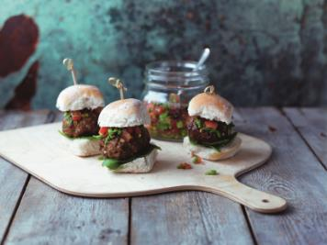
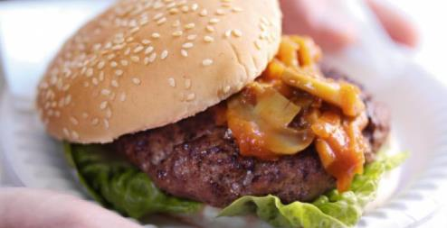
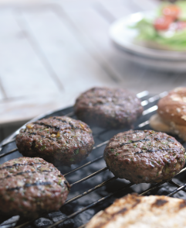
Inspiration

Slide 7


Serving your burger
What will you serve with your burger?
Think about breads, toppings, accompaniments and sides.

Slide 8
Serving your burger
Explore the different ways you could present your burger on a plate or serving dish.
Think about:
The occasion.
The plate or serving dish you could use.
How you could present the burgers attractively.
Decoration and garnish.

Slide 9
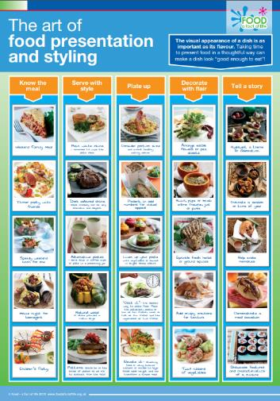
Food styling and presentation
For further ideas, why not download -
The art of food presentation and styling poster from:
https://bit.ly/2v6wlLF

Slide 10

Create your burger
Step 1
Use the Gourmet Burger Builder to create your party burger.
Step 2
Make your party burger following the recipe.
Step 3
Take a photo and share your recipe on social media.

Slide 11
Party time!
For further information, go to:
www.foodafactoflife.org.uk
This resource meets the Guidelines for producers and users of school education resources about food.

