Slide 1
Types of fish and shellfish

Slide 2
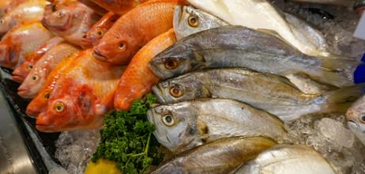
Types of fish and seafood
There are over 33,000 fish species in the world, However, not all of them are edible and people often prefer to eat a few species that are easier to catch and eat.
There are many other kinds of seafood as well, including shellfish such as mussels and oysters and cephalopods, such as squid and octopus.
Fish can be classified as ‘oily fish’ or ‘white fish’. Oily fish include fish such as mackerel or salmon, whereas white fish include fish such as cod or haddock.

Slide 3
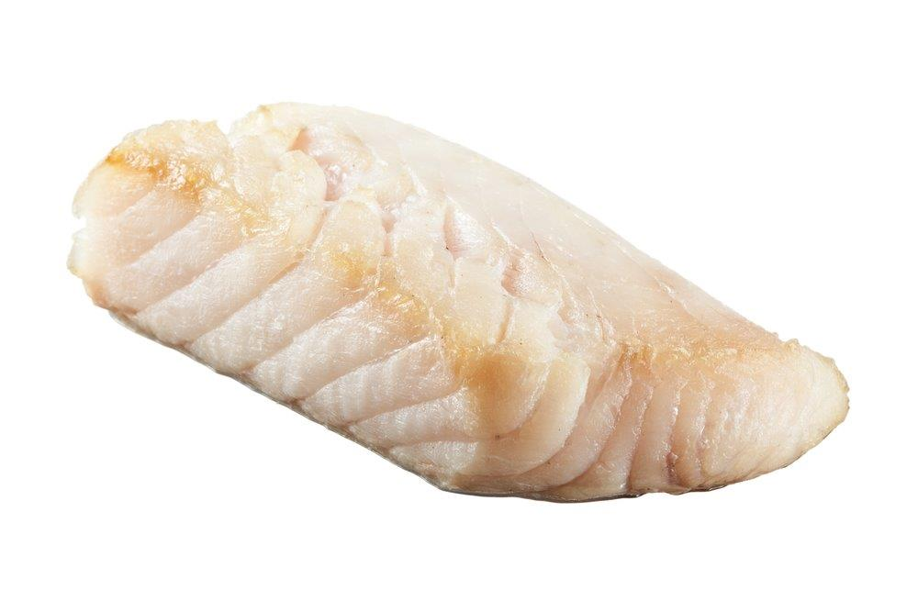
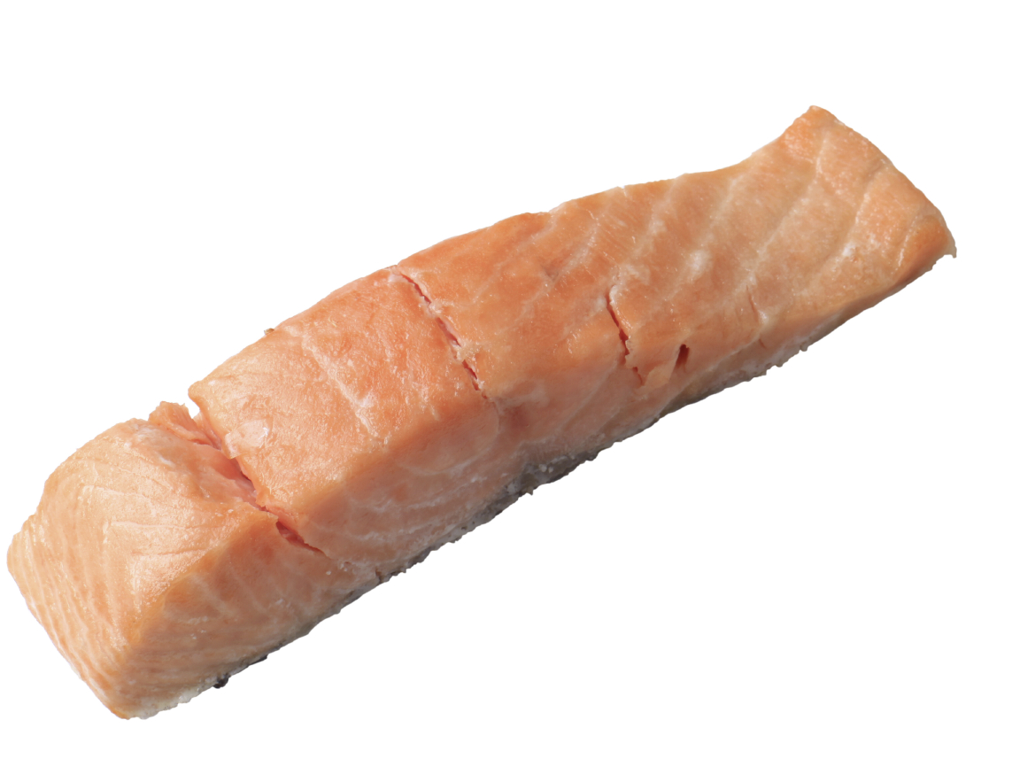
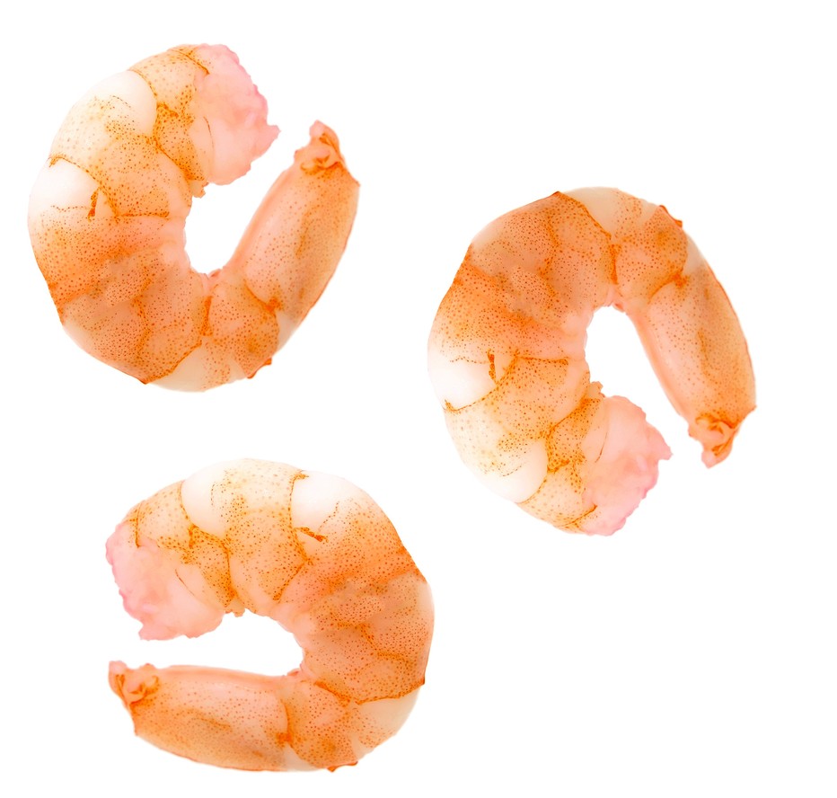
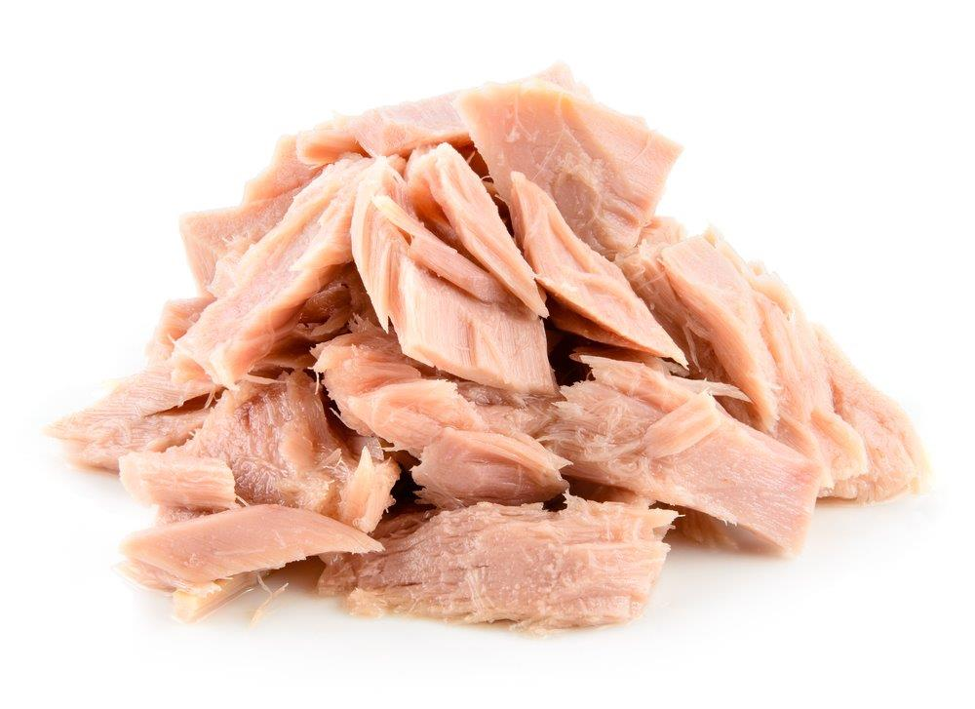
The ‘big five’
The ‘big five’ are the most common seafood items that are eaten in the UK. They are:
cod;
haddock;
tuna;
salmon
prawns.
The big five account for most of the seafood that is eaten in the UK.

Slide 4
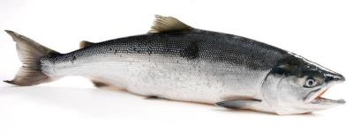
Oily fish - salmon and trout
Salmon and trout are classified as ‘oily fish’, which means they contain a type of healthy fatty acid called Omega-3. The UK Eatwell Guide states that one of the recommended two portions of fish a week should be oily.
They look similar when they are cooked. Their flesh is normally a pinky-red colour. This colour might be a little bit different, depending if they are farmed or wild. The flesh of wild fish is typically a deeper, reddish colour, as opposed to a lighter orange hue.
This type of salmon is called a ‘sockeye salmon’

Slide 5
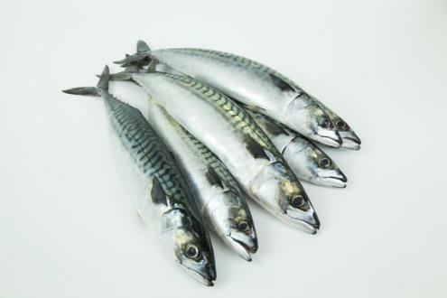
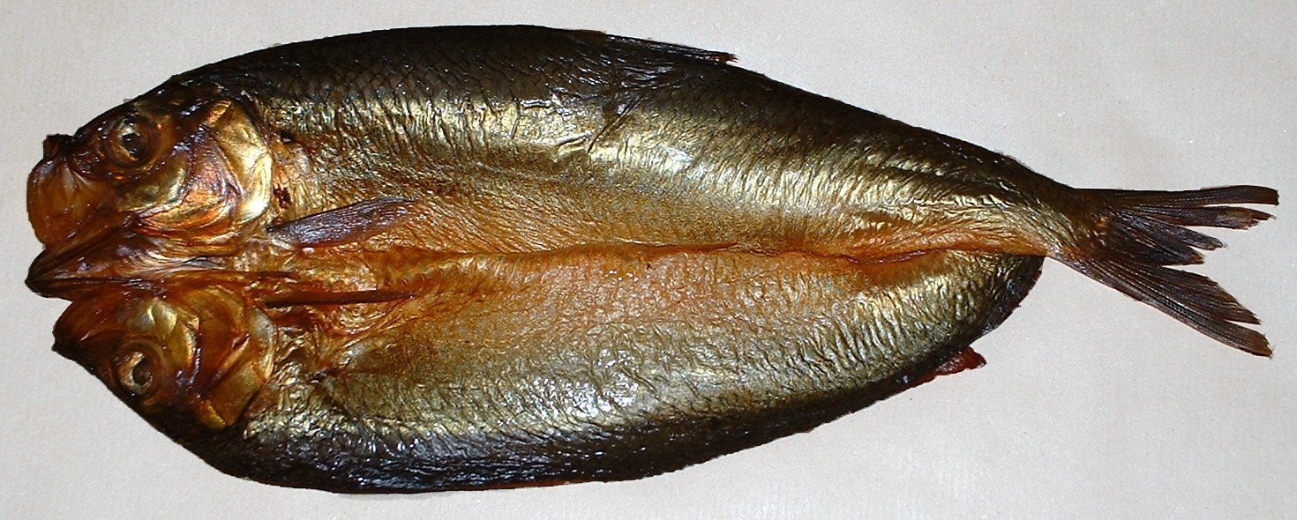
Oily fish - mackerel, herring and sardines
Mackerel, herring and sardines are types of small oily fish that are mostly sold in cans, but they can sometimes be bought whole, either fresh or smoked.
For example, kippers are herring that have been filleted, salted and smoked.
They can have quite a strong taste and so are often canned in sauces, such as tomato sauce.
The skin and bones of whole sardines are soft and edible and can provide extra calcium.
Fresh mackerel
A smoked kipper (herring)

Slide 6
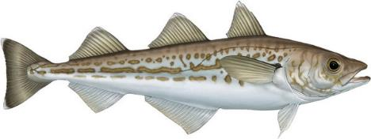
White fish - cod and haddock
Cod and haddock are the most popular fish in the UK. They are flaky, white fish when cooked.
Most of the cod and haddock eaten in the UK is breaded or battered. They are the most popular fish that can be bought at a fish and chips takeaway.
In 2019, 60 million kilograms of cod was sold in the UK.¹
These species are in danger of being overfished. Both are considered vulnerable²,³, and limits are put on how many can be caught.
However, there are many different types of fish that can be purchased instead of cod or haddock.
Pollock is a fish that is abundant in the UK and therefore a more sustainable choice. It has white flesh that is quite similar to cod, only a little softer.
¹Statista.com - Annual volume of cod sold in the United Kingdom (UK) from 2013 to 2019
² https://www.iucnredlist.org/species/13045/3406968
³ https://www.iucnredlist.org/species/8784/12931575

Slide 7
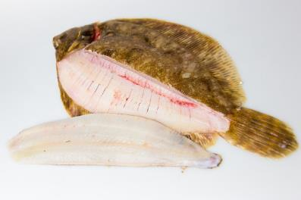
White fish - plaice, sole, halibut and turbot
Plaice, sole, halibut and turbot are all types of flatfish.
Plaice is widely available in fish mongers and supermarkets and sold in fish and chip shops. Plaice is a good option because unlike cod and haddock, it is not as vulnerable to overfishing¹.
Fillets from these fish are normally quite thin and delicate, due to the shape of the fish, so they can be cooked quickly.
A lemon sole with a fillet removed
¹ https://www.iucnredlist.org/species/135690/50018800

Slide 8
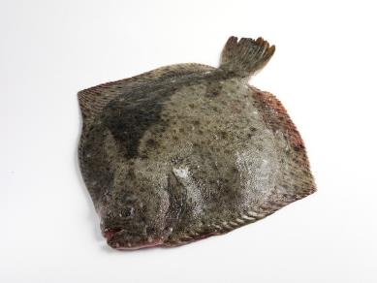
Flatfish: plaice, sole, halibut and turbot
Turbot is a much larger flatfish. They can grow up to 1.5m in diameter, although those caught around the UK are often much smaller.
Turbot is highly sought after for use in restaurants as it has a very delicate flavour.
This has led to it being classified as ‘vulnerable’¹ and as a result it is now quite often farmed.
Turbot is considered a delicacy and can be very expensive
¹ https://www.iucnredlist.org/species/198731/45790581

Slide 9
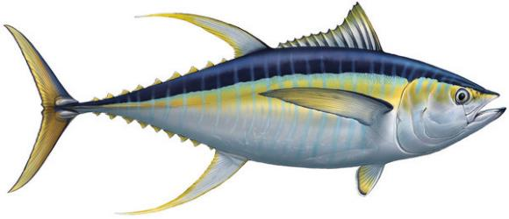
Tuna
The largest species of tuna, Atlantic bluefin tuna, can grow up to 2m long.
Tuna is available as fresh fish or canned in oil, spring water or brine. Tuna in spring water is the healthier choice.
Fresh tuna used to be classed as an oily fish but new research shows that there are not enough healthy Omega-3 fatty acids in tuna for it to be called oily.
NHS Live Well

Slide 10
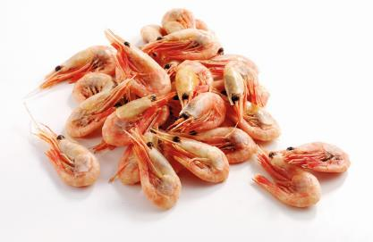
Shellfish - shrimp and prawns
Shrimp and prawns are a wide group of small shellfish.
The words ‘shrimp’ and ‘prawn’ are used to describe many different species. Usually, shrimp refers to smaller species and prawn to larger.
Prawns can be used in a wide variety of dishes and due to their small size, they can be cooked quickly in a frying pan.
The shells of prawns are tough and are not eaten, but they can be used to make stocks, soups and sauces.
Most prawns are imported species but small numbers are grown in fisheries around the UK¹.
¹ https://britishseafishing.co.uk/prawn-and-shrimp-species/

Slide 11
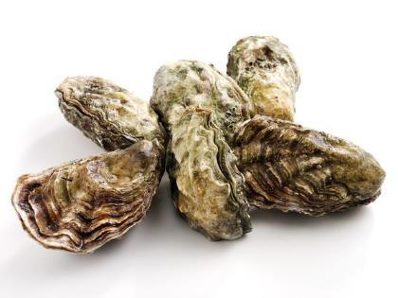
Shellfish - mussels and oysters
Mussels and oysters are ‘bivalve molluscs’. Bivalve means that they have two shells that close around the soft body inside.
Oysters are considered a delicacy. They can be served cooked or raw, often eaten straight from one half of the shell.
Mussels are typically not eaten raw but are cooked in their shells and are often served in broths or soup.
Oysters and mussels can be found in the wild, but they are often farmed, as it is easier to obtain larger numbers in this way.
Both mussels and oysters are widely grown around the UK.

Slide 12
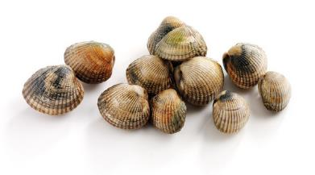
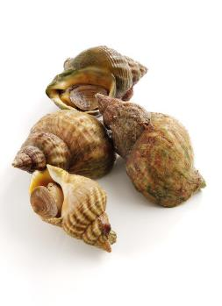
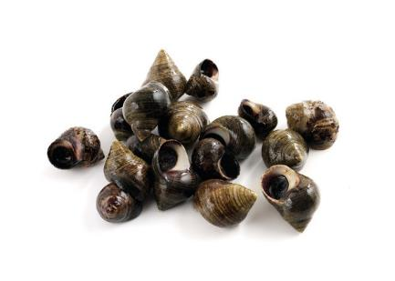
Shellfish - cockles, whelks and winkles
Cockles, whelks and winkles are small shellfish that are common around the UK.
These used to be very popular foods around the UK coast.
These shellfish can be used in soups and stews but are often eaten cooked and served with vinegar.
Cockles
Whelks
Winkles

Slide 13
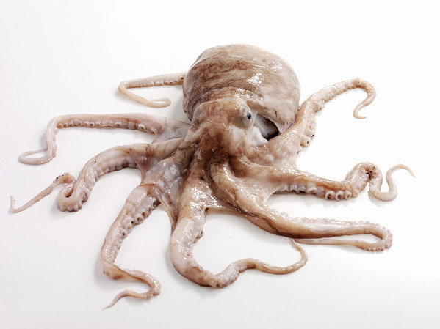
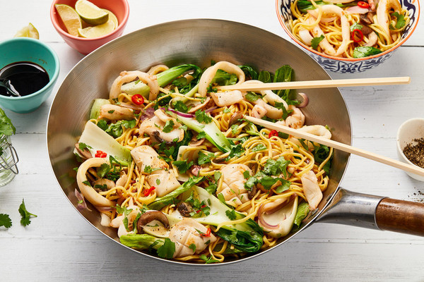
Squid and octopus
Squid and octopus are not fish but cephalopods, along with cuttlefish and some other species.
They are most commonly eaten in Japan, Mediterranean countries and throughout the Pacific.
Squid is often called ‘calamari’ when it is used in dishes.
Squid and octopus can be caught off the UK coast, usually around Dorset or Cornwall, but they are being increasingly found in the North Sea, as sea temperatures rise¹.
¹van der Kooij, 2016

Slide 14
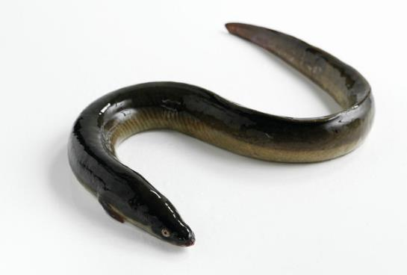
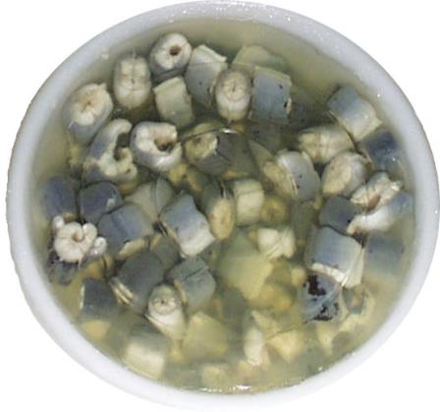
Eels
Eels were a traditional food in the UK from the 18th century onwards, and were most popular in East London as they could be found in the river Thames and were cheap and nutritious when other foods were scarce.
Eels were often boiled in a stock and cooled to form ‘jellied eels’.
Although eels are not very popular anymore, there are still a few places they can be bought. They are also available to order online and in some supermarkets.

Slide 15
Types of fish and shellfish
For further information, go to:
www.foodafactoflife.org.uk
This resource meets the Guidelines for producers and users of school education resources about food.

