Slide 1
Cheese and onion triangles
Complexity: low - medium

Slide 2
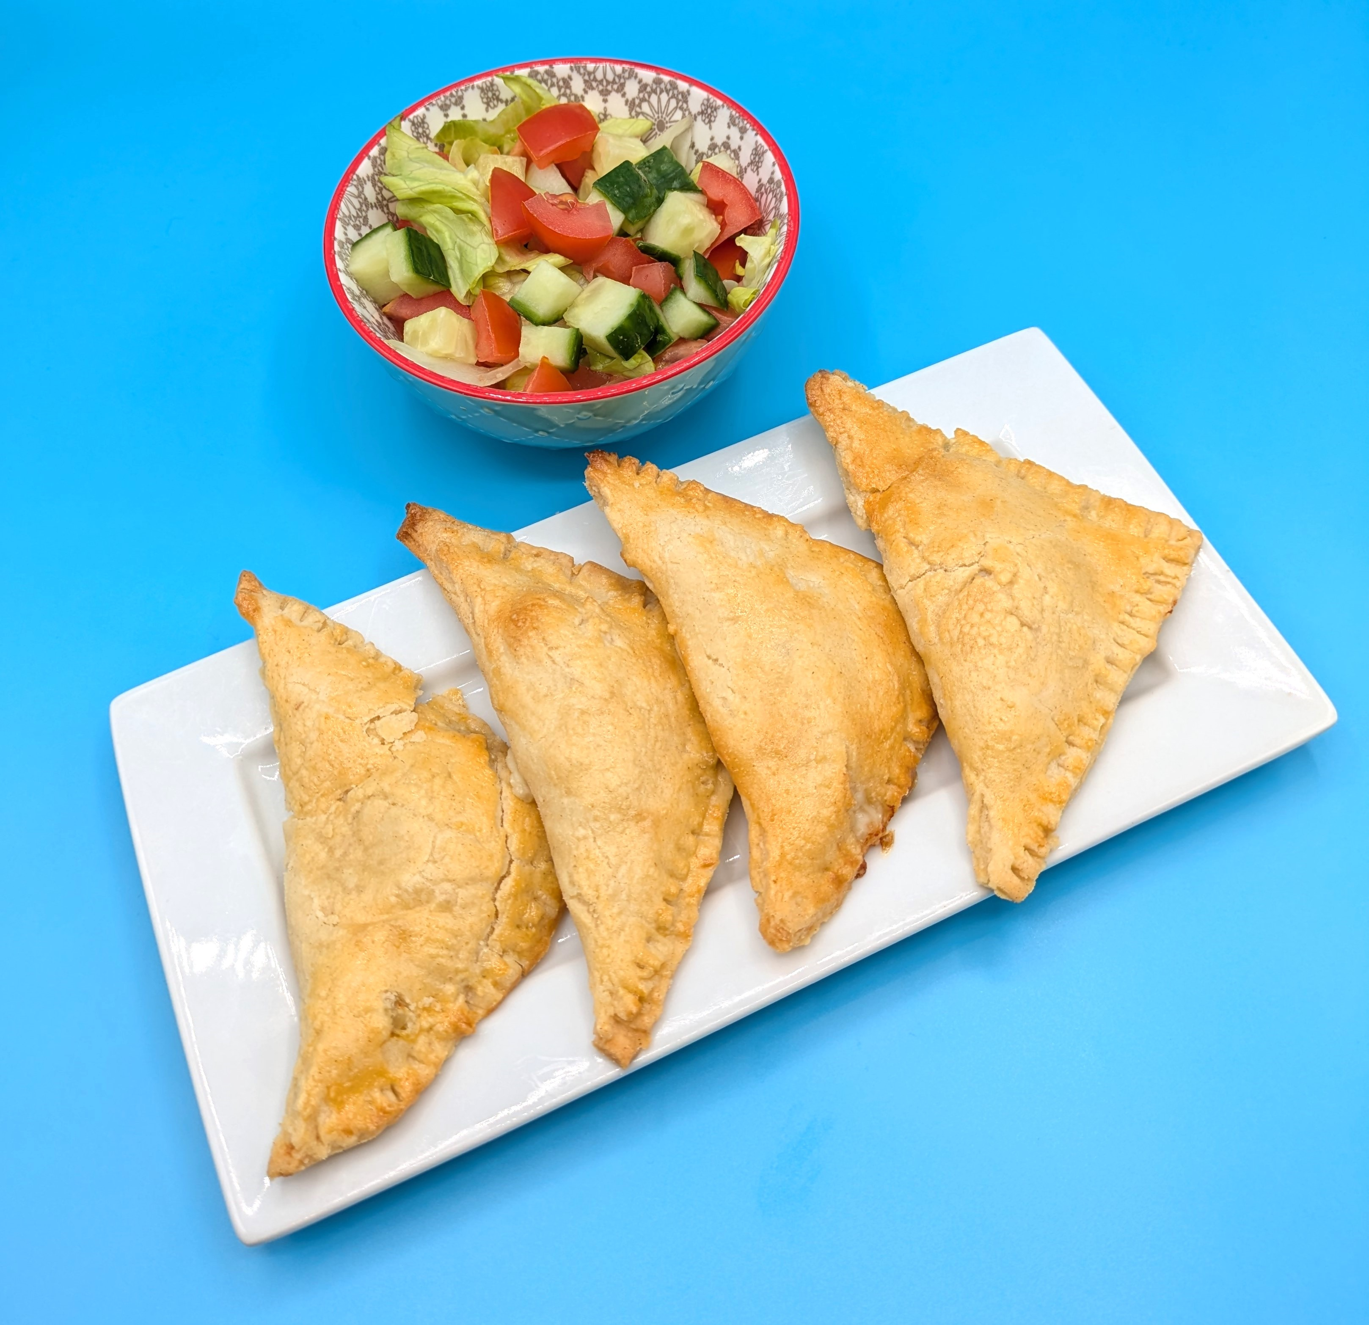
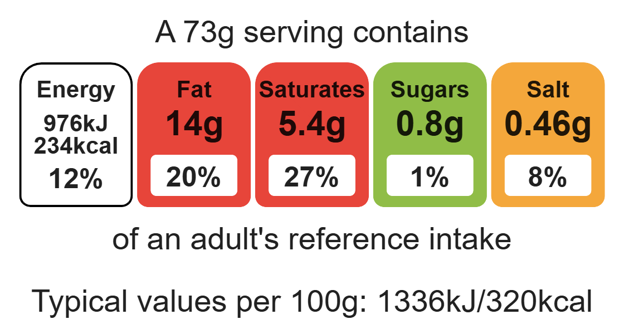
Nutritional analysis
Serves 4

Slide 3
Starter activity
Name two food skills used to prepare fruit and veg safely.
Cheese and onion triangles use the rubbing-in method. Name two other dishes that use the rubbing-in method.

Slide 4
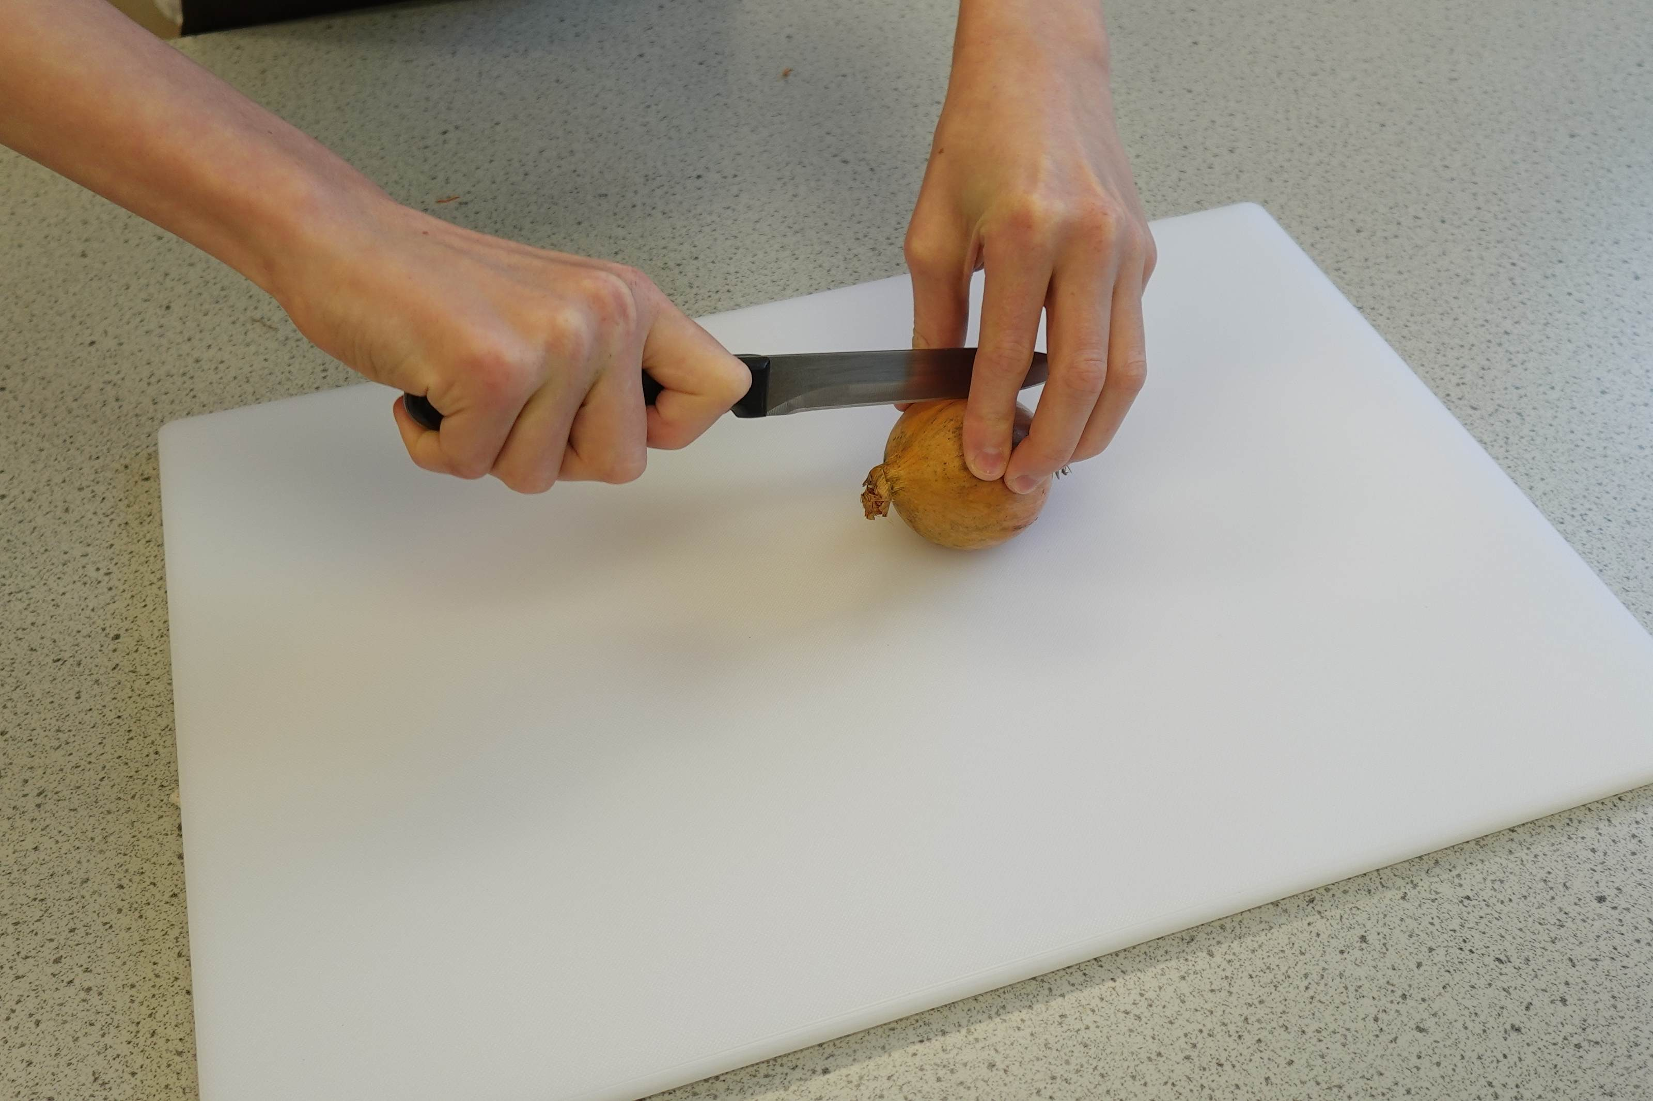
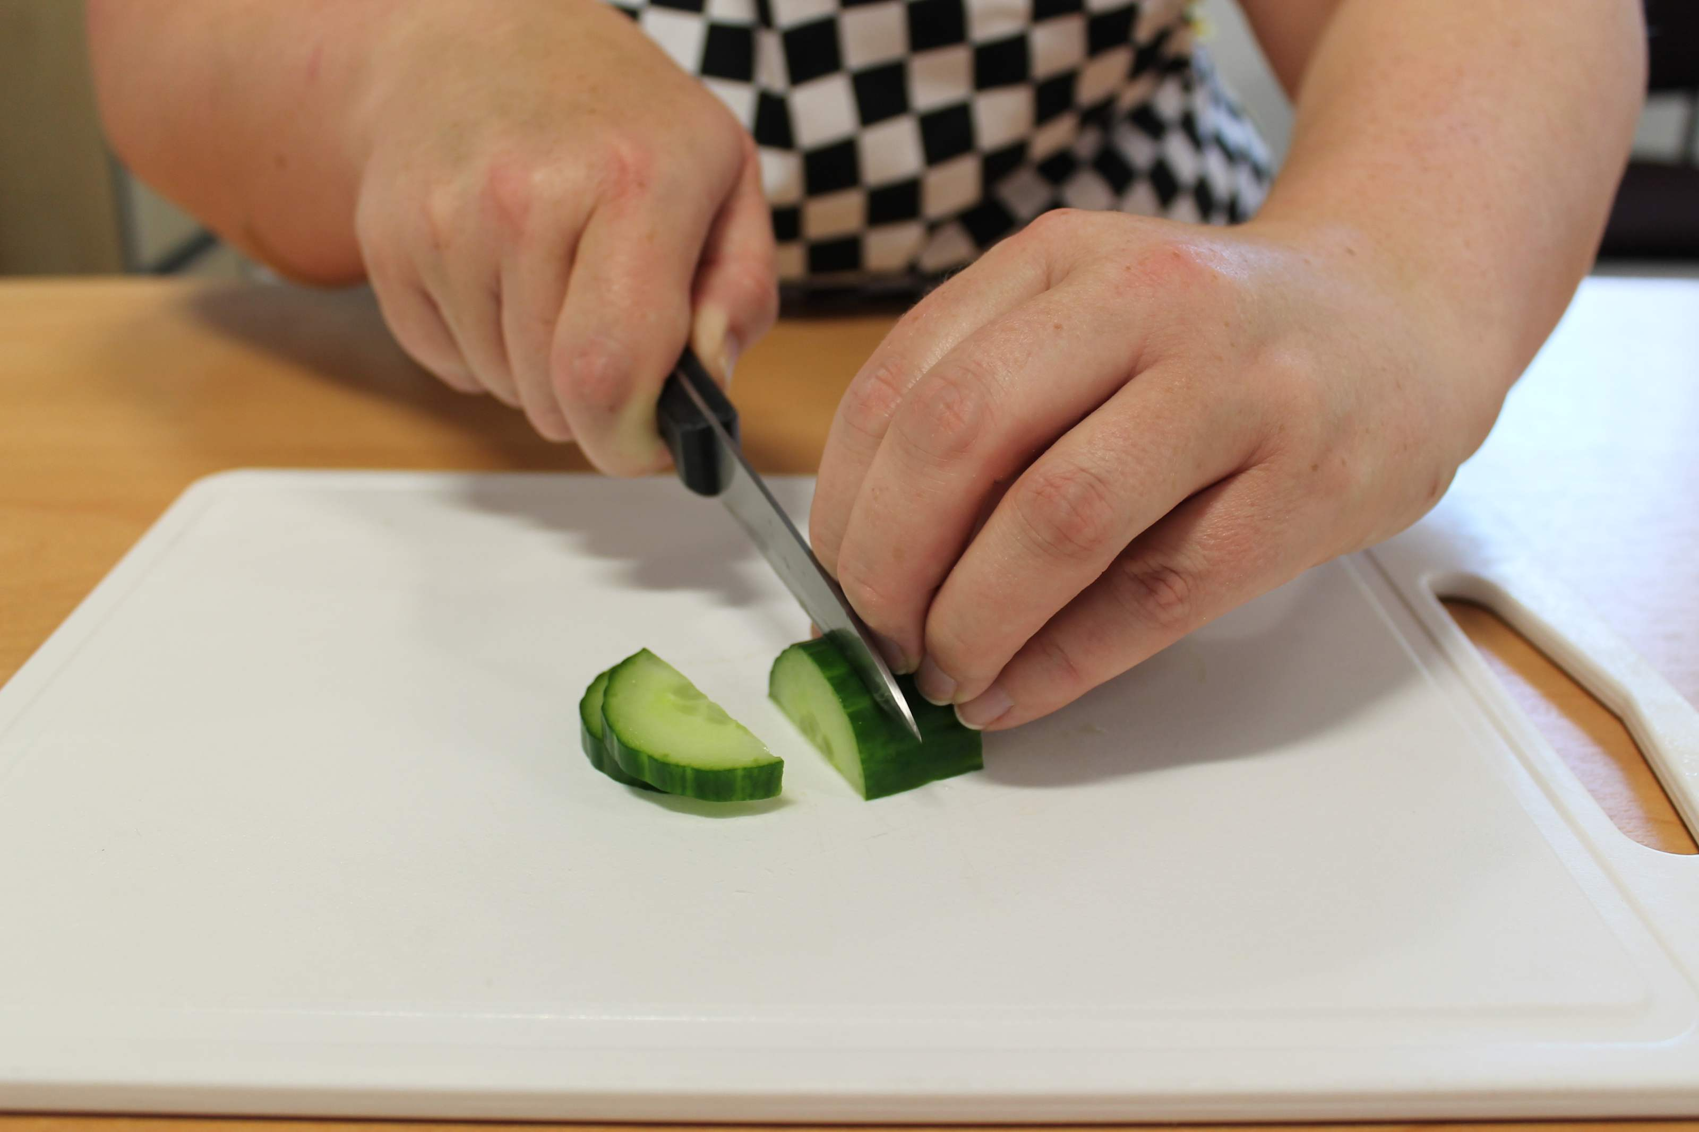
Example responses
1. Name two food skills used to prepare fruit and veg safely.
Bridge hold Claw grip
2. Cheese and onion triangles use the rubbing- in method. Name two other dishes that use the rubbing-in method.
Crumble, scones, quiche, pies.

Slide 5
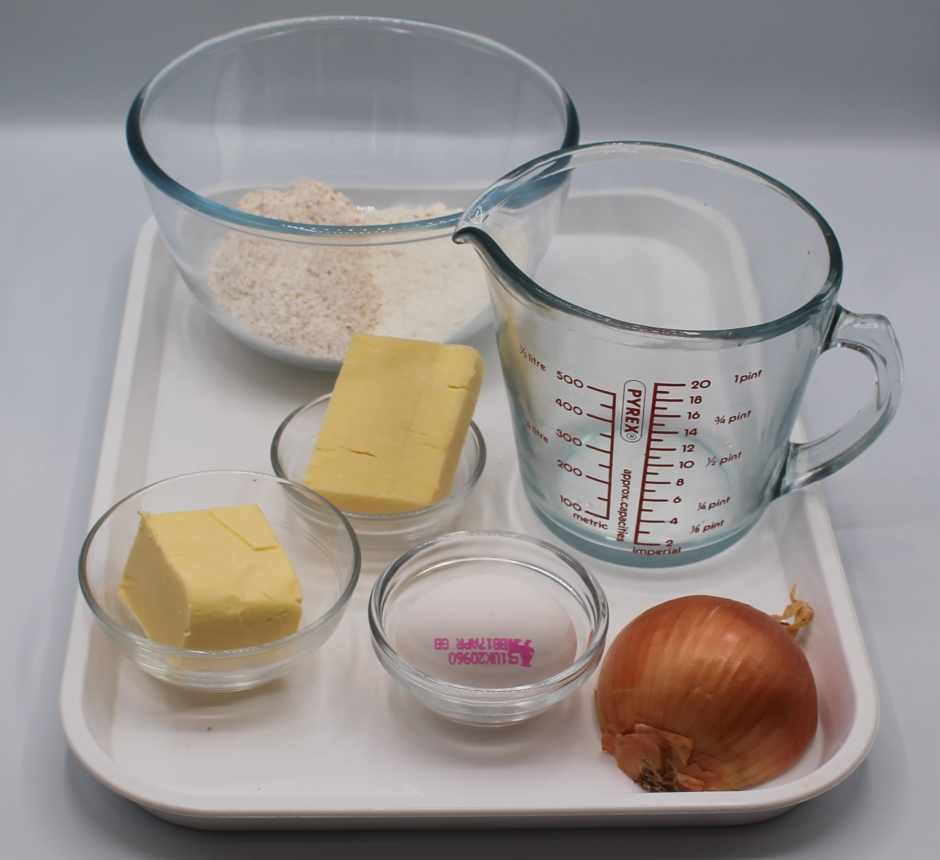

Ingredients (serves 4)
50g reduced-fat cheddar cheese
½ onion
100g plain flour
50g baking fat/block
2–3 x 15ml spoons cold water
1 egg (optional - milk can be used)
Check for any food allergy, intolerance, special dietary requirement or religious/cultural reasons for not handling or eating the ingredients in this recipe.

Slide 6
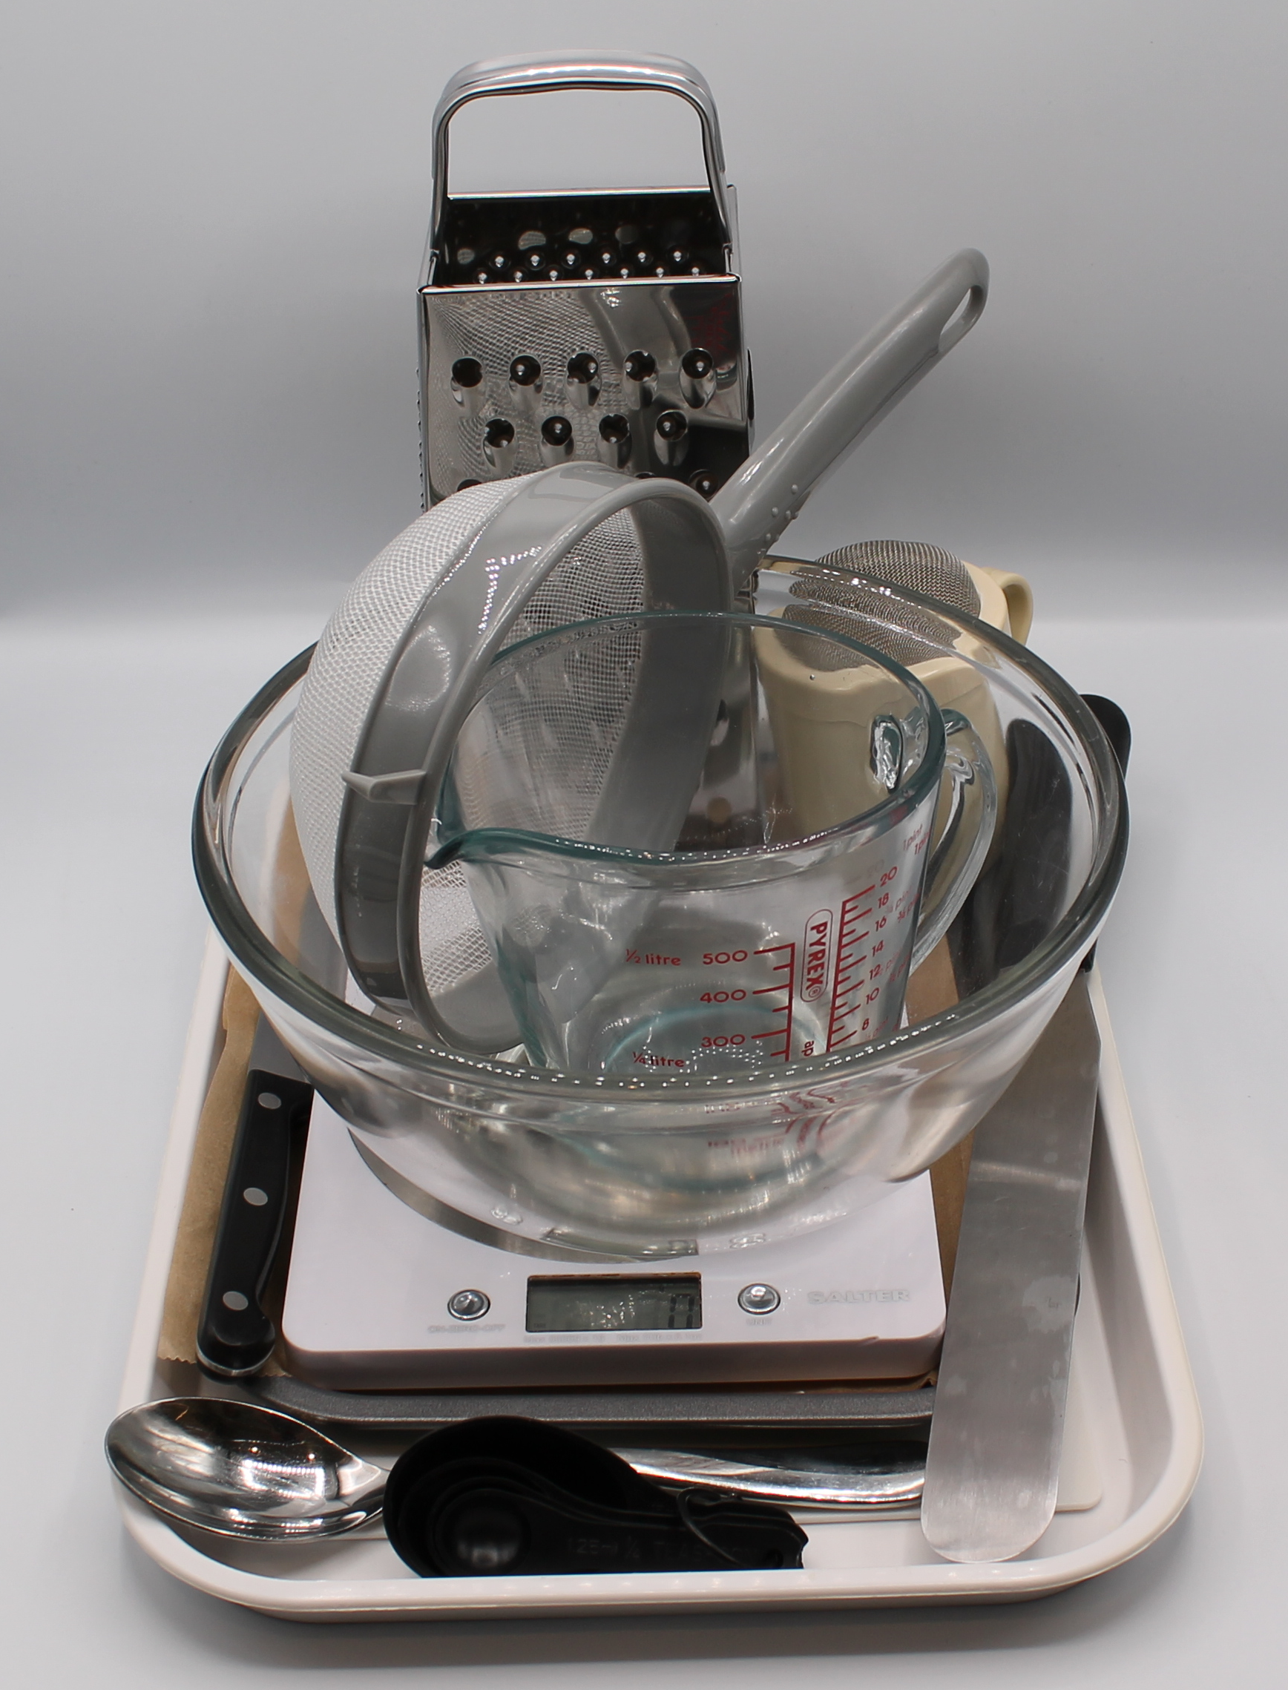
Equipment
Weighing scales
Chopping board
Grater
Sharp knife
Mixing bowl
Sieve
Measuring spoons
Palette knife
Flour dredger
Rolling pin
Metal spoon
Fork
Small bowl
Pastry brush
Baking tray
Cooling rack

Slide 7
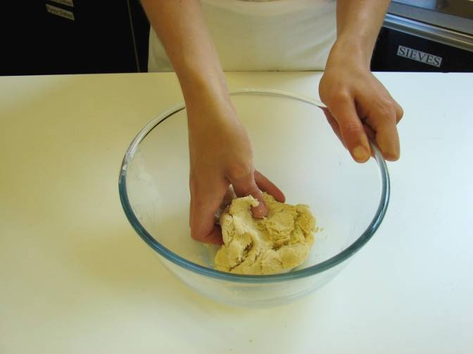
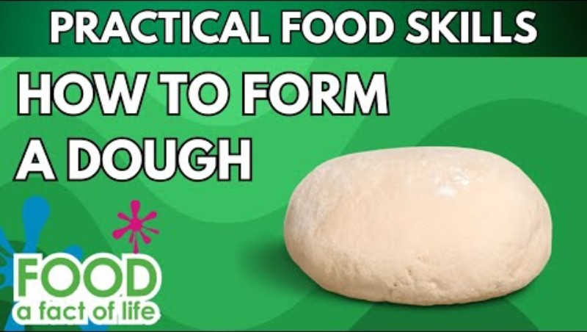
Food skills
Sift
Mix
Stir and combine
Rub-in
Roll out
Form and shape
Portion/ divide
Bake
Weigh
Measure
Grate
Peel
Cut
Chop
Slice
Click below to see forming the dough

Slide 8
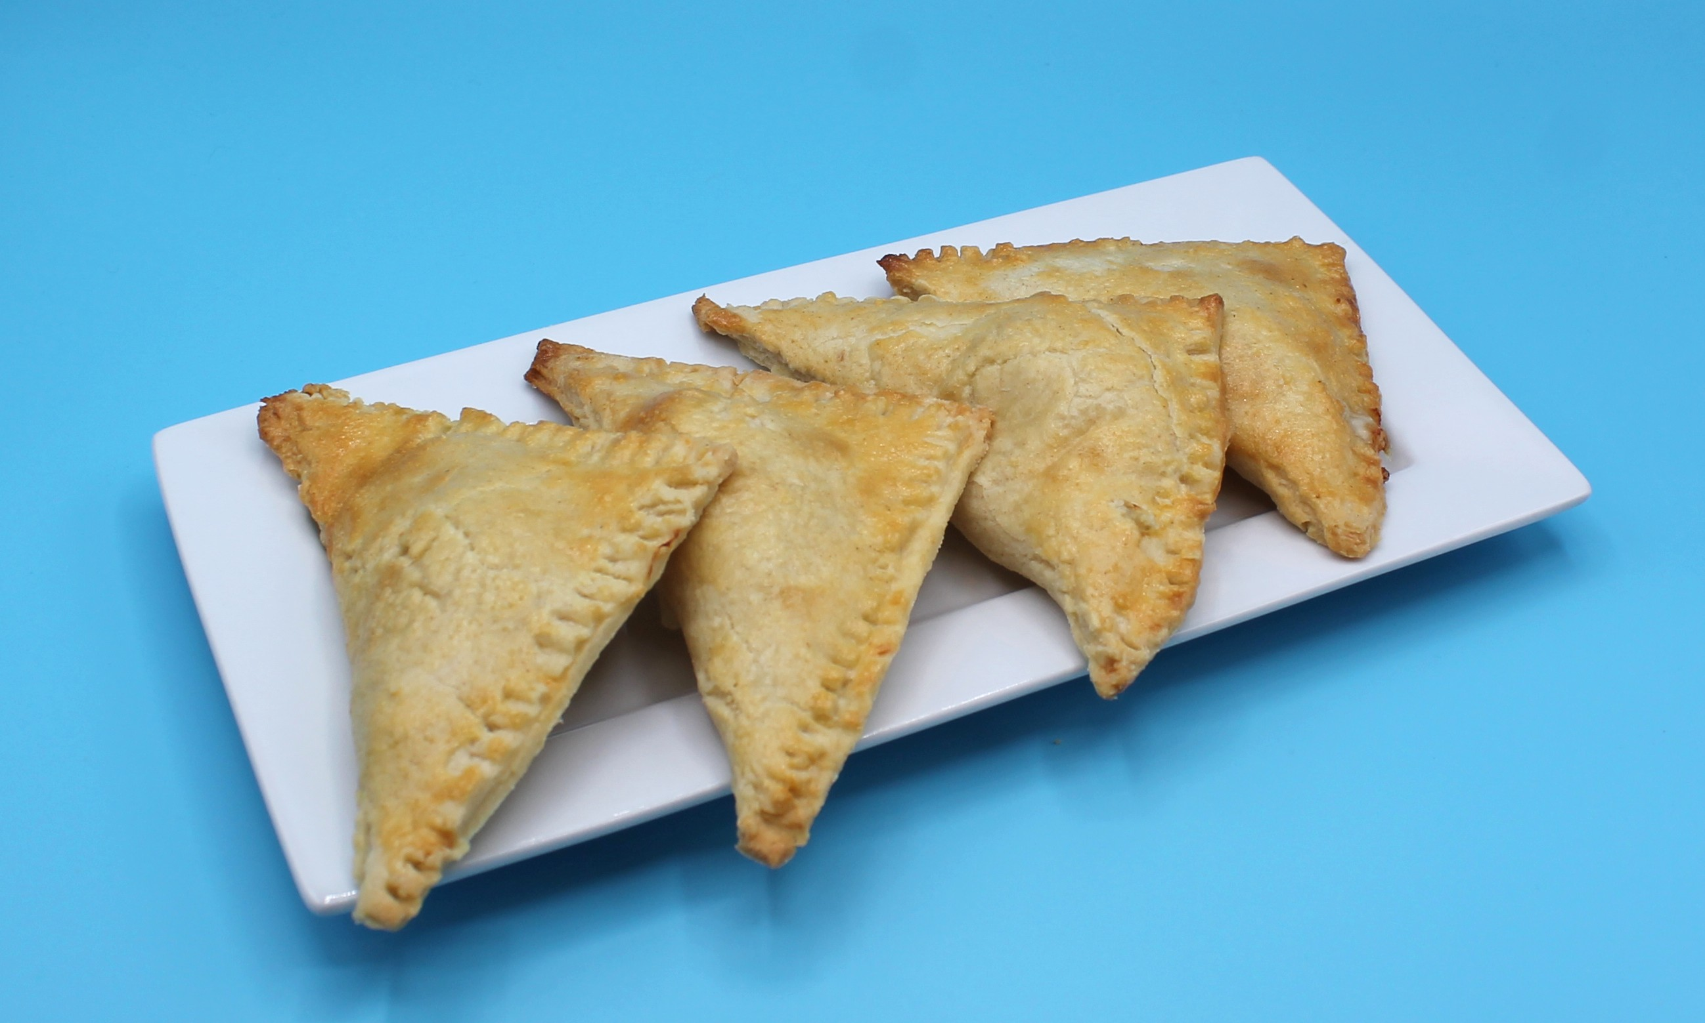
Method
Preheat the oven to 180°C or gas mark 4.
Grease or line the baking tray.
Prepare the cheese and onion filling:
grate the cheese;
peel and dice the onion;
mix the cheese and onion together in a small bowl.
4. Make the shortcrust pastry:
sift the flour into the bowl;
rub the fat into the flour, using your fingertips, until it resembles breadcrumbs;
add the cold water and mix together;
mix to form a firm, smooth dough.

Slide 9
Method
5. Roll out the pastry into a square, on a floured surface.
6. Cut the square into quarters using the palette knife.
7. Spoon a quarter of the cheese and onion filling in the middle of the square.
8. Break the egg into a small bowl and beat with a fork, brush the edges of the pastry with beaten egg.
9. Fold over to make a triangle and pinch the edges together all the way along using the edge of a fork.
10. Glaze the top of the triangle with the leftover egg or milk.
11. Transfer the triangles onto the baking tray.
12. Bake for 20 minutes, until golden brown.

Slide 10
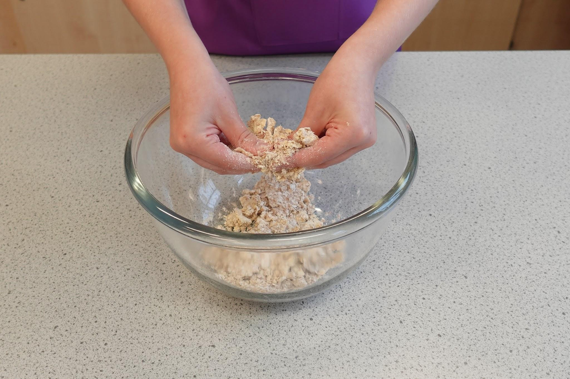
Food science
Shortening
The shortcrust pastry uses the rubbing-in method.
The fat coats the flour particles and prevents them from absorbing water. This reduces the gluten development, which would cause the dough to become elastic.
This results in a short, crumbly, melt in mouth shortcrust pastry.

Slide 11
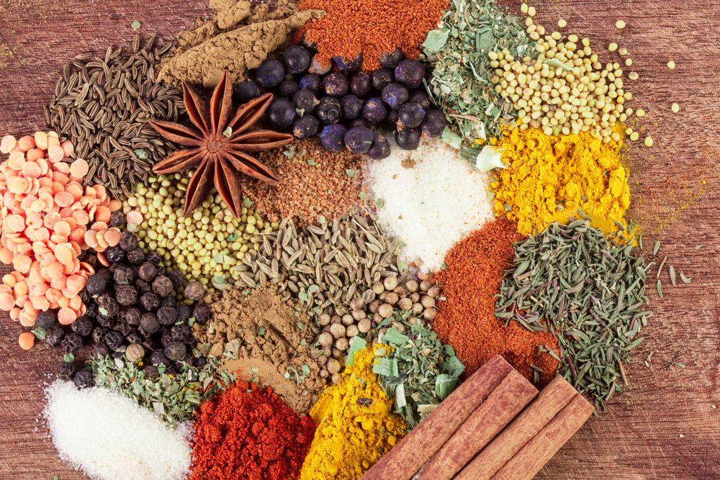
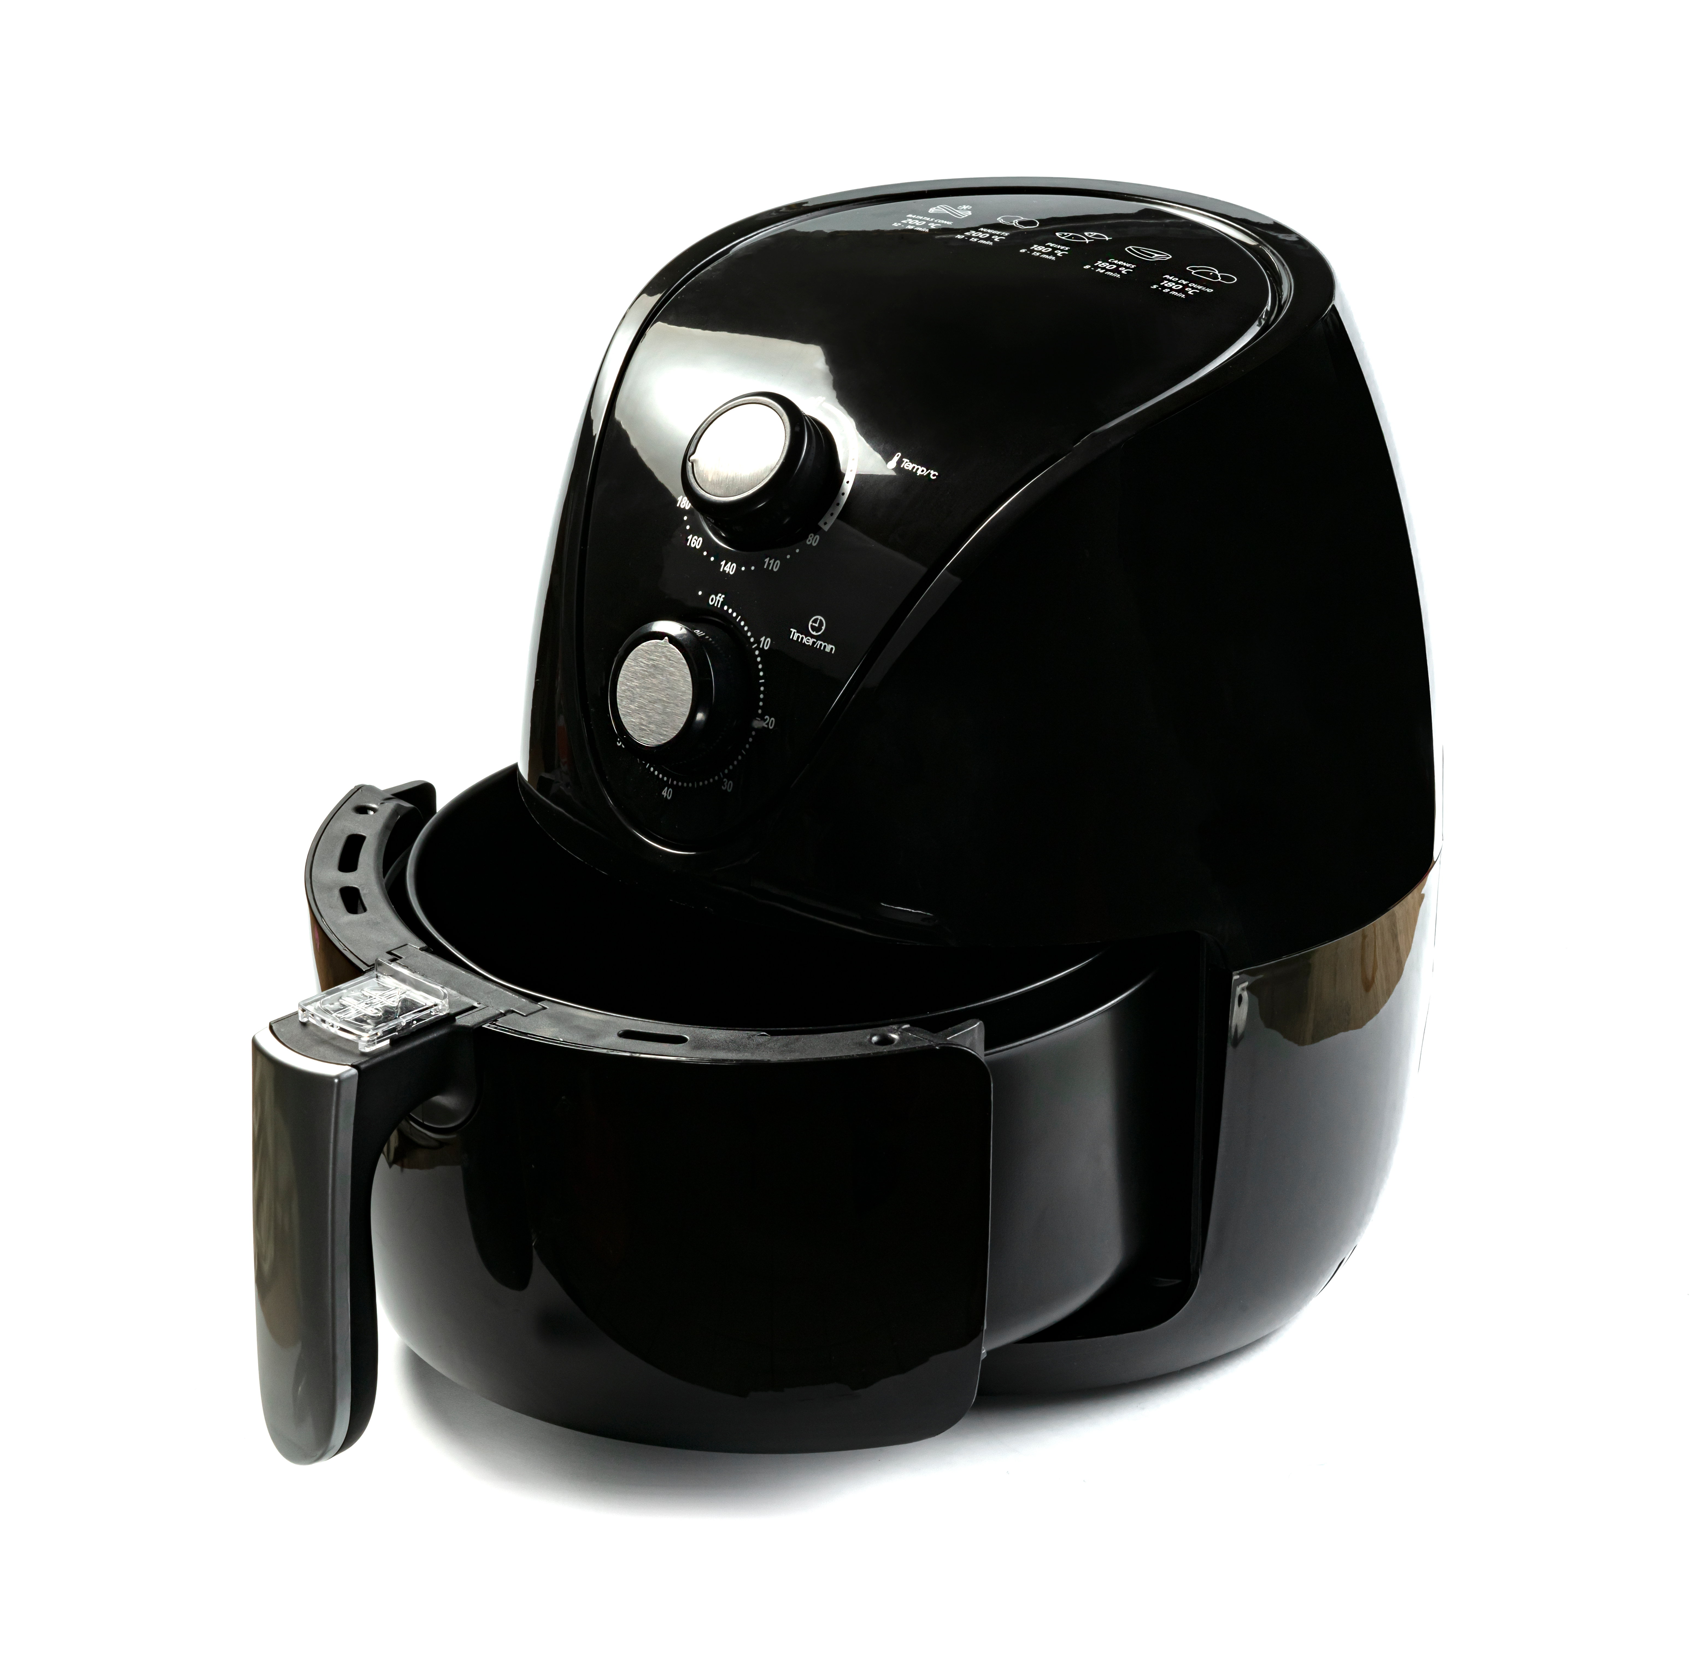
Top tips
Turn up the flavour: Add spices and herbs for different flavour combinations.
Focus on fibre: Replace half the flour with wholemeal. Remember to use a little more water.
The triangles can also be baked in an air fryer at 180°C for 15 minutes.

Slide 12
Plenary
List five top tips for creating the perfect shortcrust pastry.
Explain to a friend the food science term “shortening”, remember to use key terms in your explanation.

Slide 13
Example responses
1. List five top tips for creating the perfect shortcrust pastry
Use the fingertips as this is the coldest part of the hands and will prevent fat from melting.
Keep fat as cold as possible.
Use block fat.
Don’t over rub the fat, it should be rubbed-in until it resembles breadcrumbs.
Don’t overwork the dough as this will develop gluten.
2. Explain to a friend the food science term “shortening”, remember to use key terms in your explanation.
During rubbing-in, the fat coats the flour particles and prevents them from absorbing water. This reduces the gluten development, which would cause the dough to become elastic.
This results in a short, crumbly, melt in mouth shortcrust pastry.

Slide 14
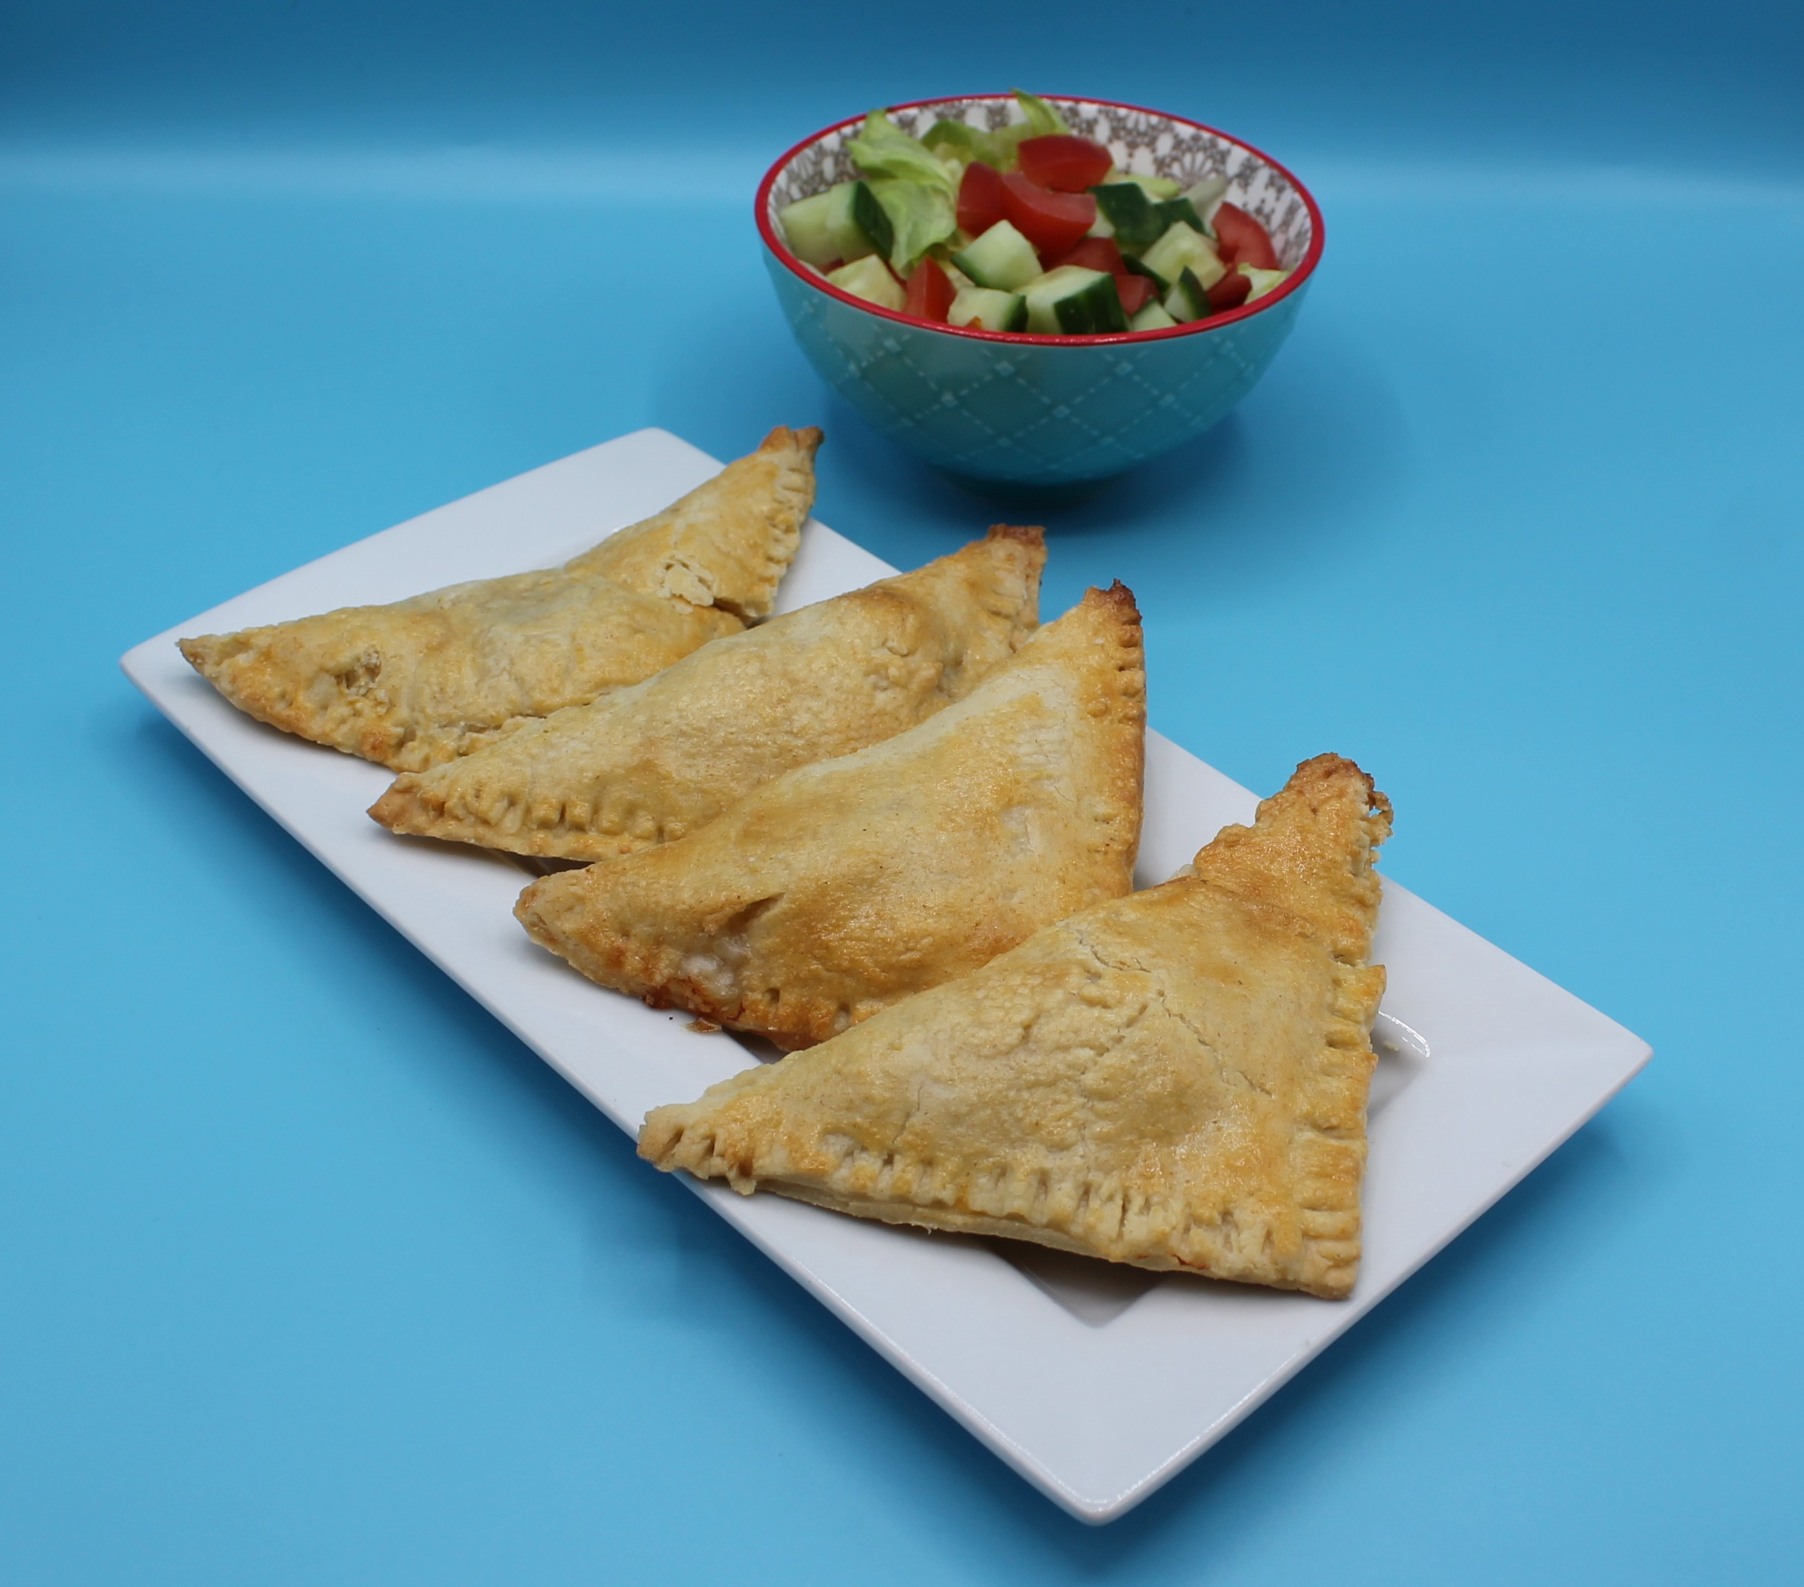
Looking for more…
Check out our principles of pastry making guide to guide your pupils in making their pastry. Use our pastry making worksheet to assess their knowledge.
Challenge your pupils to develop their pastry making skills and make a savoury tart. Use this lesson plan and recipe to support.

Slide 15
Cheese and onion triangles
For further information, go to:
www.foodafactoflife.org.uk
This resource meets the Guidelines for producers and users of school education resources about food.

