Slide 1
Using food to deliver your early years curriculum
11/01/2023

Slide 2

Covered in today’s webinar
A close look at the early years resources available on Food – a fact of life.
Ideas for food-themed activities in your setting, including games and recipes.
Support for running practical food sessions, safely, with young children.

Slide 3
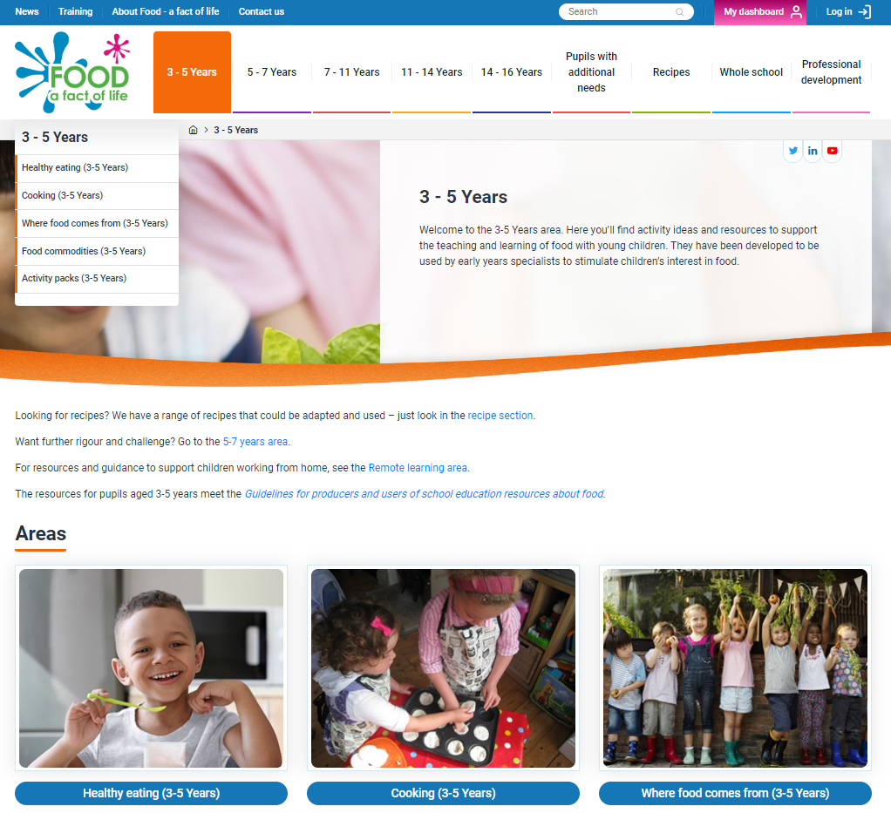
Food – a fact of life
Free resources for teaching young people aged 3-16 years about where food comes from, cooking and healthy eating.
www.foodafactoflife.org.uk

Slide 4
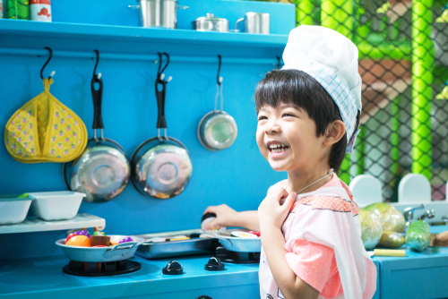
What’s in the Food – a fact of life 3-5 Years area?
Healthy eating (four sessions): – Choices, Eatwell Guide, Amounts, 5 A DAY
Cooking (four sessions): – Tasting, Hygiene, Equipment, Making
Where food comes from (four sessions): – Sorting, Seasons, Growing, Places
Food commodities – Food journey cards, Dot to dots, Counting sheets
Activity packs – Food-based sessions (x10), Six Early Years activity packs (x6), Challenge activities (x2),Vegetable activities

Slide 5
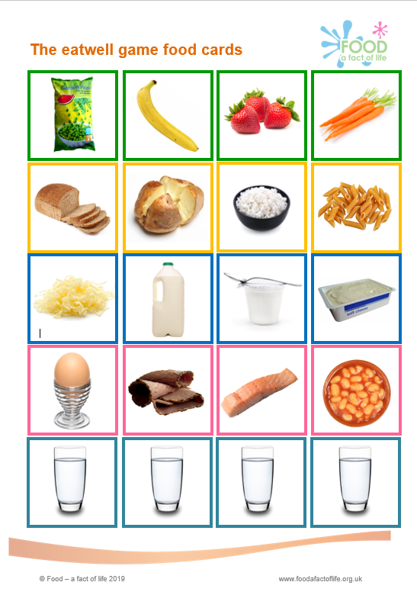
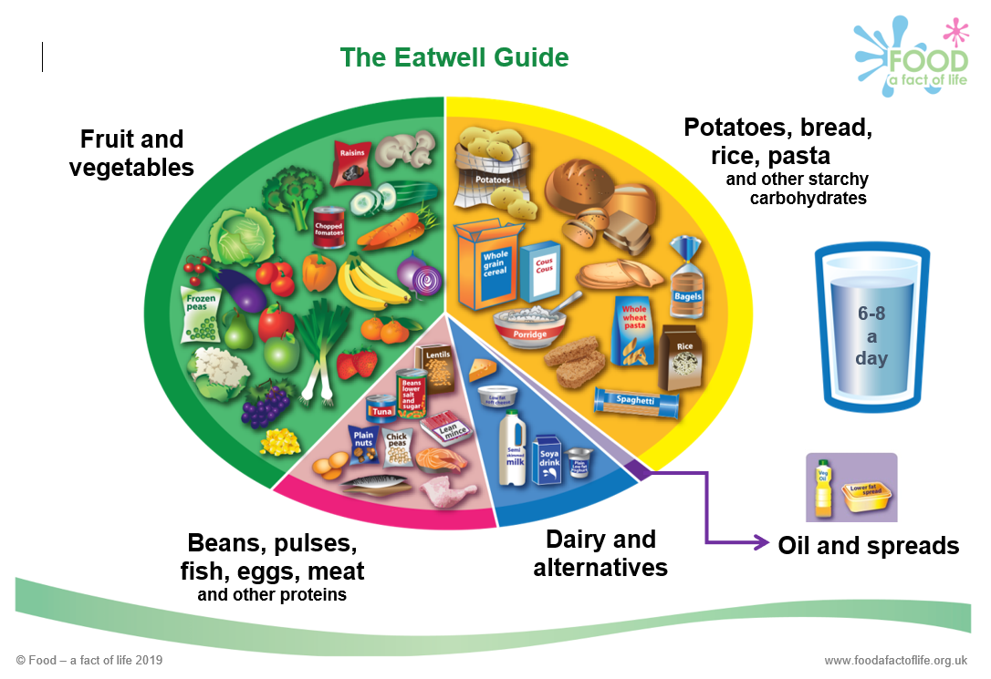
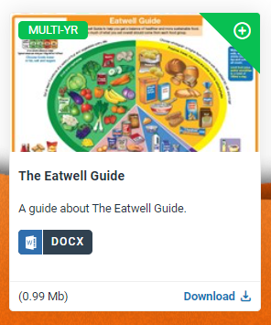
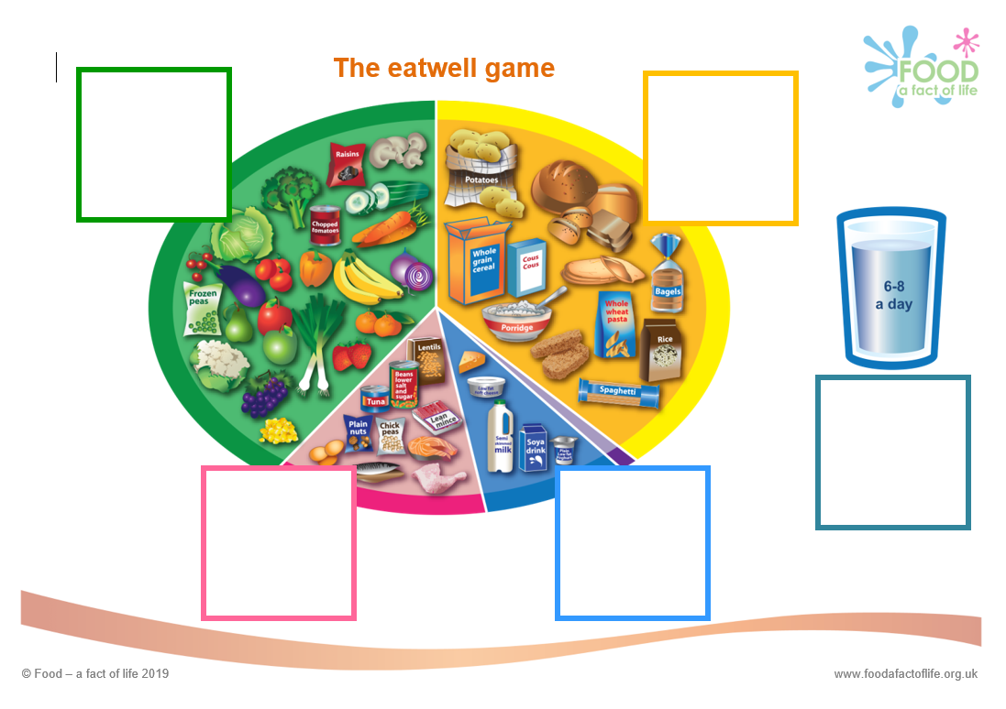
Healthy eating - Eatwell Guide session
The aim of this session is for children to:
recognise the Eatwell Guide;
name some of the food in each food group;
explain that we need different types of food, and 6-8 drink a day, to be healthy.
Session notes include:
Learning – session aims
You will need – resources for the session
Listen and respond – teaching and discussing
Have a go – whole or small group activity
Consolidate – recap activity/discussion
Resources…
Examples of questions…
Which are the two biggest groups on the Eatwell Guide?
Which is the smallest group?
What food can you see in this group?
Where is/are the – eggs, tomatoes, bread, fish, milk?
Which food in the picture have you eaten today?

Slide 6
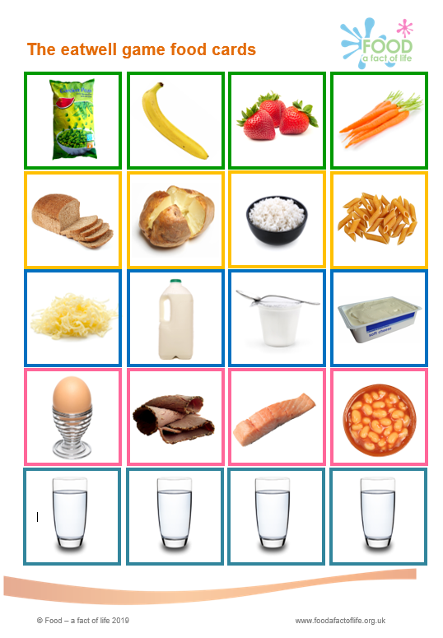
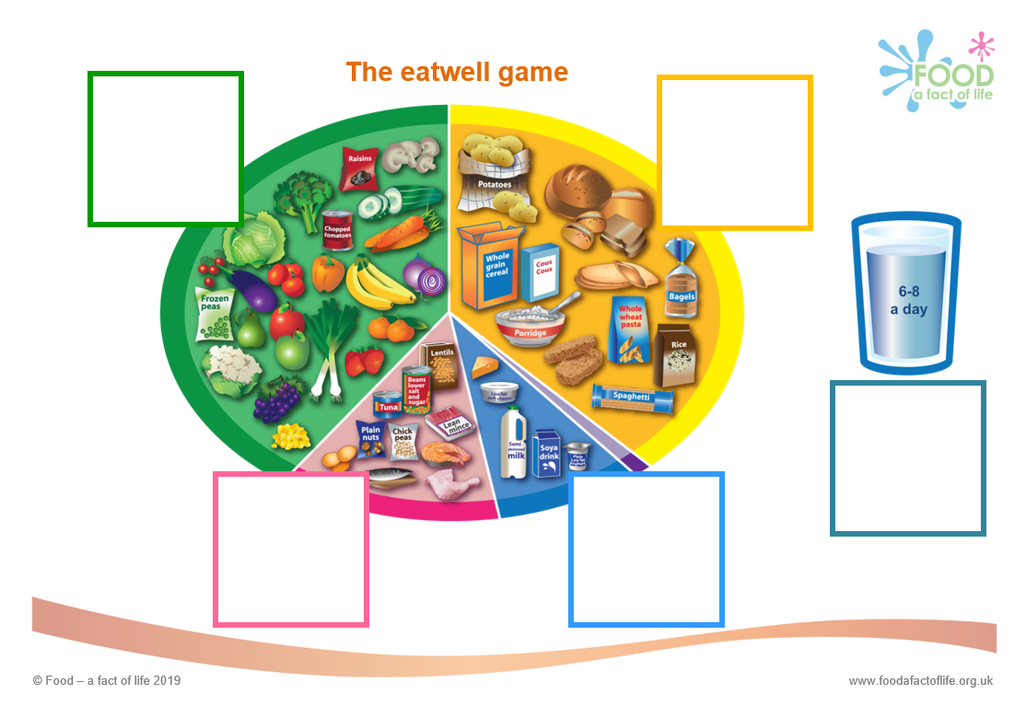

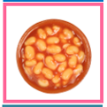




The eatwell game (3-5 years)

Slide 7
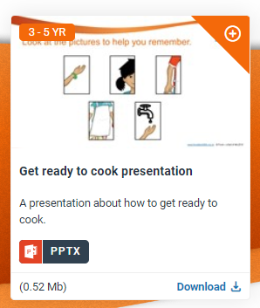
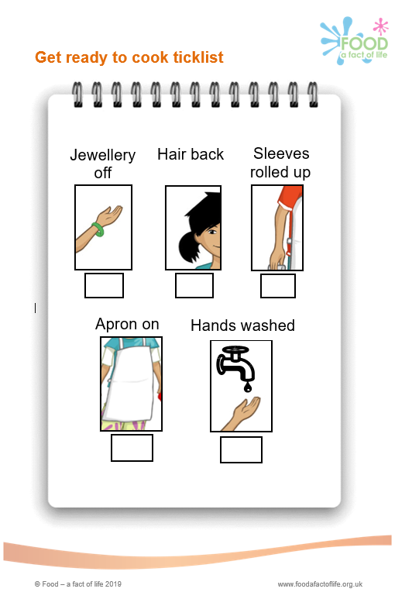
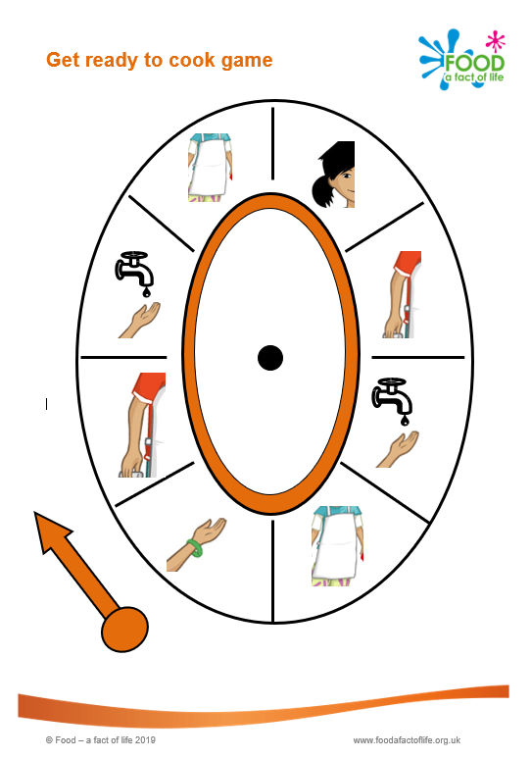
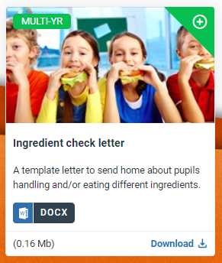


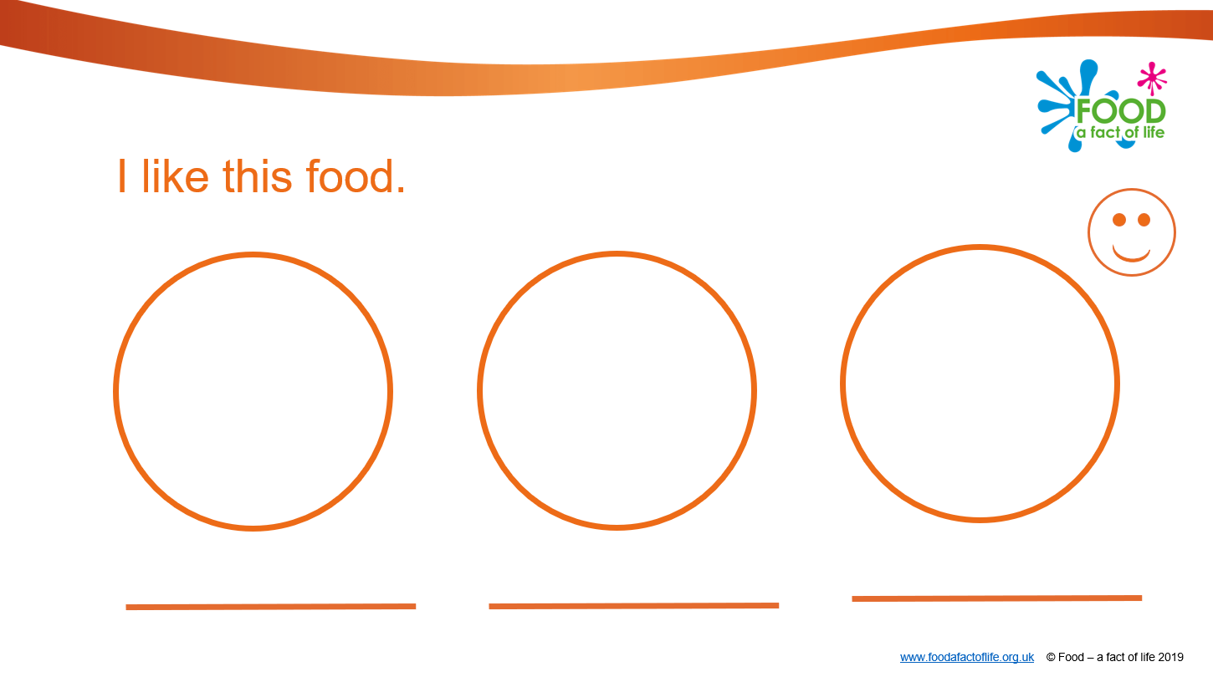

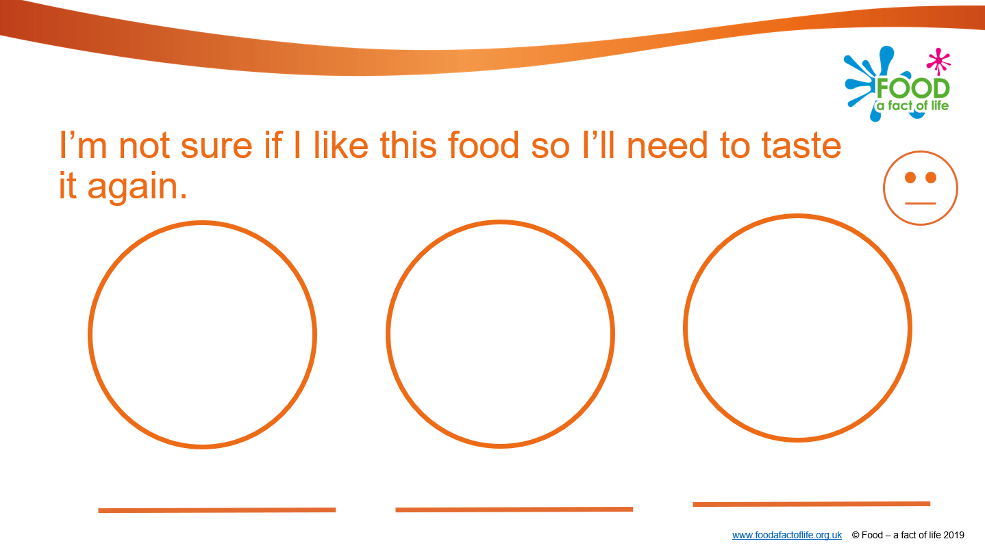
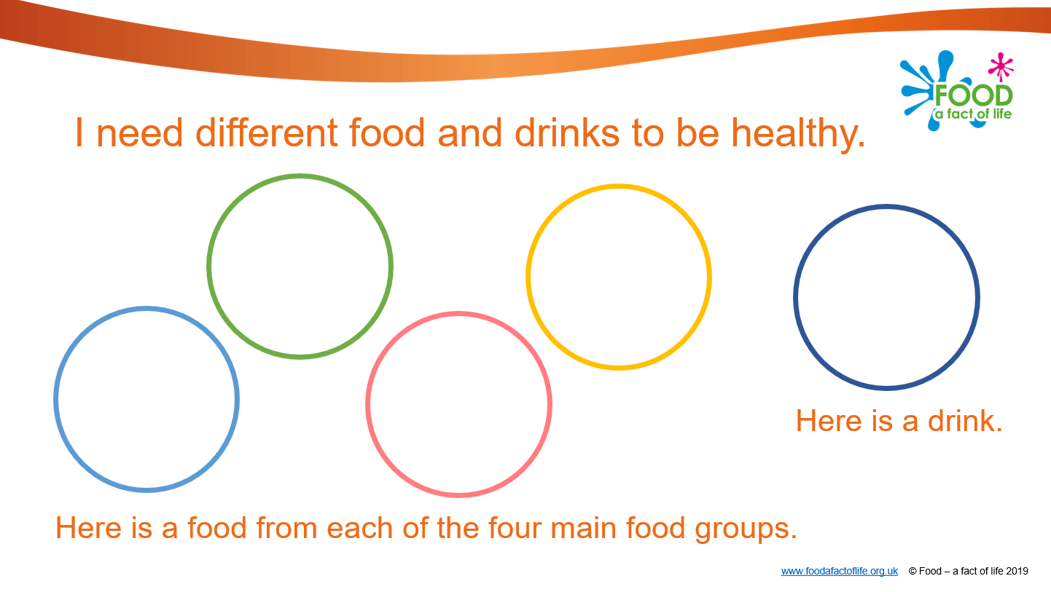
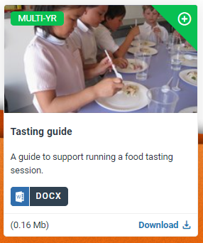
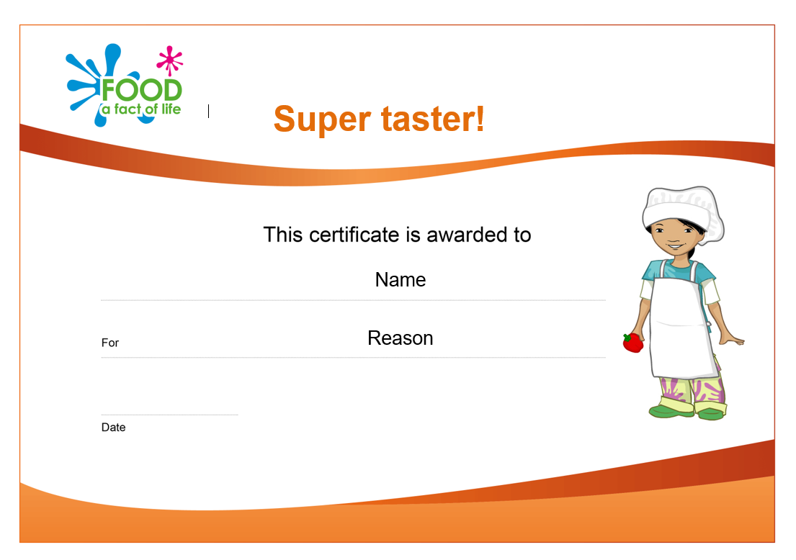
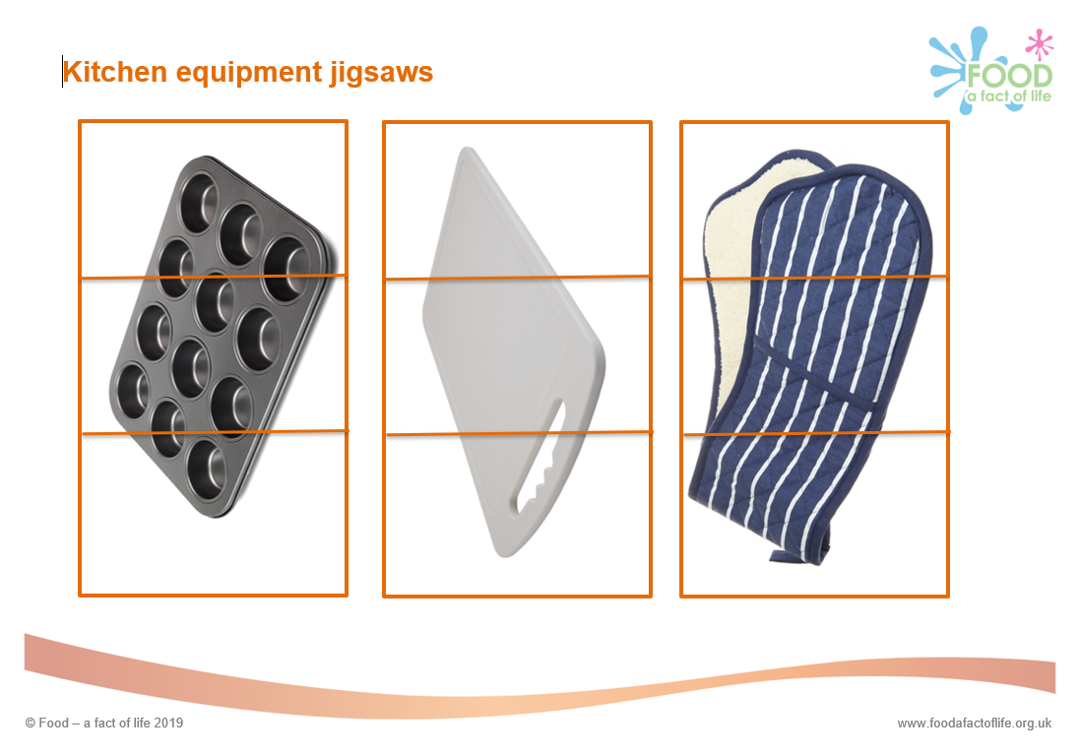
Cooking - Tasting session
Cooking – Hygiene session
Resources…
Other cooking resources…

Slide 8
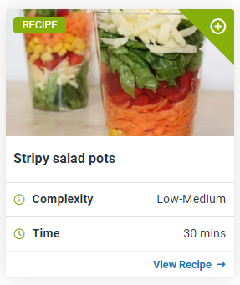
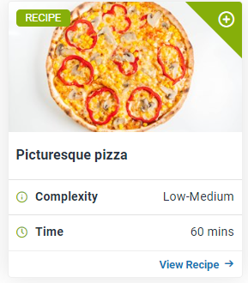
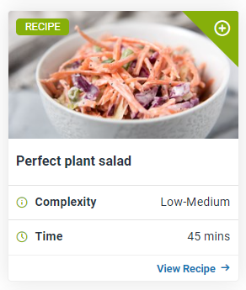
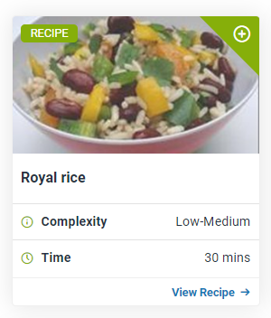
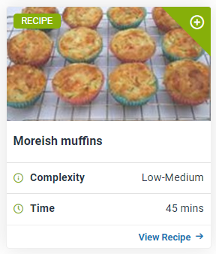
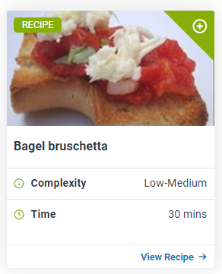
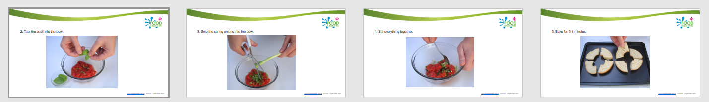
Recipes Search > 3-5 Years
Some recipes have step-by-step photos…

Slide 9
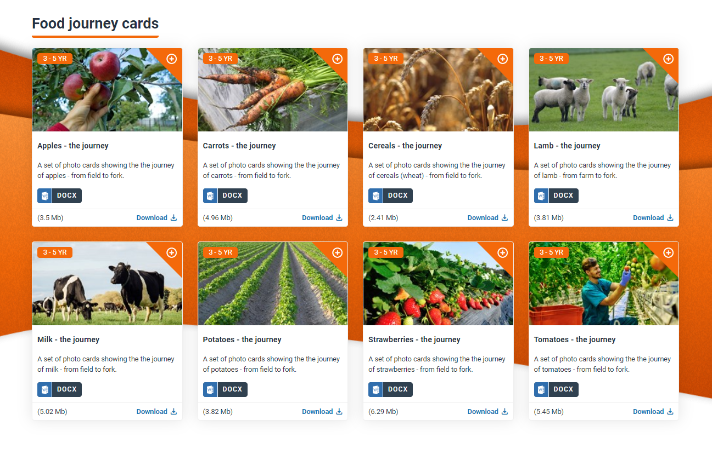
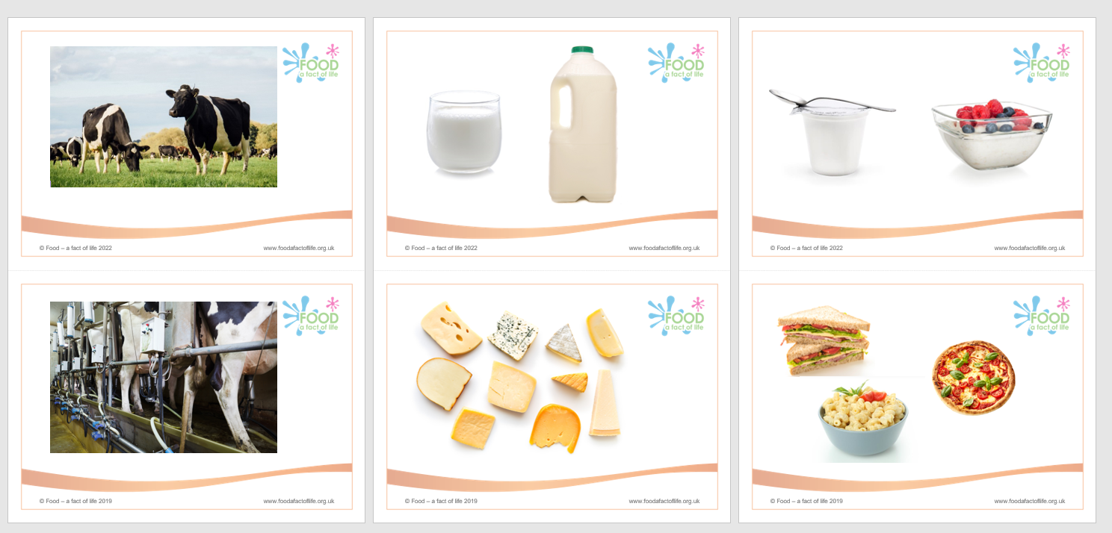
Food commodities - Food journey cards
These are simple sets of images to show where different foods come from.
Useful for:
discussion;
display;
ordering and sorting activities.

Slide 10
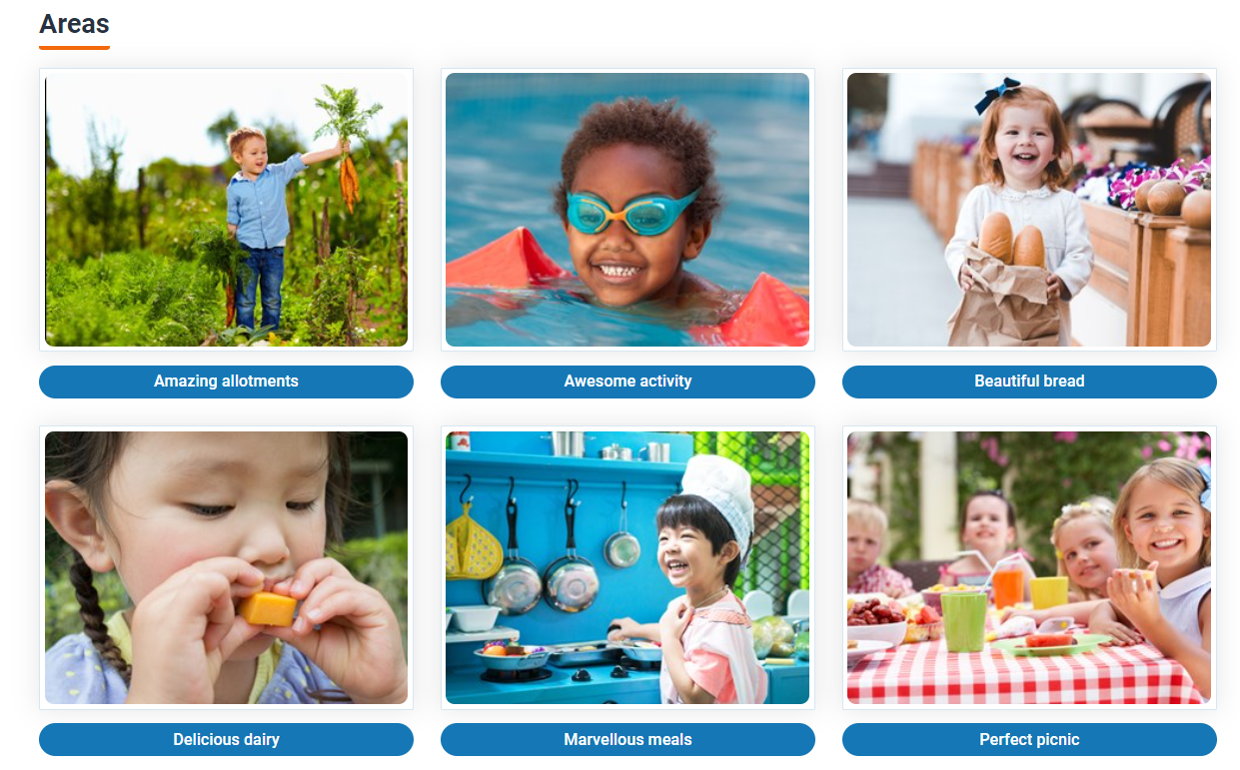
Activity packs – Six early years activity packs
The packs use food themes to deliver different areas of learning common to Early Years curricula around the UK. Each pack includes:
a leaders’ guide;
a presentation.

Slide 11
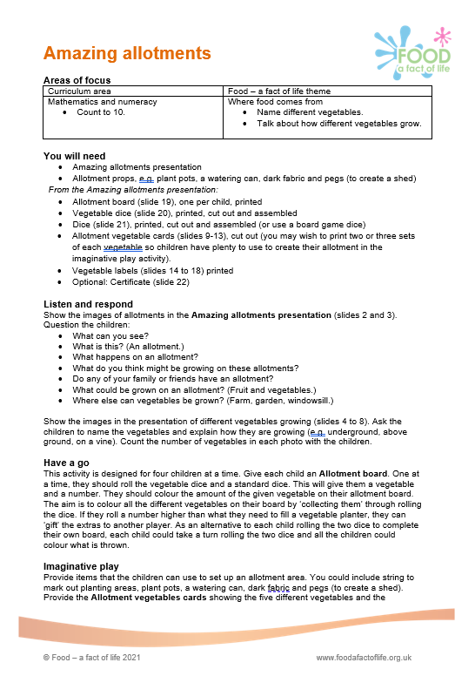
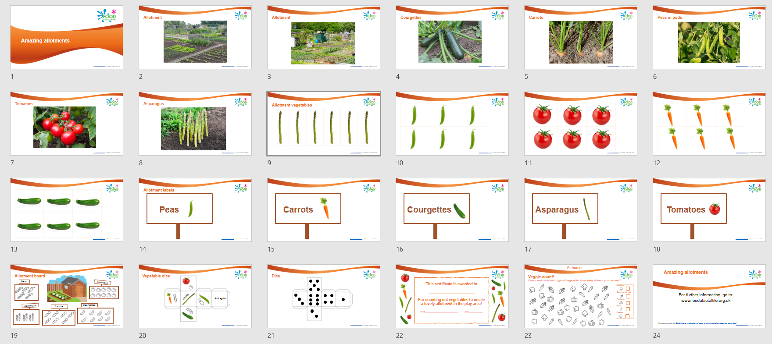
Six early years activity packs – Amazing allotments
Leaders’ guide
Presentation (containing all the supporting resources)

Slide 12
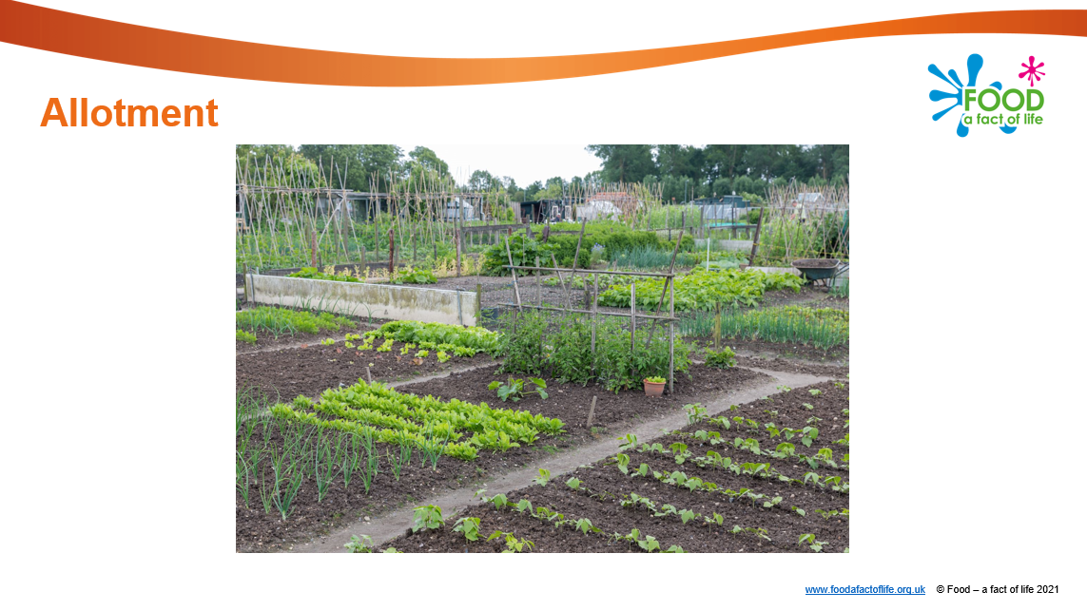
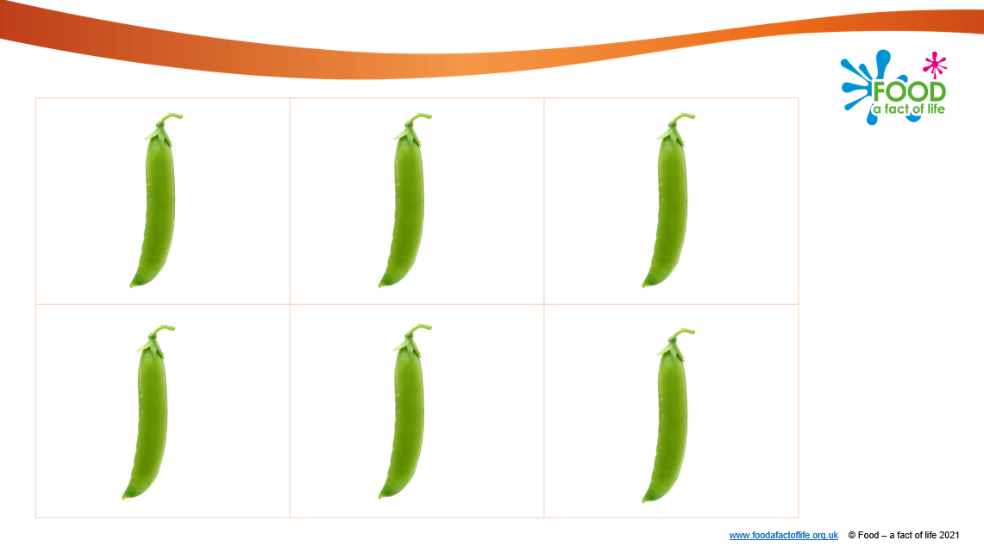
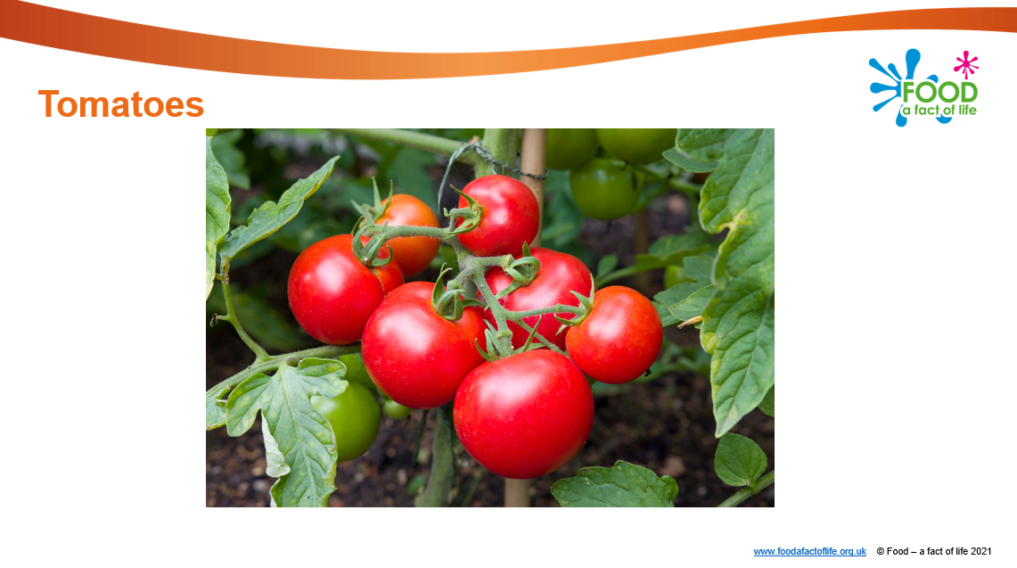
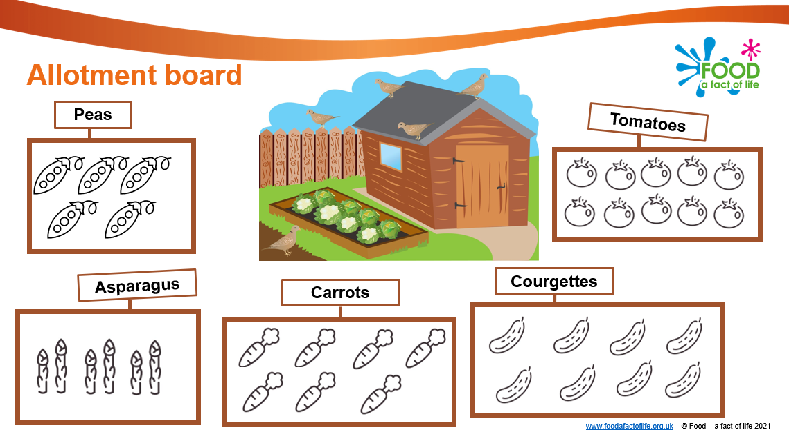
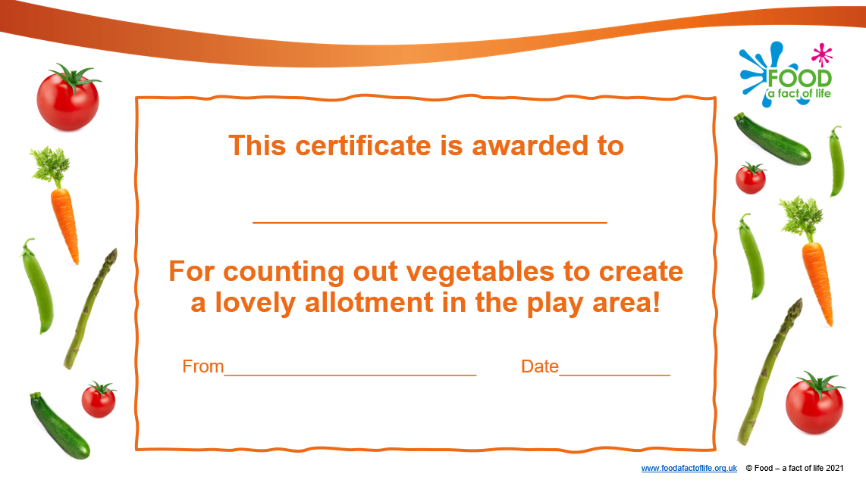
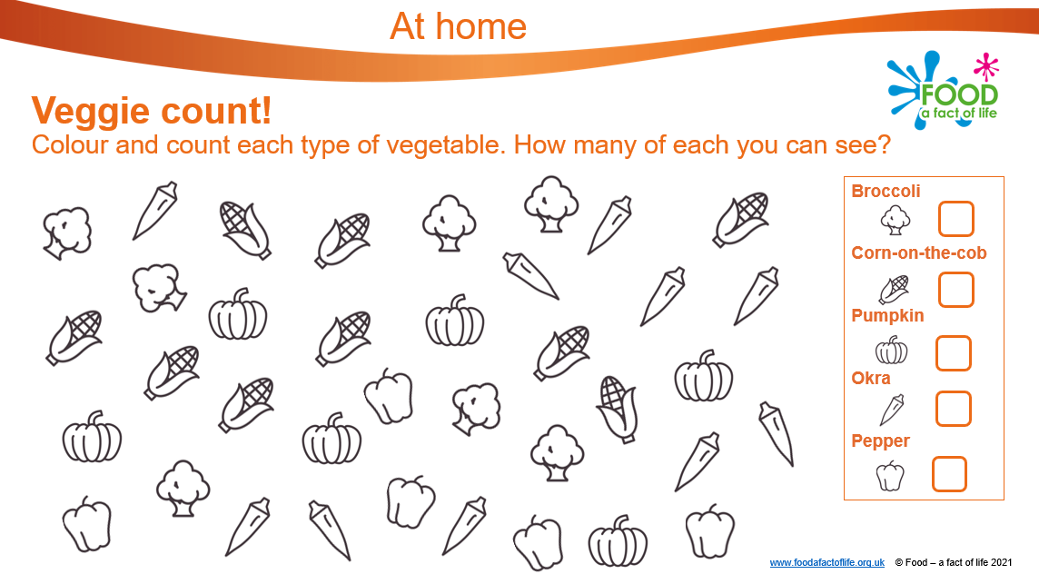
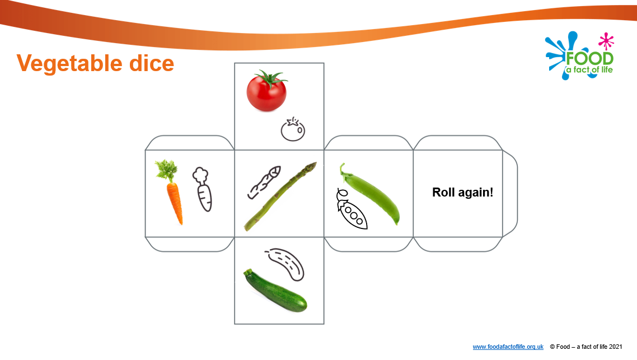
Six early years activity packs – Amazing allotments
Amazing allotments – Areas of focus
Curriculum area: Mathematics and numeracy
Count to 10.
Food –a fact of life: Where food comes from:
Name different vegetables.
Talk about how different vegetables grow.

Slide 13
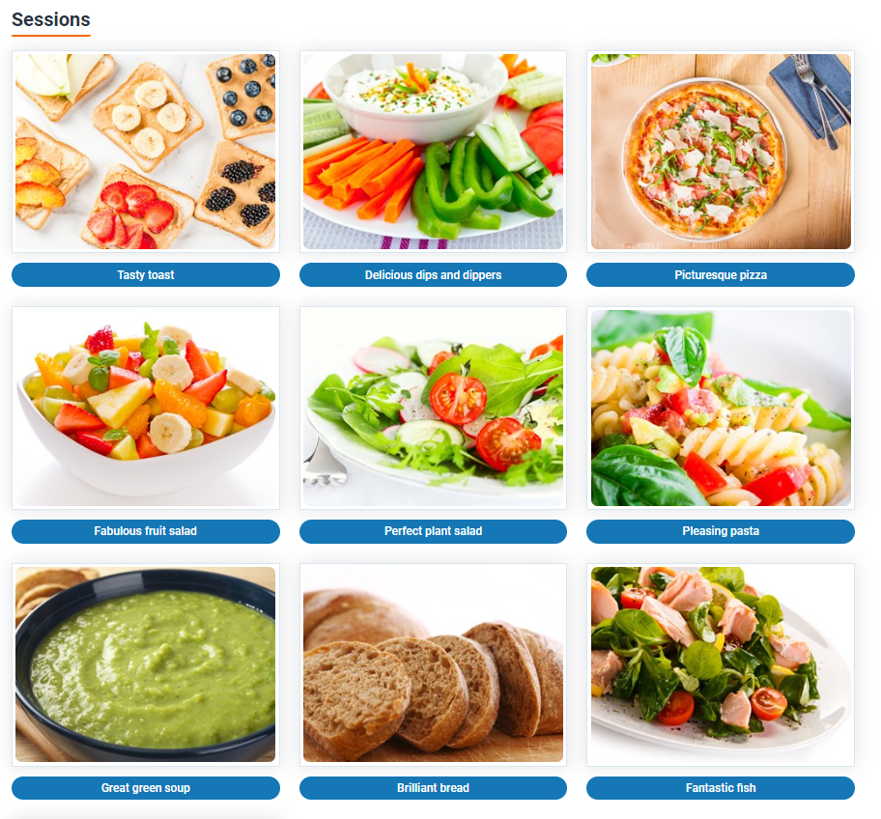
Activity packs – Food based sessions
These packs are based around different meal occasions.
Each pack:
delivers a health eating message;
teaches about specific foods;
includes a card game/activity;
involves a practical food activity;
provides a take-home task.

Slide 14
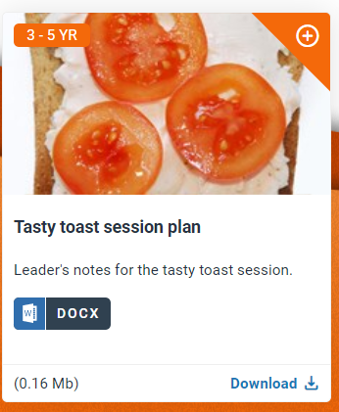
Food based sessions – Tasty toast
Overview
The aim of this session is to explore the importance of having something healthy to eat and drink every day for breakfast. The main activity, Have a go, involves selecting and adding a topping to toast. Children will taste different toppings, choose their favourites and prepare their own toast using these.
Learning
The aim of this session is for children to:
recall that they should have breakfast every day;
recognise that toast can be eaten at breakfast time;
taste and select food options to top their toast;
perform simple food skills, safely, e.g. spreading, arranging.

Slide 15
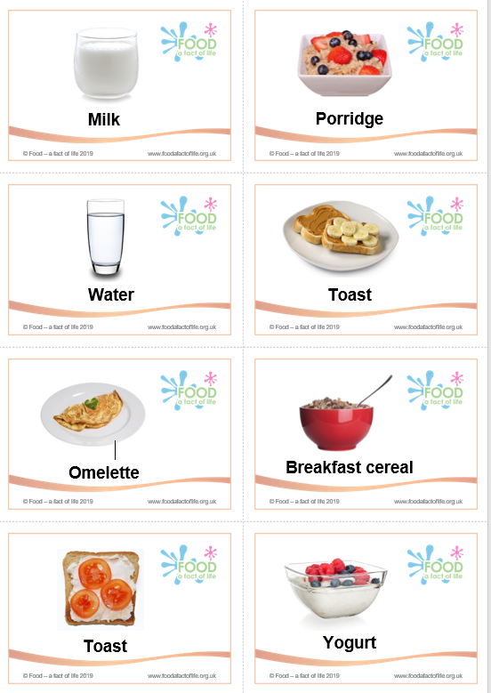
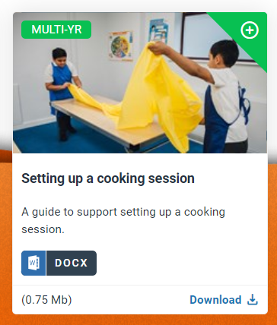
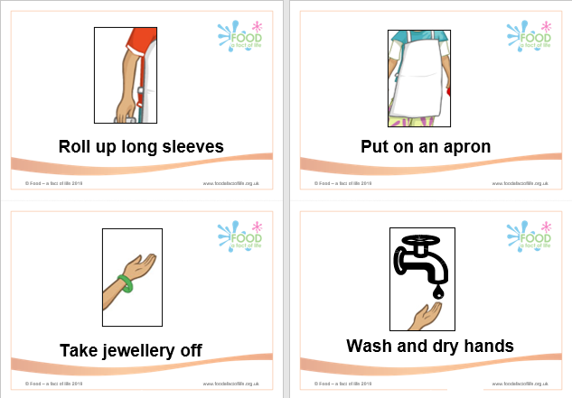
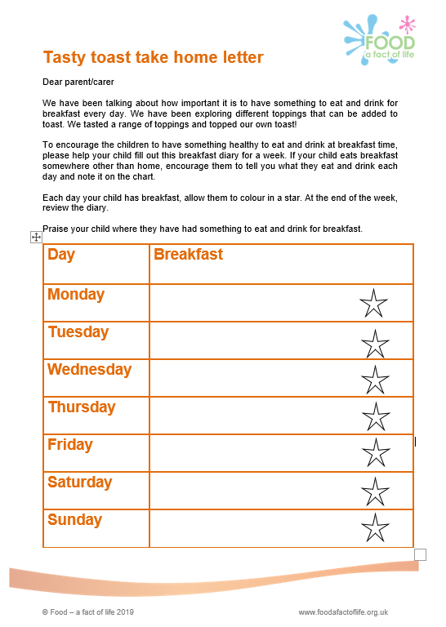
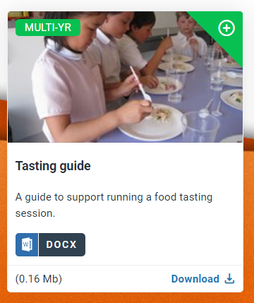
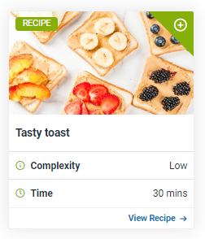
Food based sessions – Tasty toast
These packs include:
Session plan;
Guides (e.g. hygiene)
Card game/activity;
Recipe
Take-home task.

Slide 16
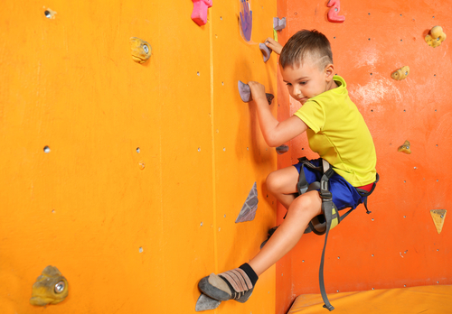
What we have looked at today
Healthy eating (four sessions): – Choices, Eatwell Guide, Amounts, 5 A DAY
Cooking (four sessions): – Tasting, Hygiene, Equipment, Making
Where food comes from (four sessions): – Sorting, Seasons, Growing, Places
Food commodities – Food journey cards, Dot to dots, Counting sheets
Activity packs – Food-based sessions (x10), Six Early Years activity packs (x6), Challenge activities (x2), Vegetable activities

Slide 17
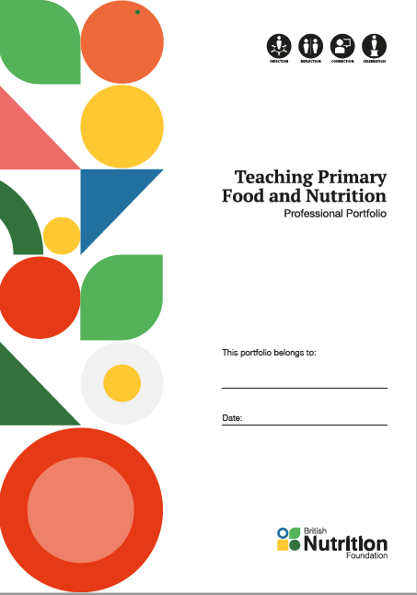
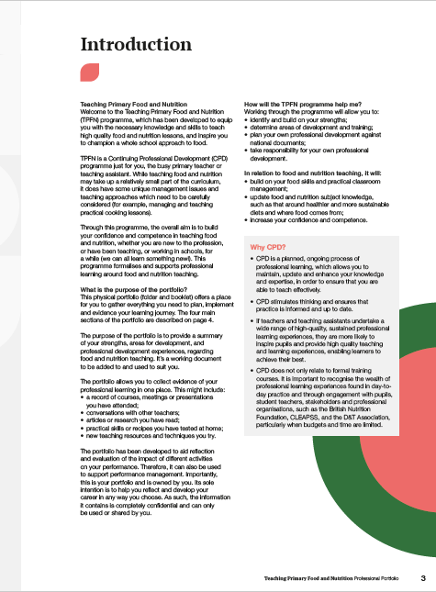
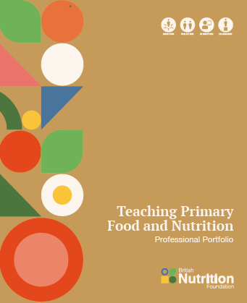


Teaching Primary Food and Nutrition
A free professional development programme for primary school teachers, trainees and teaching assistants
Free portfolio (folder and binder) for the first 1,500 registrants.
How to get involved:
register and complete a short audit;
use the supporting information to plan your own food and nutrition professional development;
book onto free Food – a fact of life training events to support your planned development;
reflect upon and record your journey.
To find out more, go to:
https://www.foodafactoflife.org.uk/teaching-primary-food-and-nutrition/

Slide 18


Keep up to date with our free resources and training
Education New (monthly email update)
Sign up on the homepage: www.foodafactoflife.org.uk
Follow us on Twitter @Foodafactoflife
https://twitter.com/foodafactoflife
Keep in touch: c.theobald@nutrition.org.uk

Slide 19
Using food to deliver your early years curriculum
For further information, go to:
www.foodafactoflife.org.uk

