Slide 1
Obesity

Slide 2

Overweight and obesity
In the UK and many other developed countries, overweight and obesity rates in adults and children have been increasing over the years.
In 2021, 26% of adults in England were obese. A higher proportion of men than women were either overweight or obese (69% compared with 59%).
It is important to lead an active lifestyle and make healthier food choices.
Overweight and obesity in adults - NHS Digital

Slide 3
Over nutrition
Over nutrition is a problem usually associated with developed countries, such as the UK.
The most common form of over nutrition is having an energy intake in excess of needs, resulting in overweight and obesity.
Very high intakes of minerals and fat-soluble vitamins (more can usually be obtained from food sources alone) can be toxic. This is because they are stored in the body, e.g. vitamin A is stored in the liver.

Slide 4
Obesity
People who are obese are more likely to suffer from:
• coronary heart disease;
• type 2 diabetes;
• gall stones;
• arthritis;
• high blood pressure;
• some types of cancers, i.e. colon, breast, kidney and stomach.

Slide 5
Body mass index (BMI)
Body Mass Index (BMI) can be used to identify if an adult is a correct weight for height.
BMI can be calculated as follows:
BMI = weight (kg)
(height in m)²
Recommended BMI range (adults)
Less than 18.5 Underweight 18.5 to 25 Desirable or healthy
range 25-30 Overweight 30-35 Obese (Class I) 35-40 Obese (Class II) Over 40 Morbidly or severely
obese (Class III)

Slide 6
BMI calculation
Calculate the BMI. Click the colour blocks to reveal the answers.
51kg 82kg 78kg
1.7m x 1.7m 1.95m x 1.95m 1.63m x 1.63m
= 17.6 BMI = 21.6 BMI = 29.4 BMI
Underweight healthy weight overweight
Samantha
Height: 1.70m
Weight: 51kg
2. Dale
Height: 1.95m
Weight: 82kg
3. Ruth
Height: 1.63m
Weight: 78kg

Slide 7
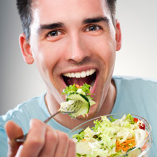
Energy balance
To maintain body weight it is necessary to balance energy intake (from food and drink) with energy expenditure (from activity).
This is called energy balance.
When energy intake is higher than energy output, over time this will lead to weight gain (positive energy balance).
When energy intake is lower than energy output, over time this will lead to weight loss (negative energy balance).

Slide 8
Positive energy balance
A person is said to be in positive energy balance when the diet provides more energy than is needed to meet energy demands of the body. Energy is stored as fat and the person puts on weight over time.
People who achieve a positive energy balance over an extended period of time are likely to become overweight or obese.
Being overweight or obese is associated with an increased risk of developing certain cancers, cardiovascular disease and type 2 diabetes.
Energy out: activity
Energy in: food and drinks
Energy in > Energy out = Weight gain

Slide 9
Negative energy balance
A person is said to be in negative energy balance when there is insufficient energy from the diet to meet energy demands of the body. Energy is derived from energy stores and the person loses weight.
People who achieve a negative energy balance over an extended period of time are likely to become underweight.
Being underweight is associated with health problems, such as osteoporosis (low bone mass), infertility (difficulty to conceive) and even heart failure.
Energy out: activity
Energy in: food and drinks
Energy out > Energy in = Weight loss

Slide 10
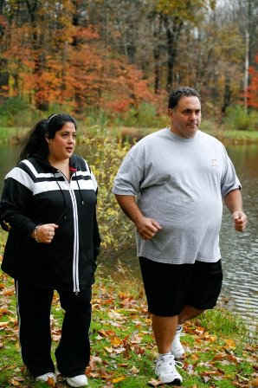
Energy balance
Energy balance can be maintained by:
regulating energy intake through the diet;
adjusting physical activity levels;
a combination of both.

Slide 11
Obesity
For further information, go to:
www.foodafactoflife.org.uk
This resource meets the Guidelines for producers and users of school education resources about food.

