Slide 1
The science of chocolate: Tempering

Slide 2
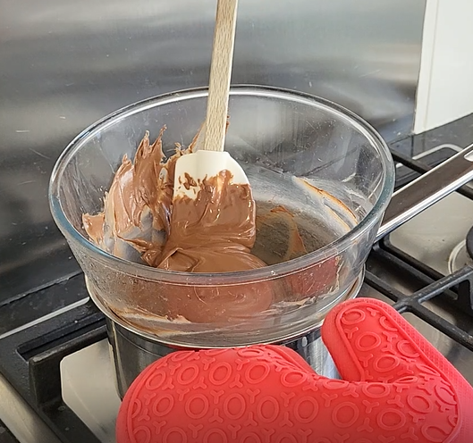
Tempering – what is it?
Tempering chocolate is the act of heating and cooling chocolate to ensure the correct crystal structure within the chocolate before working with it.
Throughout the process, the rise and fall of the temperature is controlled to specific temperatures.

Slide 3

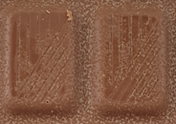
Tempering – why do we do it?
Tempering chocolate ensures the chocolate has the following attributes:
has a nice glossy shine to it;
snaps well;
contracts (shrinks) away from the mould to allow demoulding during production.
Tempered
Not tempered

Slide 4
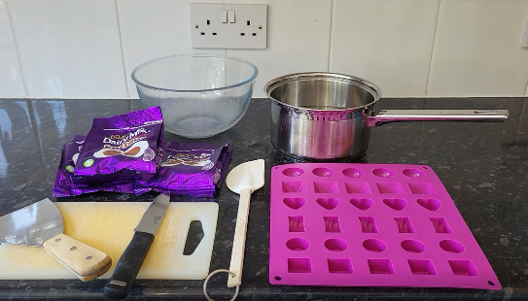
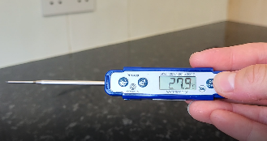
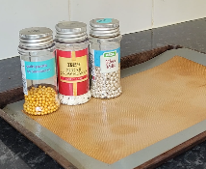
Tempering – what will you need?
Heatproof bowl (metal or Pyrex glass).
Saucepan (filled a 1/3rd with water).
Chocolate of your choice.
Chopping board and sharp knife.
Spatula (or spoon).
Scraper (or pallet knife).
Mould (or lined tray).
Digital thermometer.

Slide 5
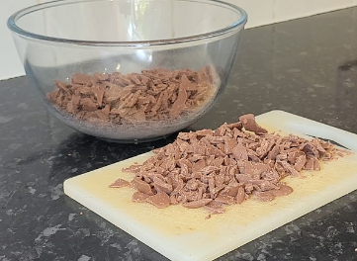
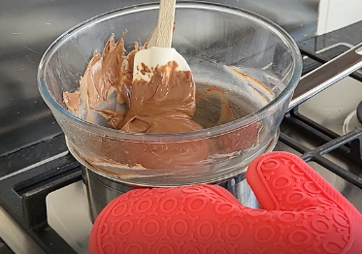
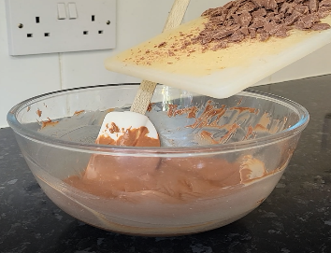
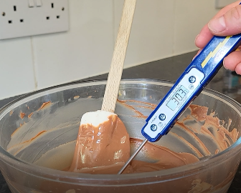
Chocolate tempering instructions
1. Chop 2/3rd of the chocolate and place into the heatproof bowl.
Keep back 1/3rd of the chocolate. This is your seeding chocolate.
2. Place bowl over pan of simmering water and stir until melted and around 45°C.
3. Add in the seeding chocolate and stir well until it has melted.
This will bring the chocolate temperature down. Aim to achieve a temperature between:
28-30°C (milk chocolate);
30-31°C (dark chocolate);
26-28°C (white chocolate).

Slide 6
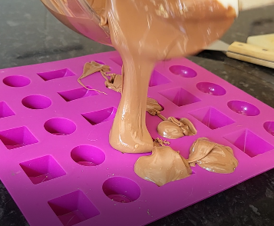
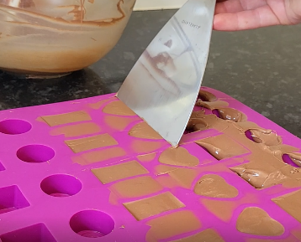
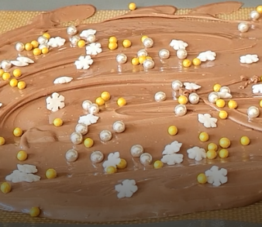
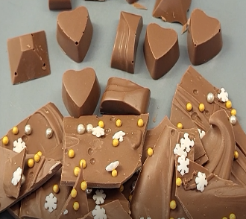
Chocolate tempering instructions continued
4. Pour the tempered chocolate into the mould. Fill each cavity with slightly more chocolate than needed- being careful not to completely overfill too much.
5. Tap the mould on the surface to remove the air bubbles and scrape off the excess to give a clean finish. Put in the fridge for 20-40 minutes to cool.
6. Alternatively, pour onto lined tray and decorate with choice of decorations- sprinkles, nuts, dried fruits etc. all work well. Put in the fridge for 20-40 minutes to cool.
7. After time in the fridge, de-mould/ snap your finished chocolates and enjoy!

Slide 7




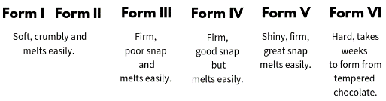
Science, safety and extra tips
Don’t let the water boil or your chocolate will overheat.
If the chocolate is still too hot, add in more chocolate. If its too cold, continue to place over the warm water to increase the temperature.
Chopping the chocolate increase the surface area of the chocolate and therefore increases the speed it melts at.
Don’t let water into the chocolate or it will seize. This happens because chocolate is made up of fat and dry ingredients, so the dry ingredients absorb all the water and seize.
Above 45°C, there are no cocoa butter fat crystals in the chocolate. This is why it is thin and easy to move. There are 5 polymorph forms in cocoa butter:
The fat in the chocolate kept back is crystalised and stable. Adding this into the mass without any crystals encourages the molecules to form in beta 5 form throughout. The fat crystal formation occurs around the nuclei of already crystalised fatty acids...
Be careful with the use of knives.
Be careful around simmering and hot water. Use an oven glove to protect against steam injuries.

Slide 8


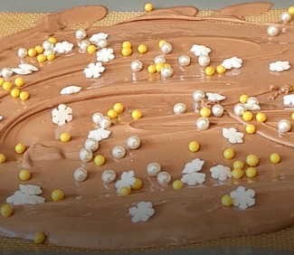

Science, safety and extra tips continued
Foods that taste good together, share a lot of the same flavour compounds as each other. For example- coffee and chocolate so play around with different flavour combinations.
The chocolate is now more vicious and thick as the fat crystals have formed. Chocolate is shear thinning, meaning that the viscosity decreases as shear increases (ketchup is also shear thinning).
Sharply tapping the mould onto a hard surface is the best way to bring the air bubbles to the surface and remove them. If you’ve used all the cavities in the mould, scrape the excess into a bowl.
Time in the fridge and an extended period of time afterwards, increases the number of stable fat crystals in the chocolate.
Tempering is a reversable change. Once tempered, you can heat it up again to above 45°C.
At this temperature, all cocoa butter fat crystals will be melted out and you can start again.

Slide 9
Key words
Key word​ | Meaning​
Beta 5 | Witten as: β5- This is the polymorph form of cocoa butter (the way the molecules in cocoa butter arrange themselves) that is desirable during the tempering process.
Contract | To shrink back and release away from the sides of the mould.
Crystal structure | Crystal structure is a description of the ordered arrangement of atoms, ions or molecules in a crystalline material.
Demoulding | Removal of a product from a mould.
Polymorphs | These are the different ways that the molecules within the cocoa butter can arrange themselves. There are 5 different ways.
Reversable change | This is when materials can be changed back to how they were before the reaction took place.

Slide 10
Key words
Key word​ | Meaning​
Seeding chocolate | This is the finely chopped pieces of chocolate that are put into already-melted chocolate to help temper.
Seize | Chocolate seizing is when the chocolate tightens up and instead of being fluid and loose, is tight, dry looking and grainy.
Shear | Shear is the force and pressure applied to a material.
Shear thinning | A characteristic of some fluids, where viscosity (thickness) decreases as force is applied (e.g. shaking or tapping a bottle of ketchup lowers the viscosity and allows it to flow more easily).
Snap (why is it important) | Having a good snap on the chocolate is a consumer expectation when eating and enjoying chocolate. When the chocolate doesn’t snap, it is also often dull and grainy in the mouth which is unpleasant for consumers.

Slide 11
Key words
Key word​ | Meaning​
Tempering | Tempering chocolate is the act of heating and cooling chocolate to ensure the correct crystal structure within the chocolate before working with it. Throughout the process, the rise and fall of the temperature is controlled to specific temperatures.
Viscous | Having a thick, sticky consistency between solid and liquid; having a high viscosity.

Slide 12
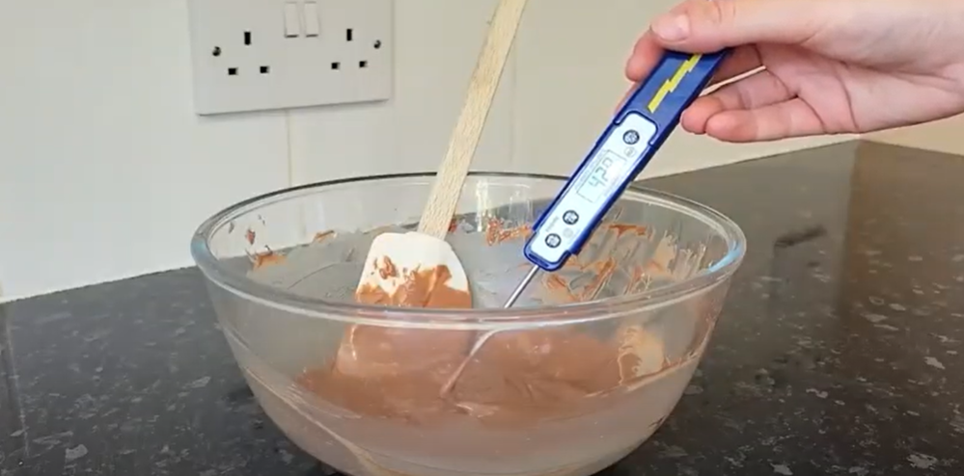
Chocolate tempering
Watch this video of Kate Rose, Apprentice Food Technologist, Mondelez International tempering chocolate.
Right click on the image above to play the video

Slide 13
The science of chocolate: Tempering
For further information, go to:
www.foodafactoflife.org.uk
This food science pack is one of a series of resources produced for the pHood Futures project, supported by the Royal Society of Chemistry
With thanks to Kate Rose, Apprentice Food Technologist, Mondelez International
This resource meets the Guidelines for producers and users of school education resources about food.

