Slide 1
New ways with red meat butchery masterclass
23/11/22

Slide 2
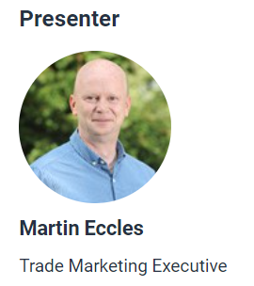
New ways with red meat butchery masterclass
Welcome!

Slide 3
Covered in today’s masterclass
Food skills for the preparation and cooking of red meat.
The versatility of red meat in cooking different dishes.
Meat types and cuts, especially for use in the classroom.
Ways to prepare and use red meat – cuts of beef, lamb, pork and offal, and recipe ideas.
Links to Food – a fact of life resources.
Sources of support and information.

Slide 4
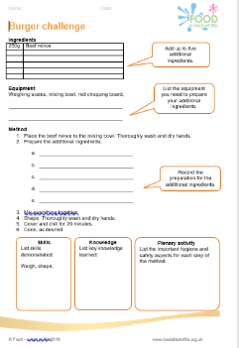
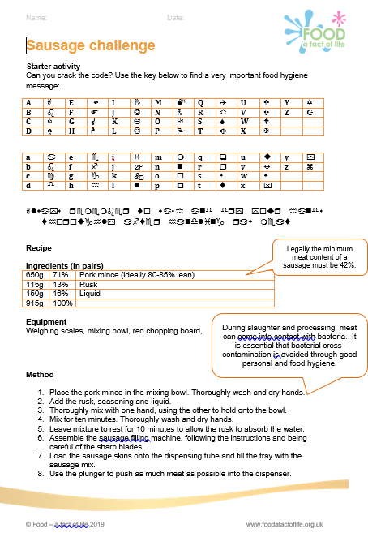
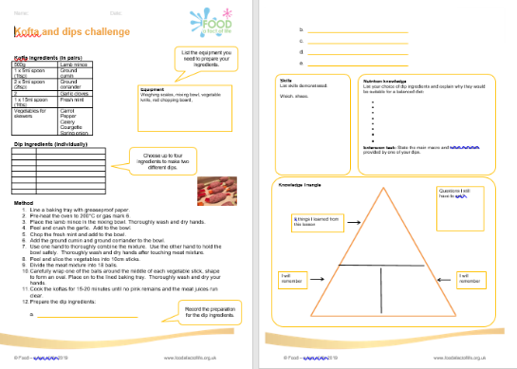

Food – a fact of life resources
Recipes, videos and activities
Over 300 tried and tested recipes.
Recipe videos.
Licence to Cook recipe videos.
Cooking session videos.
Meaty eats videos.
Red meat skills videos.
Gourmet Burger Builder

Slide 5
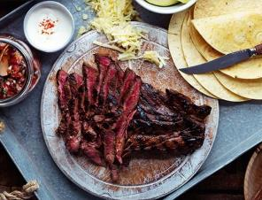
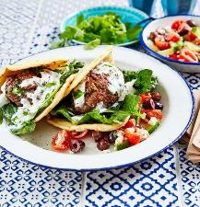
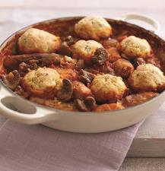
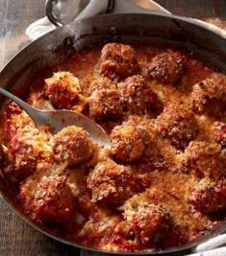

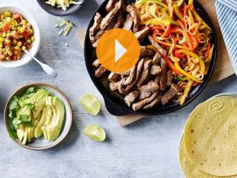
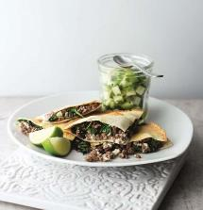
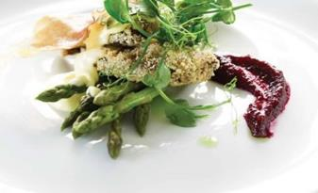
Beef, lamb, pork and offal recipes using the cuts demonstrated
DIY lamb koftas
Sausage and kidney casserole
Steak fajitas
White sauce – add sliced mushrooms gently sautéd with garlic and fill a pocket made in a pork loin
Pork meatballs with a cheesy crumb topping
Beef fajitas with sweetcorn salsa
Spiced lamb quesadillas
Crumbed pork liver

Slide 6
Food – a fact of life resources
Recipes – just a taster!
Beef
Latino beef
Beef and mozzarella meatballs
Piri piri burgers with Mediterranean vegetables
Individual steak and kidney pies
Spiced beef tartlets with chorizo
Lamb
Lamb shanks with plums
Lamb rissoles with spicy tomato dip
Meatball aloo ghobi
Moussaka stuffed aubergine with cheesy soufflé sauce
Bubble and squeak lamb brunch
Lamb cupcakes
Pork
Pork chops with sage, garlic and lemon
Pork and beetroot tarts with blue cheese
Stuffed pork fillet
Pork, lime and mint stuffed pepper tabbouleh
Pork and beans
Pork jambalaya
Pork Thai bites
Offal
Pan fried liver with onion and bacon
Devilled lamb kidneys on toast
Braised oxtail with star anise
Stuffed braised lamb heart
Pressed ox tongue salad
Crumbed pork liver

Slide 7
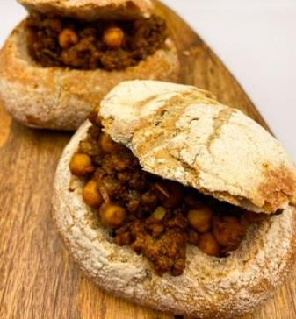
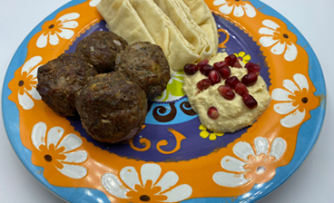
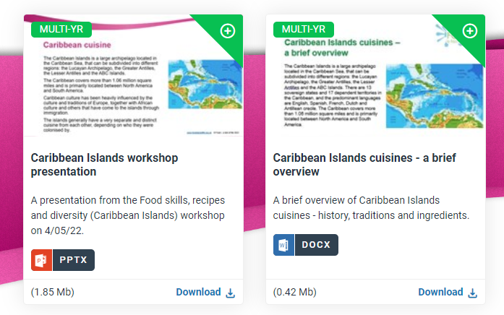
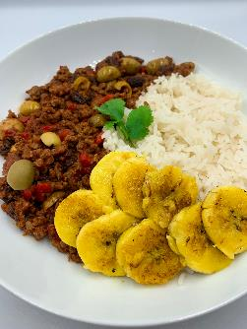
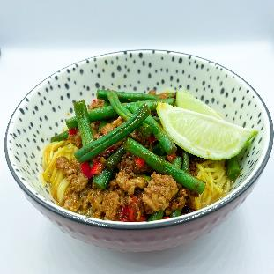
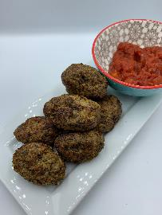
Food – a fact of life resources
New global cuisine recipes and supporting resources

Slide 8
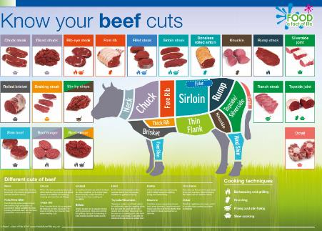
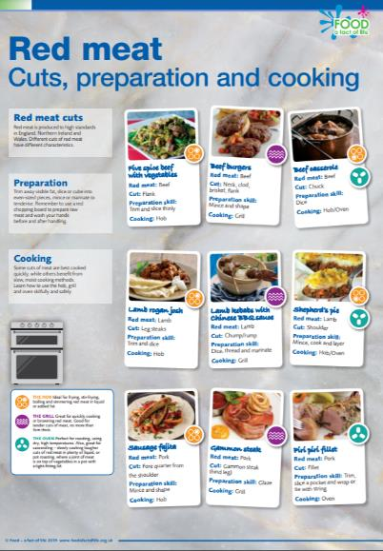
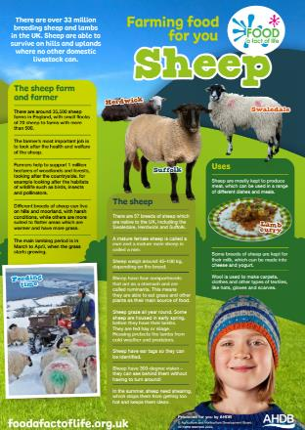
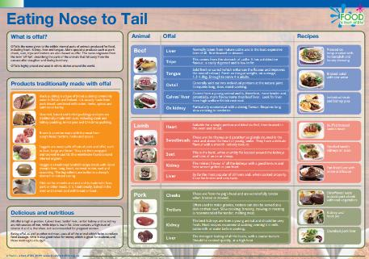
Red meat resources
Activities around red meat – from farm to fork. For example:
Change for health – modifying recipes, e.g. lasagne and bolognaise
Make it with mince challenges
Food commodities resources:
5-7 Years
7-11 Years
11-14 Years
14 – 16 Years
Posters

Slide 9
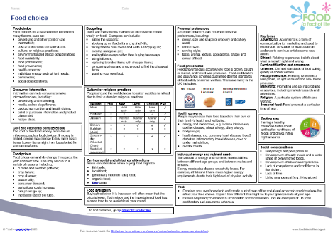
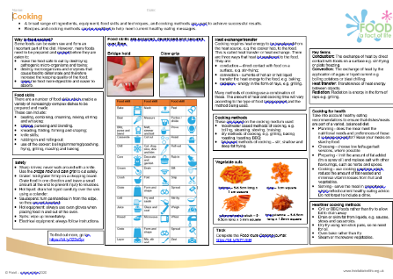
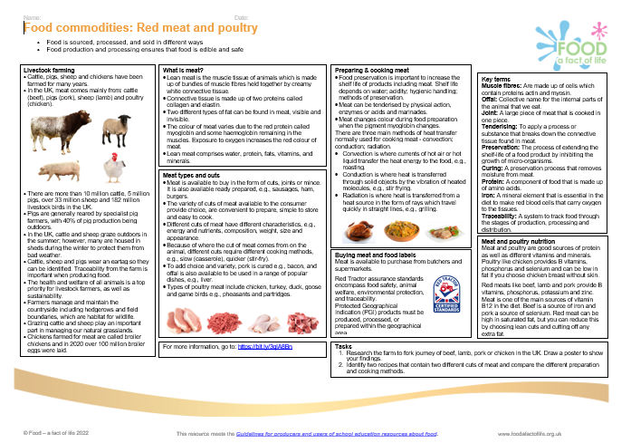
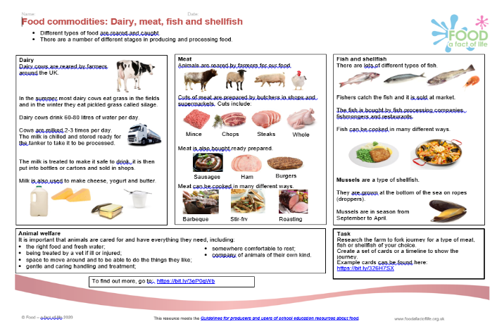
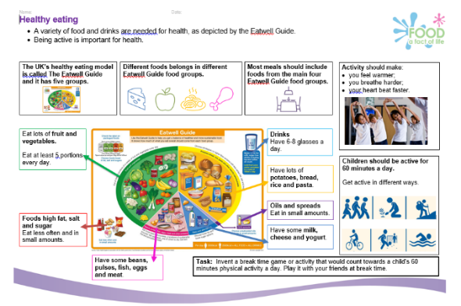
Knowledge organisers
Knowledge organisers available for 5-7 Years, 7-11 Years, 11-14 Years and 14-16 Years.

Slide 10

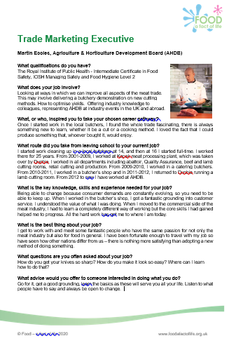
Careers in ‘food’
A downloadable poster and inspiring case studies about careers within ‘food’, covering those that 'feed the nation' and 'inform the nation'.
Careers in ‘food’

Slide 11
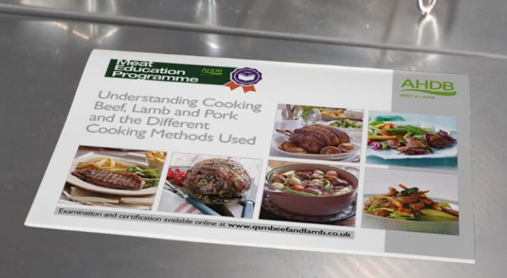
Other sources of information and support
Agriculture and Horticulture Development Board (AHDB)
AHDB: Red meat and health
NHS: Red meat in your diet
https://www.simplybeefandlamb.co.uk/
https://www.lovepork.co.uk/
AHDB’s Meat Education Programme
Designed for butchers, chefs and anybody in between, our practical butchery and theory training modules cover beef, lamb and pork cuts, cooking with red meat and customer service.
Online assessments and certifications are available for the theory modules and are completely free of charge.

Slide 12
More training …
To find out more and to book, go to https://www.foodafactoflife.org.uk/training/
Regional conferences
Scotland – Saturday 21st January 2023 (fully booked)
England – Saturday 28th January 2023
Northern Ireland – Saturday 11th February 2023 TBC
Wales – Saturday 11th March 2023
Webinars
Food styling everyday dishes – 7th December 2022
Using nutritional analysis in meaningful ways – 26th January 2023
Reformulation for health – 1st February 2023
Nutrition and gut health – 22nd March 2023
Virtual practical workshops
Food science and food skills – 4th February 2023
More PPD information, support and newsletter sign-up: https://www.foodafactoflife.org.uk/professional-development/

Slide 13
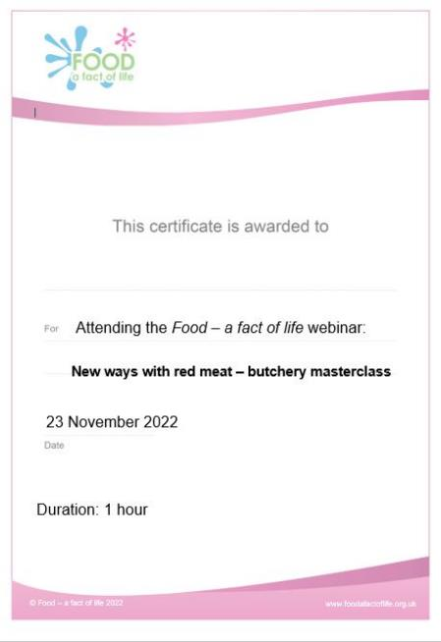
Thank you
Please complete the webinar evaluation. You should be automatically redirected to the evaluation when the webinar finishes.
New ways with red meat butchery masterclass
You will receive a link to the certificate once you have completed the evaluation. Please download the certificate, add your name and print it out for your records.

Slide 14
New ways with red meat
For further information, go to:
www.foodafactoflife.org.uk

