Slide 1
Taste-a-long workshop
Frances Meek, Education Services Manager
Claire Theobald, Education Services Manager

Slide 2
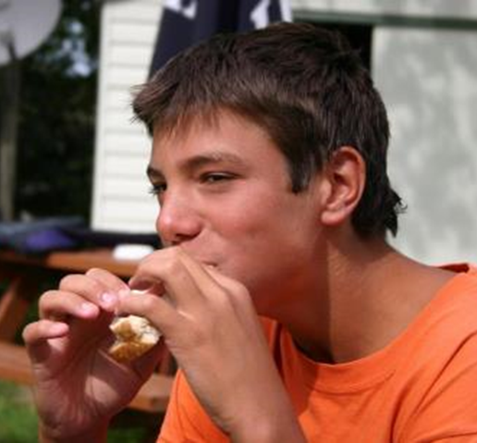
This session will cover:
What will be covered?
The five senses and how we use them when eating and drinking
The five basic tastes
Using different foods to determine the different tastes
The difference between taste and flavour
Links to Food – a fact of life resources
Running your own ‘taste-a-long’ with your colleagues

Slide 3
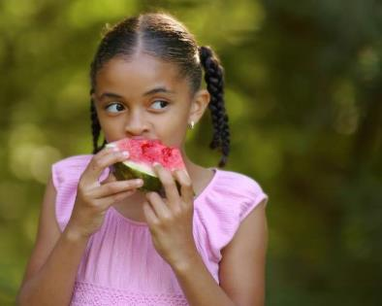
The five senses and how we use them when eating and drinking
A range of senses are used when eating food.
These senses are:
  sight;
  smell;
  hearing;
  taste;
  touch.
A combination of these senses enables you to evaluate a food.
Notes:
Example: calcium and vitamin D for bone health

Slide 4
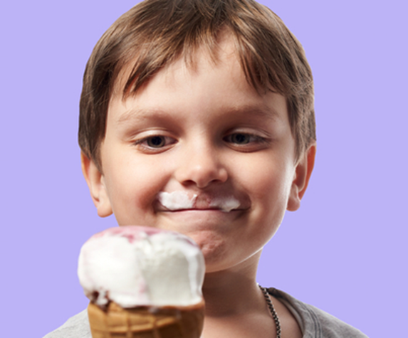
Other factors that influence the way we feel
Other factors also influence the way we feel about food. These include:
food previously eaten;
hunger and satiety;
mood;
where you eat, e.g. home, canteen, picnic;
beliefs and values, e.g. religion, culture and tradition;
social aspects, e.g. special occasions, events.

Slide 5
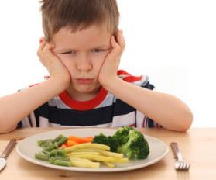
Sight (appearance)
The size, shape, colour, temperature and surface texture all play an important part in helping to determine your first reaction to a food.
Often if a food does not look appetising, then you will not eat it.
Appearance is therefore vitally important if you want your food to be eaten and enjoyed.

Slide 6
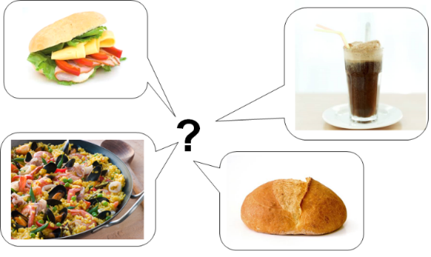
Sight (appearance)
What words would you use to describe these foods?
Useful words to describe appearance:
stringy firm dry
heavy flaky crumbly
flat crisp lumpy
fizzy fluffy smooth
hard mushy crystalline
dull sticky fragile

Slide 7
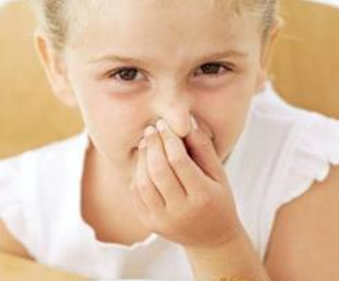
Smell (odour or aroma)
The nose detects volatile aromas released from food. An odour may be described by association with a particular food, e.g. herby, cheesy, fishy. The intensity can also be recorded.
Odour and taste work together to produce flavour. This is the reason why people with a blocked nose find it difficult to determine the flavours of foods.

Slide 8
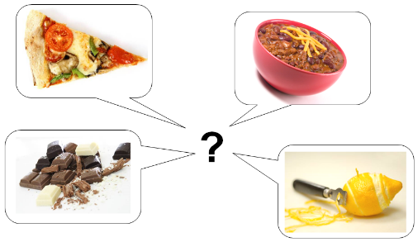
Smell (odour or aroma)
Useful words to describe odour:
aromatic pungent tart
spicy floral citrus
bland tainted strong
perfumed rancid mild
savoury rotten
What words would you use to describe these foods?

Slide 9
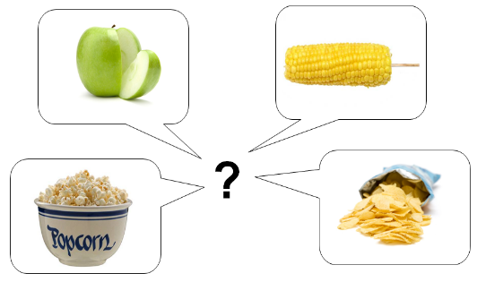
Hearing (sound)
What words would you use to describe these foods?
The sounds of food being prepared, cooked, served and eaten all help to influence our preferences.
The sound of eating food can alter our perception of how fresh a food is (e.g. crunchy carrots).
Useful words to describe hearing (sound):
Crackle Crunch Sizzle
Pop Brittle Crisp

Slide 10
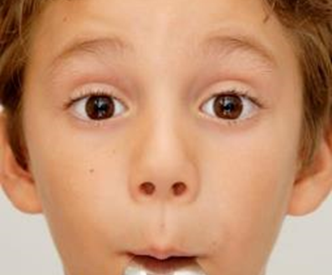
Touch (texture)
Texture can be assessed through touch.
When food is placed in the mouth, the surface of the tongue and other sensitive skin reacts to the feel of the surface of the food. The sensation is also known as mouth-feel.
Different sensations are felt as the food is chewed. The resistance to chewing also affects texture, e.g. chewiness, springiness. The viscosity is also a factor, e.g. runny, thick.
The mouth also detects temperature, which plays an important stimulus, e.g. cold ice cream, warm bread, hot soup.

Slide 11
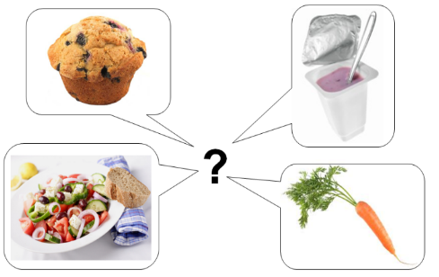
Touch (texture)
What words would you use to describe these foods?
Useful words to describe texture:
brittle rubbery short crisp fluffy
dry crumbly smooth tender waxy
hard mushy sticky soft firm
flaky gritty close stodgy lumpy
sandy tacky bubbly sticky

Slide 12

Taste
The tongue can detect five basic tastes:
bitter;
salt;
sour;
sweet;
umami.
Taste may be described by association with a particular food, e.g. meaty, minty or fruity.
The intensity can also be recorded, e.g. mild or strong Cheddar.

Slide 13
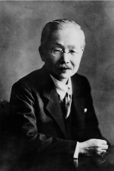
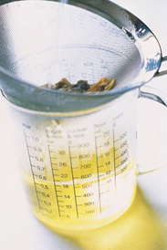
What is umami?
Umami is a savoury taste, often known as the fifth taste. It is a subtle taste and blends well with other tastes.
It was discovered by Dr Kikumae Ikeda, from Tokyo Imperial University, Japan, in 1908. He undertook research into Dashi, a traditional Japanese stock made from kombu (kelp).
Umami has its own distinct savoury taste, often associated with ripe tomatoes and cheese.

Slide 14
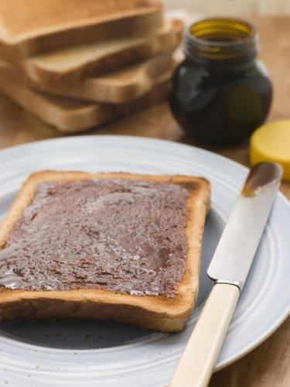
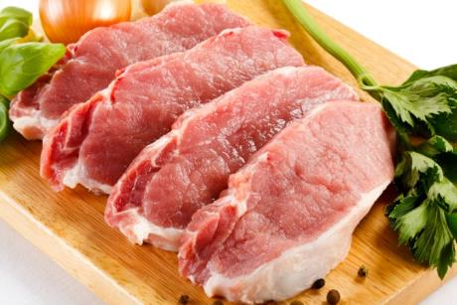
Familiar foods with an umami taste
These are foods which all have an umami taste:
tomatoes;
cured pork, e.g. ham, sausage, bacon;
cheddar cheese;
parmesan;
meat, e.g. beef;
anchovies;
yeast extract.

Slide 15
Taste receptors
Our tongues are covered with taste buds, which are designed to sense chemicals in the mouth.
Sensitivity to all tastes is distributed across the whole tongue (and indeed other regions of the mouth where there are taste buds), but some areas are more responsive to certain tastes than others.

Slide 16
Using different foods to determine the different tastes – what will you need?
Food and drink
1 x 5ml spoon salt or soy sauce*
1 x 5ml spoon sugar or honey**
1 lemon or lime
Bottle or can of plain low calorie tonic water*** or one piece of very dark chocolate
Small piece of parmesan cheese or a handful of cherry tomatoes
1 pear
Bottle/jug of water
*soya is an allergenic ingredient and soy sauce may contain wheat
**not suitable for vegans
***contains quinine which should not be consumed in large quantities if pregnant
Equipment
1 x 5ml spoon (teaspoon)
5 x small bowls or saucers
Vegetable knife
Chopping board
Plastic cup or glass
Handwipes

Slide 17
Sensory session
Where in your mouth can you taste each food/drink?
Prepare your food/drink
2. Taste the following:
  Salt or soy sauce
  Sugar or honey
  Lemon or lime
  Tonic water or very dark chocolate
  Parmesan cheese or cherry tomatoes

Slide 18
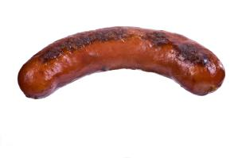
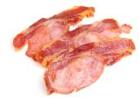
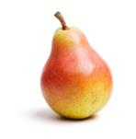

The difference between taste and flavour
Hold your nose!
When eating food the odour combines with the taste to give flavour.
The texture, or mouthfeel, of a food may also help us recognise what it is.
An experiment to test the difference between taste and flavour involves eating a pear.
Alternatively, you could use umami paste mixed with low-fat mayonnaise, yeast extract on toast, cooked sausages.

Slide 19
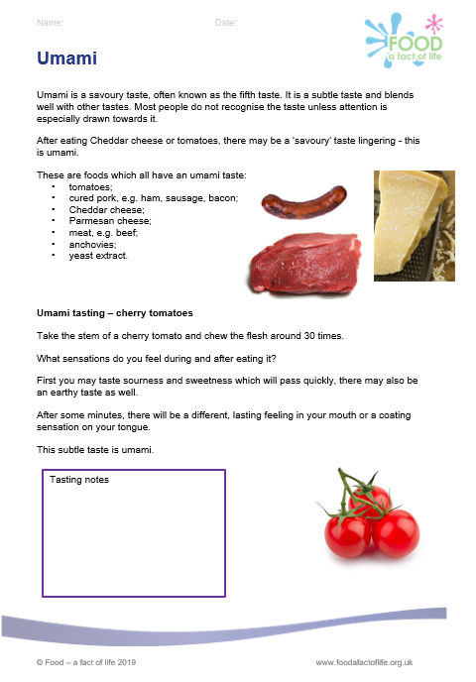
Hold your nose!
1. Wash the pear and cut into bite sized pieces.
2. Take two pieces of pear.
3. Hold your nose tightly, close your eyes and eat the piece of food.
Can you tell what the item is?
4. Release your nose and then continue to chew?
Can you now tell what the item is?
5. Repeat with the second sample.
Umami tasting worksheet

Slide 20
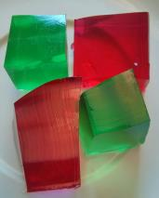
Activities – taste and flavour
Blue jelly!
Size, shape, and colour all play an important part in helping to determine the first reaction to a food. Colour in particular gives us an indication of what flavour a food might be, e.g. a red jelly is most likely to be strawberry flavour.
Test your pupils’ sense of flavour through eating blue jelly.

Slide 21

Activities – taste and flavour
Blue jelly!
Prepare a jelly using a 12g individual sachet, or four leaves of gelatine, and one pint (570ml) of water. Vegetarian jelly can also be used successfully. Add a few drops of blue liquid food colouring.
Divide the jelly mixture into five jugs and add a few drops of a different liquid flavouring, ideally colourless, into each jug.
Pour a small amount of jelly into sample pots or plastic cups and leave to set.
Once set, ask your pupils to identify the flavour of the jelly.

Slide 22
Activities - odour
There are a number of easy experiments through which the pupils learn about the sense of smell.
The experiments require the pupils be blindfolded, keep in mind that some people do not like to be blindfolded so they could close their eyes tightly instead.

Slide 23
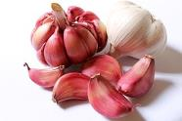
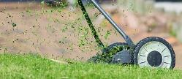
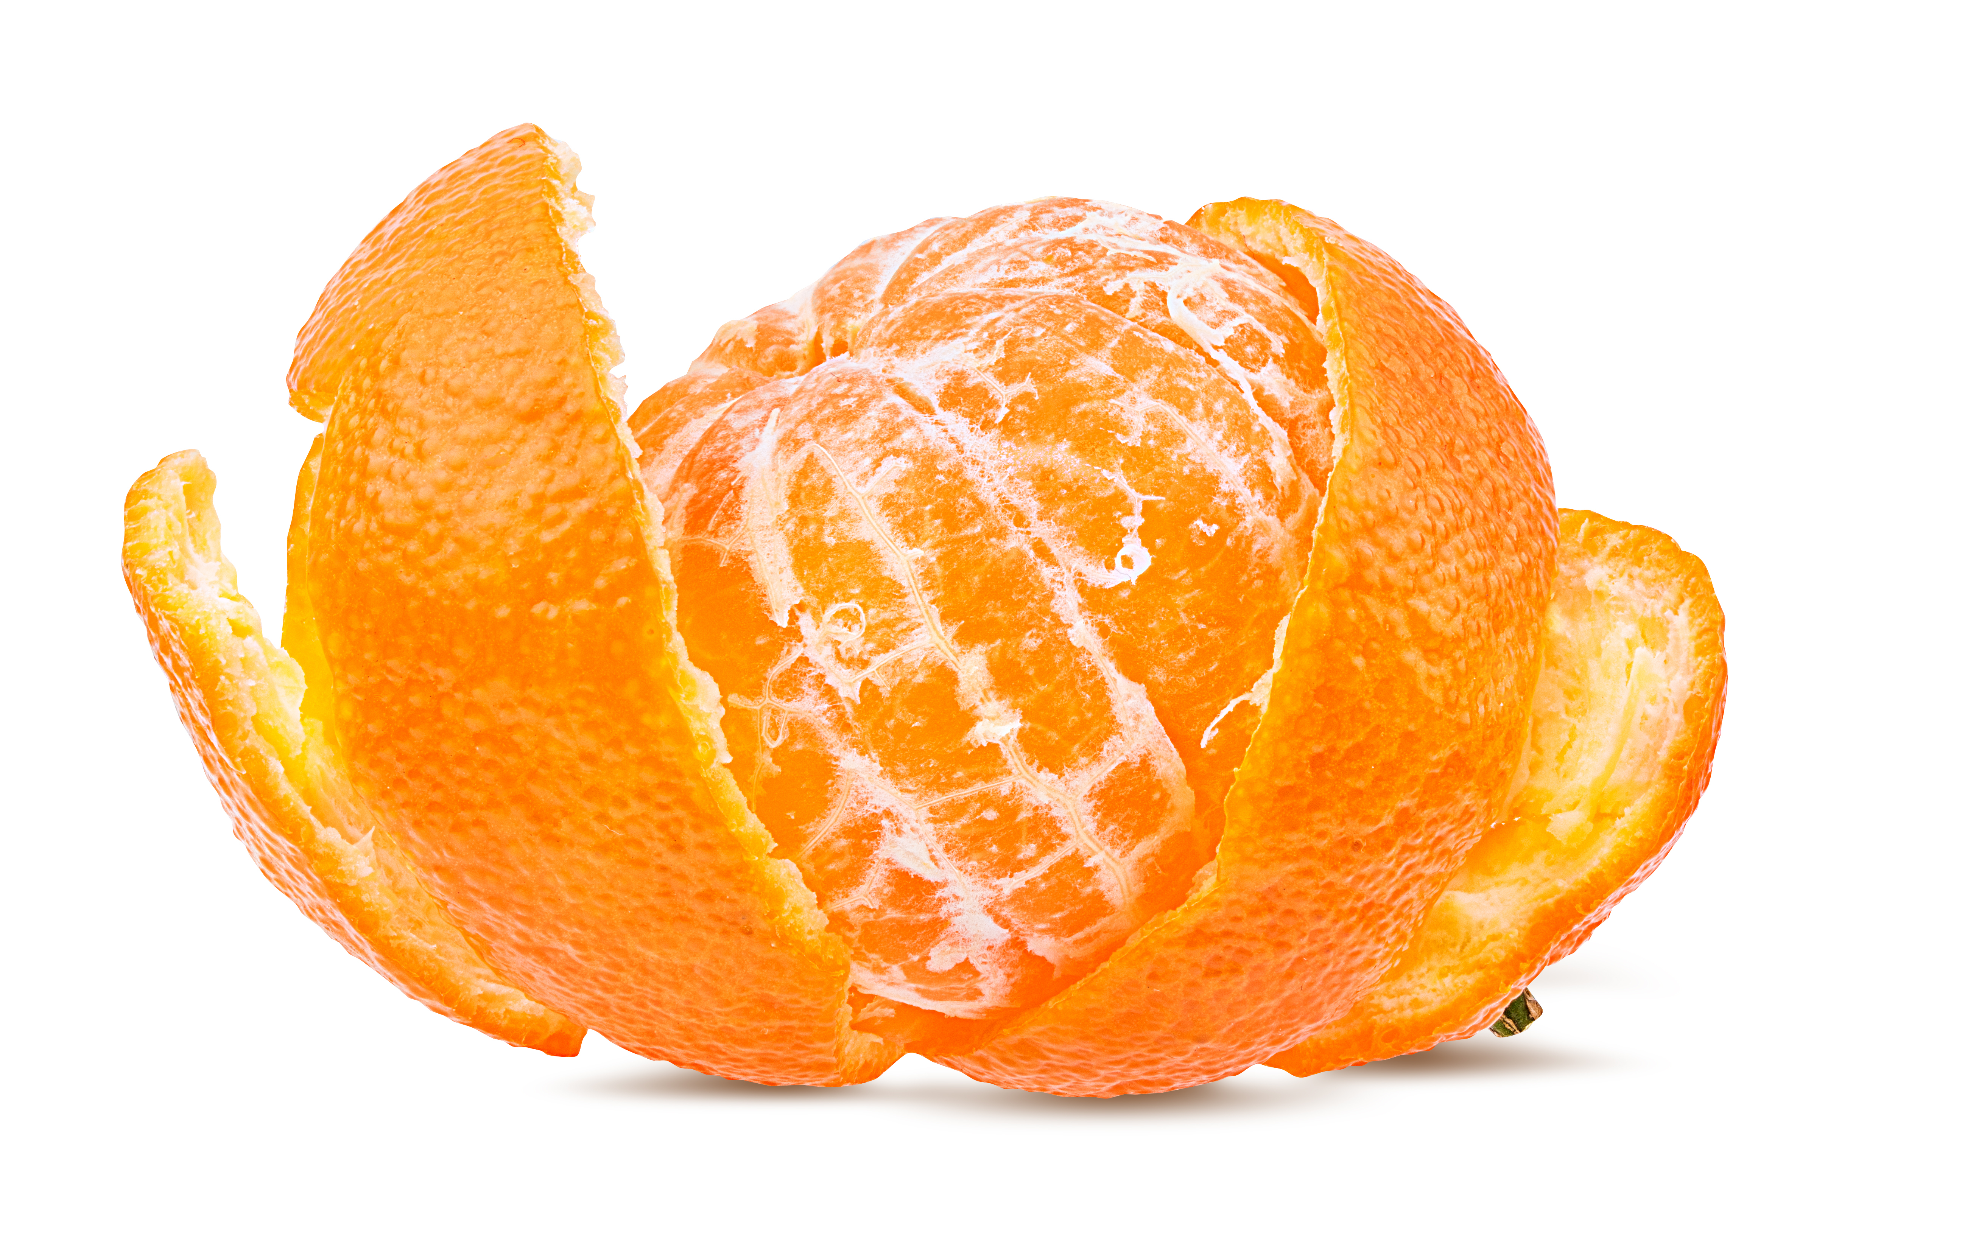
Activities - odour
Memories
We can recognise a variety of smells, or odours. Some smells can stir up memories. To demonstrate the sense of smell, collect several items that have distinctive smells such as: peppermint, chocolate, coffee, garlic, saw dust, lemon zest, orange peel, onion, rose flowers and place them in separate containers.
Task the pupils to work in pairs and see if they can:
identify the item by smell;
describe the odour, e.g. strong, pleasant, neutral, bland or unpleasant;
describe any memories associated with the smells.

Slide 24
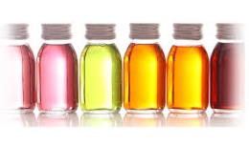
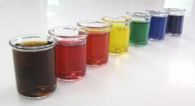
Activities - odour
Smell detective – how many odours can you smell?
Collect a range of natural food flavourings such as raspberry, caramel, custard, strawberry, rhubarb, coconut, rose, violet, cherry, banana, lemon, orange.
Place a couple of drops of the flavouring in about 20ml of water, task a pupil to smell the mixture and ask them to identify the flavouring.
Then add one more flavour – can the pupil correctly identify the additional flavouring by the aroma?
What if you mix three, four or more smells together?

Slide 25
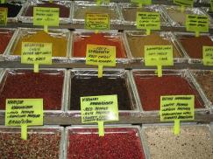
Activities - odour
Smell cards
A bit like ‘scratch and sniff’ cards.
Collect a number of dried herbs and spices that have a strong smell and glue them to pieces of card.
These cards could be used for memory or matching type games or as a starter at the beginning of a lesson to identify the flavourings to be used in a recipe.

Slide 26
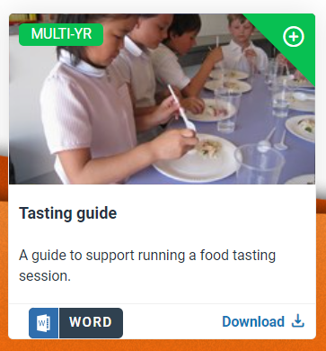
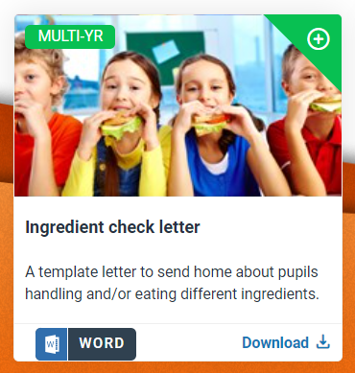
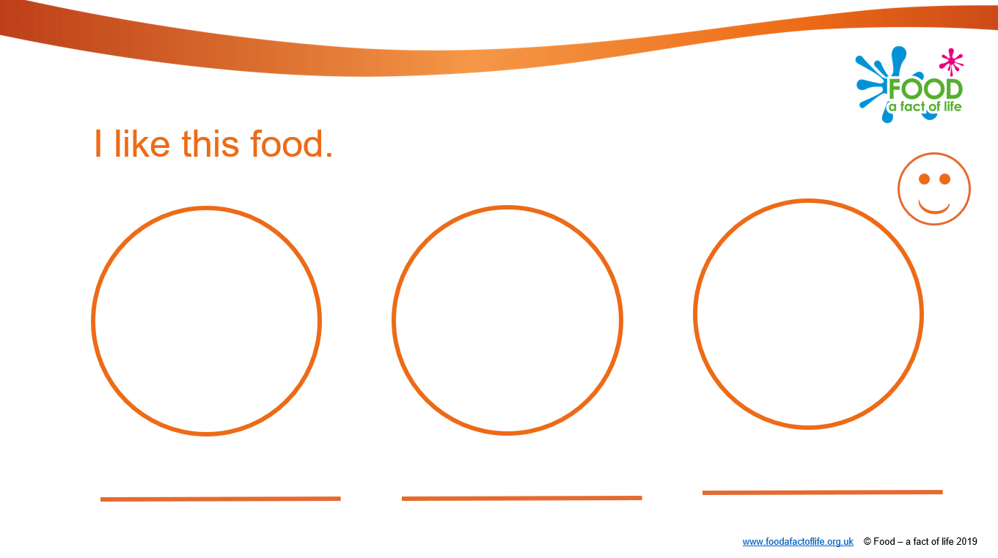
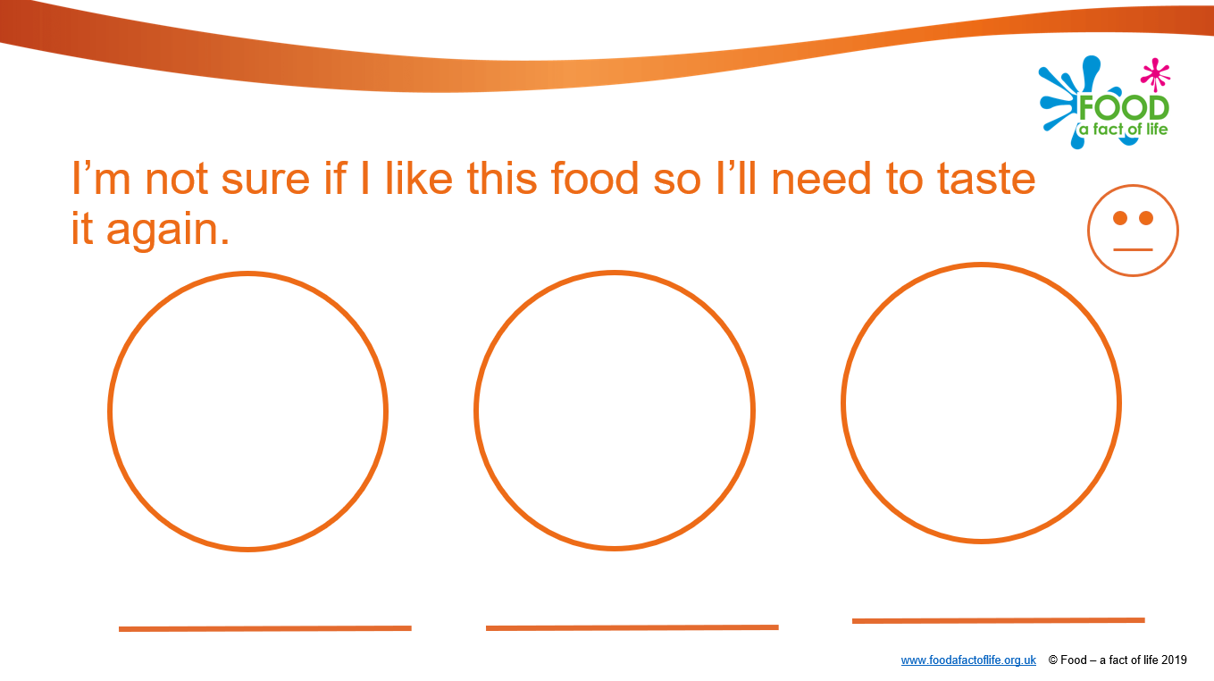
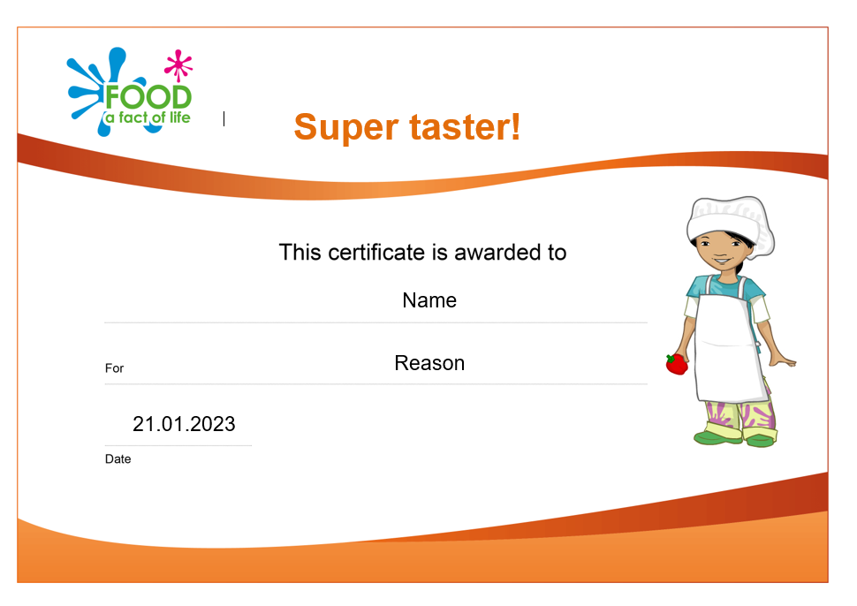
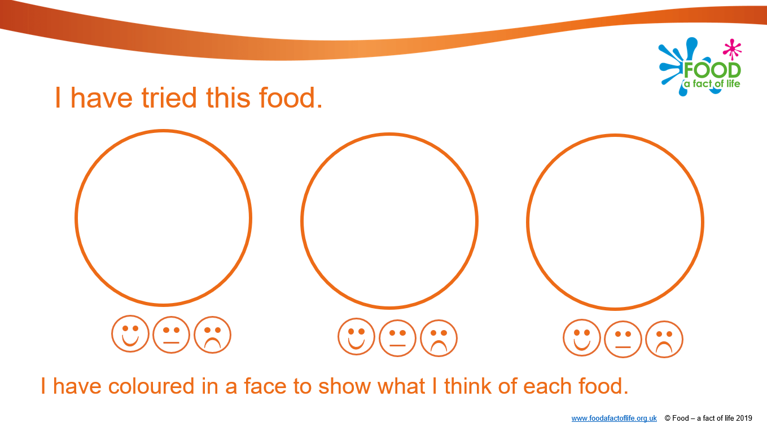
Resources to support tasting activities
Early years
3-5 years > Cooking > Tasting
  Session plan (for tasting)
  Ingredient check letter
  Tasting guide
  My food book
  Super taster! certificates

Slide 27
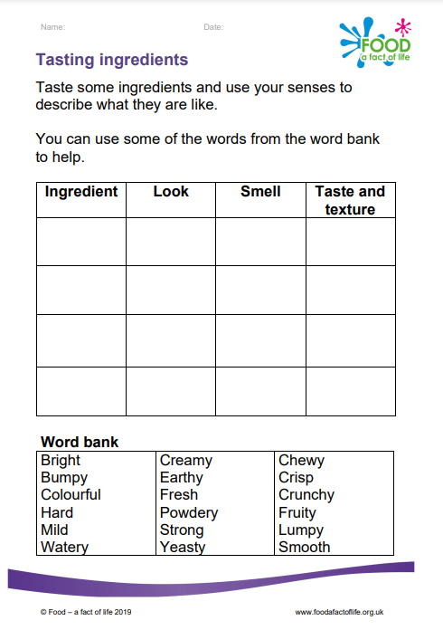
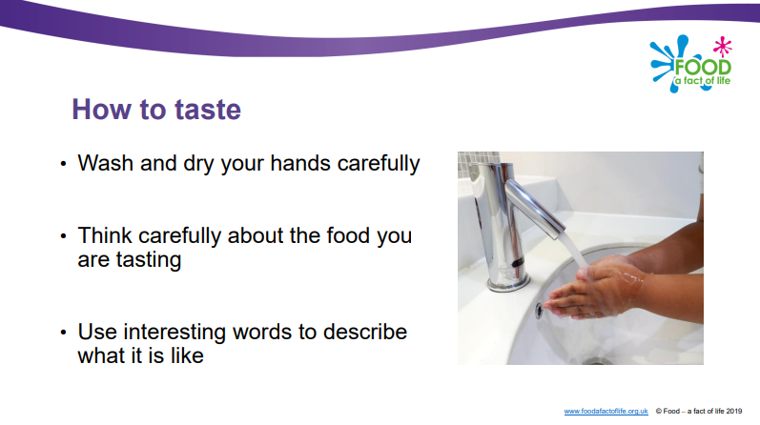
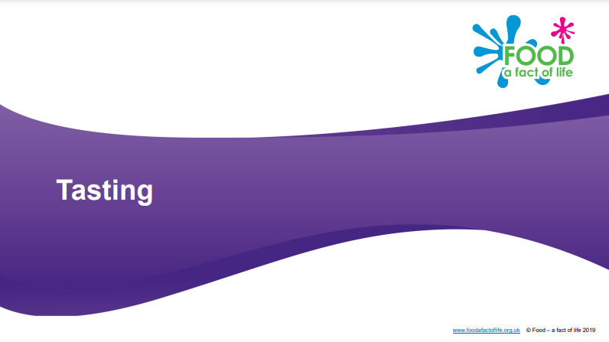
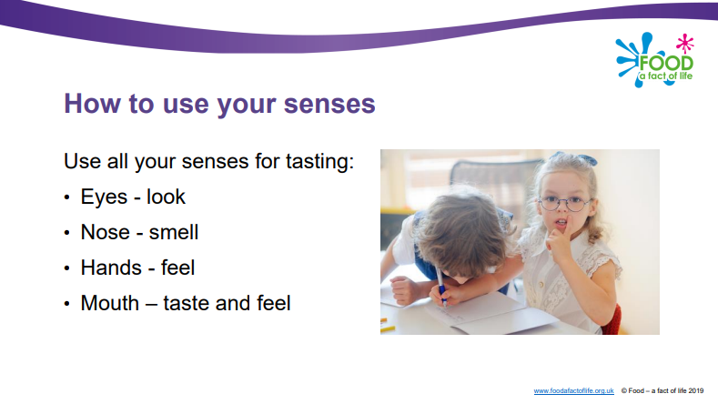
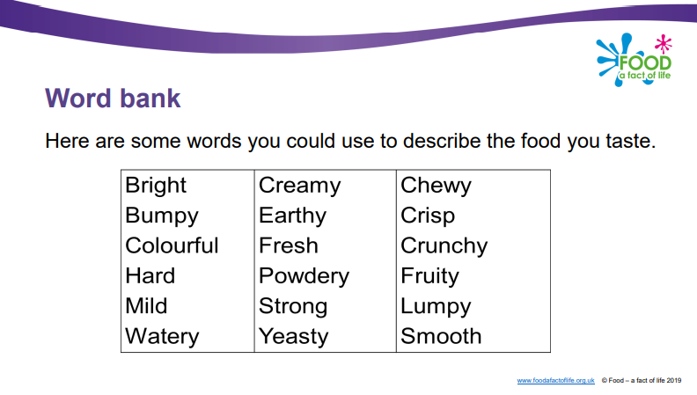
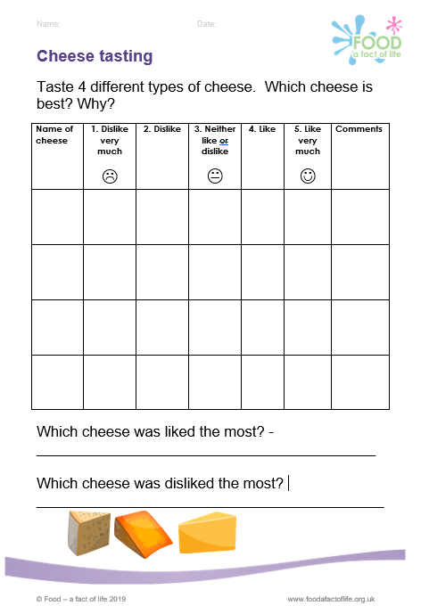
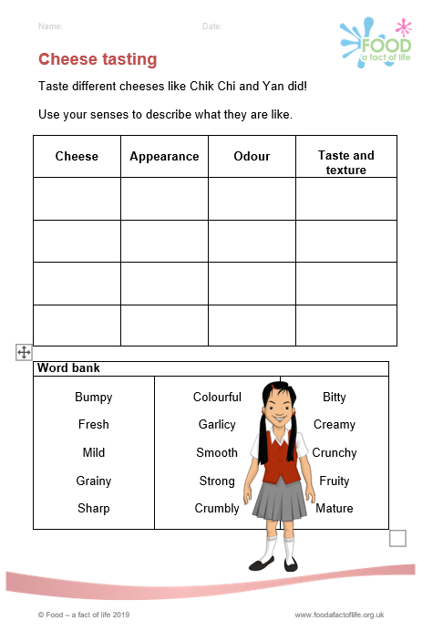


Resources to support tasting activities
Primary
5-7 > Cooking > Planning to cook
  Lesson notes (Activity 3 - tasting)
  Tasting presentation
  Tasting ingredients sheet
Learn with stories (Cheese tasting activities)
  The farm visit (5-7)
  The exciting guests (7-11)
Primary food project – Grab and go (Year 6)
  Lesson 2 – sensory evaluation
  Sensory vocabulary cards

Slide 28
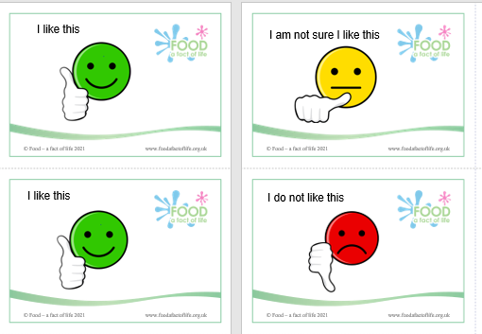
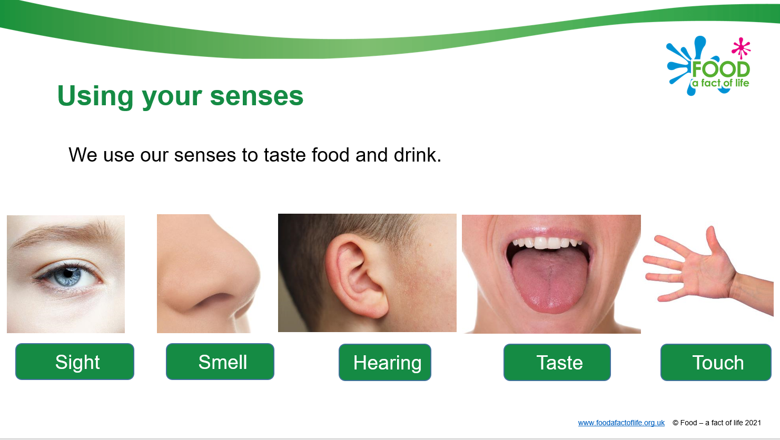
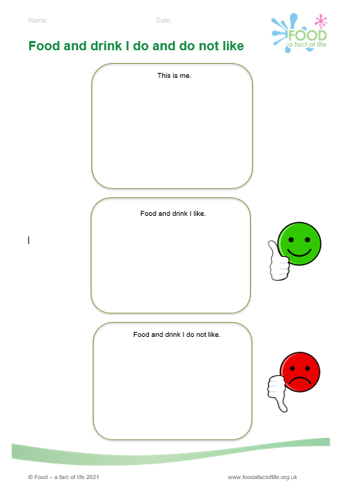
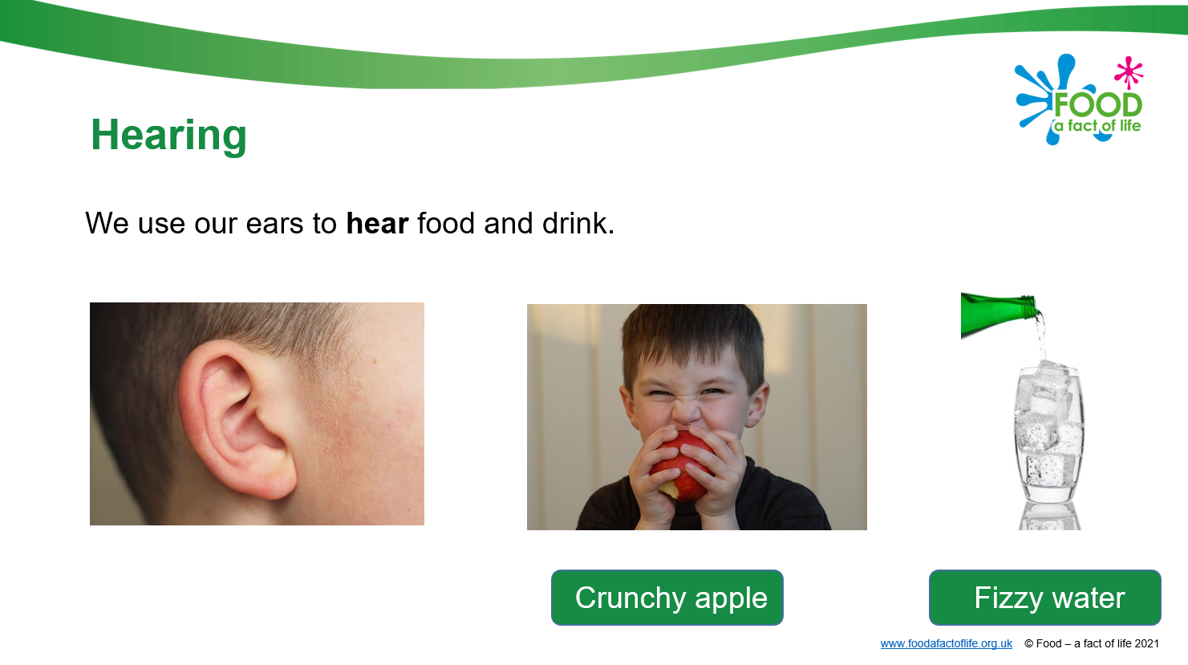
Resources to support tasting activities
Pupils with additional needs
Cooking > Choice, preference and occasions
  Guide – teachers’ notes and activity guidance
  Choice presentation
  Smilie face cards
  Tasting worksheet

Slide 29
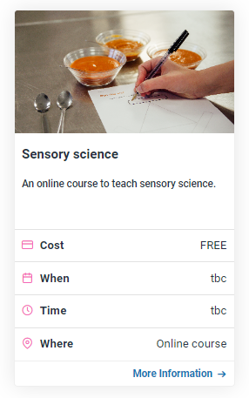
Resources to support tasting activities
Sensory science online course
  Aimed at secondary food teachers but useful background information for primary teachers
  Approximately 2-3 hours to complete
  Can stop and re-start (flexibility)
  Certificate on successful end of course assessment
  Free!

Slide 30

Running your own ‘taste-a-long’ with your colleagues
Organise a suitable space, ideally with handwashing facilities.
Check staff allergies and/or intolerances to ingredients and any dietary requirements.
Purchase food/drink and organise any equipment needed.
Prepare food/drink and get equipment ready.
Run the taste-a-long.
Use slides from this workshop to support your taste-a-long.
You could also:
Trial some additional taste, flavour and odour activities or showcase some of the Food – a fact of life pupil resources.

Slide 31
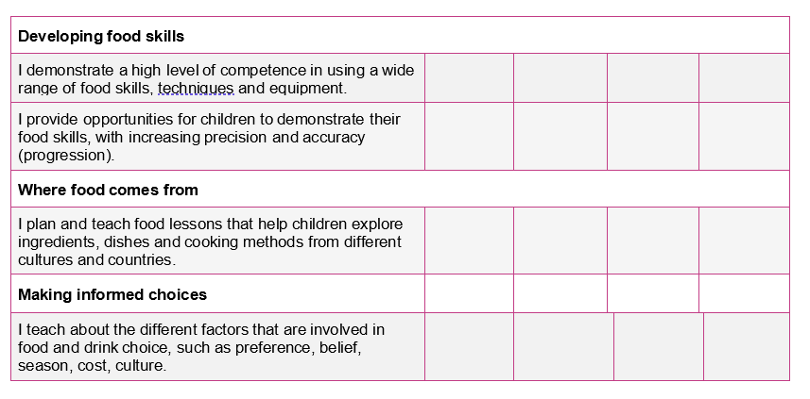
Where does this fit in the TPFN programme?
Food and nutrition experience audit
Tasting as a food skill
Tasting to explore ingredients
Tasting to support informed choices and preferences

Slide 32

Keep up to date with our free resources and training
Education News (monthly email update)
Sign up on the homepage: www.foodafactoflife.org.uk
Follow us on Twitter @Foodafactoflife
https://twitter.com/foodafactoflife
Keep in touch: education@nutrition.org.uk
Do you know anyone who would find the TPFN programme useful?
They can view this introductory presentation and then register for free!

Slide 33
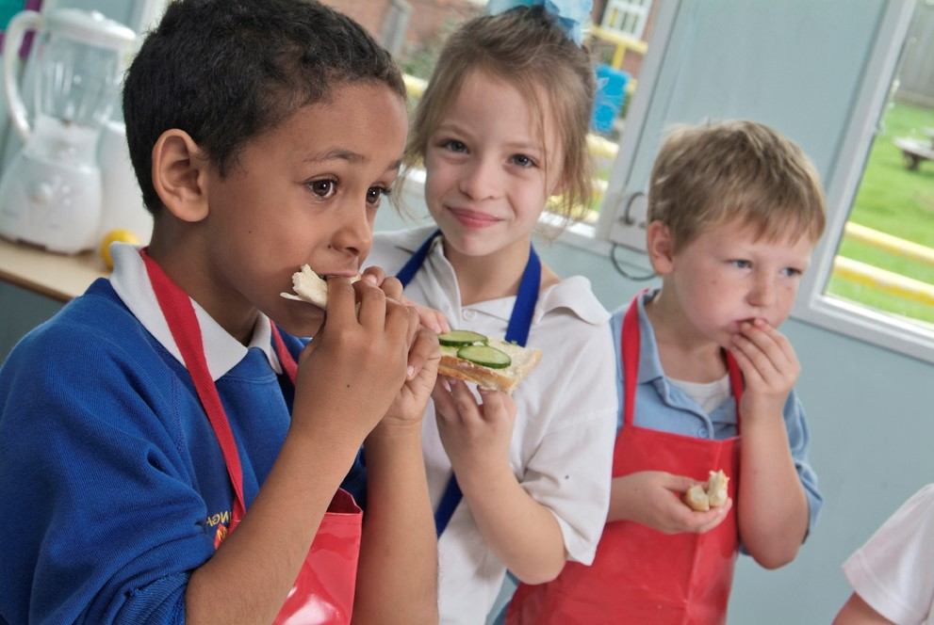
Future training events
Coming next…diary dates
Tue 21 Nov 2023 - 4pm Building cultural awareness in delivering healthy eating messages in the primary classroom
Tue 5 Dec 2023 – 4pm Supporting pupils with additional needs
Tue 16 Jan 2024 – 4pm Seasonality and where food comes from
Tue 27 Feb 2024 – 4pm Ask an expert
Tue 12 March 2024 – 4pm Engaging parents/carers & extra curricular cooking
Tue 23 April 2024 – 4pm Cooking with heat in primary 2
Tue 14 May 2024 – 4pm Outside cooking!
Tue 4 June 2024 – 4pm Cook-a-long - global recipes
Remember that all webinars are recorded and the 22/23 recordings can be found here.
Also don’t forget our INSET package – seven topical videos ideal for you and your colleagues.

Slide 34

Thank you
Please complete the webinar evaluation. If you are watching a recording of this webinar, you will find a link to the evaluation at the end of the PPT presentation in the Cooking area of the TPFN training page.
Taste-a-long
You will receive a link to the certificate once you have completed the evaluation. Please download the certificate, add your name and print it out and file in your TPFN portfolio!

Slide 35
Thank you
For further information about TPFN training or to find recordings of previous webinars and workshops,
click here.

