Slide 1
Mini fruit cakes
Complexity: low - medium

Slide 2
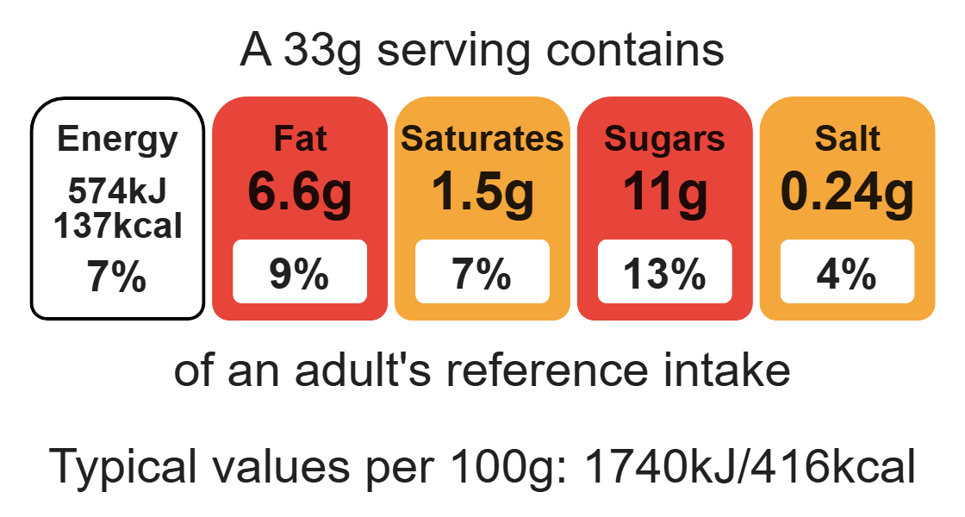
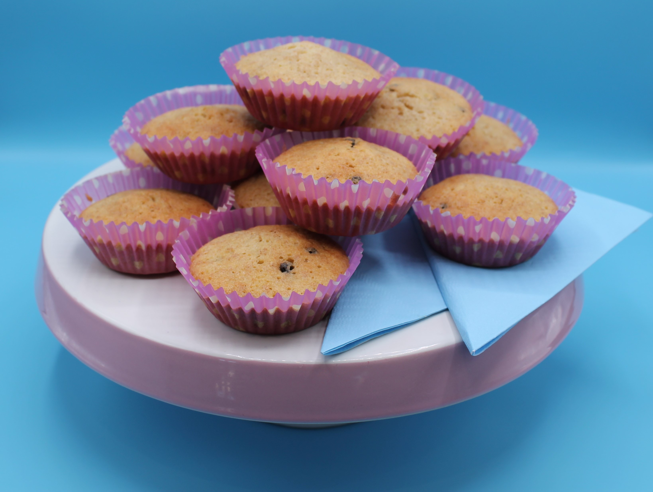
Nutritional analysis
Serves 12

Slide 3
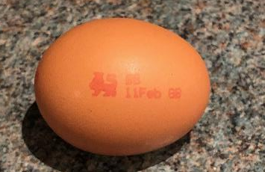
Starter activity
1. Name three ways an egg can be cooked.
2. Name three products that use eggs in the recipe.
3. What do these markings on an egg represent?

Slide 4
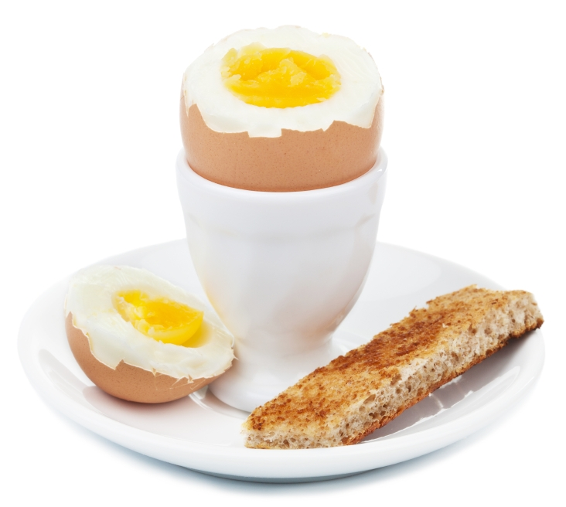
Example responses
1. Name three ways an egg can be cooked. Boiled, scrambled, poached, fried.
2. Name three products that use eggs in the recipe.
Cakes, quiche, enriched doughs, meringues, foods that are coated with breadcrumbs.
British Lion Mark
Best before date
3. What do these markings on an egg represent?

Slide 5
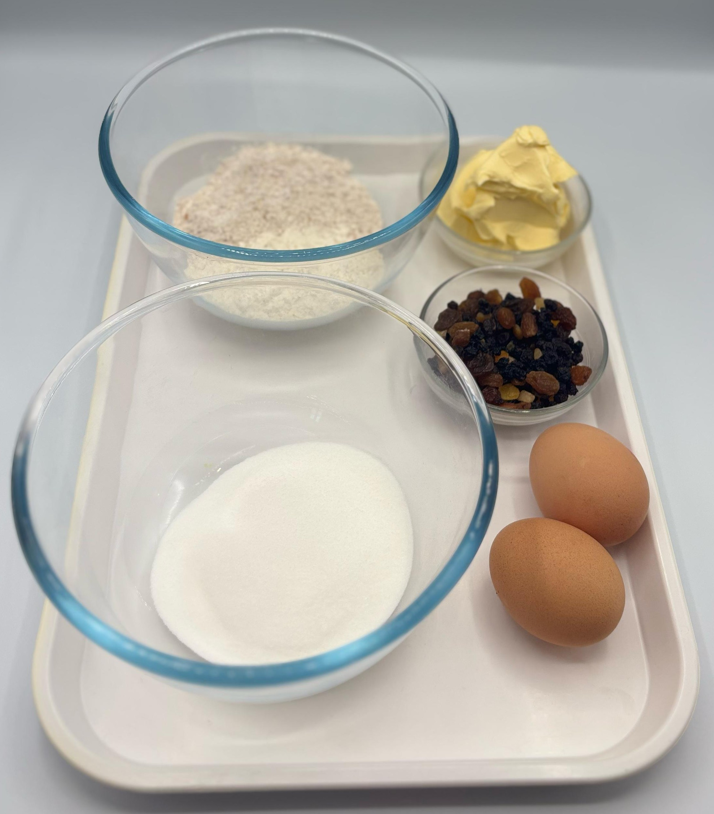

Ingredients (makes 12)
50g self-raising white flour
50g self-raising wholemeal flour
2 eggs
100g caster sugar
100g reduced-fat spread
50g dried fruit, e.g. sultanas, cranberries, apricots
Check for any food allergy, intolerance, special dietary requirement or religious/cultural reasons for not handling or eating the ingredients in this recipe.

Slide 6
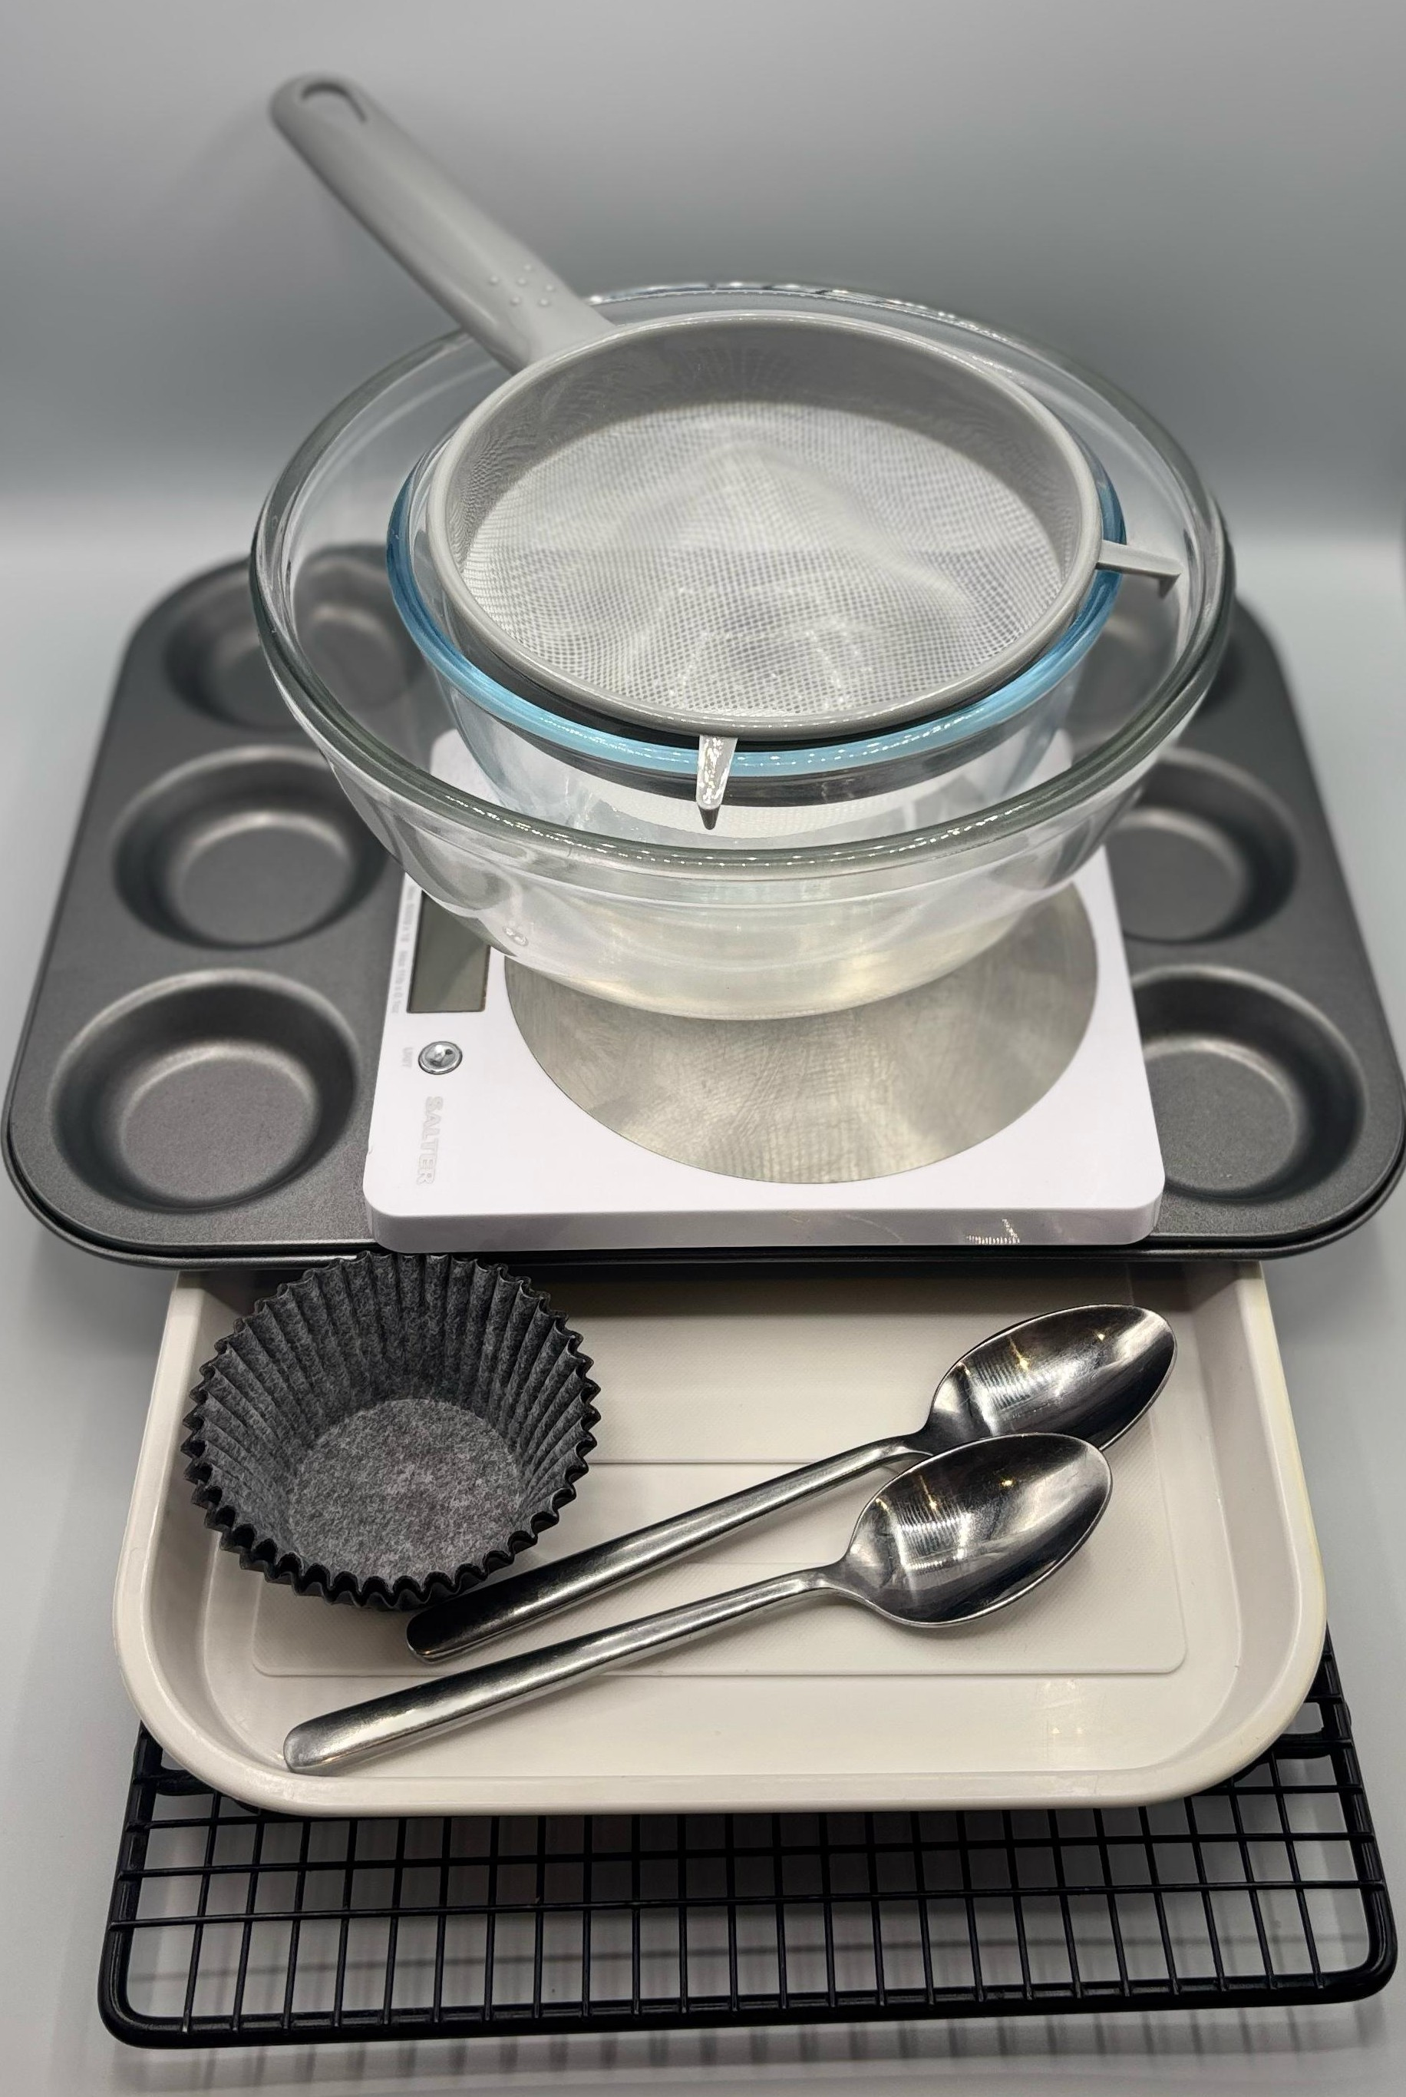
Equipment
12 cupcake cases
Cupcake tin
Weighing scales
Mixing bowl
Sieve
Mixing spoon
2 metal spoons
Cooling rack

Slide 7
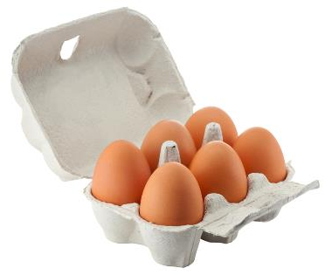
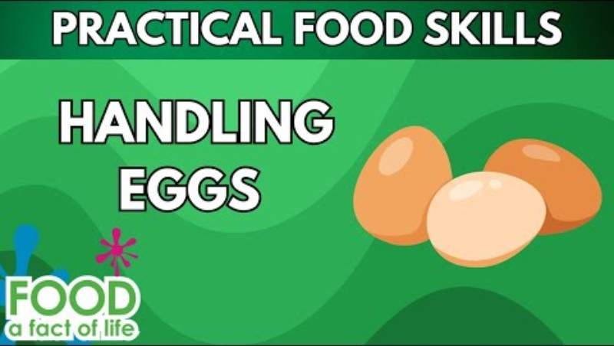
Food skills
Weigh
Sift
Stir and combine
Portion/ divide
Bake
Click below to watch how to handle eggs safely.

Slide 8
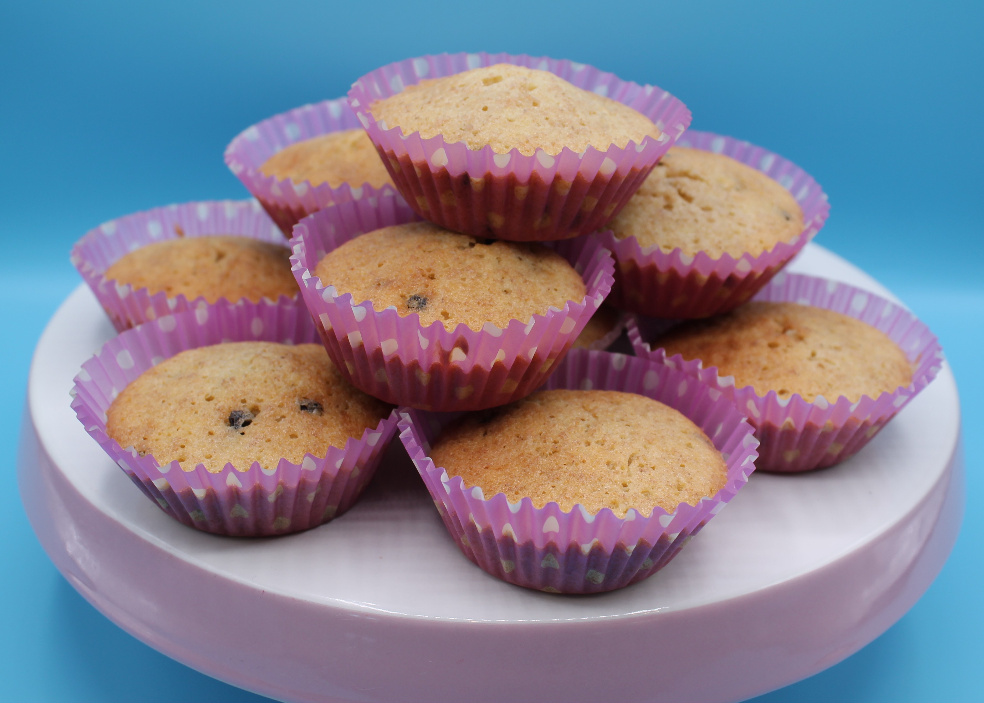
Method
Preheat the oven to 200°C or gas mark 6.
Place the cake cases in the cupcake tin.
Sift the flour into the mixing bowl.
Beat the eggs in a small bowl and add to the measuring bowl along with the sugar and fat.
Mix everything together until light and fluffy.
Stir in the dried fruit.
Divide the mixture equally between the cake cases using 2 spoons.
Bake for 15-20 minutes, until golden brown.
Remove from the oven and allow to cool on a cooling rack.

Slide 9
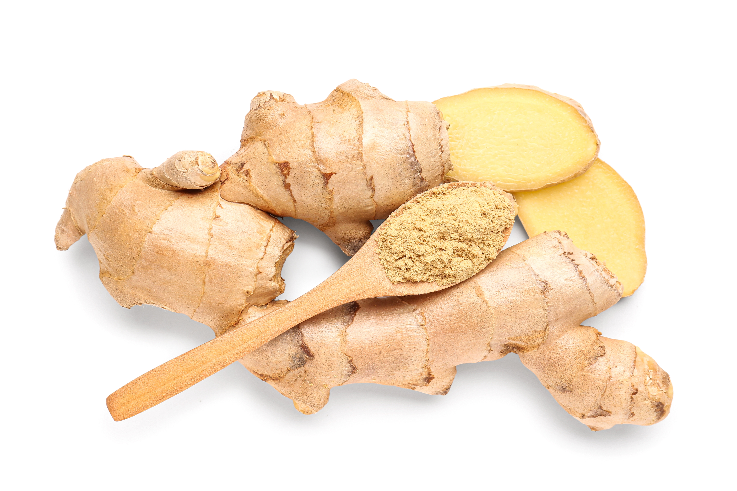
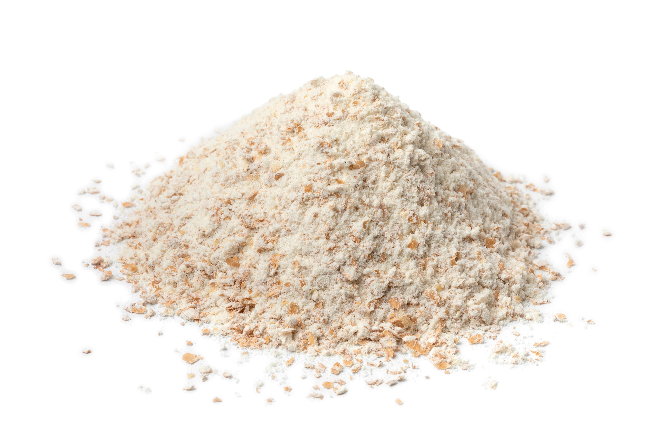
Top tips
Turn up the flavour: Add 1 x 5ml spoon cinnamon or ginger or use fresh or frozen fruit e.g. berries.
Focus on fibre: Replace the white flour with 100g wholemeal flour for an extra fibre boost
Reduce food waste: Use any leftover fruit e.g. fresh banana.

Slide 10
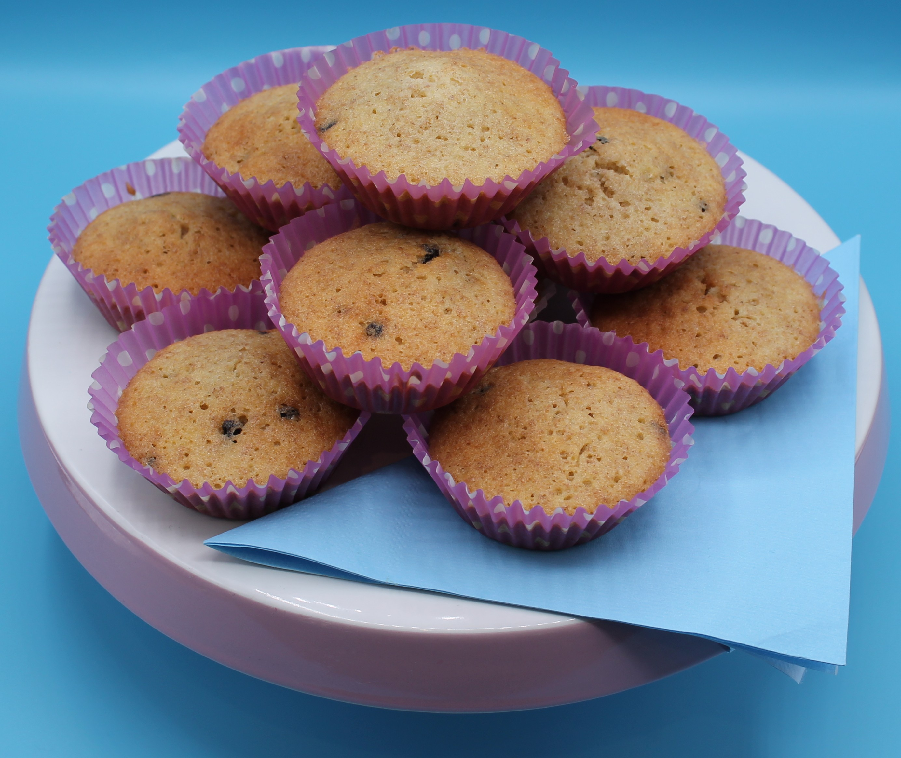
Food science
What is the function of eggs in the mini fruit cake recipe?
They:
trap air (aerate) when whisked into a foam;
coagulate (harden and set) on heating;
emulsify, holding the fat in an emulsion which keeps it stable;
add colour, flavour and nutritional value.

Slide 11
Plenary
How can the recipe be developed to add more fibre?
Explain two health and safety points when cracking eggs?
Name two things that should be checked before an egg is used.
Bonus question:
What happened to the egg when the cake mixture was baked? Explain the food science behind it.

Slide 12
Example responses
How can the recipe be developed to add more fibre?
Use frozen berries
Explain two health and safety points when cracking eggs?
Wash hands after touching raw egg, always crack into a clean bowl, never use an egg which is cracked, always check the dates.
Name two things that should be checked before an egg is used.
No cracks, date and lion mark
Bonus question:
What happened to the egg when the cake mixture was baked? Explain the food science behind it.
Eggs coagulate, harden and set, on heating, forming the structure of the cake.

Slide 13
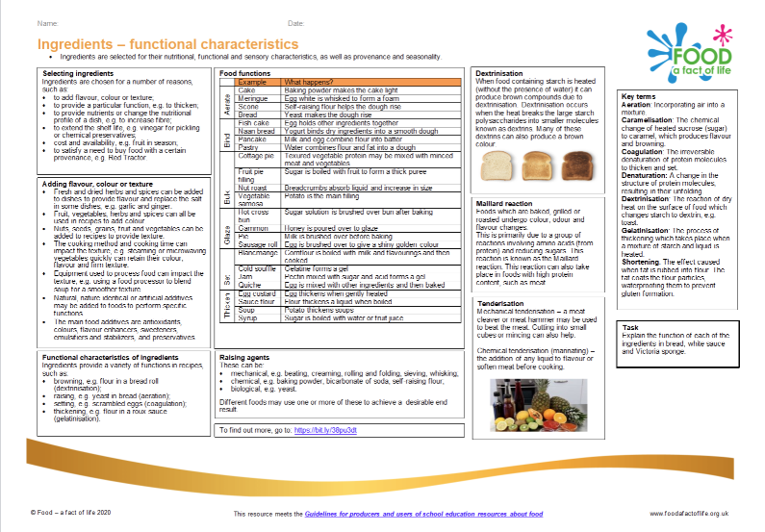
Looking for more…
Use this recipe as an opportunity to extend your pupils learning with our ingredients- functional characteristics knowledge organiser.
Explore a different function of eggs in recipes through this lesson making fish goujons from the Food – a fact of life Schemes of Work.

Slide 14
Mini fruit cake
For further information, go to:
www.foodafactoflife.org.uk
This resource meets the Guidelines for producers and users of school education resources about food.

