Slide 1
Preparing and cooking fish

Slide 2
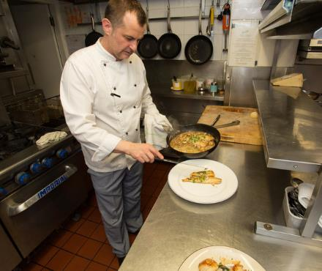
Cooking with fish
Fish can be cooked in a variety of ways, such as being grilled, baked, sautéed, fried or barbequed.
Sometimes, fish can also be eaten raw, as in sushi, or cured with an acid (e.g. lime juice), such as a dish called ceviche.
Grilling and baking are usually healthier cooking methods, because they are methods that typically use less fat than frying, for example.

Slide 3
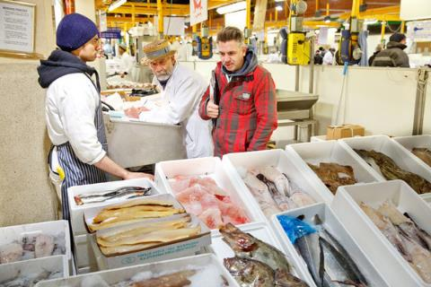
Buying fish
Many fish can be bought pre-prepared, ready to cook or use immediately:
breaded and battered: ready to be oven-baked or grilled;
fish in sauces: ready to be microwaved;
canned fish: ready to be eaten in sandwiches or salads.
Fish can also be bought whole, which usually requires some preparation before cooking.
Whole and pre-prepared fish being sold at a fish market

Slide 4
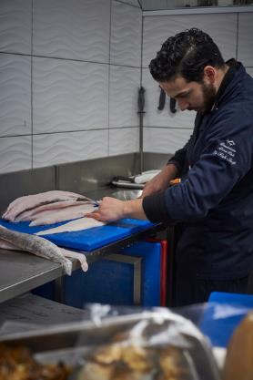
Preparing whole fish
Whole fish usually require preparation before they can be eaten. Some very small fish can be cooked and eaten whole, such as whitebait, but most fish require more steps before they are ready to eat.
In most cases, whole fish have to be descaled, gutted and portioned into fillets before they are eaten. Sometimes the skin is removed.
The head, tail and bones can be used to make stock or soup.

Slide 5
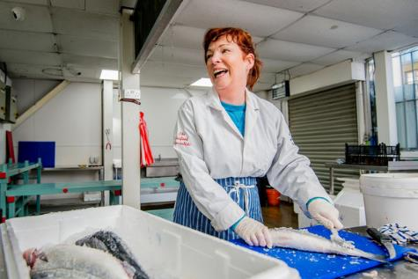
Descaling
Descaling a fish before cooking is important, as the scales are hard and have an unpleasant texture when eaten.
To descale a fish, the knife or descaling tool should be run along the scales of the fish, in the opposite direction to the scales.
This can be done whilst the fish is inside of a plastic bag to reduce mess in the kitchen.
The fishmonger above is descaling a fresh mackerel with a descaling tool. In the kitchen, this can also be done with a knife

Slide 6
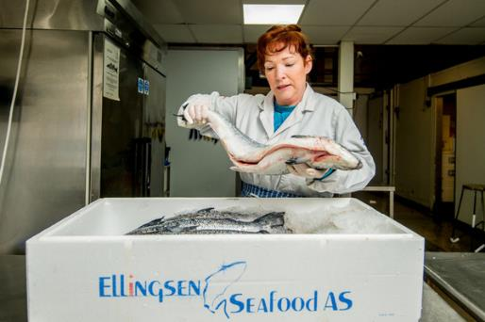
Gutting
Once the scales are removed, the fish can be dried with a cloth or paper towel. The fins and gills are cut off before the fish is gutted.
Gutting removes the entrails of the fish. This is important because keeping these in can spoil the flavour of a fish and make it deteriorate.
To gut a fish, a shallow cut is made along the abdomen and the guts are carefully pulled out.
A whole salmon that has been gutted, with a large incision along the abdomen of the fish

Slide 7
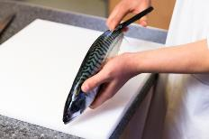
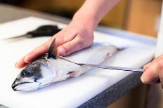
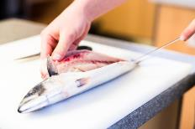
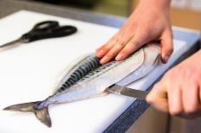
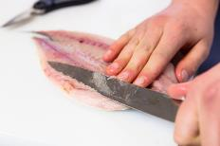
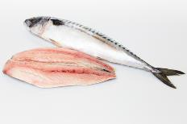
Filleting
1
2
3
The fish is then ‘filleted’. This results in portions of fish that are separated from the head, tail and major bones.
4
5
6
A mackerel being ‘butterfly filleted’

Slide 8
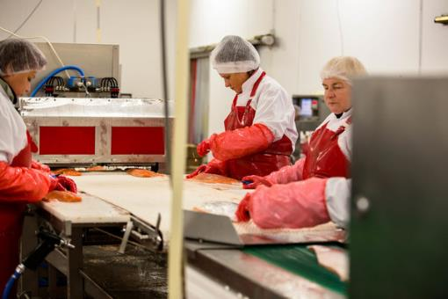
Pin-boning
Filleting a fish usually cuts away the fish from the main skeleton, but often small bones are still left and need to be removed.
This is known as ‘pin-boning’, as these bones are often very small (like a pin).
Fishmongers using tweezers to remove the pin bones from salmon fillets

Slide 9
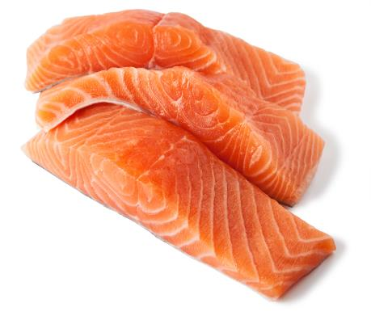
Preparing fillets
Once all of the bones are removed, the fillet is trimmed at the edges.
For larger fish, such as salmon, the whole fillet is cut into portions.
Before cooking, the fish fillets may be marinaded or seasoned with herbs, citrus fruit or other flavourings.

Slide 10
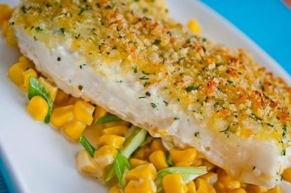
Different ways to cook fish
There are many ways to cook a piece of fish. These include:
baking;
deep frying;
grilling;
poaching or steaming;
microwaving;
sautéing or pan frying.
Grilling and poaching are usually healthier methods because they use less oil, whilst sautéing or deep frying usually use more.
Some fish can also be eaten raw (e.g. sushi).
A piece of halibut that has had a topping added and then baked until the fish is cooked
and the topping is crispy

Slide 11
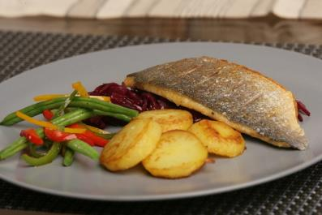
Sautéing and frying
Thin fillets or strips of thicker fish can be sautéed or pan fried.
This also works well for some other seafood, such as shrimp, prawns or scallops.
Cooking skin-side down will give a crispy skin (e.g. pan frying salmon).
A sea bream sautéed until the skin is crispy and served with potatoes and vegetables

Slide 12
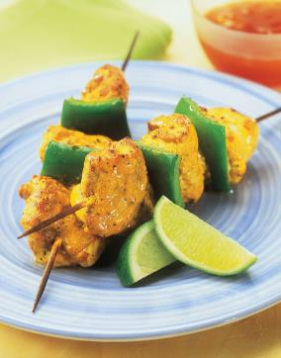
Grilling
Not all fish are suitable for grilling.
Fish used for grilling are usually thicker steak cuts of oily fish. Lean or thin cuts may dry out and be tough.
Fish suitable for grilling include monkfish, tuna or swordfish steaks, or thick salmon fillets.
The grill tray should be greased or lined with tin foil to prevent the fish from sticking and the fish should be cooked at medium to medium-high heat, so it cooks without burning.
Grilled tikka skewers made with monkfish. This fish is thick and so is good for grilling

Slide 13
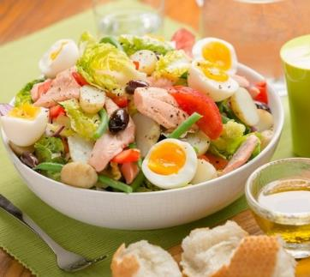
Poaching
Poaching is a versatile method and many types of fish can be cooked this way.
Poaching cooks the fish in a hot liquid, such as water, milk, stock or wine.
Fish should be cooked at a simmer, usually for around 10 minutes, though this can vary based on the size of the fillet.
Fish can also be poached whole, though this will take longer, depending on the type of fish, how much is being cooked and the thickness of the fish.
A salad niçoise made with flaked poached trout

Slide 14
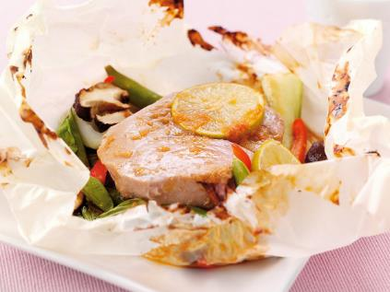
Baking
Fish can be placed on a greased or lined baking tray and placed in the oven. It can also be wrapped in a baking paper or foil parcel with other ingredients to give it more flavour.
If using a parcel, the fish will steam in its own juices. Baking on a tray, uncovered will result in a piece of fish that is more browned and crispier (if the skin is left on).
Baked fish can also be topped with breadcrumbs and other additions and these will brown in the oven.
Tuna oven-baked in a parcel with vegetables

Slide 15
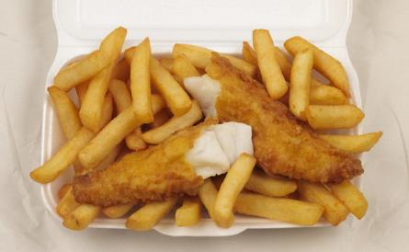
Deep frying
The fish that is bought in takeaways, such as 'fish and chip’ shops is deep fried. It is coated in a batter and placed into hot oil.
The oil needs to be the right temperature (around 180°C). Too low and the oil is absorbed into the batter, making the fish greasy. Too high and the outside will burn.
Deep frying at home can be dangerous as large amounts of hot oil can be a fire hazard. Deep frying should always be performed by an adult with the correct equipment (i.e. a deep fat fryer rather than a saucepan).
Deep-fried food should not be eaten too often, as these foods provide high amounts of fat and energy (calories).

Slide 16
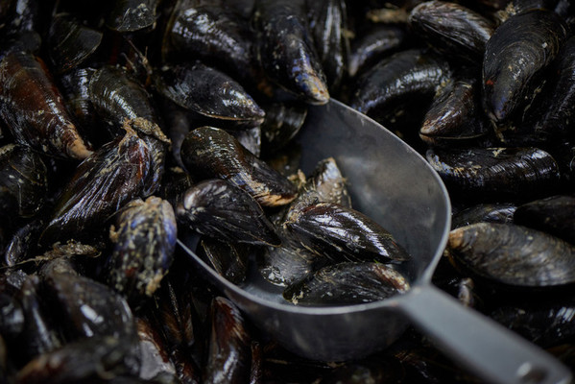
Preparing shellfish safely
Many shellfish are filter feeders. This means that they can gather up bacteria and viruses from their environment.
The best way to avoid illness is to make sure that shellfish are properly cooked.
When cooked in the shell, mussels, clams and oysters will open. Any that do not open should be discarded as they may present a risk.
Raw shrimp and prawns will turn pink and firm up when properly cooked.
You should also wash hands thoroughly before and after preparation and make sure that no raw shellfish or juices can contaminate surfaces or other food.
Fresh mussels like these need to be cleaned just before cooking

Slide 17
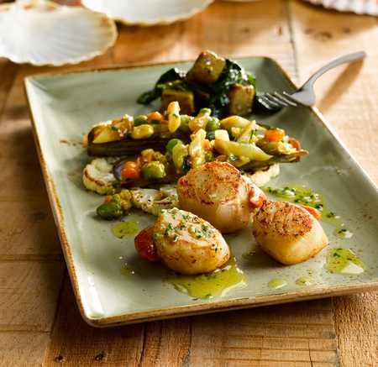
Cooking with shellfish
There are several ways to cook shellfish. A common way to cook mussels and clams is to steam them in a broth, often containing butter, white wine, garlic and lemon juice.
Larger shellfish, like oysters, can be baked or grilled. These are often also cooked in butter and garlic. They can also be removed from the shells, poached and added to dishes such as a seafood pasta.
Scallops are large shellfish that have a large ‘adductor muscle’, a round, thick piece of seafood that is usually pan-fried for just a few minutes on each side.
Pan-seared king scallops with charred cauliflower

Slide 18
Preparing and cooking fish
For further information, go to:
www.foodafactoflife.org.uk
This resource meets the Guidelines for producers and users of school education resources about food.

