Slide 1
Cheese straws
Complexity: low - medium

Slide 2
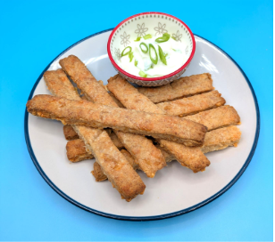
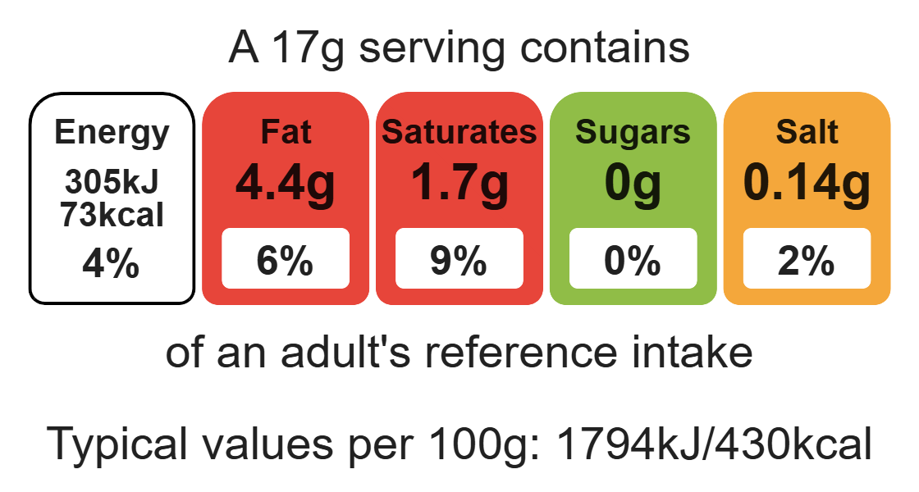
Nutritional analysis
Makes 12

Slide 3
Starter activity
True or False
Jewellery can be worn during a practical session.
A clean apron should be worn.
Long hair should be styled before cooking.

Slide 4
Example responses
True or False
Jewellery can be worn during a practical session.
False, jewellery must be removed as it can harbour dirt and bacteria.
2. A clean apron should be worn.
True
3. Long hair should be styled before cooking.
False, long hair should be tied back to prevent any hair getting into the food.

Slide 5
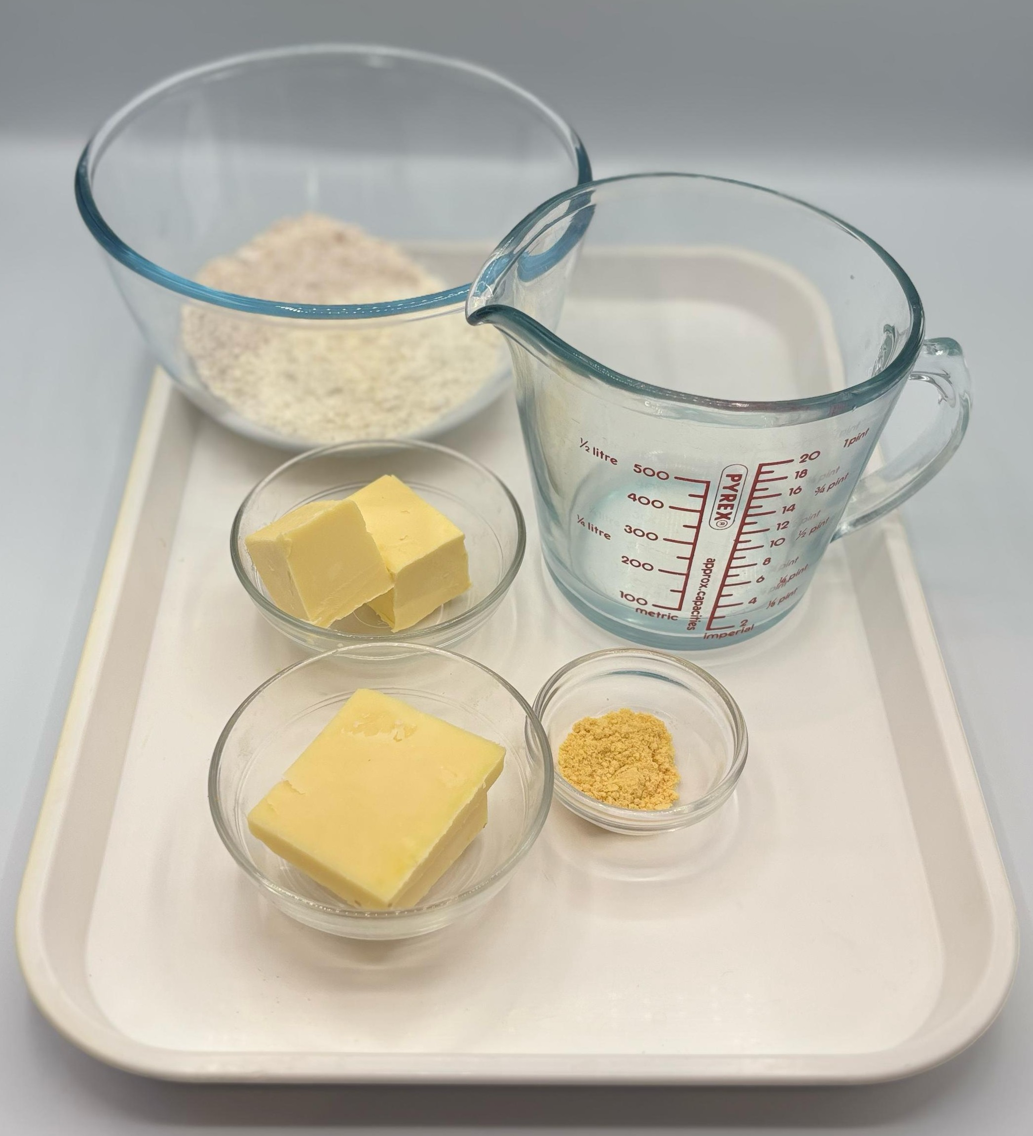

Ingredients (makes 12)
50g reduced-fat cheddar cheese
75g plain white flour
25g plain wholemeal flour
½ x 5ml spoon mustard powder
50g hard baking fat
2 x 15ml spoons cold water
Check for any food allergy, intolerance, special dietary requirement or religious/cultural reasons for not handling or eating the ingredients in this recipe.

Slide 6
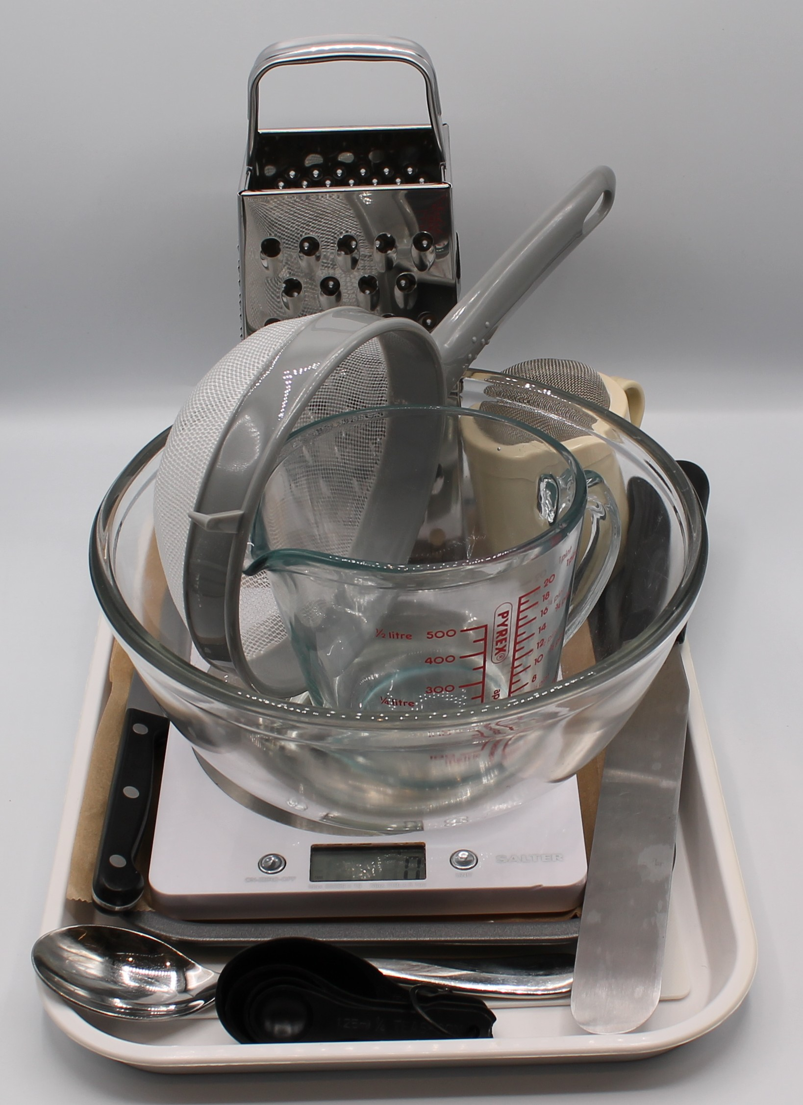
Equipment
Weighing scales
Baking tray
Grater
Chopping board
Sieve
Measuring spoons
Mixing bowl
Palette knife
Flour dredger
Rolling pin
Cooling rack

Slide 7
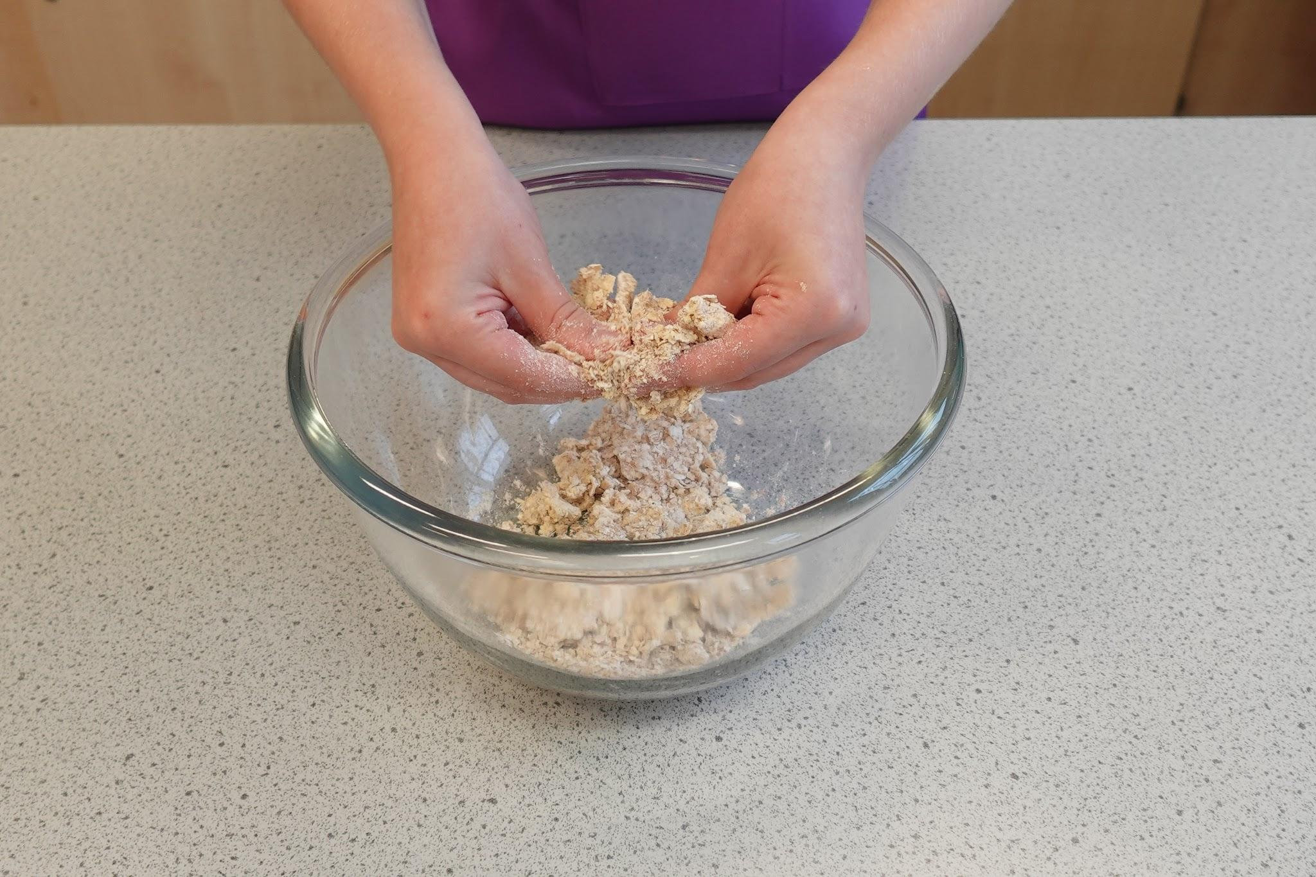
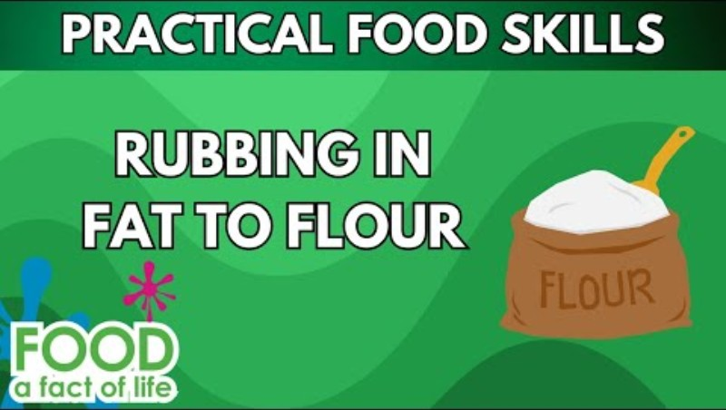
Food skills
Cut
Form and shape
Bake
Weigh
Measure
Grate
Sift
Rub-in
Mix
Stir
Combine
Roll out
Click below to see the rubbing- in method

Slide 8
Method
Preheat the oven to 200ºC or gas mark 6.
Grease or line the baking tray.
Grate the cheese.
Sift the flour and mustard powder into the mixing bowl.
Using your fingertips, rub the fat into the flour until it resembles fine breadcrumbs.
Stir the cheese into the flour mixture.
Using a palette knife, mix to form a smooth dough, adding a little cold water gradually to help bind the mixture together.
Roll out, on a lightly floured surface, to form a rectangle (20cm x 15cm) approximately 0.5cm deep.
Trim away the edges and cut into thin strips, about 1.5cm x 7cm, using a palette knife.
Place the straws on the baking tray.
Bake for 10 minutes, until golden brown.

Slide 9
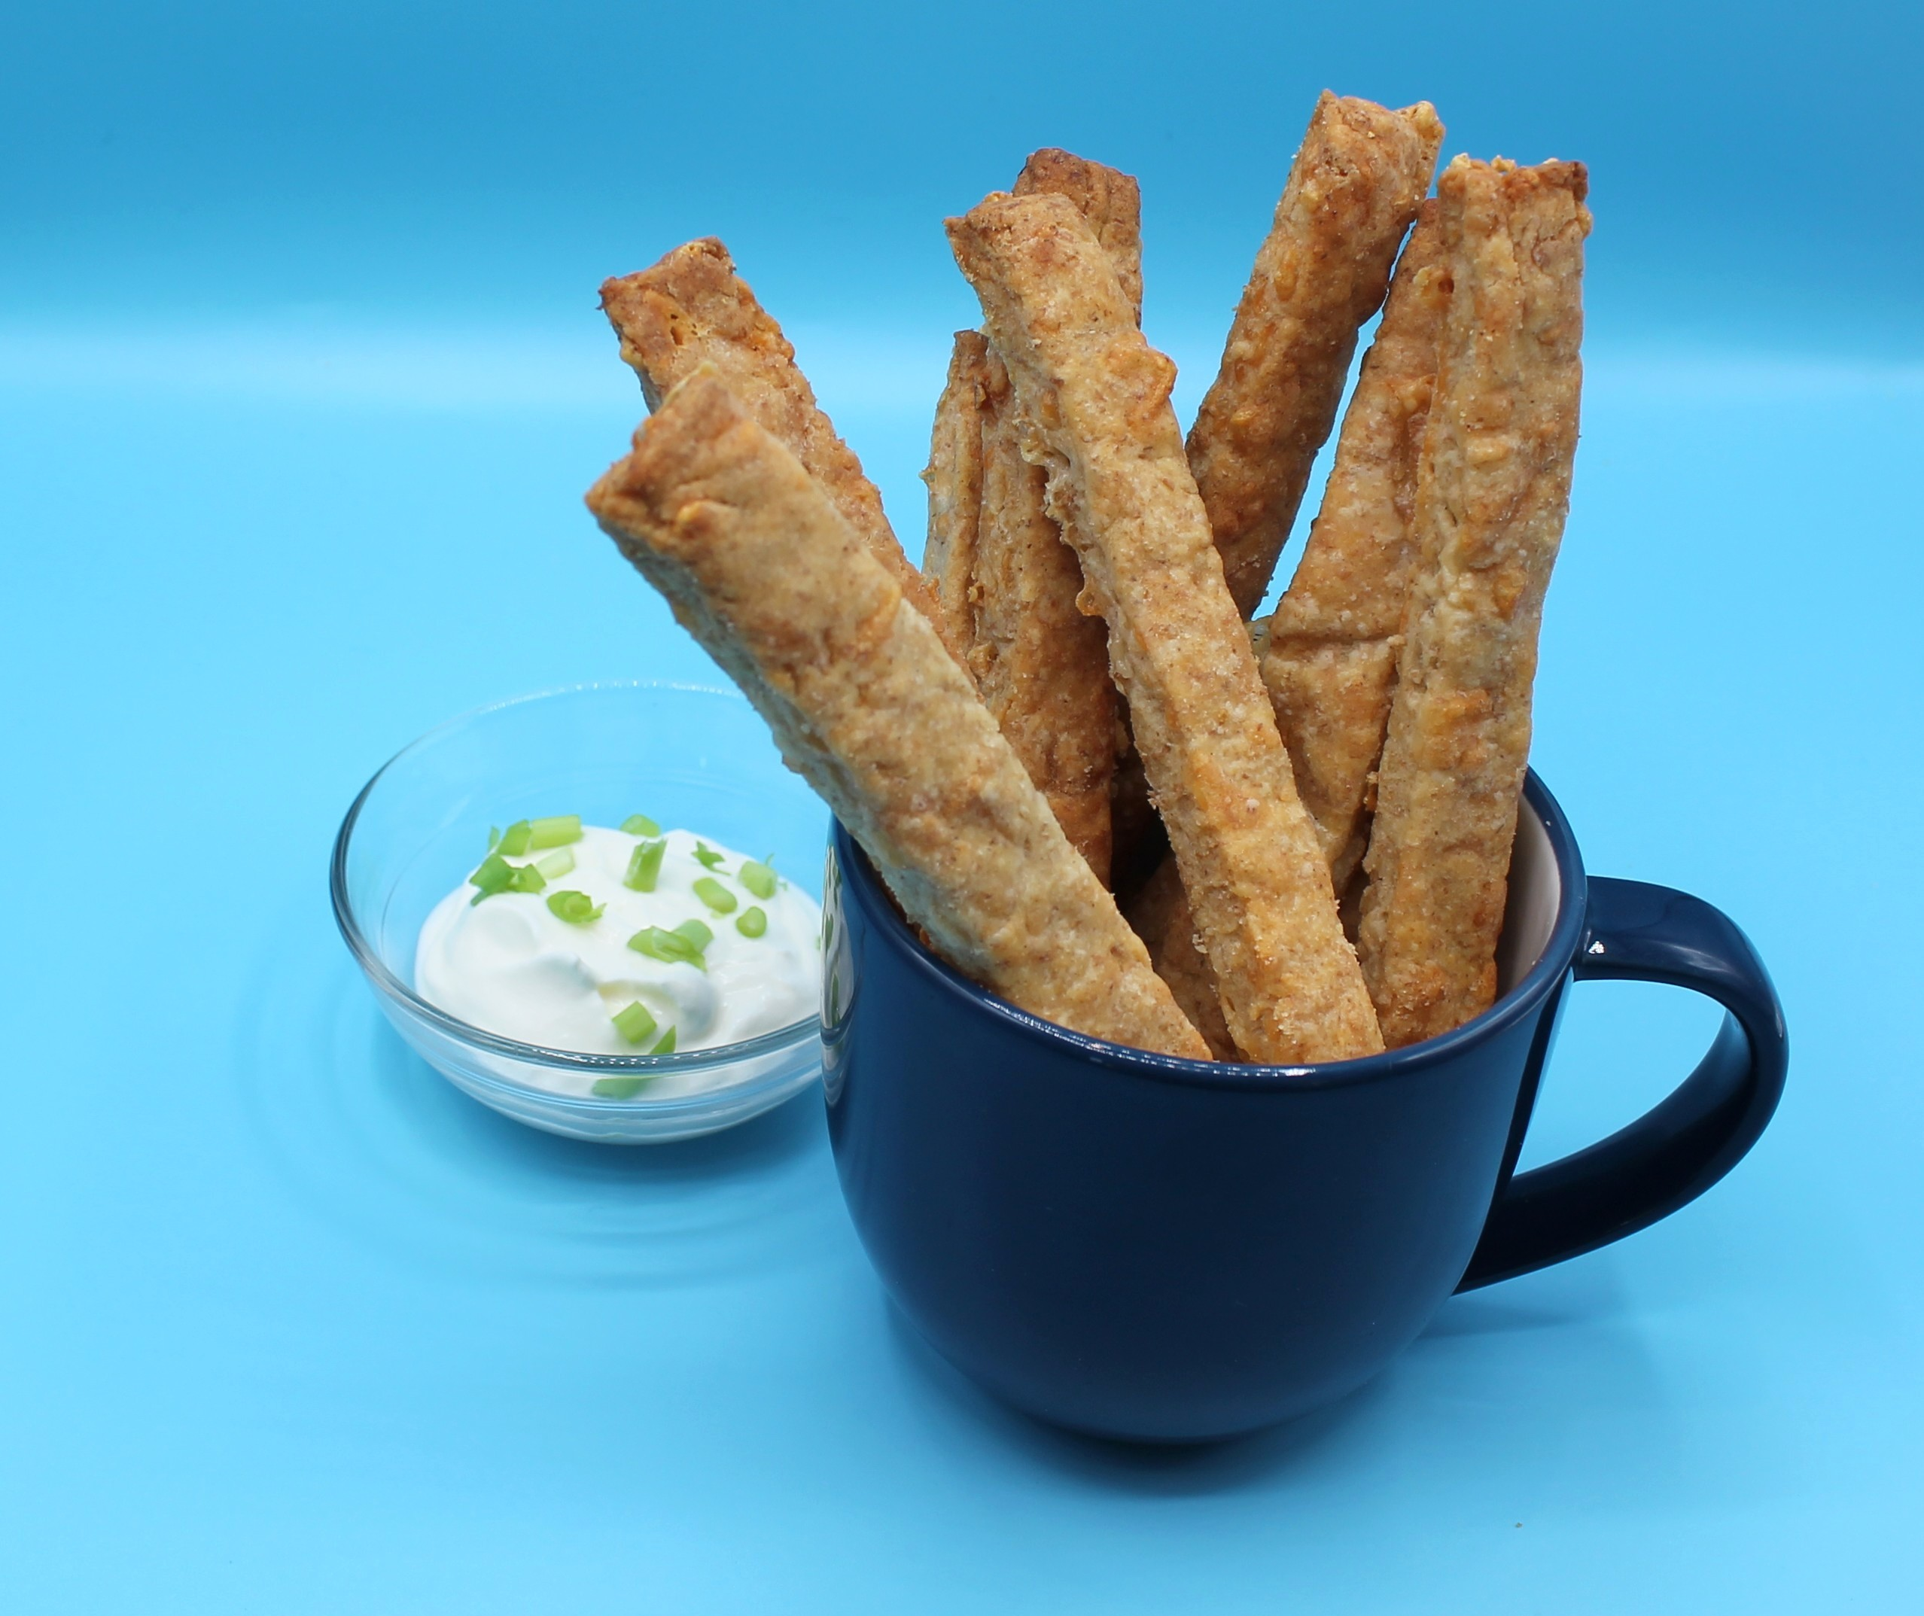
Food science
Dextrinisation
When the starch in the flour turns to dextrin, under the application of dry heat, causing a golden brown colour.

Slide 10
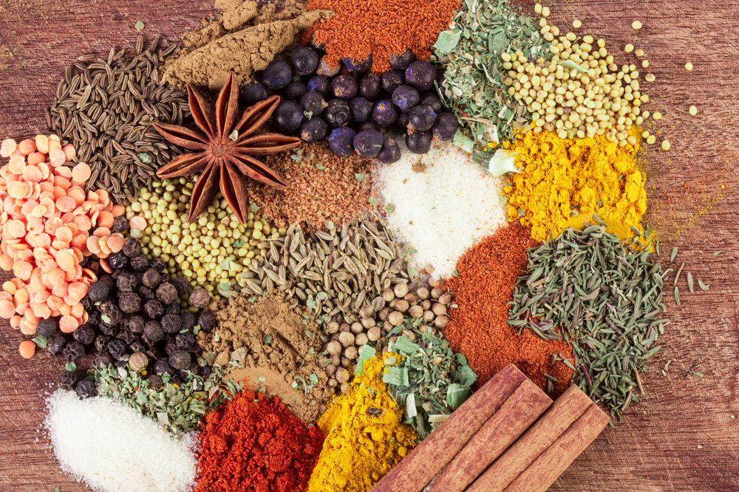
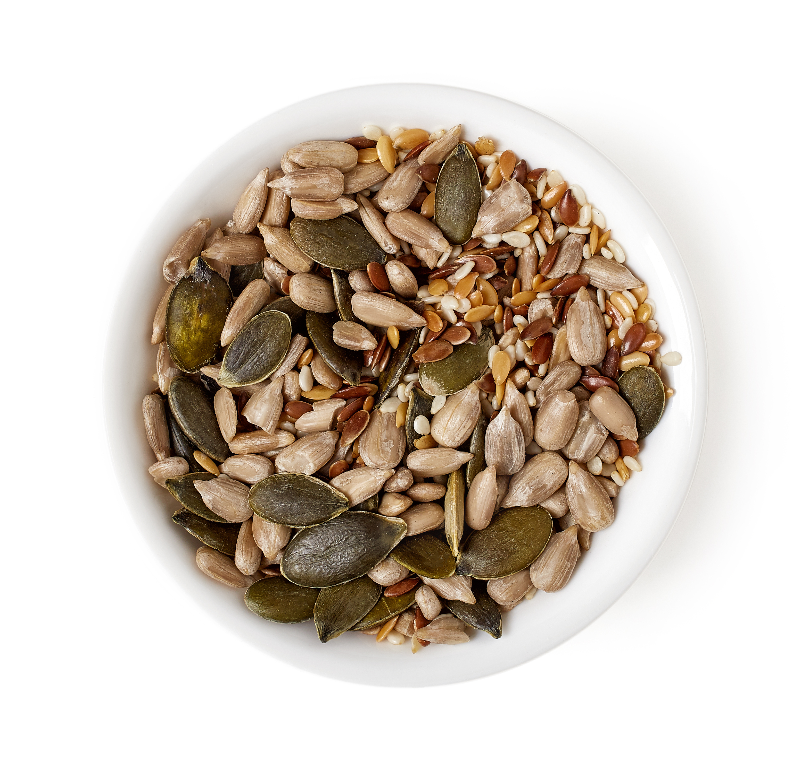
Top tips
Serving suggestion: Serve with reduced-fat crème fraiche and spring onion dip.
Turn up the flavour: Add mixed herbs, chilli flakes or a different type of cheese.
Focus on fibre: Brush the straws with water and sprinkle with seeds before baking. Be ingredient aware!
Use the rolling pin like a ruler, to help cut even strips.

Slide 11
Plenary
List 3 different ways you could develop your cheese straws.
The first one has been done for you.
Change | Explain | Example
Change flavour | I could add different types of cheese. | e.g. change to reduced-fat mature cheese.

Slide 12
Example responses
List 3 different ways you could develop your cheese straws.
Change | Explain | Example
Change flavour | I could add different types of cheese. | e.g. change to mature cheese.
Add herbs or spices | I could add herbs or spices to develop the flavour. | e.g. I can add basil.
Add toppings | I can add seeds as a topping to add more fibre. | e.g. I can brush the straws with water and add sesame seeds.
Change shape | I could develop the shape of my straws. | e.g. I could use a shaped cutter.

Slide 13
Looking for more…
Continue the learning and use our presentation about the effects of dry heat.
Challenge your pupils to develop their practical food skills and use the rubbing-in method to make fruit scones. This year 8 lesson from the Food – a fact of life Schemes of Work, will give you all that you need.

Slide 14
Cheese straws
For further information, go to:
www.foodafactoflife.org.uk
This resource meets the Guidelines for producers and users of school education resources about food.

