Slide 1
Spaghetti Bolognese
Complexity: medium-high

Slide 2
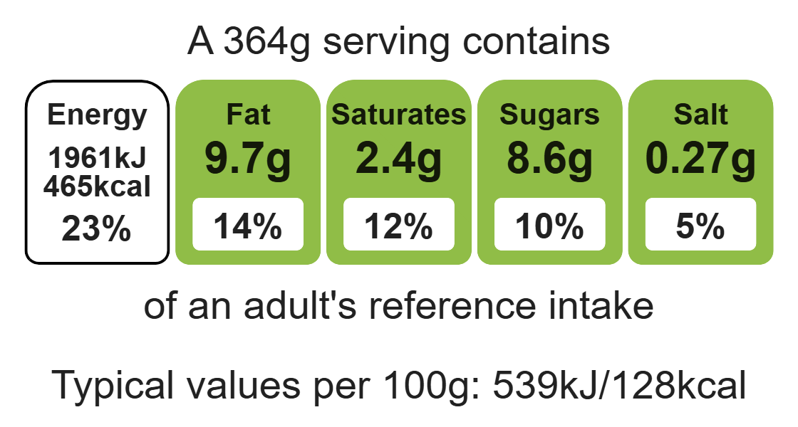
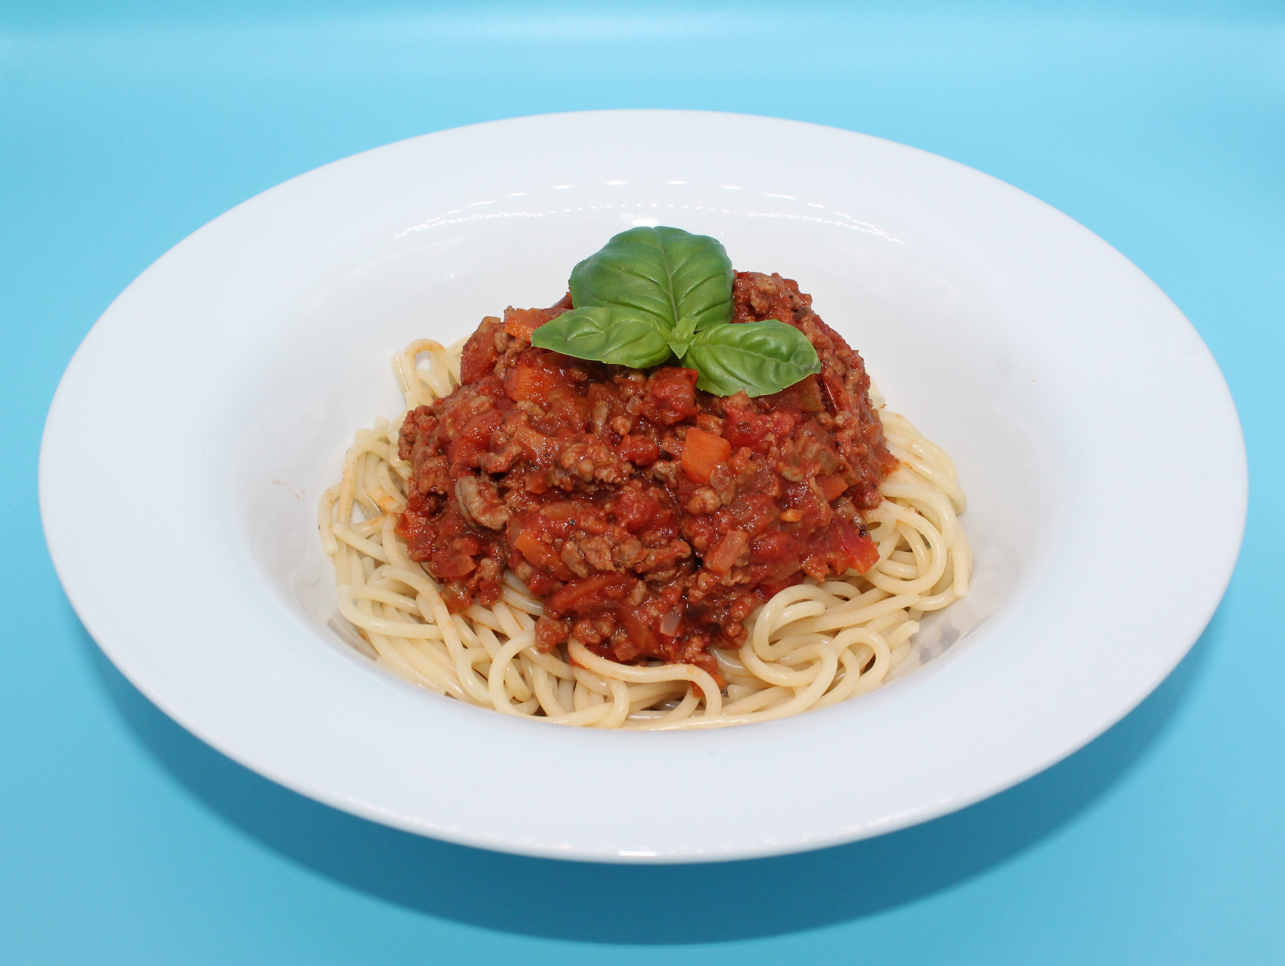
Nutritional analysis
Serves 3

Slide 3
Starter activity
1. Give two food hygiene tips when handling raw meat.
Explain cross-contamination.
How would you know the meat is cooked correctly?

Slide 4
Example responses
1. Give two food hygiene tips when handling raw meat.
Use a red chopping board, always wash hands after handling raw meat.
Explain cross-contamination.
Where bacteria is transferred from one place to another via a vehicle e.g.hands, equipment.
How would you know the meat is cooked correctly?
  The beef mince will turn from red to brown, with no red/pink remaining, and will be piping hot.

Slide 5
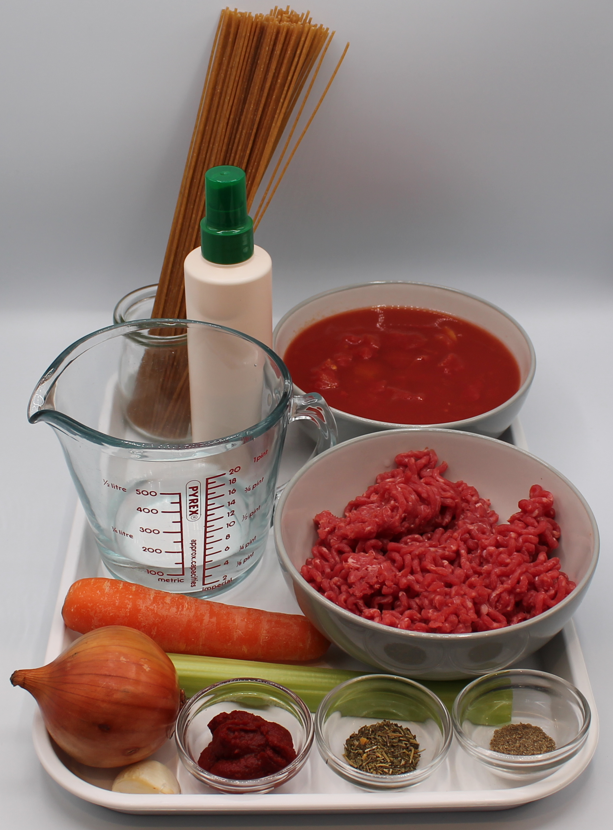
Ingredients (serves 3)
1 onion
1 clove garlic
1 carrot
1 celery stick
1 x 15ml oil r spray oil
250g lean minced beef
1 can chopped tomatoes (400g)
1 x 15ml spoon tomato purée
100ml water
1 x 5ml spoon
mixed herbs
Black pepper
240g wholemeal
spaghetti

Slide 6
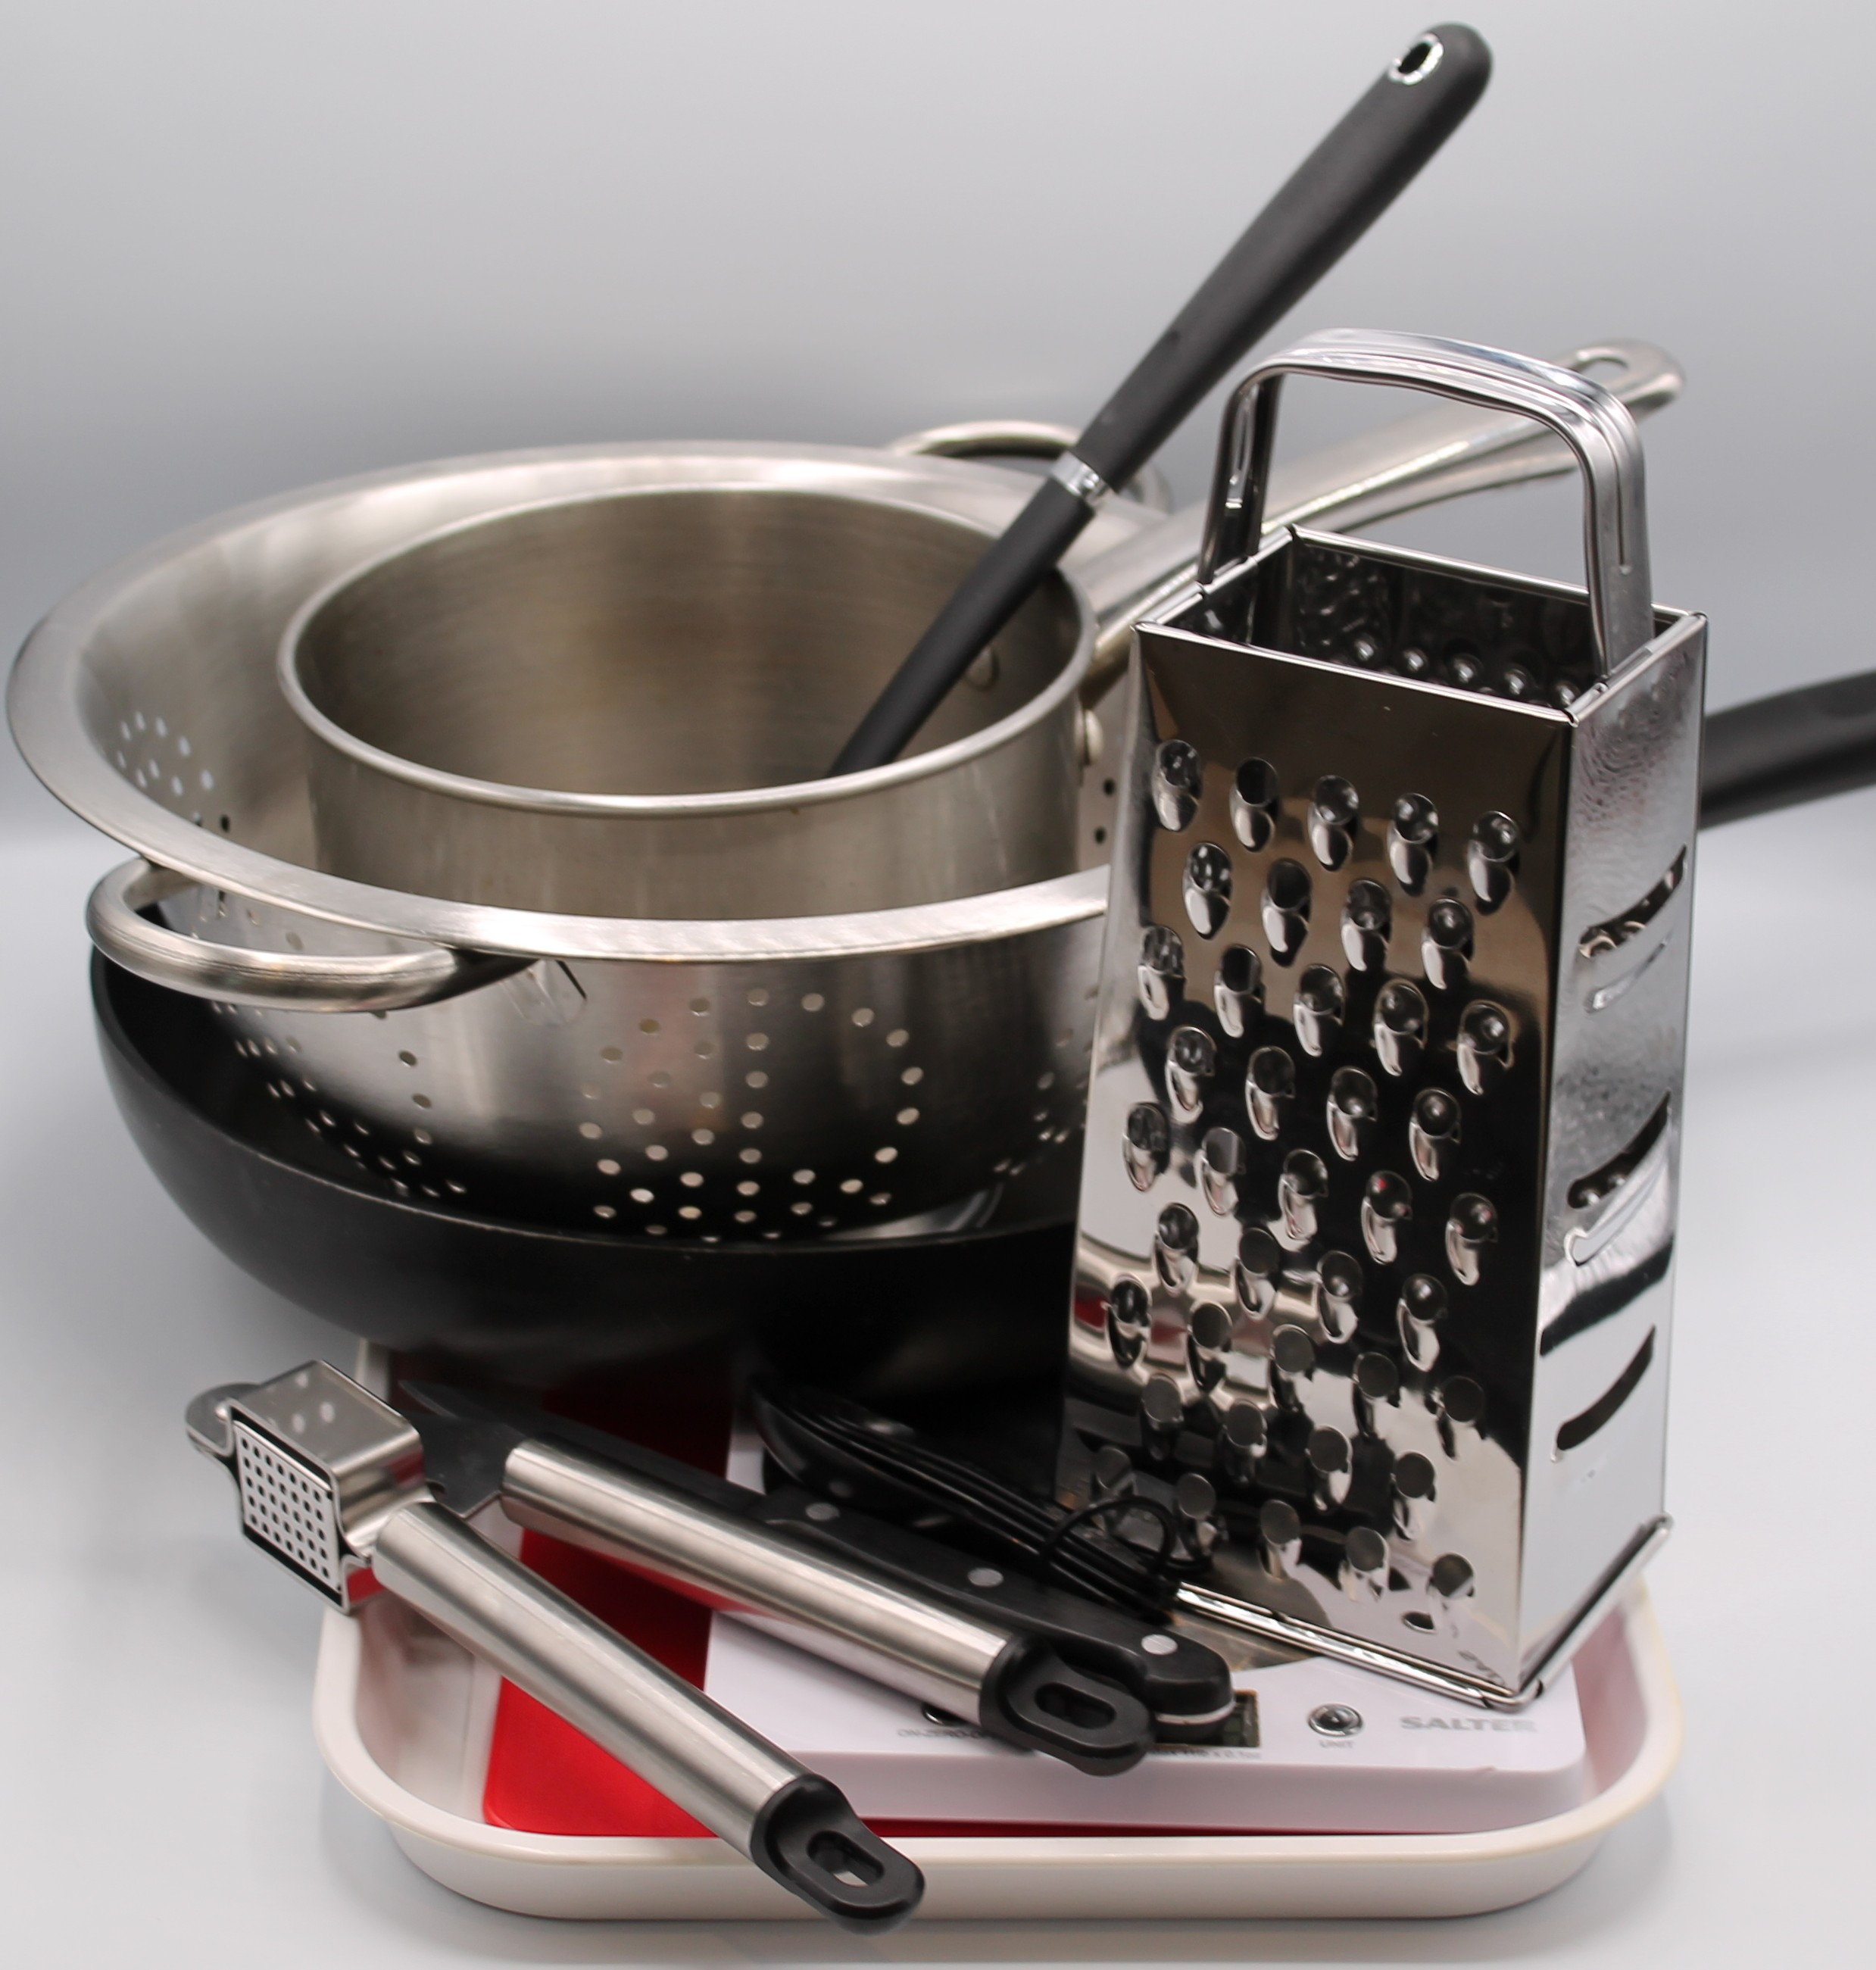
Equipment
Chopping board
Sharp knife
Garlic press
Peeler
Measuring spoons
2 saucepans
Weighing scales
Measuring jug
Heat resistant spoon
Colander
Grater

Slide 7
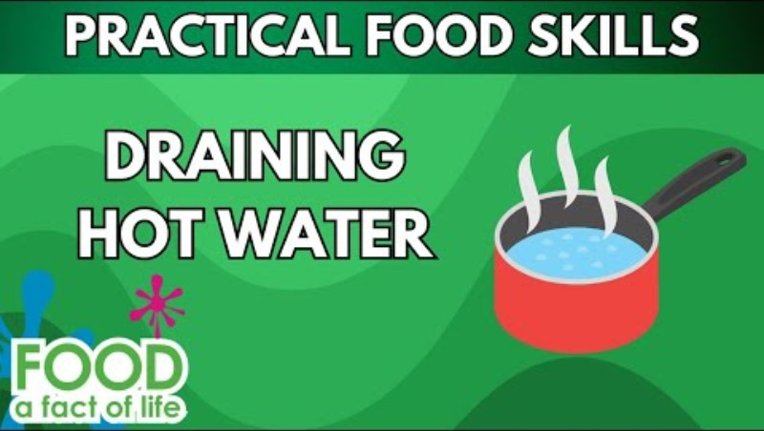
Food skills
Click below to see how to drain pasta safely.
Weigh
Measure
Peel
Crush
Chop, slice, dice and trim
Fry and sauté
Stir
Melt, boil and simmer
Drain

Slide 8
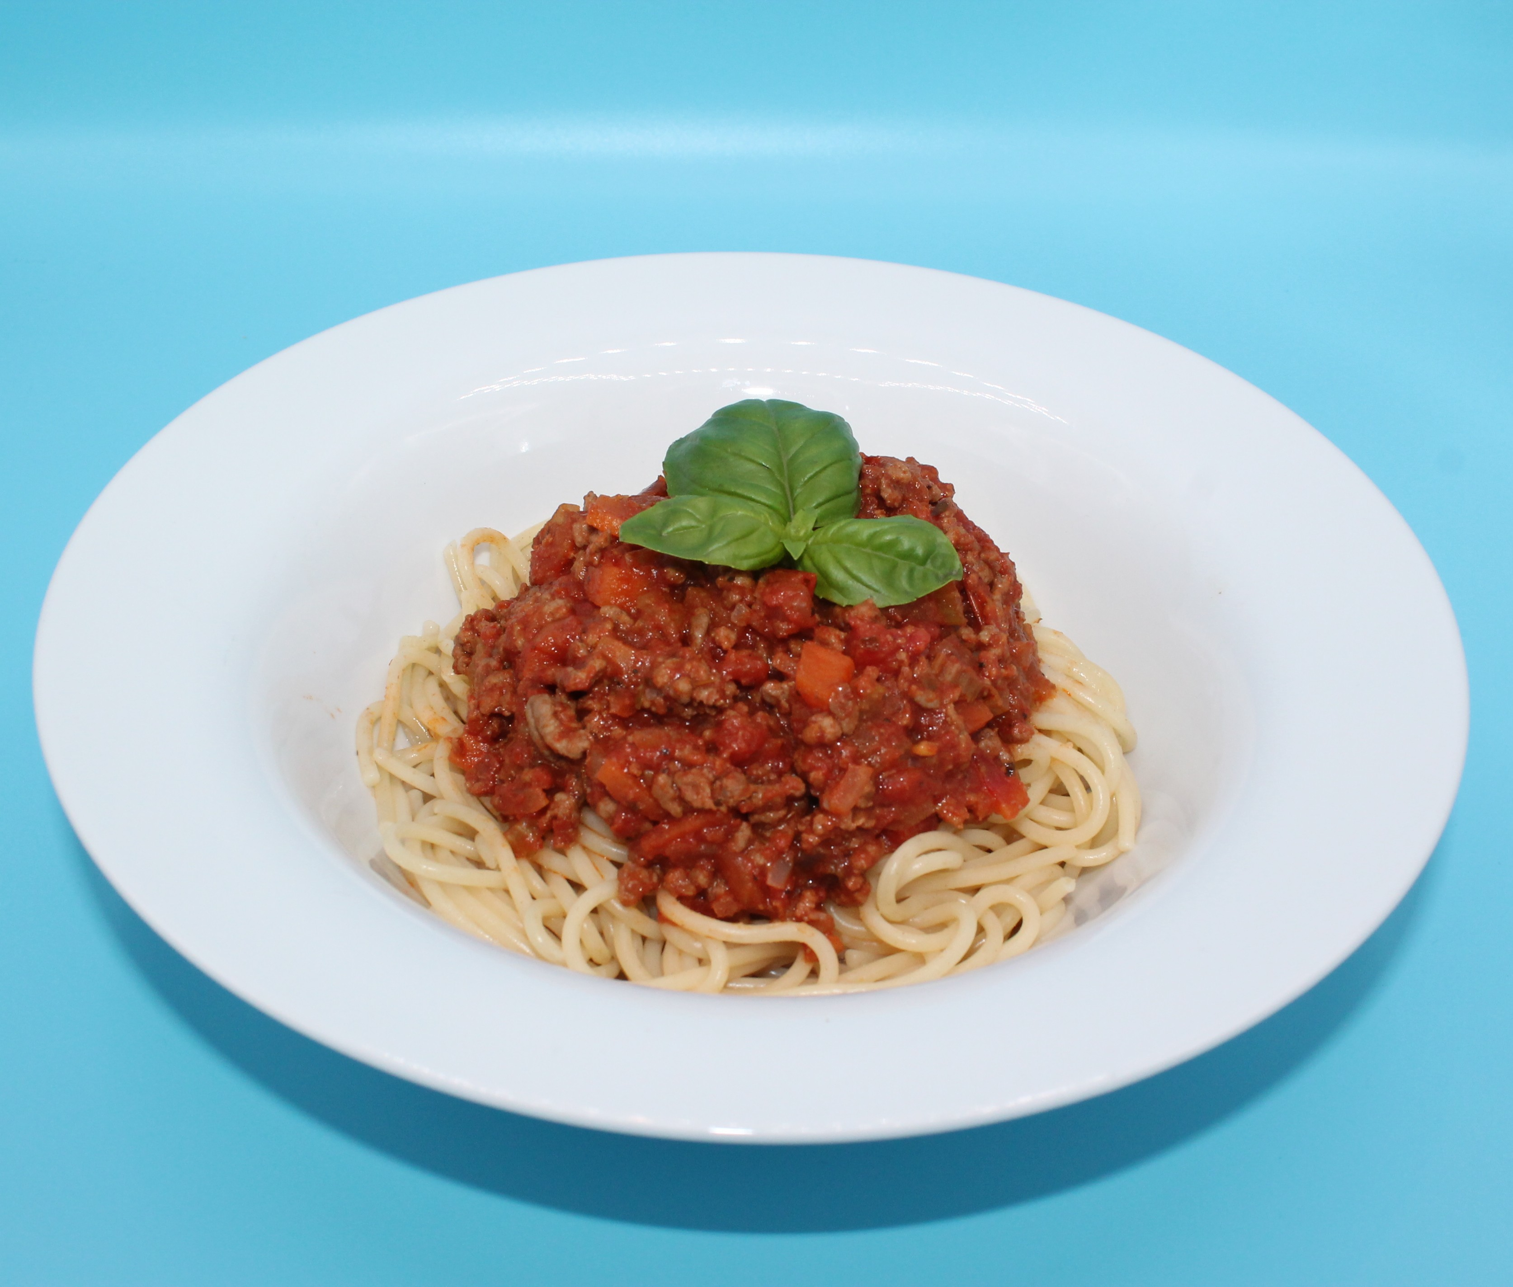
Method
  1. Prepare the vegetables:
  Peel and dice the onion;
  Peel and crush the garlic;
  Peel and slice the carrot;
  Finely slice the celery.
  2. Fry the onion, garlic, carrot and celery in the oil.
  3. Add the meat and cook until the mince is lightly browned.
  4. Add the tomatoes, tomato puree, mixed herbs and water and mix all the ingredients together. Then add a few twists of black pepper.

Slide 9
Method
5. Bring to the boil, then simmer for 20 minutes.
6. Meanwhile place the spaghetti in a separate saucepan of boiling water. Cook for 10 - 12 minutes or until the spaghetti is al dente (tender).
7. Drain the boiling water away from the spaghetti into a colander in the sink.
8. To serve pour some of the bolognaise sauce over the spaghetti.

Slide 10
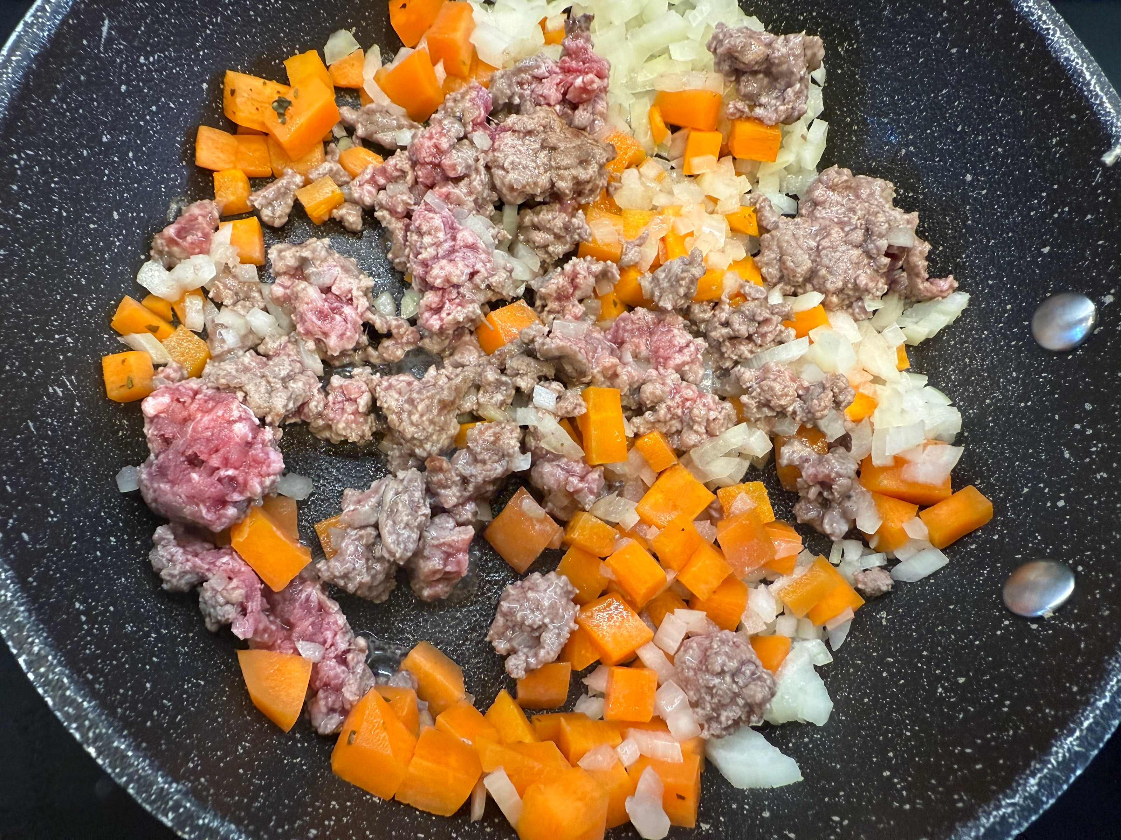
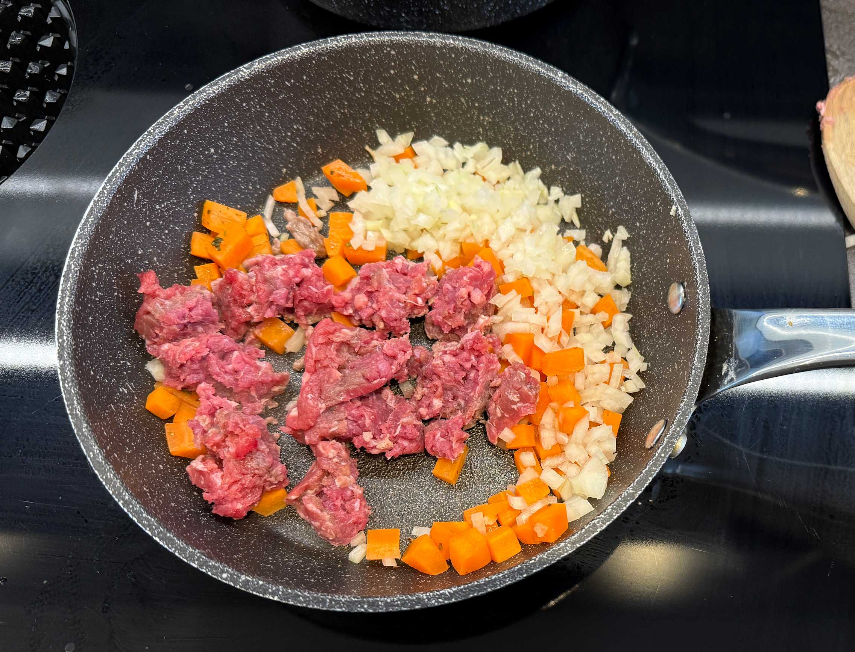
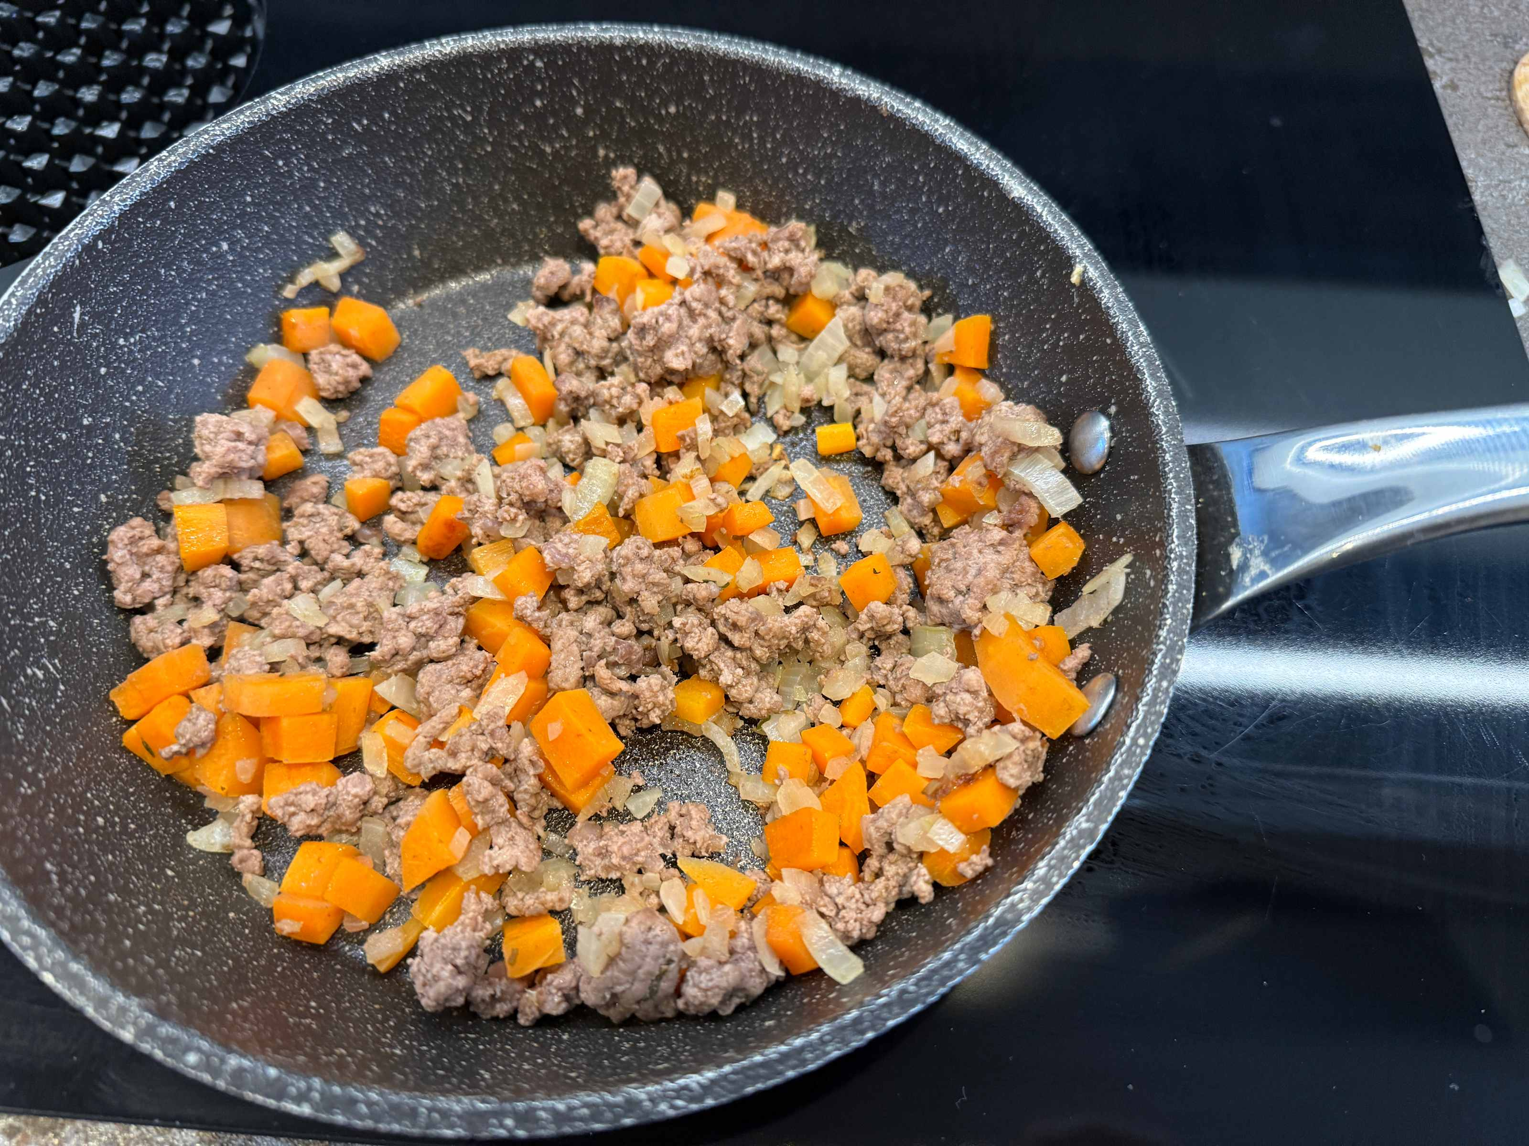
Food science
Maillard reaction
The beef mince is high in protein, the amino acids (from protein) and reducing sugars react and add to the colour and flavour of the beef mince.

Slide 11
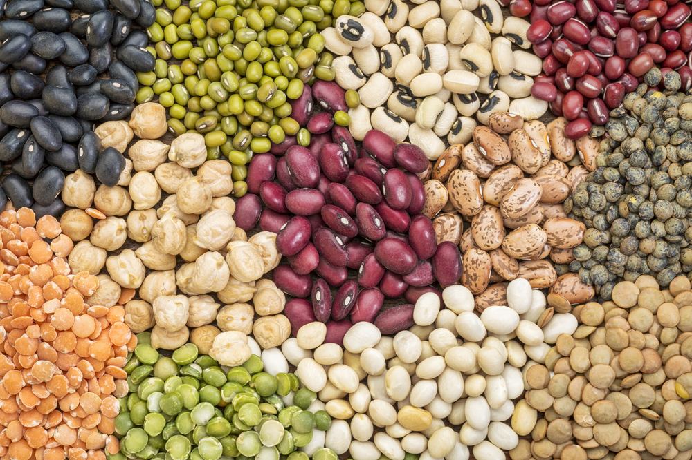
Top tips
Serving suggestion: Serve your spaghetti bolognese with parmesan cheese and fresh basil.
Transform your leftovers: Use your leftover bolognese to create a new dish like nachos, burritos or chilli con carne.
For a vegetarian option swap the minced beef for lentils or beans.

Slide 12
Plenary
1. Rate at least four food skills or cooking techniques for your level of competency. Make note of any improvements for the future.
Food skills and techniques | beginner | intermediate | advanced | expert
Beginner – starting to learn the skill
Intermediate – can complete tasks with some help
Advanced – can work independently
Expert – demonstrates full mastery of the skill and can help others
2. Provide a comment on each of your ratings.

Slide 13


Example response
1. Rate at least four food skills or cooking techniques for your level of competency. Make note of any improvements for the future.
Food skills and techniques | beginner | intermediate | advanced | expert
Measuring
Slicing
Beginner – starting to learn the skill
Intermediate – can complete tasks with some help
Advanced – can work independently
Expert – demonstrates full mastery of the skill and can help others
2. Provide a comment on each of your ratings.
  I can measure ok, but I need some help using a measuring jug.
  I can slice well, I can do so independently and safely.

Slide 14
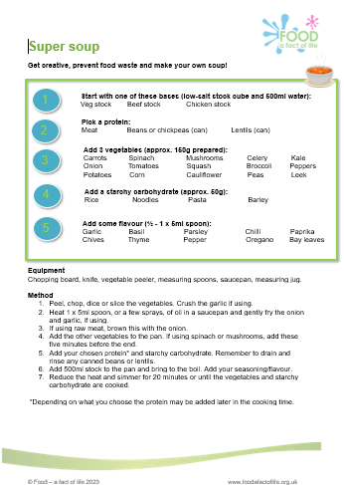
Looking for more…
Why not extend the learning and discuss reducing food waste and transforming leftovers with your pupils?
Check out our Zero waste, full taste presentation!
Challenge your pupils to make a Super soup and quick flatbreads using leftovers. There is information for the teacher, a pupil recipe/activity sheet and a flatbread recipe.

Slide 15
Spaghetti bolognese
For further information, go to:
www.foodafactoflife.org.uk
This resource meets the Guidelines for producers and users of school education resources about food.

