Slide 1
Taking a whole school approach
Claire Theobald, Education Services Manager (primary)

Slide 2
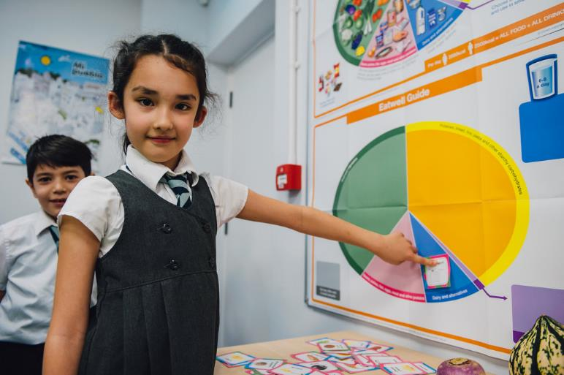
This session will cover:
Why a whole school approach is important and how you can contribute to this
Ensuring consistency of healthy eating messages across subjects and age groups and throughout the school day
Working with colleagues to enhance learning opportunities
Links to Food – a fact of life resources

Slide 3
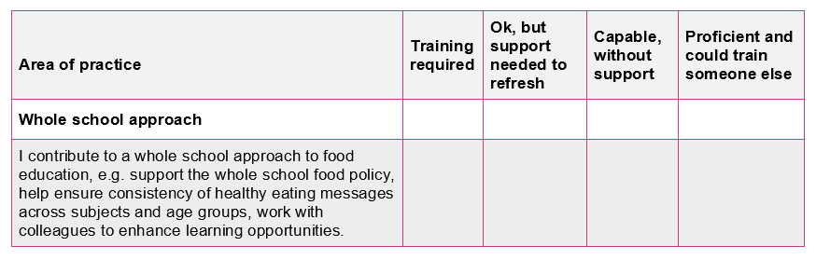
Your audit (completed with registration)
Whole school approach

Slide 4

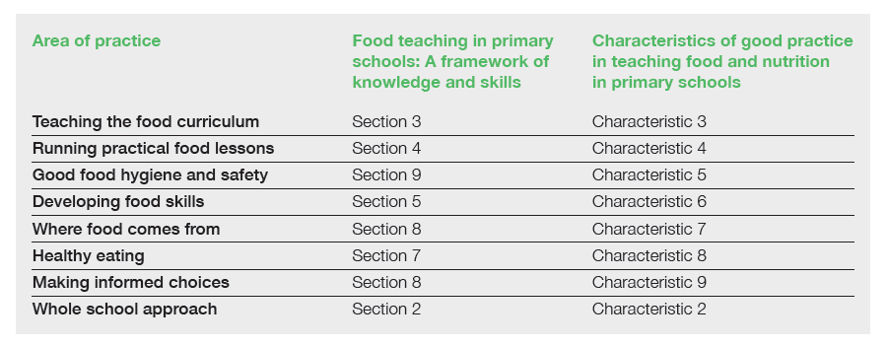


Where food comes from
Supporting documents
TPFN booklet, page 5

Slide 5

Why is a whole school approach important?
Common understanding
Provides consistency for everyone (pupils, staff, parents/carers)
Reinforces appropriate messages

Slide 6
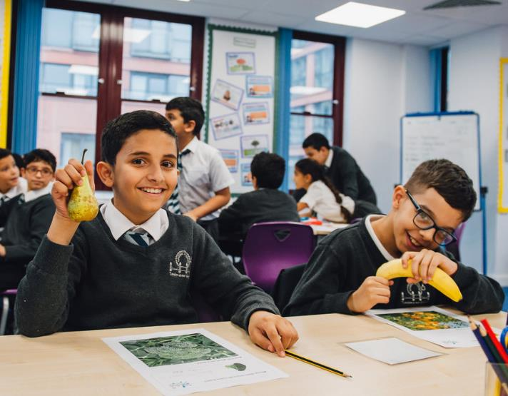
A whole school approach to food covers…
All things food!
Formal curriculum subjects, including their equipment, resources and ingredient provision, and continuing professional development for staff
Extra-curricular activities, e.g. cookery club, school gardens
Provision of food and drink at school, e.g. breakfast clubs, tuck shop, school lunch, healthy hydration
Use of food and drink as a reward

Slide 7

A whole school approach to food covers…
All things food!
Consumption of food and drink at school, e.g. dining room environment, time, pupils bringing food to schools, lunchboxes (including information to parents/carers)
Promotion of food and drink, including advertising
Events at school, e.g. school fete
Participation in national events and initiatives

Slide 8

Resources for a whole school approach
Dedicated whole school area on the Food – a fact of life website.

Slide 9
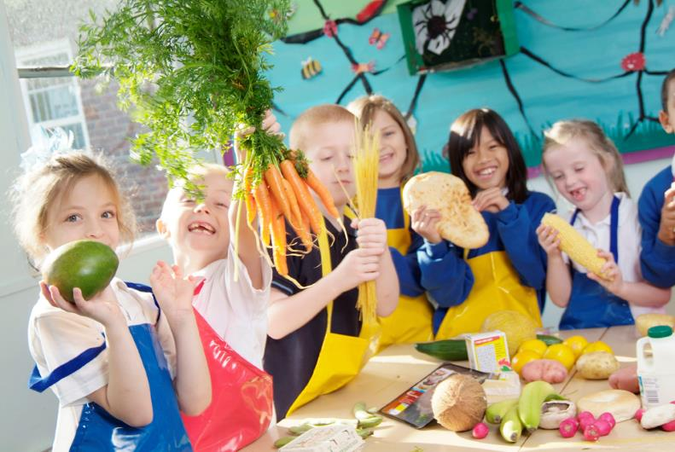
Resources for a whole school approach
A whole school food policy – what is it?
A whole school food policy is a shared, evolving document for all stakeholders that interact with your school.
It expresses a common vision of the ethos, status and role of all aspects of food within your school.
In particular, it aims to develop a coherent approach to healthy eating activities in your school.

Slide 10
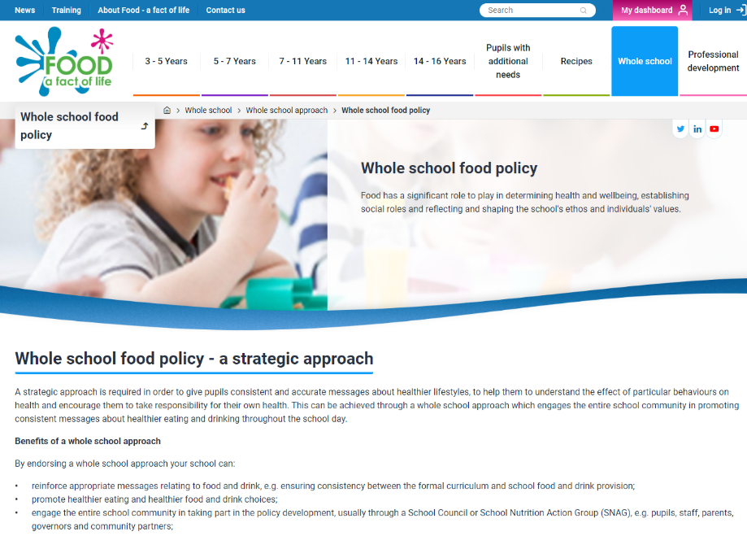
Resources for a whole school approach
Writing a whole school food policy
Information on Food – a fact of life, includes:
What it is
Benefits
Step-by-step guide to writing

Slide 11
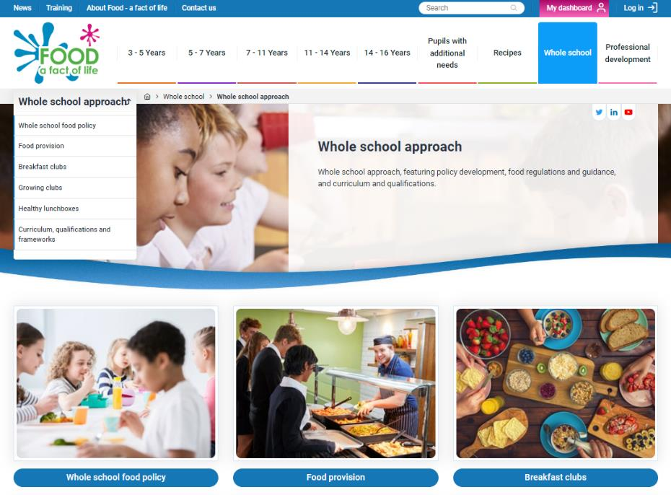
Resources for a whole school approach
Guidance for aspects of food across the school day
Information on Food – a fact of life, includes:
Food provision (e.g. national guidance around school food standards)
Breakfast clubs
Growing clubs
Healthy lunchboxes

Slide 12



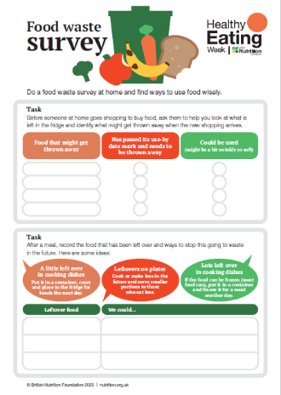
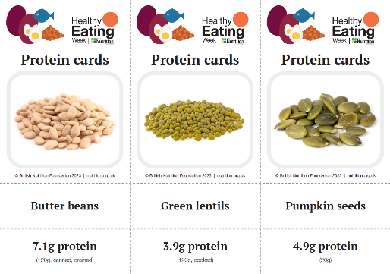
Resources for a whole school approach
Healthy Eating Week
Run the British Nutrition Foundation’s annual Healthy Eating Week in your school!
Register for free resources and updates
Plan your health promoting week
Chance to get the whole school involved
Spotlight important health messages
Raise awareness of healthier lifestyles in the wider school community
You can still register for this year’s Healthy Eating Week which is taking place from 12-16 June 2023.
Five key Healthy Eating Week resources Easy to use and organise – ideal if you’re short on time!

Slide 13
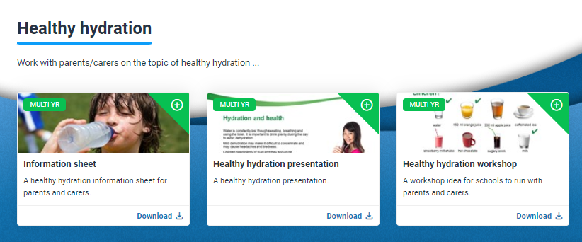
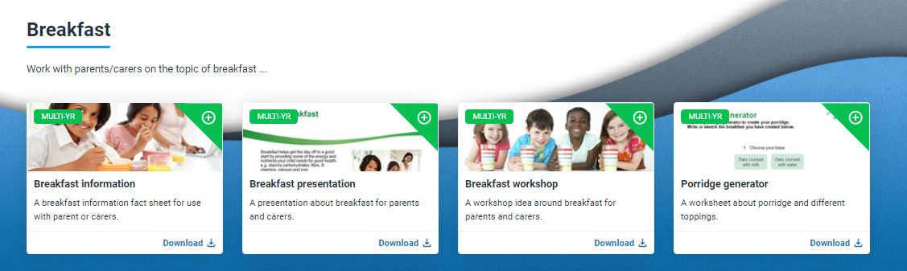
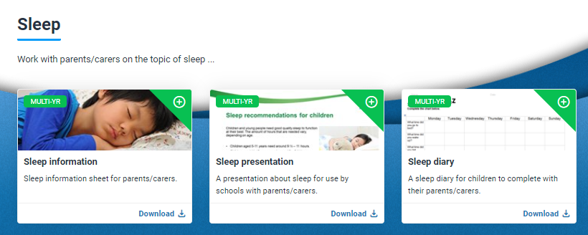
Resources for a whole school approach
Parental engagement area on Food – a fact of life
Eat more vegetables
Breakfast
Eat well
Healthy lunchboxes
Healthy hydration

Slide 14
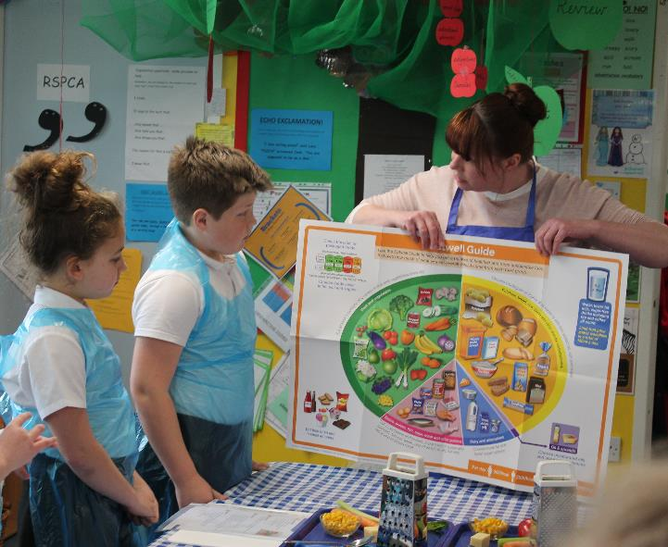
What’s your role?
Finding out
Do you know what your whole school food policy says? Does it need reviewing? Could you lead with this?
Do you know what your colleagues are teaching about food in your school? (Different year groups/lessons.)
What food and drinks are provided in your school? Are there guidelines for these?
What does ‘good’ look like? Can you find out about, or visit, other schools?
What support is available locally? E.g. Healthy Schools

Slide 15
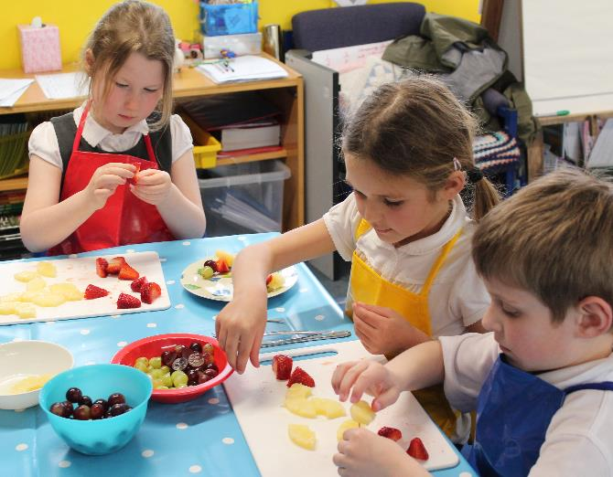
What’s your role?
Facilitating
Champion good practice in your classroom and around school, e.g. lessons, displays, assemblies
Share up-to-date, accurate information with colleagues, e.g. Eatwell Guide
Run health promoting initiatives in your school, e.g. Healthy Eating Week, Grow Your Own Potatoes

Slide 16

Keep up to date - free resources and training
Education News (monthly email update)
Sign up on the homepage: www.foodafactoflife.org.uk
Follow us on Twitter @Foodafactoflife
https://twitter.com/foodafactoflife
Keep in touch: education@nutrition.org.uk
Do you know anyone who would find the TPFN programme useful?
They can visit Food – a fact of life, search ‘TPFN’ and register for free!

Slide 17

Thank you
Please complete the webinar evaluation. If you are watching a recording of this webinar, you will find a link to the evaluation at the end of the PPT presentation here.
Taking a whole school approach
You will receive a link to the certificate once you have completed the evaluation. Please download the certificate, add your name and print it out for your records.

