Slide 1
Party pizza
A Where food comes from Challenge for pupils aged 3-5 years

Slide 2
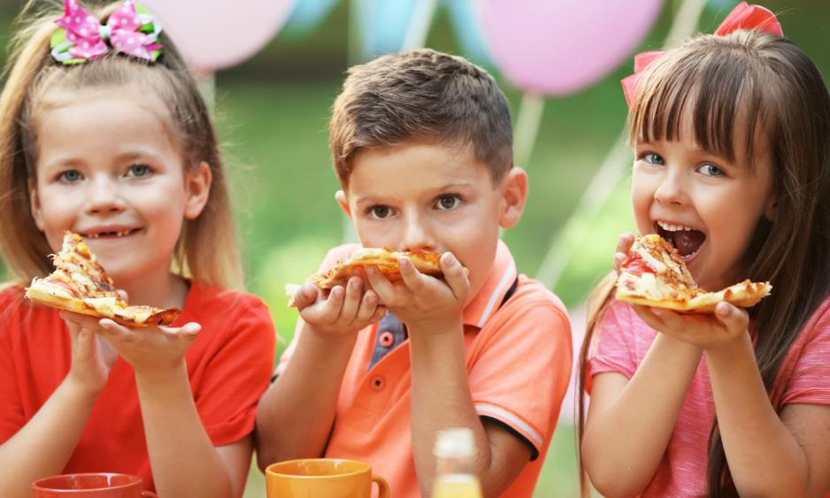
The challenge
Make a pizza for a party that uses lots of different ingredients.
Share your pizza with friends.

Slide 3
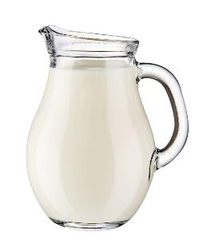
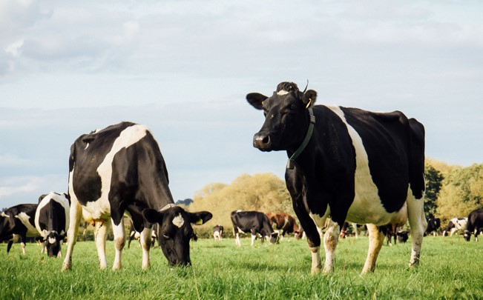
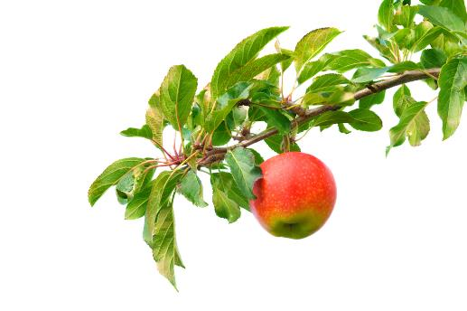
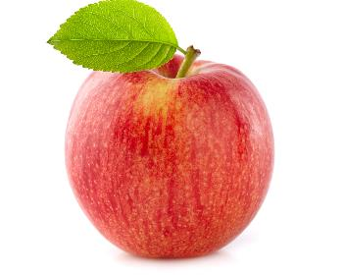
Let’s get started – the Challenge is on!
Our food comes from plants and animals.
What can you see here?
Where does it come from?

Slide 4
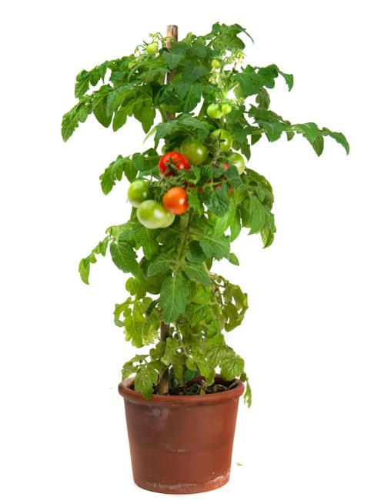
Growing food from plants
Some plants grow food that we can eat.
What food can you see growing on this plant?
Remember, not all plants can be eaten.

Slide 5
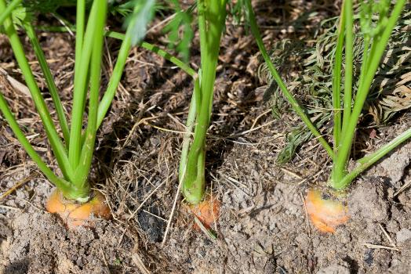
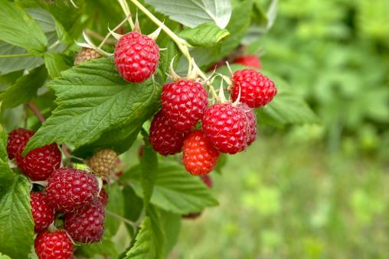
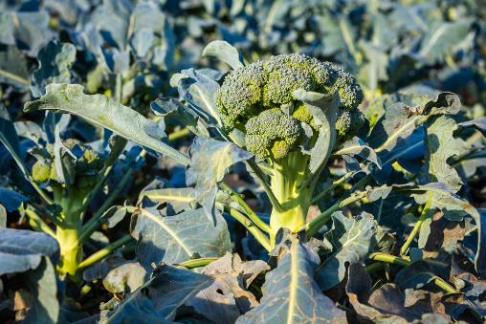
What food can you see growing here?
Carrots
Raspberries
Broccoli
Which food is growing under the ground?
Notes:
https://thumbs.dreamstime.com/b/growing-corn-29167273.jpg
https://thumbs.dreamstime.com/z/hand-picking-apple-apple-tree-lots-apples-close-up-caucasian-middle-aged-womans-hand-reaching-out-to-pick-97320422.jpg
https://thumbs.dreamstime.com/b/ripe-broccoli-cabbage-growing-garden-ripe-broccoli-cabbage-growing-garden-ready-to-harvest-135558835.jpg
https://thumbs.dreamstime.com/b/close-up-isolated-lit-summer-sun-growing-branch-beautiful-ripe-red-juicy-raspberries-fresh-green-leaves-bright-light-138535529.jpg
https://thumbs.dreamstime.com/b/close-up-carrots-growing-soil-218843856.jpg

Slide 6
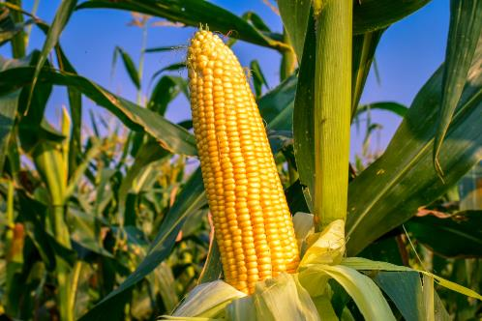
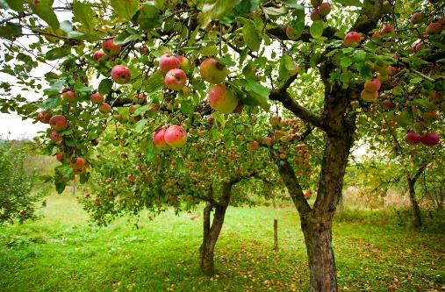
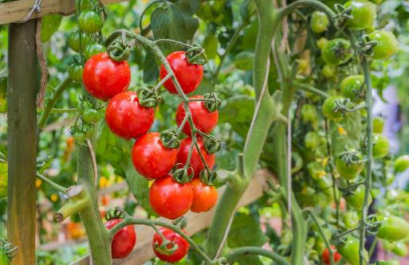
What food can you see growing here?
Sweetcorn
Apples
Tomatoes
Which food is growing on a vine?
Notes:
https://thumbs.dreamstime.com/b/growing-corn-29167273.jpg
https://thumbs.dreamstime.com/z/hand-picking-apple-apple-tree-lots-apples-close-up-caucasian-middle-aged-womans-hand-reaching-out-to-pick-97320422.jpg
https://thumbs.dreamstime.com/b/ripe-broccoli-cabbage-growing-garden-ripe-broccoli-cabbage-growing-garden-ready-to-harvest-135558835.jpg
https://thumbs.dreamstime.com/b/close-up-isolated-lit-summer-sun-growing-branch-beautiful-ripe-red-juicy-raspberries-fresh-green-leaves-bright-light-138535529.jpg
https://thumbs.dreamstime.com/b/close-up-carrots-growing-soil-218843856.jpg

Slide 7
Food from animals
Some of our food comes from animals.
What food comes from this animal?

Slide 8
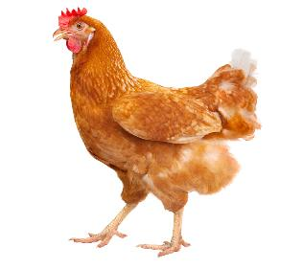
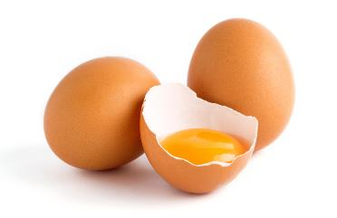
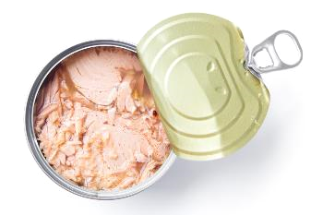
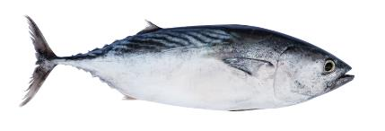
What can you see here?
Eggs come from hens.
Eggs
Canned tuna comes from a tuna fish.
Tuna
Notes:
https://thumbs.dreamstime.com/b/chicken-eggs-white-isolated-background-free-range-egg-yolk-color-95721167.jpg
https://thumbs.dreamstime.com/b/fresh-tuna-fish-isolated-white-background-92909920.jpg
https://thumbs.dreamstime.com/b/tuna-fish-isolated-white-canned-canned-soy-free-albacore-meat-packed-water-open-tin-background-81516445.jpg

Slide 9
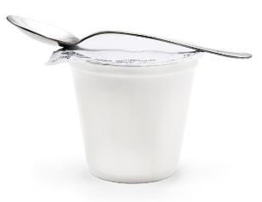
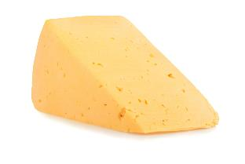
What can you see here?
Yogurt is made with milk from a dairy cow.
Yogurt
Cheese is made with milk from a dairy cow.
Cheese
Notes:
https://thumbs.dreamstime.com/b/chicken-eggs-white-isolated-background-free-range-egg-yolk-color-95721167.jpg
https://thumbs.dreamstime.com/b/fresh-tuna-fish-isolated-white-background-92909920.jpg
https://thumbs.dreamstime.com/b/tuna-fish-isolated-white-canned-canned-soy-free-albacore-meat-packed-water-open-tin-background-81516445.jpg

Slide 10
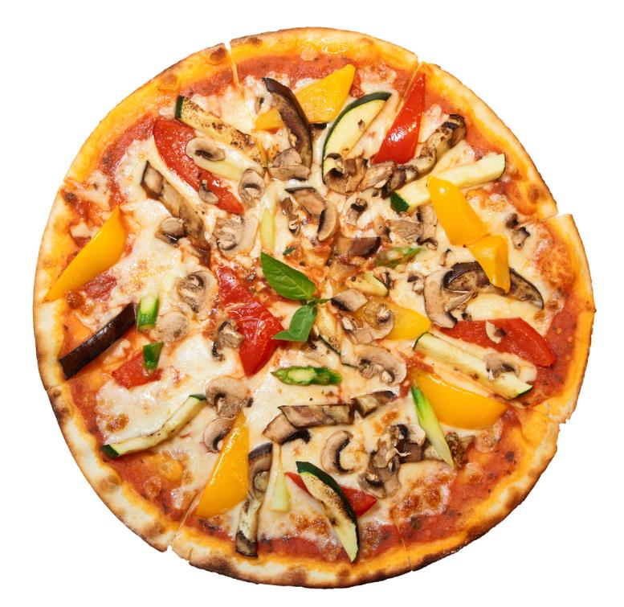
Pizza perfect
Base
What country does pizza come from?
There are three main parts to a pizza.
Tomato Sauce
Topping

Slide 11
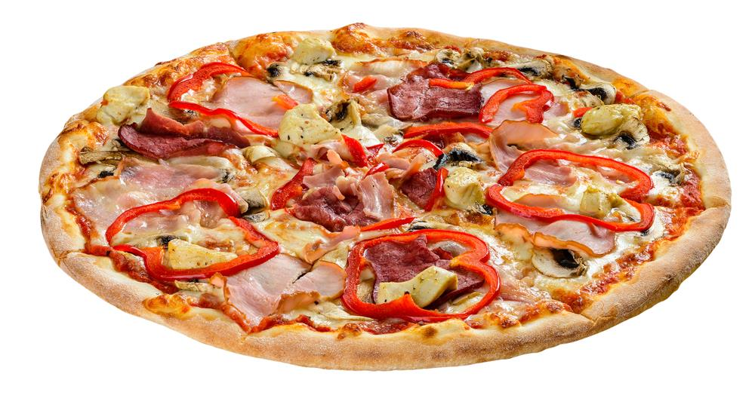
Spot these ingredients on the pizza
Bread
Tomato sauce
Ham
Red pepper
Cheese

Slide 12
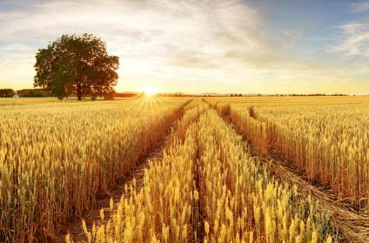
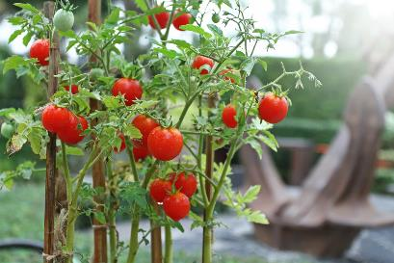
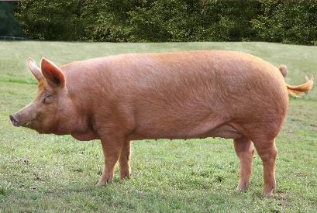
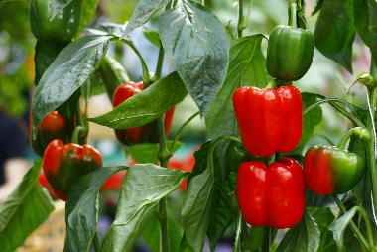
Are these ingredients from a plant or animal?
Bread
Tomato sauce
Ham
Red pepper
Cheese

Slide 13
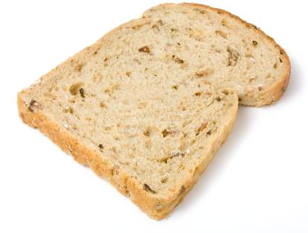
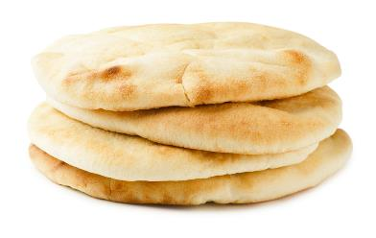
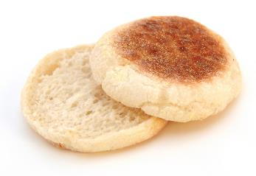
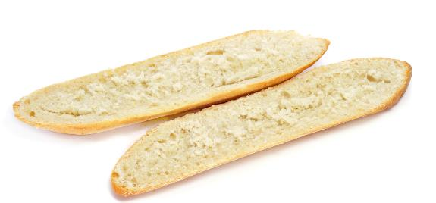
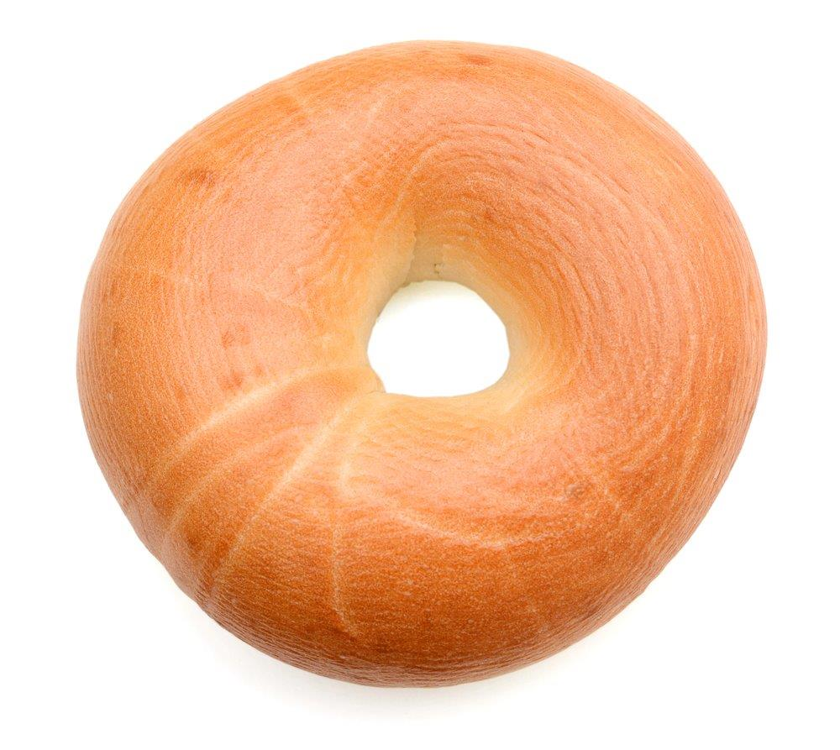
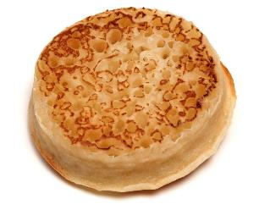
Pizza base
What food do we need for the base of a pizza?
Name each type of bread you can see here.

Slide 14
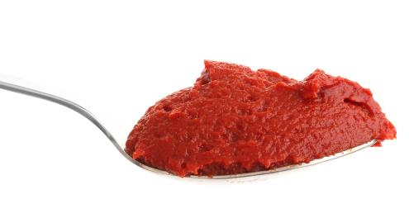
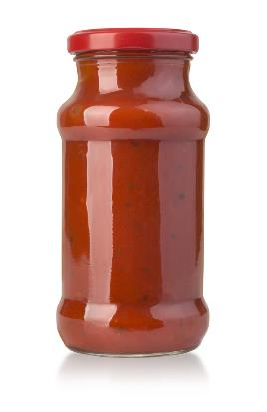
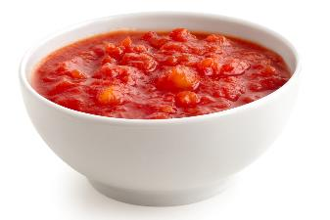
Pizza sauce
What could we use for the tomato sauce?
We could use…
Tomato puree
Canned tomatoes
A jar of tomato sauce

Slide 15
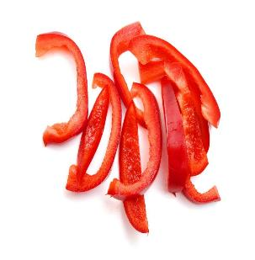
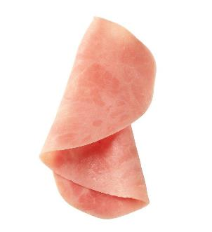
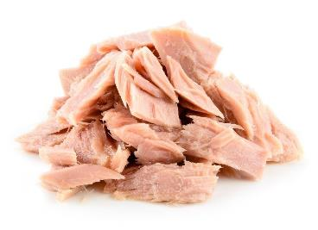
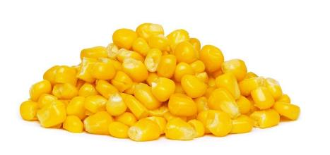
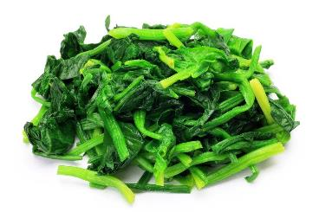
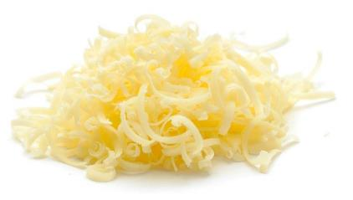
Pizza topping
Name these foods.
Which of these foods would you use for a pizza topping?
What other toppings could you use?

Slide 16
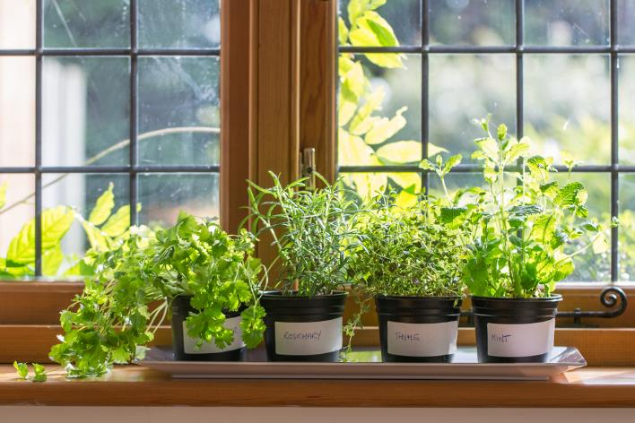
Herbs
Herbs are often used when making pizza.
Herbs can be grown in pots and in the garden or allotment.
You could grow some herbs in your classroom!

Slide 17
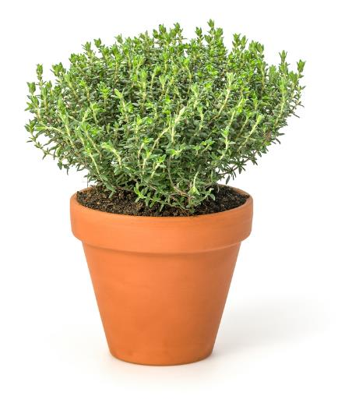
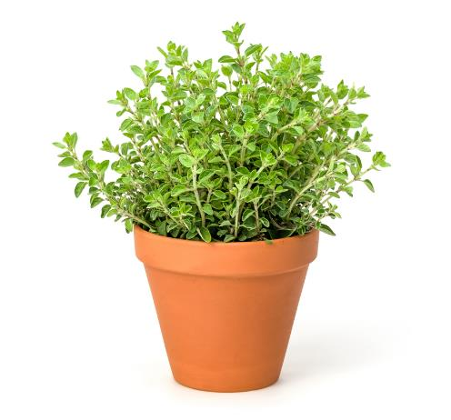
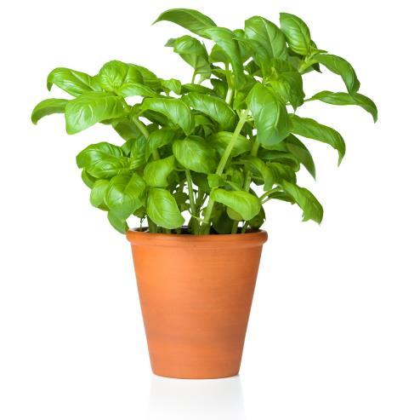
Tasty herbs
Have you tried these herbs?
Oregano
Basil
Thyme

Slide 18
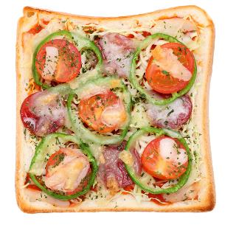
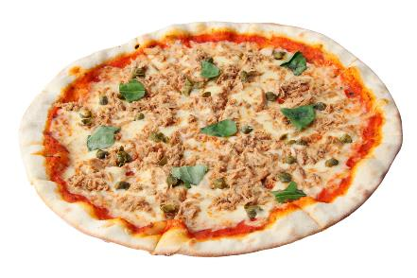
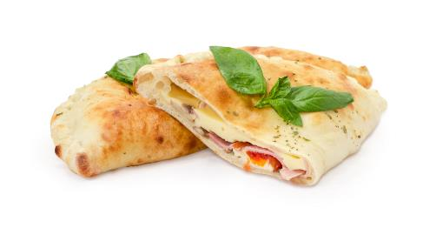
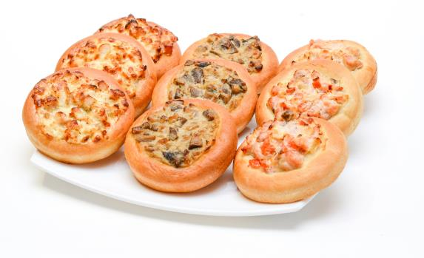
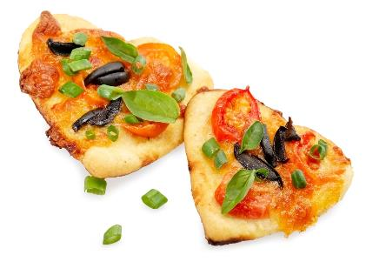
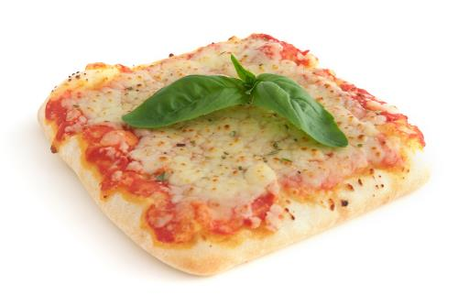
What sort of pizza could you make?

Slide 19
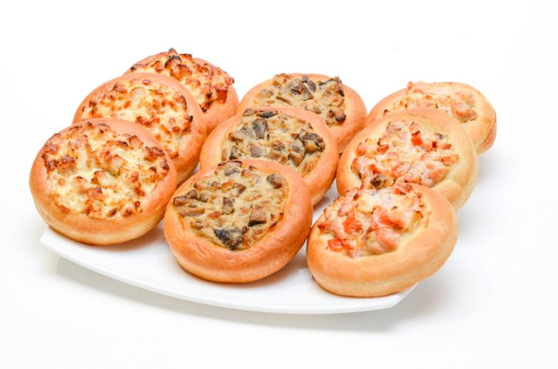
Make a plan
Plan a tasty pizza for a party that uses different ingredients.
What ingredients will you need to make the pizza?
How will you make the pizza?

Slide 20

We need to get ready to cook so the food we make is safe to eat.
Tie back long hair
Roll up long sleeves
Remove jewellery
Put on an apron
Wash and dry hands

Slide 21
The challenge
Make a pizza for a party that uses lots of different ingredients.
Share your pizza with friends.
Good luck!

Slide 22
Teachers’ guide

Slide 23
The Food – a fact of life Challenges
The Food – a fact of life Challenge activities have been written to support teachers not following the national curriculum for their specific country or those following a challenge or theme-based approach. However, they could be used in any school across the UK.
The Challenges cover Healthy eating, Cooking and Where food comes from and provide a wide range of activities that teachers can select depending on their pupils’ needs, age and abilities, and the time available.
There are 12 Challenges developed to be used with nursery, primary or secondary pupils.
Each Challenge comprises the Challenge, opportunities for learning and a variety of pupil activities that can be completed individually or in groups. Each Challenge culminates in a final outcome, which could be paper based, such as a report, poster, newspaper article or presentation, a video or interactive activity, or a recipe, menu or dish/range of dishes, depending on the theme of the Challenge.
Optional pupil certificates are available to download and personalise once the Challenge has been achieved.

Slide 24
The challenge
Make a pizza for a party that uses lots of different ingredients.
Share your pizza with friends.

Slide 25
Opportunities for learning
By undertaking this challenge, the opportunities for learning include:
recalling where food comes from;
identifying foods from plants and animals;
growing and/or tasting a variety of herbs;
naming ingredients that are used to make a simple pizza;
preparing a simple pizza, safely and hygienically.

Slide 26
How can pupils complete the Challenge?
A range of activity suggestions have been provided – you can choose the ones that are most suitable for your pupils and the time that you have available to complete the challenge.
Activities include:
Finding out – investigating food, recognising and sorting foods by plant or animal origin, exploring how plants are grown, learning about how to prepare and cook safely and hygienically.
Making and evaluating – identifying suitable ingredients and making a simple plan for the pizza, tasting/sensory activity using herbs, practical food hygiene and safety.
Bringing it all together – with guidance, planning and safely preparing a pizza using different foods.

Slide 27
Finding out - activities
Pupils, individually or in groups, could:
Sorting:
review where food comes from and sort a selection of foods according to their plant or animal origin using the Where food comes from cards – the children name each food and say where it comes from.
Growing:
describe what is needed to grow a plant such as a herb, and how it should be cared for. Follow the instructions on the How to grow chives sheet which could be adapted for different plants. There is also a Plant watering sheet. The herbs can be used when making the pizza.

Slide 28
Finding out - activities
Seasonality:
investigate the food that is available at different times of the year using the Season cards and talk about why food is in season at different times of the year.
Activity packs:
Amazing allotments can be used to support learning about where food comes from, naming different vegetables and talking about how different vegetables grow.
Food based sessions:
use the Picturesque pizza session to help children understand what pizza is made from, plan and make pizza developing spreading, grating and assembling food skills. Resources include: Picturesque pizza session plan, Build a pizza game, and a take home activity sheet to explore dishes around the world.

Slide 29
Making and evaluating - activities
Pupils, individually or in groups, could:
Tasting:
carry out a tasting activity with a variety of vegetables or herbs, and learn how to experience the samples using their senses. Use the Tasting guide and Ingredient check letter when planning.
use the My food book presentation to record their tasting session experience.
be presented with the Super taster certificate (Alisha) or Super taster certificate (Ronnie) to reward their willingness to taste new foods.
taste the pizza they have prepared/cooked. Discuss how it looks, smells and tastes. Fill in the ‘I have tried these foods’ sheet from the My food book.

Slide 30
Making and evaluating - activities
Cooking:
use the Get ready to cook presentation to help children name and describe the steps required before cooking.
play the Get ready to cook game with the Get ready to cook tick list to embed the getting ready to cook steps.
use the Get ready to cook cards to help remember what they need to do before they cook.

Slide 31
Teacher resources
Setting up a cooking session - a guide to support setting up a cooking session.
Getting ready to cook cards - five cards each illustrating a get ready to cook step.
Use the Tasting guide and Ingredient check letter when planning tasting and practical activities.
Certificate - Super taster certificate (Alisha) or Super taster certificate (Ronnie)
Cooking - a guide about cooking in the primary school classroom.
Demonstration guide - a guide about cooking demonstrations in the primary classroom.
Recipes - a range of recipes that can be sorted by age range, commodity, complexity, food skills and cooking methods.

Slide 32
Bringing it all together
Pupils should:
Make a pizza for a party that uses lots of different ingredients. Share their pizza with friends.
Through making their pizzas, children should demonstrate the following knowledge and skills:
understanding (at a basic level) of where food comes from;
naming foods from plants and foods from animals;
demonstrate safely and hygienically tasting and preparing food;
use and develop appropriate food skills to make a pizza.

Slide 33

Celebrate!
An optional pupil certificate is available to download and personalise once the Challenge has been achieved.
Why not present the certificate at a celebration assembly?

Slide 34
Party pizza
For further information, go to:
www.foodafactoflife.org.uk
This resource meets the Guidelines for producers and users of school education resources about food.

