Slide 1
Nutrients

Slide 2
Nutrients
Food is eaten and digested in the body to allow the absorption of energy and nutrients.
There are two different types of nutrients:
macronutrients;
micronutrients.
There are three macronutrients that are essential for health.
These are:
carbohydrate;
protein;
fat.
Macronutrients are measured in grams (g).

Slide 3
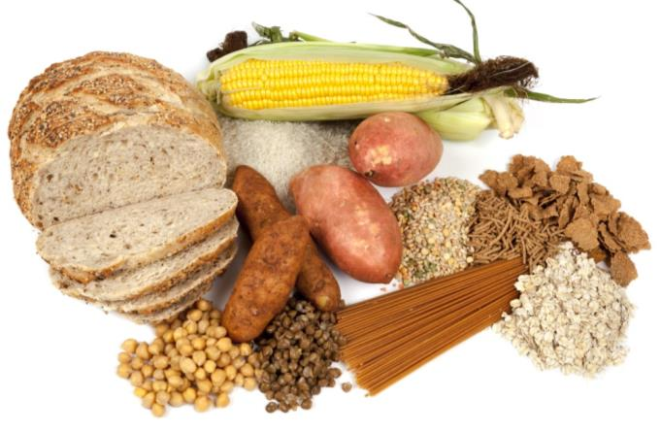
Carbohydrate
The two main types of carbohydrate that provide dietary energy are starch and sugars. Dietary fibre is also a type of carbohydrate.
Starchy carbohydrate is an important source of energy.
One gram of carbohydrate provides 3.75kcal/16kJ energy.
One gram of fibre provides 2kcal/8kJ energy.

Slide 4
Structure of carbohydrate
All types of carbohydrate are compounds of carbon, hydrogen and oxygen.
They can be classified in many different ways. One common way is according to their structure.
Sugars
Sugars come from a variety of foods. Some are within the cellular structure of the food, e.g. in fruit or vegetables. These are called intrinsic sugars.
Other sugars are not bound into the cellular structure of the food, e.g. in milk or honey. These are called extrinsic sugars.

Slide 5
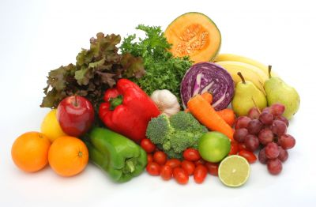
Sources of sugar
Can you give some examples of sources of sugar in the diet?
fruit and vegetables (fructose);
milk and dairy products (lactose);
honey;
fruit juice;
table sugar (sucrose);
sweets and chocolate.

Slide 6

Starchy carbohydrate
Starch is found in a variety of foods. It is made up of many sugar molecules.
Can you give some examples of sources of starch in the diet?
Potatoes
Bread
Rice
Pasta
Cereal and cereal products are the main source of carbohydrate for adults in the UK.

Slide 7

Protein
Protein is essential for growth and repair and keeping cells healthy.
Protein also provides energy:
1 gram of protein provides 4 kcal (17 kJ).

Slide 8
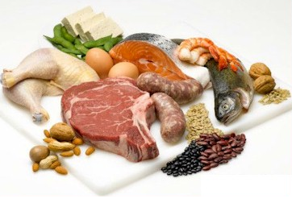
Structure of protein
Protein is made up of building blocks called amino acids. Different foods contain different amounts and different combinations of amino acids.
Protein from animal sources (e.g. meat, fish, eggs and dairy products) contains the full range of essential amino acids needed by the body.
Protein from plant sources (e.g. pulses and cereals) typically contain fewer essential amino acids.

Slide 9
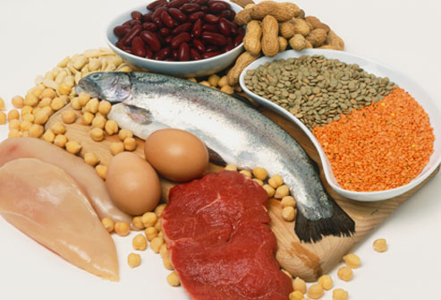
Sources of protein
Animal:
meat;
fish;
eggs;
milk;
cheese.
Plant:
nuts;
seeds;
pulses, e.g. beans, lentils;
mycoprotein;
soya products.

Slide 10
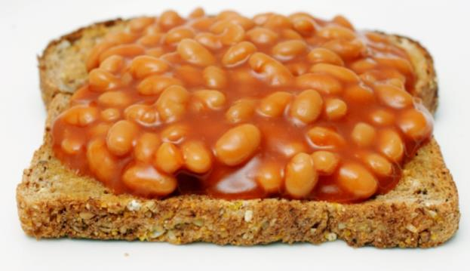

Protein sources
Eating different types of protein can ensure sufficient intake of essential amino acids which are needed by the body.
Name some examples of dishes which combine protein from different sources.
For example:
Baked beans on wholegrain toast.
Breakfast cereal with milk.
Cottage pie with vegetables.
Hummus and salad wrap.
Fish pie and peas.
Spinach and chickpea curry with rice.

Slide 11
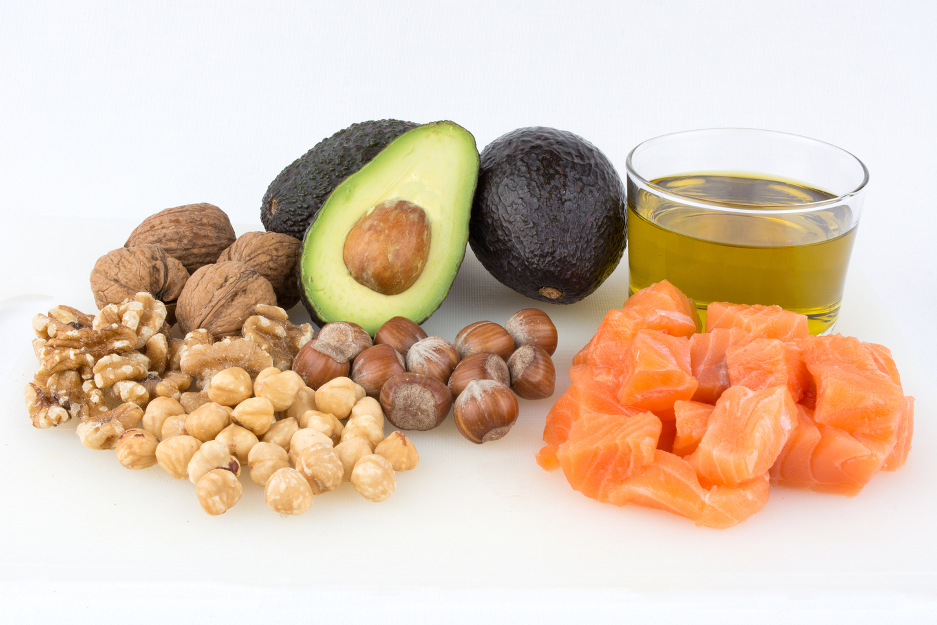
Fat
Fat provides fat-soluble vitamins A, D, E and K, and is necessary for their absorption. It is also important for essential fatty acids the body cannot make.
Fat provides a concentrated source of energy:
1 gram of fat provides 9 kcal (37 kJ) of energy.
Foods that contain a lot of fat provide a lot of energy.

Slide 12
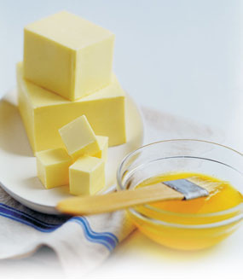
Structure of fat
Fat is made up of different types of fatty acids and glycerol.
The structure of the fatty acids determines:
their effect on our health;
their characteristics, e.g. melting point.

Slide 13
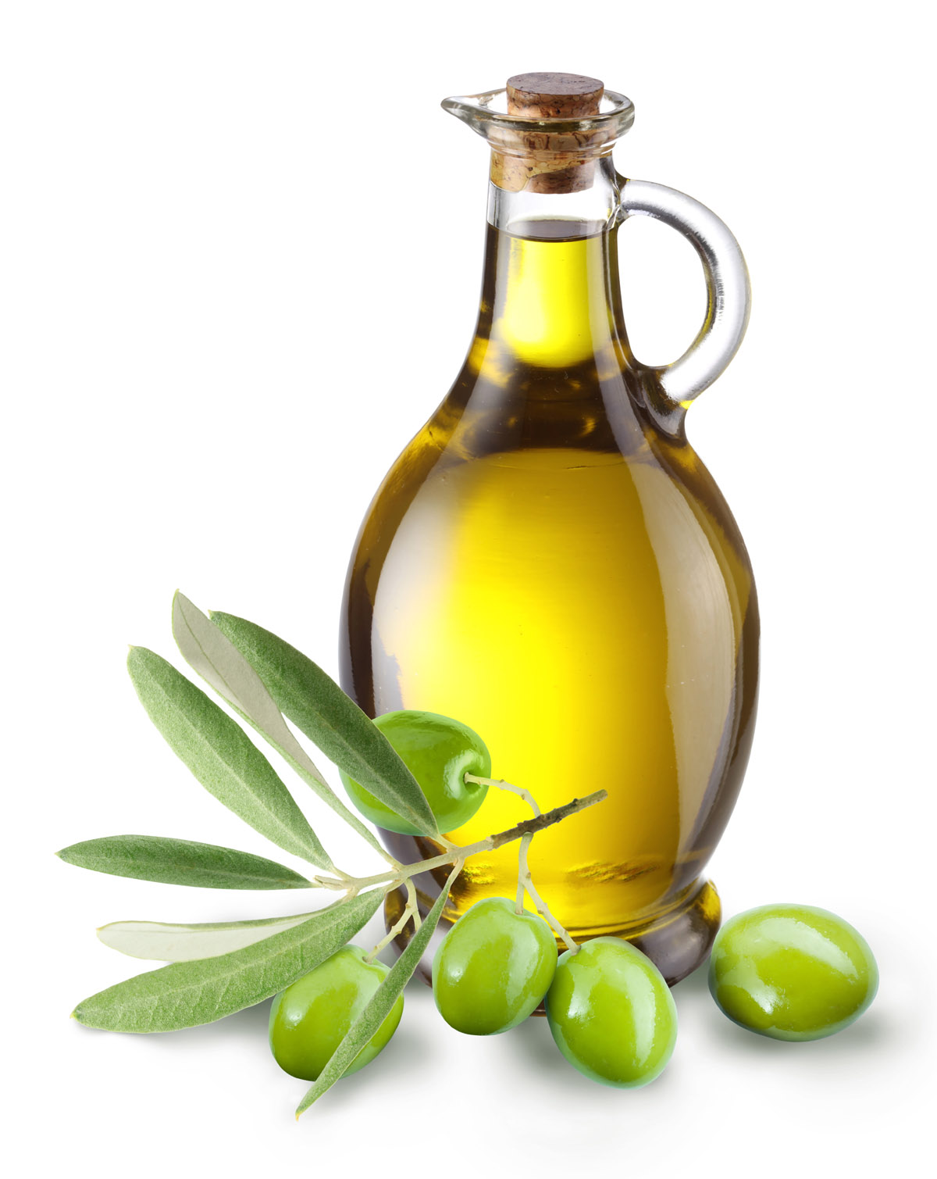
Structure of fat
Depending on their chemical structure, fatty acids are usually classified as:
saturated;
monounsaturated;
polyunsaturated.
There is strong and consistent evidence that replacing saturated fatty acids with unsaturated fatty acids reduces the risk of CVD events and can help lower cholesterol.

Slide 14
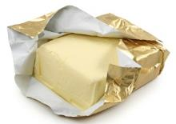
Fatty acids
All foods provide different types of fatty acids in varying proportions.
Butter is often described as a ‘saturated fat’ because it has more saturated fatty acids than unsaturated fatty acids.
Most vegetable oils are described as ‘unsaturated fats’ as they have more mono and polyunsaturated fatty acids than saturated.

Slide 15
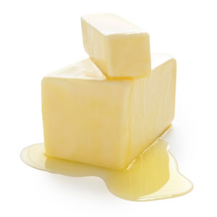
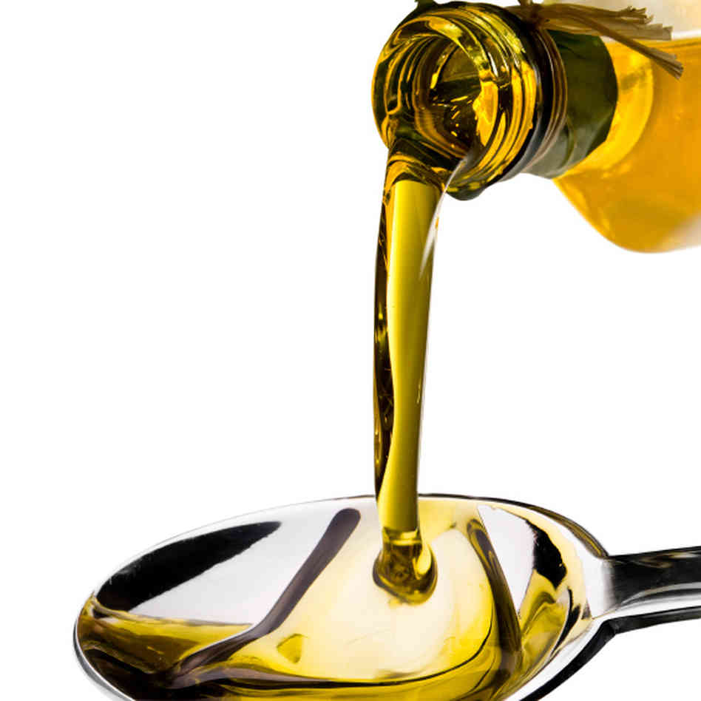
Saturated and unsaturated fatty acids
Most saturated fats are solid at room temperature and tend to come from animal sources.
Some plant sources such as palm oil and coconut oil also have high levels of saturated fat.
Most unsaturated fats are liquid at room temperature and are usually from plant sources.
Oily fish is also high in long chain omega-3 fatty acids.

Slide 16
Micronutrients
There are two types of micronutrients:
vitamins;
minerals.
Vitamins and minerals are needed in much smaller amounts than macronutrients. Their amounts are measured in milligrams (mg) and micrograms (μg).
(1mg = 0.001g)
(1μg = 0.001mg).

Slide 17
Vitamins
There are two groups of vitamins:
fat-soluble vitamins, which can be stored in the body, e.g. vitamins A and D.
water-soluble vitamins, which cannot be stored in the body and are therefore required daily, e.g. B vitamins and vitamin C.

Slide 18
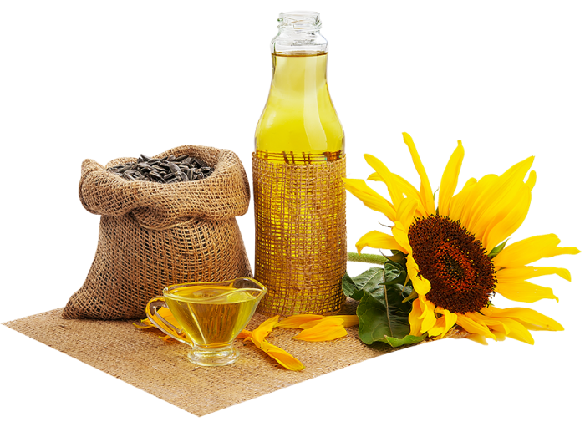
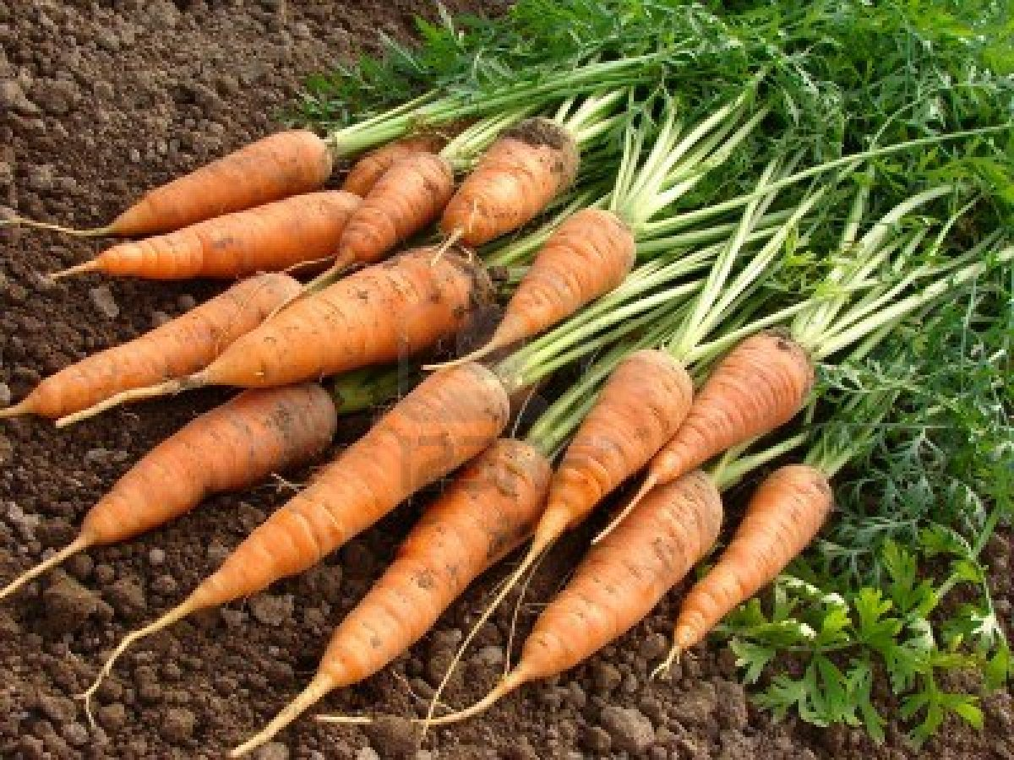
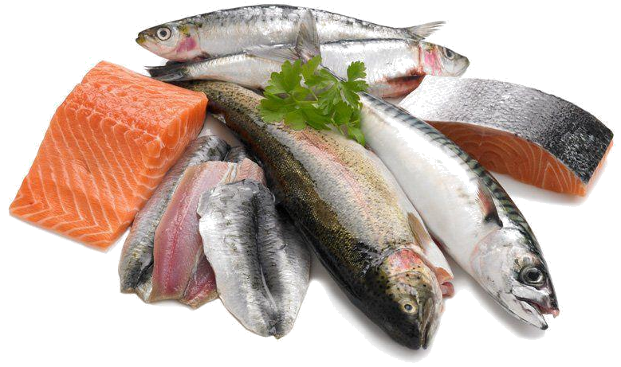
Fat-soluble vitamins
Fat-soluble vitamins can be stored in the body, i.e. vitamins A, D, E and K.

Slide 19

Vitamin A
Vitamin A helps:
the immune system to function normally, helps with vision and helps the maintenance of normal skin.

Slide 20
Vitamin A
Vitamin A (retinol) can be obtained in two forms:
ready-made, as retinol from animal sources;
carotenoids (e.g. beta carotene) from plant sources, from which retinol can be made in the body.
Vitamin A concentration is usually expressed as retinol equivalents (RE).
Some carotenoids can be converted to retinol in the body.
6µg of beta carotene is equivalent to 1µg of retinol.

Slide 21
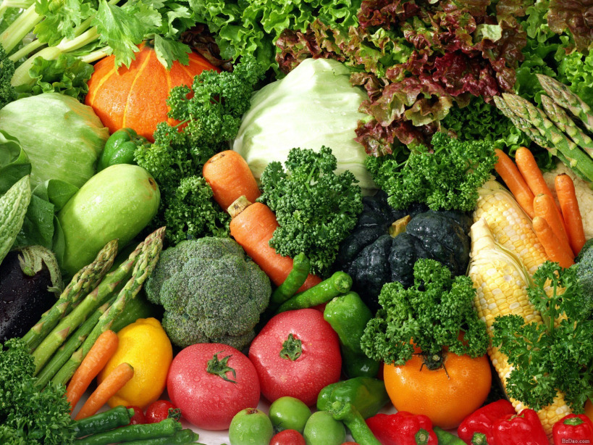
Vitamin A sources
Vitamin A is found pre-formed in liver and whole milk.
It can also be produced from beta-carotene provided by dark green leafy vegetables, carrots and orange coloured fruit.
Vitamins A and D are also often voluntarily added to reduced fat spreads.

Slide 22
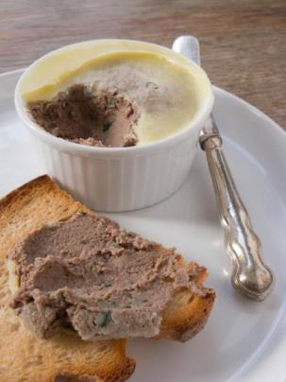
Vitamin A deficiency
Severe vitamin A deficiency in the UK is rare. It can lead to night blindness (unable to adapt to low-intensity light) and ulceration of the eye which may cause total blindness.
Large intakes of vitamin A (>1500µg of RE/day) can be toxic and may cause bone damage. The RNI for vitamin A is 600µg/d for females (11+) and 700µg/d for males (15+).
Pregnant women should not consume liver and liver pâté as high levels of retinol may be present. Excess retinol during pregnancy can lead to birth defects.

Slide 23
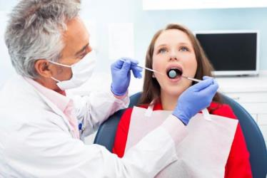
Vitamin D
Vitamin D helps:
…the body to absorb calcium and to build and maintain healthy bones and muscles. It also helps the immune system to work as it should.

Slide 24

Vitamin D
Vitamin D is a pro-hormone in the body. It can be obtained in two forms:
ergocalciferol (vitamin D₂);
cholecalciferol (vitamin D₃) formed by the action of sunlight.
Vitamin D is only required in very small amounts and is measured in micrograms.

Slide 25

Vitamin D sources
According to national surveys in the UK, across the population approximately 1 in 5 people have low vitamin D levels.
The main source of vitamin D is synthesis in the skin following exposure to sunlight however, the Recommended Nutrient Intake (RNI) for all people aged 4 and above is 10 µg/day.
Did you know?
The wavelength of UVB during the winter months in the UK does not support vitamin D synthesis.

Slide 26
Vitamin D sources
Sources of vitamin D include:
oily fish (such as salmon, trout, mackerel, sardines, pilchards, herring, kipper);
meat;
eggs;
fortified breakfast cereals and margarine/spreads;
supplements.
Dietary sources are relatively insignificant for most people because the main source is synthesis in the skin following exposure to sunlight during the summer months in the UK (April – October).

Slide 27

Vitamin D
People who have darker skin, wear concealing clothing or are housebound make much less vitamin D and are at greater risk of vitamin D deficiency.
There is evidence of poor vitamin D status across the UK population, especially during the winter months.
A lack of vitamin D in the body causes rickets in children, where leg bones become weakened and bent, and a related condition called osteomalacia in adults.
Poor vitamin D status has also been linked to increased falls in elderly people, thought to be linked to an adverse effect on muscle.

Slide 28
Vitamin D supplementation
The Recommended Nutrient Intake (RNI) proposed by SACN for all people aged 4 and above is 10 µg/day. SACN have also produces supplementation advice.
Between late March/early April and September, the majority of people aged 5 years and above will probably obtain sufficient vitamin D from sunlight when they are outdoors, alongside foods that naturally contain or are fortified with vitamin D. As such, they might choose not to take a vitamin D supplement during these months.
From October to March everyone over the age of five will need to rely on dietary sources of vitamin D. Since vitamin D is found only in a small number of foods, it might be difficult to get enough from foods that naturally contain vitamin D and/or fortified foods alone. So everyone, should consider taking a daily supplement containing 10 micrograms of vitamin D.
https://www.nutrition.org.uk/nutritioninthenews/new-reports/983-newvitamind.html

Slide 29
Vitamin D supplementation
There are further recommendations that:
People with very little or no sunshine exposure and p eople from minority ethnic groups with dark skin should take a daily supplement containing 10 micrograms vitamin D throughout the year.
All breastfed infants 0 – 1 years - as a precaution, it is recommended that infants from birth to one year of age, whether exclusively or partially breastfed, should be given a daily supplement containing 8.5 to10 micrograms of vitamin D.
Infants fed infant formula should not be given a vitamin D supplement unless they are receiving less than 500mls (about a pint) of formula a day.
All children aged 1 to 4 years of age should be given a daily supplement containing 10 micrograms of vitamin D.
https://www.nutrition.org.uk/nutritioninthenews/new-reports/983-newvitamind.html

Slide 30
Vitamin E
Vitamin E is an antioxidant and is required to protect the cells in our bodies against damage. Generally, good sources of vitamin E are those that also provide a large amount of polyunsaturated fatty acids, for example:
plant oils such as sunflower, soya, corn and olive oils and their spreads;
nuts;
seeds.
This is because vitamin E is present naturally in these foods to prevent oxidation.
Vitamin E helps maintain healthy skin and eyes and strengthen the immune system.

Slide 31
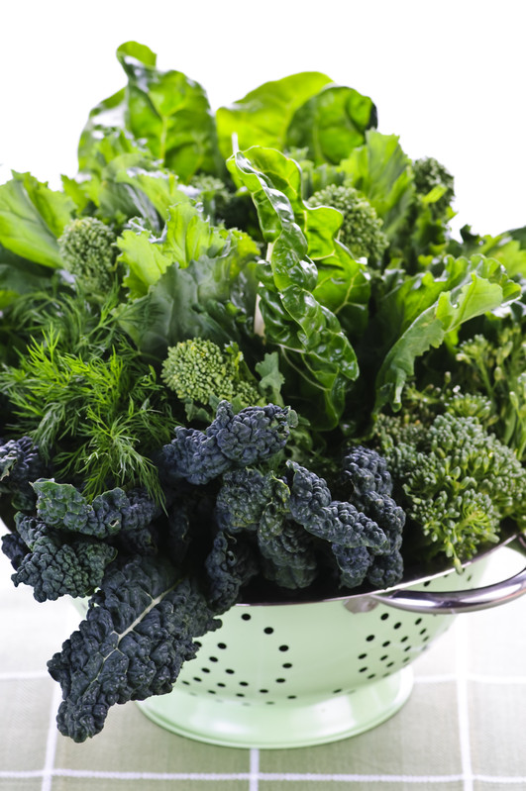
Vitamin K
Vitamin K helps with normal clotting of blood and is required for normal bone structure.
Sources of vitamin K include green leafy vegetables, meat, dairy products and eggs.
Deficiency of vitamin K is considered to be very rare as it is widely available in the diet and produced to some extent in the gut by bacteria.
Babies up to 6 weeks may have very low vitamin K levels and so it is usual to give a vitamin K injection to all newborn infants.

Slide 32
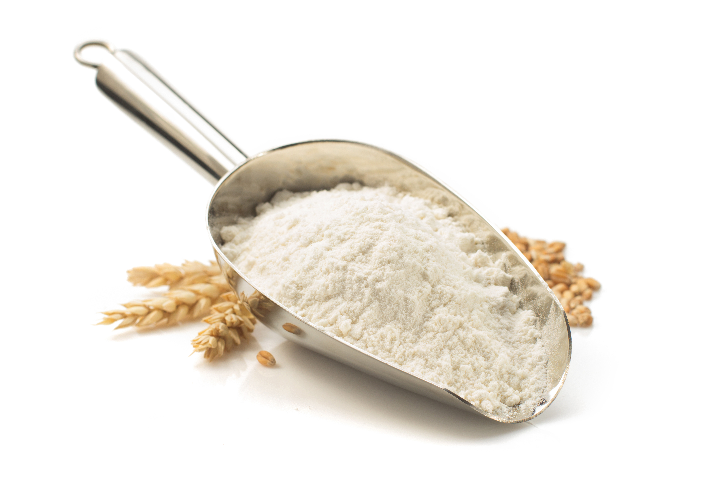
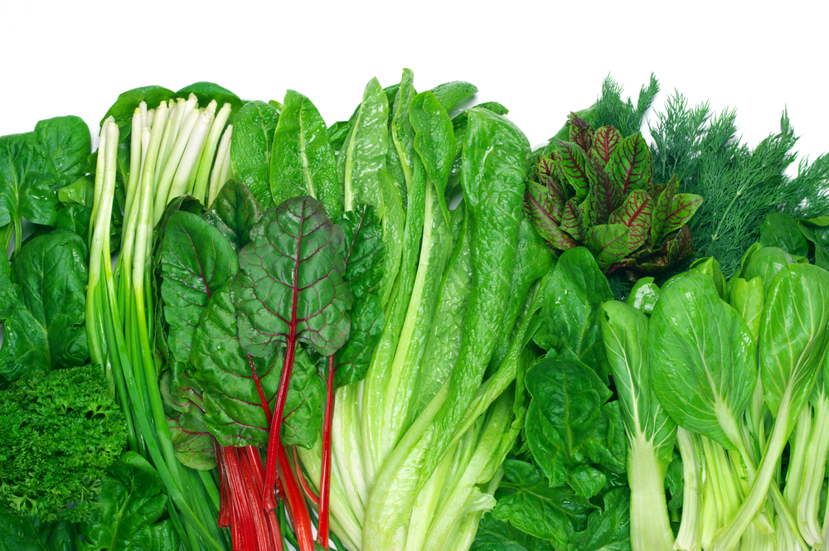
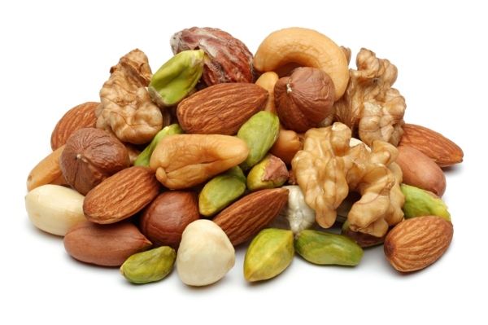
Water soluble vitamins
Water-soluble vitamins cannot be stored in the body and are therefore required daily, i.e. B vitamins and vitamin C.

Slide 33
B vitamins
There are a number of B vitamins. Regular intake of each is essential as each has specific functions in the body. These are:
Thiamin (vitamin B₁);
Riboflavin (vitamin B₂);
Niacin (vitamin B₃);
vitamin B₆;
vitamin B₁₂;
folate/folic acid (vitamin B₉);
pantothenic acid (vitamin B₅);
biotin (vitamin B₇).

Slide 34

Thiamin (vitamin B₁)
Thiamin helps to release energy from food. It also helps our nervous system and heart function normally.
Deficiency of thiamin causes the nervous system disease beri-beri, although this is rare in the UK.

Slide 35
Thiamin (vitamin B₁) sources
Sources of Thiamin (vitamin B₁):
Bread, fortified breakfast cereals, nuts and seeds, meat (especially pork), beans and peas.
Did you know?
In the UK, white and brown bread flour are fortified with thiamin by law (and also with calcium, iron and niacin).

Slide 36
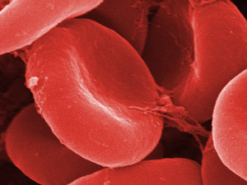
Riboflavin (vitamin B₂)
Riboflavin helps to release energy from food, reduce tiredness, and helps to maintain normal skin and a normal nervous system.

Slide 37
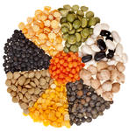
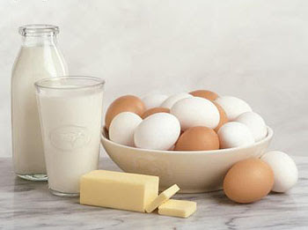
Riboflavin (vitamin B₂) sources
Sources of riboflavin include:
Milk and milk products, eggs, fortified breakfast cereals, offal, some oily fish (such as mackerel and sardines), mushrooms and almonds.
Deficiency of riboflavin is characterised by dryness and cracking of the skin around the mouth and nose, and a painful tongue that is red and dry (magenta tongue), but this is rare in the UK.
There is evidence of low intakes and poor status in teenagers and young adults, especially teenage girls.

Slide 38
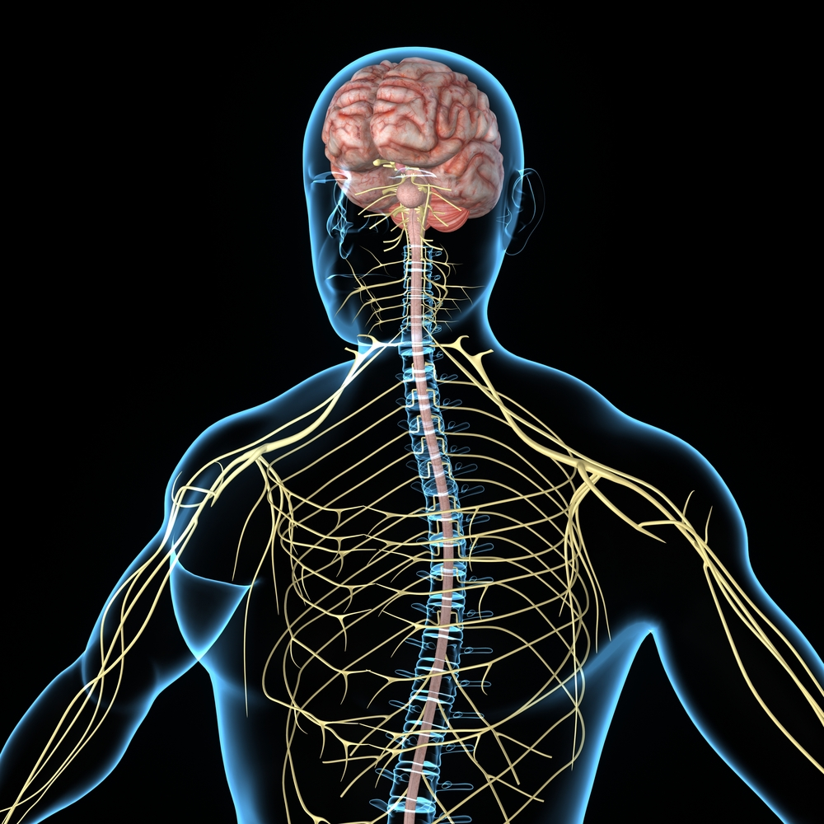
Niacin (vitamin B₃)
Niacin (vitamin B₃) helps to release energy from food, reduce tiredness, and helps to maintain normal skin and a normal nervous system.

Slide 39
Niacin (vitamin B₃) sources
Sources of niacin include:
Meat, poultry, fish and shellfish, wholegrains (such as brown rice, wholewheat pasta and quinoa), bread and some nuts and seeds (such as peanuts and sesame seeds).
White and brown flour in the UK are fortified with niacin.
Deficiency of niacin is characterised by sun-sensitive skin known as pellagra, but this is rare in the UK.

Slide 40
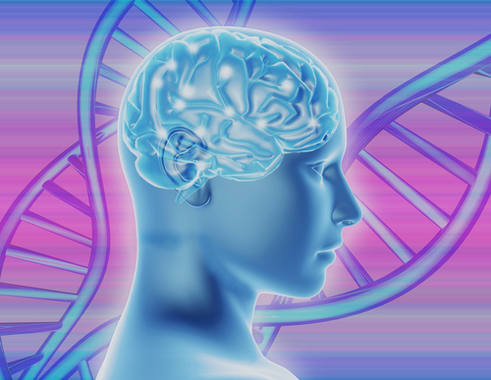
Vitamin B₆
Vitamin B₆ helps to make red blood cells, which carry oxygen around the body.
It helps our immune system work properly, regulates hormones and helps to reduce tiredness.

Slide 41
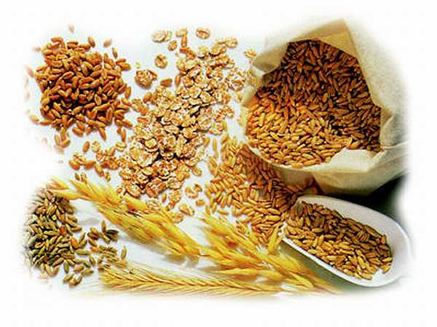
Vitamin B₆ sources
Together with folate and vitamin B₁₂, vitamin B₆ is required for the maintenance of normal blood homocysteine levels.
Sources of vitamin B₆ include meat, poultry, fish, fortified breakfast cereals, egg yolk, yeast extract, soya beans, sesame seeds, some fruit and vegetables (such as banana, avocado and green pepper).
Deficiency of vitamin B₆ is rare because it is widely distributed in foods; but it can occur as a complication of disease or prolonged administration of certain drugs.

Slide 42
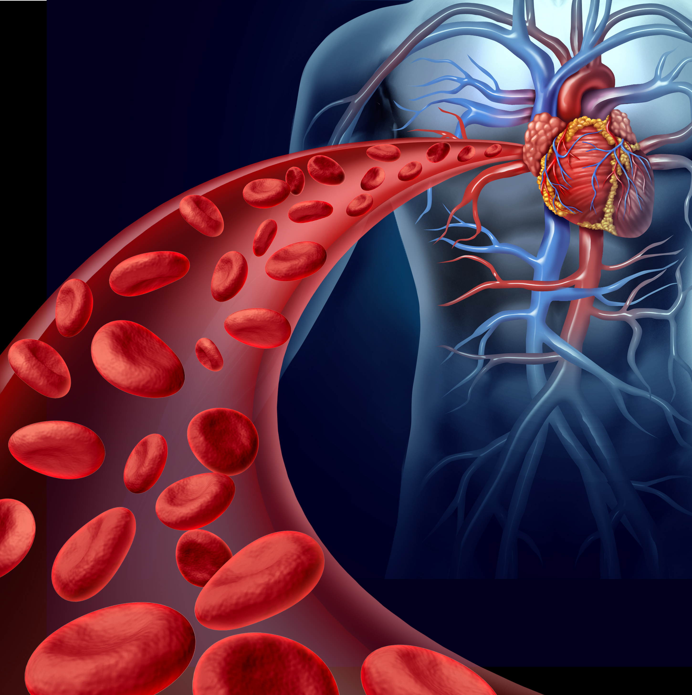
Vitamin B₁₂
Vitamin B₁₂ helps to make red blood cells, helps the nervous system function normally, and helps to reduce tiredness.
Together with folate and vitamin B₆, vitamin B₁₂ is required for the maintenance of normal blood homocysteine levels.

Slide 43
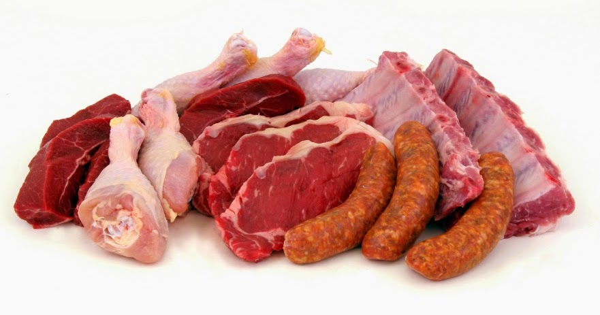
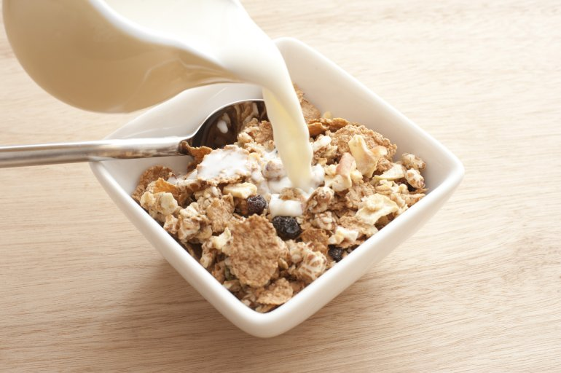
Vitamin B12 (Cyanocobalamin) sources
Sources of vitamin B₁₂ include meat, fish, shellfish, milk, cheese, fromage frais, eggs, fortified yeast extract and fortified breakfast cereals.
Dietary deficiency of vitamin B₁₂ in young people is rare and usually occurs only in strict vegans. However, blood levels of vitamin B₁₂ (vitamin B₁₂ status) can be low because of poor absorption, especially in older people.
Severe vitamin B₁₂ deficiency results in pernicious anaemia, in which red blood cells are enlarged, and peripheral nerve damage develops, e.g. in the legs.

Slide 44

Folate/Folic acid
Folate helps to make red blood cells, reduce tiredness and helps the immune system work as it should. It is also needed for the normal development of the nervous system in unborn babies.
Did you know?
Folic acid is the synthetic form of folate. It is used in supplements and for food fortification.

Slide 45
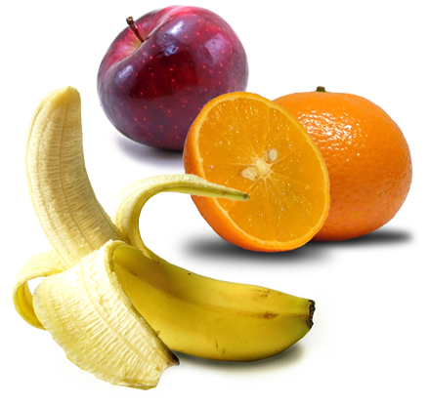
Folate/Folic acid sources
Folate is found naturally in green leafy vegetables, brown rice, peas, oranges and bananas.
There is some evidence of low intakes in teenage girls and in elderly people.
Poor folate status results in neural tube defects in newborns and megaloblastic anaemia, characterised by the release of immature red blood cells into the blood stream.
This is due to impairment in the normal process of blood cell maturation in the bone marrow.

Slide 46

Vitamin C (ascorbic acid)
Vitamin C is helps to protect cells from damage. It helps form collagen, which is important for normal bones, gums, teeth and skin. It also helps the immune system and the nervous system to function normally.
Did you know?
Vitamin C can help with the absorption of iron from plant foods when they are consumed at the same meal.

Slide 47
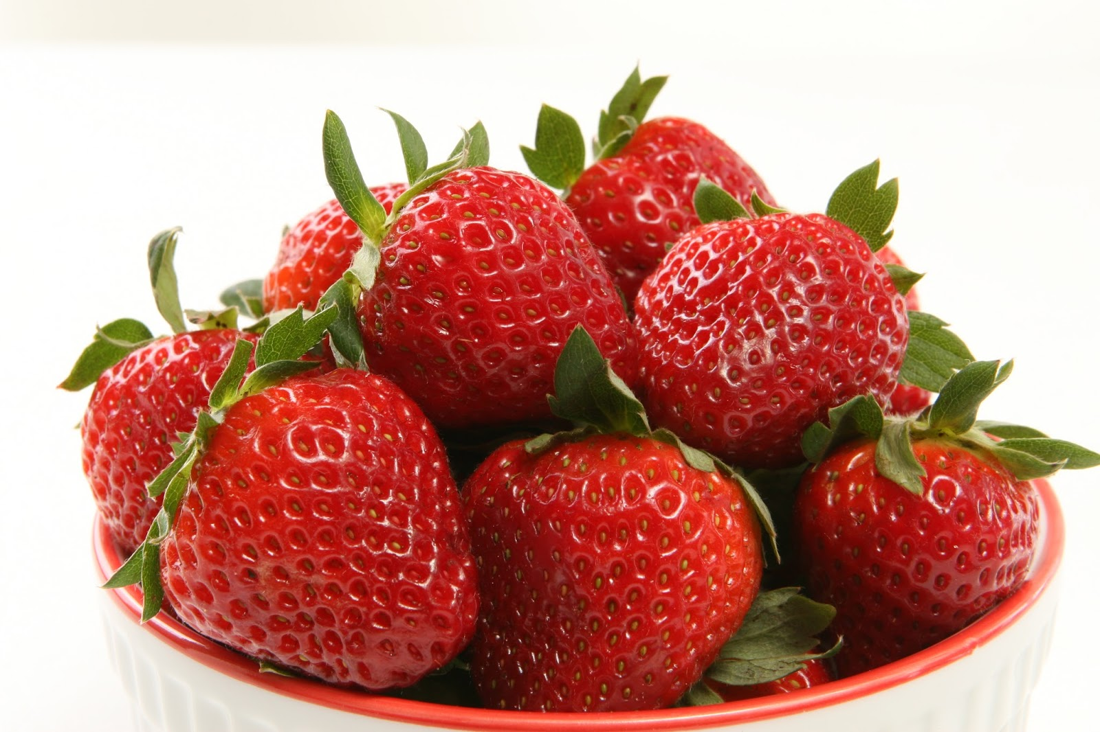
Vitamin C (ascorbic acid) sources
Sources of vitamin C include citrus fruits and berries, green vegetables, peppers, tomatoes and potatoes (especially new potatoes).
Name six citrus fruits
Lime, orange, grapefruit, tangerine, lemon, clementine.
Name six types of berries
Blackberries, blackcurrants, strawberries, raspberries, blueberries, cranberries.
Severe deficiency of vitamin C can cause scurvy, which is characterised by the bleeding of gums and poor wound-healing. It is also associated with fatigue, weakness, aching joints and muscles.

Slide 48
Minerals
Minerals are inorganic substances required by the body in small amounts for a variety of different functions.
The body requires different amounts for each mineral.
Some minerals are required in larger amounts, while others are needed in very small amounts and are called ‘trace elements’.

Slide 49
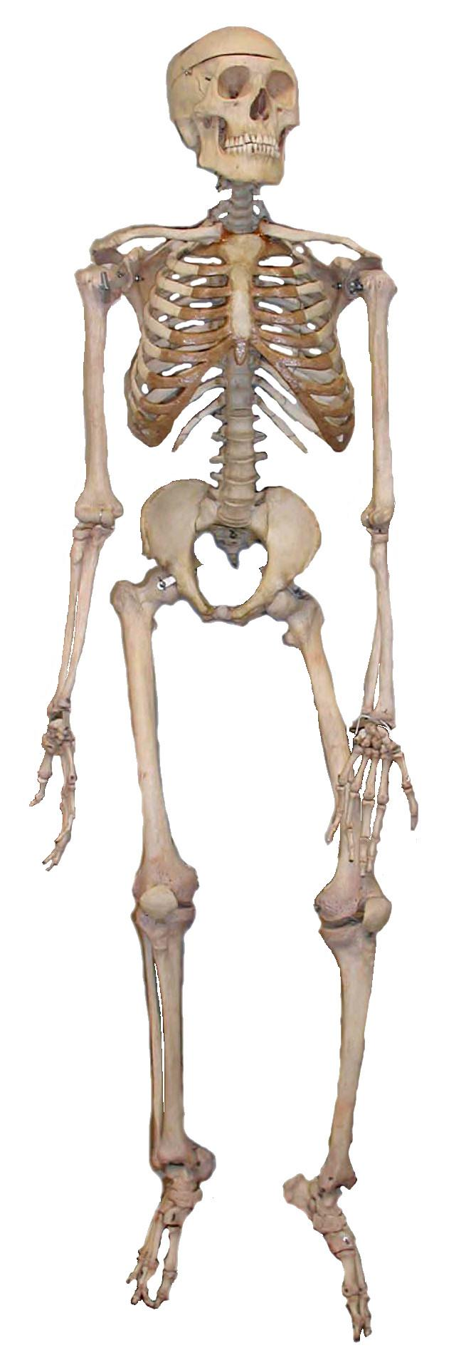
Calcium (Ca)
The body contains more calcium than any other mineral. It is essential for a number of important functions, including to build and maintain strong bones and teeth. It helps nerves and muscles to function normally and helps blood to clot normally.
Did you know?
The skeleton contains about 99% of the body’s calcium with approximately 1kg present in adult bones.

Slide 50
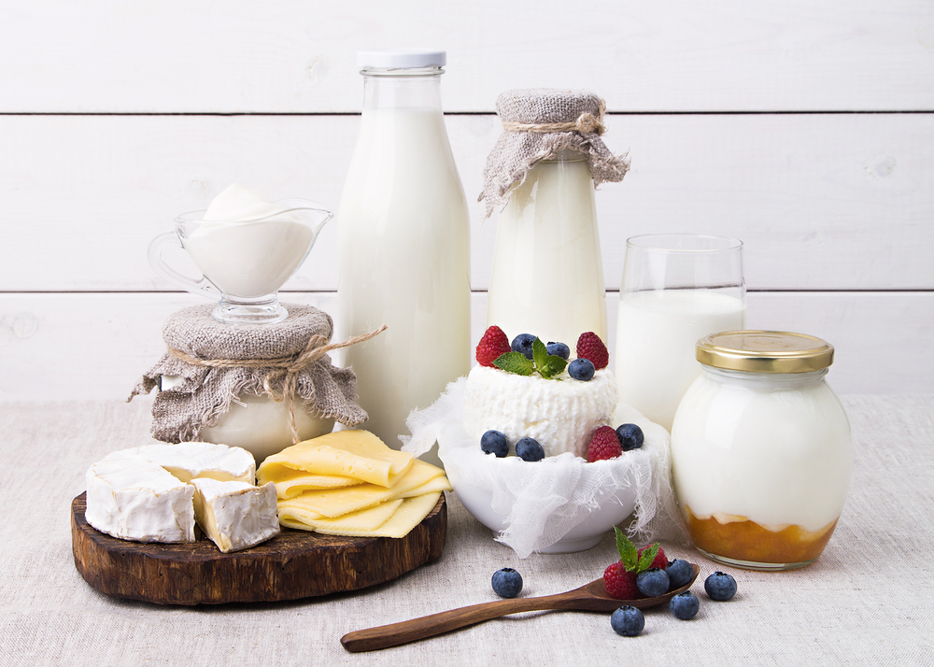
Calcium (Ca) sources
Sources of calcium include:
Milk, cheese, yogurt, fromage frais, some green leafy vegetables (such as kale), calcium-fortified dairy-alternatives, canned fish (where soft bones are eaten) and breads (white, brown and wholegrain)

Slide 51
Calcium (Ca)
Did you know?
The calcium level in blood is carefully regulated by hormones, including vitamin D, to keep it within narrow limits. This means that calcium balance can be maintained at different levels of calcium intake.
If calcium intake is too low, calcium is withdrawn from bones to maintain blood levels. So, a poor supply of dietary calcium can lead to low bone density. Over time, this will lead to osteoporosis, characterised by weak, brittle bones.
This condition may also reflect a lack of vitamin D, which is involved in calcium absorption.
There is evidence of low calcium intakes in teenage girls in particular.

Slide 52

Phosphorus (P)
Phosphorus helps to build strong bones and teeth and helps to release energy from food.
Sources of phosphorus include red meat, poultry, fish, milk, cheese, yogurt, eggs, bread and wholegrains (such as brown rice and wholewheat pasta).
Phosphorus is unlikely to be in short supply in UK diets because it is present in many foods.

Slide 53

Iron (Fe)
Iron help to make red blood cells, which carry oxygen around the body. It also helps the immune system to work and helps the brain to function normally.

Slide 54
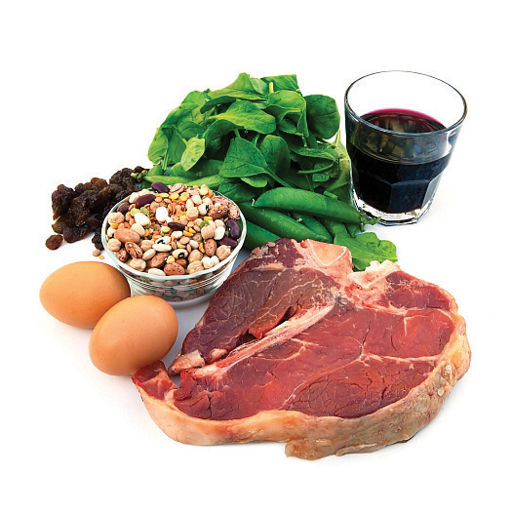
Iron (Fe) sources
Did you know?
There are two types of iron; one from animals sources (haem iron) and the other from plant sources, fortified foods and supplements (non-haem iron).
Haem iron is readily absorbed by the body. Vitamin C helps the absorption of non-haem iron when eaten at the same time.
Sources of iron include cereals, vegetables, nuts, eggs, fish and meat.

Slide 55

Iron (Fe)
Teenage girls and women of childbearing age need more iron than males of the same age.
Over half of teenage girls in the UK do not consume enough iron and intakes are also low in a large proportion of young women. A lack of iron may lead to iron deficiency anaemia.
Did you know?
More than 2 billion people worldwide suffer from iron deficiency anaemia, making it the most common nutritional deficiency.

Slide 56
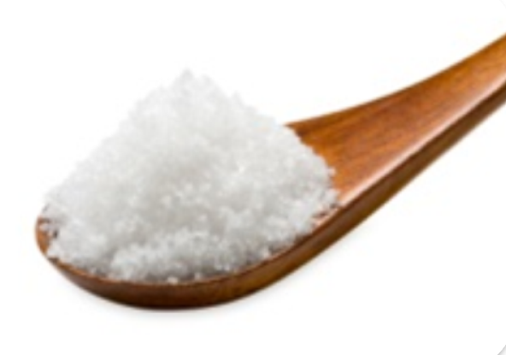
Sodium (Na)
Sodium helps …regulate the water content in the body.
Sodium levels in the body are under homeostatic control and are regulated by the kidneys.
Did you know?
Sodium is a component of common salt, known as sodium chloride (NaCl).

Slide 57

Sodium (Na)
Sodium intakes in the UK are higher than the recommended levels.
High intakes of sodium are linked to high blood pressure (hypertension), which increases the risk of stroke and coronary heart disease.
Did you know?
It is recommended that adults have a maximum of 6g salt per day. Children under 11 years should eat less.

Slide 58
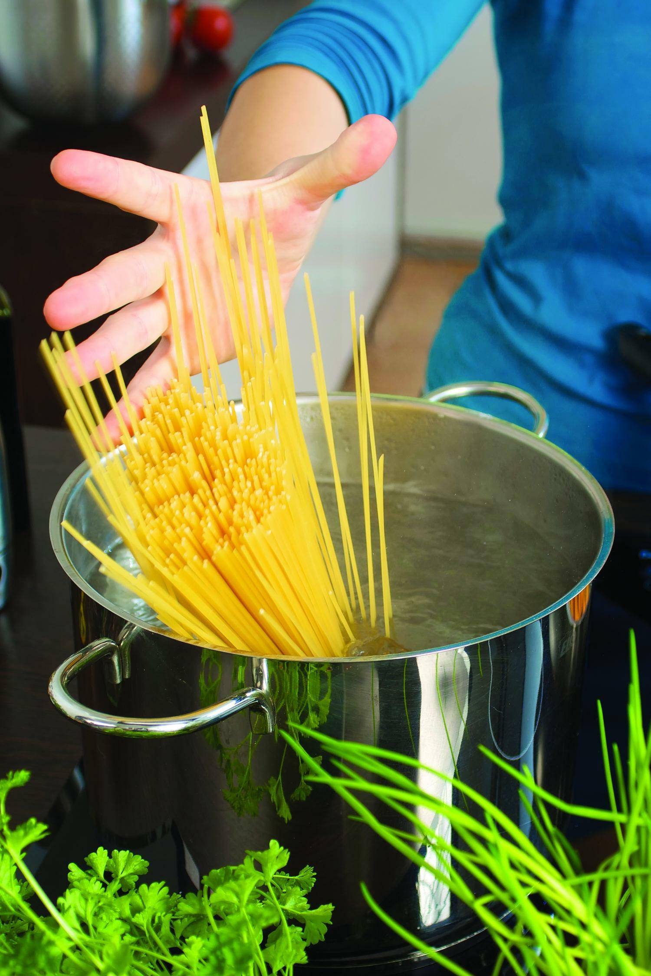
Sodium (Na)
Most raw foods contain very small amounts of sodium chloride (salt).
Salt is often added during the processing, preparation, preservation and serving of foods. Reductions in sodium levels in foods have been happening across the UK food industry.
About 20% of salt we eat is added at home during cooking and at the table.
How can we reduce salt when preparing and cooking food?

Slide 59
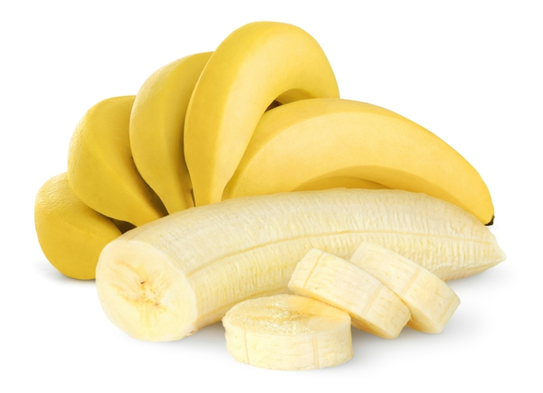
Potassium (K)
Potassium helps regulate the water content in the body and maintain a normal blood pressure. It also helps the nerves and muscles to function normally. Low blood potassium levels can be a result of severe diarrhoea. Symptoms include weakness, mental confusion and, if extreme, heart failure. Low dietary potassium intakes have been found in the UK, particularly among women.
Sources of potassium include some fruit and vegetables (such as banana, blackcurrants, avocado, spinach, parsnip and beetroot), dried fruit (such as apricots, sultanas and figs), poultry, red meat, fish, milk and wholegrain breakfast cereals

Slide 60

Fluoride (F)
Fluoride helps to form strong teeth and helps to reduce the risk of tooth decay.
Fluoride is now added to most toothpastes but is also found in fluoridated water, tea and fish.
The addition of fluoride to toothpaste is important in those areas where the water supply is low in fluoride.

Slide 61
Summary
Macronutrients include carbohydrate, protein and fat. These provide energy and are needed in large amounts.
Micronutrients include vitamins and minerals. These do not provide energy but are essential for health.

Slide 62

Quiz - Kahoot
Open the link below on the main screen and get students to log onto kahoot.it on their tablets or smartphones.
They can then enter the code (that will come up on the main screen when you start the game) and their own nickname.
They can then play along with the quiz choosing the multiple choice answers that correspond with the questions on the main screen. There will then be a leaderboard of the scores after each question and at the end.
https://create.kahoot.it/share/nutrients/fb67ce7b-ce4b-46fd-b843-5b3d026e0330

Slide 63
Nutrients
For further information, go to:
www.foodafactoflife.org.uk
This resource meets the Guidelines for producers and users of school education resources about food.

