Slide 1
Eat with mates!

Slide 2
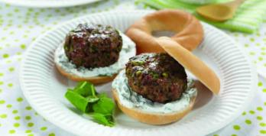
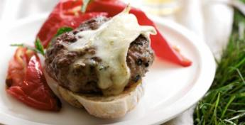
The challenge
Create a burger to eat on a night in with friends.

Slide 3

Burgers with friends
Burgers are great to eat with friends.
They can be casual and fun, eaten with or without cutlery and are perfect for a relaxed evening at home.

Slide 4

‘Come burger with me’
In groups of three, create your ideal burger to eat with a group of friends. Using the Gourmet Burger Builder ingredient cards, identify:
Who the burgers will be made for and why
Main burger ingredients
Breads and toppings
A name for your burger.
Nominate someone in your group to present your idea to the class. Your idea will then be judged out of 10, ‘Come Dine With Me’ style.
http://bit.ly/1MiIATz

Slide 5
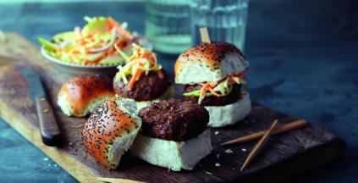
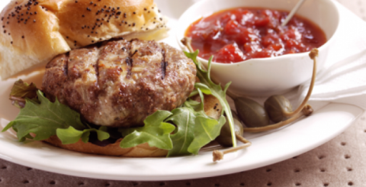
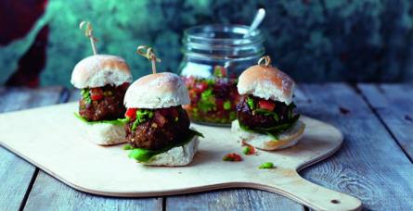
Inspiration

Slide 6
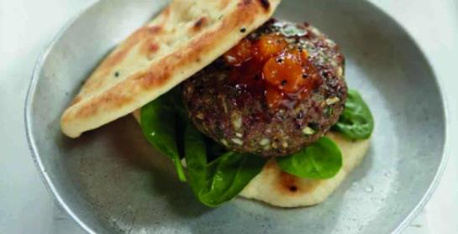
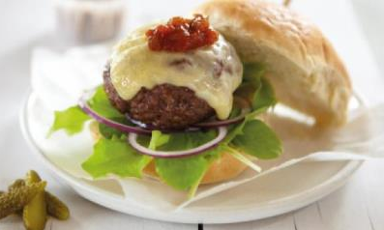
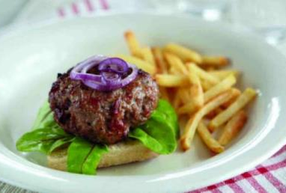
Inspiration

Slide 7
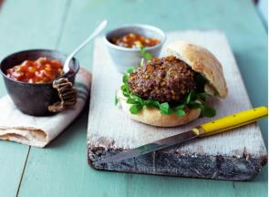
Create your burger
Step 1
Use the Gourmet Burger Builder to create your burger.
Step 2
Make your burger following the recipe.
Step 3
Take a photo and share your recipe on social media.

Slide 8
Eat with mates!
For further information, go to:
www.foodafactoflife.org.uk
This resource meets the Guidelines for producers and users of school education resources about food.

