Slide 1
Food science and red meat

Slide 2
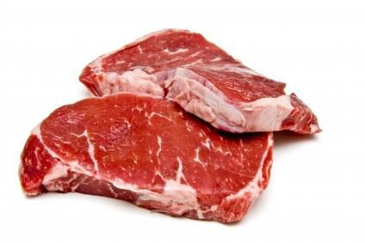
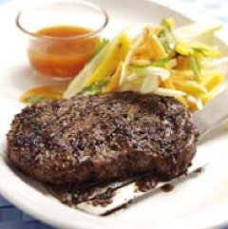
What happens when meat is cooked?
Protein
The proteins in meat coagulate on heating. At around 60°C the protein begins to denature, and the muscle fibres become firmer.
After 60°C the fibres shrink, and the meat juices are squeezed out.

Slide 3
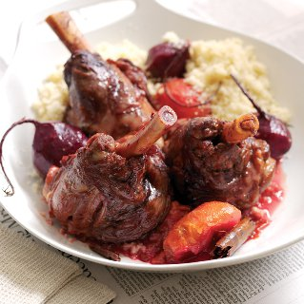
What happens when meat is cooked?
Collagen
When meat is cooked, the collagen becomes soft and soluble, and forms gelatine.
Collagen becomes water soluble more easily when there is some liquid with the meat.
Meat cuts that have a lot of collagen are therefore best cooked by a moist heat method.

Slide 4
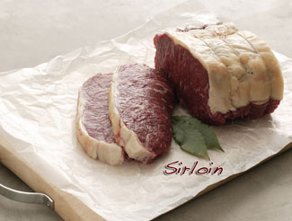
What happens when meat is cooked?
Fat
The fat on the outside and in the muscle fibres melts during cooking. This means more of the collagen is exposed to the heat helping the meat to become more tender.
Marbling therefore helps meat to stay tender.

Slide 5
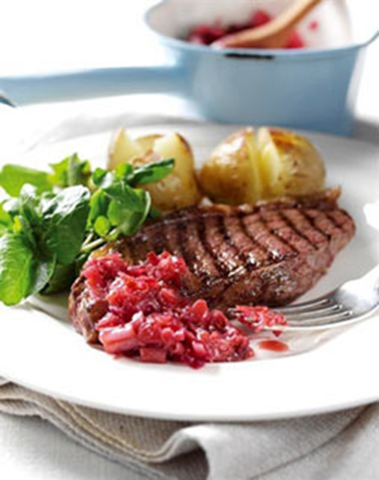
What happens when meat is cooked?
Colour
The colour of meat changes during cooking because myoglobin becomes a brown/grey colour.
Other colour changes are due to non-enzymic browning known as the Maillard reaction. This occurs in dry heat on the outside surface of meat when the proteins and carbohydrates react with each other.

Slide 6
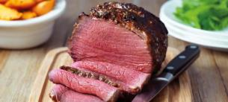
Leaving meat to rest
It is important to leave a steak or joint of meat to rest for a few minutes once cooked.
This allows the juices, which have been driven to the centre of the meat during cooking, to be redistributed throughout the meat and be reabsorbed.
As a result, the meat will lose less juice when it is cut and will be far more tender and juicier to eat.

Slide 7
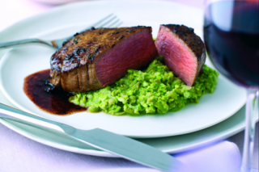
Leaving meat to rest
To test the optimum time to leave meat to rest for the best flavour and texture:
cut a piece of steak into four pieces;
griddle the steak over a medium heat for four minutes on each side;
place the meat on four separate clean plates;
slice one piece in half immediately and take a photograph. Then taste and evaluate using a ranking chart;
slice the remaining pieces of steak in half after two, three and four minutes. Take a photograph each time and taste;
compare the amount of meat juice on the plate and complete a ranking test each time.

Slide 8
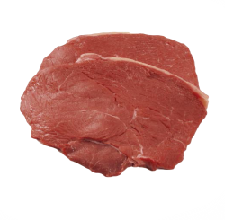
Cutting meat against the grain
If you cut the meat along the length of the fibres, you increase the toughness.
If you cut the meat against the grain - across those fibres - you shorten them, which makes the meat more tender.
This applies to both raw and cooked meats.

Slide 9
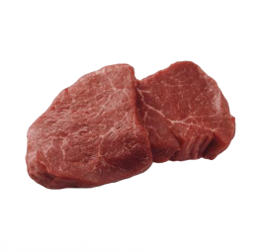
Cutting meat against the grain
To test how cutting meat against the grain can affect the tenderness:
cut a piece of steak against the grain and another with the grain;
fry the pieces of steak separately in a small amount of spray oil;
taste and compare.
This could be done as a paired comparison test (discrimination) or a triangle test if three steaks are used.

Slide 10
Tenderising meat
The aim of tenderising is either to break down or soften the muscle and connective tissue or to increase the hydration or water-holding capacity of the proteins.
The two main ways to tenderize meat are:
mechanical tenderising;
marinating.

Slide 11
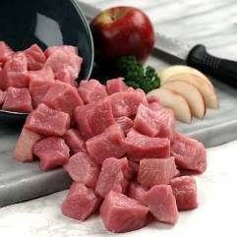
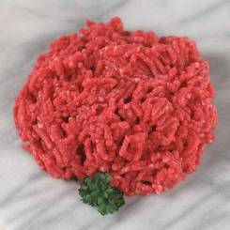
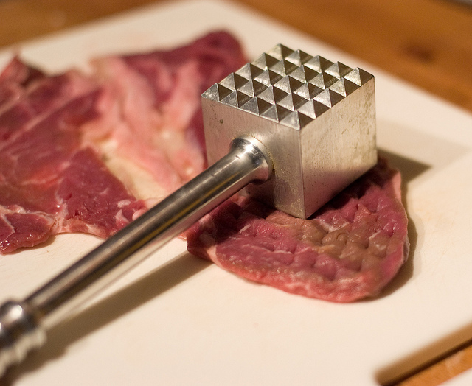
Tenderising meat
Mechanical tenderising
A meat cleaver or meat hammer may be used to beat the meat.
This disrupts the structure by separating and reducing the length of the fibres to improve the tenderness.
Cutting into small cubes or mincing can also help.

Slide 12
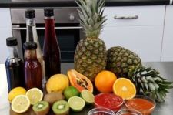
Tenderising meat
Marinating
The addition of any liquid to flavour or soften meat before cooking. Mixing the meat with an acid such as lemon juice or vinegar before cooking or adding acids or tomatoes to the cooking liquid can help to tenderise the meat by breaking down some of the collagen. During this process the substances used (alkalis, salt and acids) can also increase the hydration or water holding capacity of the muscle fibre proteins.
Powdered artificial tenderisers are concentrated enzymes which break down proteins into amino acids by breaking the structure of the meat. This can also be done by using the leaves of certain trees and the juices of some fruits such as pineapples.

Slide 13
Food science and red meat
For further information, go to:
www.foodafactoflife.org.uk
This resource meets the Guidelines for producers and users of school education resources about food.

