Slide 1
Where are we eating?

Slide 2
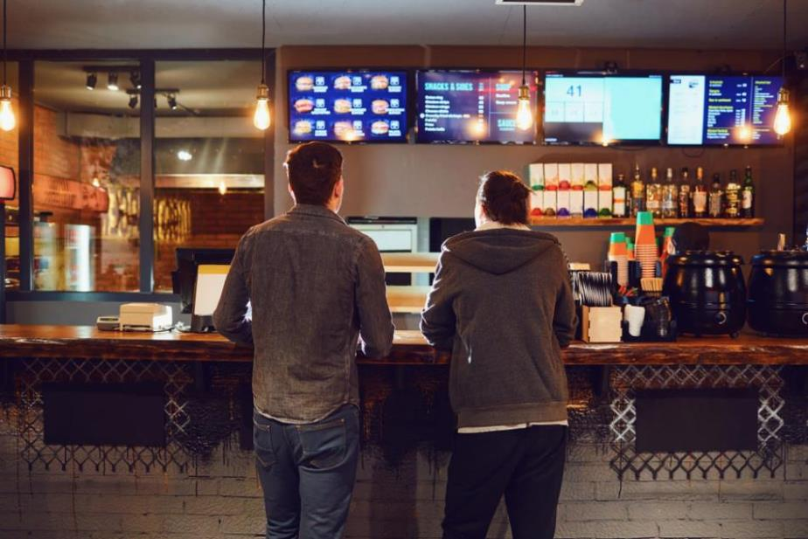

Slide 3
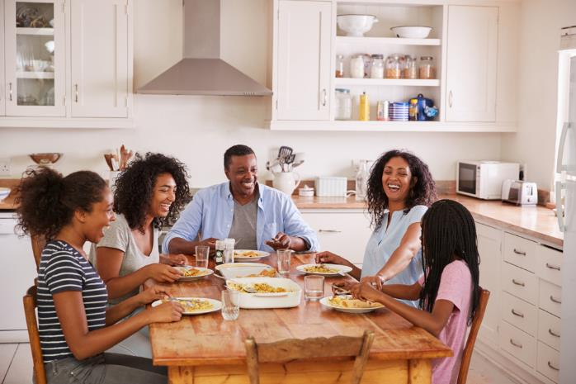

Slide 4
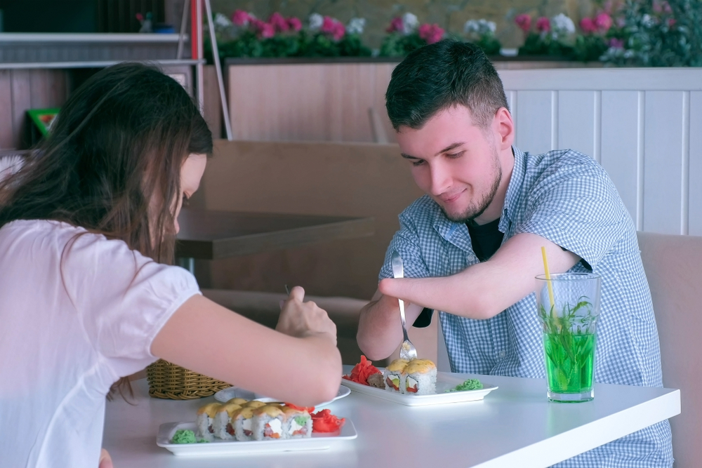

Slide 5
You can help to wash up when you are finished.

Slide 6
You can help set the table.

Slide 7
You can help cook the food.

Slide 8
You will have to buy and cook
your food.

Slide 9
You can make more than you need and eat it the next day.

Slide 10
You will be given your food at
a counter.

Slide 11
You will have to queue up for
your food.

Slide 12
Your food will come in packaging.

Slide 13
You can take your food and eat it wherever you want.

Slide 14
You will pay for your food after you have been given the bill at your table.

Slide 15
Your order will be taken at
your table.

Slide 16
Your food will be served at
your table.

Slide 17
You will choose what to eat from a menu at your table.

Slide 18
Where are we eating?
For further information, go to:
www.foodafactoflife.org.uk
This resource meets the Guidelines for producers and users of school education resources about food.

