Slide 1
Energy balance

Slide 2
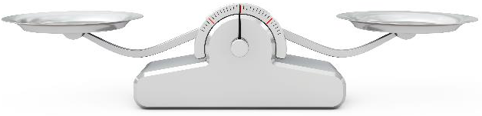
Energy balance
To maintain body weight it is necessary to balance energy intake (from food and drink) with energy expenditure (from activity).
This is called energy balance.
When energy intake is higher than energy output, over time this will lead to weight gain (positive energy balance).
When energy intake is lower than energy output, over time this will lead to weight loss (negative energy balance).

Slide 3
Positive energy balance
A person is said to be in positive energy balance when the diet provides more energy than is needed to meet energy demands of the body. Energy is stored as fat and the person puts on weight over time.
People who achieve a positive energy balance over an extended period of time are likely to become overweight or obese.
Being overweight or obese is associated with an increased risk of developing certain cancers, cardiovascular disease and type 2 diabetes.
Carrying a large amount of weight/fat around the waist also increases the risk of these health problems.
Energy out: activity
Energy in: food and drinks
Energy in > Energy out = Weight gain

Slide 4
Negative energy balance
A person is said to be in negative energy balance when there is insufficient energy from the diet to meet energy demands of the body. Energy is derived from energy stores and the person loses weight.
People who achieve a negative energy balance over an extended period of time are likely to become underweight.
Being underweight is associated with health problems, such as osteoporosis (low bone mass), infertility (difficulty to conceive) and even heart failure.
Energy in: food and drinks
Energy out: activity
Energy out > Energy in = Weight loss

Slide 5
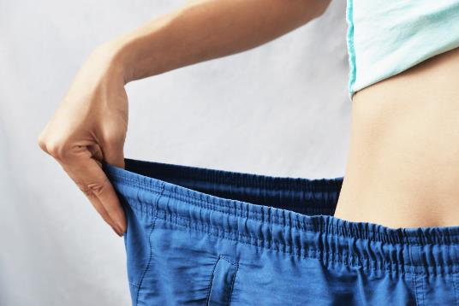
Energy balance
Energy balance can be maintained by:
regulating energy intake through the diet;
adjusting physical activity levels;
a combination of both.

Slide 6
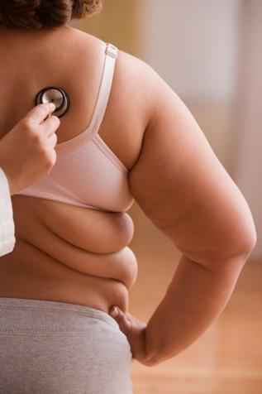
Energy balance
In the UK and many other developed countries, overweight and obesity rates in adults and children have been increasing over the years.
It is important to lead an active lifestyle and make healthier food choices.

Slide 7
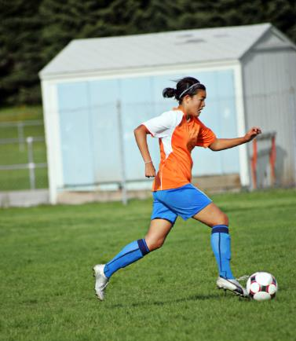
Physical activity
Physical activity should be an important part of our daily energy expenditure.
Many different types of activity contribute to our total physical activity, all of which form part of everyday life.
What do you think physical activity includes?
Activity at work, e.g. use the stairs not the lift.
Household chores, e.g. vacuuming.
Looking after others.
Leisure-time activities, e.g. gardening.
Transport (walking or cycling to school or work).
Sport.

Slide 8

Physical activity
Children and young people are recommended to do at least 60 minutes of moderate intensity exercise every day.
Adults are recommended to do at least 150 minutes of moderate aerobic activity every week or 75 minutes of vigorous aerobic activity. They are also recommended to do strength exercises on two or more days a week that work all the major muscles.
https://www.nhs.uk/live-well/exercise/exercise-guidelines/physical-activity-guidelines-for-adults-aged-19-to-64/

Slide 9
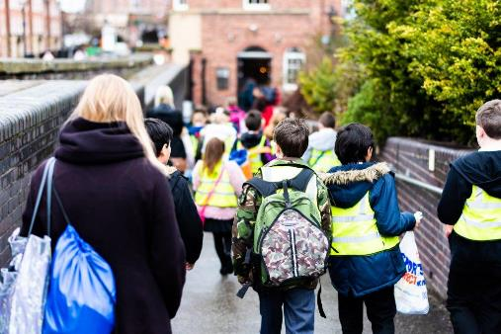
Physical activity
Average physical activity levels in the UK are lower than recommendations.
Most adults, older children and teenagers do not meet the targets.

Slide 10
Energy balance
For further information, go to:
www.foodafactoflife.org.uk
This resource meets the Guidelines for producers and users of school education resources about food.

