Slide 1
Testing pH using red cabbage

Slide 2
Mix and match
Acid
Neutral
Alkaline
pH scale
A solution with a pH of exactly pH 7
A solution with a pH of less than pH 7
A scale from 0 to 14 that tells us how acidic or alkaline an aqueous solution is
A solution with a pH of exactly pH 7

Slide 3
Mix and match
Acid
Neutral
Alkaline
pH scale
A solution with a pH of less than pH 7
A solution with a pH of exactly pH 7
A scale from 0 to 14 that tells us how acidic or alkaline an aqueous solution is
A solution with a pH of exactly pH 7

Slide 4
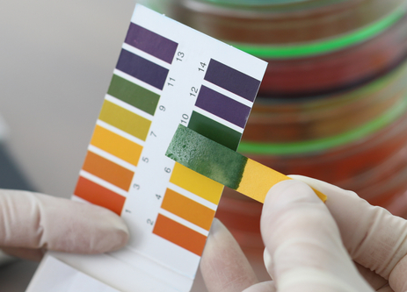
The pH scale
The pH scale shows how acidic or alkaline a substance is.
It can be measured using a pH meter which gives a numerical value (0 to 14).
pH can be also be measured using an indicator and comparing the colour with a comparison chart.
One example is Universal indicator (UI), which is a mixture of indicators, but there are lots of other examples.

Slide 5
Indicators
You can even make your own indicators.
Lots of highly coloured vegetables and flowers can be used to make indicators. Red cabbage is the one we will use today but beetroot and blackberries are other examples.
We can make this indicator by mashing red cabbage in hot water.
This is because red cabbage contains anthocyanin pigments which change colour at different pH.

Slide 6
pH scale – red cabbage indicator
This is the colour scale for using red cabbage as an indicator.
Strong Acid
Weak Acid
Neutral
Weak alkali
Strong alkali

Slide 7
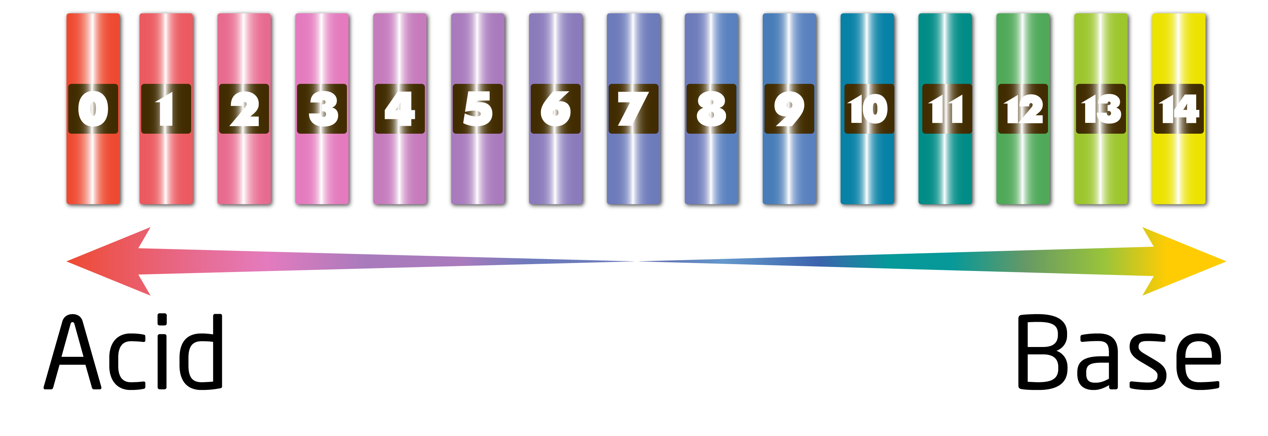
Cabbage indicator pH scale
Copy the colours and numbers of the cabbage indicator pH scale from the board.

Slide 8
Match the description to the colour
Strong acid
Weak alkaline
Weak acid
Neutral

Slide 9
Match the description to the colour
Weak acid
Neutral
Strong acid
Weak alkaline

Slide 10
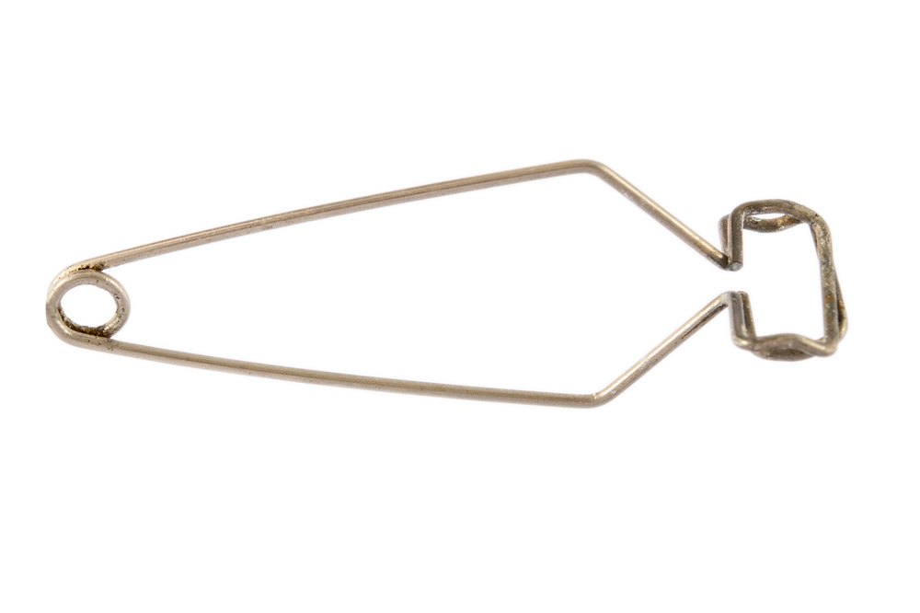
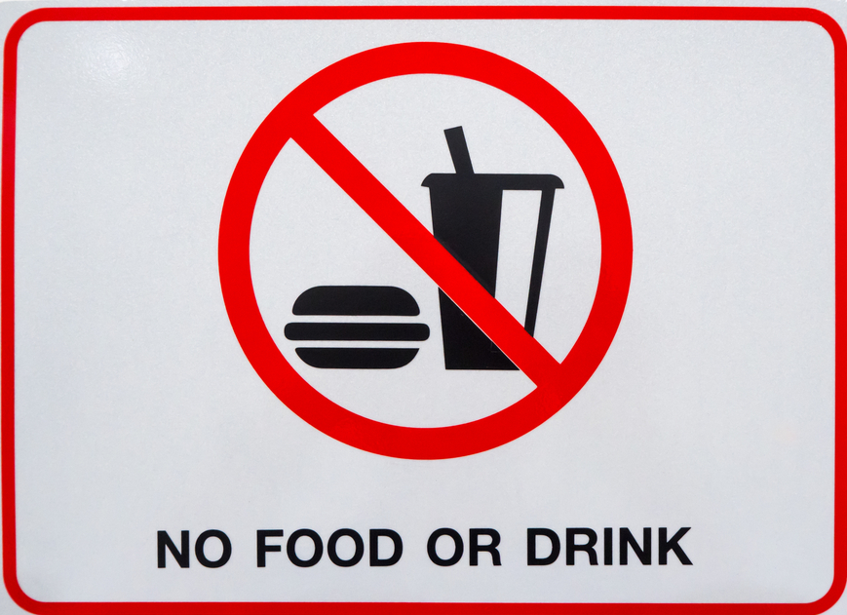
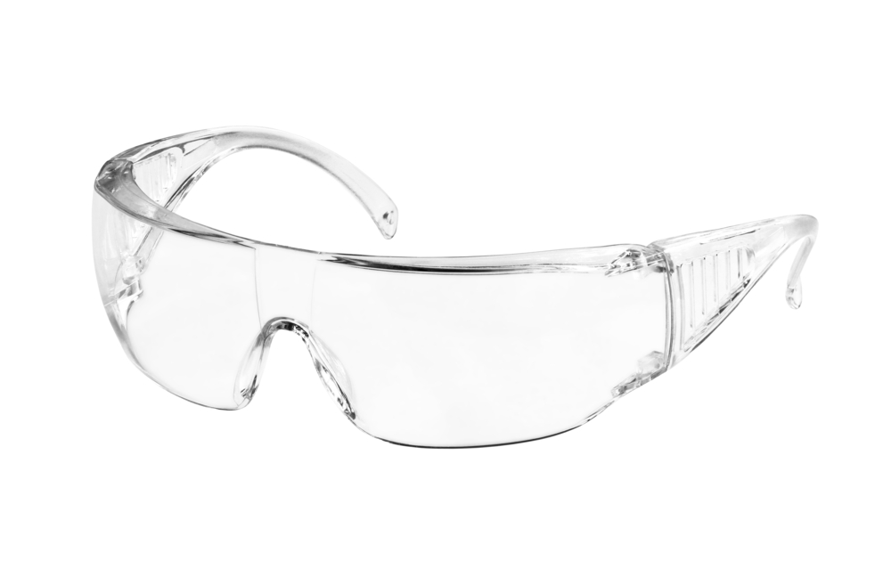

Turn and talk – how are we going to stay safe during this practical?
Wear safety goggles
Use test tube holders
No eating or drinking
Keep desks/benches tidy and make sure bags are not trip hazards

Slide 11
Hypothesis
A hypothesis is a prediction of what you think might happen in an experiment.
Today’s activity will be to test the pH of different substances (whether they are acidic, alkaline or neutral).
The table on the next slide gives the list of substances we’ll be testing. Make a prediction of the colours each indicator will turn once tested.

Slide 12
Results table
Food tested | Predicted colour change | Actual colour change | Acid/Alkali/Neutral?
Hydrochloric acid
Sodium Hydroxide
Distilled Water
Scouring Powder
Vinegar
Toothpaste
Coca cola
Salt water

Slide 13
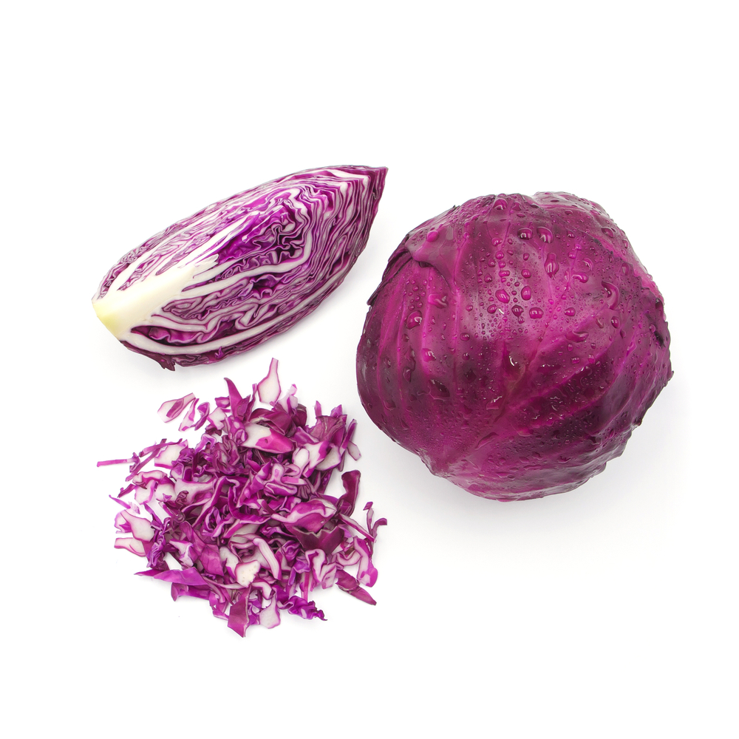
Prepare your indicator
In pairs, take one pestle and mortar with 1-2 slices red cabbage
Cut up the cabbage into small pieces with scissors and add a small splash of warm water
Grind the red cabbage
Now add another splash of warm water and mix gently.
Pipette out the purple liquid into a clean beaker.

Slide 14
Detect whether substances are acidic, alkaline or neutral
Use your pipette to add about 0.5ml of the sample you want to test to the well plate.
Add a few drops of your cabbage indicator.
Record the colour the indicator changes to.
Try hydrochloric acid, sodium hydroxide and water first! This will tell you the colour you should see for acid, alkali and neutral.
Use your observations to predict whether each substance is acid, alkali and neutral.

Slide 15
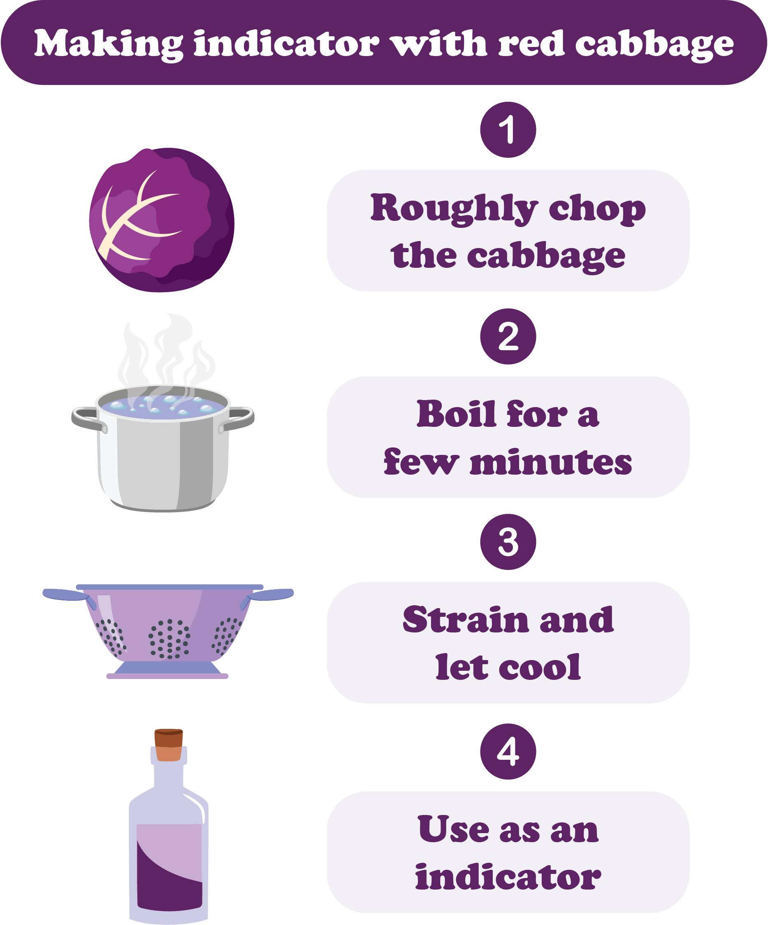
Storyboard
Describe how you can use red cabbage indicator to test whether substances are acidic, alkaline or neutral and draw and label pictures to show each step. .
Remember to include:
How you made your red cabbage indicator .
How you used it to detect whether substances are acidic, alkaline or neutral.
Extension: do the same for using Universal Indicator. What are the differences between using the two different indicator?

Slide 16
Key words
Key word​ | Meaning​
Acid | Any substance that increases the concentration of hydrogen (H+) ions when added to a water solution (pH 1-6).
Neutral | A solution with a pH of exactly 7.
Alkali | Any substance that decreases the concentration of hydrogen (H+) ions when added to a water solution (pH 7-14).
pH scale | A scale from 0 to 14 that tells us how acidic or alkaline an aqueous solution is
Aqueous solution | A solution made by dissolving a substance in water.
Anthocyanin | A group of pigments that produce blue to red colouring in flowers and plants.

Slide 17
Teachers’ guide

Slide 18
Lesson structure
Starter: Mix and match definitions (5 minutes).
Discussion around pH scale and indicators, and copy pH scale (15 minutes).
Match the descriptions – use as class Assessment for Learning (5 minutes).
Practical (20 minutes) – ask the pupils to prepare their indicator, then pause the class and discuss how to carry out the next part of the practical.
Complete results table and storyboard (10 minutes).

Slide 19
Running a pH testing practical classroom
Common misconceptions:
All acids show up red with indicator, all alkalis show up blue/purple – carry out multiple different experiments using different indicators. Universal Indicator will show up like this but using red cabbage as an indicator will show up differently.
Acid strength and concentration are the same thing – this is important to get across to students in KS3 as it will be tested in further detail in KS4. The following slides give some information on how you might be able to teach these or, for KS3, just focussing on using the correct terminology and correcting mistakes will be important.

Slide 20
Running a pH testing practical classroom
Common pitfalls:
Overfilling dimple trays – when demonstrating the practical, ensure it is clear how much of the substance (and indicator) to put in each of the dimple trays. When stucents are carrying dimple trays around the room there is always a risk of dropping or spilling which adds to tidying time.
Spillages – spillages are always a risk in science practicals, but there are ways to minimise. One way is to get students to leave their dimple trays on their desk and to bring the substances to their desk to pipette. This could add time, but will minimise the risk of carrying and spilling overfilled dimple trays.

Slide 21
Running a pH testing practical classroom
Common pitfalls:
Poor/slow tidying - for tidying, make sure it is clear where everything needs to go and explain how to clean dimple trays and pipettes. Many students at KS3 will not have cleaned a pipette before which can often lead them to spraying water into them and water going everywhere. Setting up a beaker of water by sinks (to clean pipettes) and having sieves available at the sink will save time.
Bottlenecking in the classroom – make sure to spread out equipment to avoid bottlenecking. You could set up by giving each pair a dimple tray, pipette and pestle and mortar and then spread the substances to test evenly around the room.

Slide 22
Strength and concentration
Strength and concentration are not the same thing.
You can think of concentration in terms of concentrations of a squash drink.
How could I get two different concentrations of orange squash that have the same overall volume?

Slide 23
Strength and concentration
In terms of the particle model, these are:
High concentration
Low concentration

Slide 24
Concentration
From the particle model, we can see that the more particles there are in the same volume, the greater the concentration.
Therefore we can define concentration as:
‘…the amount of particles of solute in a certain volume of solvent’.

Slide 25
Strength
However strength is different. You can have strong acids that are concentrated or dilute or you can have weak acids that are concentrated or dilute.
Acids in solution are a source of H+ (hydrogen) ions,. The H+ ions are produced when the acid dissociates or breaks down to form ions.
We can define strength as:
‘…a measure of the fraction of acid particles that are ‘split up’ or dissociated.’

Slide 26
Strong and weak acids
Strong acids completely dissociate into ions in solution.
Weak acids only partially dissociate in solution.
The pH of a solution is a measure of its concentration of hydrogen ions:
the higher the concentration of H⁺ ions, the lower the pH.
the lower the concentration of H⁺ ions, the higher the pH.

Slide 27
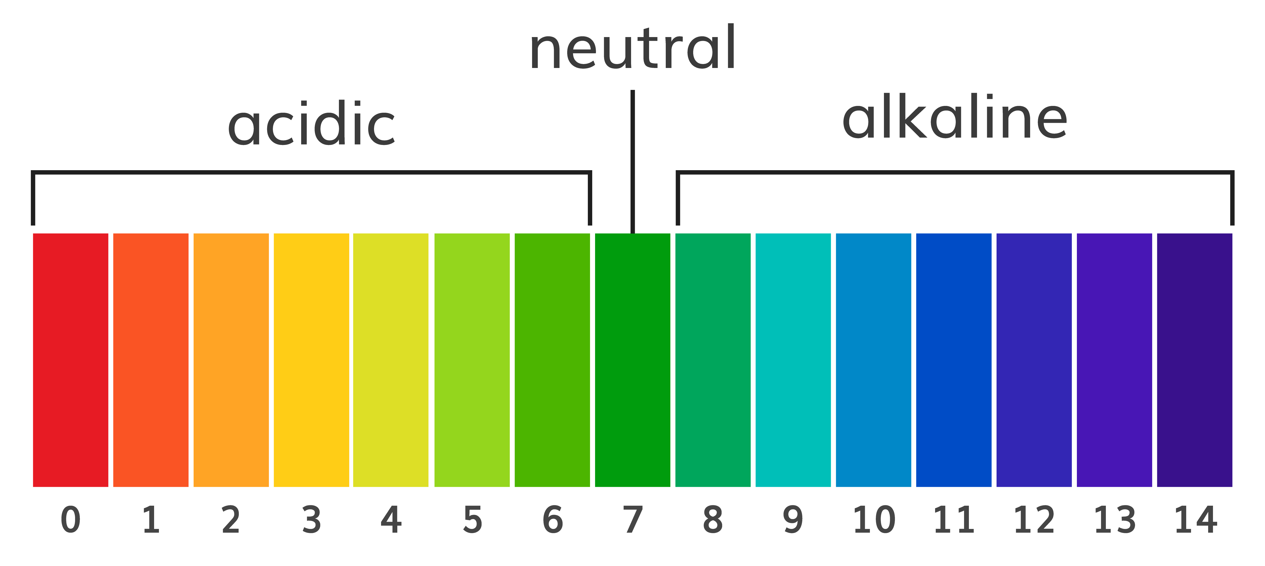
For a given concentration…
All of this means that when we talk about the pH scale we need to use the phrase, for a given concentration in aqueous solution, the stronger an acid, the lower the pH.
This is because the more concentrated the solution of an acid, the lower its pH will be.
A strong acid has a lower pH than a weak acid for a given concentration.

Slide 28
Teaching about pH
Explain now to evaluate whether a substance is acid, alkali or neutral.
Describe the factors affecting pH.
Icentifynstrong and weak acids.
Analyse the data and use observations to determine the pH of a solution.

Slide 29
Progressing the learning
The topic of pH is also covered at GCSE (14-16 years).
It is covered as part of the human digestive system, particularly looking at different enzymes involved in digestion and the stomach.
At GCSE level, students can also investigate the effect of temperature on the rate of decay of fresh milk by measuring pH change.

Slide 30
Talking about the science of pH testing
During a demonstration, explain the importance of practical safety during science practicals.
Discuss the difference between strength and concentration of acids.
Discuss how substances that are acidic or alkaline will likely have different roles in industry.
Discuss how the pH of the stomach changes.

Slide 31
Testing pH using red cabbage
For further information, go to:
www.foodafactoflife.org.uk
This science pack is one of a series of resources produced for the pHood Futures project, supported by the Royal Society of Chemistry.
This resource meets the Guidelines for producers and users of school education resources about food.

