Slide 1
Supporting cooking with heat in primary schools
Claire Theobald, Education Services Manager (primary) Frances Meek, Education Services Manager (secondary)

Slide 2
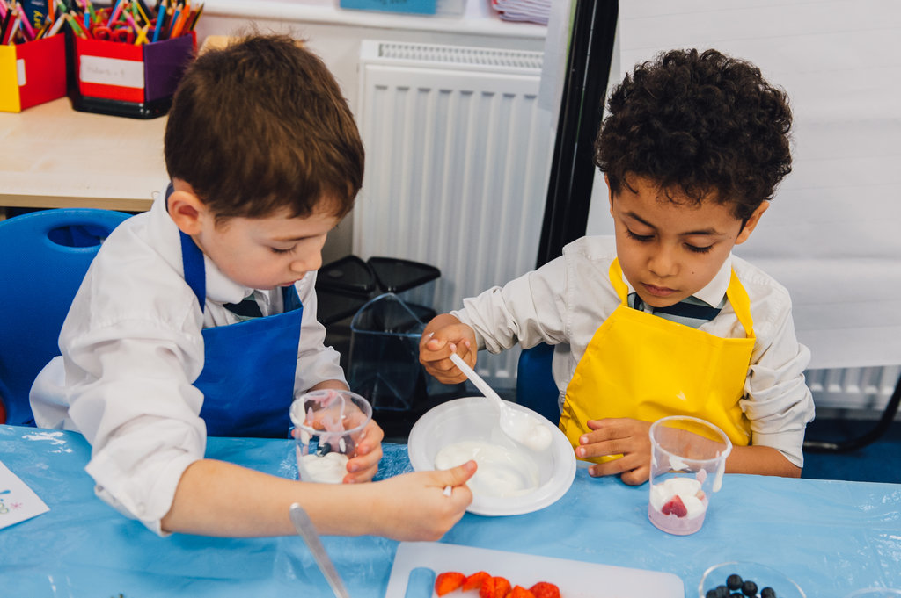
This session will cover:
Setting up practical food lessons (a reminder).
Teaching practical food skills (a reminder).
Storing and preparing high risk ingredients and finished dishes safely.
Making Lamb Rogan josh.
Ensuring good safety practices when cooking with heat.
The practicalities of cooking with heat in a primary classroom, including equipment.
Links to Food – a fact of life resources.

Slide 3
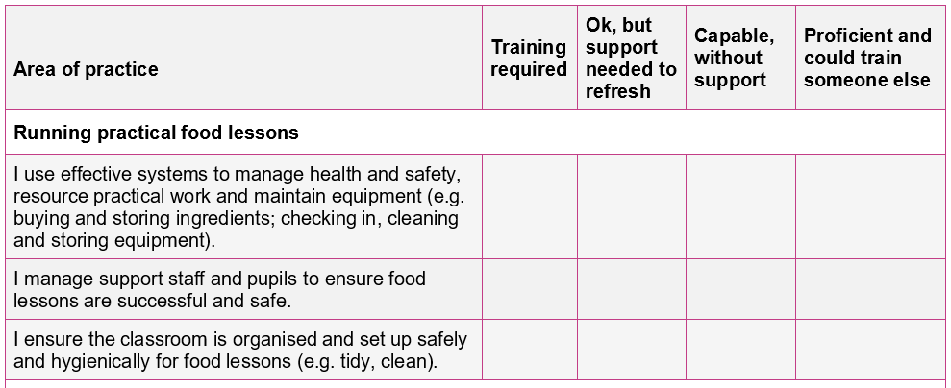

Your audit (completed with registration)
Running practical food lessons

Slide 4
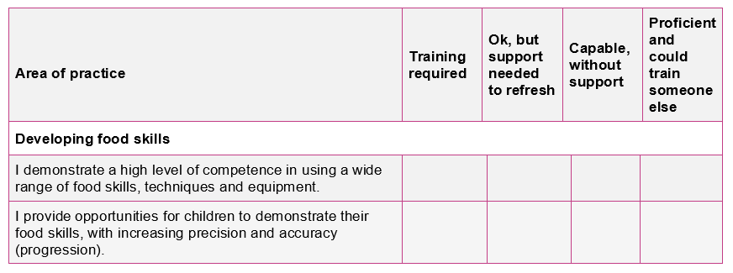
Your audit (completed with registration)
Developing food skills
Audit document is also available online (see Supporting documents)

Slide 5
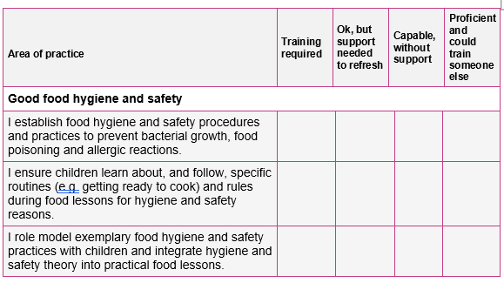
Your audit (completed with registration)
Good food hygiene and safety

Slide 6
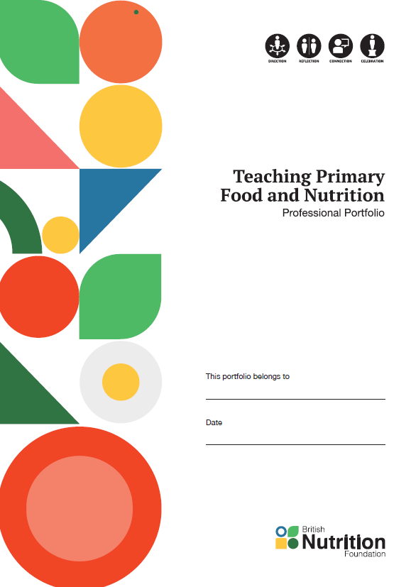
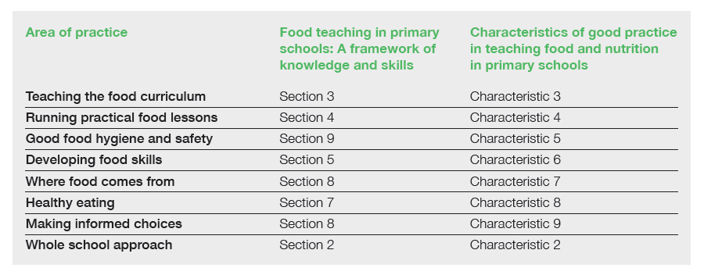
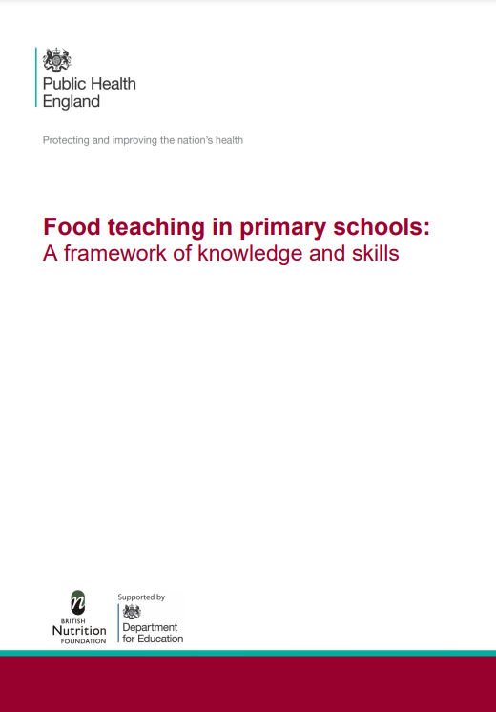




Supporting documents
TPFN booklet, page 5

Slide 7
Cooking with heat
Design and Technology: Cooking and Nutrition progression framework (National Curriculum Expert Group for D&T)
Across KS1 pupils should know:
how to prepare simple dishes safely and hygienically, without using a heat source;
how to use techniques such as cutting, peeling and grating.
Across KS2 pupils should know:
how to prepare and cook a variety of predominantly savour dishes safely and hygienically, including where appropriate, the use of a heat source;
how to use a range of techniques such as peeling, chopping, slicing, grating, mixing, spreading, kneading and baking.
In KS2 pupils should also know:
that recipes can be adapted to change the appearance, taste, texture and aroma.
Food teaching progression 5-11 years chart

Slide 8
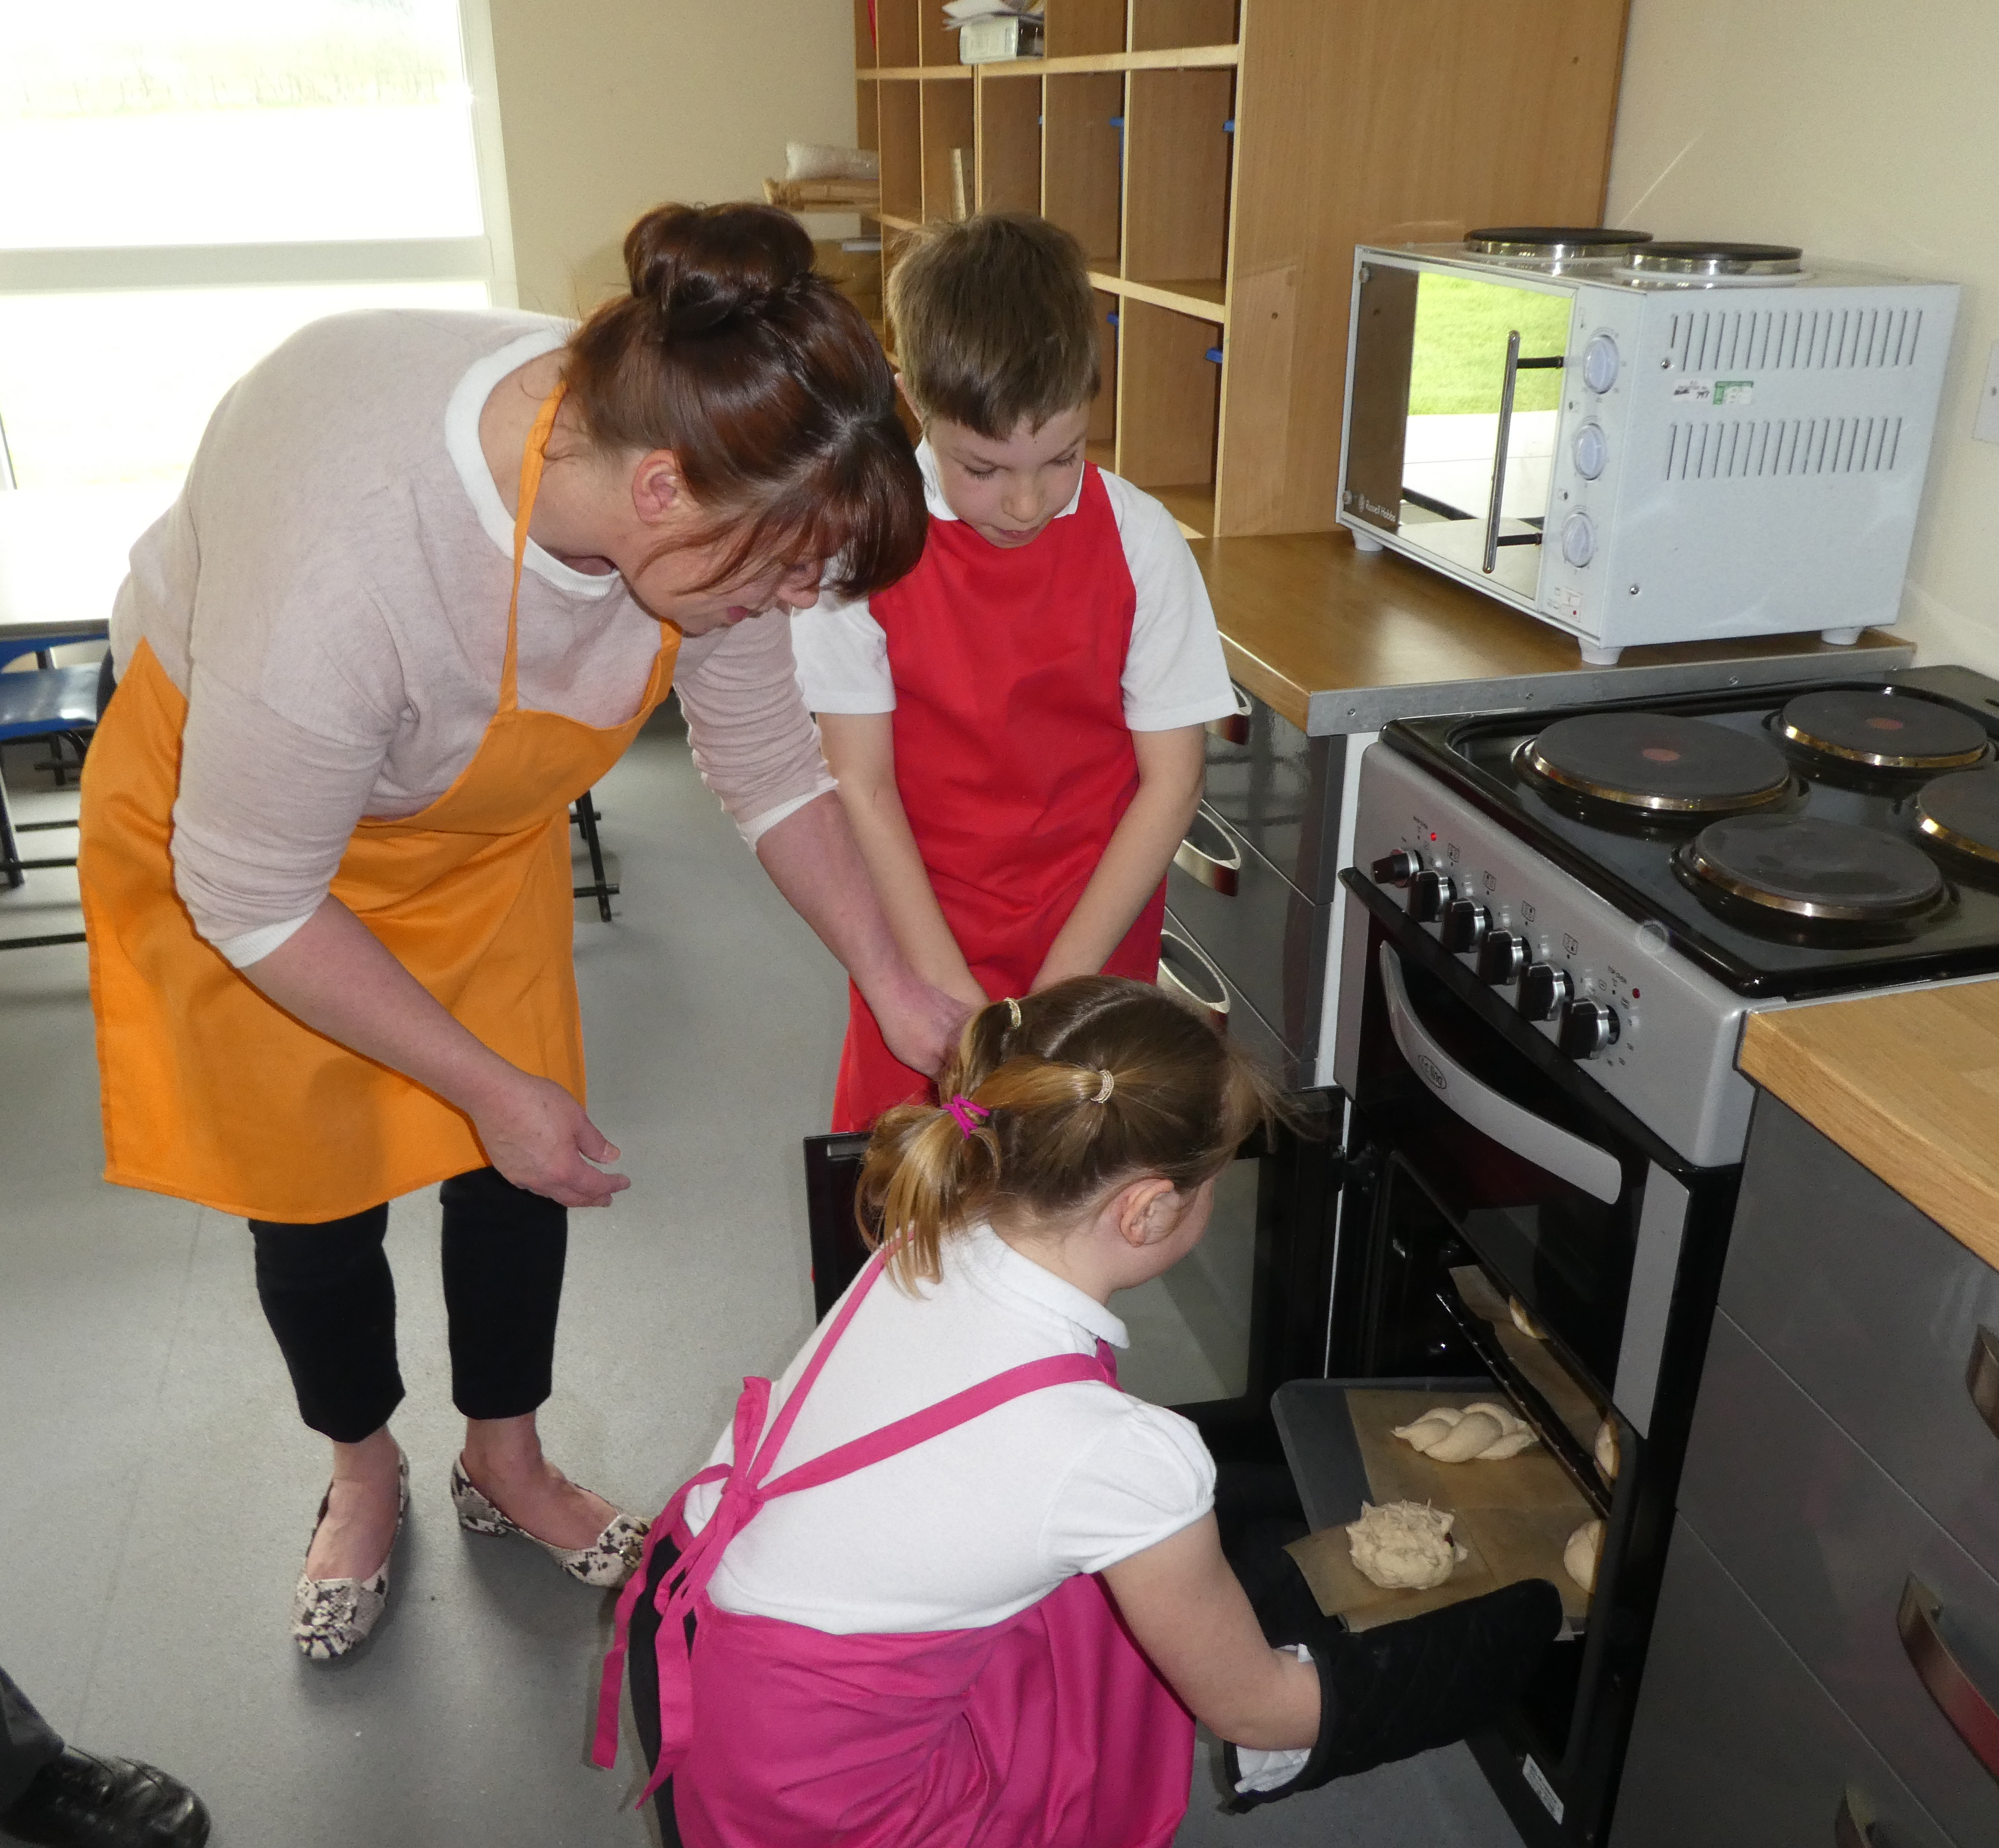
How to run practical food lessons in the primary school classroom
What is your learning intention/objective?
For children to able to:
get themselves ready to cook?
set up the classroom for a food activity?
practise the bridge and claw techniques to chop and slice?
use a range of kitchen equipment?
use a hob, oven or grill? (independently or with supervision)?
wash up?
Remember your focus – you don’t have to do it all in one lesson!

Slide 9
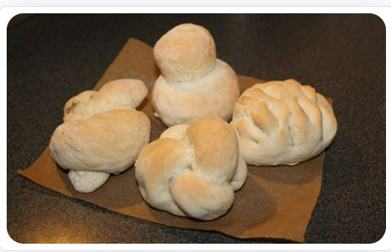
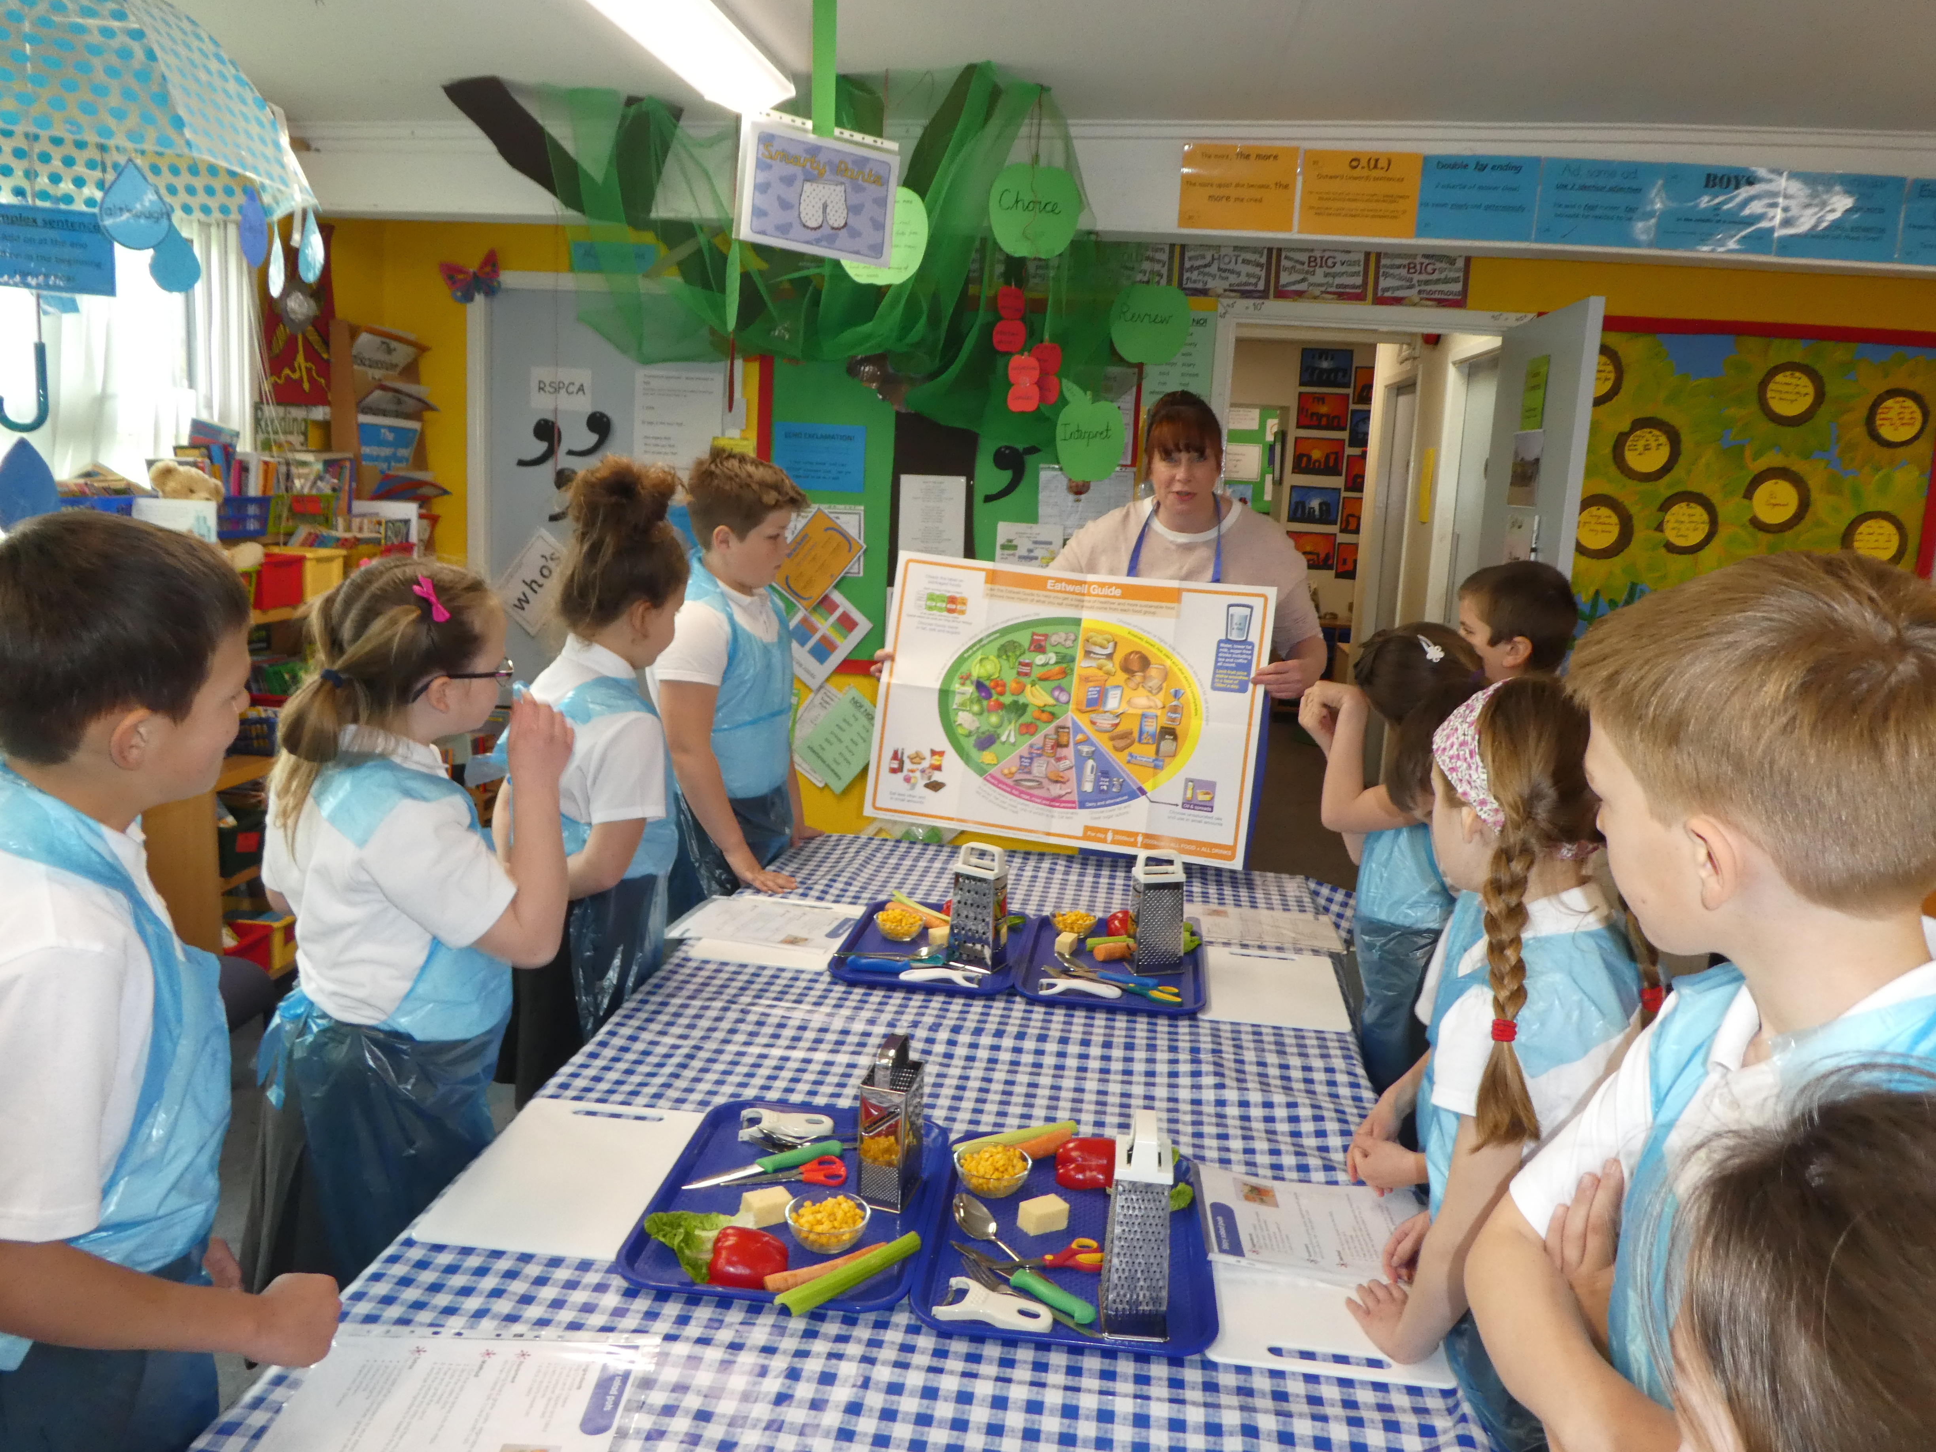
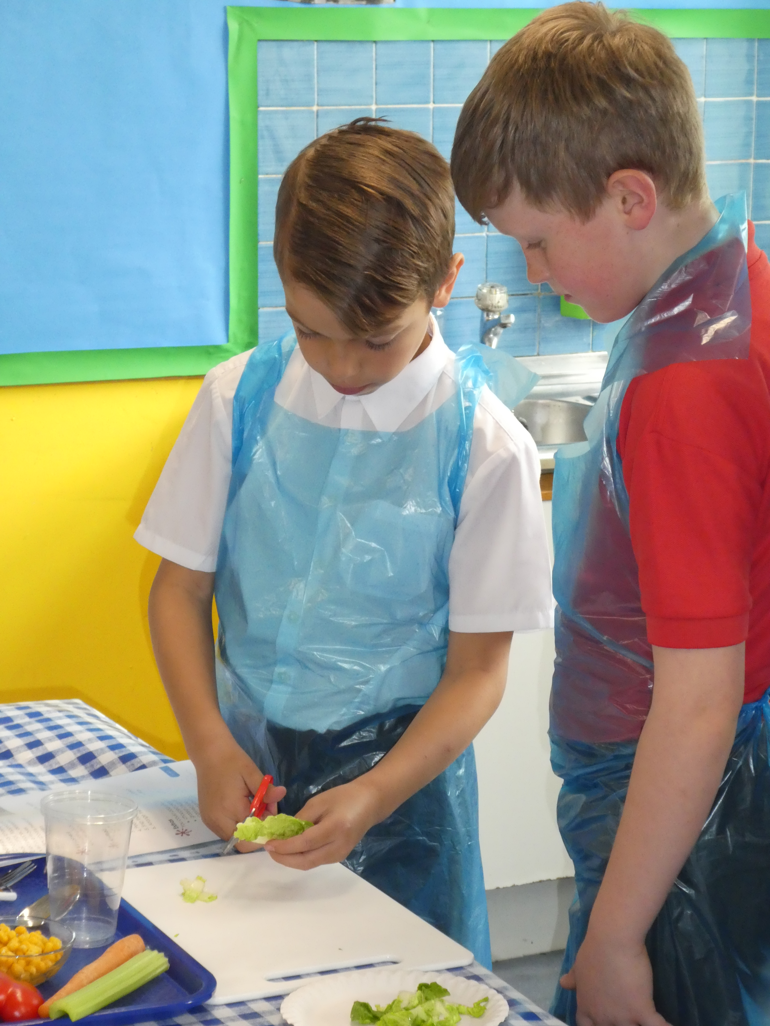
How to run practical food lessons in the primary school classroom
How will you organise the lesson?
Think about:
table/furniture layout?
individual or group work?
ingredients – partly prepared?
equipment – organisation, amount – group work, ‘spotters’?
demonstrating – how, where?
try it at home!
Organisation and preparation is key!

Slide 10
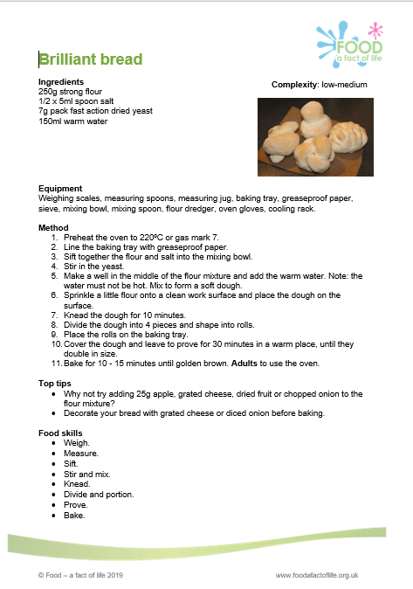
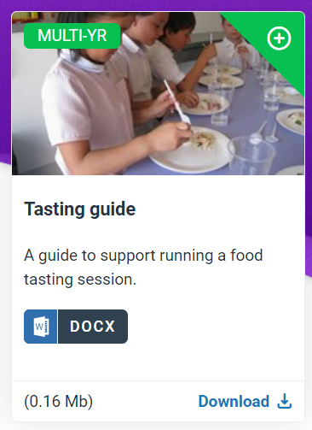
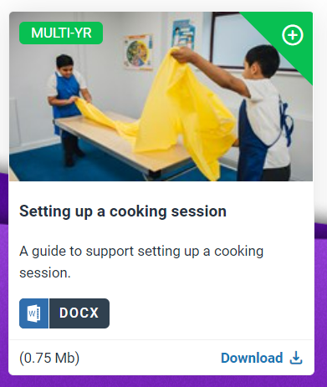
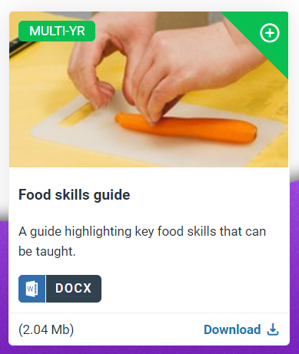
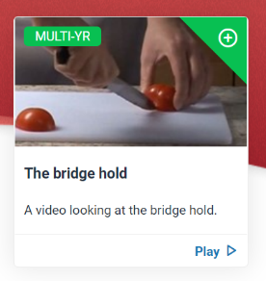
How to run practical food lessons in the primary school classroom
How will you organise the lesson?
Take a look at the guides, recipes and videos to help!

Slide 11
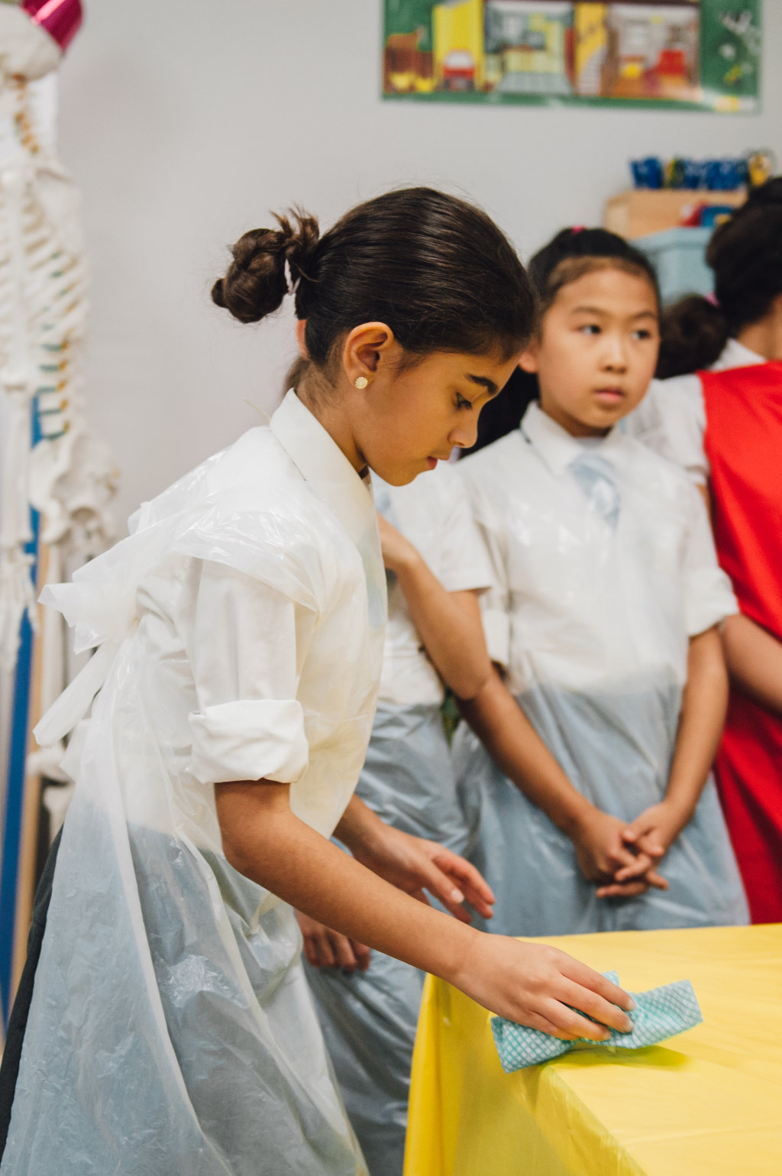
How to run practical food lessons in the primary school classroom
What routines and procedures will you have in place?
For:
getting pupils ready to cook, e.g. handwashing?
setting up, e.g. trays side of the room?
using sharp equipment, e.g. stay at the table?
using hot equipment, e.g. safe space around hob/oven, use of oven gloves, 1 person at a time?
tidying away, wiping tables, removing aprons?
washing up – where? rota?
food waste?
other adults?
Make sure everyone knows what they need to do!

Slide 12
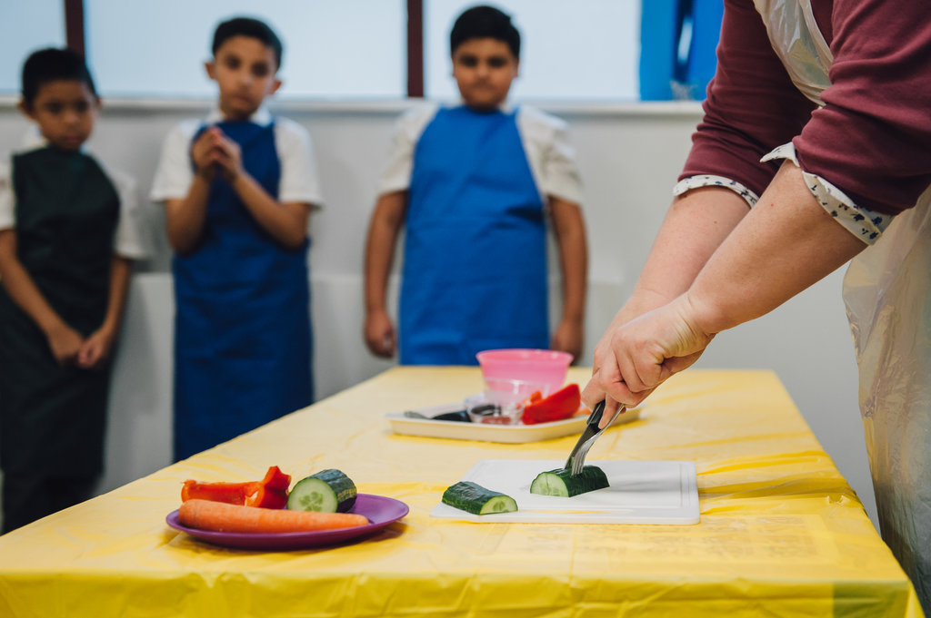
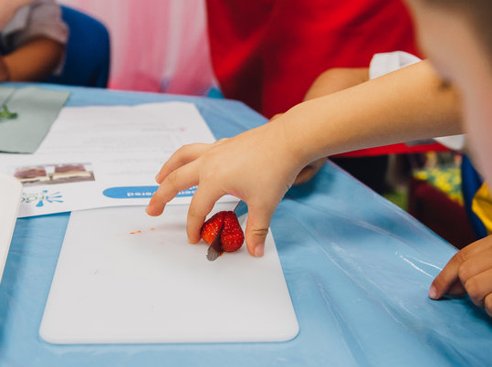
Developing food skills
Thinking about you
Make sure you feel confident about teaching the food skills safely
Plan a manageable lesson that you feel comfortable with - start small, e.g. make vegetable soup with low-risk ingredients and then move onto handling and cooking meat
Be organised and think everything through carefully – risk assessment
Organise extra support in the classroom
Put procedures in place in case of an injury – make sure pupils know about these too
Make sure you are confident and comfortable with your plan for the lesson.

Slide 13
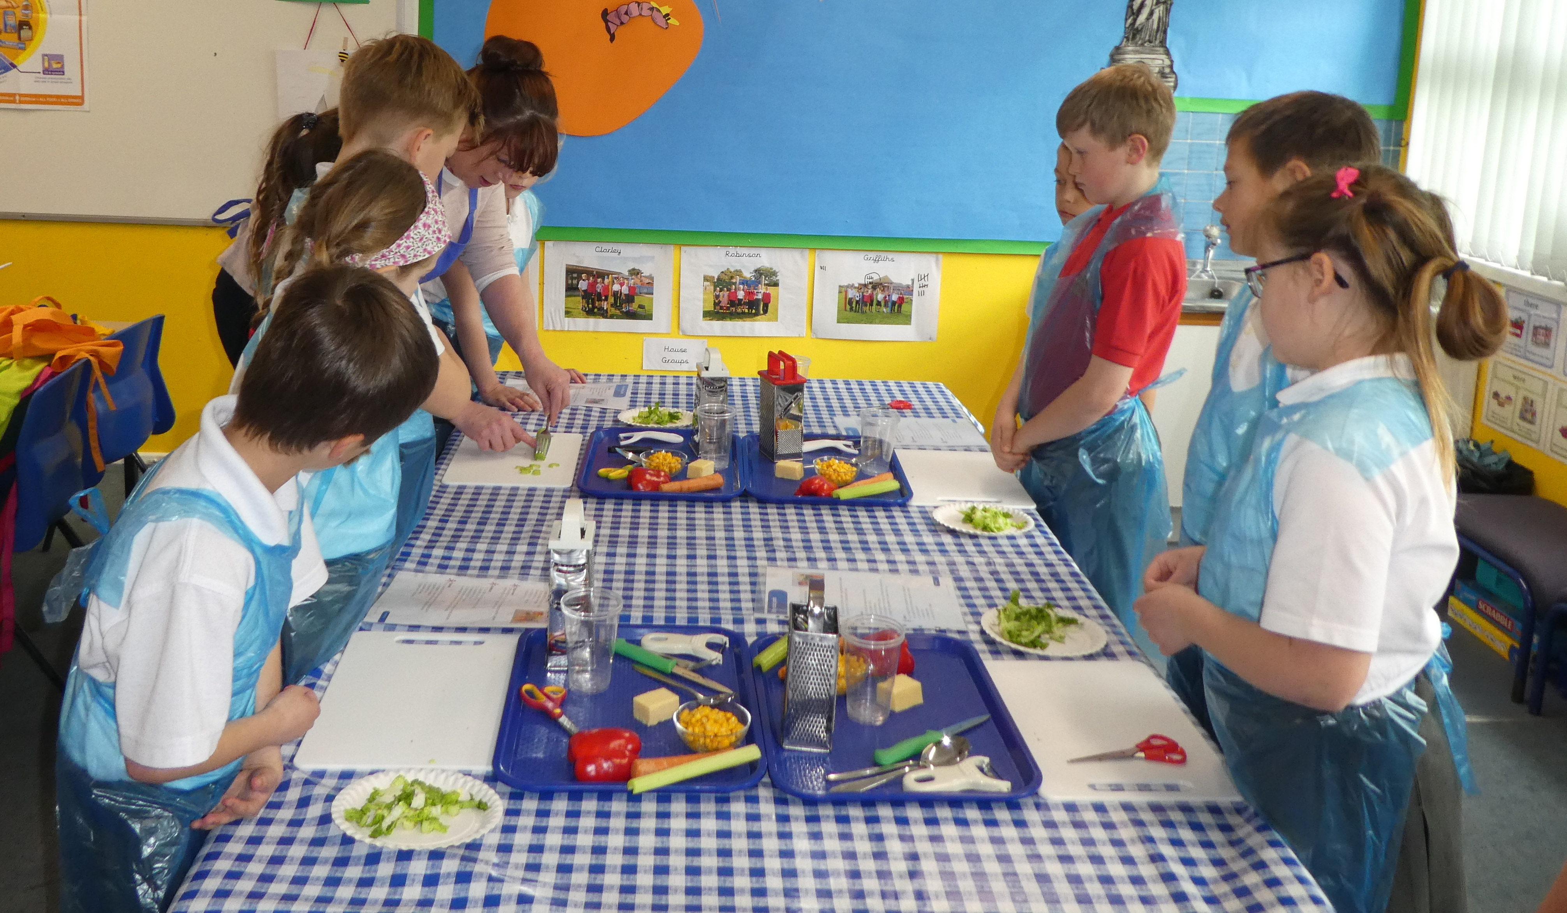
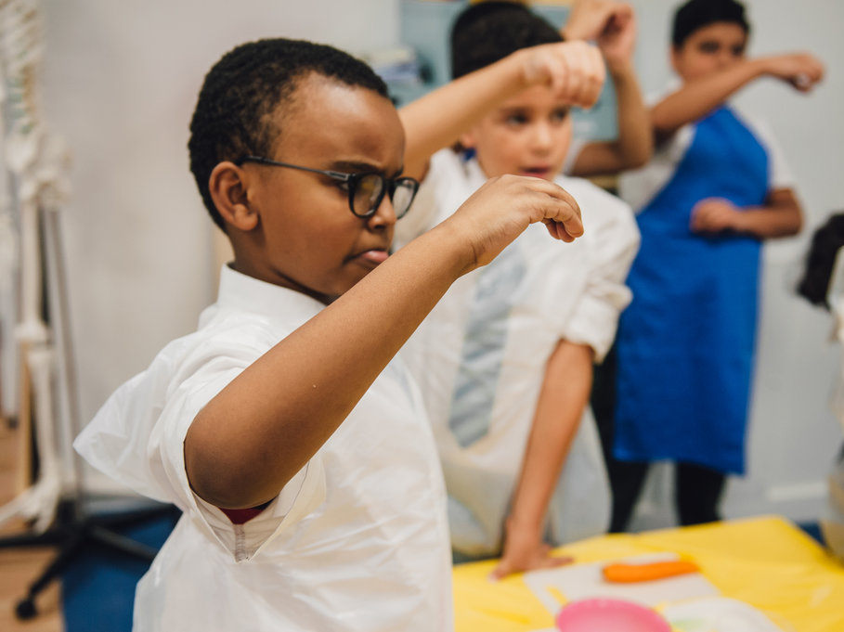
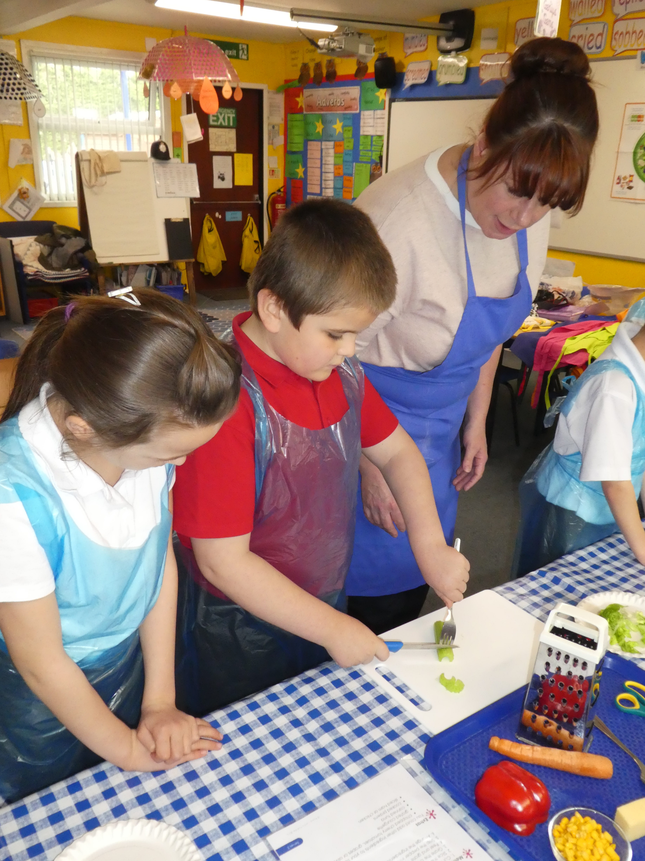
Developing food skills
Thinking about the pupils
Are they used to the routines of food lessons? E.g. getting ready to cook, rules for using equipment
What are their food skill capabilities?
Have you got equipment that is an appropriate size for their hands?
Will the ingredients be appropriate in terms of size, firmness (not too hard to cut)?
Will they be able to see your food skill demonstration properly?
How long will they need to avoid having to rush?
Think it through from a pupil perspective.

Slide 14
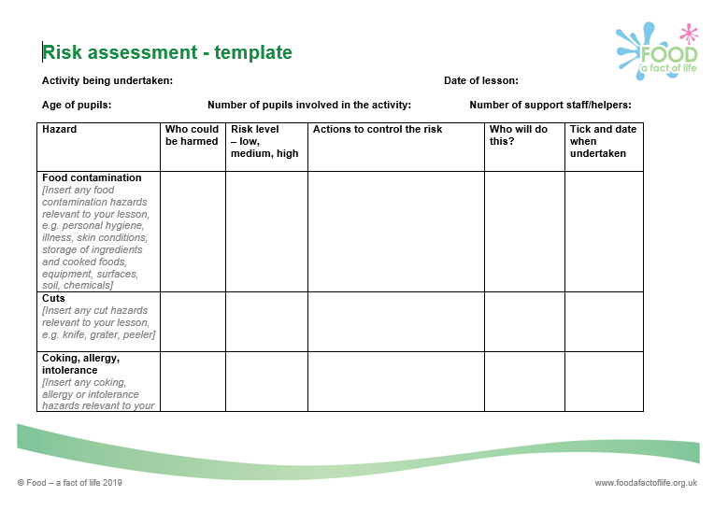
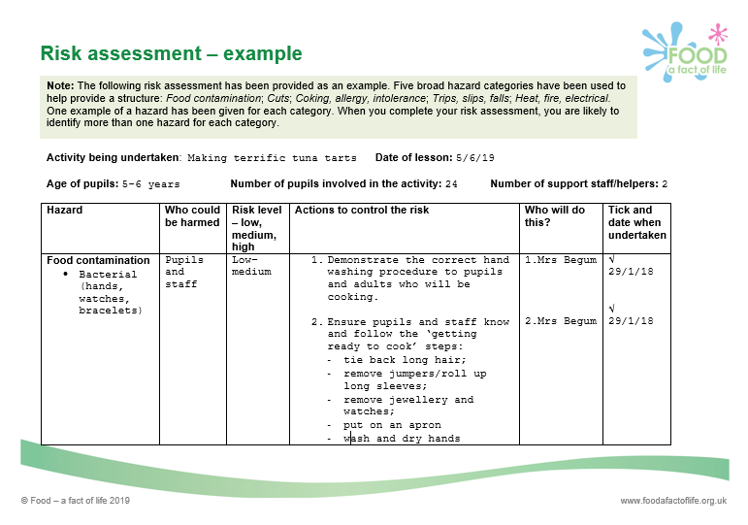
Why is good food hygiene and safety important?
To prevent food poisoning – pupils, parents and staff.
Teacher’s own indemnity.
Considerations:
Do you need a food hygiene and safety award/certificate?
Risk assessments – exemplars available on Food – a fact of life

Slide 15

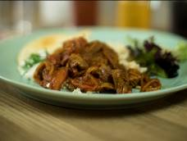






Curry in a hurry – Lamb Rogan josh
Why are we doing this?
Learning in lesson: focus on skill/knowledge, not recipe.
Demonstrates using an extended range of cooking equipment and skills with growing accuracy and confidence to prepare increasingly challenging ingredients:
Weigh and measure
Knife skills – cut, peel, slice, crush, chop
Stir
Fry, boil and simmer (use of the hob)
Demonstrates cooking with a heat source.
Quick recipe – under 1 hour. Can be made in pairs or groups.
Great for using up leftovers and easy to change/adapt ingredients.
Opportunity to develop descriptive vocabulary during tasting and testing.
Food teaching progression 5-11 years chart

Slide 16
Curry in a hurry – Lamb Rogan josh
Ingredients
225g lean lamb leg steaks or neck fillet
1 onion
2 tomatoes
1 clove garlic
1 x 15ml spoon fresh coriander
1 x 5ml spoon oil or spray oil
2 x 15ml spoons Rogan josh curry paste
200g can chopped tomatoes
Method
Cube the lamb and remove any visible fat. Thoroughly wash and dray hands.
Prepare the vegetables:
peel and slice the onion;
cut the tomatoes into wedges;
peel the garlic and crush or chop;
roughly chop the coriander.
Heat the oil in a large pan and add the lamb. Cook for 3-4 minutes.
Add the Rogan josh curry paste, sliced onions and garlic. Cook for a further 2-3 minutes.
Add the canned and fresh tomatoes and cook for further 2 minutes.
Stir the chopped coriander into the curry and serve.

Slide 17
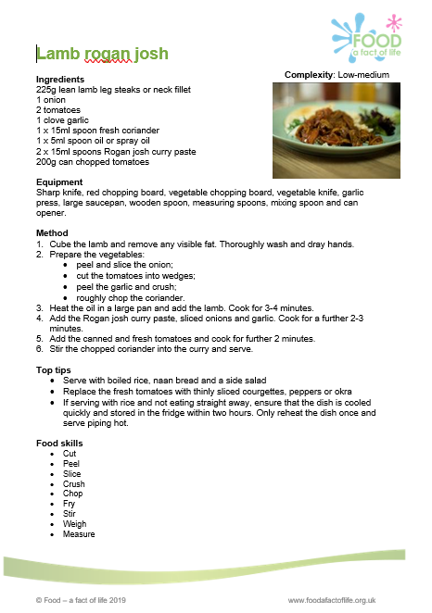
An ingredient check letter has been sent home.
Ingredients checked for allergens (especially packaged foods).
Do you need separate equipment for pupils with allergies or intolerances?
Equipment is appropriate for size of children’s hands.
Equipment is stored safely, that it is in working order, clean and ready to use (count knives and sharp tools out and in).
Ingredients and finished dishes are stored safely.

Slide 18
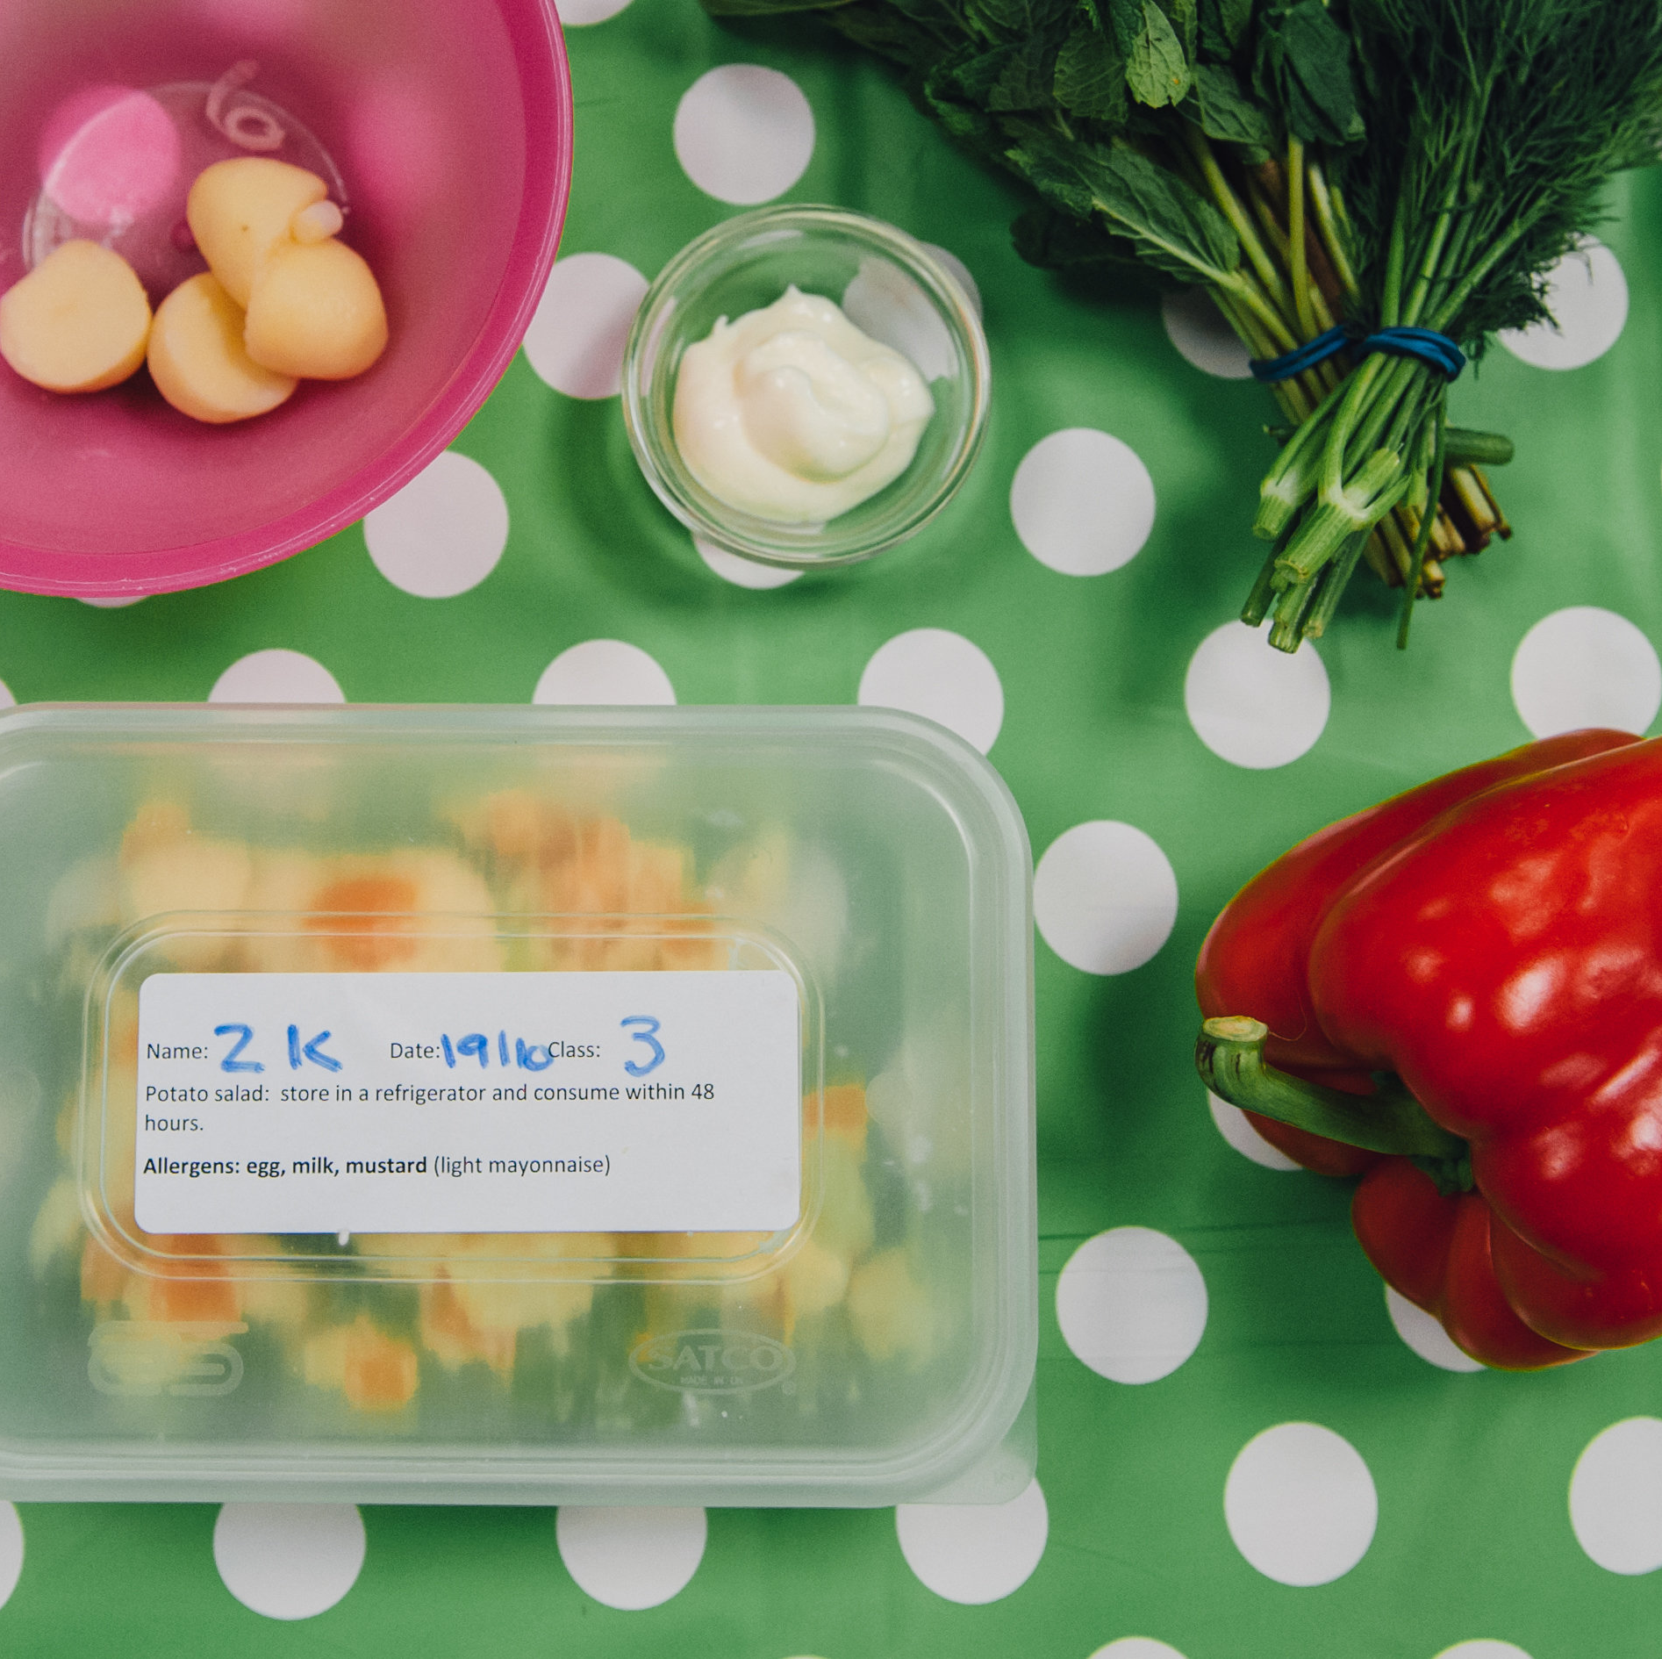
Storage of ingredients and finished dishes
In order to prevent bacterial multiplication and cross-contamination, it is important that safe storage practices are followed:
Store allergenic ingredients, such as flour and nuts, separately in lidded containers. Label with an ‘opened’ or ‘best before’ date.
Store high risk ingredients such as meat, fish and dairy in the fridge below 5°C.
Store raw ingredients below cooked or ready to eat foods in the fridge to prevent cross-contamination.
Decant part used cans into plastic containers with a lid. Label with a ‘use by’ date. Store in the fridge.

Slide 19
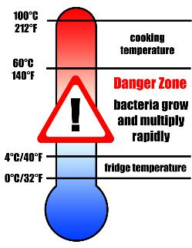
Storage of ingredients and finished dishes
Store all opened jars and bottles in the fridge and label with an ‘opened on’ or ‘use by’ date.
Cool cooked food quickly and store below 5°C within 90 – 120 minutes.
Check and record fridge temperatures regularly.
Clean fridges regularly with hot soapy water and a sanitising spray.

Slide 20
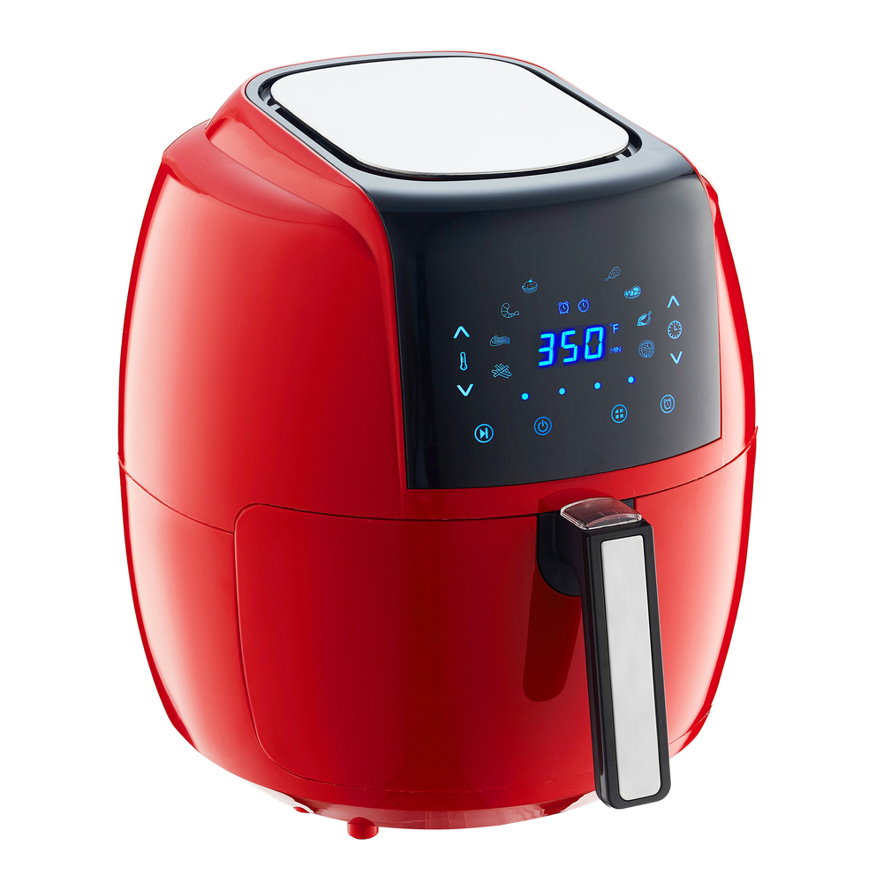
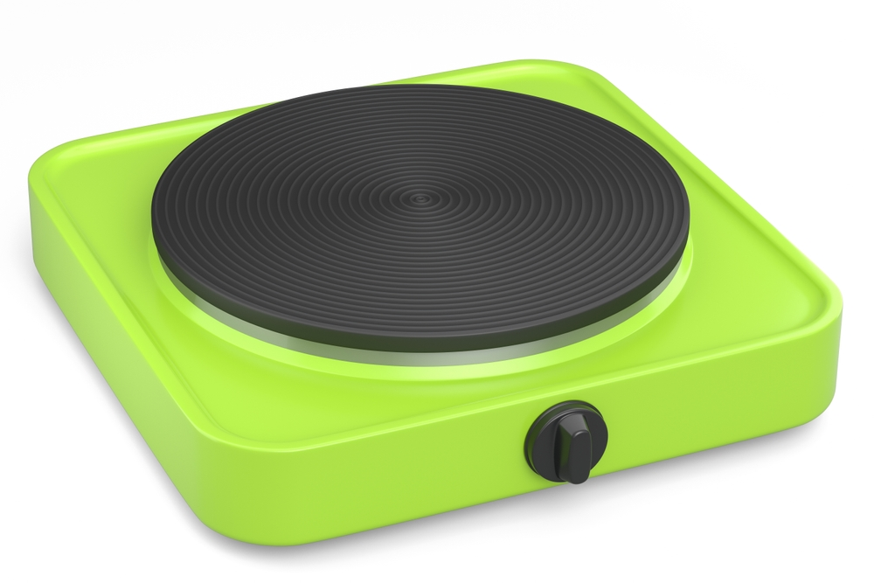
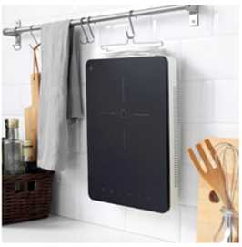
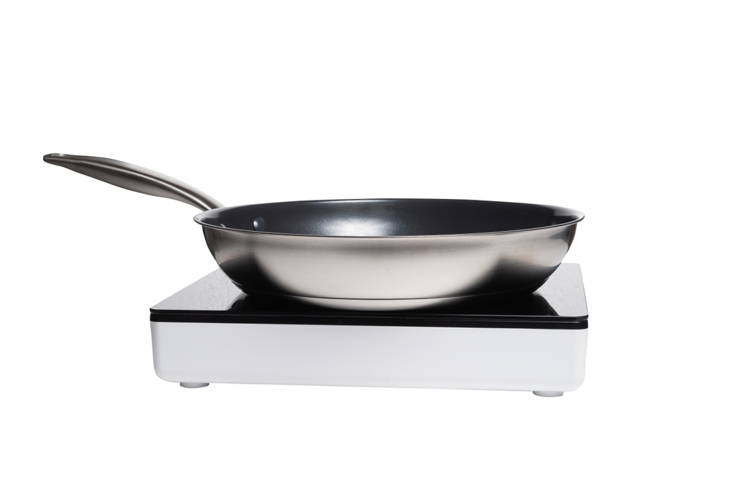
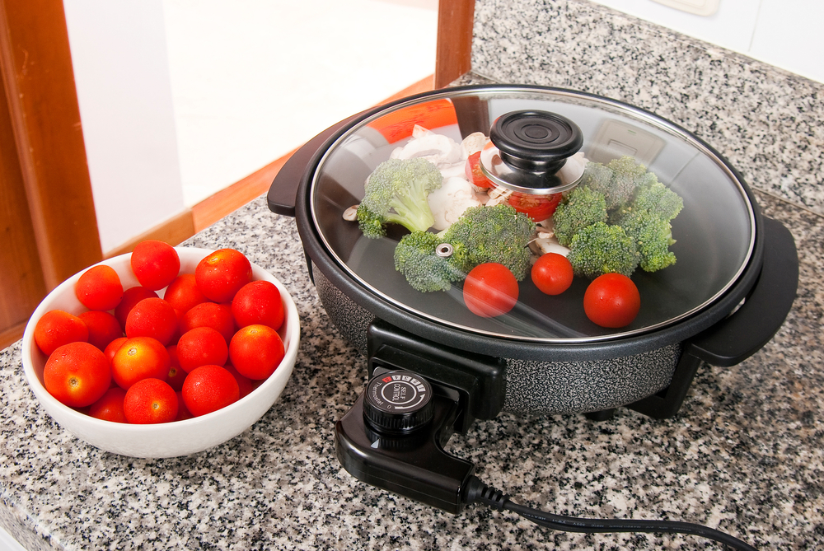
Equipment
Portable hobs
Air fryers
Approx. £35 each
You might need new pans!
‘Party pans’ – electric frying pans

Slide 21
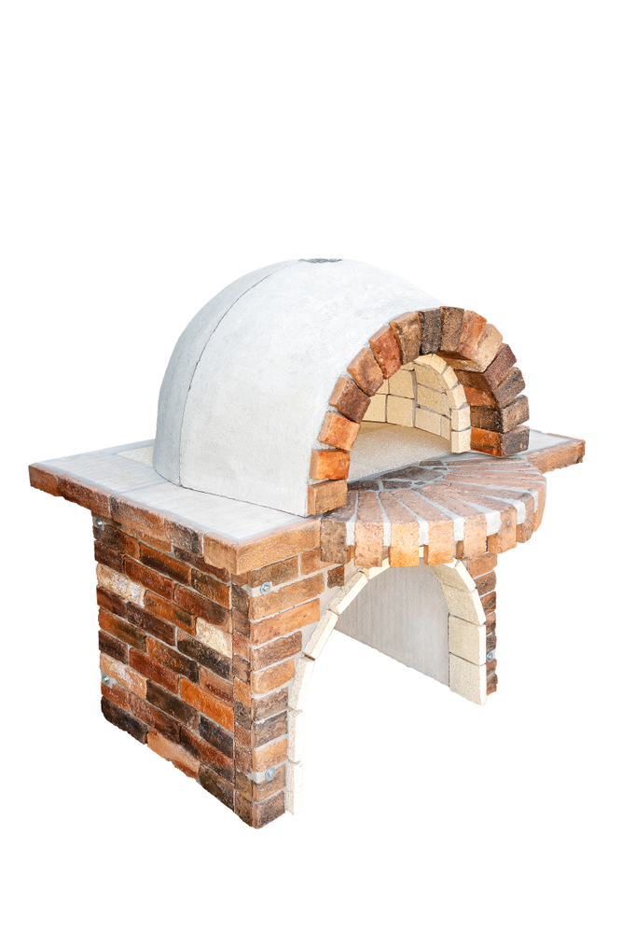
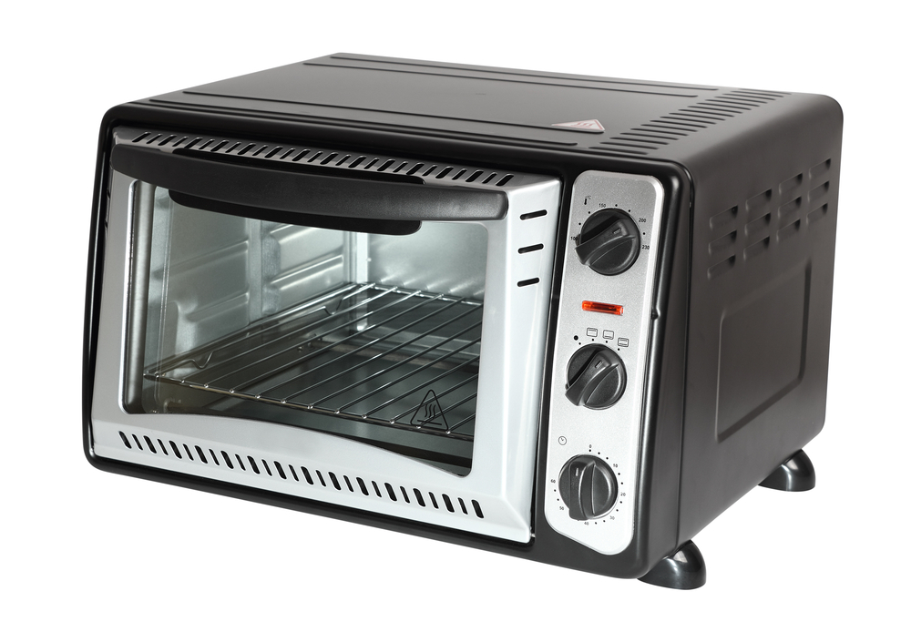
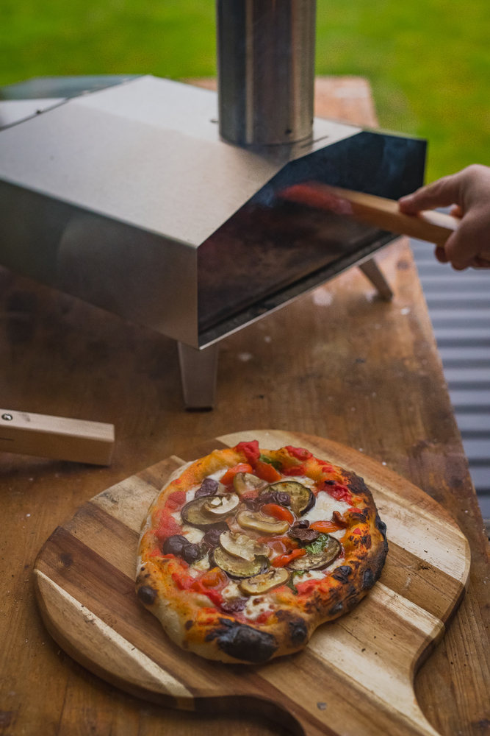
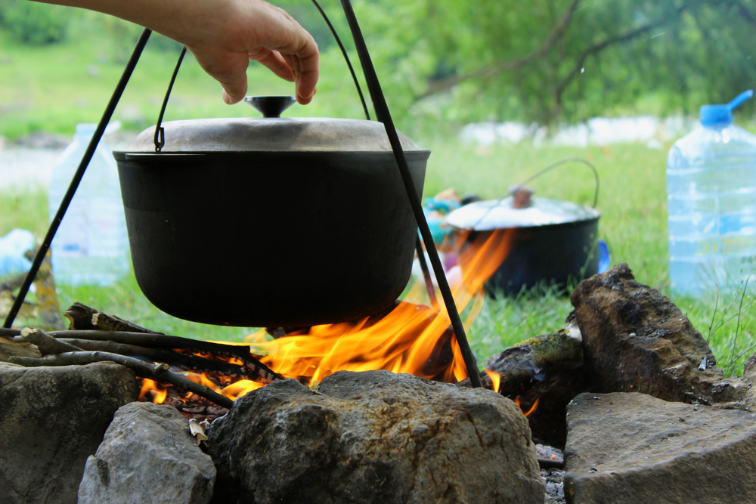
Equipment
Portable oven (with/without hob)
Pizza oven
Outdoor cooking area

Slide 22
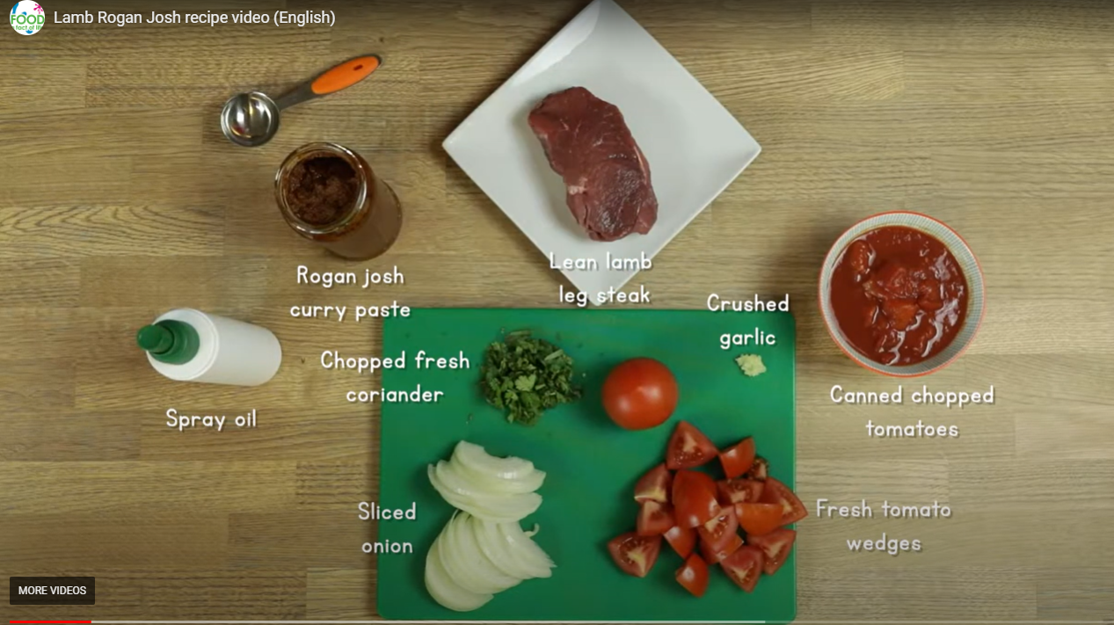
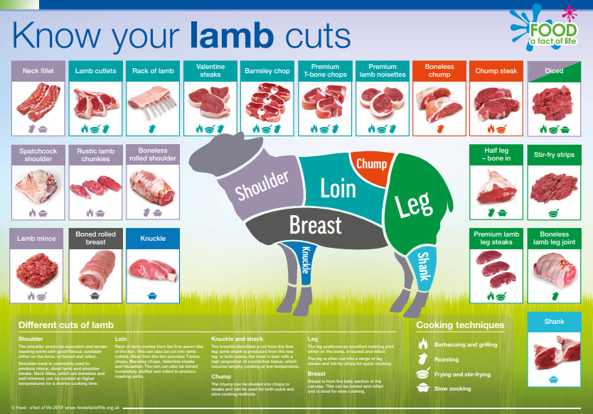
Lamb Rogan josh resources
Lesson guide – for 11-14 pupils but provides ideas for starter and plenary activities that could be adapted for upper primary level
Lamb Rogan josh labels for finished dishes
Lamb Rogan josh recipe costing spreadsheet – ideal for a numeracy extension activity
Meat for my meal (lamb) worksheet
Meaty eats recipe video (quick 1 minute inspiration video)
Lamb Rogan Josh (curry in a hurry) video (full recipe)
Posters

Slide 23
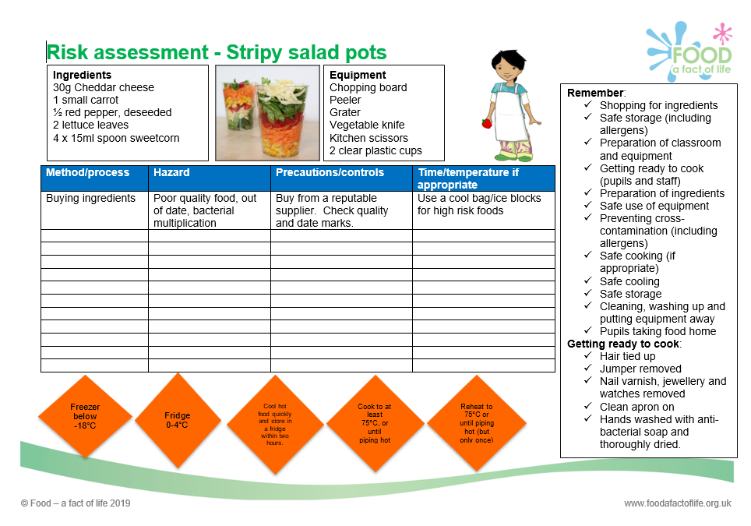
Food – fact of life resources
Resources to support running practical food lessons, developing food skills and good food hygiene and safety can be found in the PPT presentations from recent TPFN webinars:
Running practical food lessons and good food hygiene and safety
Knife skills workshop
The recordings are also available here.

Slide 24
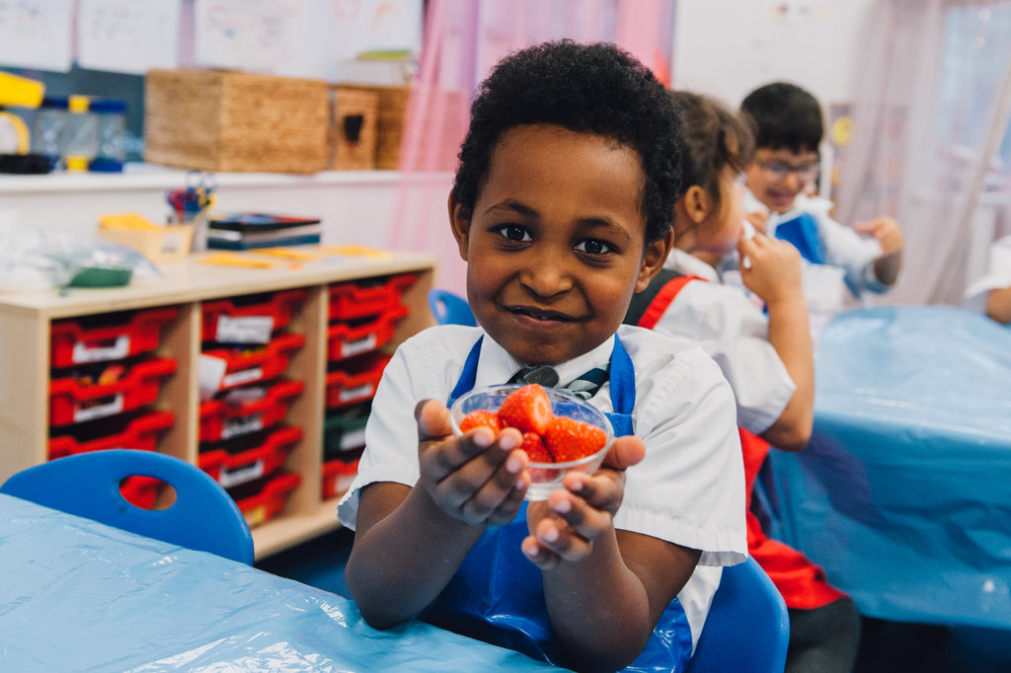
TPFN training
All webinars have been recorded and can be found here.
Coming soon!
FREE ‘INSET package’ for you to use with your colleagues in school. Recorded presentations will include:
A ‘state of the nation’ presentation on children’s health in the UK
The importance of school food in primary schools
Healthy eating and cooking in primary schools
Grow Your Own Potatoes programme for primary schools and resources on Food – a fact of life
Food and farming - a demonstration of what can be offered to primary schools on farms (in person and virtually)
TasteEd – sensory education in primary schools
The science of food – practical ideas and experiments to support using food as a context for learning across the curriculum

Slide 25
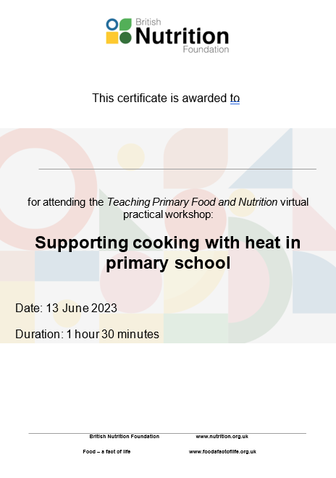
Thank you
Please complete the webinar evaluation. If you are watching a recording of this webinar, you will find a link to the evaluation at the end of the PPT presentation here.
Supporting cooking with heat in primary school
You will receive a link to the certificate once you have completed the evaluation. Please download the certificate, add your name and print it out for your records.

Slide 26
Supporting cooking with heat in primary school
For further information and resources, go to: www.foodafactoflife.org.uk
Email: education@nutrition.org.uk

