Slide 1
Food poisoning

Slide 2
Food poisoning
Food Standards agency research shows that:
An estimated 2.4 million cases of foodborne illness occur every year in the UK.
Campylobacter and Salmonella cause the greatest burden of disease in terms of number of reported cases each year.
Listeria monocytogenes and Shiga toxin-producing E. coli (STEC) O157 cause more severe disease leading to higher rates of hospitalisation and death.
An estimated 380,000 cases linked to foodborne norovirus occur in the UK every year with 30% linked to eating out and 26% to takeaways.
FSA and United Kingdom Food Security Report

Slide 3
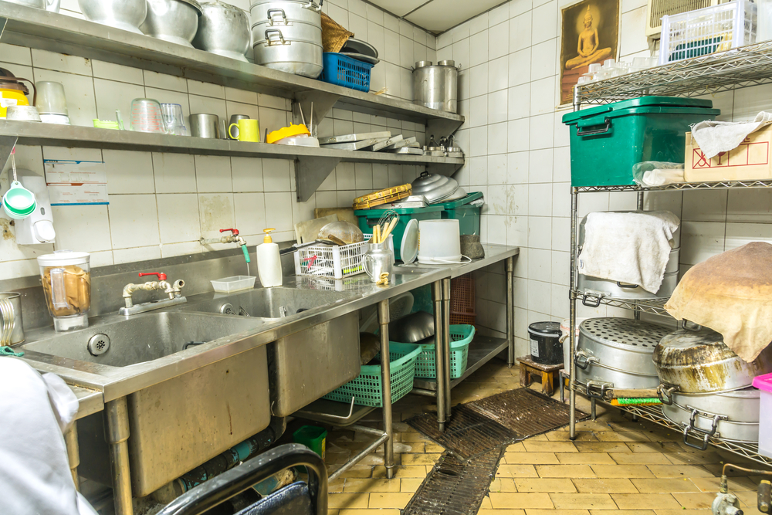
Food poisoning
Food poisoning may result from poor domestic food preparation, or poor food processing in industry including restaurants, cafes and take-away food.
This may result in loss of business and people’s jobs if it is a serious outbreak.

Slide 4
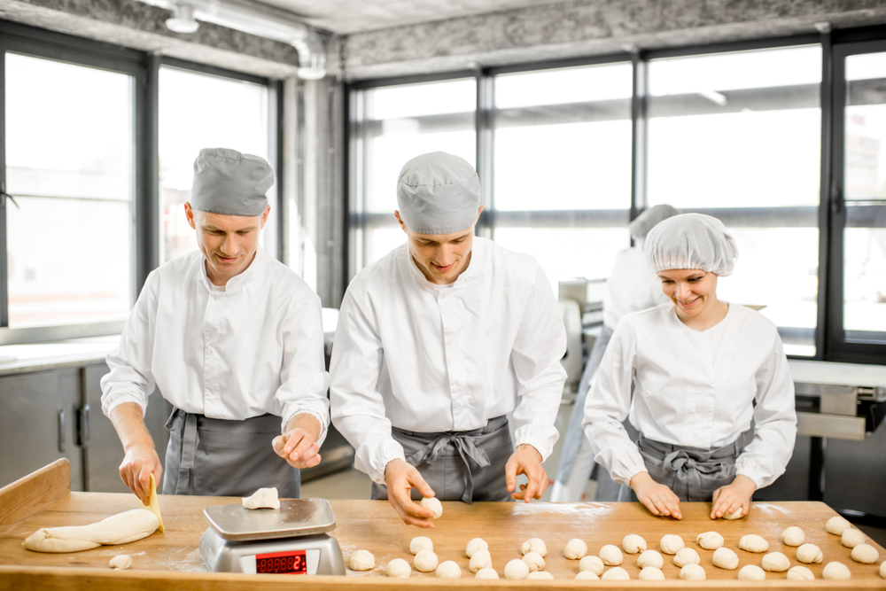
Food poisoning
Micro-organisms occur naturally in the environment, on cereals, vegetables, fruit, animals, people, water, soil and in the air.
Most bacteria are harmless but a small number can cause illness.
Food which is contaminated with food poisoning micro-organisms can look, taste and smell normal.

Slide 5
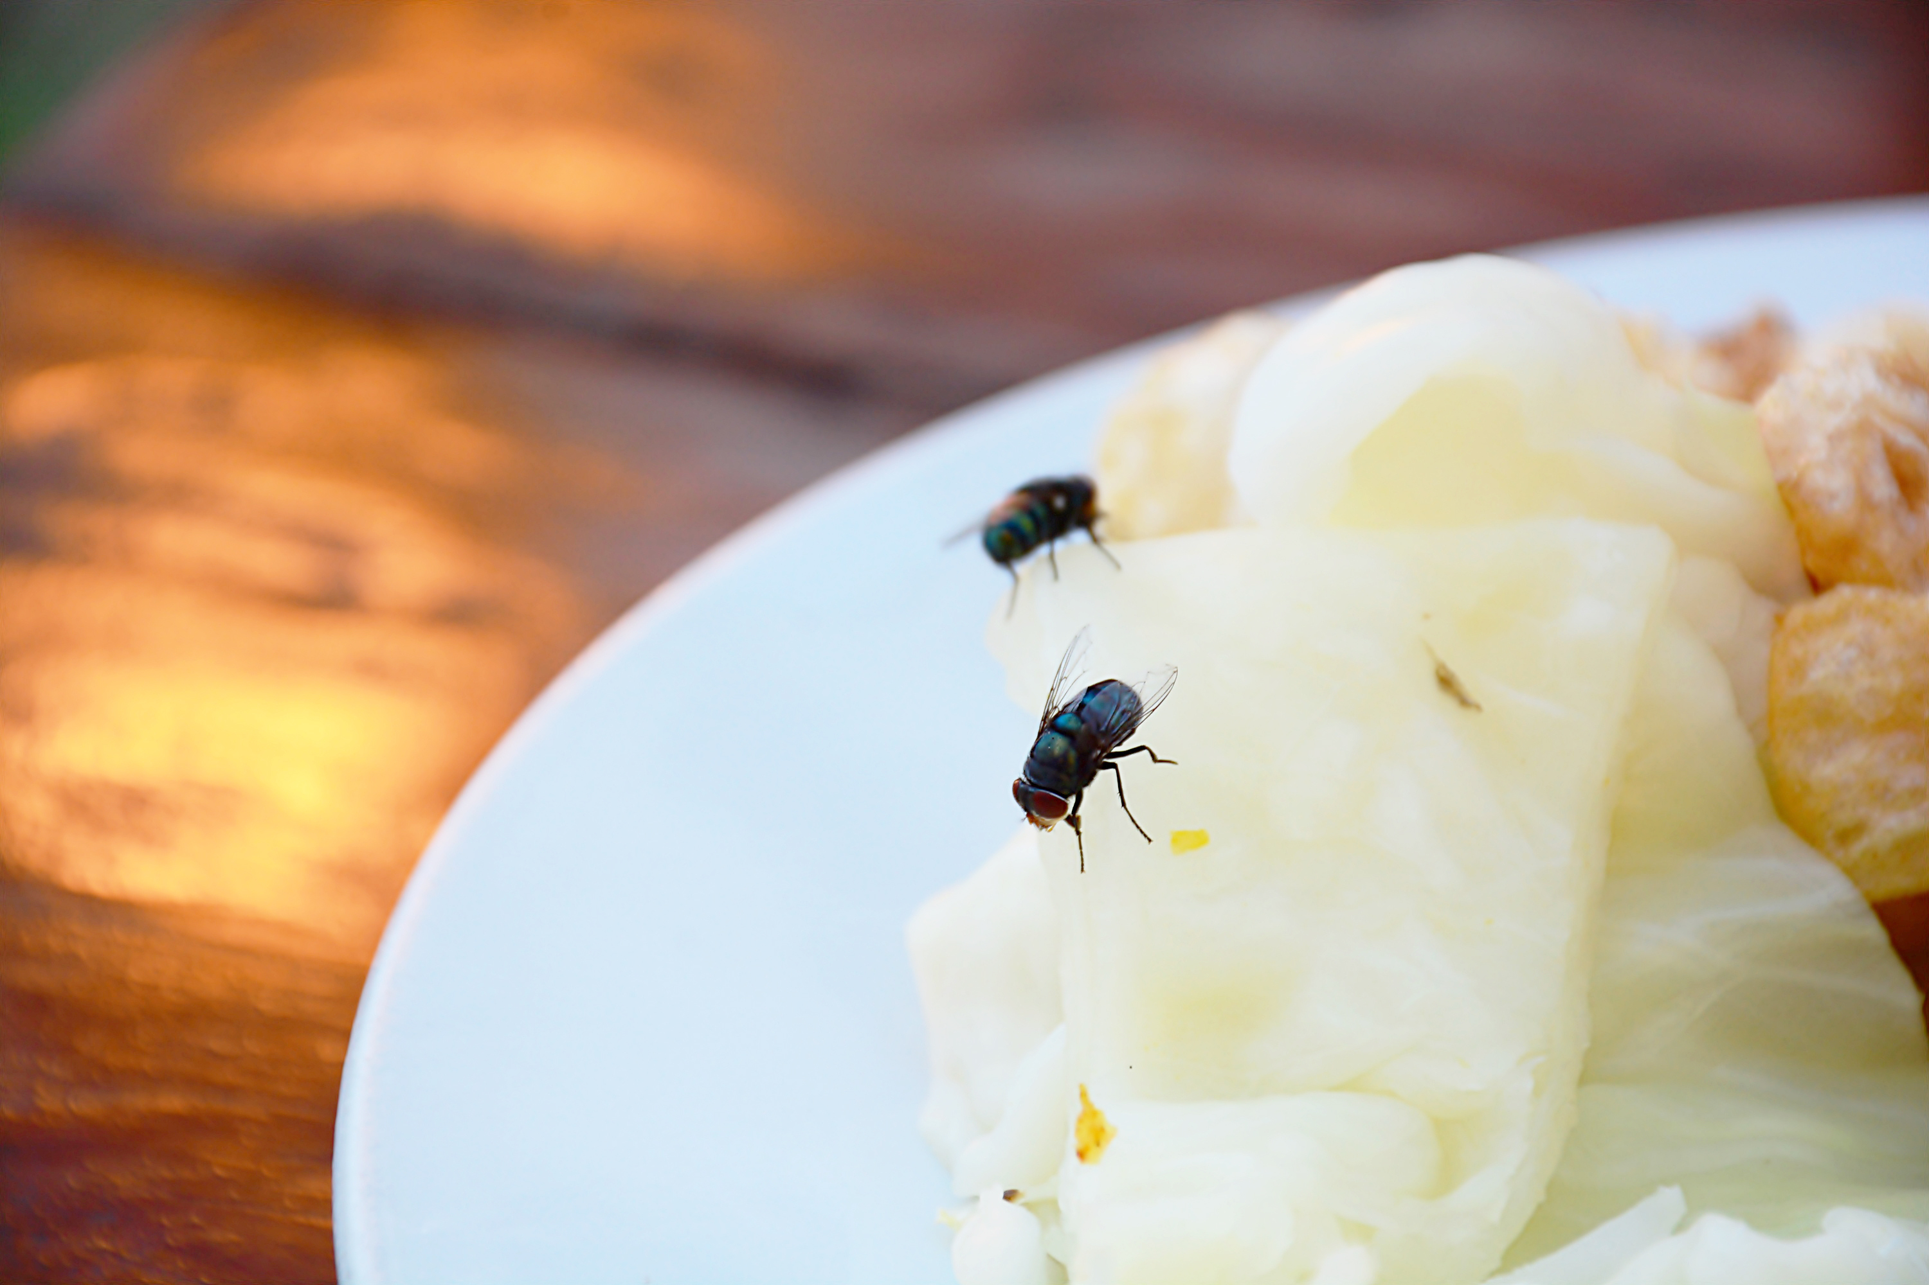
Food spoilage
Changes in food, either through enzyme deterioration of food or micro-organism growth, will eventually lead to the food becoming inedible or unsafe if eaten.
The rate of deterioration depends on a variety of factors which must be controlled carefully.
Contaminants may be already present in the food, e.g. salmonella in chicken or transferred to the food by humans, flies, rodents and other pests.

Slide 6

High risk foods
Some foods are high-risk, as they provide the ideal conditions needed for micro-organisms to grow. These include:
meat, meat products and poultry;
milk and dairy products;
eggs – uncooked and lightly cooked;
shellfish and seafood;
prepared salads and vegetables;
cooked rice and pasta
If these foods become contaminated with food-poisoning micro-organisms and conditions allow them to multiply, the risk of food-poisoning increases.
Lion mark hen eggs can now be eaten raw or lightly cooked. Although people who have a severely weakened immune system and who are on a medically supervised diet prescribed by health professionals should cook all eggs thoroughly, even eggs that have the Red Lion stamp.

Slide 7

People at high risk
Elderly people, babies and anyone who is ill or pregnant needs to be extra careful about the food they eat.
For example, pregnant women or anyone with low resistance to infection should avoid high risk foods such as unpasteurised soft cheese.

Slide 8
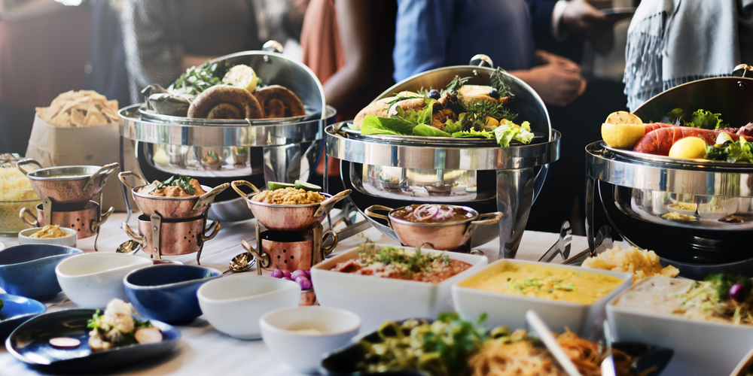
Factors affecting food poisoning
Some common factors leading to food poisoning include:
preparation of food too far in advance;
storage at ambient temperature;
inadequate cooling;
inadequate reheating;
under cooking;
inadequate thawing.

Slide 9
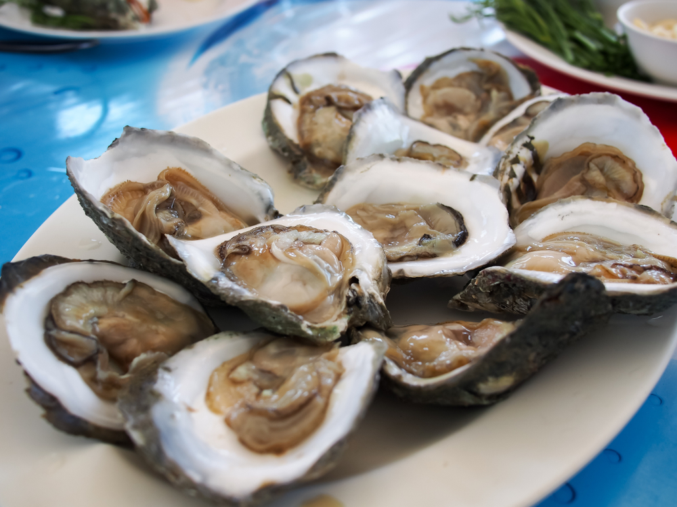
Factors affecting food poisoning
Further common factors leading to food poisoning include:
consuming raw food;
improper warm holding (i.e. holding ‘hot’ food below 63ºC);
infected food handlers;
contaminated processed food;
poor hygiene.

Slide 10

Symptoms of food poisoning
Food poisoning can be mild or severe. The symptoms will be different depending on what type of bacteria is responsible.
Common symptoms include:
severe vomiting;
diarrhoea;
exhaustion;
headache;
fever;
abdominal pain;
tiredness.

Slide 11
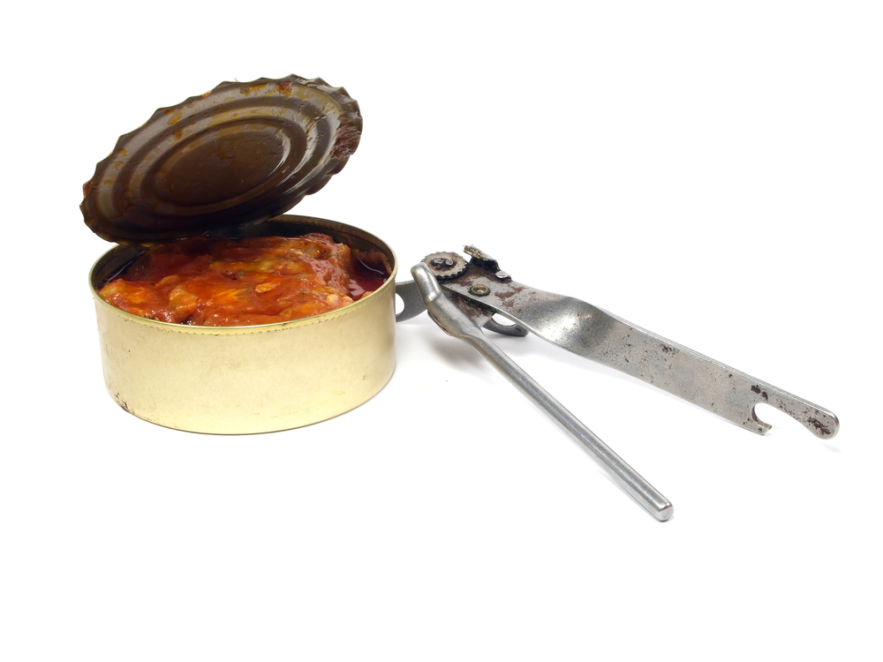
Preventing food spoilage, contamination and poisoning
Tips for buying food include:
it is illegal to sell food that has passed its ‘use by’ date;
dented, blown or rusted cans of food should not be purchased;
frozen food which has frozen together in the pack should not be purchased;
do not buy food where the packaging has been damaged;
only shop in clean and hygienic stores.

Slide 12
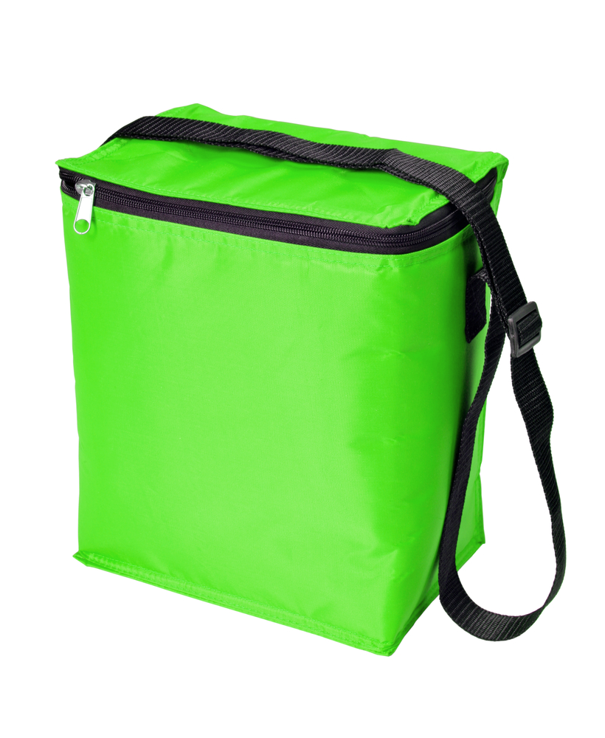
Preventing food spoilage, contamination and poisoning
Tips for transporting food back home:
buy chilled and frozen foods at the end of the shopping trip;
keep frozen and chilled foods cold, by using cool boxes/bags and packing these types of foods together;
cooked and uncooked foods should be kept separate;
dry and moist foods should be packed separately;
household chemicals should be packed separately.

Slide 13
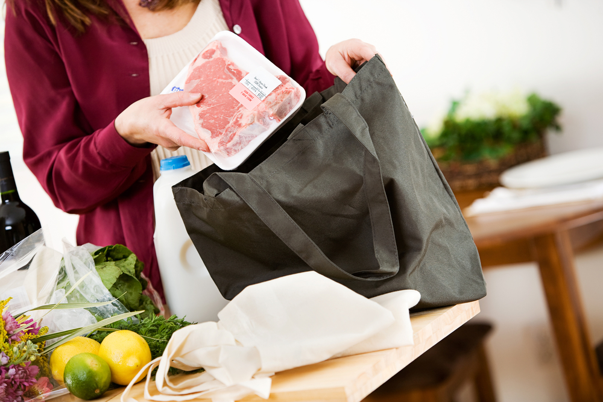
Preventing food spoilage, contamination and poisoning
Tips for storing food in the home:
food should be unpacked as soon as possible;
old stocks of food should be used before buying new ones (first in, first out theory);
store food in the correct place, i.e. dry food, in cool, dry clean places and chilled food in the refrigerator.

Slide 14
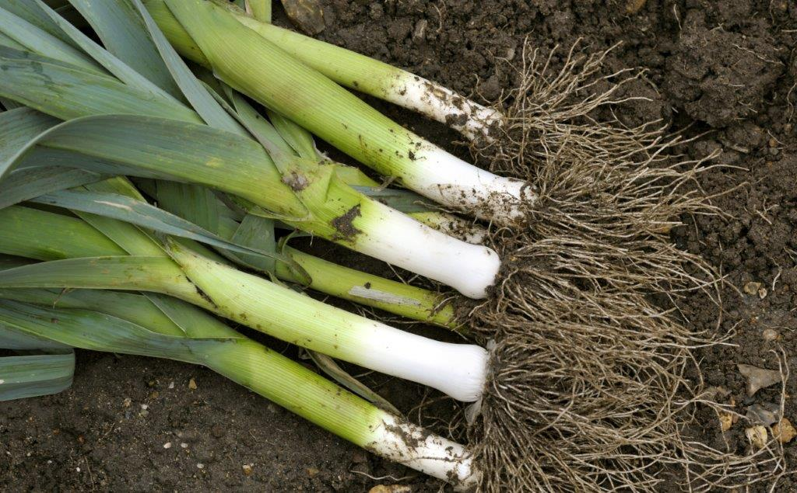
Bacteria - Clostridium botulinum
Sources
Fish and meat. Dust, soil and vegetables. Inadequately processed canned meat, vegetables and fish (faulty canning).
Signs and symptoms
Onset 12-36 hours. Voice change, double vision, drooping eyelids, severe constipation.
Death within a week or a slow recovery over months.

Slide 15
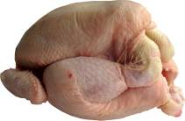
Bacteria – Campylobacter
Sources
Raw and undercooked poultry, unpasteurized milk, contaminated water.
Signs and symptoms
Onset 2 – 5 days (can be longer). Fever, headache and dizziness for a few hours, followed by abdominal pain.
This usually lasts 2 – 7 days and can recur over a number of weeks.

Slide 16
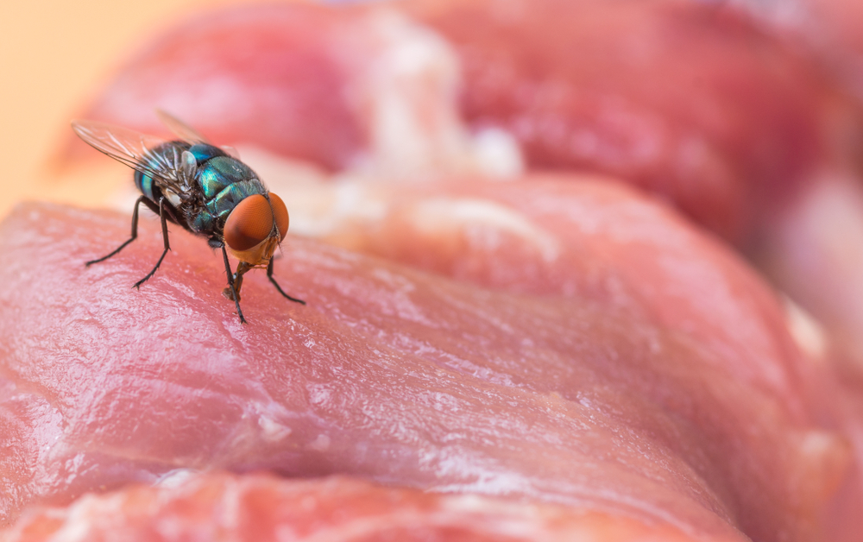
Bacteria - Clostridium perfringens
Sources
Animal and human waste. Dust, soil and vegetables. Raw meat. Insects.
Signs and symptoms
Onset 12-18 hours. Abdominal pain, diarrhoea and nausea.
This usually lasts 12 – 48 hours.
Clostridium perfringens forms spores.

Slide 17

Bacteria - E Coli 0157
Sources
Raw and undercooked meat and poultry. Unwashed vegetables. Contaminated water.
Signs and symptoms
Onset usually 3-4 days. Diarrhoea, which may contain blood, can lead to kidney failure or death.

Slide 18
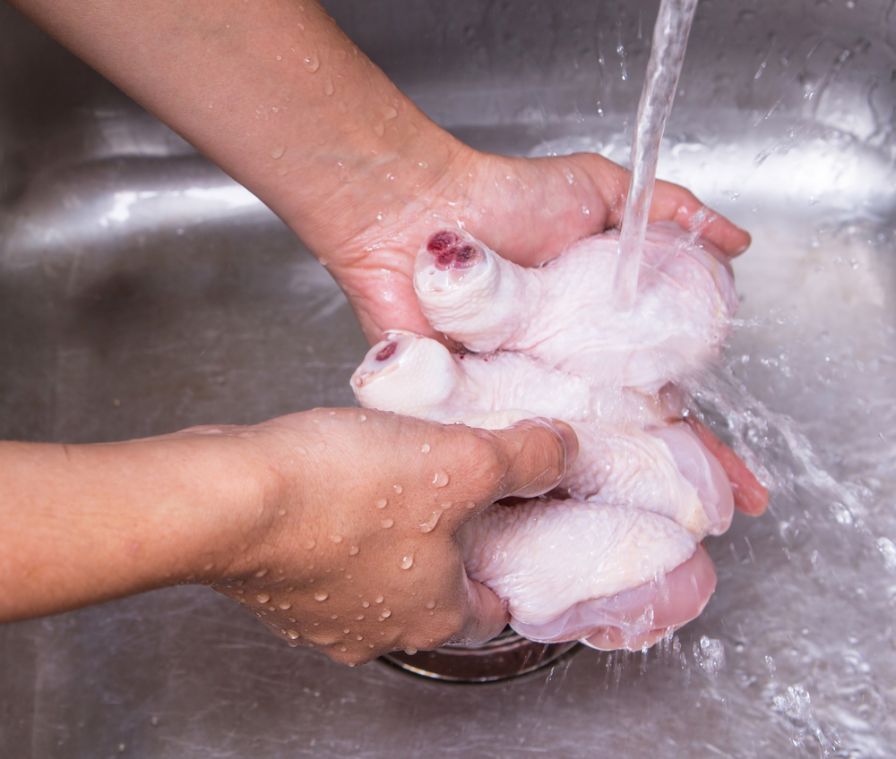

Bacteria – Salmonella
Sources
Raw meat, poultry and eggs. Flies, people, sewage and contaminated water.
Signs and symptoms
Onset 6-48 hours. Headache, general aching of limbs, abdominal pain and diarrhoea, vomiting and fever.
This usually lasts 1 – 7 days, and rarely is fatal.

Slide 19

Bacteria - Staphylococcus aureus
Sources
Humans: nose, mouth and skin. Untreated milk.
Signs and symptoms
Onset 1 – 6 hours. Severe vomiting, abdominal pain, weakness and lower than normal temperature.
This usually lasts 6 – 24 hours.

Slide 20
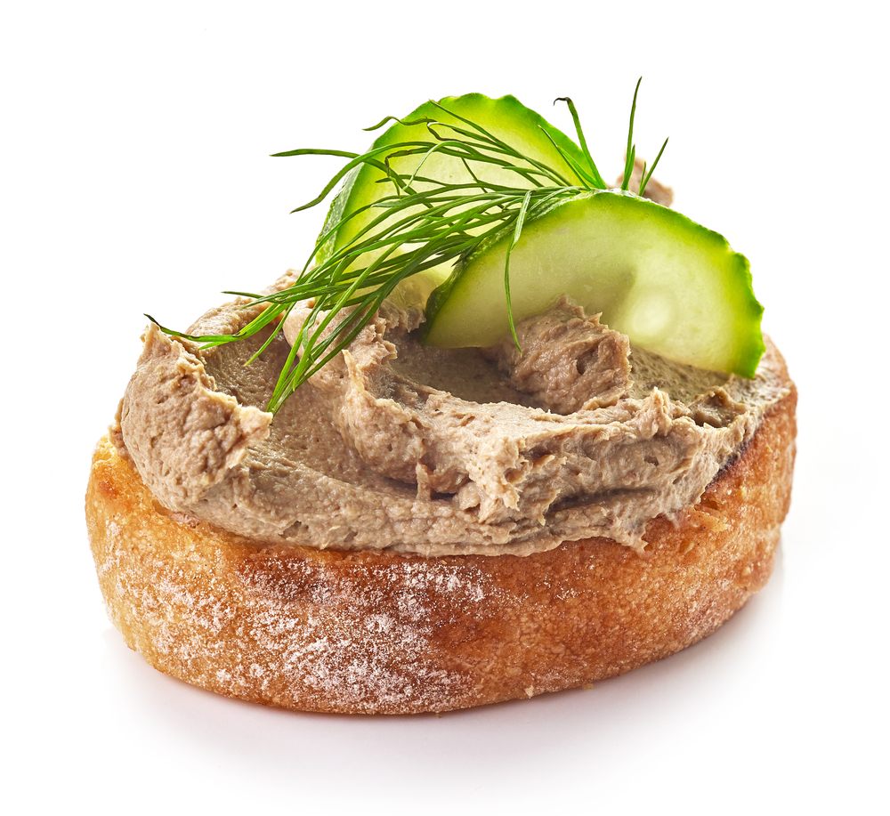
Bacteria – Listeria
Sources
Unpasteurised milk and dairy products, cook-chill foods, pate, meat, poultry and salad vegetables.
Signs and symptoms
Onset 1-70 days. Ranges from mild, flu-like illness to meningitis, septicaemia, pneumonia.
During pregnancy may lead to miscarriage or birth of an infected baby.

Slide 21
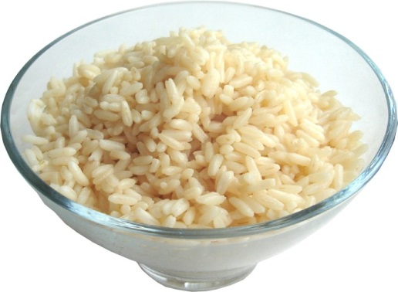
Bacteria - Bacillus cereus
Sources
Rice and cereals. Dust, soil and vegetables.
Signs and symptoms
Ranges nausea and vomiting and abdominal cramps and has an incubation period of 1 to 6 hours .
This usually lasts less than 24 hours after onset.
Bacillus cereus forms spores and releases toxins which cause illness.

Slide 22
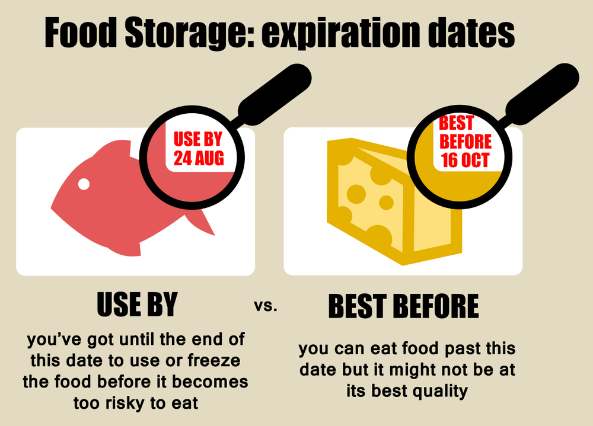
To reduce the risk of food poisoning, follow these simple rules:
Always follow ‘use by’ dates;
Store food correctly, either cold or hot, never warm;
Separate raw and cooked food;
Wash fruits and vegetables;
Thoroughly cook food;
Keep yourself and your workspace clean;
Don’t cough or sneeze over food;
Thoroughly wash and dry hands regularly.

Slide 23
Food poisoning
For further information, go to:
www.foodafactoflife.org.uk
This resource meets the Guidelines for producers and users of school education resources about food.

