Slide 1


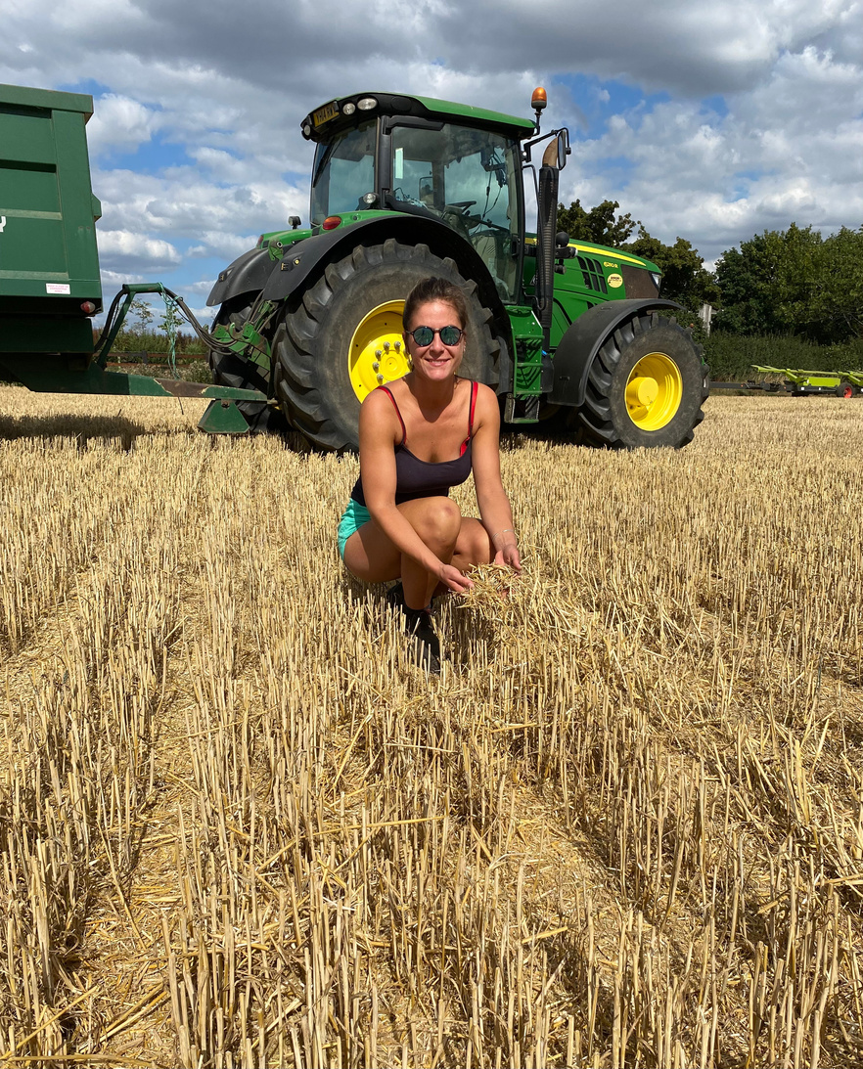

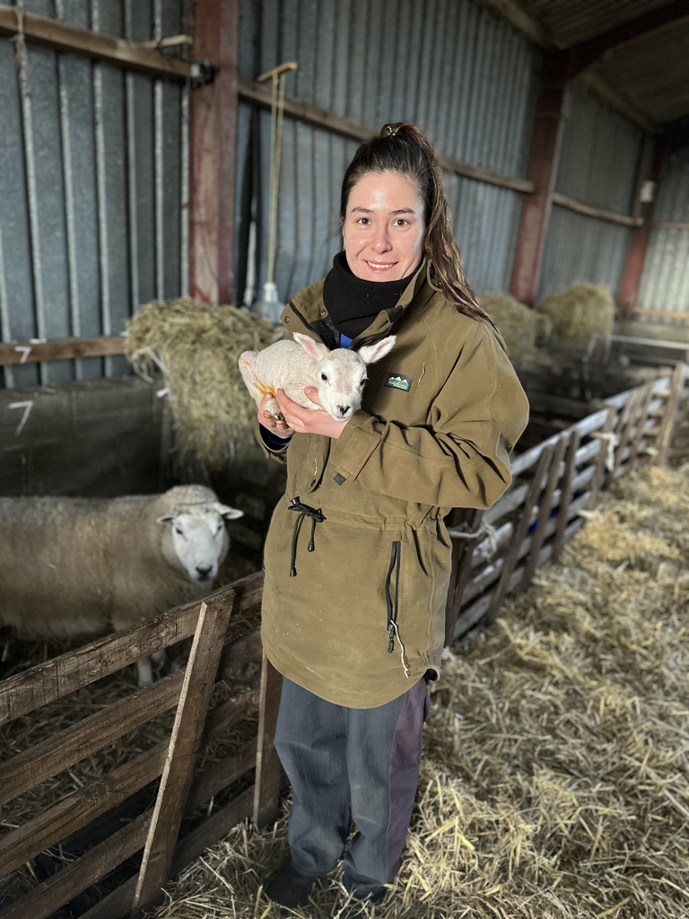

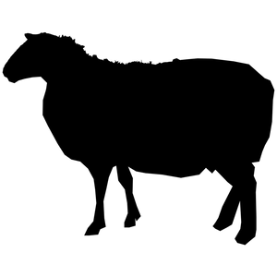
REBECCA WILSON
FARMING FOR TOMORROW
My role in sustainable food production
@rebeccawilsonfarming

Slide 2
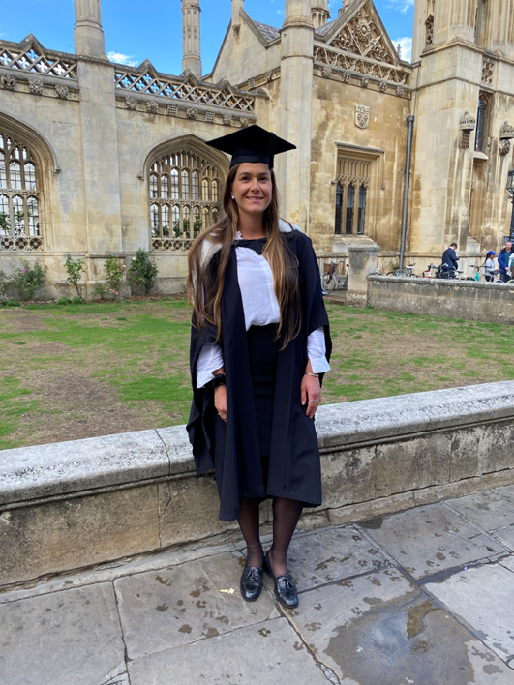
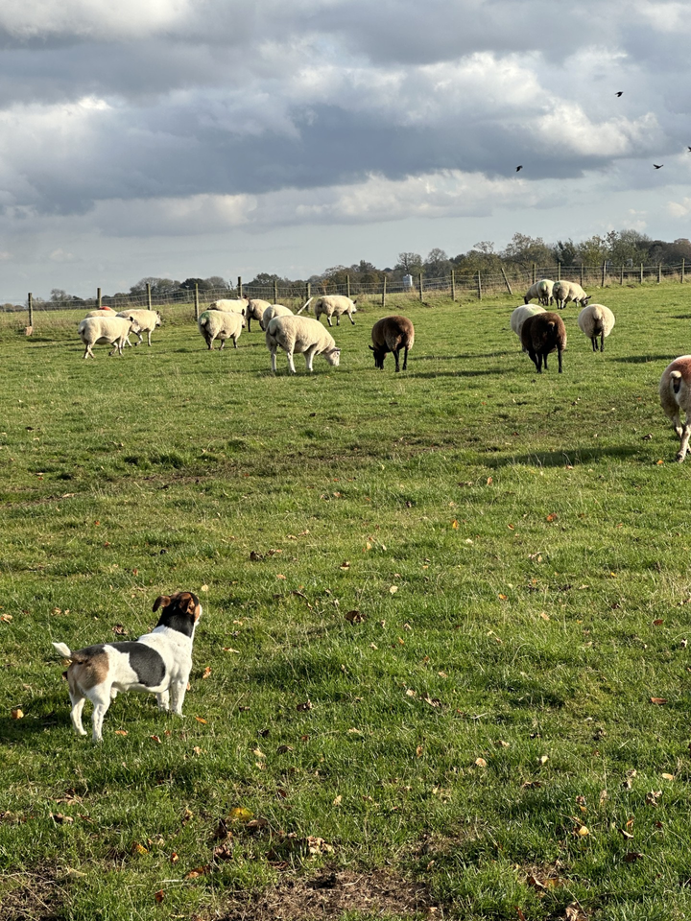
Hello
  HSPS - University of Cambridge
  Rural Land Management - Royal Agricultural University
  Rural Surveyor
  Project Manager
  Returned to the family farm in 2021
  Fifth generation
  North Yorkshire
  Sheep & arable enterprises
  Diversification - Airbnb, social media, speaking events, new podcast
  Helix Trial Farm - “linking technology, knowledge and advice to deliver sustainable farming”

Slide 3
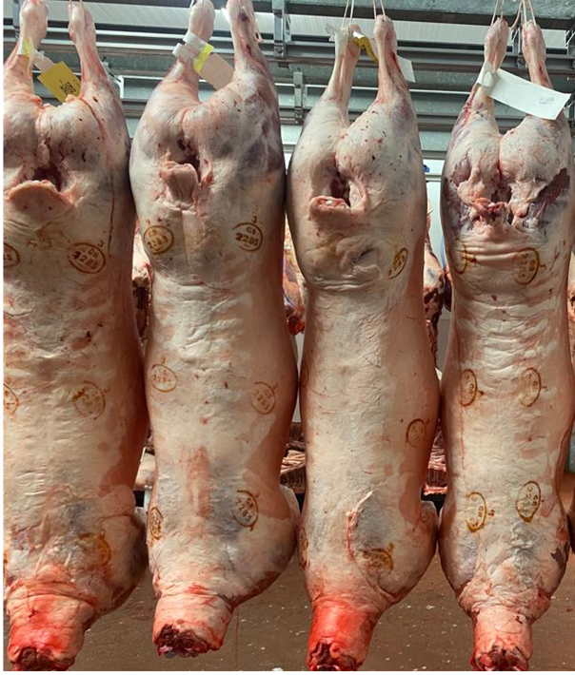
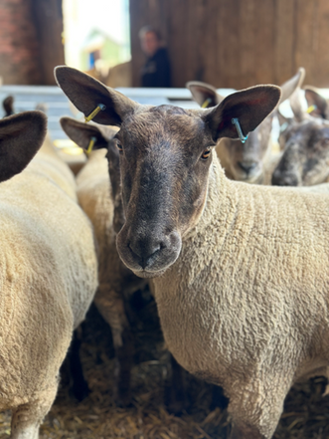
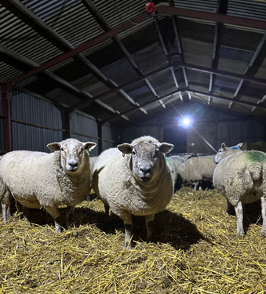
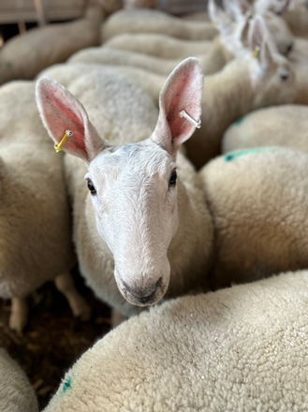
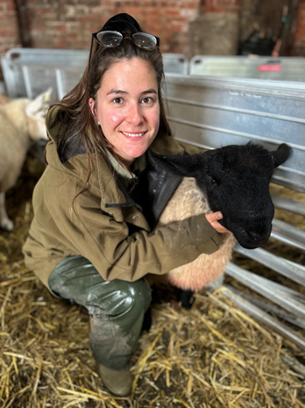
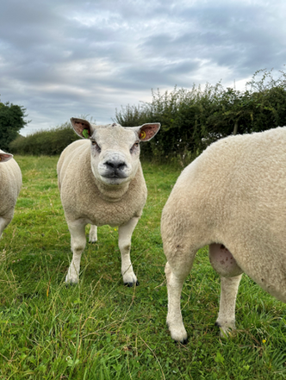
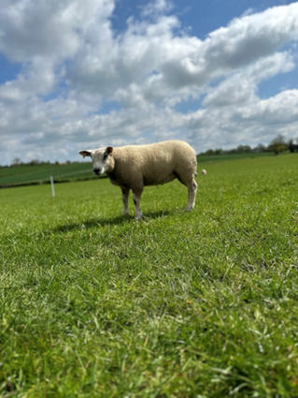
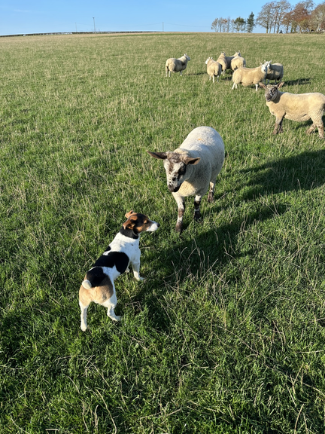
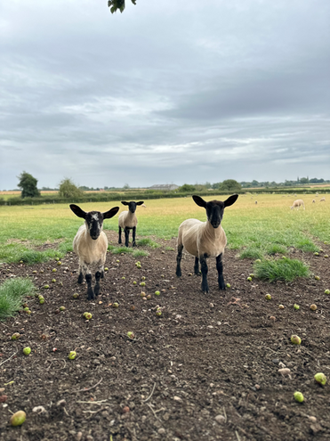
The Sheep
Our system
High welfare
Sustainable
Knowledge based

Slide 4
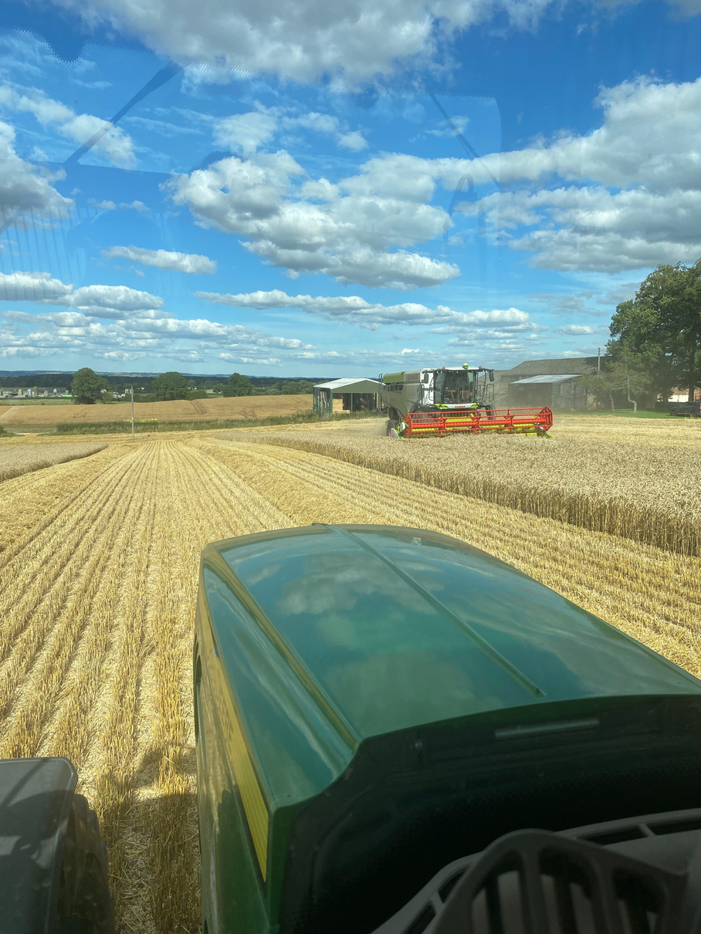
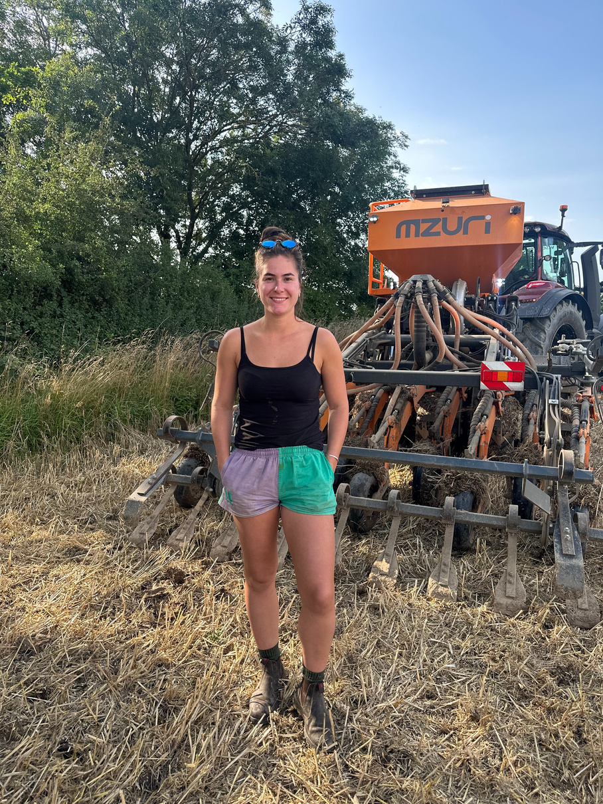
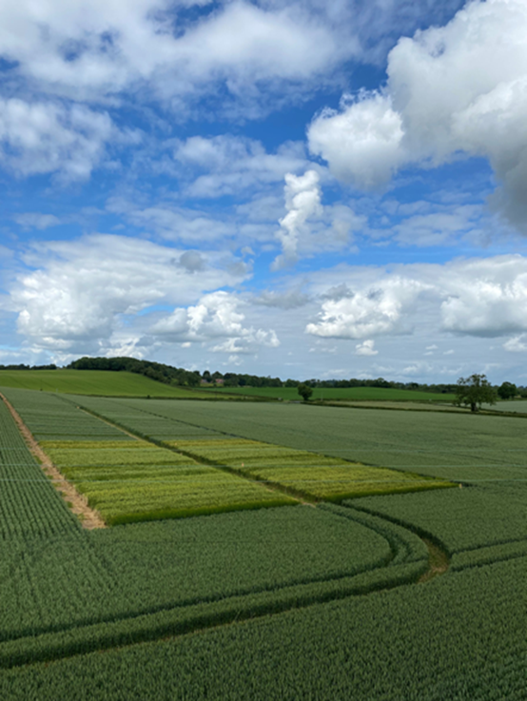
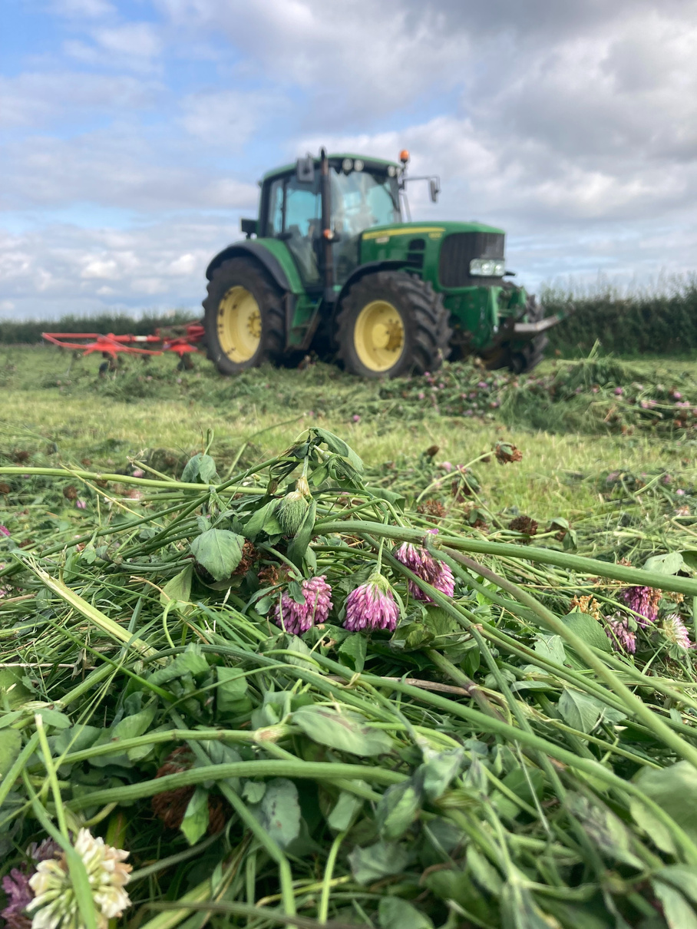
The Arable
Regenerative principles
  Long rotation
  Soil health
  Interaction with livestock
  Reduced inputs
Technology & innovation
  Variety trials
  New product trials
  Field mapping
  Variable rate application

Slide 5


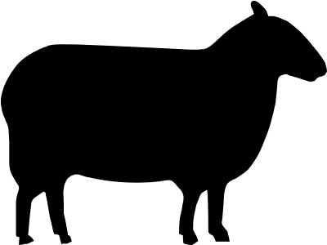

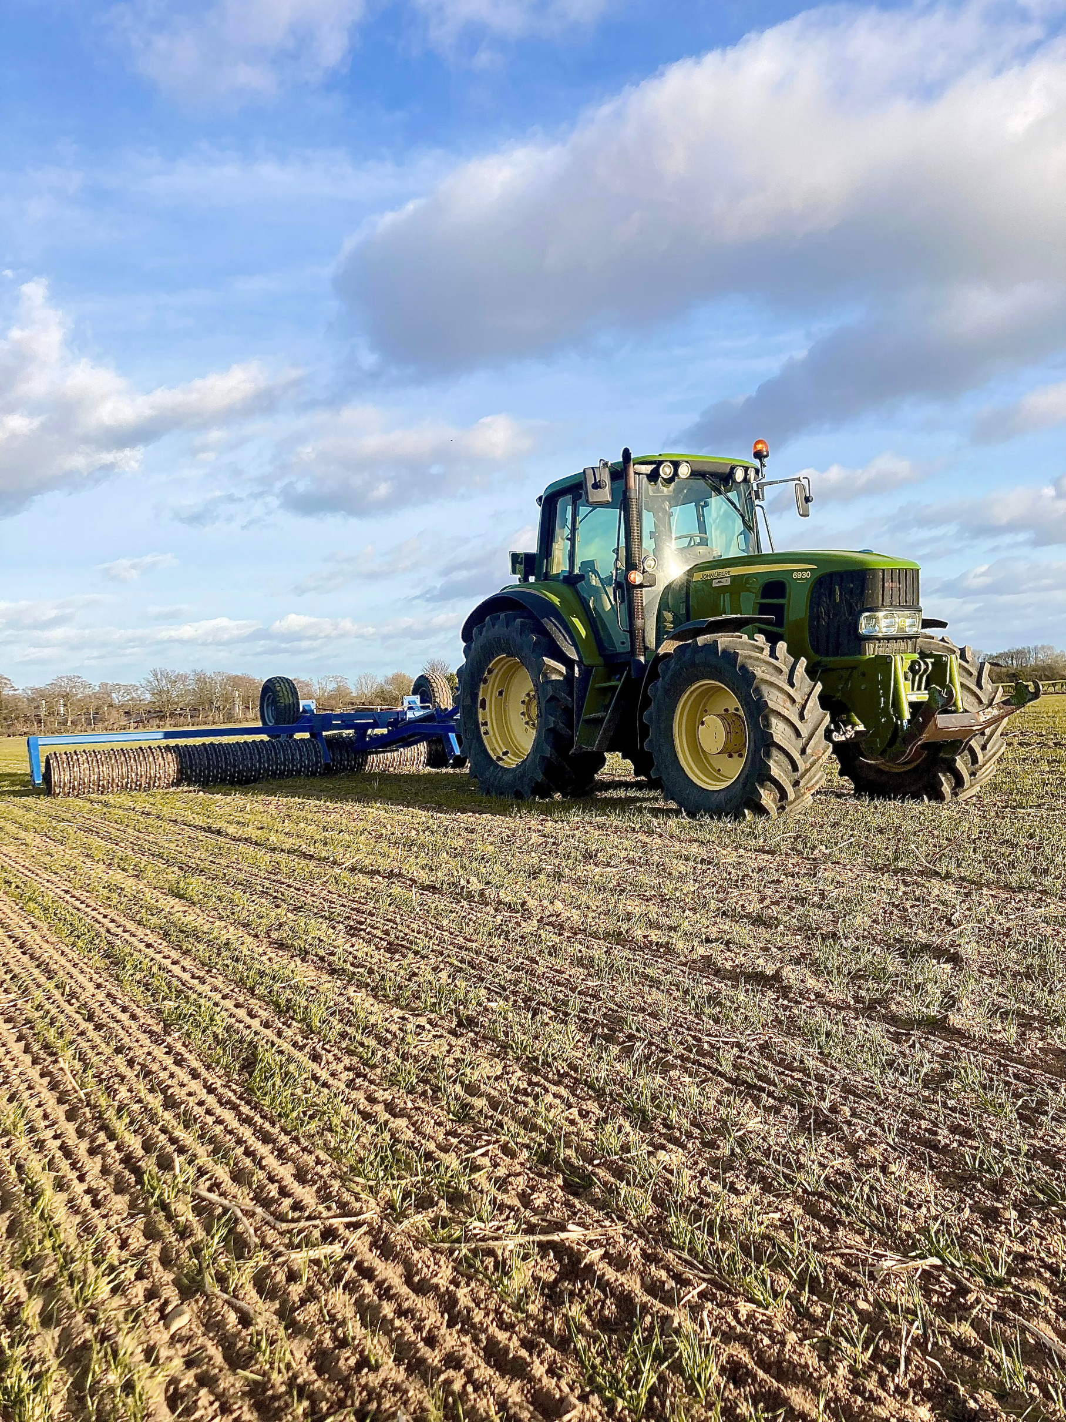
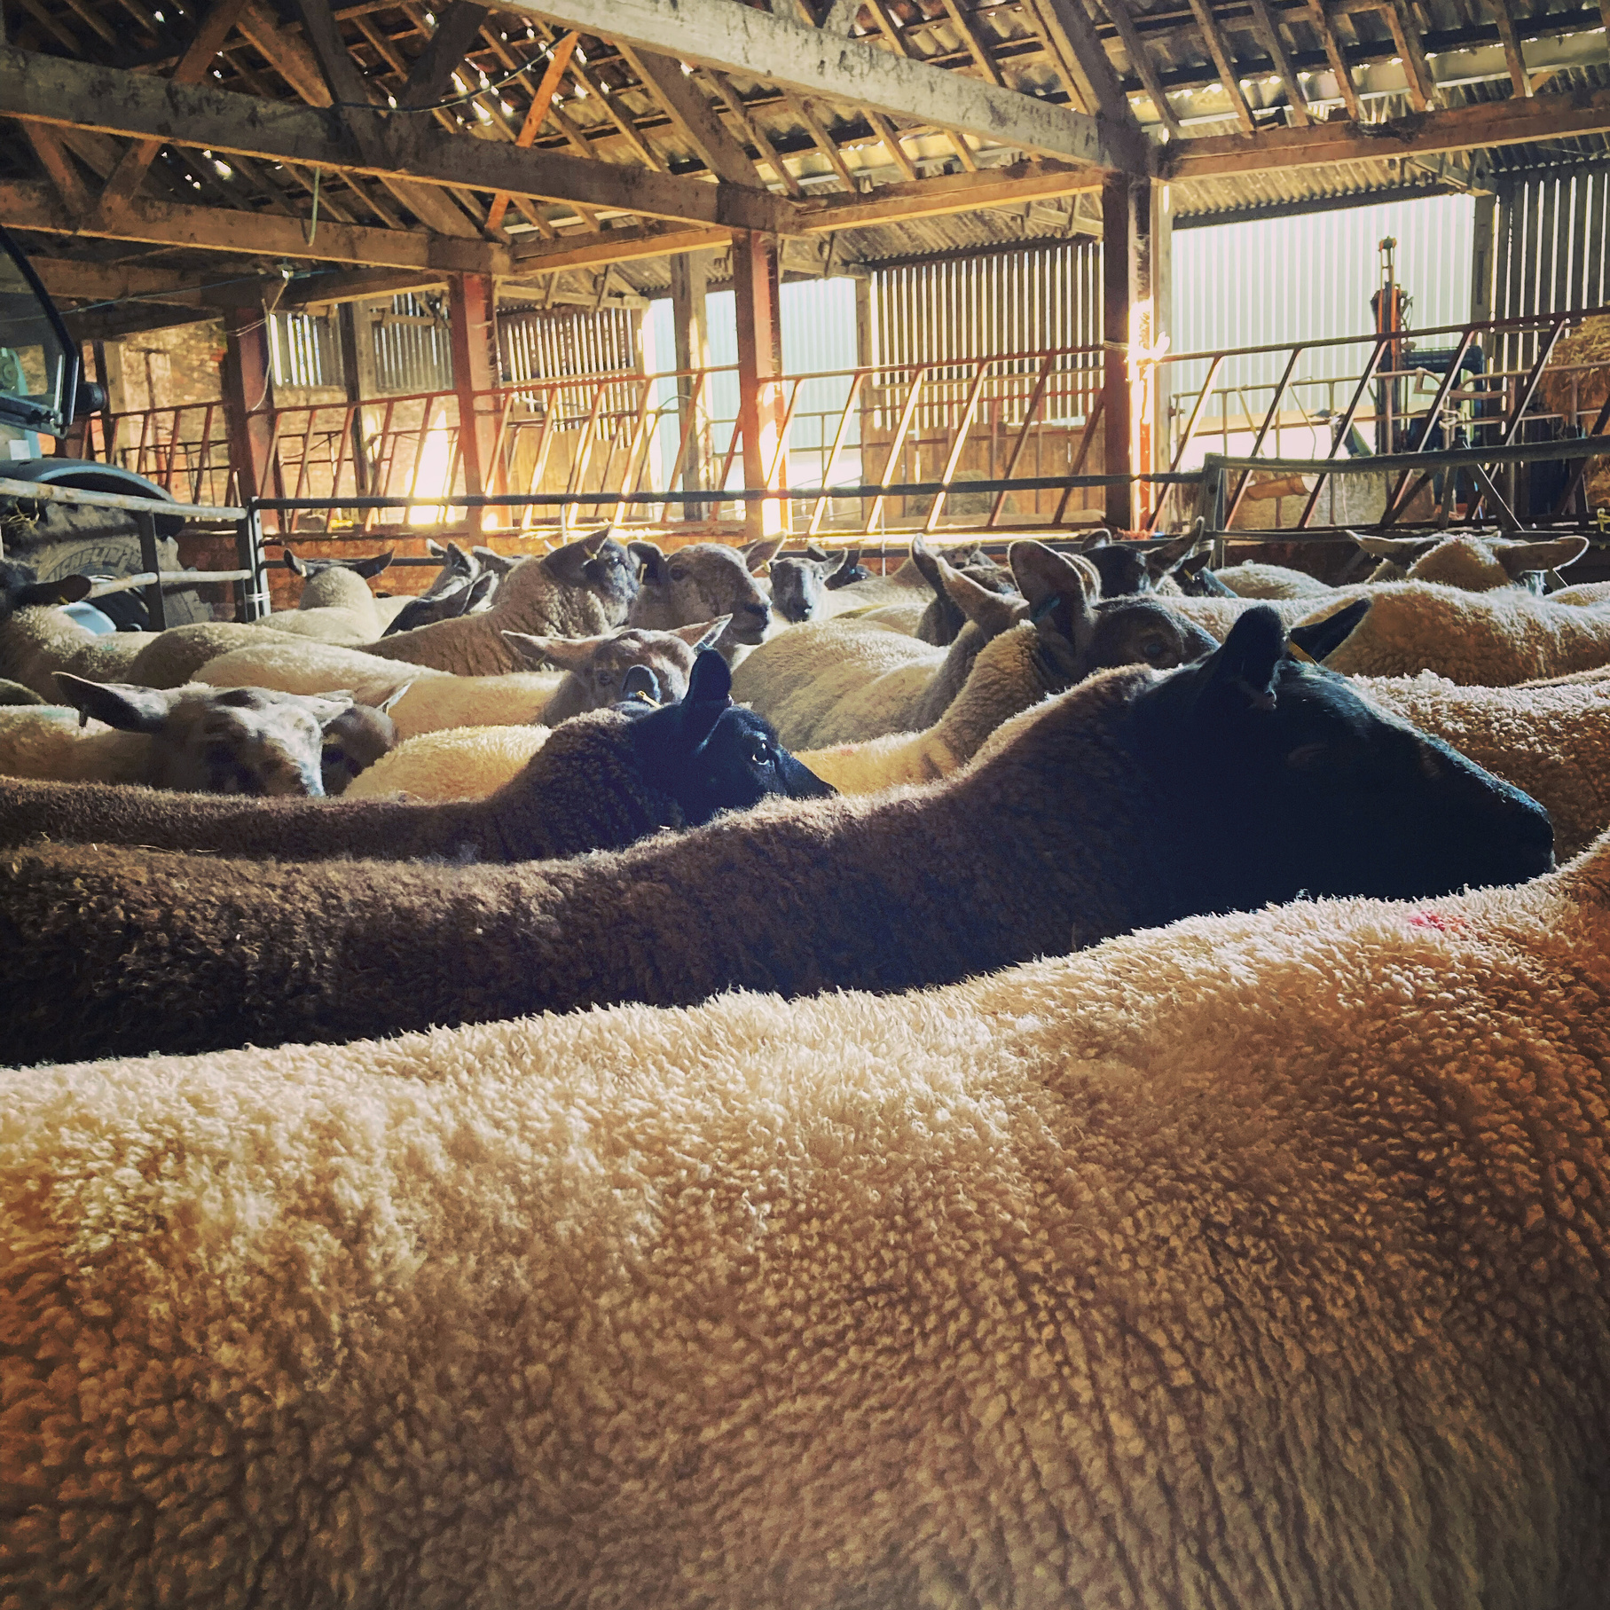
What is sustainable food production?
SUSTAINABLE = “able to continue over a period of time”
Animal
welfare
People
Environment
Financial
  Farmers as price takers = costs of production are not covered
  Supply chain is grossly unfair
  Policy e.g. loss of BPS and IHT proposals
  Consumers demand high welfare
  Health and longevity of the animal
  Healthy animal = reduced inputs
  Employees - training, pay, working conditions, work/life balance, personal development, wellbeing, encouraging new employees
  Consumers....
  Minimal soil disturbance
  Carbon sequestration
  Biodiversity
  Water quality
  Air quality
  Nutrient management

Slide 6
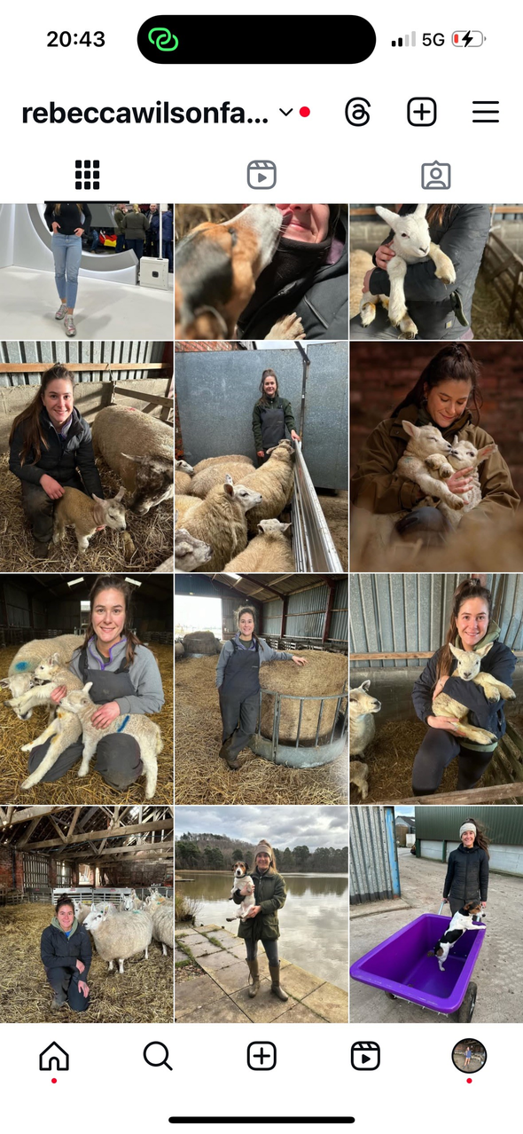
How to connect consumers with sustainable food production?
SOCIAL MEDIA
56.2 million active social media users as of January 2024, representing 82.8 percent of the population
Bring food and farming directly into the hands of the consumer
Combat misinformation by providing an honest, on the ground and authentic portrayal of food production

Slide 7
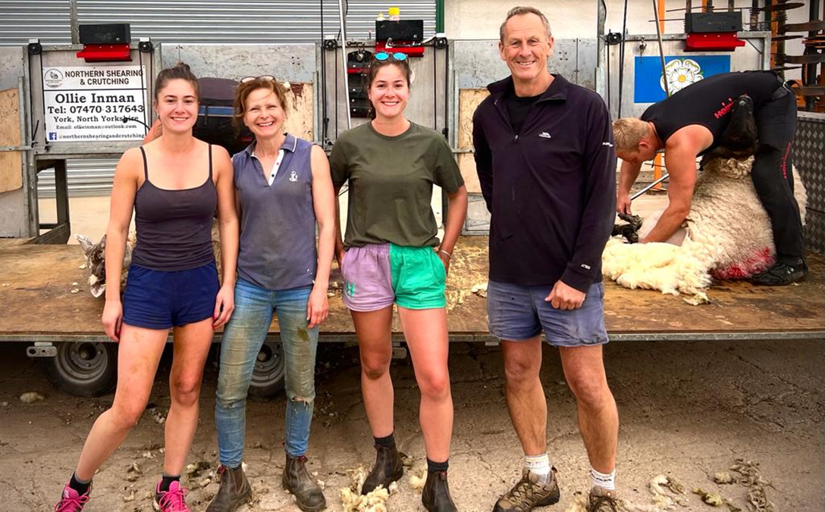
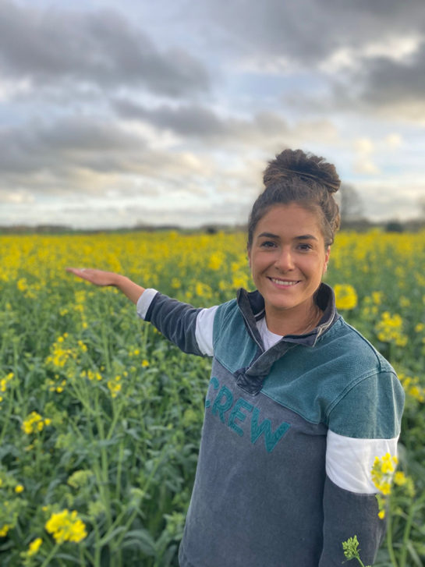
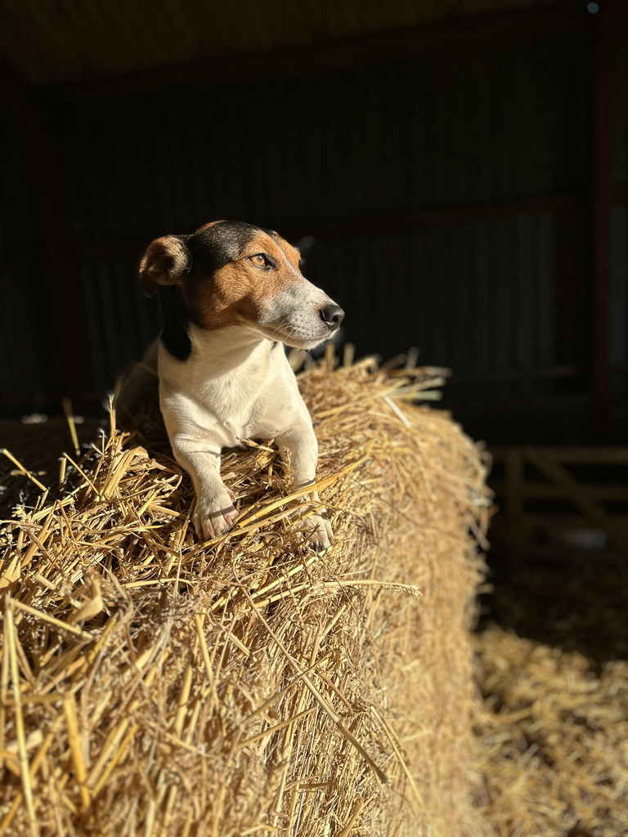
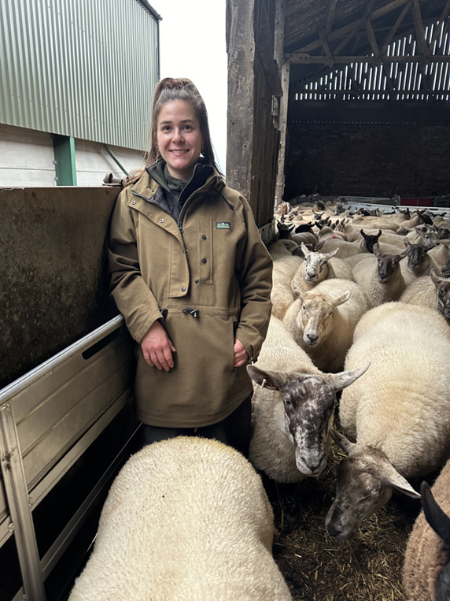
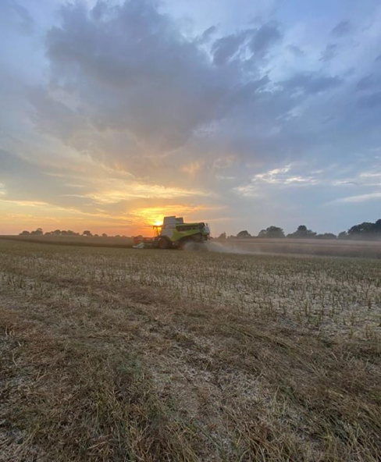
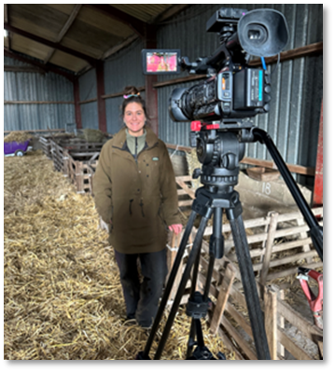
SUSTAINABLE
ABLE TO CONTINUE OVER A PERIOD OF TIME

Slide 8
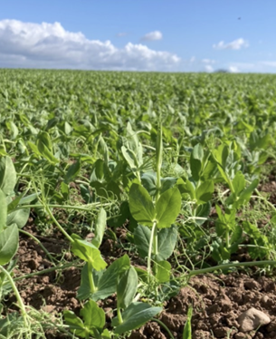
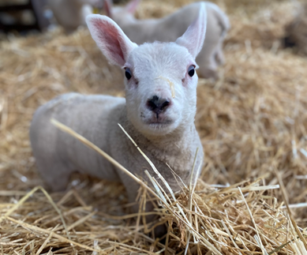
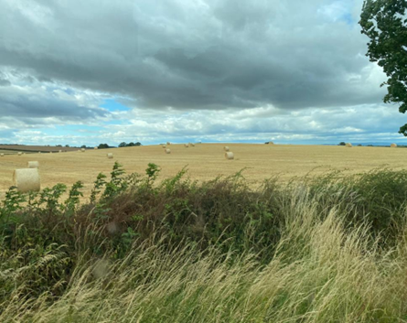

THANK YOU!
@rebeccawilsonfarming

