Slide 1
Hydration handouts

Slide 2
Activity instructions
Distribute printed copies of the Healthy hydration handouts to small groups of pupils. Ask them to complete the answers for the drink on their card; share the answers with the class.
What are the benefits and disadvantages of some of the drinks?

Slide 3
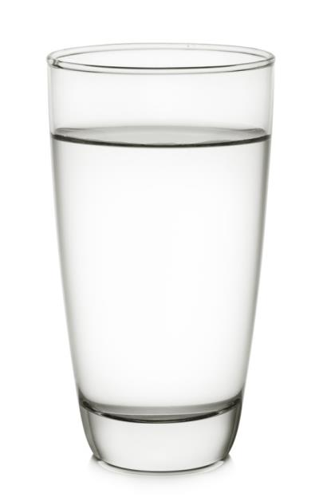
Water
How often is it recommended to be consumed:
Why it can be beneficial for health (may be none):
Why it can be negative for health (may be none):

Slide 4
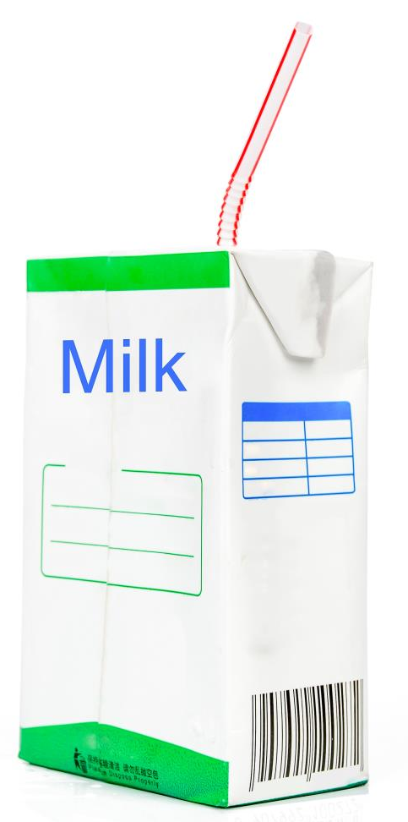
Milk
How often is it recommended to be consumed:
Why it can be beneficial for health (may be none):
Why it can be negative for health (may be none):

Slide 5

Tea and coffee
How often is it recommended to be consumed:
Why it can be beneficial for health (may be none):
Why it can be negative for health (may be none):

Slide 6
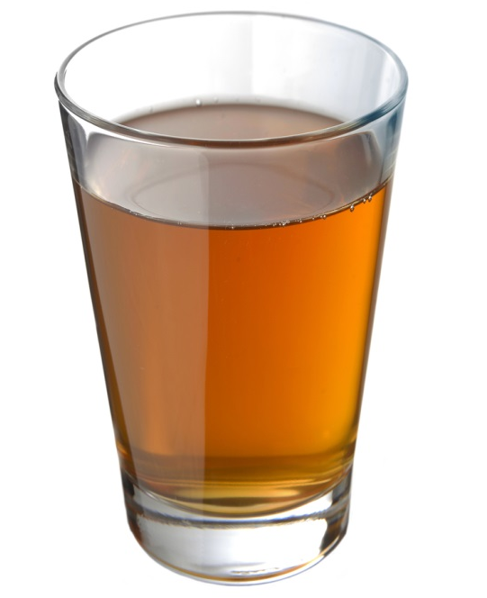
Fruit/vegetable juices and smoothies
How often is it recommended to be consumed:
Why it can be beneficial for health (may be none):
Why it can be negative for health (may be none):

Slide 7

Alcohol
How often is it recommended to be consumed:
Why it can be beneficial for health (may be none):
Why it can be negative for health (may be none):

Slide 8
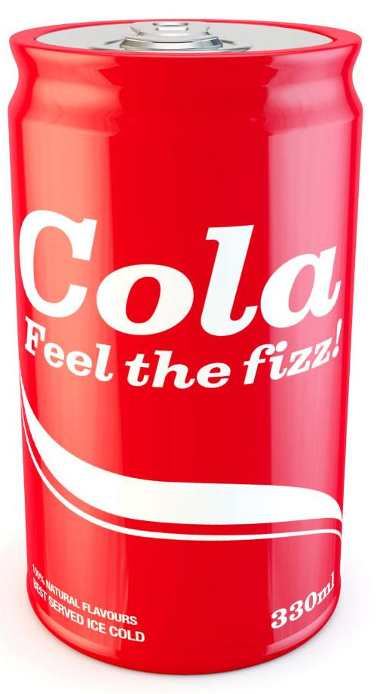
Sugary drinks
How often is it recommended to be consumed:
Why it can be beneficial for health (may be none):
Why it can be negative for health (may be none):

Slide 9
Hydration handouts
For further information, go to:
www.foodafactoflife.org.uk
This resource meets the Guidelines for producers and users of school education resources about food.

