Slide 1
World diets

Slide 2
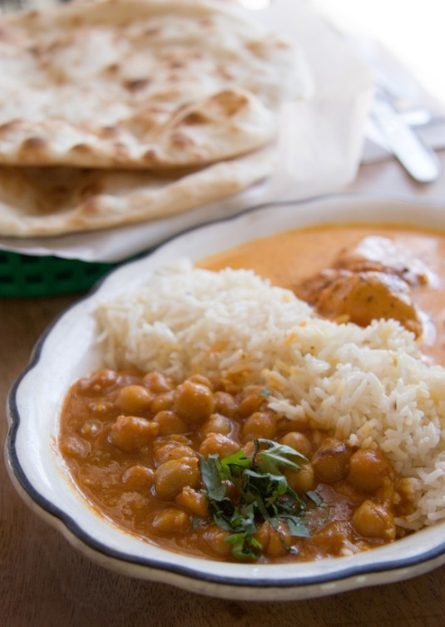
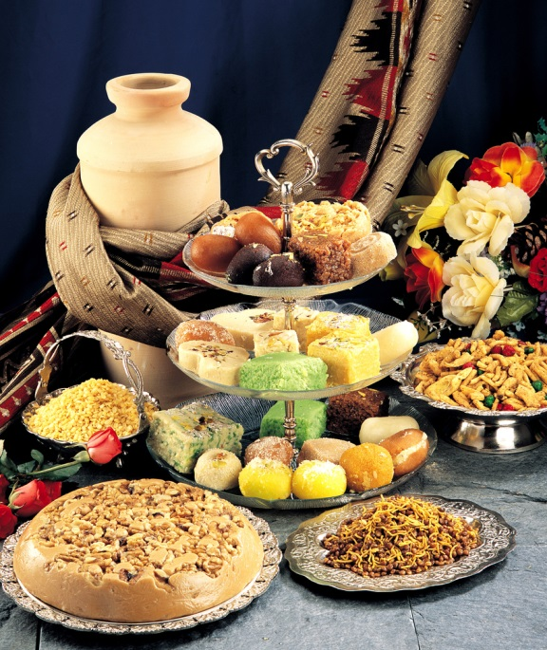
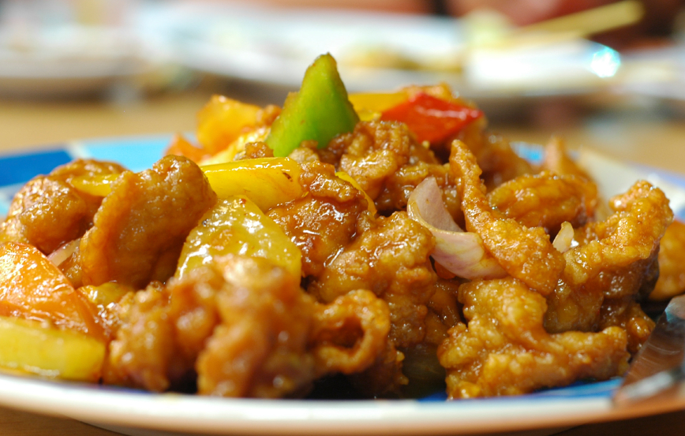
People around the world eat lots of different types of food.

Slide 3
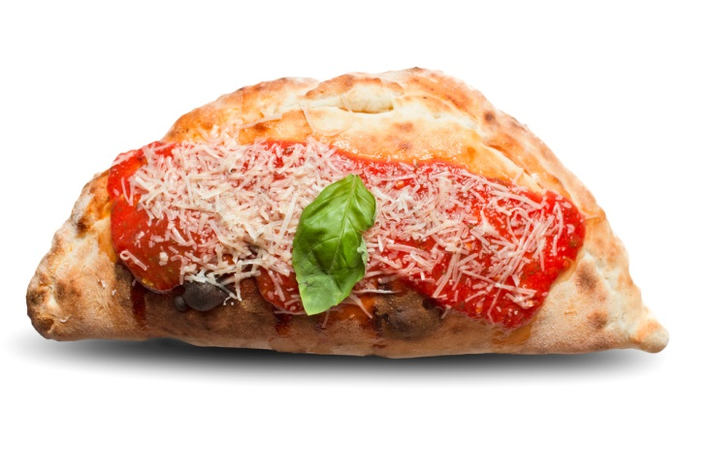
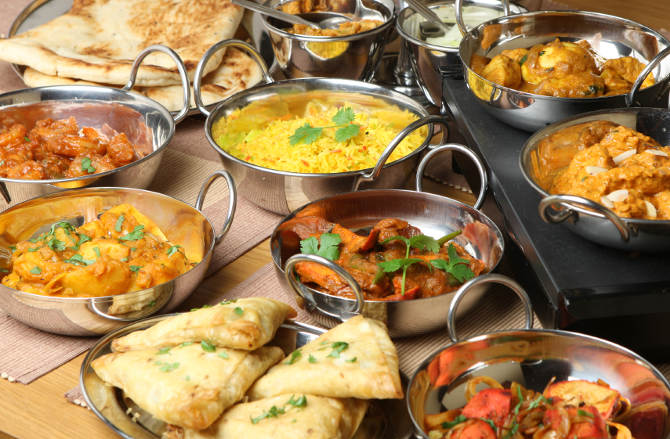
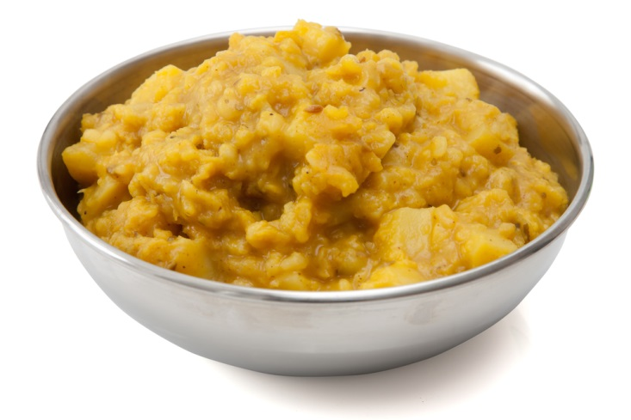
Some food might be very familiar to you.

Slide 4

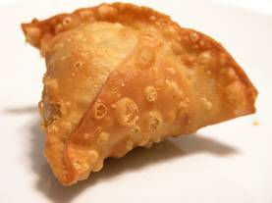
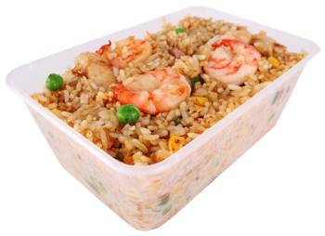
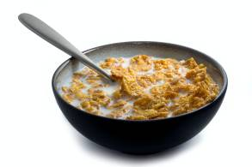
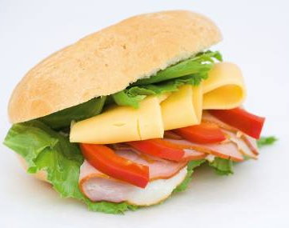
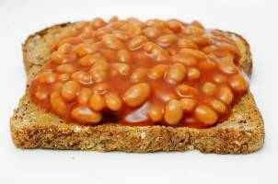

Slide 5
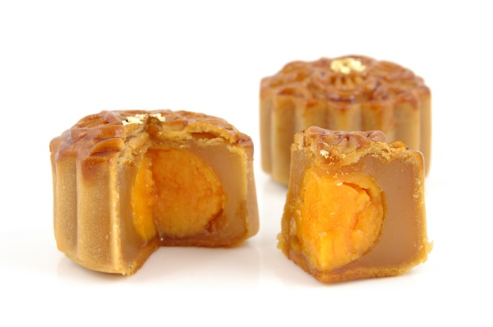

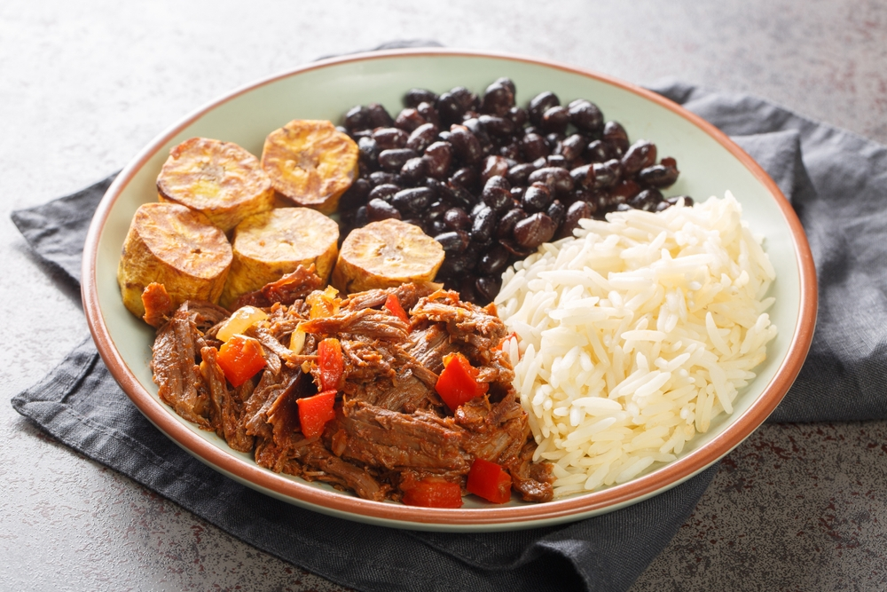
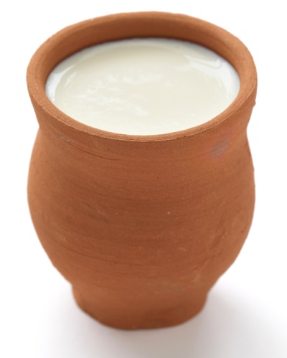
Some food you might never have seen before.

Slide 6

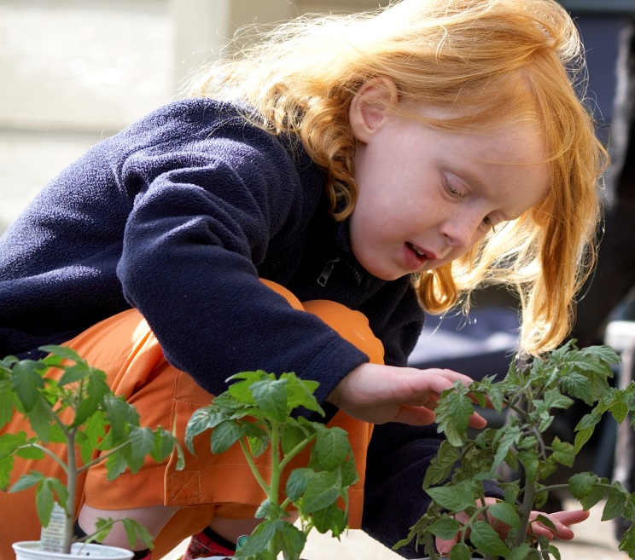

However, we all need food and drink to:
grow
be active
stay healthy

Slide 7













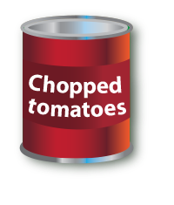

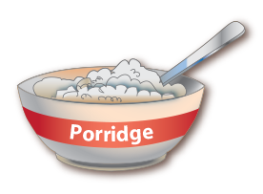
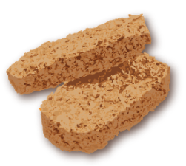
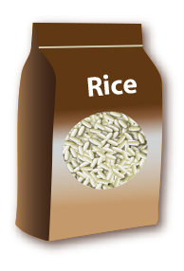

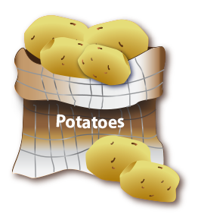



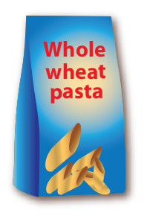

Although the foods eaten may look different, diets are usually based on:
Fruit and vegetables
Potatoes, bread, rice, pasta and other starchy carbohydrates

Slide 8


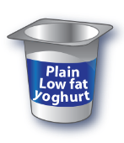

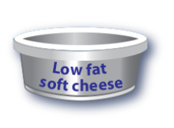

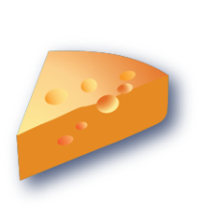








Although the foods eaten may look different, diets are usually based on:
Dairy and alternatives
Beans, pulses, fish, eggs, meat and other proteins

Slide 9
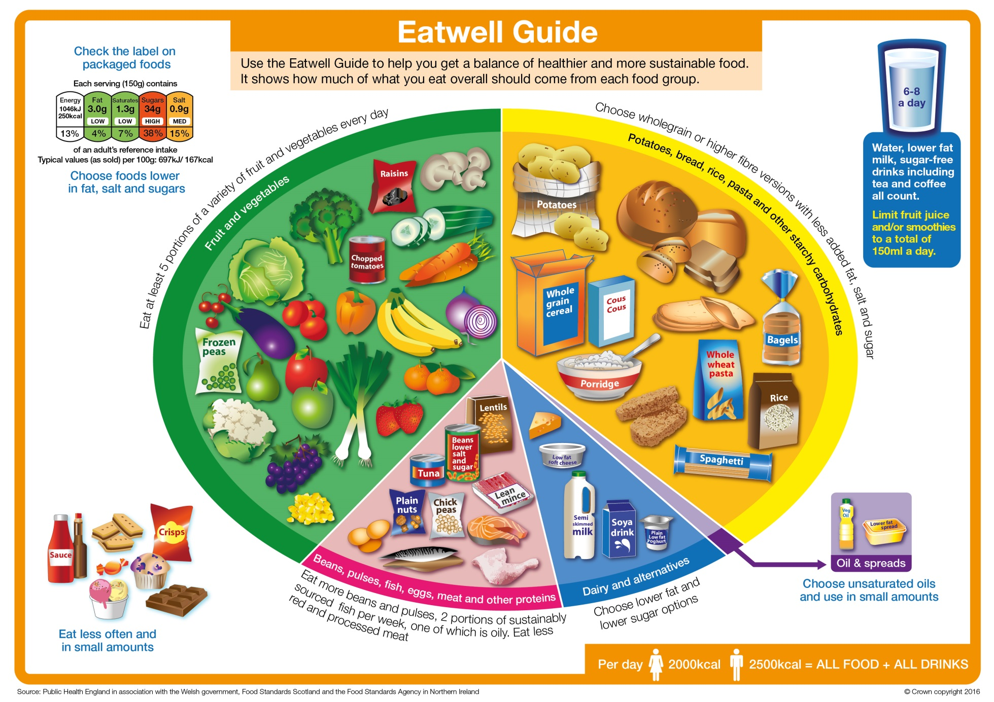
The Eatwell Guide
Potatoes, bread, rice, pasta and other starchy carbohydrates
Fruit and vegetables
Oils and spreads
Beans, pulses, fish, eggs, meat and other proteins
Dairy and alternatives

Slide 10
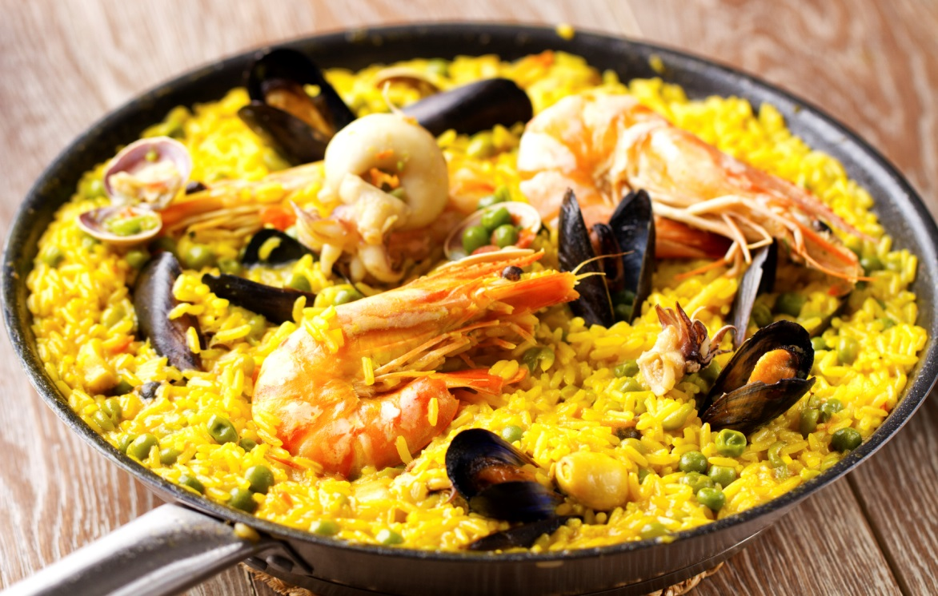
Is this really different?
Think about the different food groups.
Rice
Vegetables
Seafood

Slide 11
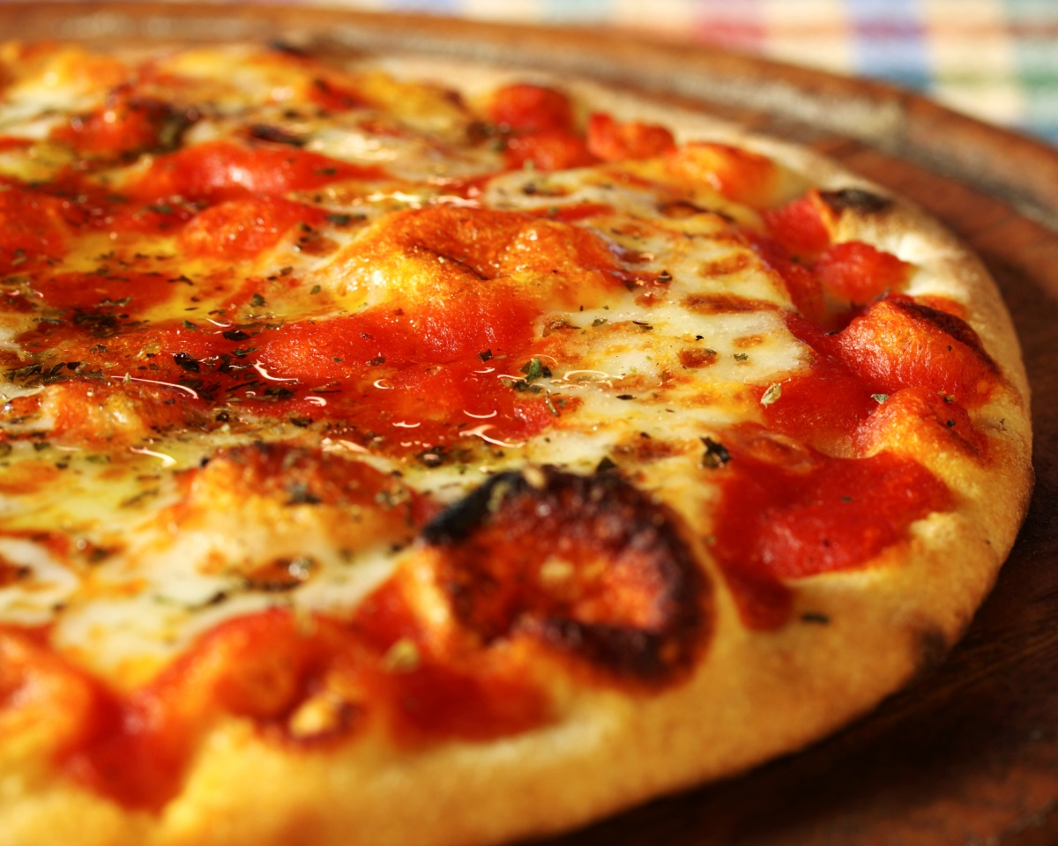
Is this really different?
Think about the different food groups.
Bread base
Tomato
Cheese

Slide 12
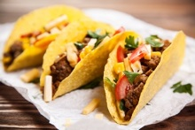
Is this really different?
Think about the different food groups.
Taco shell
Vegetables
Minced beef

Slide 13
What goes with what?
Chicken and vegetable curry
Fufu (cassava)
Yogurt
Tuna and sweetcorn
Spaghetti
Glass of milk
Bolognese sauce
Jacket potato
Lassi
Groundnut and okra stew
Rice
Grated cheese

Slide 14
What goes with what?
Chicken and vegetable curry
Rice
Lassi
Tuna and sweetcorn
Jacket potato
Grated cheese
Bolognese sauce
Spaghetti
Yogurt
Groundnut and okra stew
Fufu (cassava)
Glass of milk

Slide 15
Although people eat lots of different types of foods, their diets are based on the same main food groups:
Fruit and vegetables
Potatoes, bread, rice, pasta and other starchy carbohydrates
Dairy and alternatives
Beans, pulses, fish, eggs, meat and other proteins

Slide 16
World diets
For further information, go to:
www.foodafactoflife.org.uk
This resource meets the Guidelines for producers and users of school education resources about food.

