Slide 1
Kitchen equipment

Slide 2
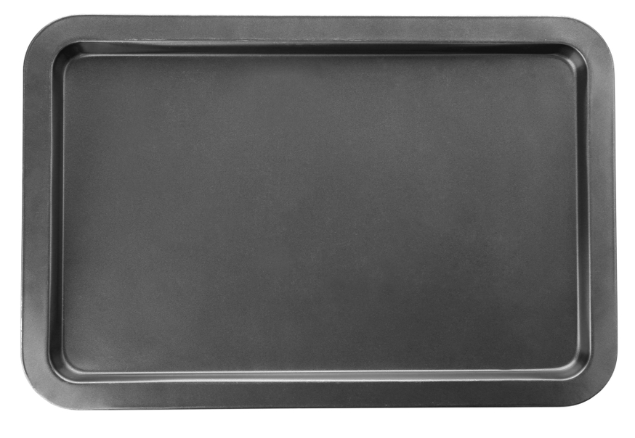
Baking tray

Slide 3
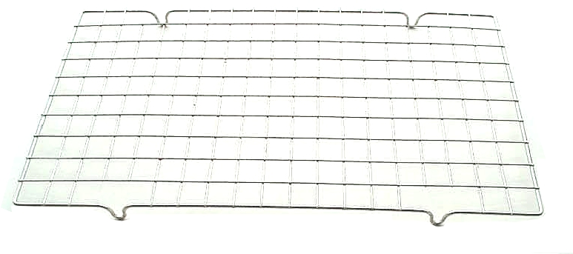
Cooling rack

Slide 4
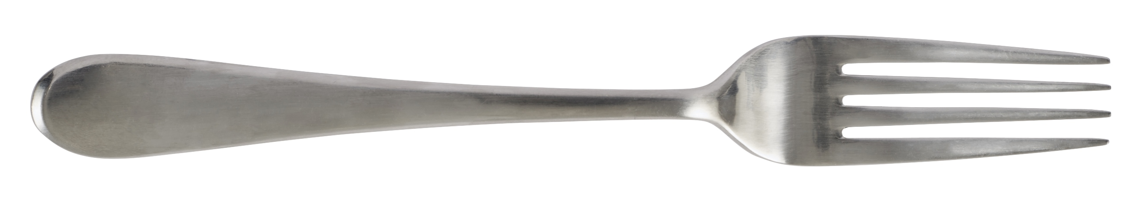
Fork

Slide 5
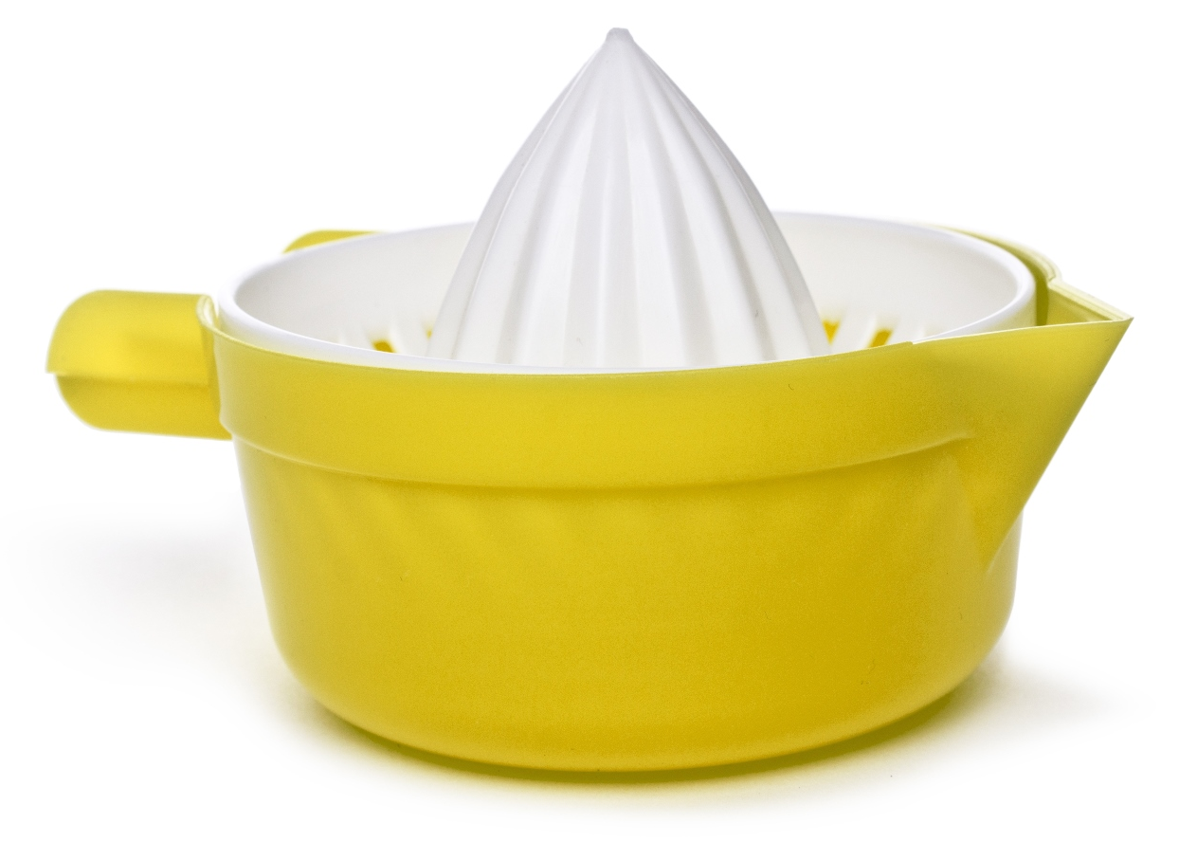
Juicer

Slide 6
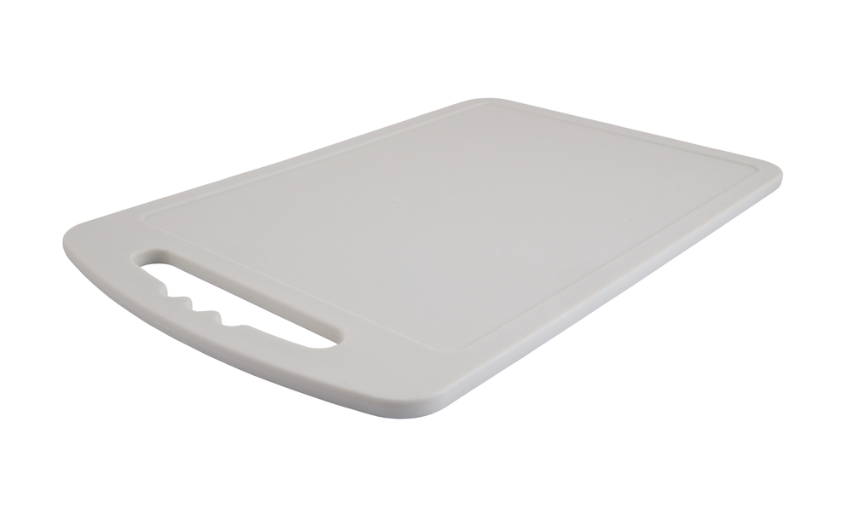
Chopping board

Slide 7
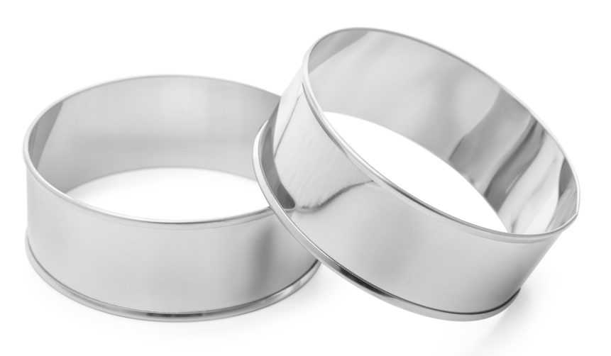
Cutters

Slide 8
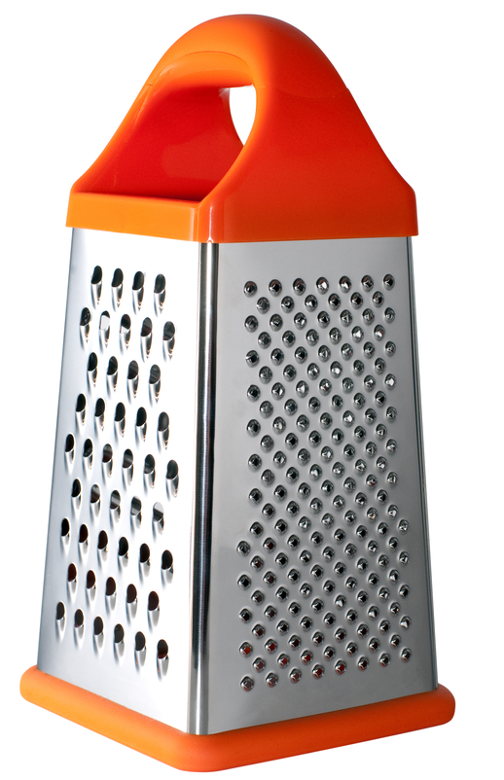
Grater

Slide 9
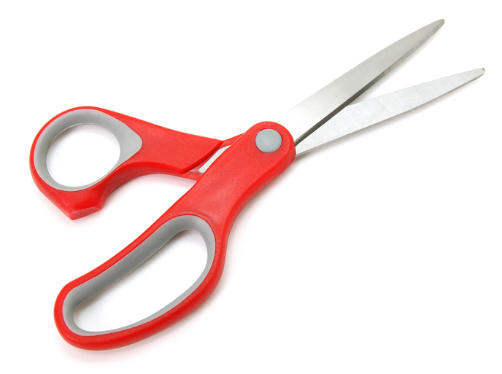
Kitchen scissors

Slide 10
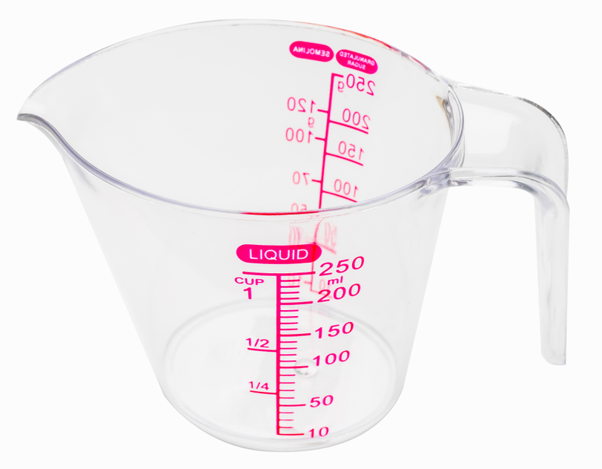
Measuring jug

Slide 11
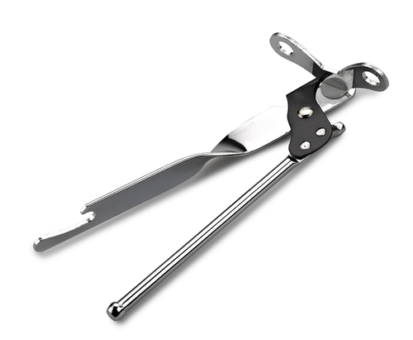
Can opener

Slide 12
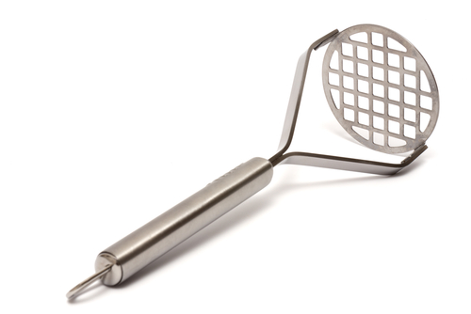
Potato masher

Slide 13
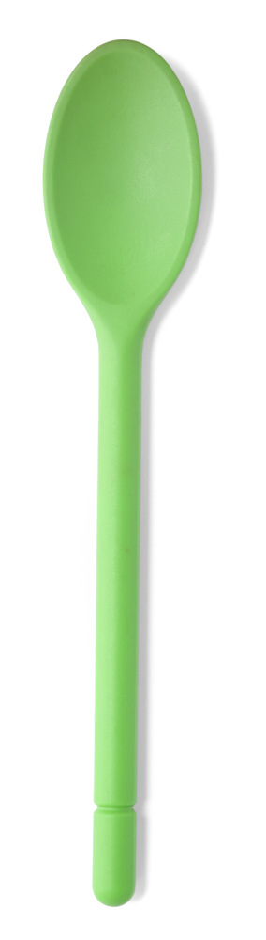
Mixing spoon

Slide 14
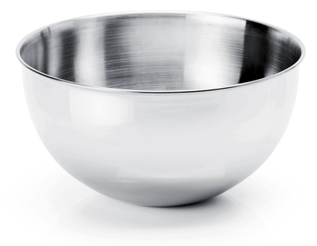
Mixing bowl

Slide 15
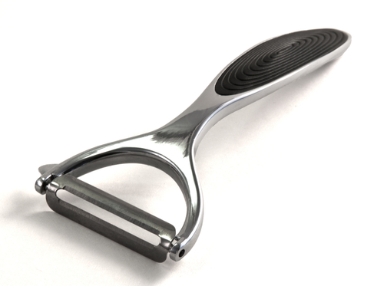
Peeler

Slide 16
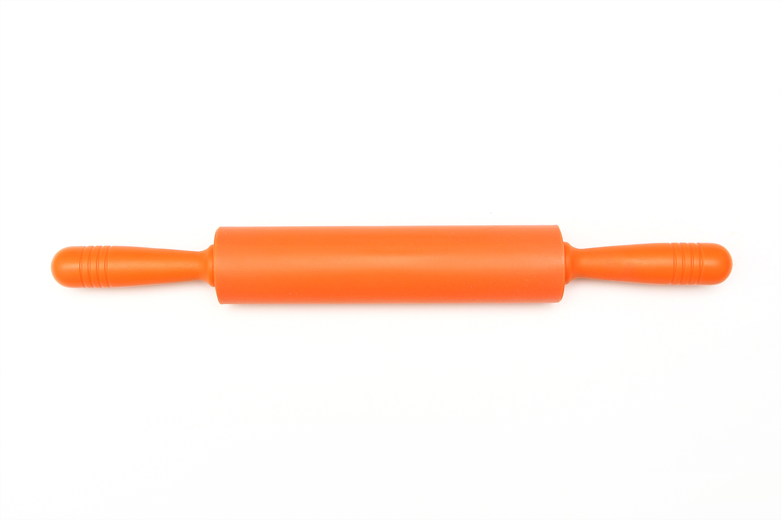
Rolling pin

Slide 17
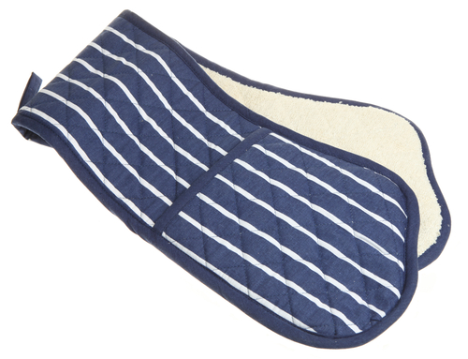
Oven gloves

Slide 18
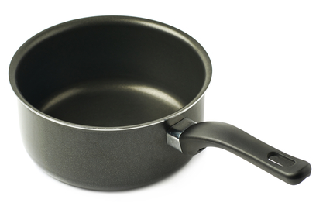
Saucepan

Slide 19

Table knife

Slide 20
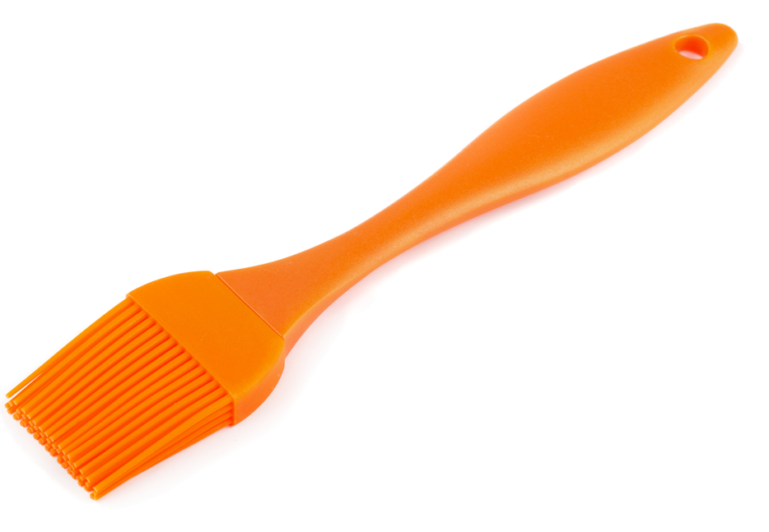
Pastry brush

Slide 21
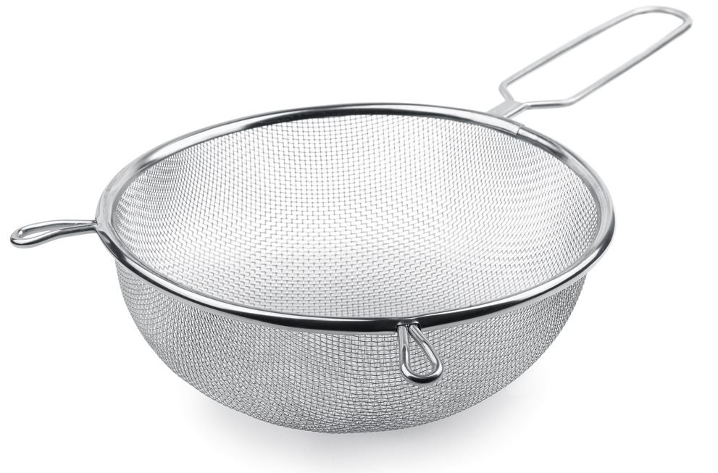
Sieve

Slide 22
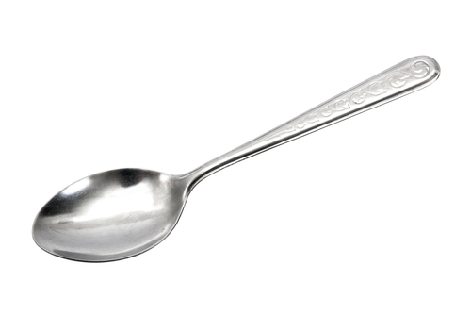
Spoon

Slide 23
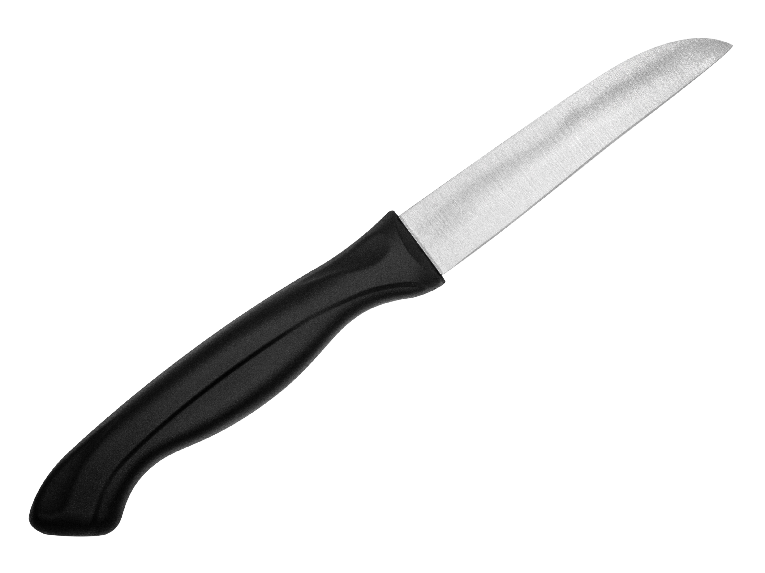
Vegetable knife

Slide 24
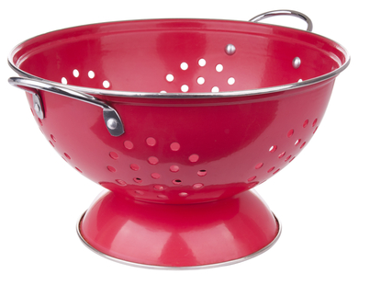
Colander

Slide 25
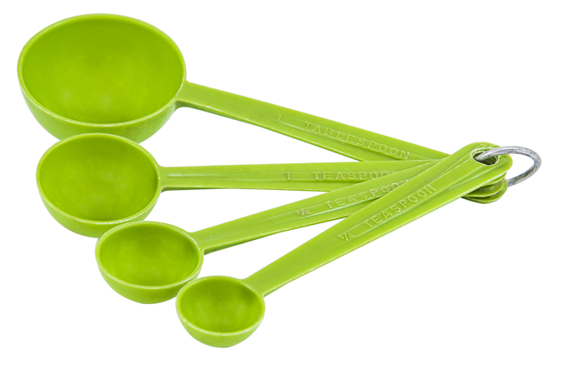
Measuring spoons

Slide 26
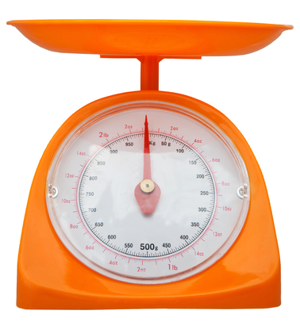
Weighing scales

Slide 27
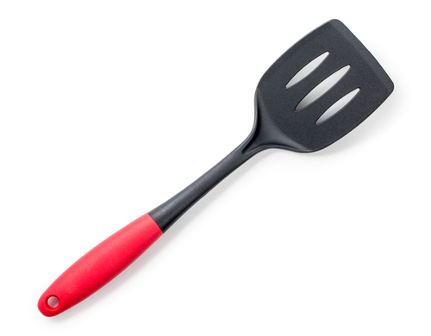
Fish slice

Slide 28
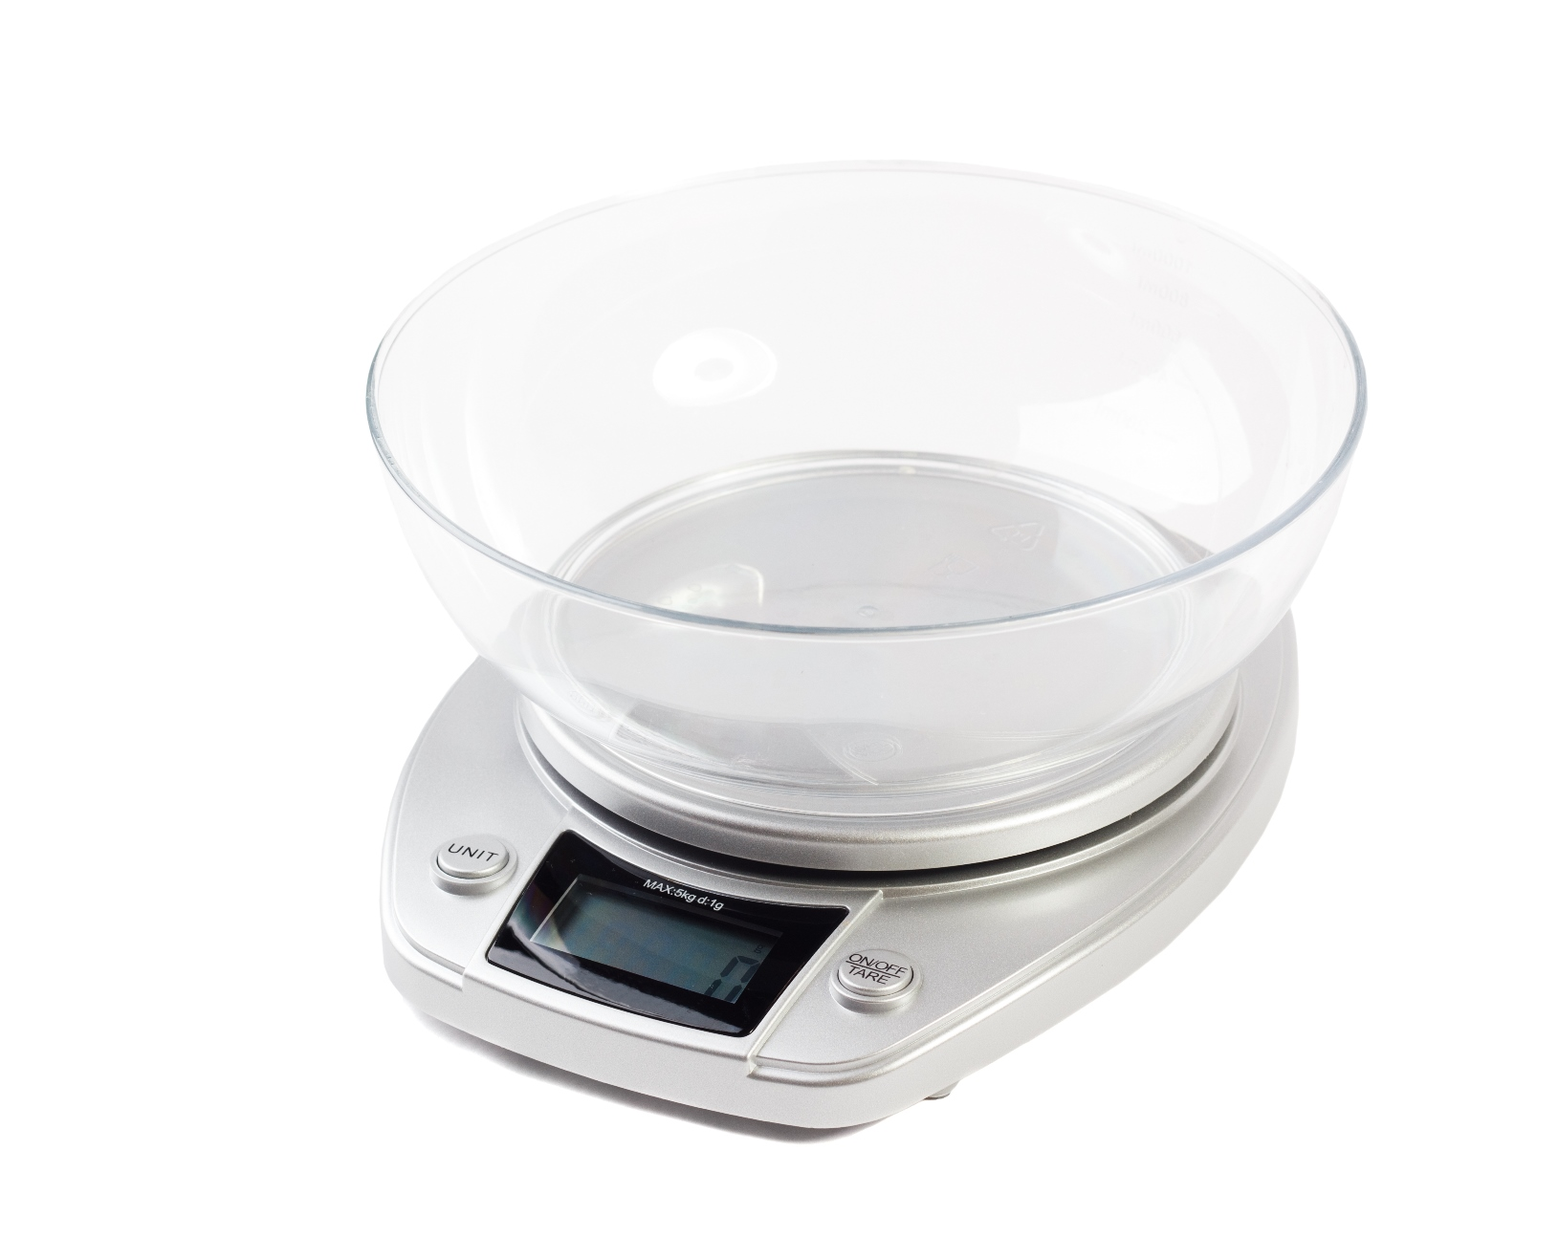
Digital scales

Slide 29
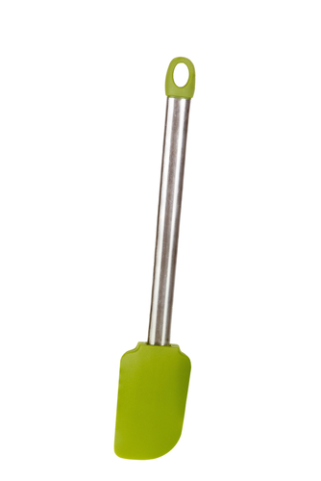
Spatula

Slide 30
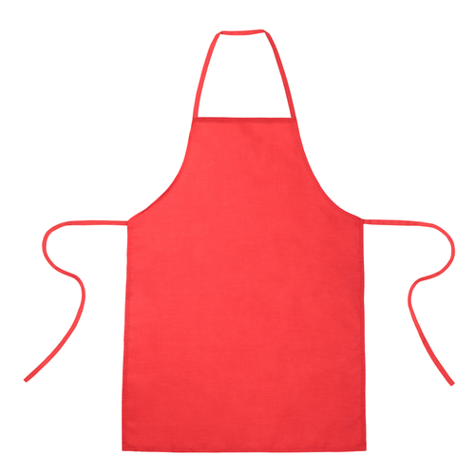
Apron

Slide 31
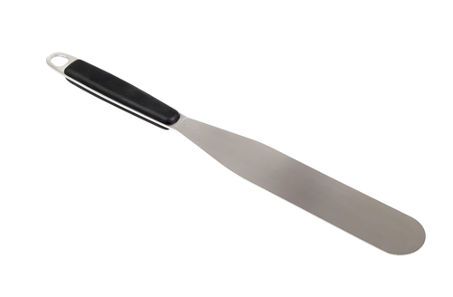
Palette knife

Slide 32
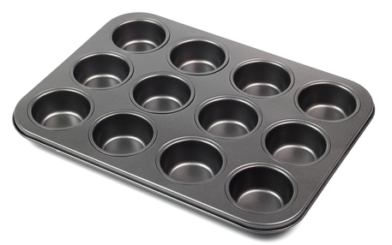
Patty tin

Slide 33
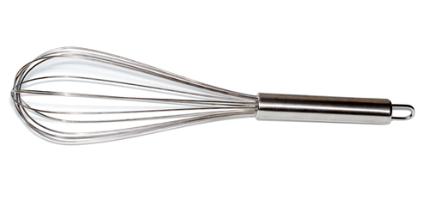
Balloon whisk

Slide 34
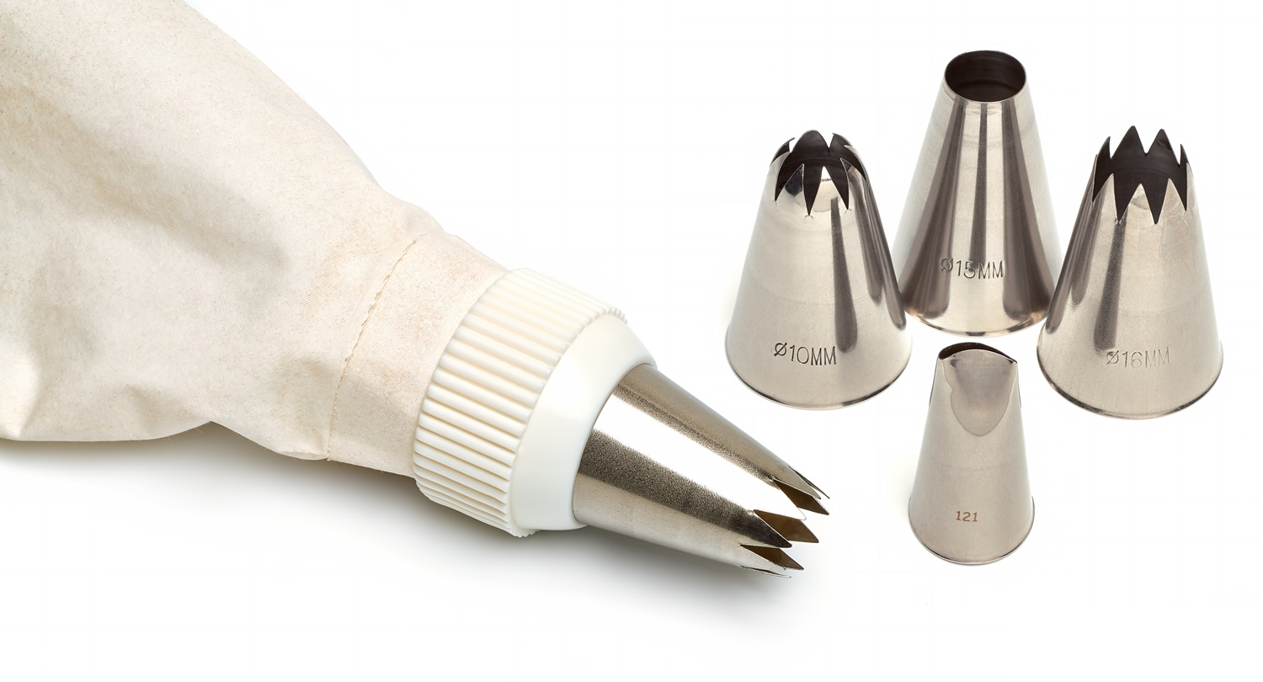
Piping bag and nozzles

Slide 35
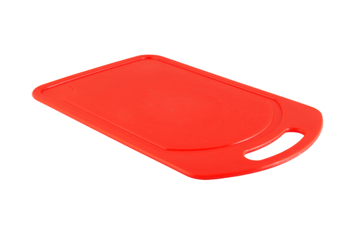
Red chopping board (raw meat)

Slide 36
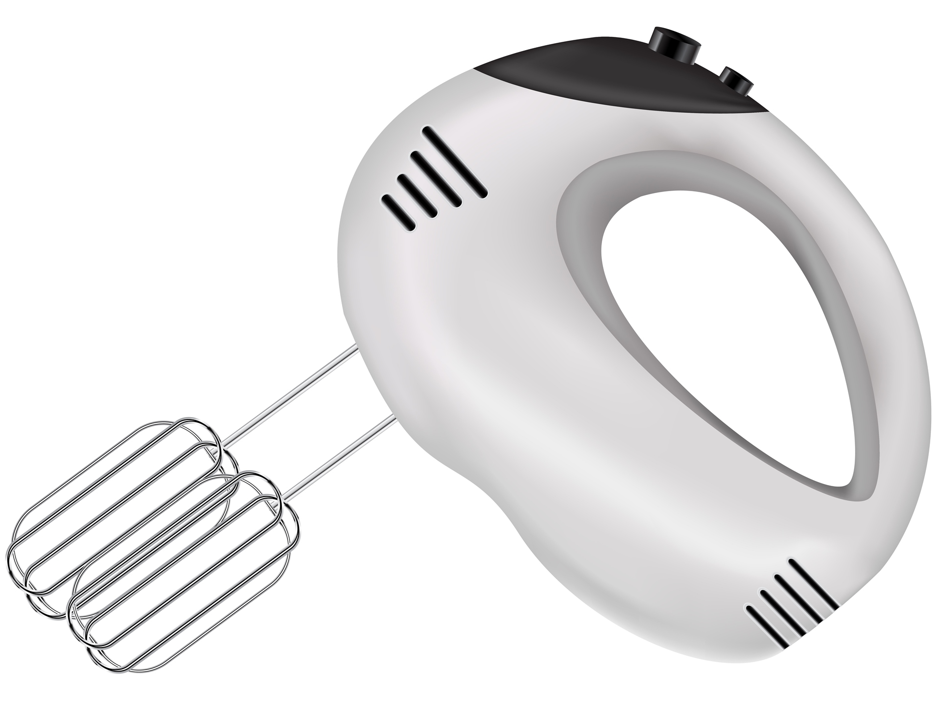
Hand mixer

Slide 37
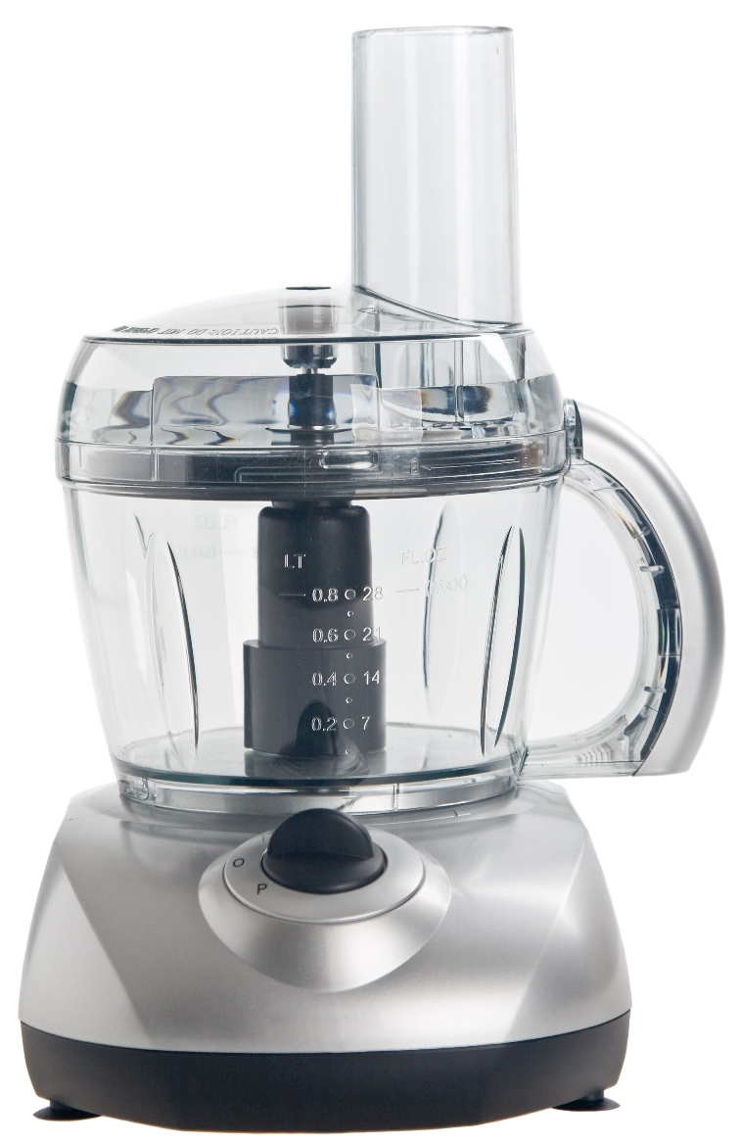
Food processor

Slide 38
Kitchen equipment
For further information, go to:
www.foodafactoflife.org.uk
This resource meets the Guidelines for producers and users of school education resources about food.

