Slide 1
Using nutritional analysis in a meaningful way
26/01/23

Slide 2
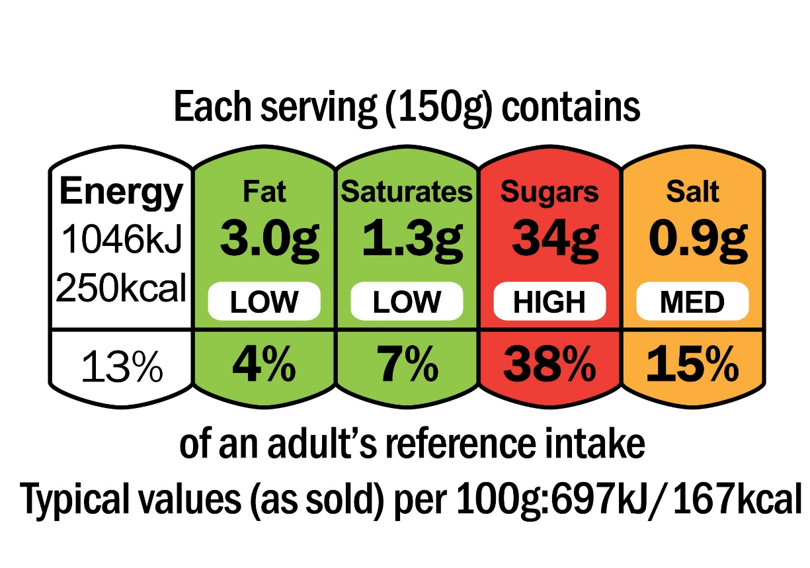
What is nutritional analysis used for?
Nutritional analysis lets consumers know what nutrients are provided by food and helps them to make healthier choices.
It allows consumers to know if they are meeting the Dietary Reference Values (DRVs):
In the UK, we have a set of Dietary reference values (DRVs) so people know how much of each nutrient they should be consuming.
Knowing whether or not DRVs are being met enables you to determine whether the diet should be modified.
Legally, some nutrition information is required to be displayed, by law.
Food products have typically been tested to determine their nutrient content, but nutritional analysis is crucial when they are being developed.
Notes:
Also product development

Slide 3
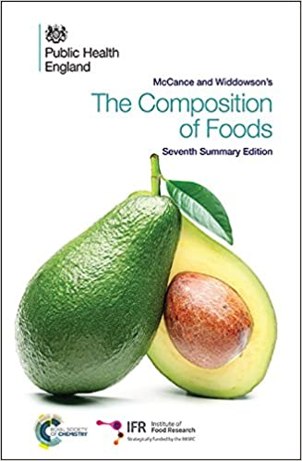
McCance and Widdowson’s Composition of Foods
The Chemical Composition of Foods was first published in 1940 and even in its seventh edition it is very much the “bible” for nutritionists, food scientists, dietitians and many others:
Data on the composition UK foods.
First published in 1940.
7th edition published in 2015.
1180 foods and nearly 50 nutrients.
Integrated Dataset with more detailed information is available online.

Slide 4
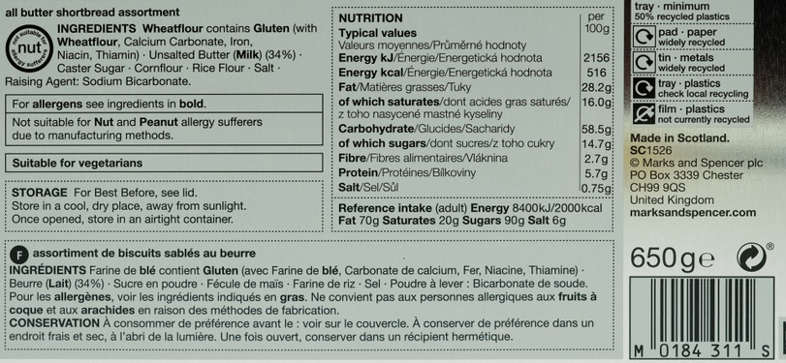
Information on pack
Name and ingredients listing
Additional information (e.g. allergen box, suitability for vegetarians)
Storage instructions
Weight of product
Recycling information
Nutrition information, including Reference Intakes (RI)

Slide 5
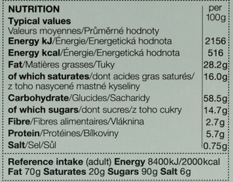
Nutrition labelling (back of pack)
By law, back of pack labels must include (in order):
Energy (in kJ and kcal)
Fat (in grams)
Saturated fat (in grams)*
Carbohydrate (in grams)
Sugar (in grams)*
Protein (in grams)
Salt (in grams)
This information must legally be given per 100g or 100ml but can also be displayed per portion.
Other information is voluntary and may include fibre, starch, unsaturated fats, polyols, vitamins and minerals.

Slide 6

Nutrition labelling (front of pack)
Front of pack labelling is a voluntary scheme in the UK.
However, most major supermarkets and manufacturers have embraced this system.
Some products do not usually show this label (e.g. alcohol) or may show a reduced version or a version without colours (e.g. some confectionery, small packets).
Guidance for the creation of labels and more information is available online.
Teachers can use the nutrient comparison exercises, to help pupils understand how labels help consumers make healthier choices.
Notes:
Purpose: ‘At a glance’ understanding of a product and quick comparison

Slide 7
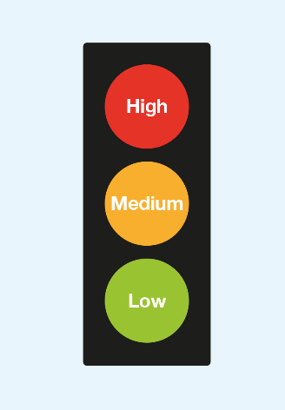
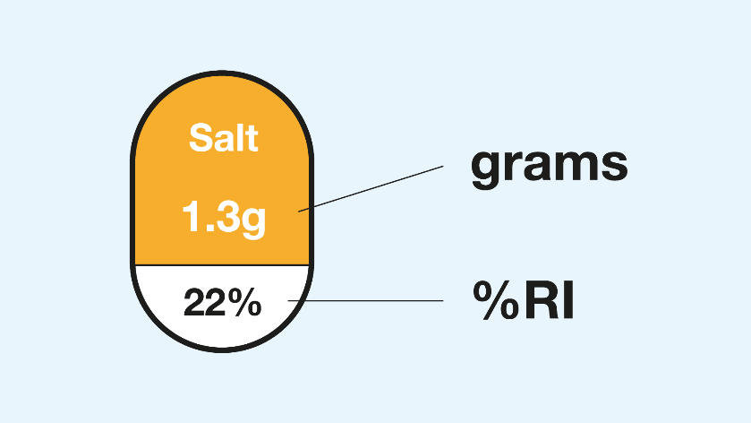
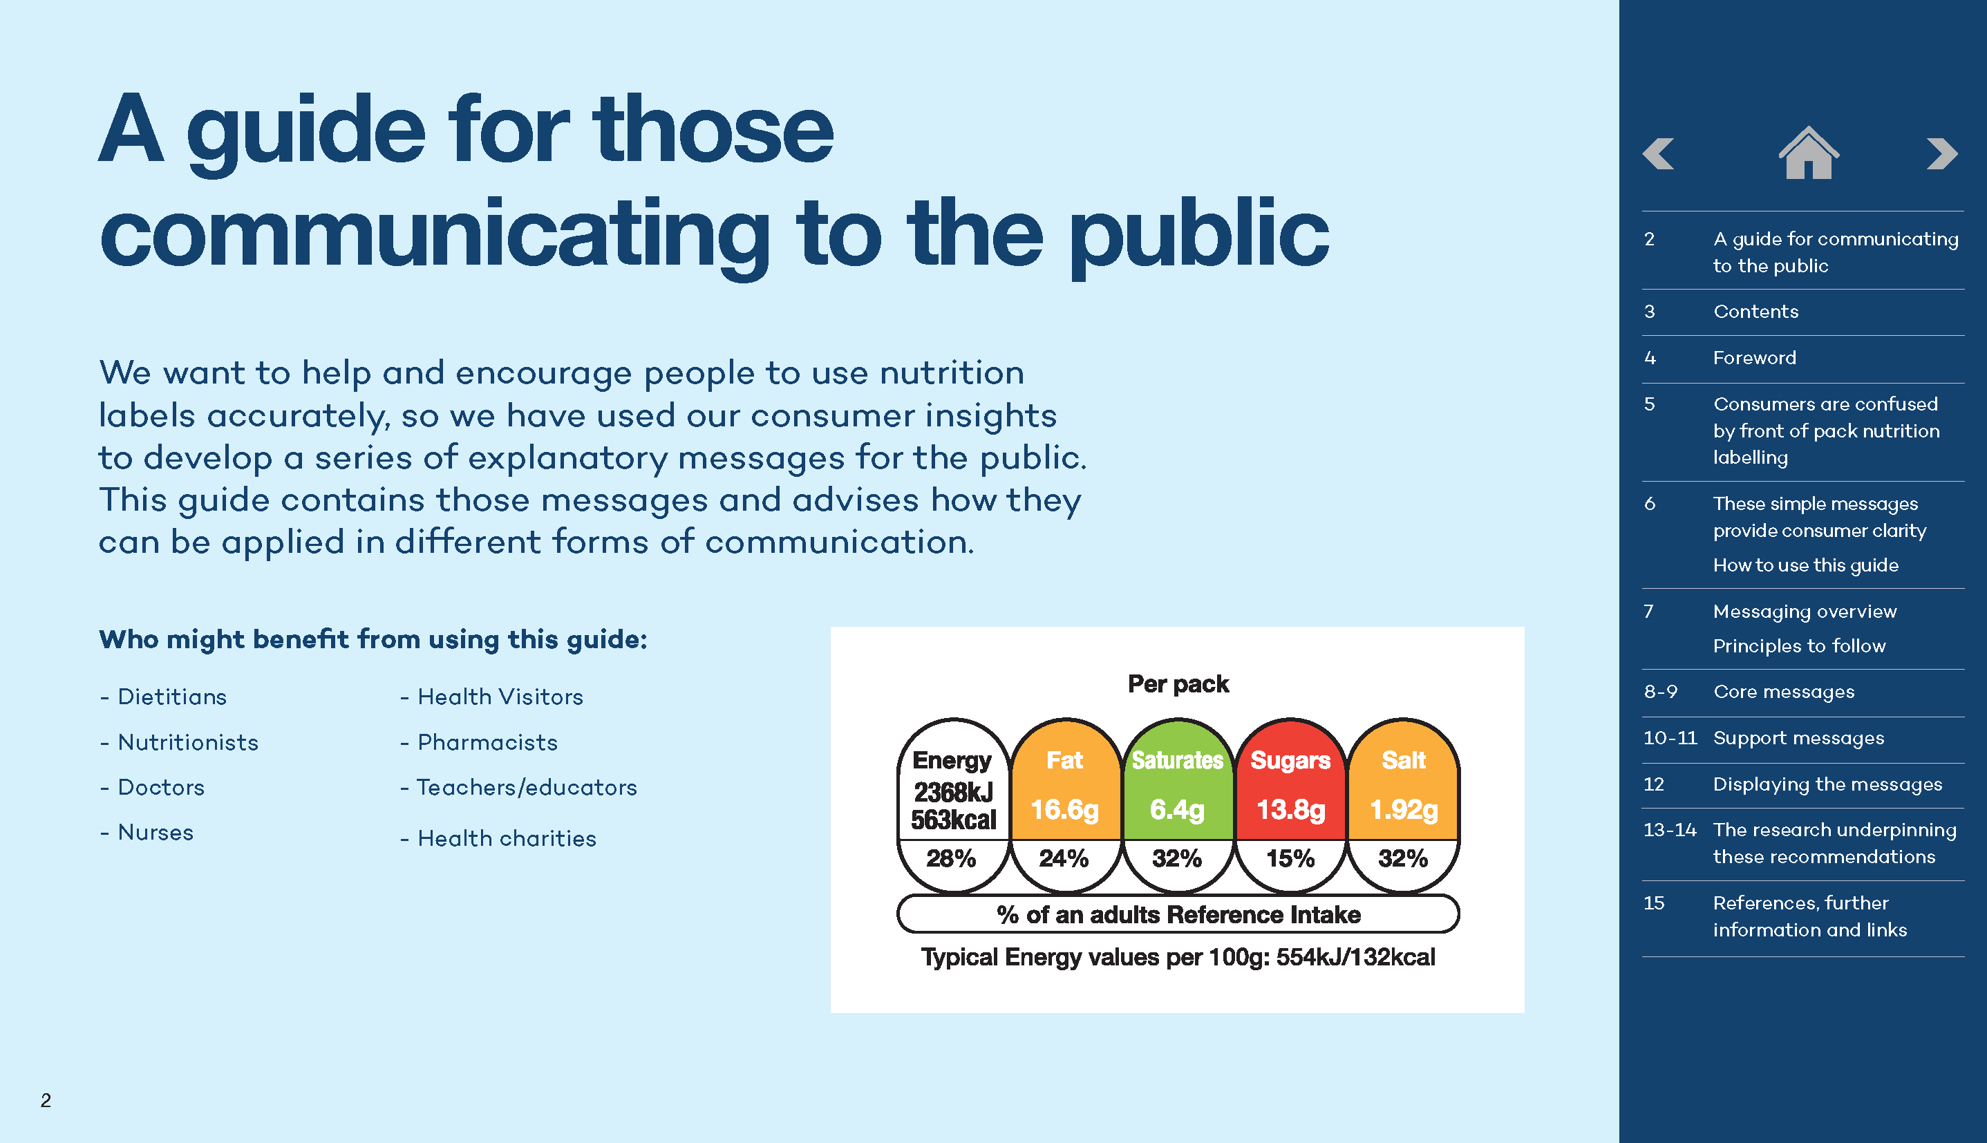
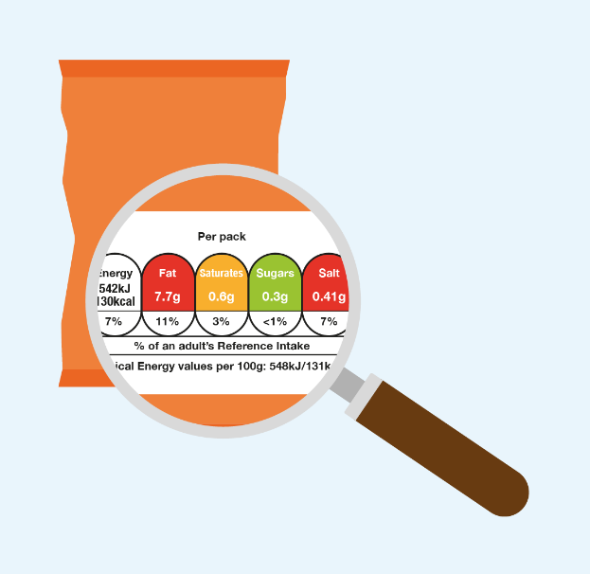
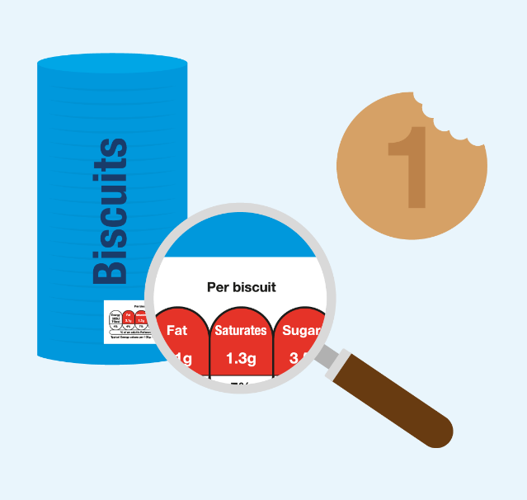
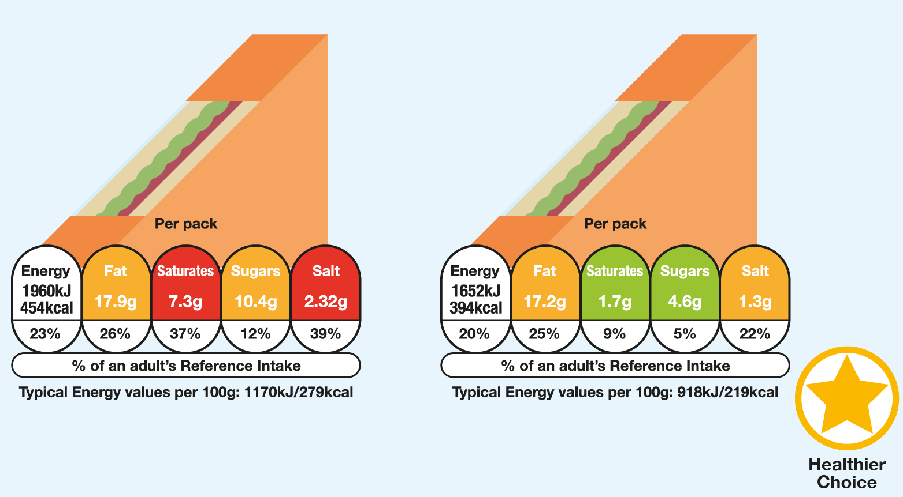
IGD Resources
IGD have produced guides and infographics to help educators explain nutrition labels on FOP visually and clearly

Slide 8

Why use nutritional analysis in school?
Integrating cooking with health and nutrition is a valuable tool to embed learning of both.
When learning about the Eatwell Guide, pupils can be thinking about how to incorporate ingredients into recipes, and vice versa.
Pupils undertaking non-examined assessments may be asked to adapt methods of cooking (e.g. to reduce fat, increase fibre) and complete a nutritional analysis of their dishes.
Our ‘Cooking for health’ area on the website is full of practical uses for nutritional analysis.

Slide 9

Performing nutritional analysis in school
When running your own analysis, make sure that you understand the recipe and the process.
You will need to know the weights of ingredients and also the number of portions.
Depending on how ingredients are processed, the values in the calculation may differ. For example, you may peel an apple before adding it to a recipe.
There are 5 main steps to take to ensure a successful analysis.

Slide 10

Step 1: Check the recipe
Chilli Con Carne Recipe
2 tins chopped tomatoes
Onions
2 Carrots
1 pack minced beef
1 bay leaf
400g kidney beans
Tsp chilli powder
Pepper to taste
Tip: Serve with rice and top with yogurt.
Does your recipe contain all of the information?
Weight of tinned tomatoes not defined
Number of onions not defined
Carrot size not specified
Is the minced beef standard or lean?
Bay leaf will be removed in final dish
Are the kidney beans drained, or with liquid?
How much seasoning? (estimate)
Should it be analysed with our without the ‘Tip’?

Slide 11

Step 1b – volume vs weight
Recipes may have ingredients in ml or in g.
Generally, volume and weight measurements are similar, but not identical.
The density of the liquid will affect its weight.
‘Specific gravity’ or relative density refers to the value that you multiply the volume by to get the weight in g.
 | Volume | Weight
Water | 100ml | 100g
Milk | 100ml | 103g
Vegetable Oil | 100ml | 91g
Notes:
Ice cream example SG 0.55

Slide 12

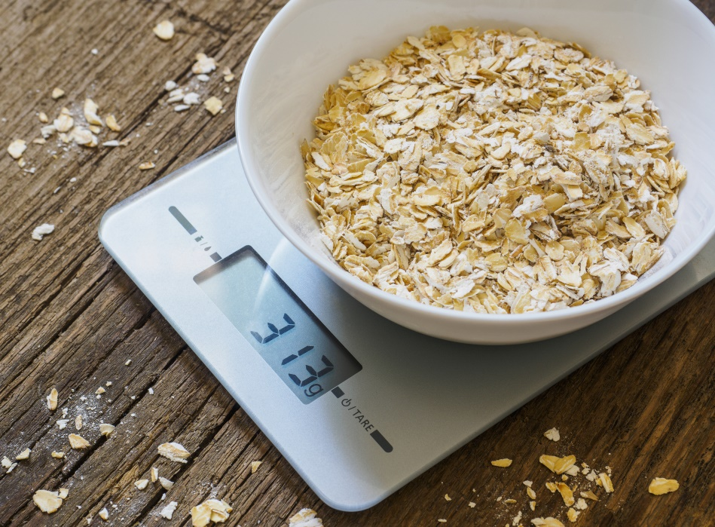
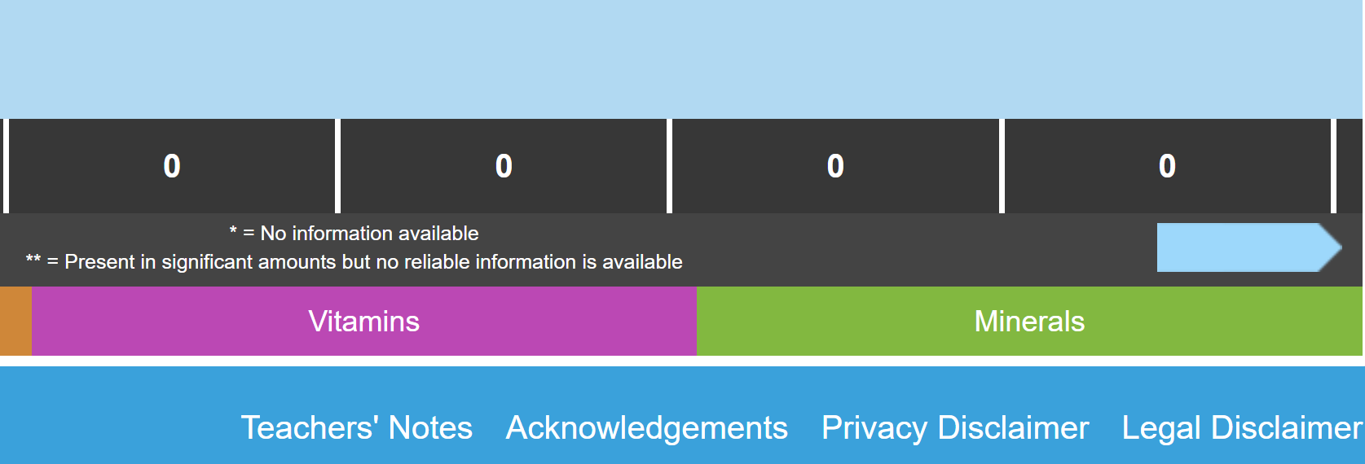
Step 2: Check the portions
Check for generic portion sizes in the recipe (e.g. dollop, large, small, units).
Convert these to grams to input in Explore Food.
It might be worth annotating the recipe to show the estimated gram weight for different ingredients.
Portion sizes for some key foods can be found in the Teachers’ Notes on Explore Food.
Teachers could use the weighing and measuring activity to help pupils understand the importance of accurate measurements.

Slide 13



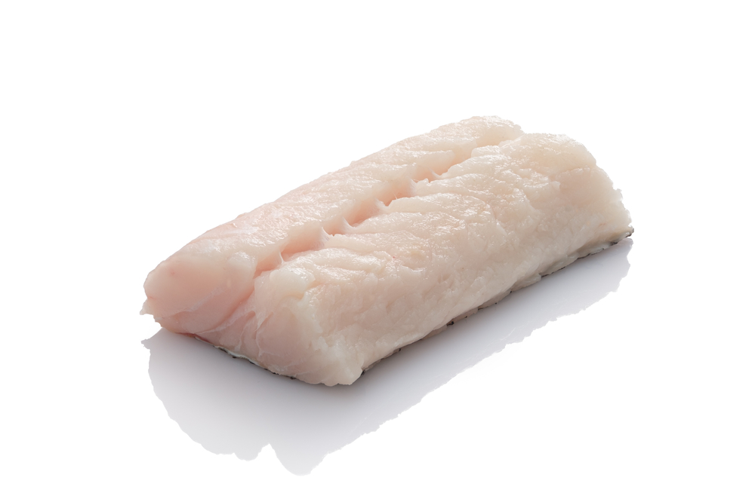
Step 3: Check the preparation methods
Some foods can change in weight and/or nutrition, depending on how they are prepared.
Methods that can affect this include:
Peeling
Trimming
Filleting
Deboning
De-shelling
Explore Food may offer several different options for an ingredient (e.g., skin on vs peeled, boned vs deboned)

Slide 14



Step 4: Check the cooking methods
Foods can change weight when they are cooked.
For example, foods like pasta and rice can become significantly heavier as they absorb water.
This means that the nutrition per 100g dried is significantly higher than 100g cooked.
Other foods (e.g. baked foods) may reduce in weight, as water evaporates off.
Dried pasta will more than double in weight when cooked!
Healthier cooking methods – 11-14 years

Slide 15

Step 5: Perform your analysis!
Once you have your portions, weights and methods figured out, it’s time to begin the analysis.
Input ingredients and their weight (for the whole recipe) into Explore Food.
Check whether you have selected a cooked or dried version of an ingredient (or other similar preparation differences).
Some ingredients may not have exact matches, so consider similar ingredients that could be a suitable replacement.
Input the number of portions, to see the values per portion as well as per recipe and per 100g.

Slide 16
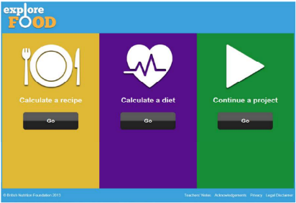
Explore Food
Explore Food is a simple online nutritional analysis tool available free to use from the British Nutrition Foundation’s Food – a fact of life education programme.
Explore Food allows students to:
calculate the energy and nutrients provided by a recipe or diet;
model different portion sizes for a recipe;
compare the diet for a day to DRVs;
model different DRVs and the diet;
save work to continue another time (saved as a file); export work into a spreadsheet file for further analysis;
print work.
A simple guide for pupils to learn how to use Explore Food can be downloaded here

Slide 17
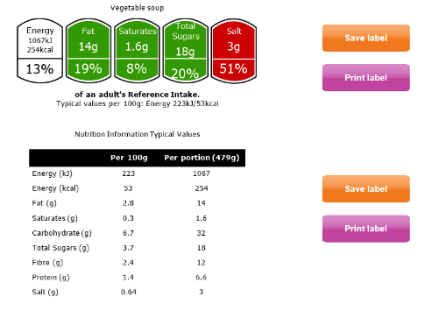
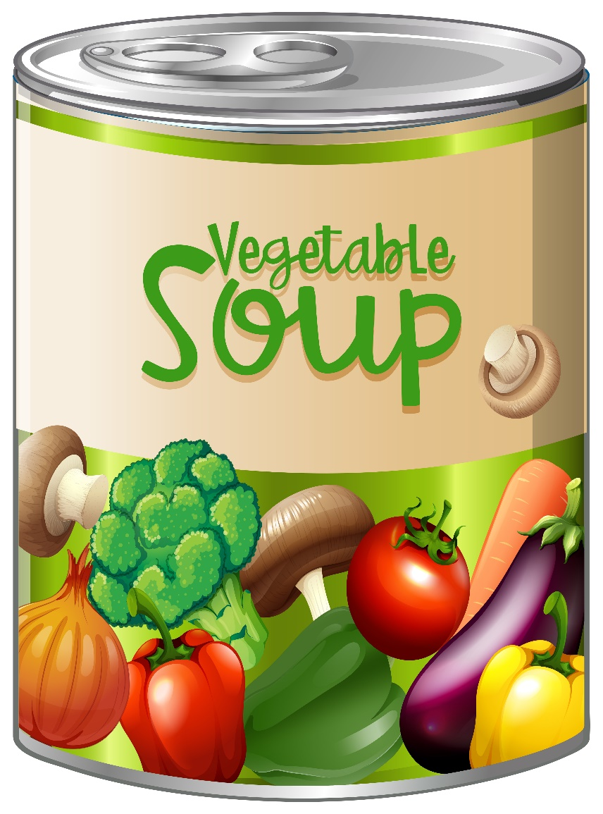
Example analysis
Ingredients and Nutritional value
Cost
Sensory analysis
Labels
Homecooked soup using seasonal vegetables
Bought canned soup comparison:
Worksheet looking at the sensory properties of canned soup.
Notes:
Homemade – canned basic – premium comparison
Nutritional analysis
Costing
Sensory analysis
Food labels

Slide 18
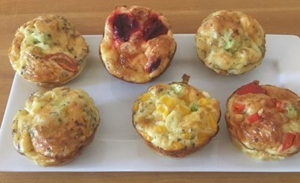
Explore Food Demo!
Using the ‘Easy veg frittatas’ recipe
This recipe:
2 spring onions
50g cheddar cheese
Fresh coriander
3 eggs
80g sweetcorn
40ml milk
Black pepper
Spray oil
Notes:
2 spring onions – about 30g
Coriander – about 25g
3 eggs – about 150g
40 ml semi-skimmed milk – about 41.2g
Pepper – about 5g
Oil – about 5g

Slide 19
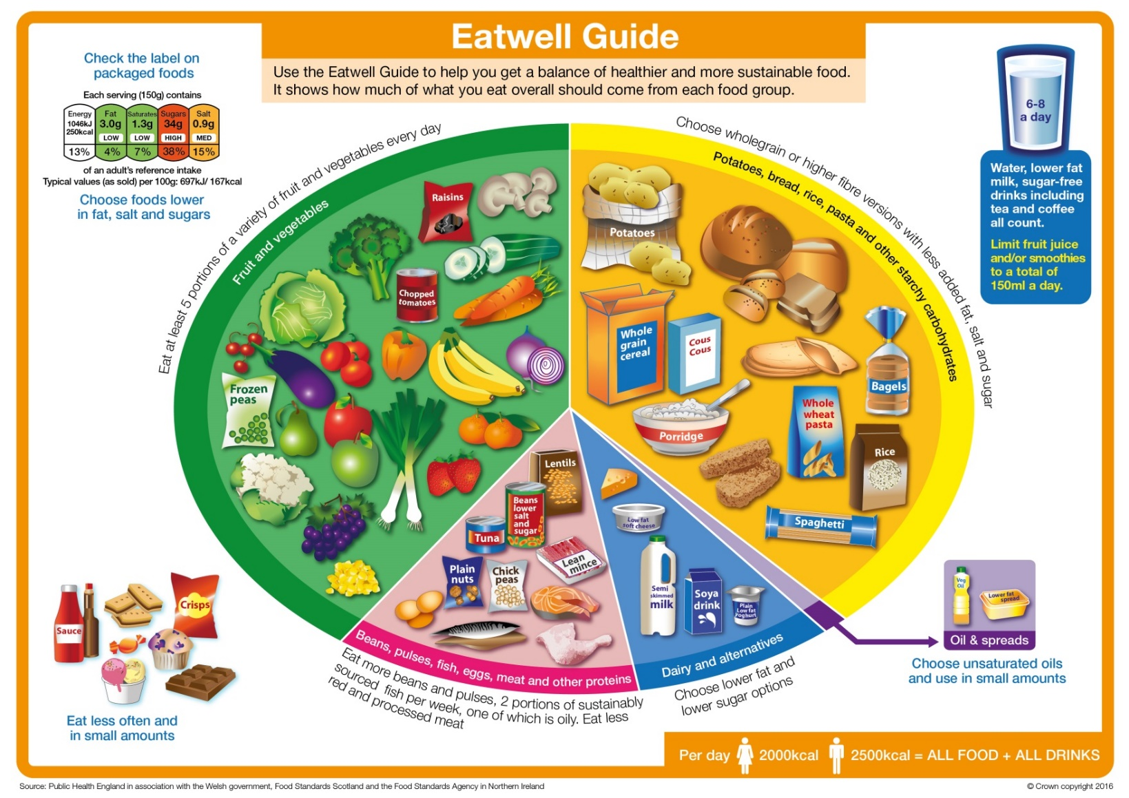
Modified recipes
When modifying recipes to make them healthier, consider the principles of the Eatwell Guide.
Eat lots of fruit and vegetables
Cut down on saturated fat, salt and sugar
Eat more fish, including a portion of oily fish per week
Base meals on starchy carbohydrates
Choose lower fat and lower sugar dairy
Choose unsaturated oils and spreads

Slide 20
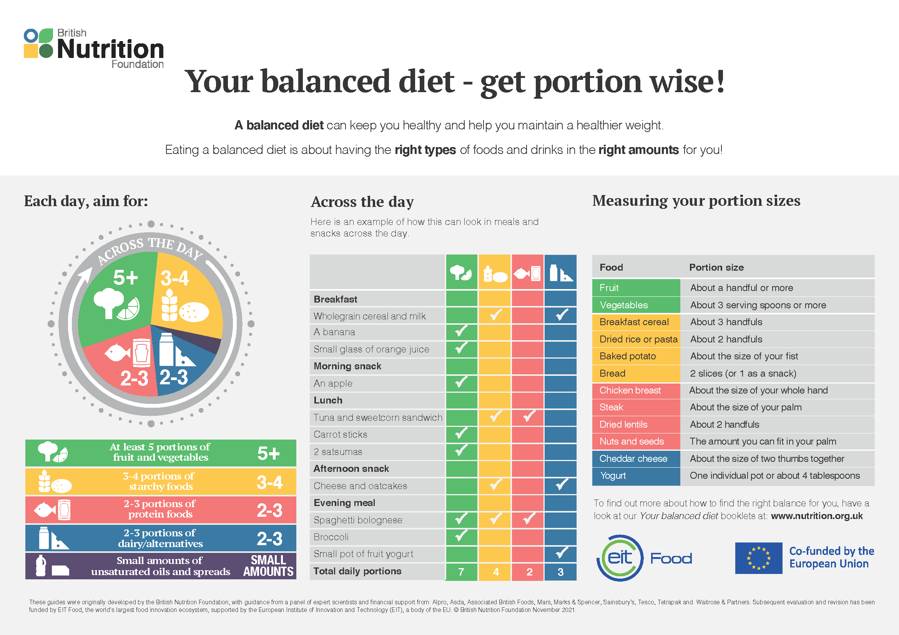
Tips for modification
Reduce salt by adding other seasonings, such as herbs, spices, chilli, lemon etc.
Increase the proportion of fruit and vegetables.
Choose fruit canned in juice, rather than syrup.
Use reduced fat varieties of dairy and spreads, where possible.
Swap ‘white’ carbs for wholegrain varieties.
Consider portion size guidance – is the portion size too large? Download the Explore Food teachers’ notes for portion size estimates.
The British Nutrition Foundation recently updated guidance on portion sizes, including simple measures, estimated with your hands!

Slide 21
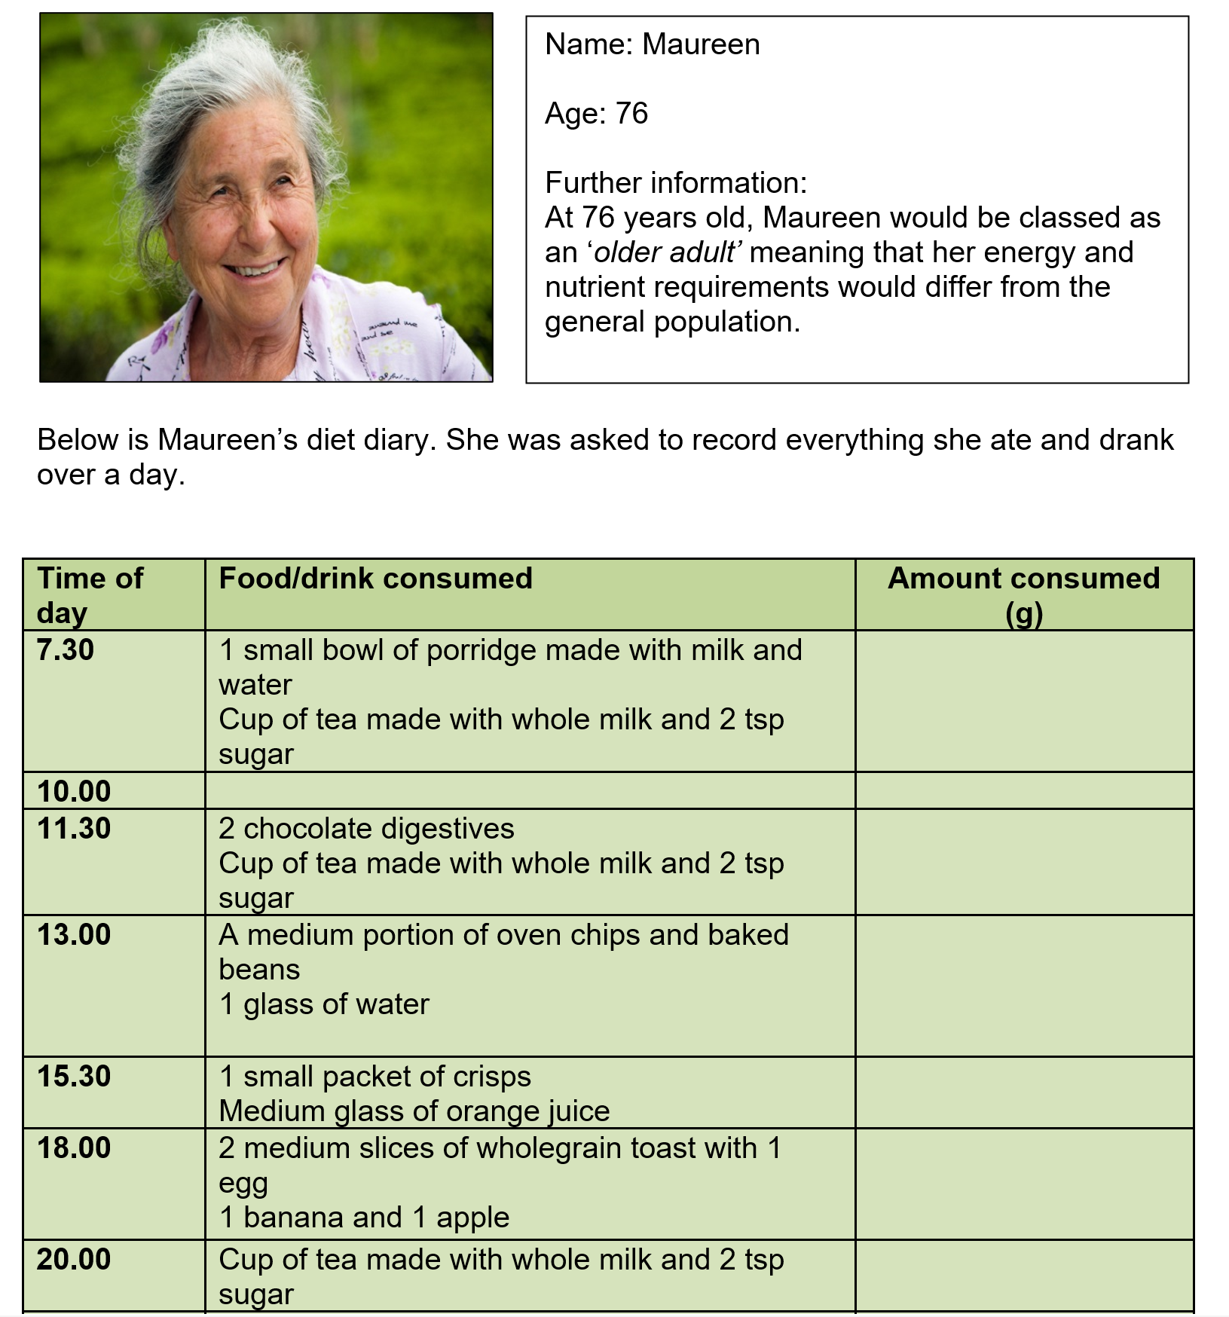
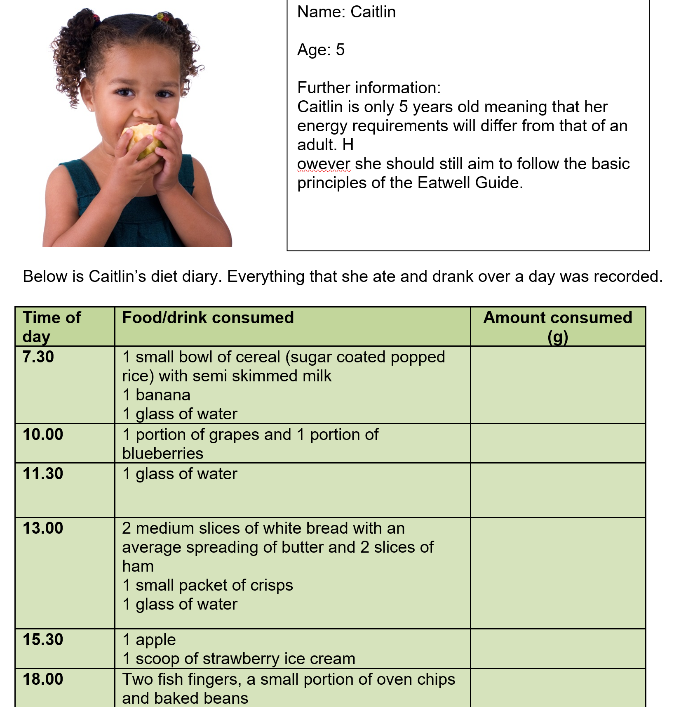
Nutritional analysis - case studies

Slide 22
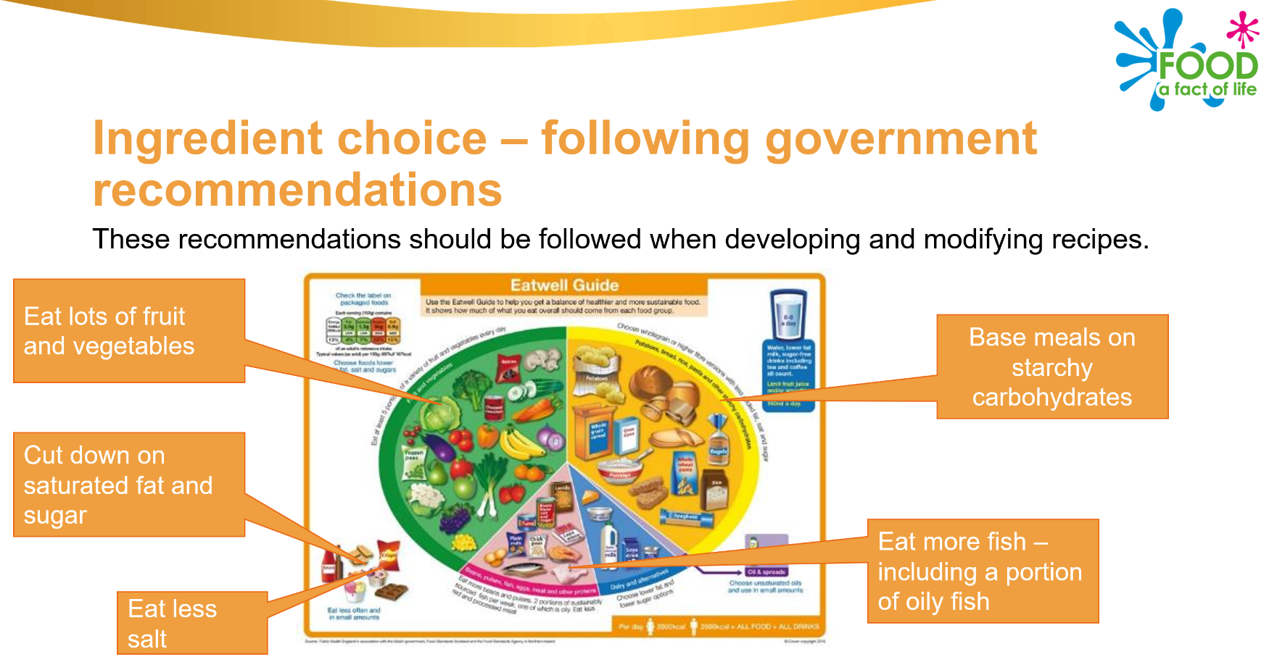
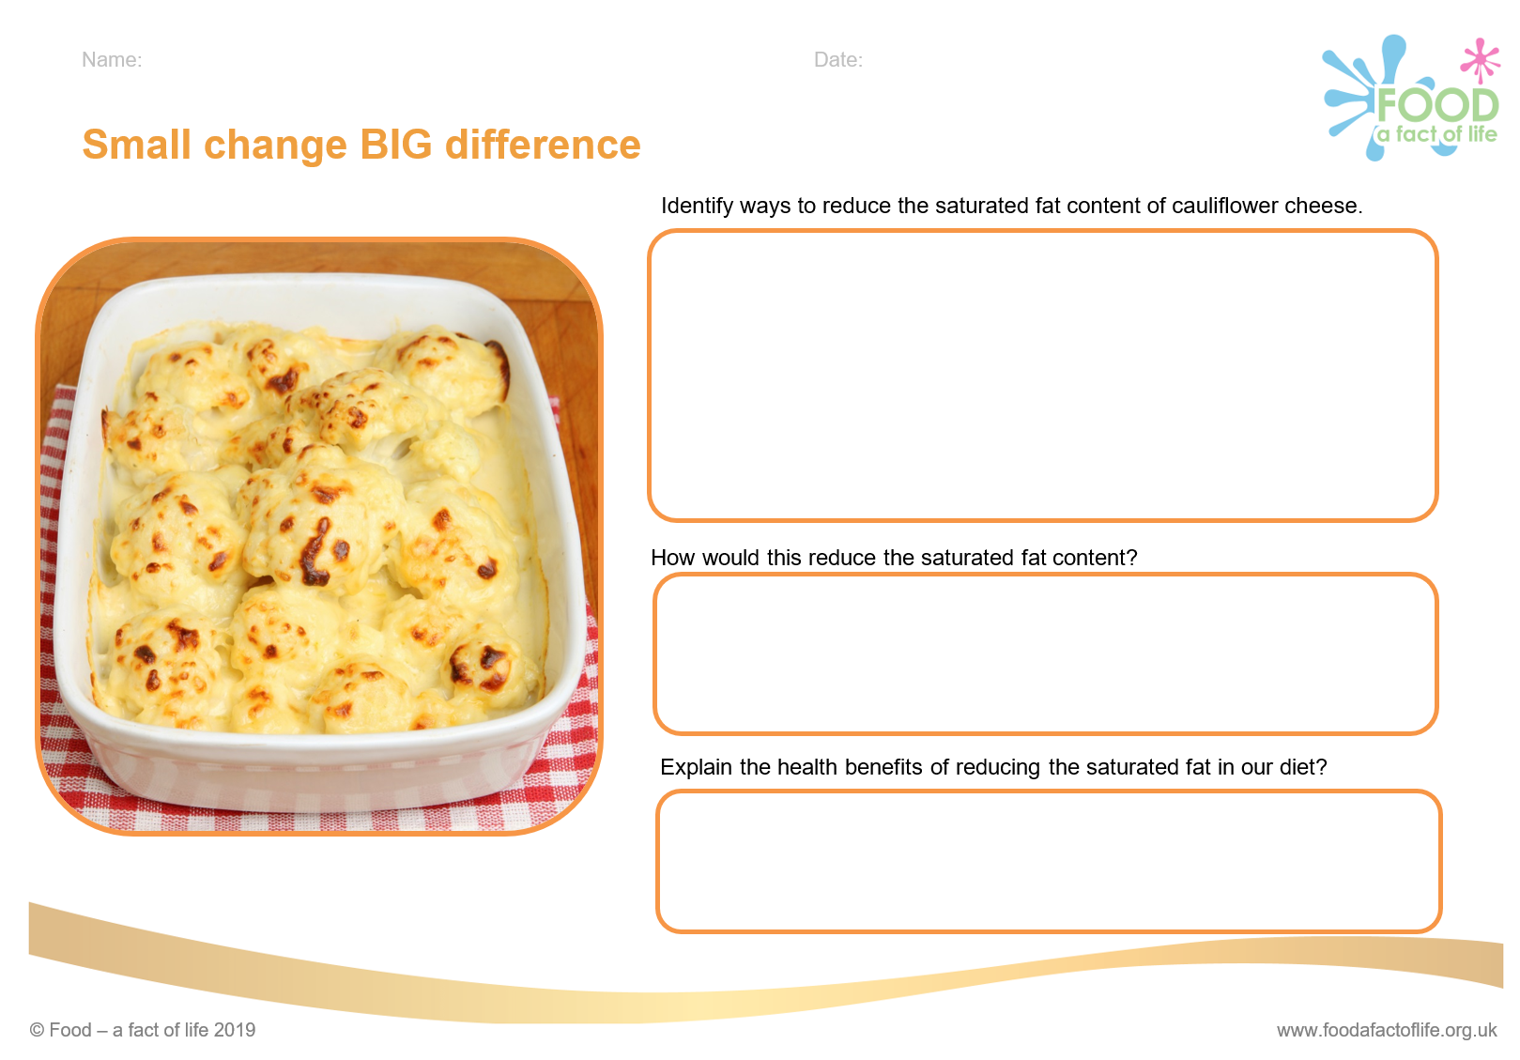
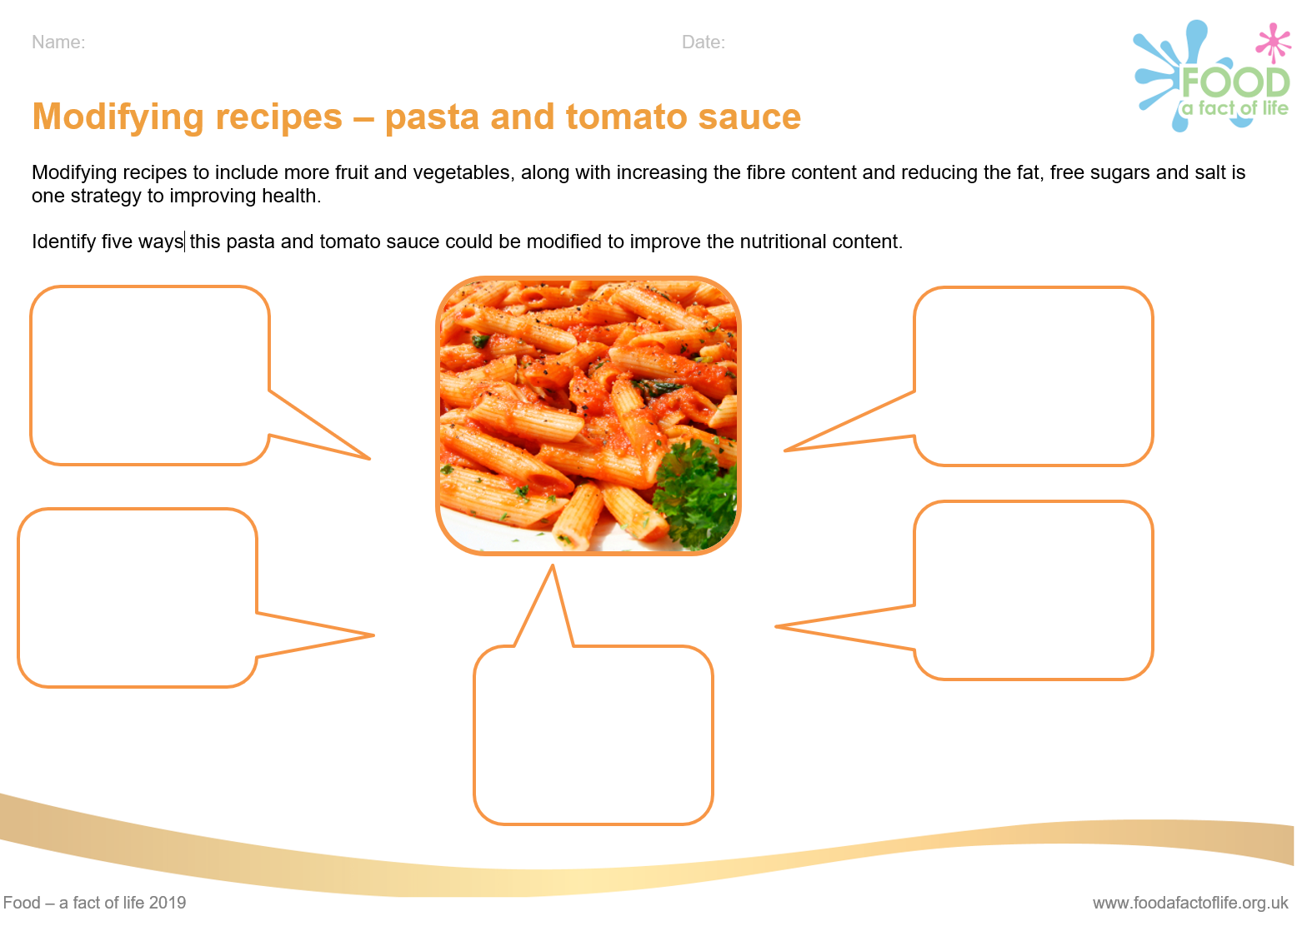
Modifying recipes resources
Cooking for health – Modifying recipes

Slide 23
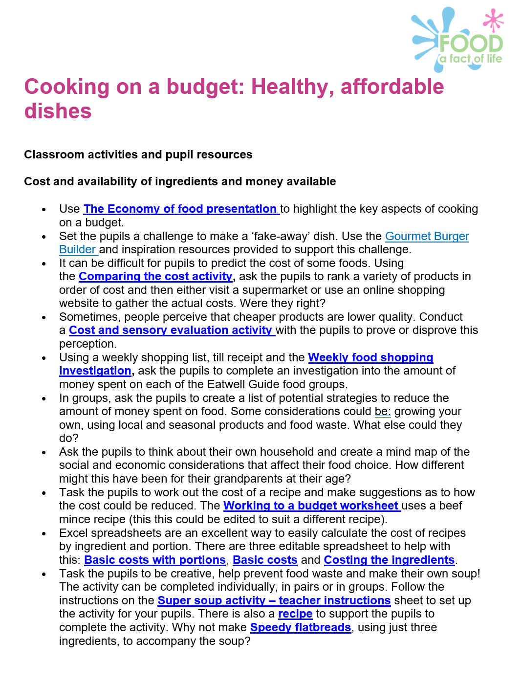
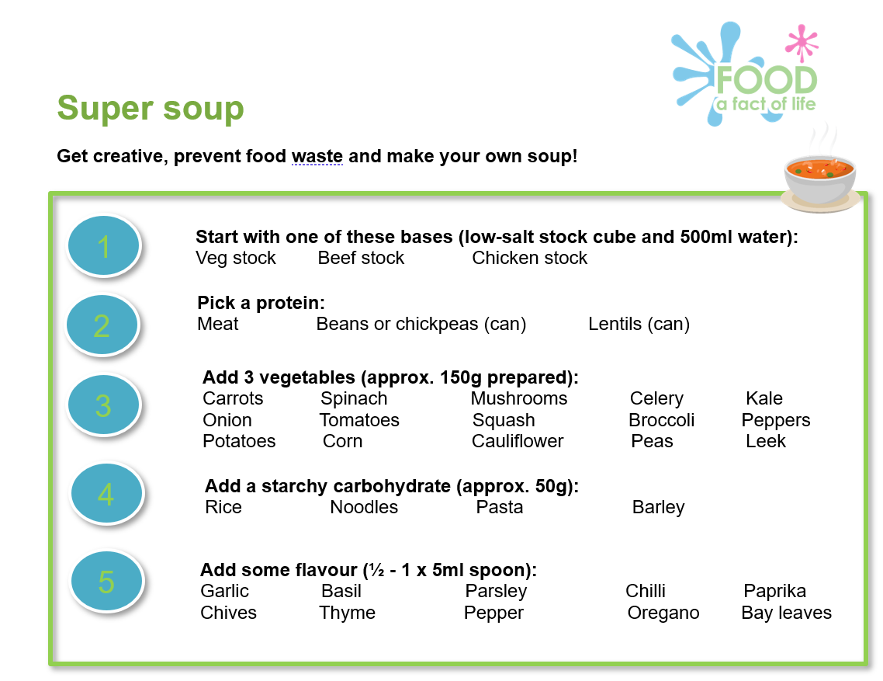
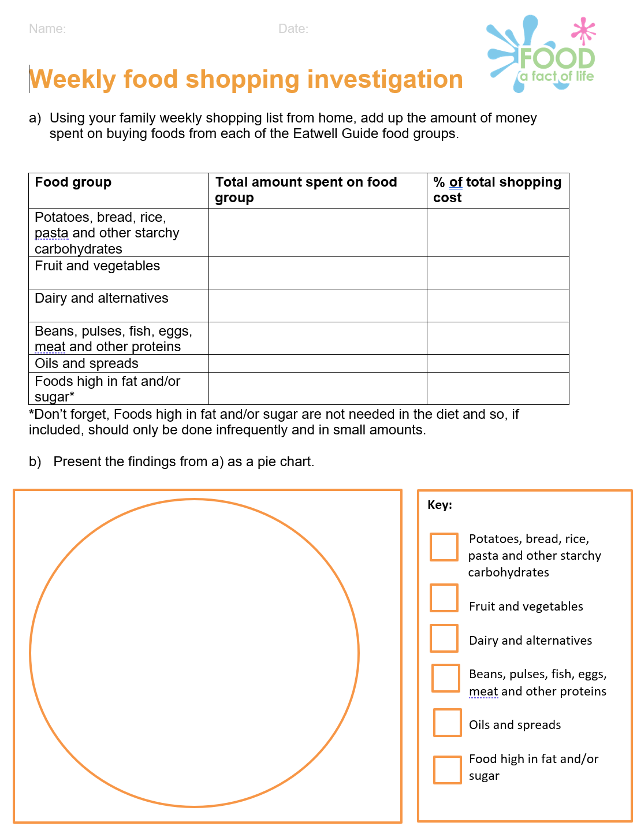
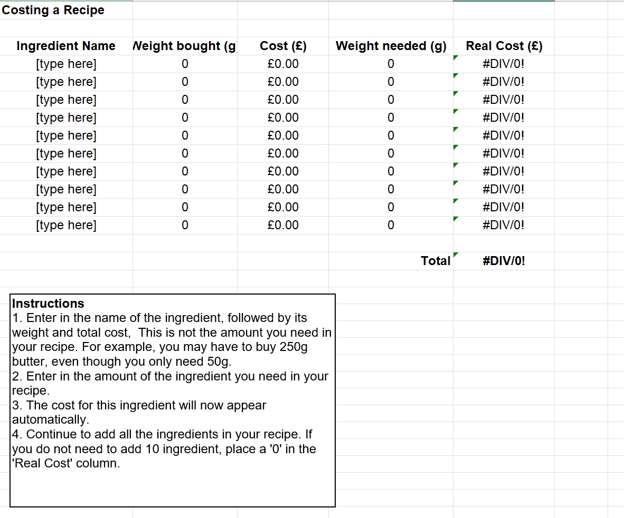
Cooking on a budget resources
Cooking on a budget – teachers’ guide

Slide 24
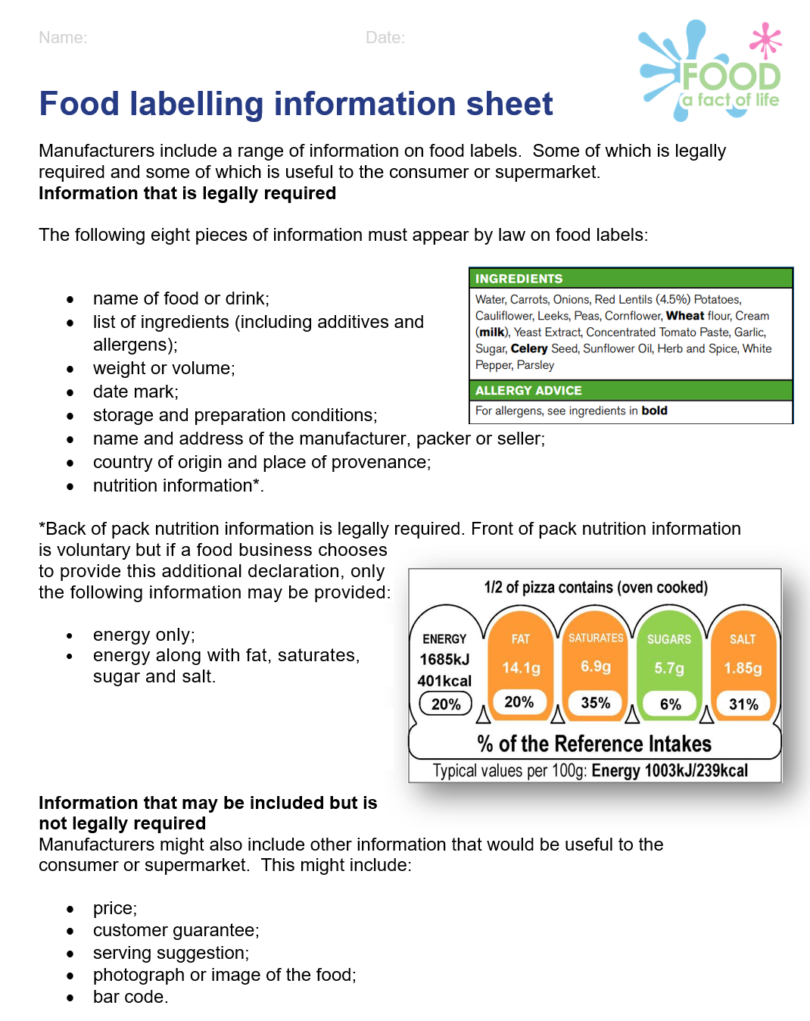
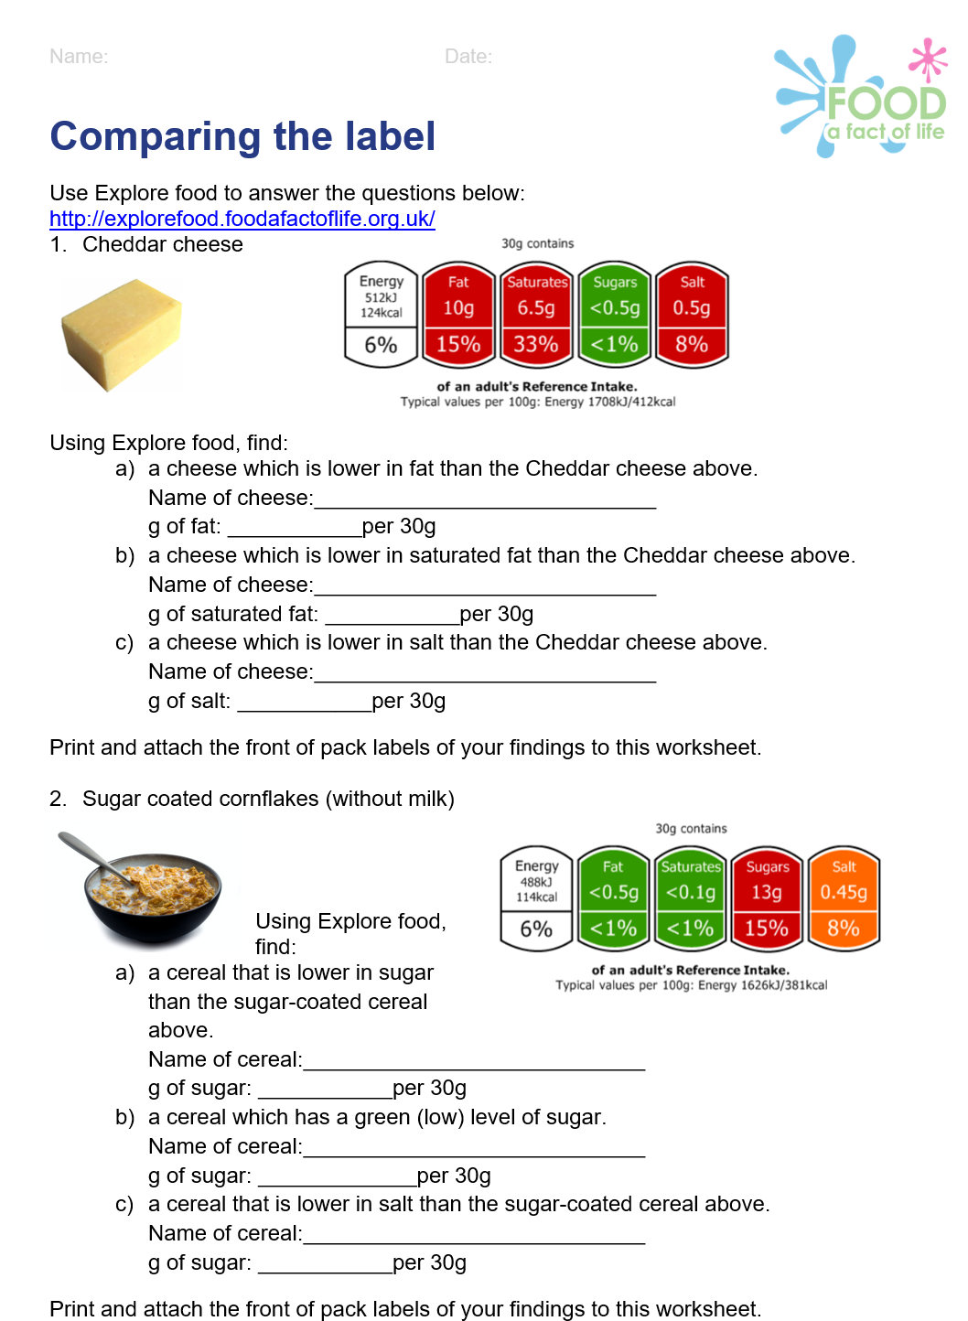
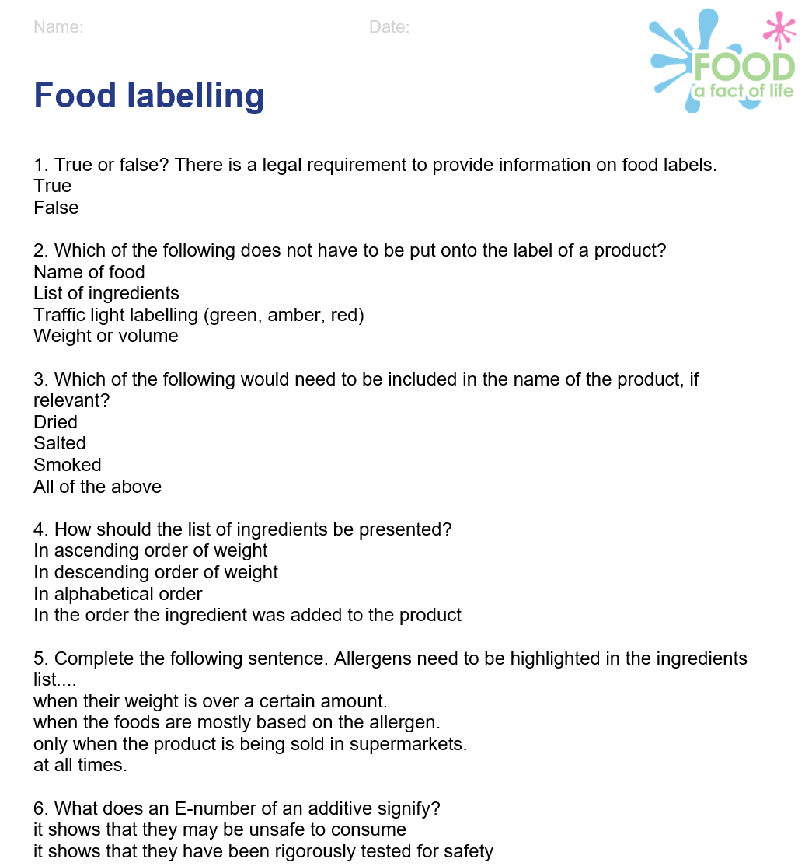
Food labelling and health claims resources
Food labelling and health claims (14-16)

Slide 25
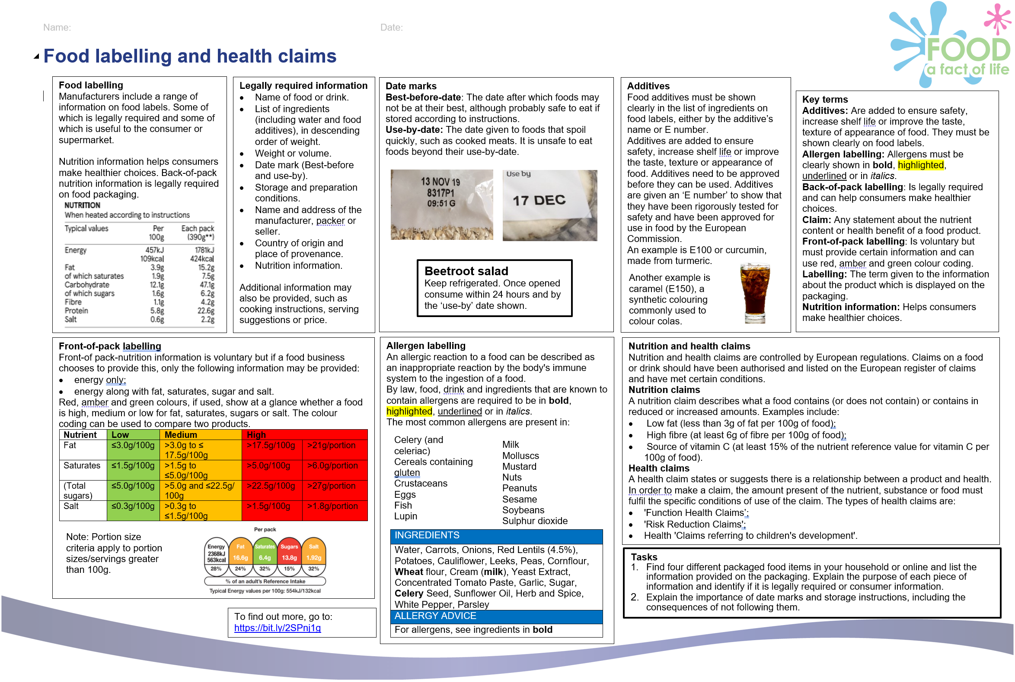
Food labelling and health claims KO
Food labelling and health claims Knowledge organiser
Knowledge organisers (11-14)
Knowledge organisers (14-16)

Slide 26
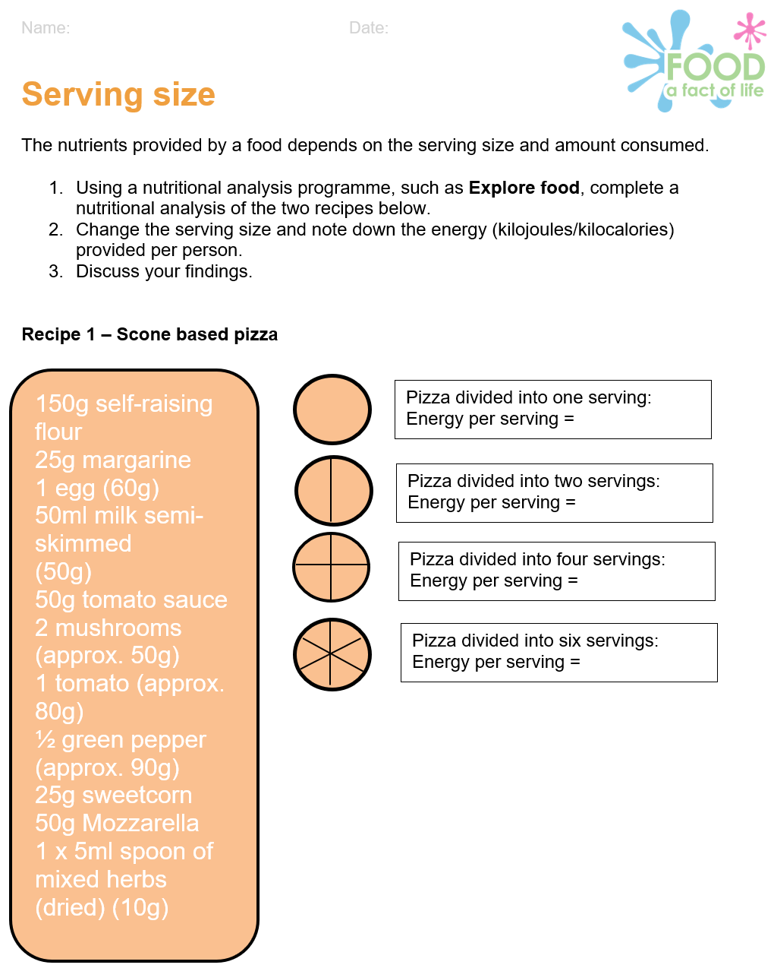
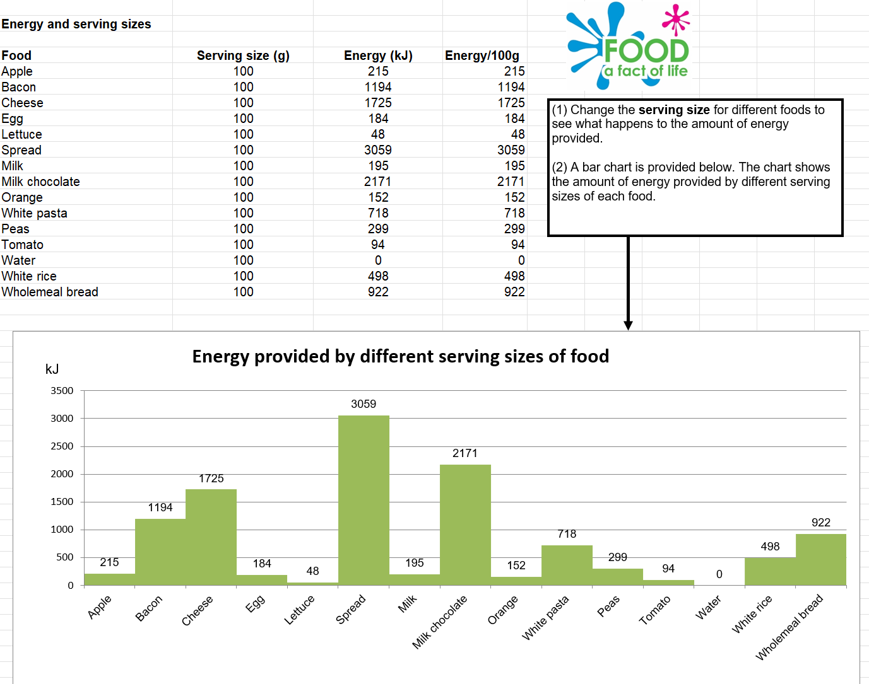
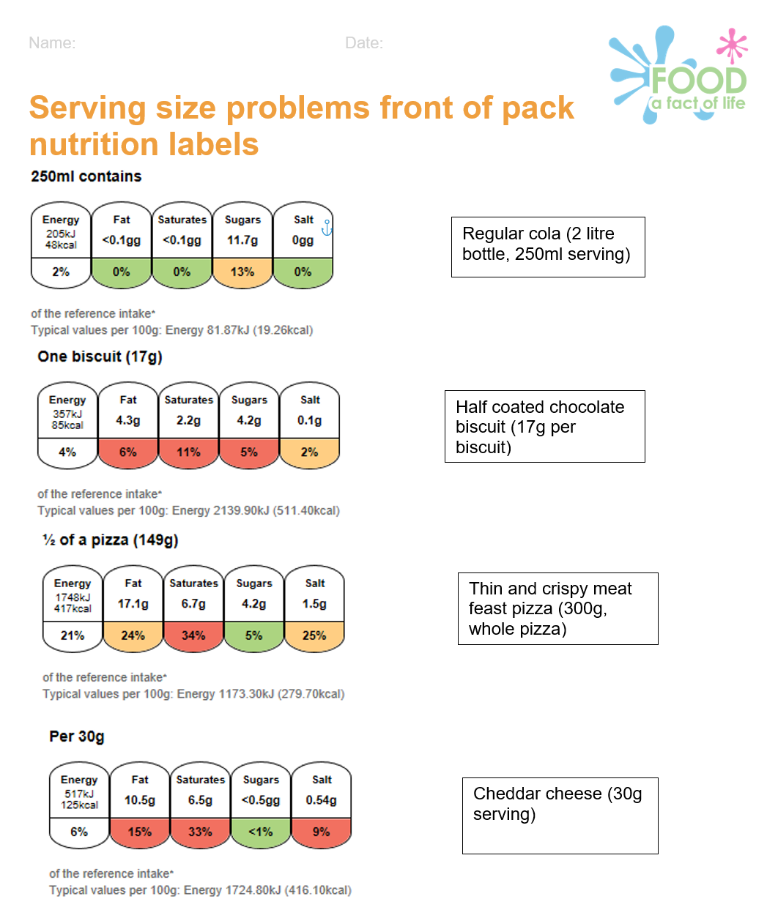
Serving size resources
Serving size resources

Slide 27
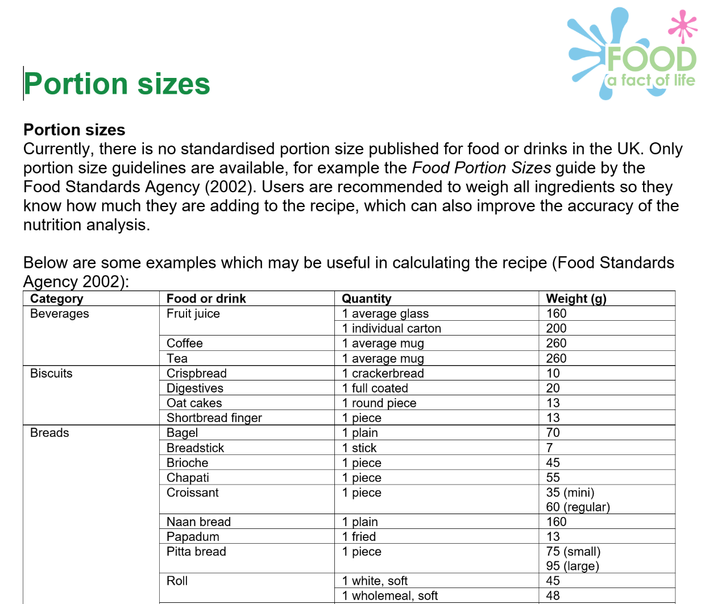
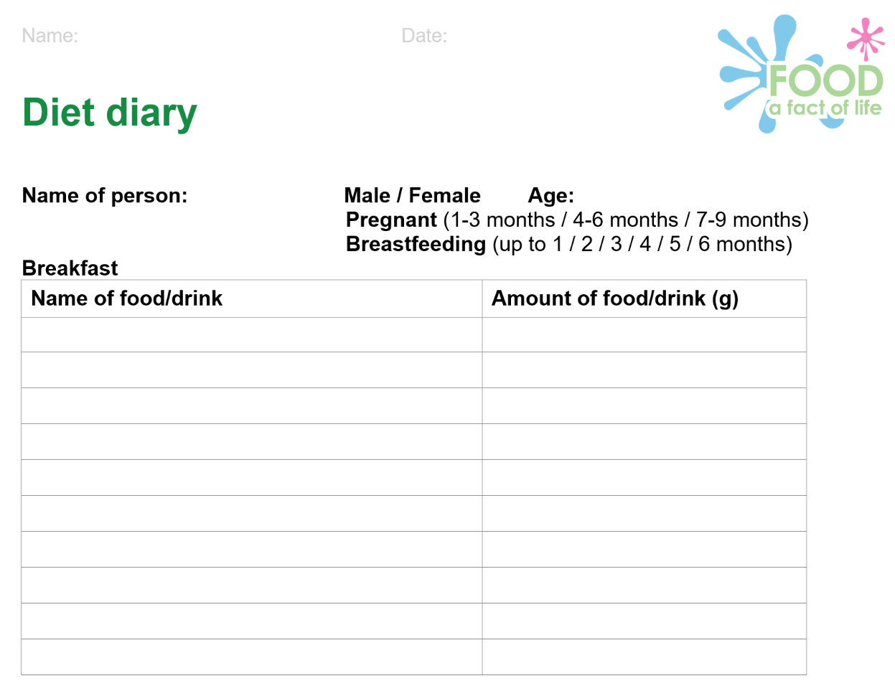
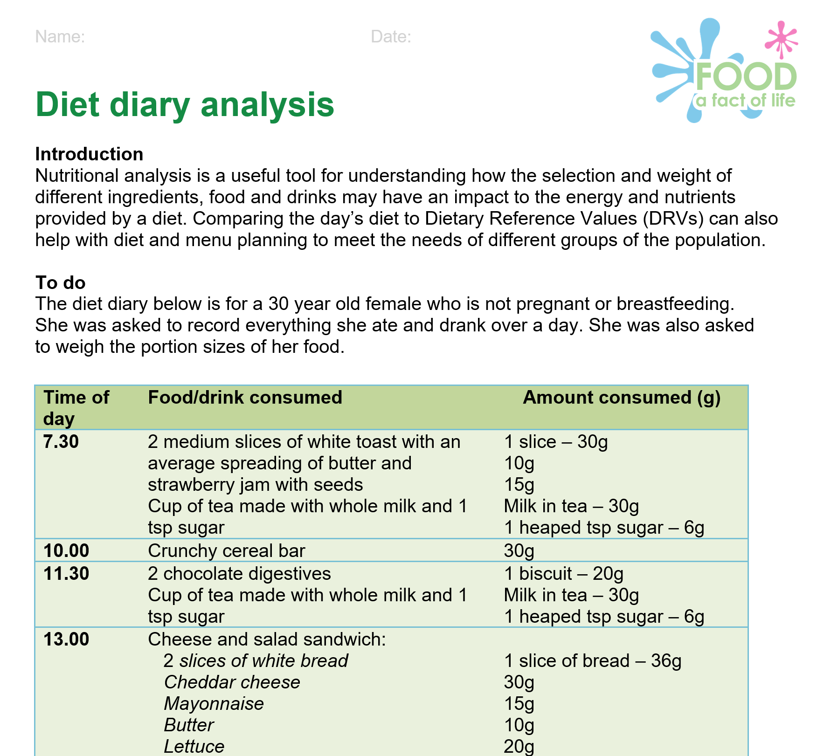
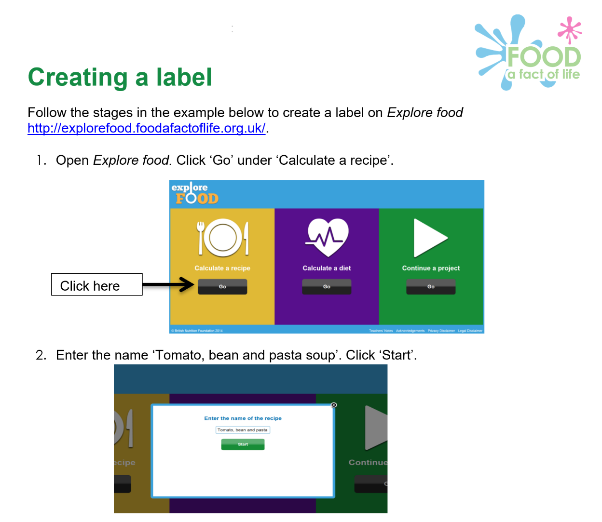
Nutritional analysis - other resources
Nutritional Analysis (11-14)
Nutritional Analysis (14-16)

Slide 28
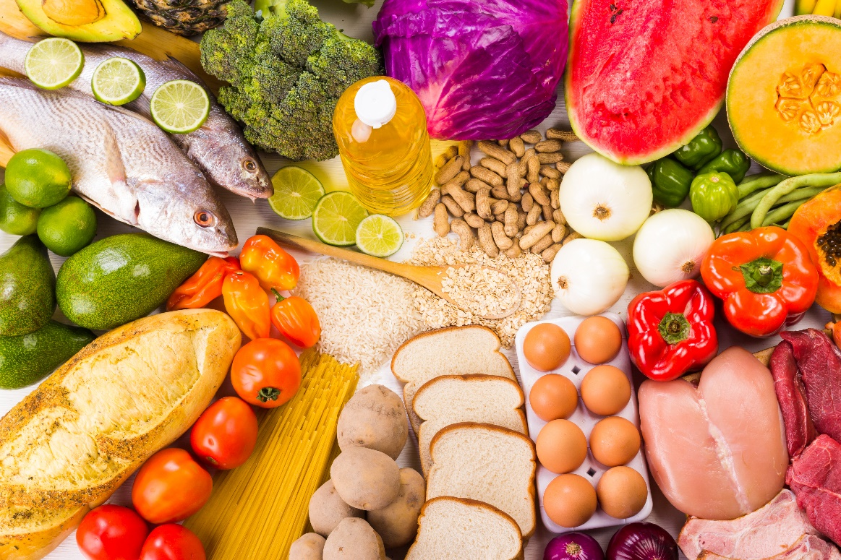
Conclusion
Nutritional analysis is a crucial tool for manufacturers to formulate products.
Analysis in schools can help pupils to embed the concepts of nutrition and cooking, as well as supporting numeracy development.
Understanding the differences made through modifying recipes can demonstrate pupil progression and support curricula and examination requirements (e.g. in NEA assessments).
Explore Food uses the McCance and Widdowson Composition of Foods dataset to make nutritional analysis easier, as well as ensuring the data is scientifically sound.
Further resources are available on the website.
ICT, numeracy and literacy in food and nutrition lessons presentation

Slide 29


Keep up to date with our free resources and training
Education News (monthly email update)
Sign up on the homepage: www.foodafactoflife.org.uk
PPD newsletter (find out about upcoming FFL training)
https://www.foodafactoflife.org.uk/professional-development/
Follow us on Twitter @Foodafactoflife
https://twitter.com/foodafactoflife
Keep in touch:
education@nutrition.org.uk

Slide 30
Using nutritional analysis in a meaningful way
For further information, go to:
www.foodafactoflife.org.uk

