Slide 1
Diet, insulin and blood glucose

Slide 2
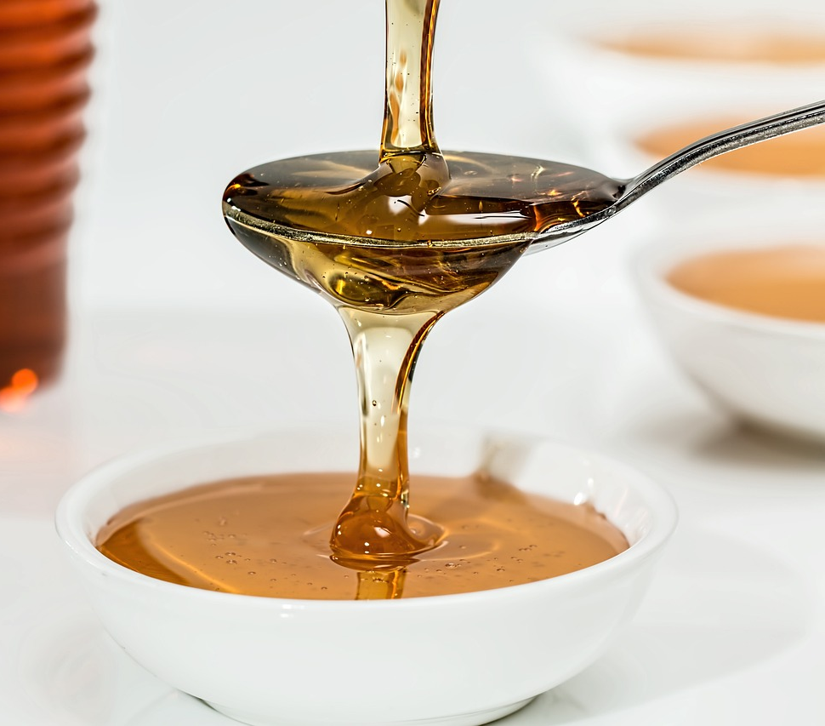
What is glucose?
Glucose is a sugar that is made when plants use the sun’s energy to convert water and carbon dioxide. Glucose is needed in the blood to supply cells with glucose for respiration. Blood contains glucose which is an important source of energy for the body, including the brain and nervous system.
The glucose in blood must be kept within a normal range for the body to work properly. If it rises or falls significantly, the body can usually bring it back to normal. This process is called homeostasis.

Slide 3
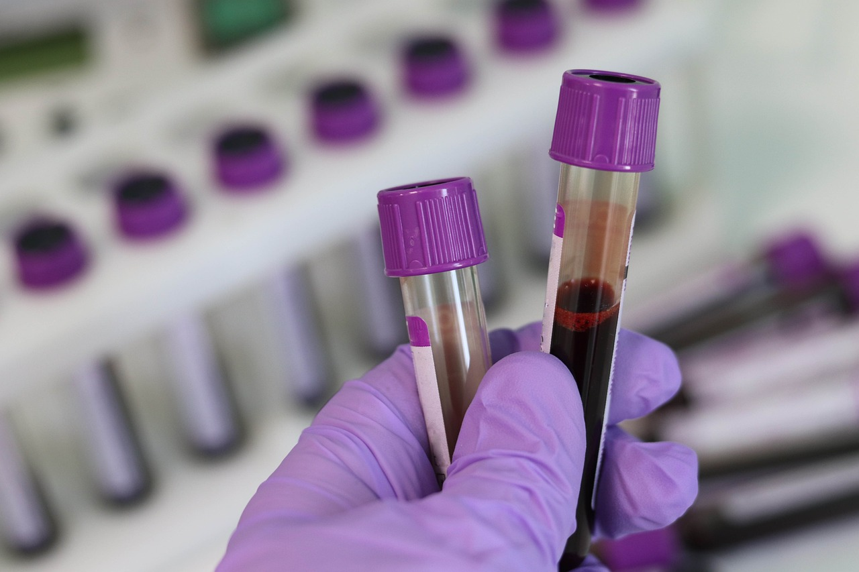
Regulation of glucose by hormones
Hormones are chemical messengers produced in one part of the body and carried in the blood to cause some action in another part of the body. Different hormones have different actions.
The level of glucose is regulated by the hormones, insulin and glucagon, both produced and released by the pancreas.

Slide 4
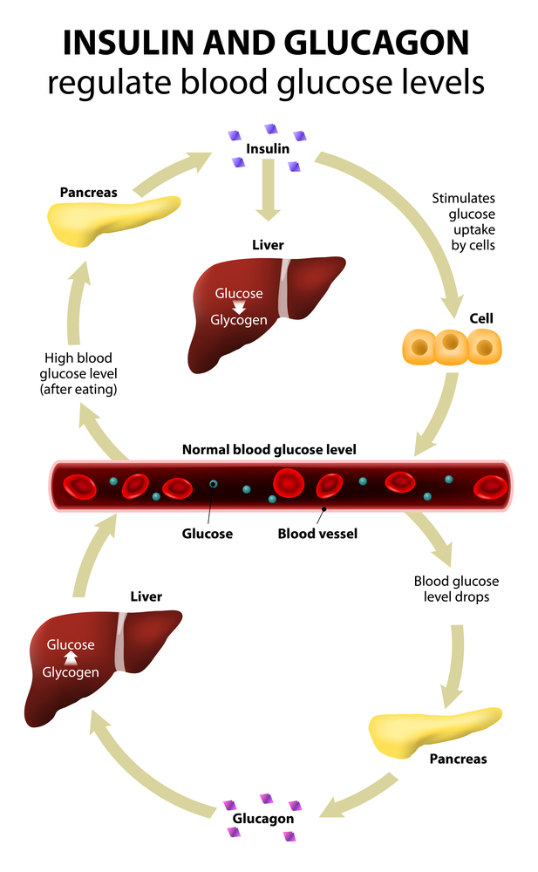
When blood glucose rises
The amount of glucose in blood increases after a meal. This is called hyperglycaemia.
Insulin is released from the pancreas and causes the cells in the body, the liver, muscle and fat tissues in particular, to take up glucose from the bloodstream.
This reduces the amount of glucose in blood and the pancreas stops producing insulin. The blood glucose level then falls back to normal.

Slide 5
When blood glucose falls
As the body takes up the glucose in blood for energy its level falls. The pancreas releases glucagon, which has the opposite effect from insulin. It increases the level of glucose in the blood by stimulating the liver to release glucose.
Other hormones are also produced when the blood glucose level falls too low, e.g. adrenaline and cortisol. These help to bring the level of glucose in the blood back to normal.

Slide 6
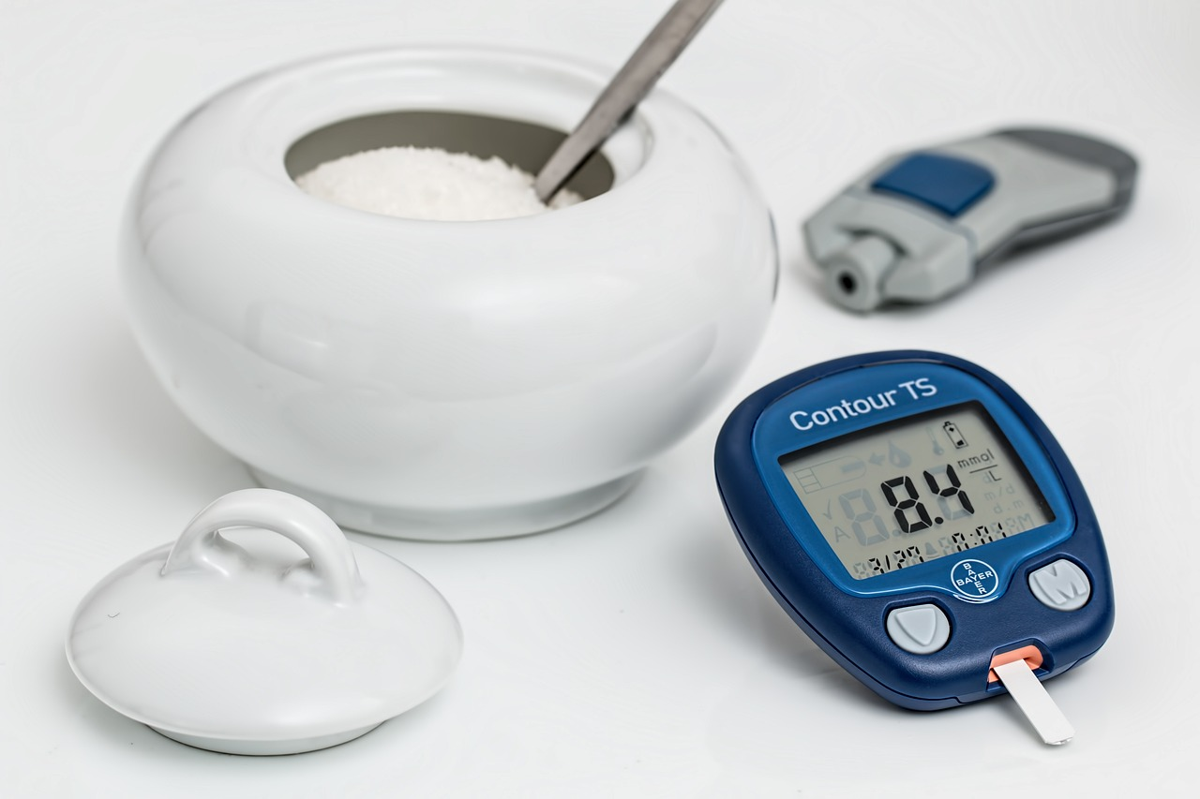
Diabetes Mellitus
Diabetes Mellitus, commonly referred to as diabetes, is a condition where chronic hyperglycaemia occurs since the body is unable to control the amount of glucose in blood. The glucose rises above the normal range.
People with diabetes either do not produce enough insulin or the insulin they produce is not effective.

Slide 7

Health problems caused by diabetes
Diabetes is a common, serious, chronic disease which affects health and life expectancy. Symptoms of diabetes include thirst, large amounts of urine, tiredness, blurred vision, dry skin and the loss of weight in some cases.
In the long-term, uncontrolled diabetes can lead to damage to the eyes, nerves, kidneys and blood vessels. Coma and death may also result.

Slide 8
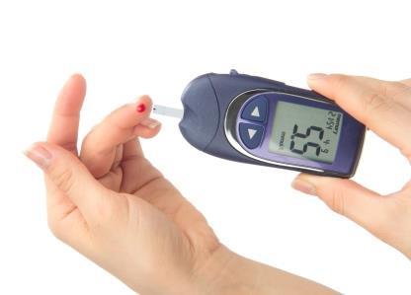
Types of diabetes
There are two main types of diabetes:
Type 1 diabetes
Also known as insulin dependent diabetes mellitus. This accounts for around 10% of all cases of diabetes.
Type 2 diabetes
Also known as non-insulin dependent diabetes mellitus. This accounts around 90% of all cases of diabetes.

Slide 9

Type 1 diabetes
The pancreatic cells which normally produce insulin in people with Type 1 diabetes are missing or damaged. The body does not produce insulin so blood glucose levels remain high.
Type 1 diabetes usually develops in a few weeks and the symptoms are very obvious, but they can quickly be relieved by treatment.
This must be treated by daily injections of insulin which helps control the blood glucose level. Type 1 diabetes usually begins before the age of 40, often in early childhood.

Slide 10
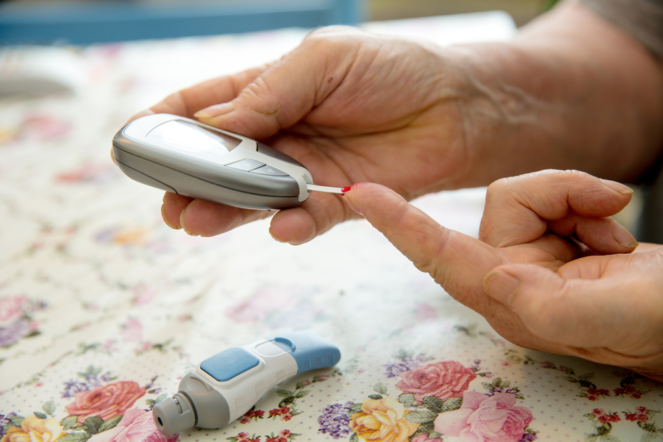
Type 2 diabetes
This is also called non-insulin dependent diabetes. People with Type 2 diabetes produce insulin in their pancreas, but it is insufficient to control blood glucose effectively. This is often because the body tissues are resistant to the action of insulin.
Type 2 diabetes can be controlled or improved by diet. If someone with Type 2 diabetes is overweight, then weight loss will usually improve the symptoms. Some people with Type 2 diabetes need to take medicines to reduce the level of glucose in blood.
Type 2 diabetes usually develops in middle-aged people (over the age of 40) and in later life.

Slide 11
Risk factors for diabetes
Type 1 diabetes:
family history/genetics;
viral infection.
Type 2 diabetes:
family history/genetics;
overweight or obesity, especially central obesity;
adults aged over 40;
people of Asian or African-Caribbean origin;
lower socio-economic low birth weight;
previous gestational diabetes (during pregnancy).

Slide 12
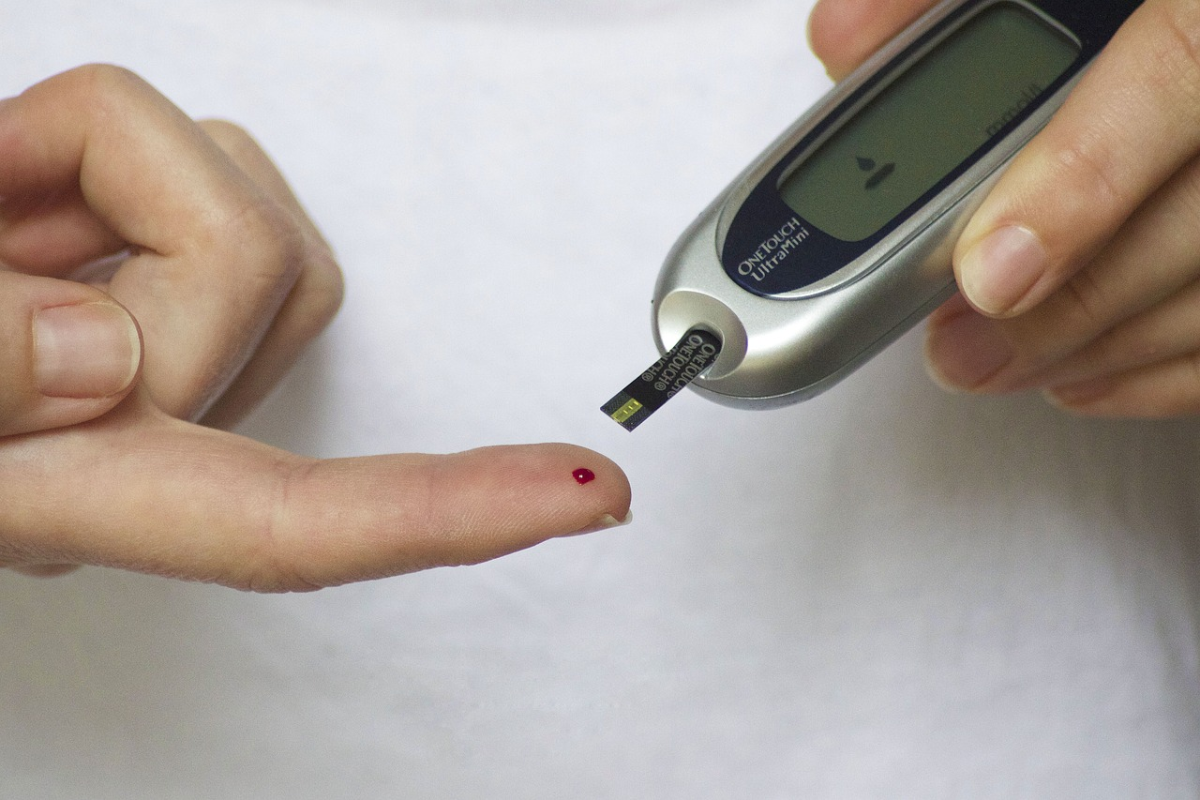
Diet and diabetes
Having a healthy, balanced diet is important for controlling the symptoms of both types of diabetes.
People with diabetes should try to keep their blood glucose levels within the normal range. To do this, it is important to eat regular meals, with lots of fruit and vegetables and plenty of wholegrain starchy foods.
People with diabetes are still recommended to follow the Eatwell Guide.
Usually patients with diabetes are given individual dietary guidance by Registered Dietitians.

Slide 13
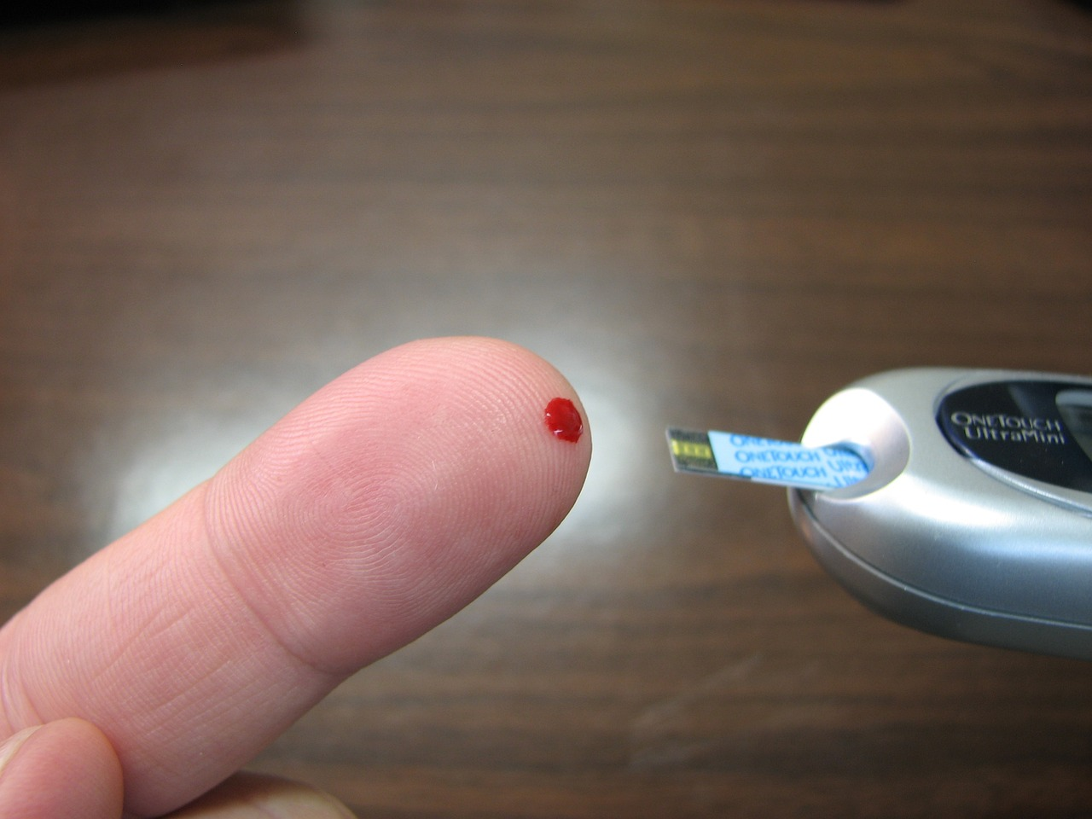
Diet and diabetes
Changing diet and increasing physical activity are the two main approaches used to treat type 2 diabetes. The aim of the treatment is to help the patients to control blood glucose levels and also to help overweight patients to lose weight.
Usually, it is possible to control diabetes through changes to the diet and physical activity patterns, but some people may need tablets or insulin injections. The recommended diet for patients with type 2 diabetes is the same healthy varied diet recommended for all people.

Slide 14


Alcohol
Advice on alcoholic drinks is the same as the general population. The recommendation for men and women is to consume no more than 14 units per week and to spread them over 3 or more days.
No level of alcohol is safe to drink in pregnancy.

Slide 15
Energy balance
Energy out: activity
Physical inactivity, overweight and obesity have been strongly linked to an increased risk of Type 2 diabetes, as well as other diseases, such as hypertension, heart disease, stroke and cancer.
It is important to balance the energy from food with the energy used through activity and keep a healthy weight to maintain health.
Energy in: food and drinks
Energy in > Energy out = Weight gain
Energy in: food and drinks
Energy out: activity
Energy out > Energy in = Weight loss

Slide 16
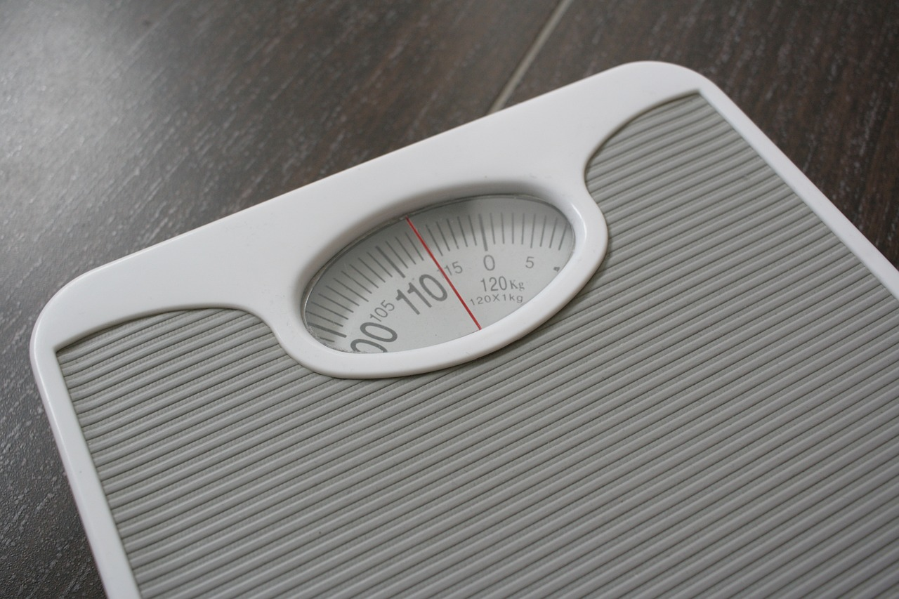
Losing weight with diabetes
If you're overweight or obese – you have a body mass index (BMI) of 30 or over – you should lose weight by gradually reducing your calorie intake and becoming more physically active.
According to the NHS, losing 5-10% of your overall body weight over the course of a year is a realistic initial target.
If someone with Type 2 diabetes is overweight, then weight loss will usually improve the symptoms.

Slide 17
Quiz- Kahoot
Open the link below on the main screen and get students to log onto kahoot.it on their tablets or smartphones. They can then enter the code (that will come up on the main screen when you start the game) and their own nickname. They can then play along with the quiz choosing the multiple-choice answers that correspond with the questions on the main screen. There will then be a leader board of the scores after each question and at the end.
https://play.kahoot.it/#/?quizId=ac3fda90-06f9-4483-9325-6a1664c04ed1

Slide 18
Diet, insulin and blood glucose
For further information, go to:
www.foodafactoflife.org.uk
This resource meets the Guidelines for producers and users of school education resources about food.

