Slide 1
Mycoprotein

Slide 2

Mycoprotein
Mycoprotein is a form of protein that is derived from a naturally occurring fungus called Fusarium venenatum.
It has been produced as a vegetarian, and sometimes vegan, dietary alternative to meat products.
Although not derived from meat products, it has a similar texture to some meat.

Slide 3
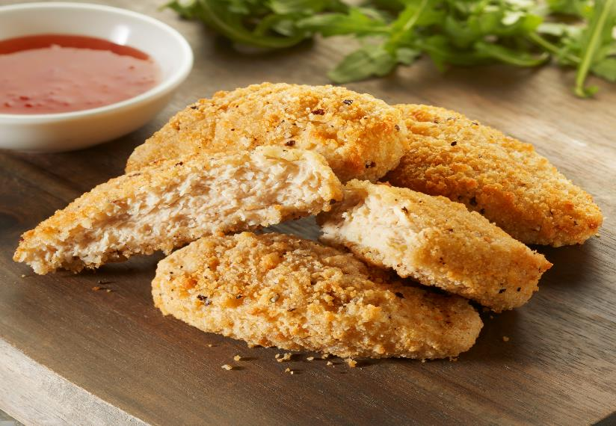
History of mycoprotein
The term ‘mycoprotein’ is derived from the Greek for ‘fungi protein’.
Research into developing mycoprotein began in the 1960s. There was a significant period of research and development before Fusarium venenatum was identified as the fungus that would be used, and a product was developed.
Mycoprotein was first sold in the UK, by food company Quorn, in 1985.
Notes:
https://bit.ly/2L2JbTn – Finnigan et al.
https://assets.ctfassets.net/2bynbqpgfb2s/3RUuJCYSKcmUOms4OuGSqw/1d5356584af34b88f1fce2b71f387a44/mycoprotein_factsheet-3.pdf

Slide 4
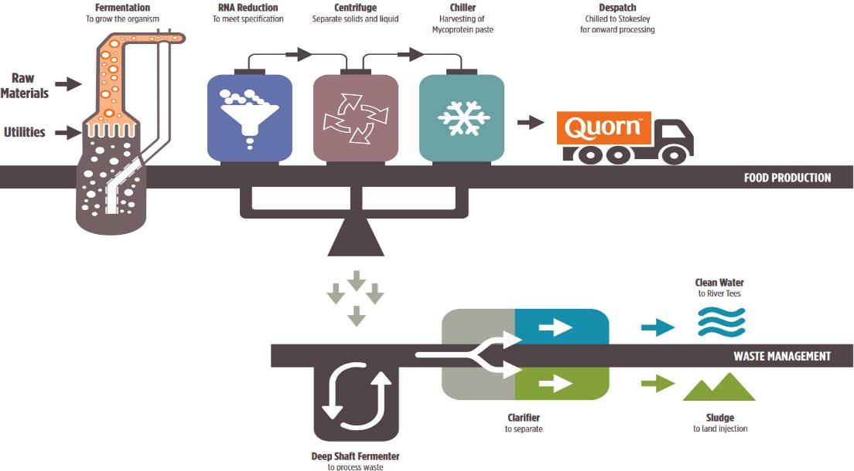
The processing of mycoprotein
The Fusarium venenatum fungus is extracted from the soil and grown via fermentation using glucose as a fuel source.
It is then exposed to steaming, chilling and freezing.
This creates the meat-like texture of mycoprotein.
Notes:
https://bit.ly/2OrcFfU

Slide 5
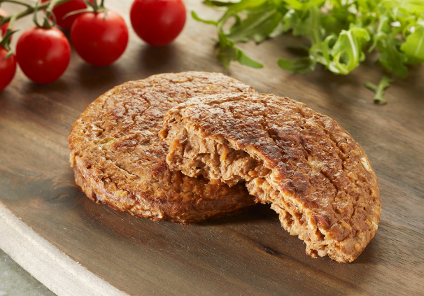
The processing of mycoprotein
MIX
SHAPE (fiber alignments)
COOK (heat set proteins)
FREEZE TEXTURIZATION
READY TO COOK
In the later stages of processing, egg albumin is added as a binder to help shape the product. In vegan mycoprotein products, potato extract is used as an alternative.
The product is then frozen so
it can be transported to supermarkets and sold.
Notes:
https://www.quorn.us/news/how-is-quorn-made-introduction-to-quorn-and-mycoprotein

Slide 6
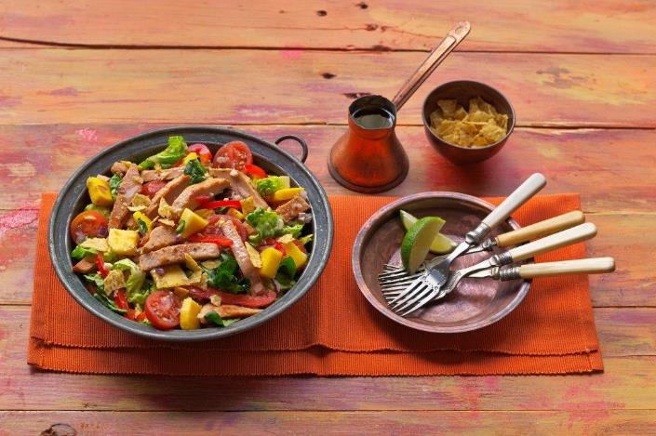
Is mycoprotein suitable for vegans?
A vegan is someone who does not consume any food derived from animal sources, including meat, fish, eggs, dairy and honey.
This means that, due to the use of egg albumin, and sometimes small amounts of milk, in the production of mycoprotein, it is not classed as vegan.
However, recent processing changes have meant that some products are now classified as vegan as they do not use any egg in their production. Potato extract is used instead of egg albumin in vegan ranges.
Notes:
https://www.quorn.us/news/how-is-quorn-made-introduction-to-quorn-and-mycoprotein

Slide 7
Nutritional composition
Nutrient | Amount per 100g of mycoprotein pieces*
Energy | 73kcals
Protein | 14g
Fat | 1.4g
Saturated fat | 0.4g
AOAC fibre | 8.3g
Iron | 0.6mg
Riboflavin | 0.39mg
Mycoprotein is high in protein, high in fibre and low in saturated fat.
Compared with other plant-based protein sources, such as beans and pulses, it tends to be higher in protein.
The nutritional composition of ‘quorn pieces’ is summarised in the table.
*figures for ‘as purchased’ - source: McCance and Widdowson’s

Slide 8
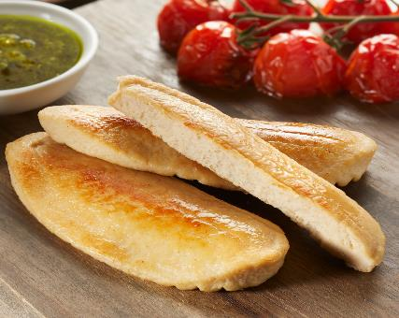

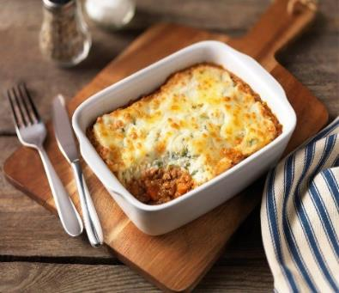
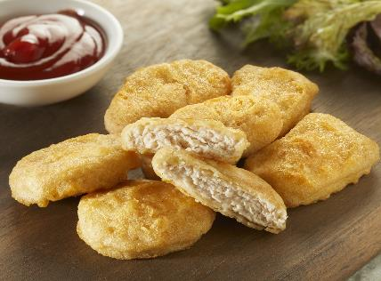
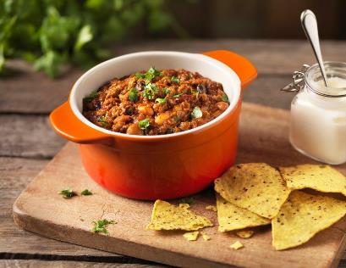
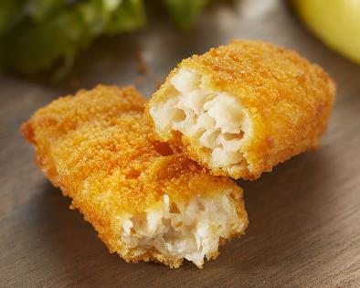
Mycoprotein types
There are a number of mycoprotein products that are sold including:
mince;
cutlets;
nuggets;
burgers;
ready-meals.

Slide 9
Mycoprotein
For further information, go to:
www.foodafactoflife.org.uk
This resource meets the Guidelines for producers and users of school education resources about food.

