Slide 1
The BBQ

Slide 2
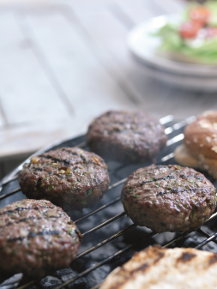
The challenge
Create a burger for a BBQ.

Slide 3
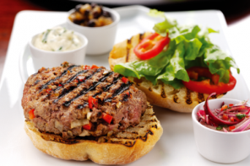
Summer eating
BBQ, barbeque or barbecue is the name of a cooking method and an apparatus used to cook food on.
Food is cooked by radiation through indirect heat. The charcoals used produce smoke which gives the food a distinctive smoky flavour.

Slide 4
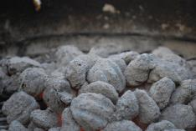
Cooking food safely
When cooking food on a BBQ, it is important to follow a few simple rules to ensure that it is safe to eat:
Store high risk food, such as meat and dairy, in the fridge below 5°C until just before you need it
Make sure the BBQ is lit well in advance. Wait until the coals have heated up to a red glow and any flames have died down.
This usually takes about 30 minutes

Slide 5

Cooking food safely
Use meat tongs to turn the meat over and try not to pierce it as the meat juices will escape and the burgers may become tough and dry.
Always cook burgers until the juices run clear and no pink remains.
If using a digital probe, the core temperature should read at least 75°C or 70°C for two minutes.

Slide 6
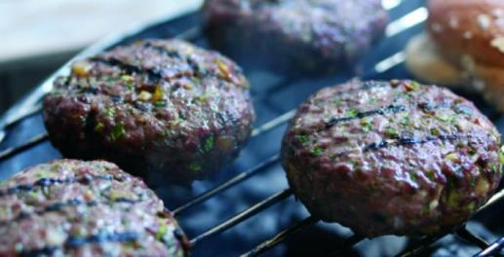
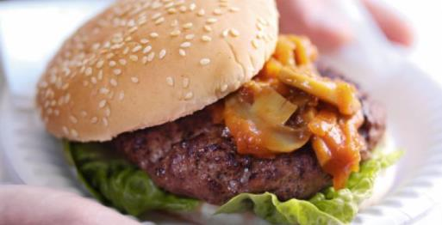
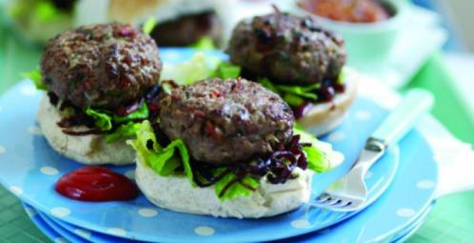
Inspiration

Slide 7
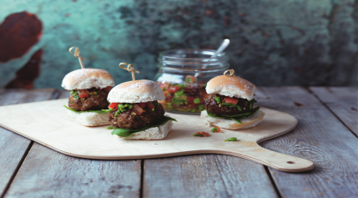
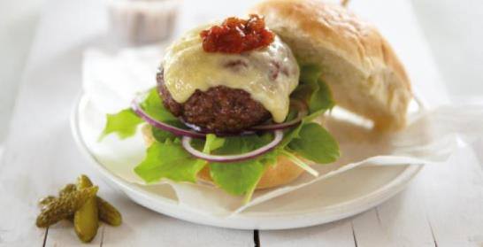
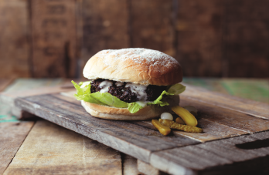
Inspiration

Slide 8
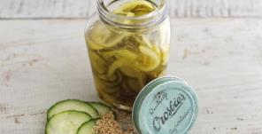
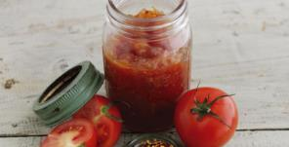
Add a bit of relish!
Adding a relish or sauce provides colour, flavour and texture to your BBQ burger.
Think about the main burger ingredients and the toppings you might use to ensure that the flavours are complimentary.
Why not make your own sauce or relish? Consider using seasonal fruit and vegetables and why not shop locally too!

Slide 9
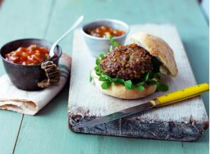
Create your burger
Step 1
Use the Gourmet Burger Builder to create your BBQ burger.
Step 2
Make your BBQ burger following the recipe.
Step 3
Take a photo and share your recipe on social media.

Slide 10
The BBQ
For further information, go to:
www.foodafactoflife.org.uk
This resource meets the Guidelines for producers and users of school education resources about food.

