Slide 1
Get active

Slide 2
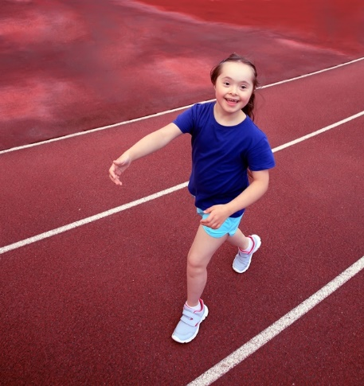
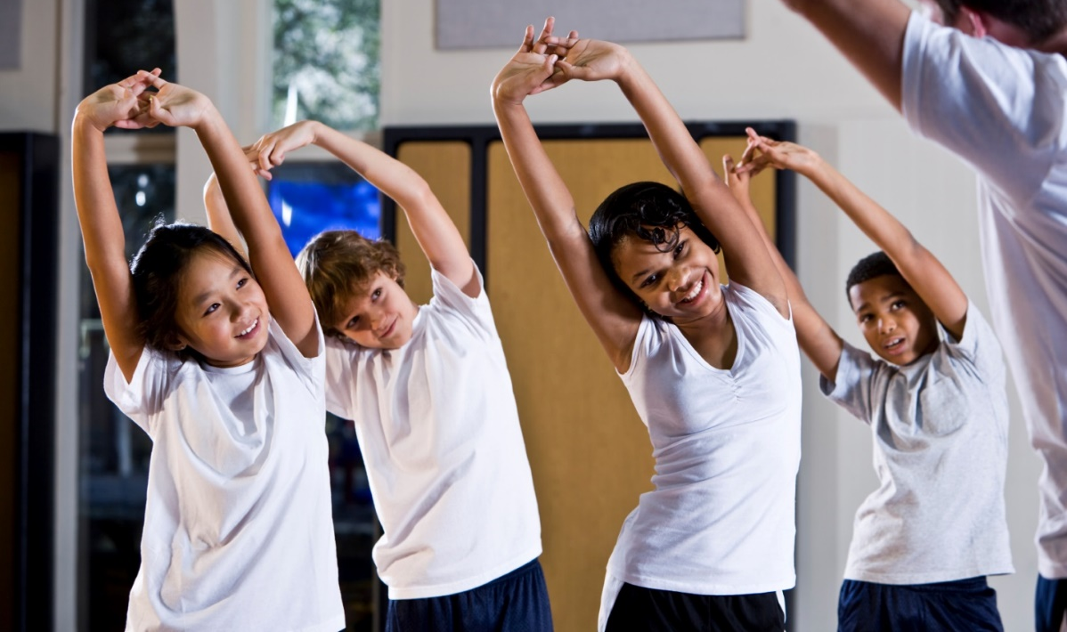
Activity
Move more, be active!

Slide 3
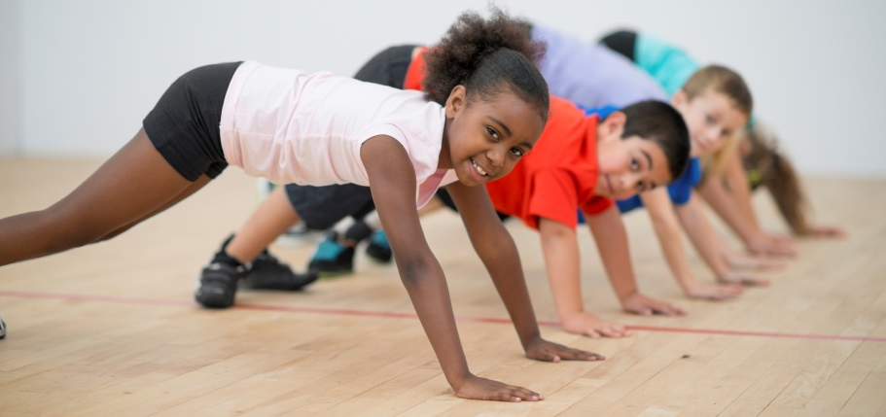
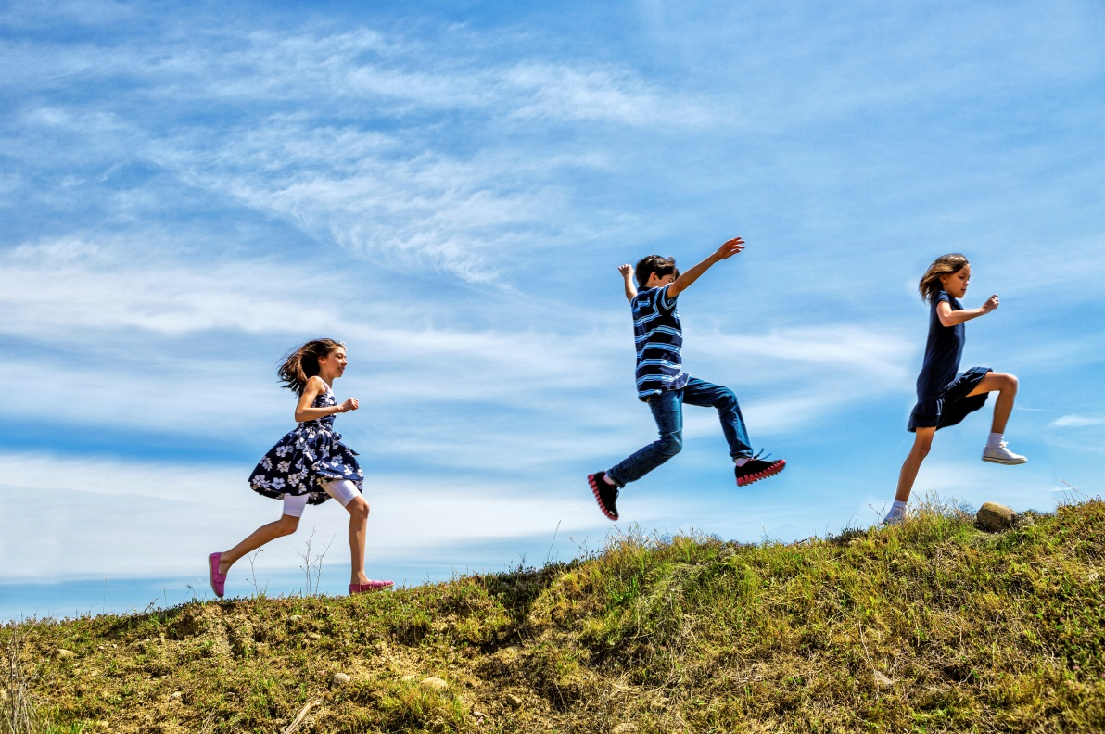
Why do we need to be active?
To help us to have…
strong bones;
strong muscles;
a healthy heart.
Being active can also…
help us to feel happy;
help us make new friends;
provide new experiences!

Slide 4
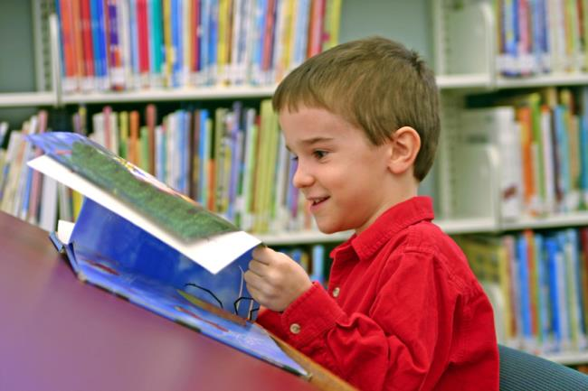
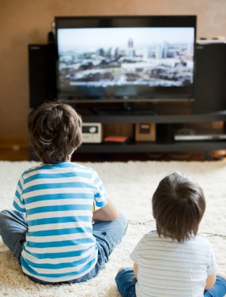
Sit less
When are you not active?
Reading
Watching TV

Slide 5
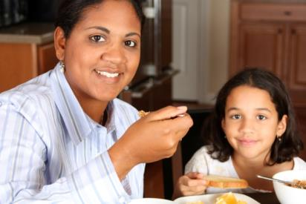
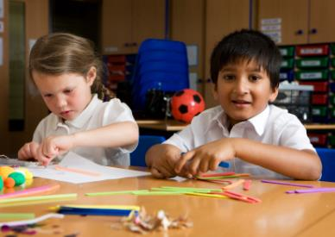
Sit less
Sometimes it is important to sit.
When do you think this is?
Eating a meal
Working at school

Slide 6
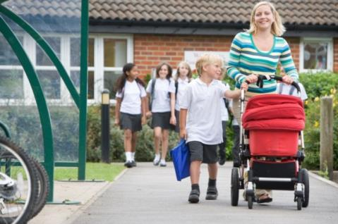
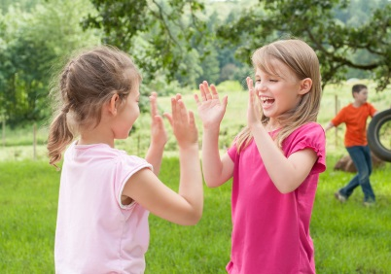
Move more
What is moving more?
Walking to school
Moving more means being active every day.
Playing games

Slide 7
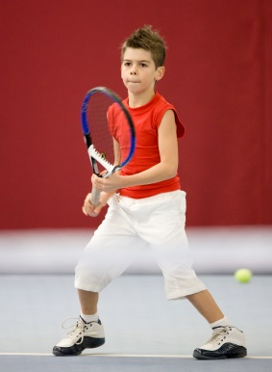
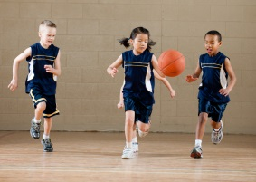
Be active for 60 minutes a day
What would count towards your 60 minutes a day?
Playing team games
Playing tennis

Slide 8

Be active
What makes you feel like this?
How does being active feel?
You…
You…
Your…
feel warmer
breathe harder
heart beats faster

Slide 9
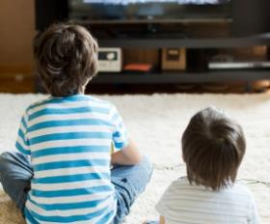
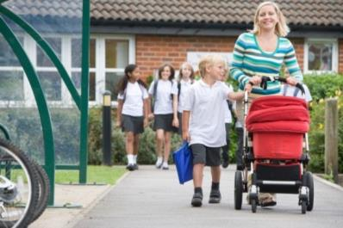
Every day…
Sit less
What could you do to be more active?
Move more
Be active for at least 60 minutes

Slide 10
Get active
For further information, go to:
www.foodafactoflife.org.uk
This resource meets the Guidelines for producers and users of school education resources about food.

