Slide 1
How is food grown, reared or caught?

Slide 2
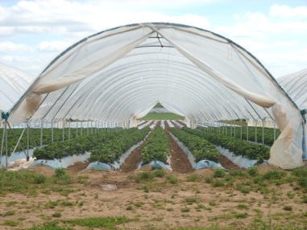
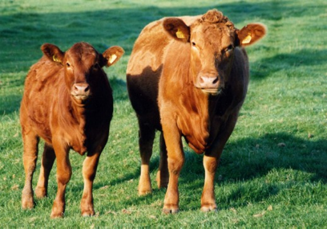
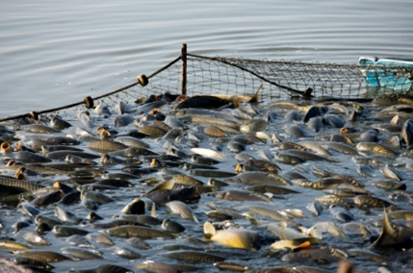
Where does this food come from?

Slide 3
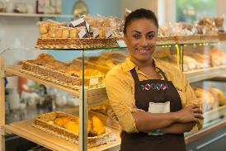
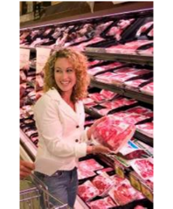
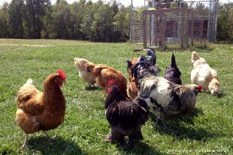
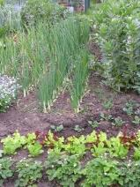
Introduction
Whilst we buy most of our food from supermarkets, smaller food shops or markets, all of the food we eat must be grown, reared or caught.
Some people also grow or rear food at home or on allotments.

Slide 4
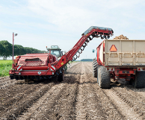
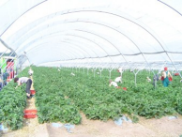
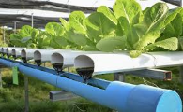
Growing food
Food is grown in an environment where light, food (soil) and water are available to them so they can grow and photosynthesise.
Some farmers use large plastic tunnels to grow crops so that they are protected from the weather. Carrots and strawberries are often grown in polytunnels.
Other farmers use hydroponics, where plants are grown without the use of soil and are instead grown in water. Tomatoes, peppers, cucumbers and lettuce are successfully grown this way.

Slide 5
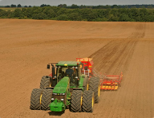
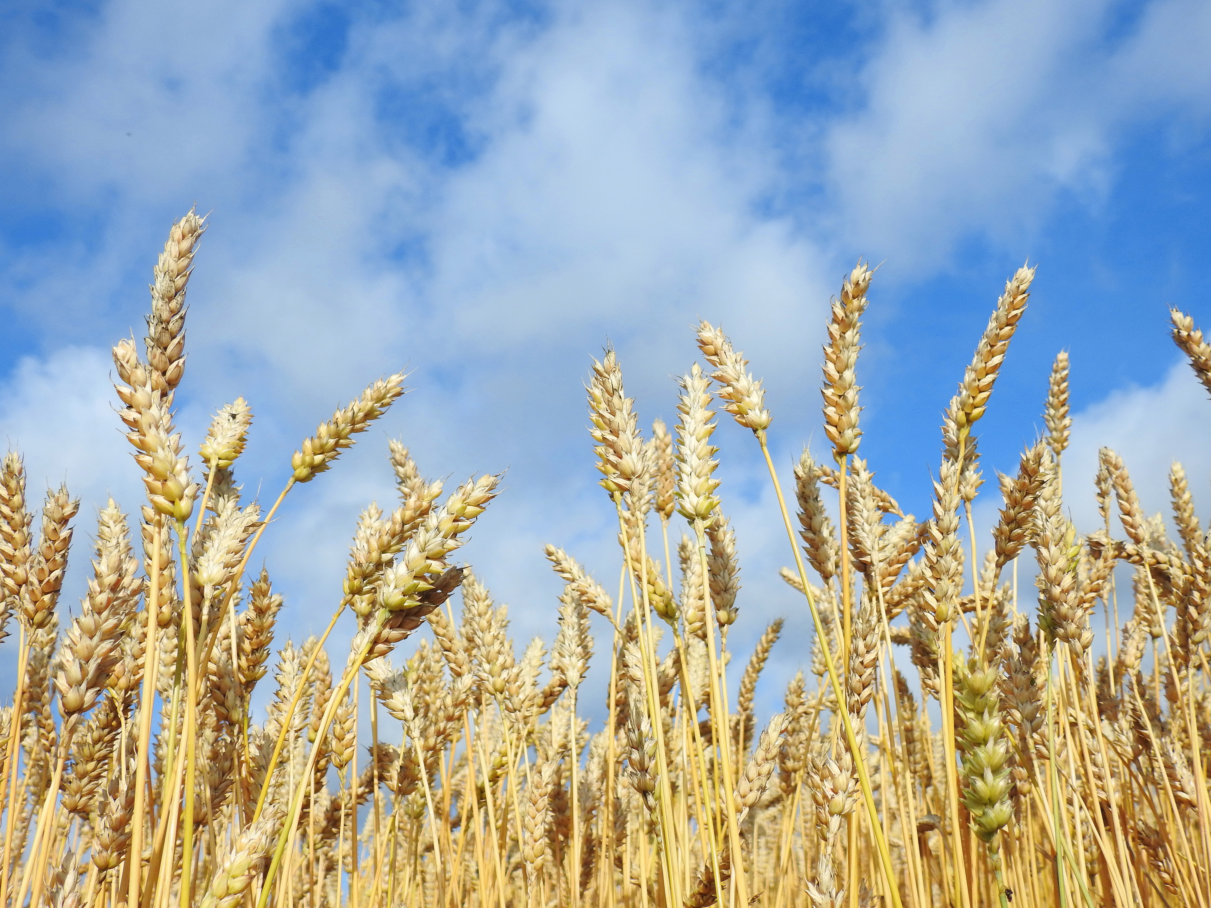
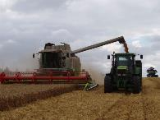
Growing food - wheat
Wheat is sown on two fifths of Britain’s arable land, resulting in a total harvest of 15-17 million tonnes per year.
In the UK, wheat is sown in September, October and November and harvested the following August or September.
The harvesting process removes the grains from the plant.
The grain is stored and, when needed, transported to the mill where it is cleaned, ground and turned into flour.

Slide 6
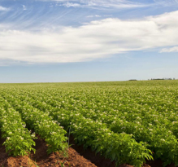
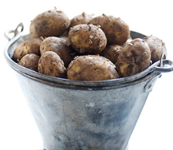
Growing food - potatoes
More than 5.4 million tones of potatoes are produced in the UK annually and there are around 2,500 specialist potato farms within the UK.
Planting usually takes place in spring, but depends on the climate. For example, farmers in Cornwall can plant and harvest potatoes much earlier than farmers in Scotland.
These differences make potatoes more sustainable as it means GB-grown potatoes are available all year round.
Potatoes are grown for around 5 months before they are ready for harvesting. Harvesting can start as early as June and finish at the end of October.

Slide 7
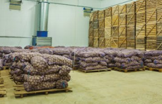
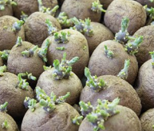
Growing food - potatoes
Once harvested, the potatoes are placed in bulk storage or weighed and bagged ready for distribution. Potatoes can also be stored in boxes in an insulated potato store. Farmers will check the potatoes regularly throughout the storage season.
However, not all potatoes are sent to supermarkets and other shops. Many are used for:
  future crops – potatoes are reproduced from other potatoes;
  manufacture of potato crisps;
  ready prepared potato products – British manufacturers of frozen potato products such as frozen chips, are the largest purchasers of British potatoes.

Slide 8
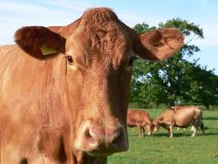
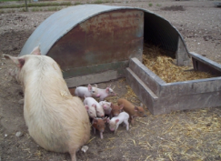
Rearing food
There are many different breeds of animals which are reared, each with their own features/qualities.
Cattle - there are nearly 10 million cattle in the UK. Different breeds of beef cattle have evolved in different parts of the country, including Aberdeen Angus, Hereford, Shorthorn, Limousine, Charolaise, Simmental and Belgian Blue.
Pigs - originally, pigs were bred to consume waste products, fertilise the land and provide essential meat. Both the Greeks and Romans ate pork and history books refer to ‘swine’ being kept as early as 800BC. At one time most people in Britain would have kept a pig however this is very rare now and pigs are generally reared on specialised pig farms. Approximately 40% of UK pig production is outdoors.

Slide 9
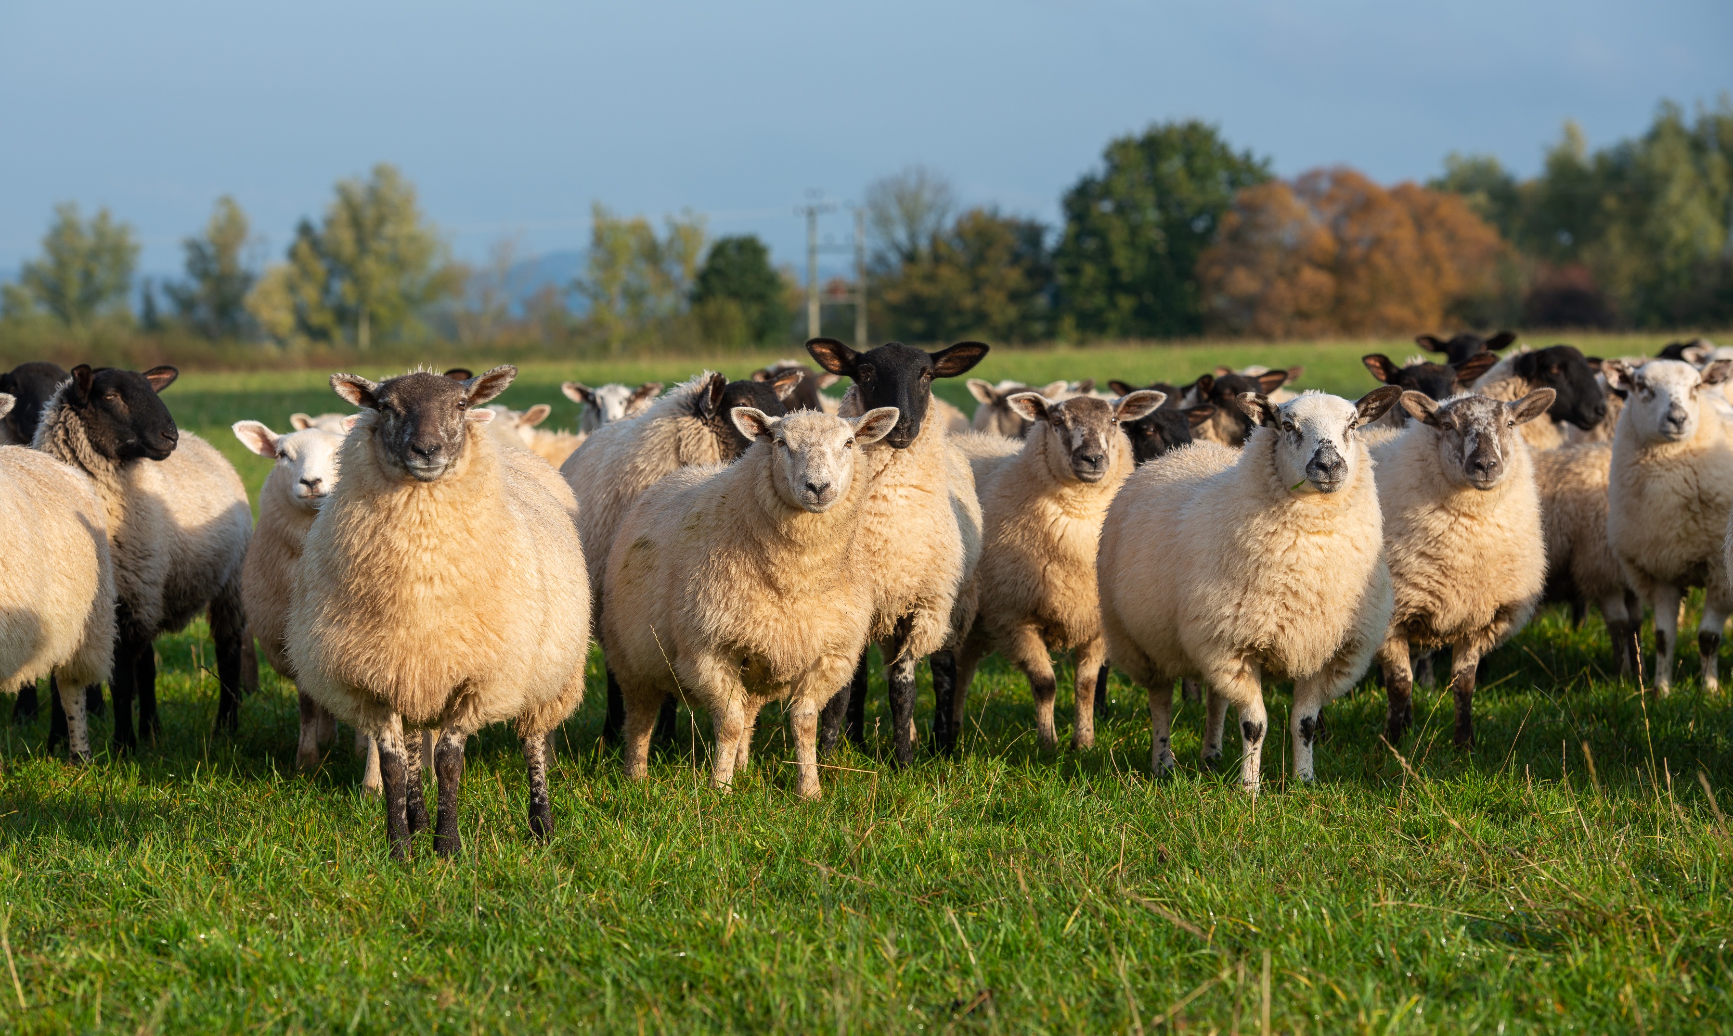
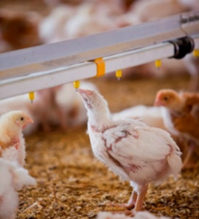
Rearing food
Sheep - there are over 33 million sheep in the UK and there are 90 different breeds and crosses.
Spring is when most ewes in the UK give birth to their lambs, but lambs can be born anytime between December and May, depending on the system and location. By the time they give birth, ewes will have been pregnant for five months.
Poultry - nearly a billion poultry birds are reared in the UK each year and 95% of these are grown indoors. Chickens are also reared on free-range and organic farms.

Slide 10
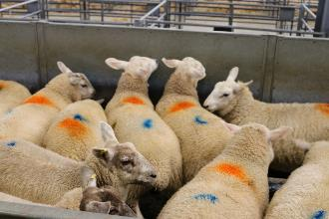
Rearing food – the next stage
Animals are usually sent to market when they reach slaughter weight, are no longer suitable for breeding or to be sold for finishing or breeding.
In the UK, the animals are protected by government legislation to ensure they are treated humanely.
Some farmers transport their animals directly to the abattoir for slaughter or sell through virtual online auctions.

Slide 11
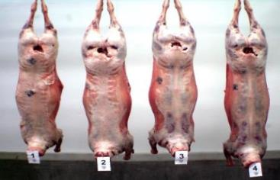
Rearing food - slaughter
Abattoirs are legally required to ensure that the animals have been well treated throughout the process.
Humane slaughter is ensured by protecting animals from avoidable excitement, pain or suffering.
Staff must be trained and the facilities provide adequate ventilation, light and shelter to protect from adverse weather conditions.

Slide 12
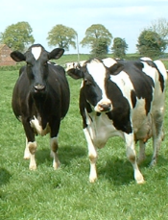
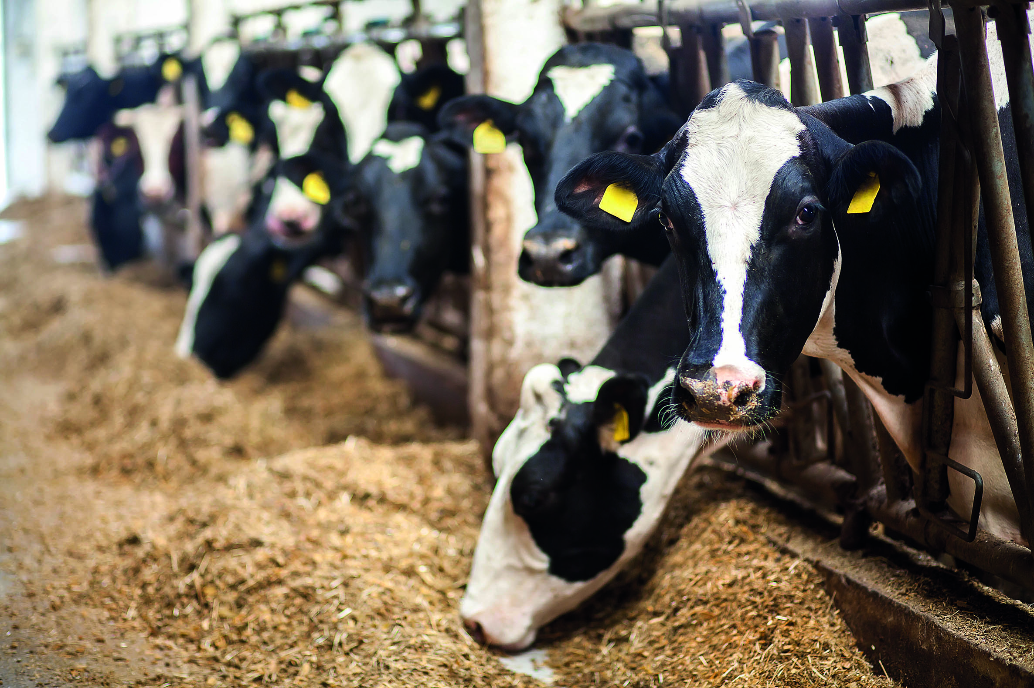
Rearing food – dairy farms
Cows are reared on dairy farms to produce milk.
Currently, 14.5 billion litres of milk each year are produced on dairy farms in the UK. Around 6.5 billion litres of these are sold for drinking and some goes to the production of dairy products such as cheese or butter.
A dairy cow needs to give birth to a calf in order to produce milk.
Most British dairy cows eat grass during the summer and silage (dried grass or maize) in the winter.

Slide 13
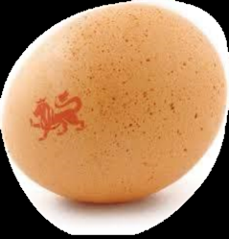
Rearing food – egg production
There are different systems for producing eggs:
  Laying cage - across the EU conventional 'battery' cages have been banned.
  In the UK, they have been replaced by larger, ‘enriched’ colony cages;
  Barn - hens are able to move freely around the barn. The number of hens is limited and they are given space to perch, scratch and dust bathe;
  Free-range - hens must have continuous daytime access to runs which are mainly covered with vegetation and there is maximum number of hens in a flock;
  Organic - hens producing organic eggs are always free range. In addition, hens must be fed an organically produced diet and ranged on organic land.
The British Lion mark is the UK's food safety scheme that relates to eggs. All eggs that carry the British Lion mark have been produced under the stringent requirements of the British Lion Code of Practice which ensures the highest standards of food safety.
Source: www.egginfo.co.uk

Slide 14
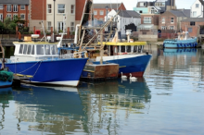
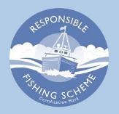
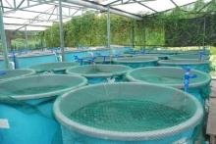
Catching food
Most of the fish we eat, we have to catch; we catch fish in the sea, such as crab and haddock as well fish in rivers and lakes, for example salmon and trout.
Fishing boats go out to catch the fish on most days of the year and some can stay out at sea for a long period of time. Larger fishing trawlers also prepare and deep freeze their catch whilst at sea.
There are specific rules in place which must be followed to limit the number of fish that can be caught; for example, the Responsible Fishing Scheme is in place to raise standards in the fishing trade
Some fish is also farmed in tanks either on land or in the sea for example sea bass, turbot, halibut and mussels.

Slide 15
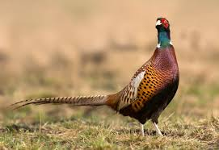
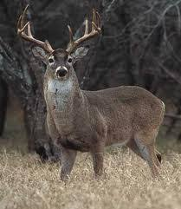
Catching food - game
Game can be caught in the wild or farmed:
Wild game cannot be caught in the ‘closed season’ when breeding takes place.
Game is usually classified into two categories:
  small – birds (e.g. pheasant, grouse, partridge, duck), hares, rabbits and squirrel;
  large - venison and wild boar.
Wild game is sometimes shot using lead ammunition. The Food Standards Agency recommends that people who regularly eat lead-shot game reduce their consumption as consuming lead can be harmful. This is especially important for toddlers, children, pregnant women and women trying for a baby. www.food.gov.uk

Slide 16
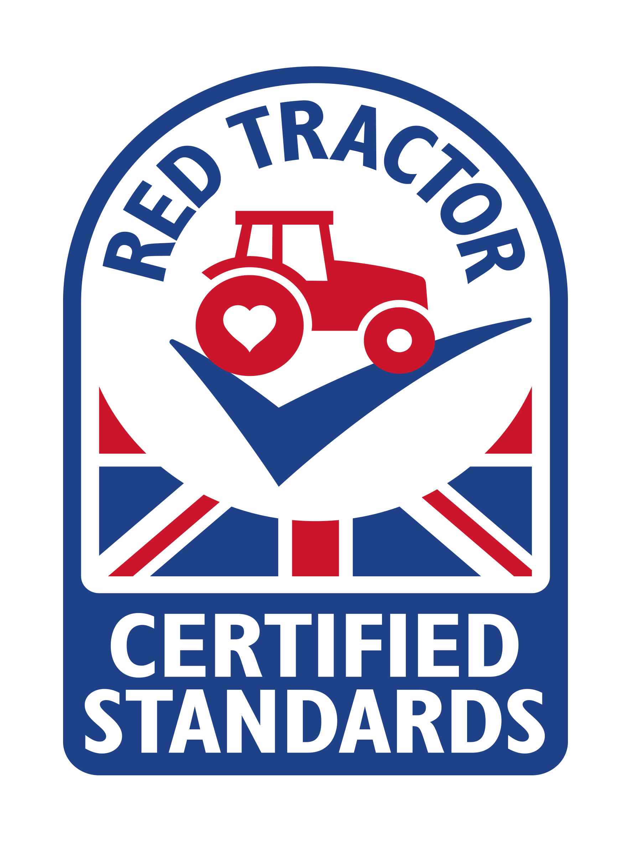
Food assurance scheme for British foods
Red Tractor producers are monitored and overseen by Assured Food Standards (AFS).
AFS carries out their own independent inspections to confirm that different businesses are meeting the standards.
These standards include food safety and animal welfare, but also aspects such as the environment and also the traceability of foods.
If you ever see the Red Tractor logo, you know the foods have been checked during every step of the way and that the foods can be traced back to the initial source on the farm.
This logo can be seen on many products such as meat, poultry, dairy products, flour and even fruits and vegetables.

Slide 17
How is food grown, reared or caught?
For further information, go to:
www.foodafactoflife.org.uk
This resource meets the Guidelines for producers and users of school education resources about food.

