Slide 1
Processing food from land and sea

Slide 2
Food – basic processes
Food is processed to make it edible and safe.
Where does each of these food start?
What happens to them before they reach us in the shops?
What processes have they been through?

Slide 3
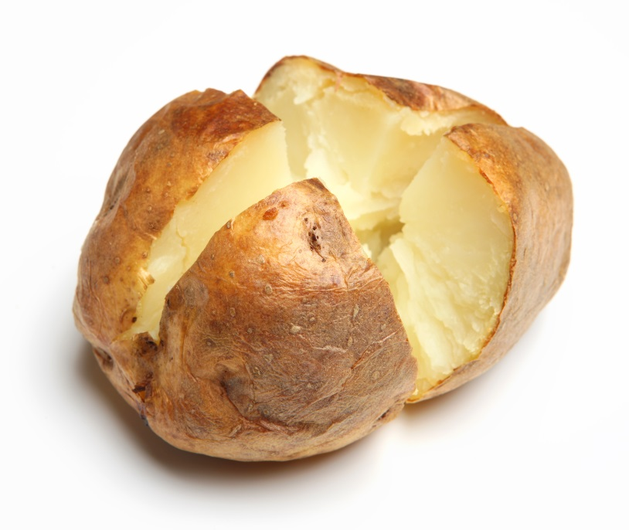
A jacket potato
What processes are used to make a jacket potato?

Slide 4
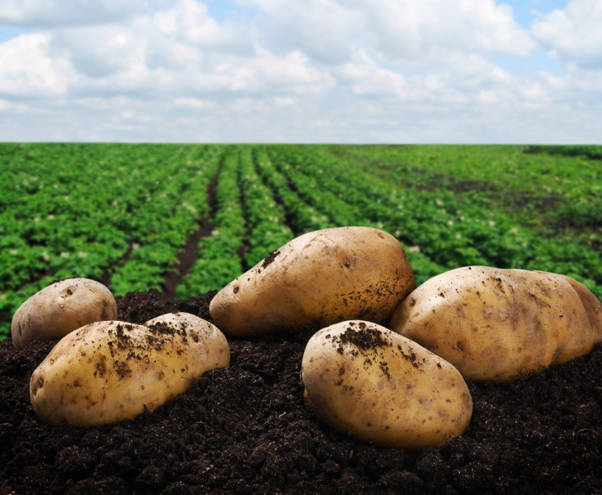
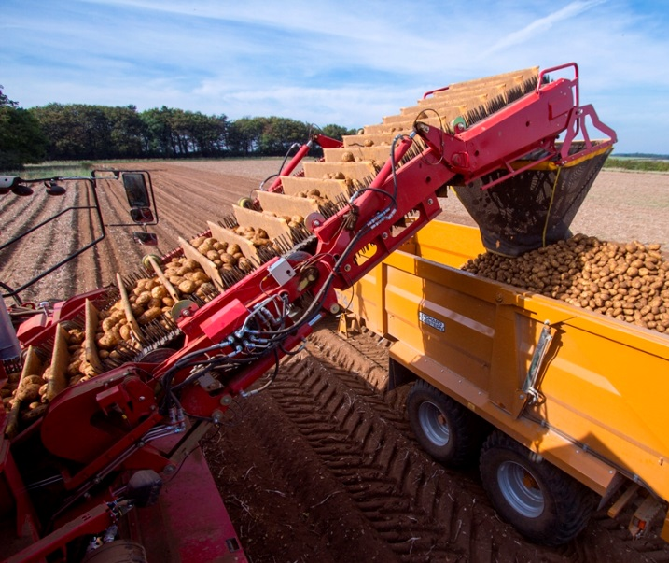

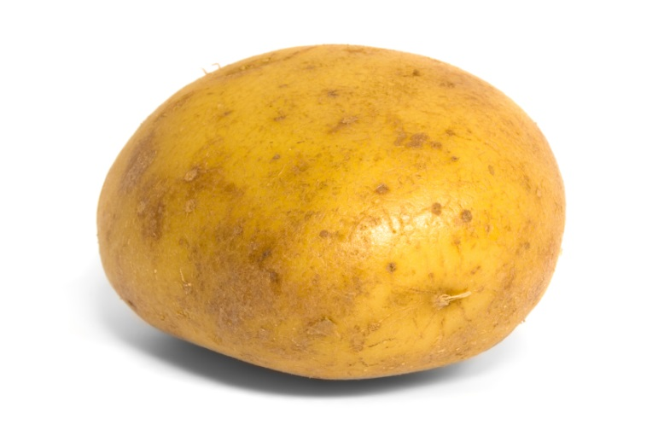
A jacket potato
Potatoes are grown by farmers.
Potatoes are harvested.
Potatoes are washed and sold.
Potatoes are baked in an oven.

Slide 5
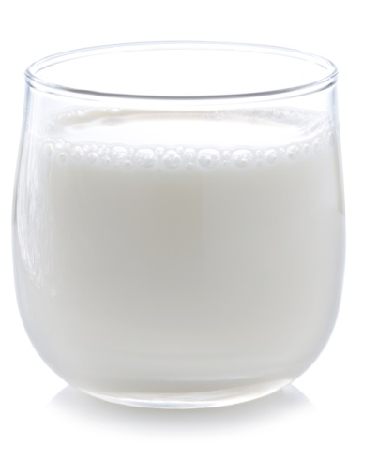
A glass of milk
What processes are used to produce a glass of milk?

Slide 6
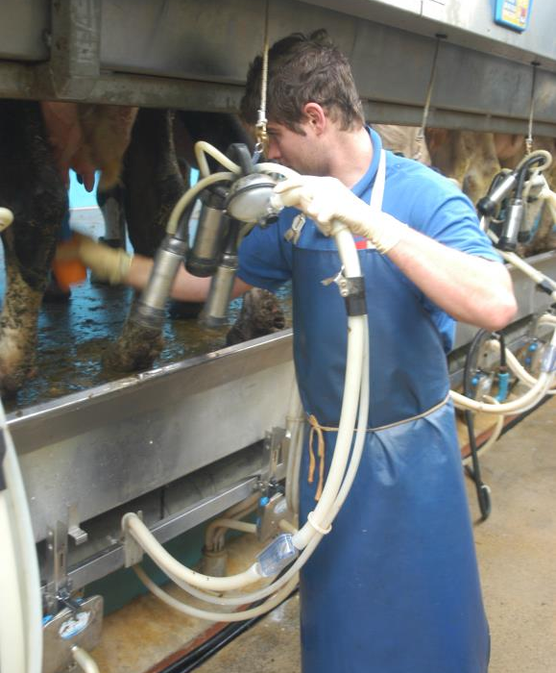
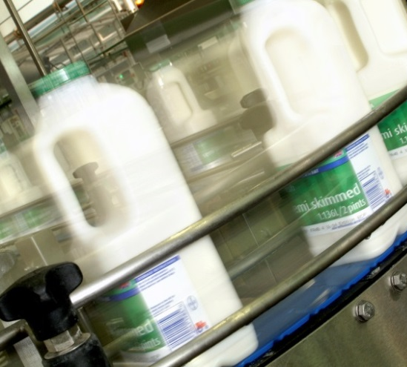
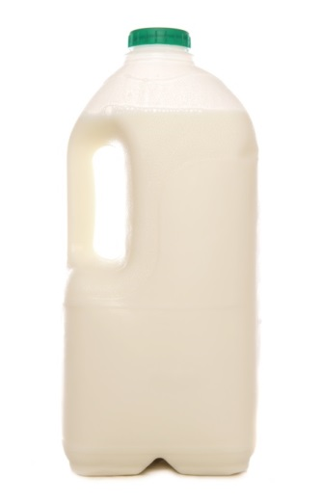
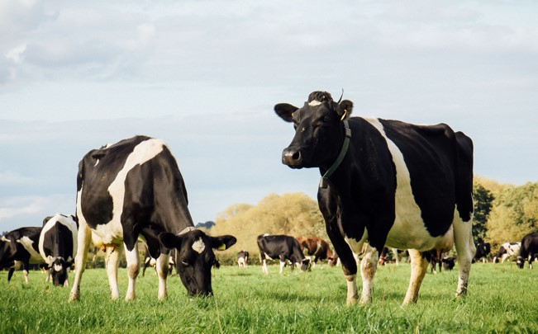
A glass of milk
The milk is heat processed to make it safe to drink. It is put into bottles.
The milk is ready to be consumed – as a drink, with breakfast cereal or in a recipe.
A glass of milk.
Cows are reared by farmers.
They are milked twice a day.

Slide 7
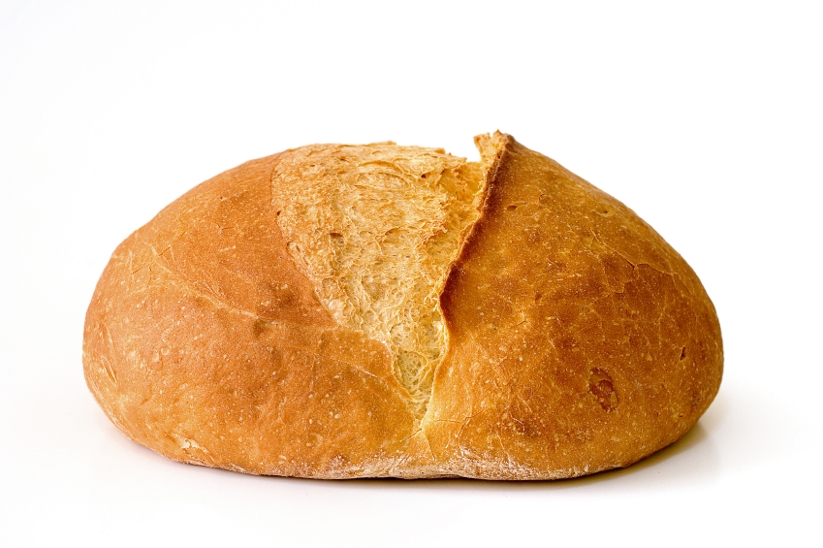
A bread roll
What processes are used to produce a bread roll?

Slide 8
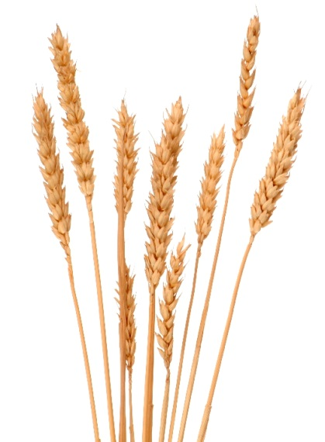
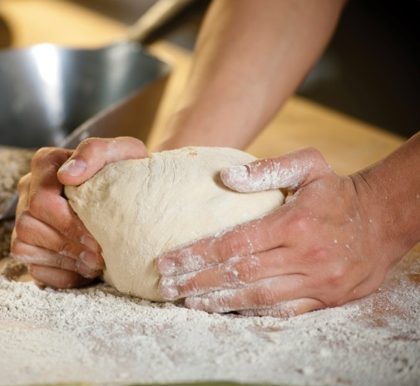
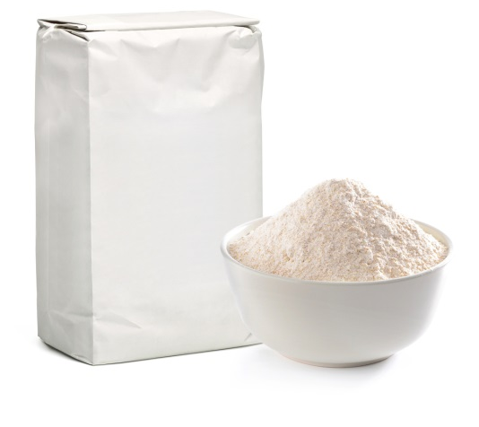
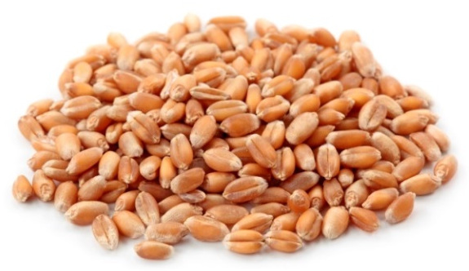

A bread roll
Wheat is grown and harvested by farmers.
The grains are removed from the wheat.
The wheat is milled into flour.
The flour is mixed with water, yeast and salt to make a dough.
The dough is divided into rolls and baked.

Slide 9
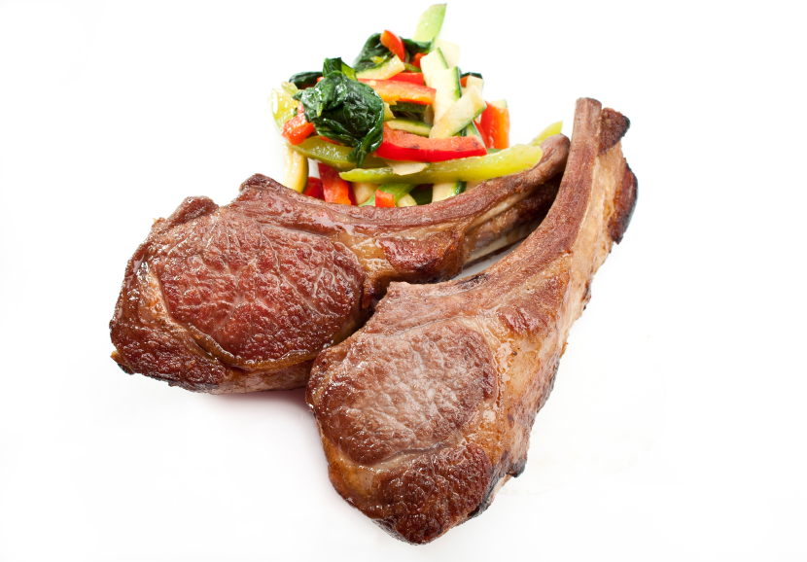
Grilled lamb chops
What processes are used to make grilled lamb chops?

Slide 10
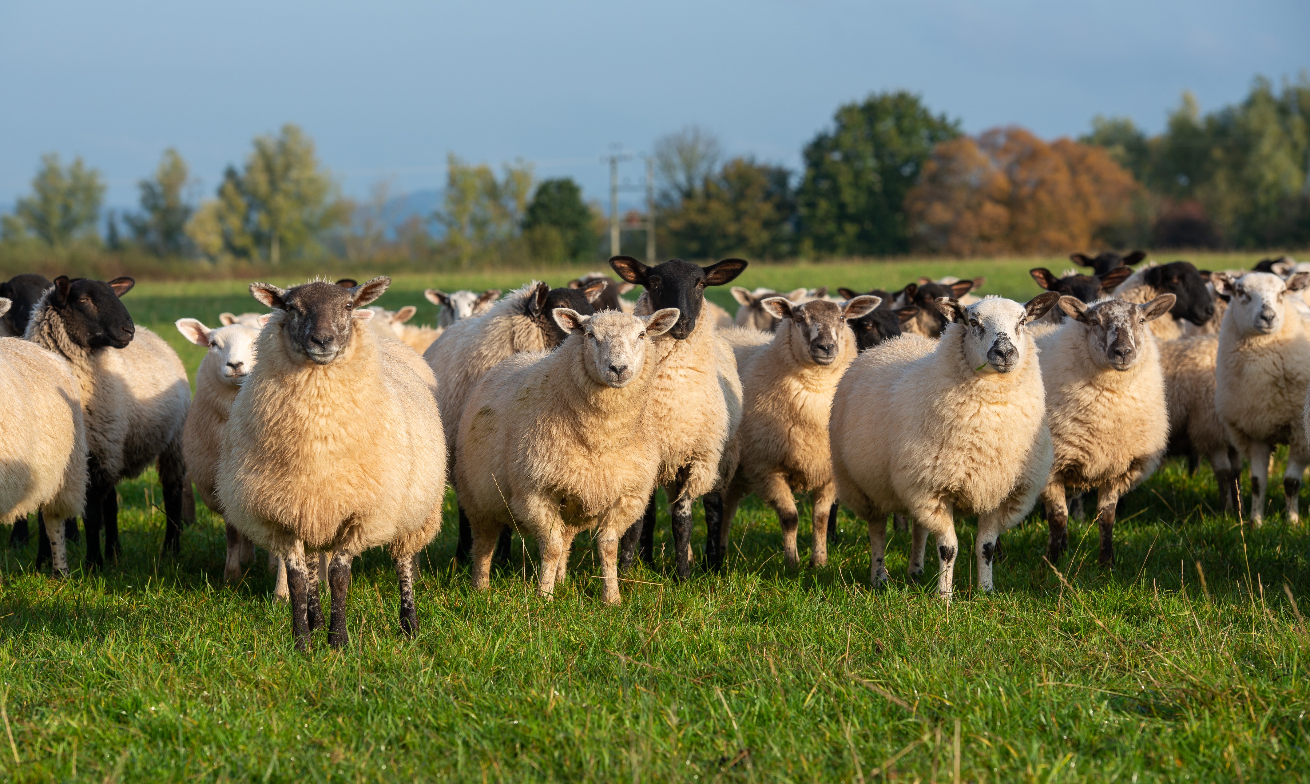
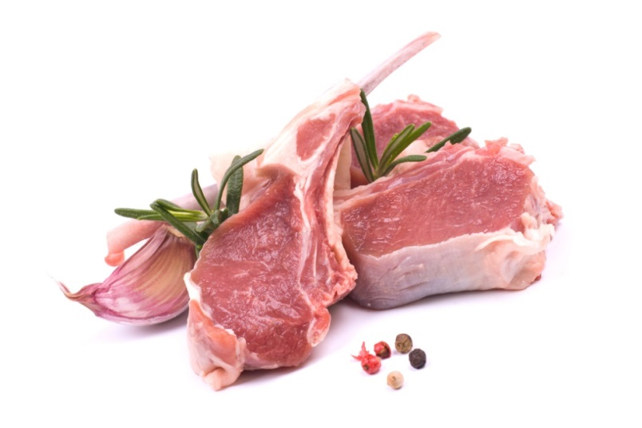
Grilled lamb chops
The lamb is processed into meat and cut into chops.
The lamb is grilled to make it safe to eat.
Lamb is reared by farmers.

Slide 11
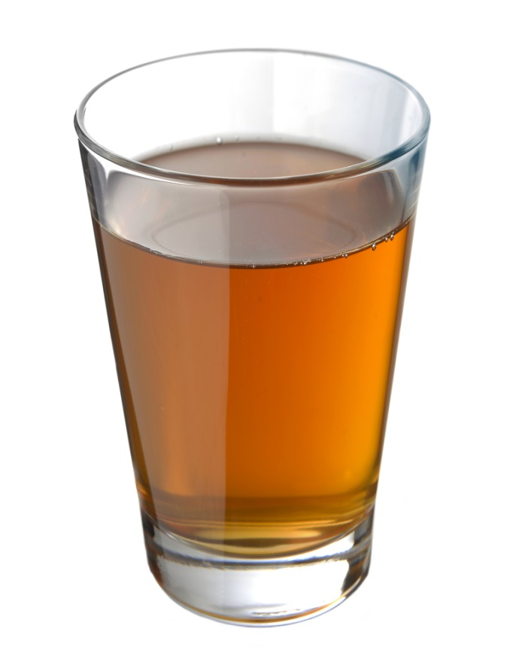
Apple juice
What processes are used to make apple juice?

Slide 12
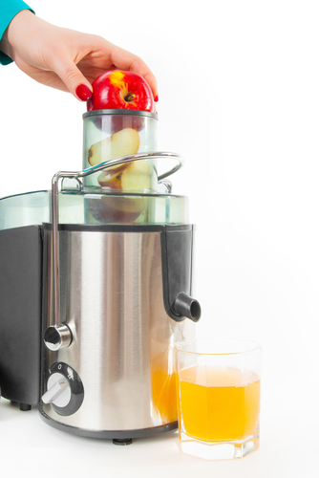
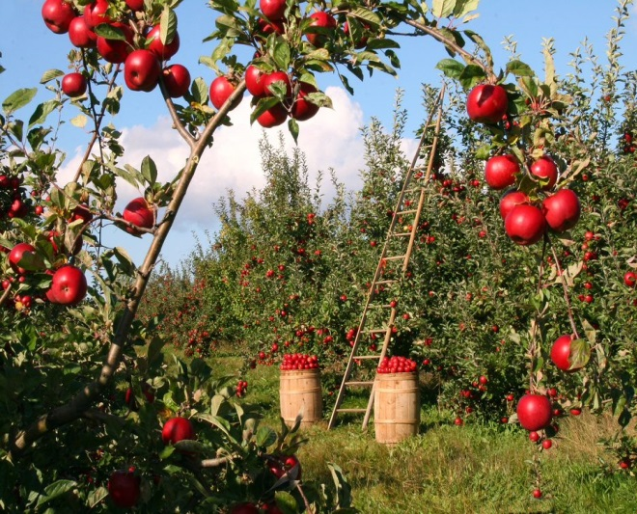
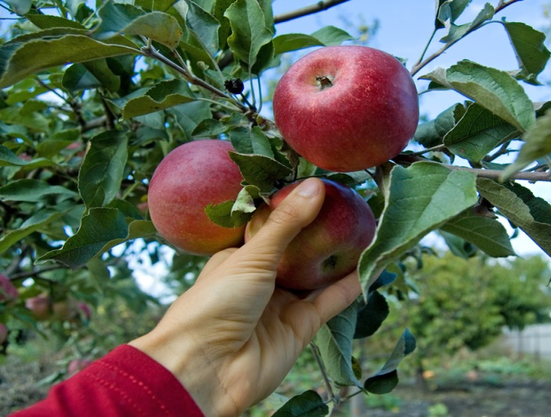

Apple juice
Apples are grown by farmers.
The apples are picked and washed.
The apples are squeezed to release the juice.
A glass of apple juice.

Slide 13
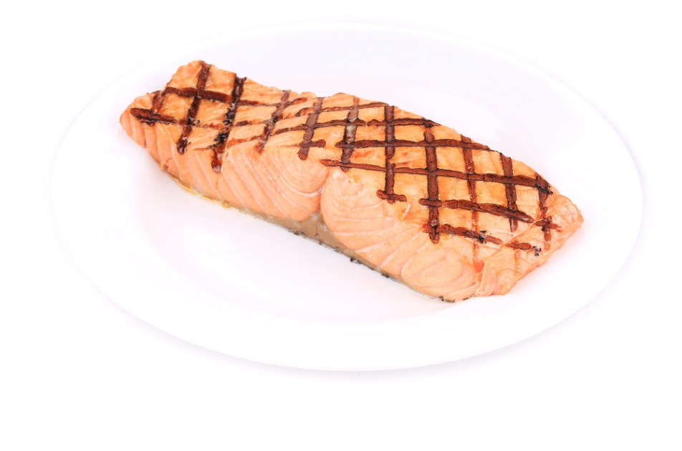
Grilled salmon
What processes are used to make grilled salmon?

Slide 14
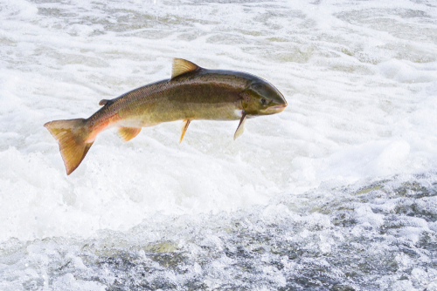
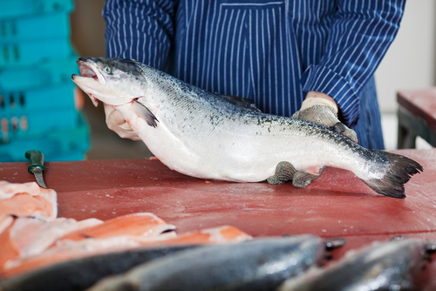
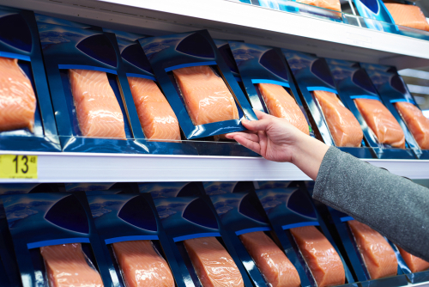

Grilled salmon
Salmon is either farmed or caught wild.
The salmon is filleted and cut into pieces.
The salmon is packed and sold.
The salmon is grilled.

Slide 15
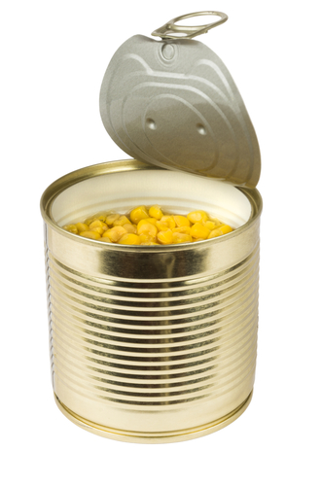
Canned sweetcorn
What processes are used to make canned sweetcorn?

Slide 16
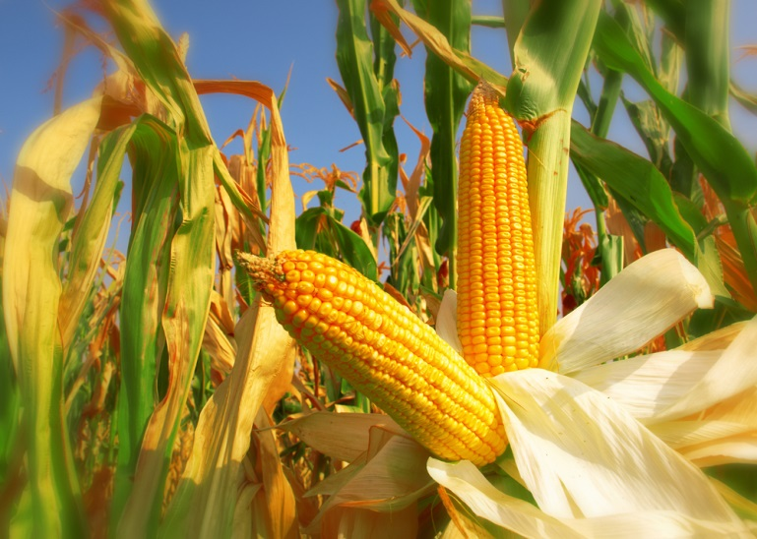
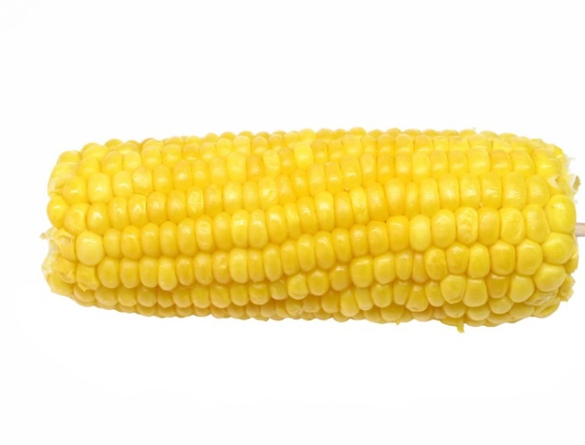
Canned sweetcorn
The corn is grown by farmers in a field.
The corn is harvested, the outer leaves removed and the ‘kernels’ cut away.
The ‘kernels’ are placed in a can which is sealed. It is then heated – this cooks the corn and allows it to keep for along time.

Slide 17
Processing food from land and sea
For further information, go to:
www.foodafactoflife.org.uk
This resource meets the Guidelines for producers and users of school education resources about food.

