Slide 1
The digestion process

Slide 2
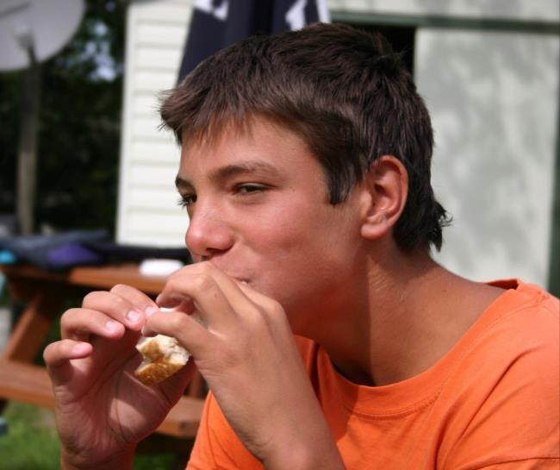
Food as a fuel
The body requires energy from food.
Our bodies act as a converter, releasing energy and nutrients from food.
Sometimes food can take 2 or 3 days to be fully digested and absorbed by the body.

Slide 3
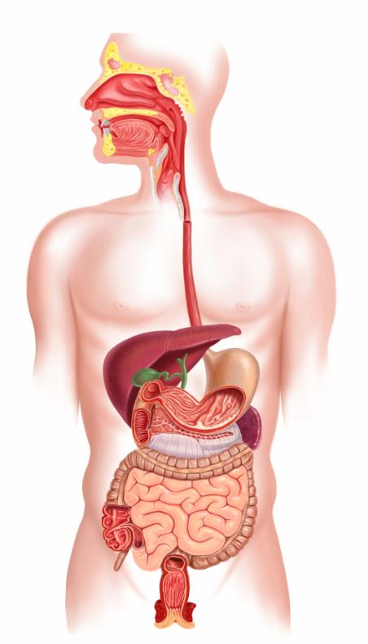
The digestion process
The body parts involved in the digestion process are:
the mouth;
oesophagus;
stomach;
small intestine;
colon;
anus.

Slide 4

The body parts used in the digestion process
Mouth
Oesophagus
Stomach
Small intestine
Colon
Anus

Slide 5
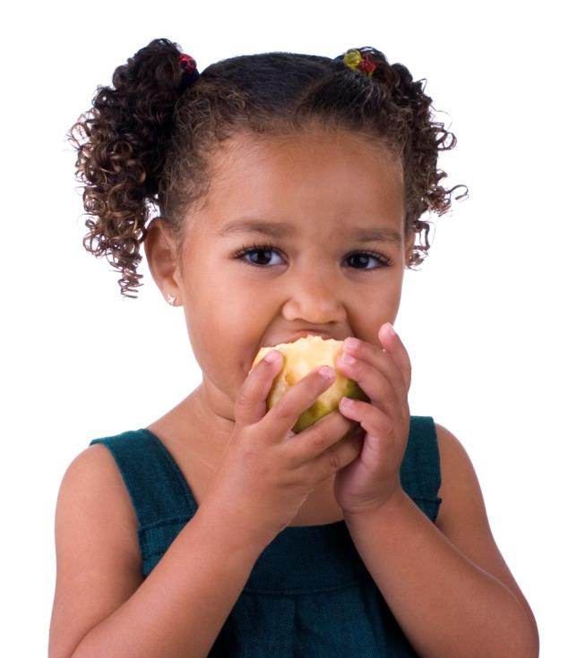
Ingestion
The mouth
When we eat, the teeth mechanically break down food into smaller pieces.
Teeth of different shape tear, chop and grind the food.
The cheeks and tongue help to push the food towards the teeth.
The food is then rolled into a ball and swallowed down the oesophagus.

Slide 6
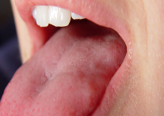
Saliva
Saliva is released into the mouth at the sight, smell, taste or even the thought of food.
Saliva is secreted from salivary glands in the mouth. It contains the enzyme amylase which helps break down starch into simple sugars.
Saliva also moistens the food making it easier to chew and swallow.

Slide 7
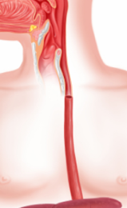
Oesophagus
When food is swallowed, the muscles in the oesophagus contract and relax, helping to push the food down into the stomach. These waves of muscular contractions which move food along the digestive system are called peristalsis.
Did you know?
Each mouthful of food takes about six seconds to reach the stomach once it is swallowed.
Even when the body is upside down, the food will still pass from the mouth to the stomach.

Slide 8
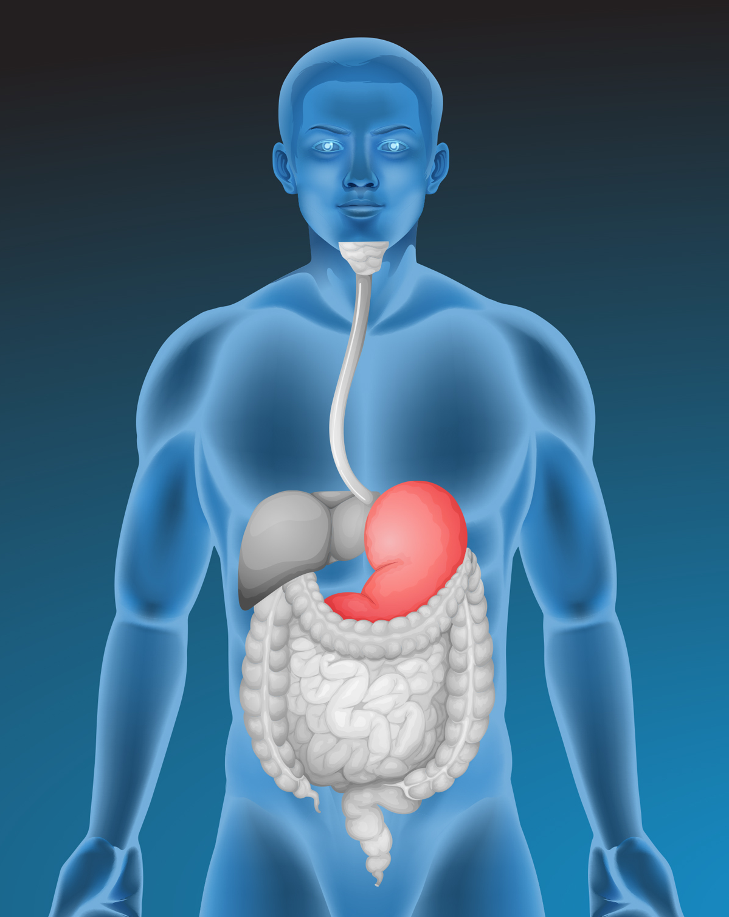
Digestion
The stomach
The stomach is a sac made of muscles that contract and churn food, breaking it down even further.
The acid and enzymes in the stomach also help to break down the food.
When the food has been churned into a creamy mixture known as chyme, it passes gradually into the small intestine.
Did you know?
Food can spend up to 2 to 3 hours in the stomach.

Slide 9
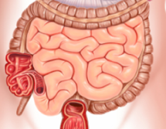
Small intestine
The small intestine is a tube about 6 metres long.
The first section of the small intestine is called the duodenum, followed by jejunum and ileum.
The inner surface of the small intestine is folded into numerous tiny finger-like structures called villi to increase the surface area for absorption.

Slide 10
Duodenum
In the duodenum, food is mixed with pancreatic juice from the pancreas which decreases the acidity of the stomach juices.
Pancreatic enzymes in the small intestine are also released from the pancreas, which include proteases, amylase and lipases.

Slide 11
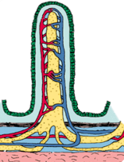
Absorption
After the chyme has passed into the duodenum some of the nutrients can pass through the wall of the villi into the bloodstream or lymphatic system.
These nutrients can be used by body cells for energy, growth and development.
The small intestine absorbs most of the nutrients. Undigested food continues to move along the small intestine into the large intestine.

Slide 12
Elimination
The colon
The colon is shorter than the small intestine.
The main function of the colon is to remove water.
Bacteria ferment the remaining food and produce some molecules and gases.
Faeces are formed and are stored in the rectum until these are excreted through the anus.

Slide 13
Bacteria in digestion
The digestive system contains trillions of bacteria which have many important jobs in the digestive system.
Bacteria can produce some vitamins that humans need (e.g. B vitamins and vitamin K).
They can digest certain carbohydrates and fibre that humans cannot.
They can control the growth of harmful bacteria which can cause disease.
Probiotics are live microorganisms which can help your gut stay healthy. They are known as ‘good’ bacteria and can be found in certain dairy products (specifically yogurts).

Slide 14
Phases of digestion
Ingestion –
food is taken into the mouth.
Digestion –
physical and chemical processes that start in the mouth and continue in the stomach and small intestine.
Absorption –
the movement of nutrients across the gastro-intestinal lining into the blood and lymphatic system for the body to use.
Elimination –
excretion of undigested food and waste substances as faeces.

Slide 15
The digestion process
For further information, go to:
www.foodafactoflife.org.uk
This resource meets the Guidelines for producers and users of school education resources about food.

