Slide 1
Considerations for food lessons with pupils with additional needs
Rosalie Forde
Head of Food and Design Technology
Three Ways School

Slide 2
Outline
Considerations – behaviour, food issues, resources and equipment
Practical examples of meeting pupils’ needs and ensuring inclusion
Communication and transition tools
Adaptations – to equipment, space and teaching
Links to Food – a fact of life resources

Slide 3
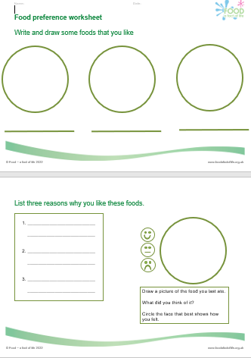
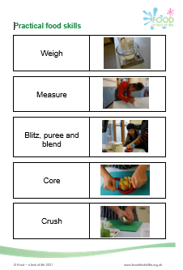
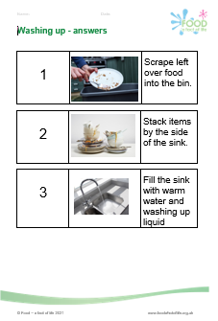
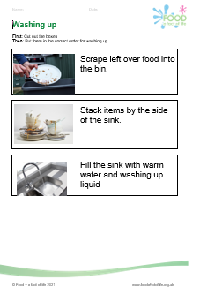

Food – a fact of life resources
The resources for pupils with additional needs cover nine key areas:
Food and drink for life
Variety (eat well)
Being active
Choice, preference and occasions
Cooking (including food hygiene and safety)
Serving and sharing
Food origins
Food is produced and processed
Shopping
Plus Developing skills for independent living*
*resources created with the support of the Sodexo Stop Hunger Foundation

Slide 4
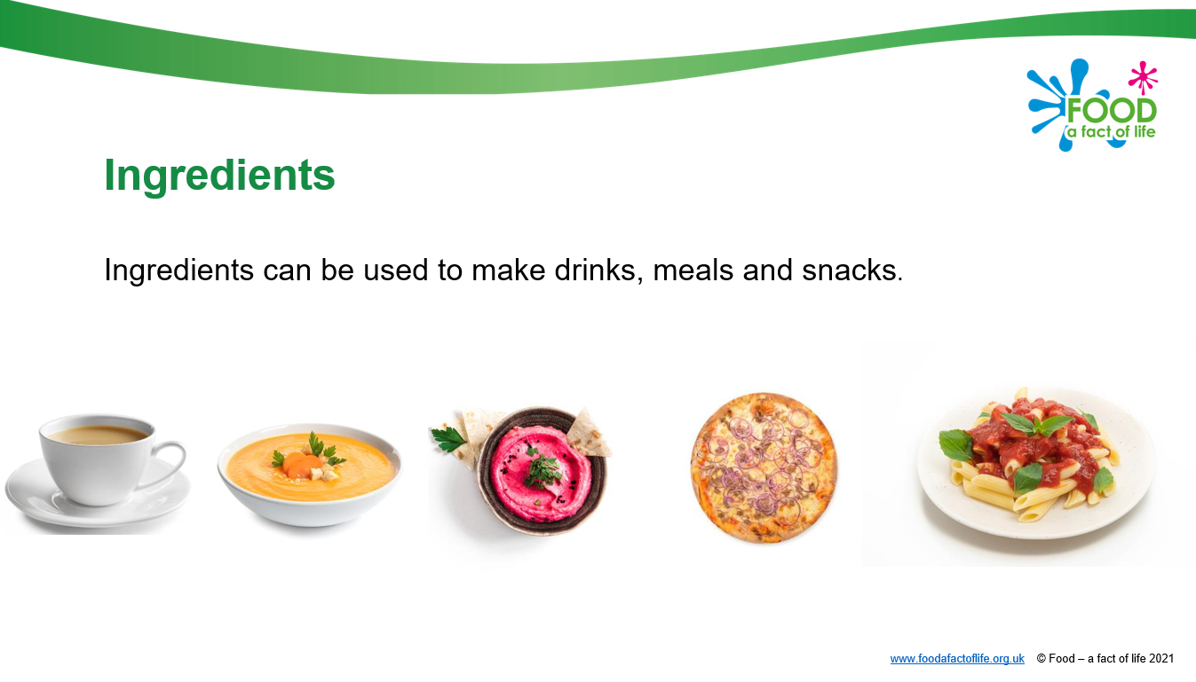
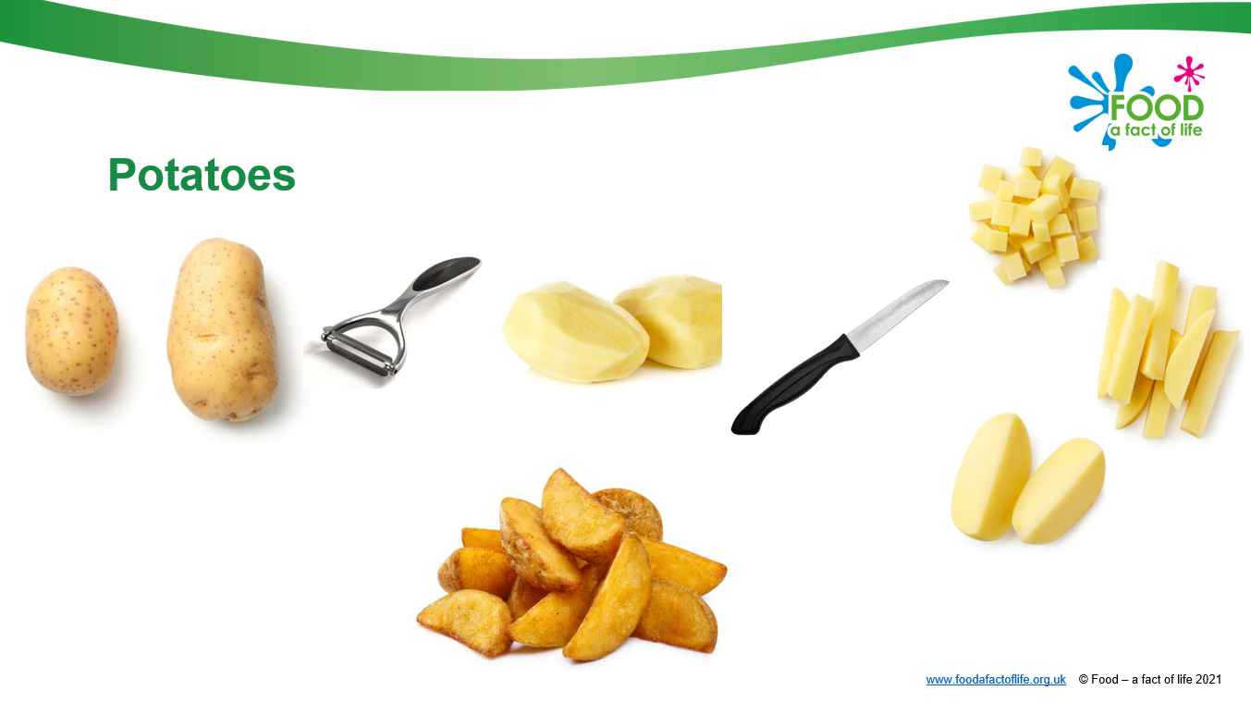
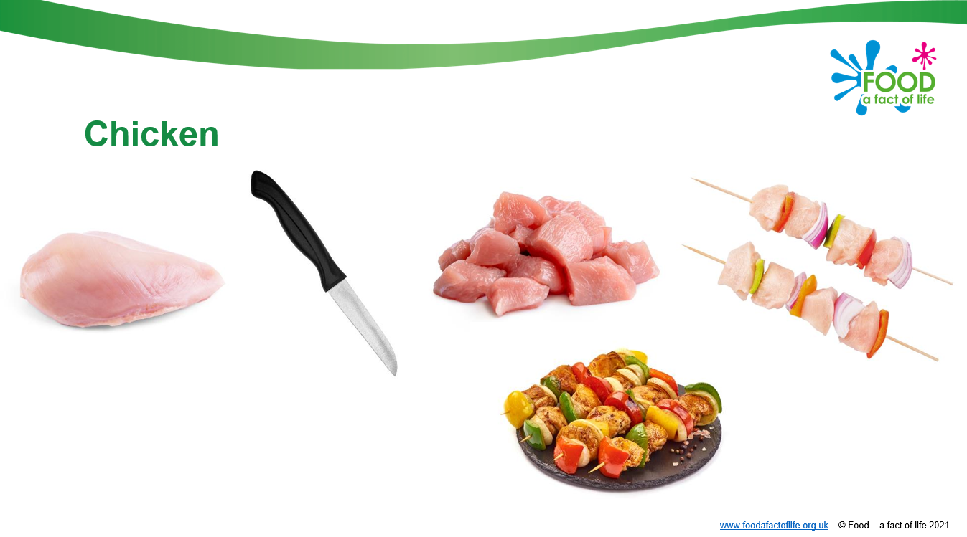

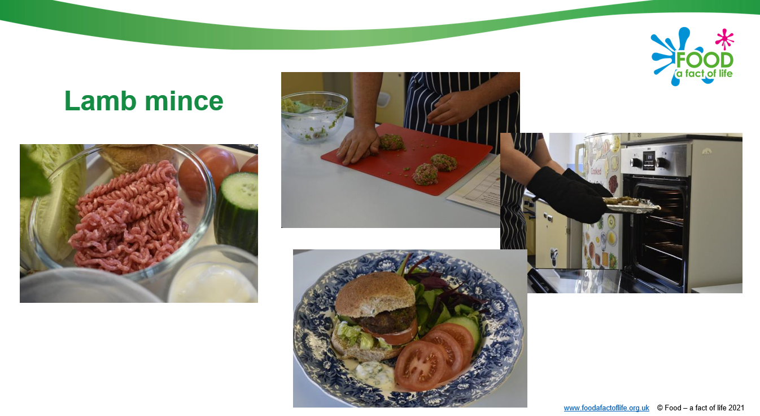
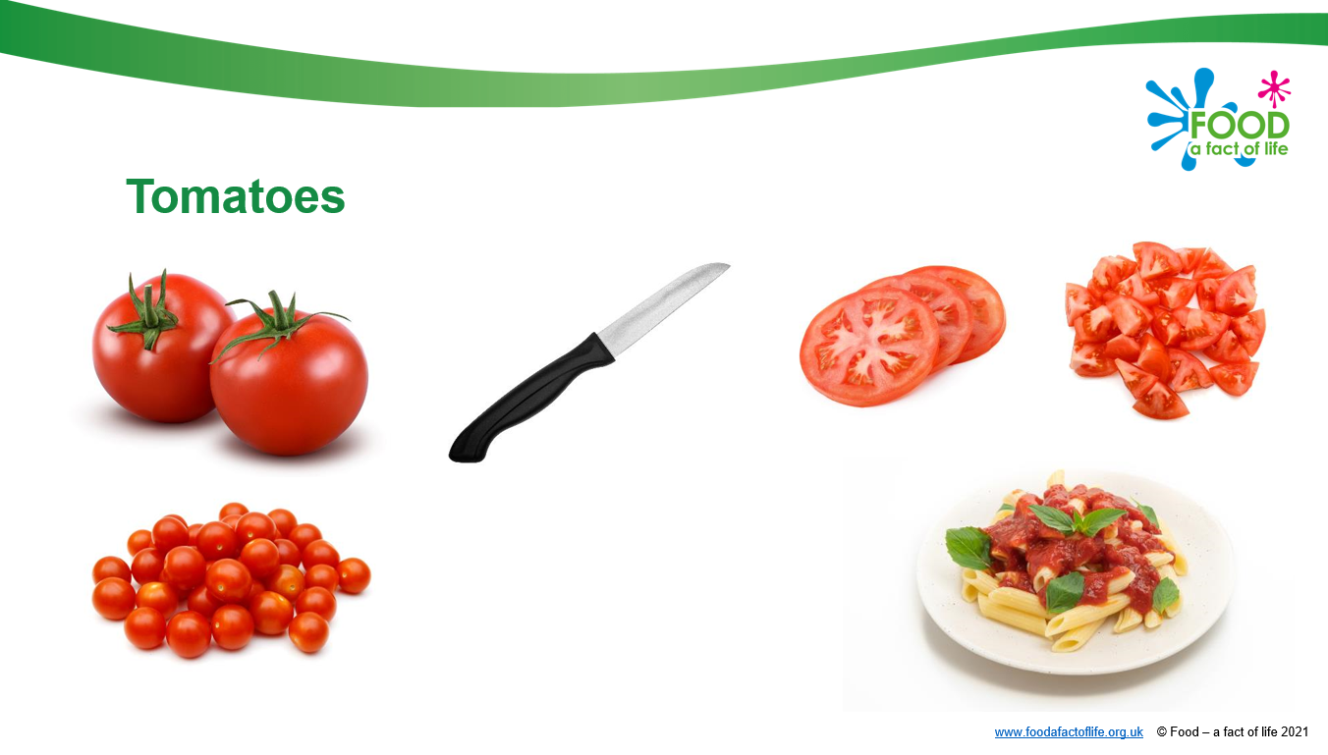
All resources are fully editable
Ingredients

Slide 5
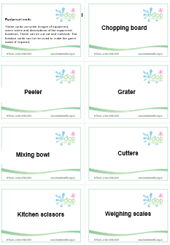
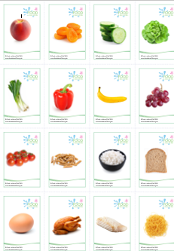
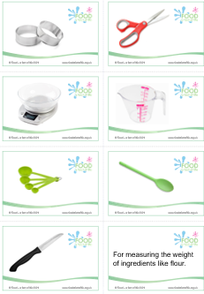
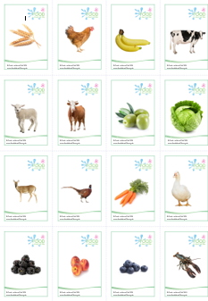
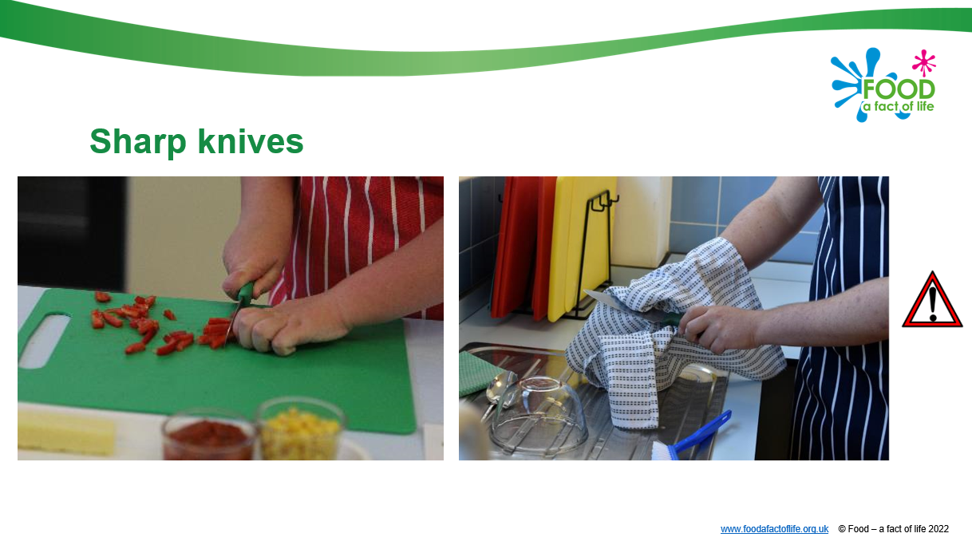
Presentation around kitchen hazards
Equipment cards for recognition, matching and sorting
Food cards
Grown reared or caught cards

Slide 6
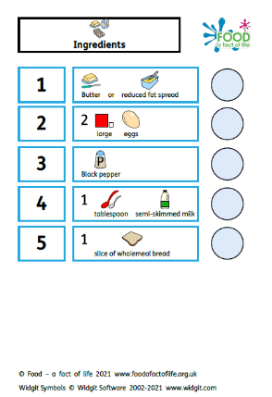
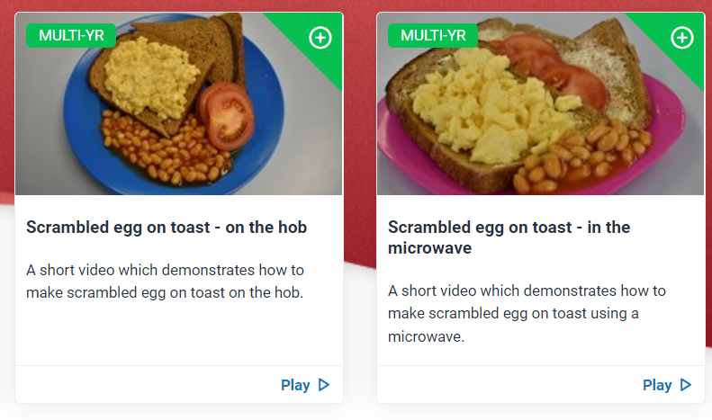
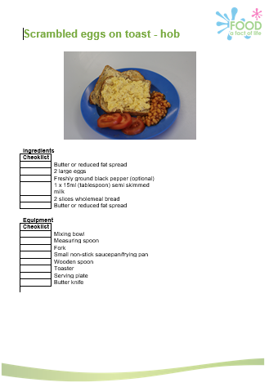
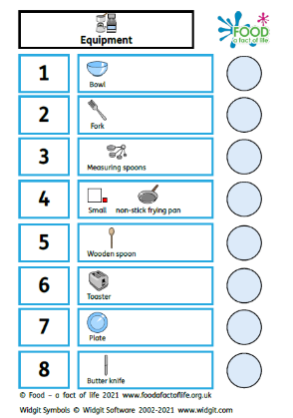
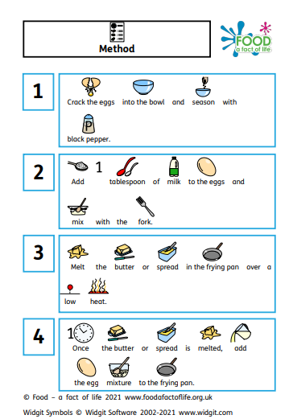
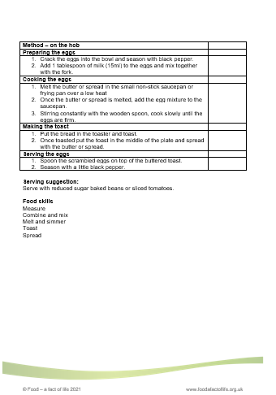
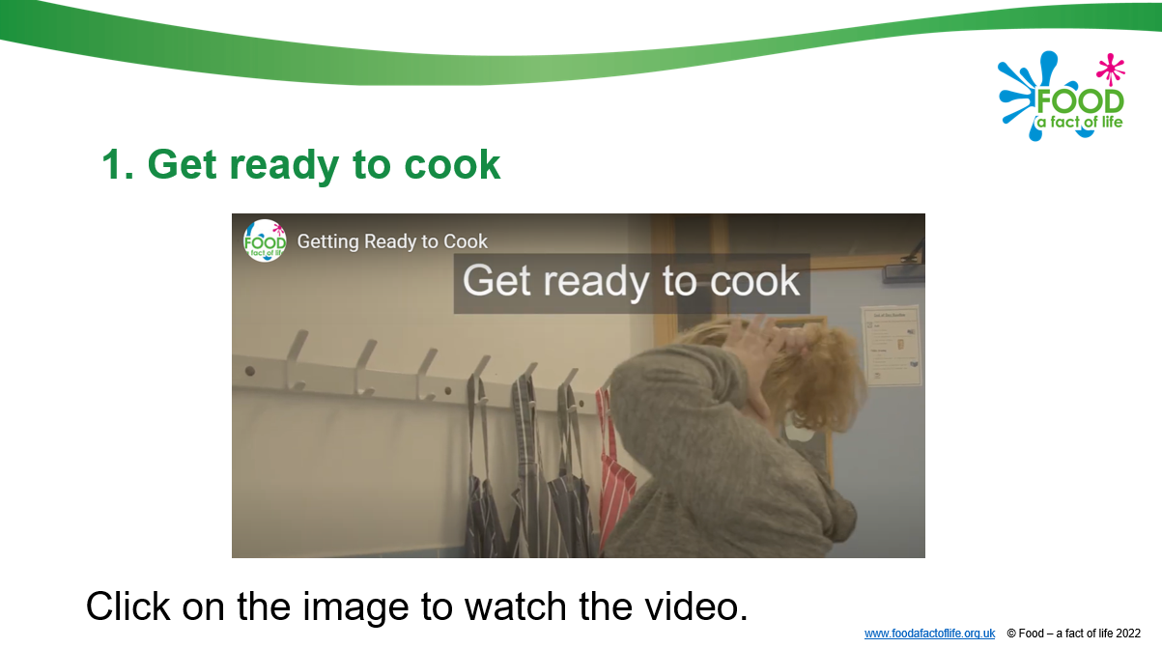

Slide 7
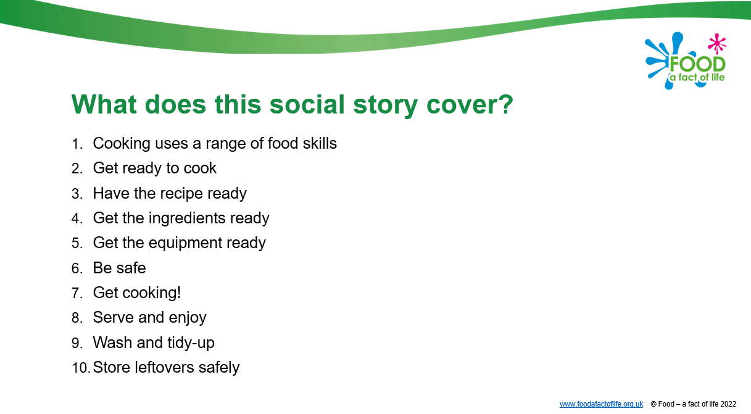
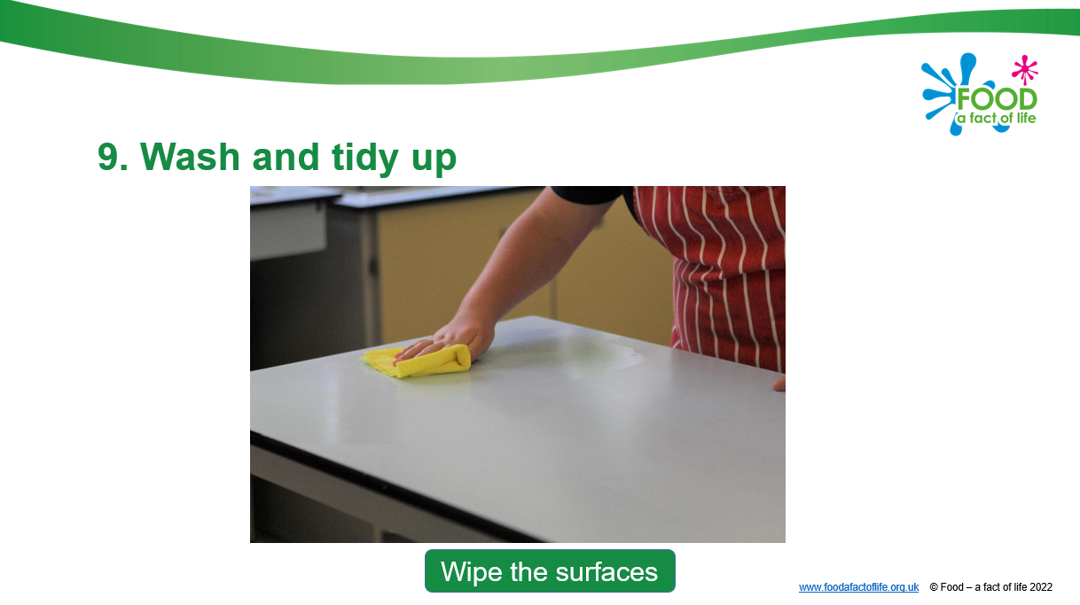
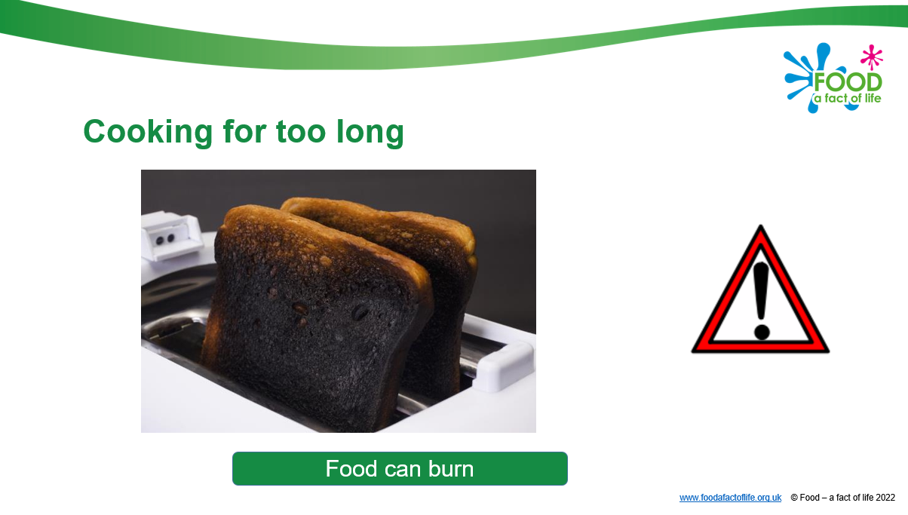
Developing skills for independent living
Planning what to cook
Going shopping
Cooking
Eating and sharing

Slide 8
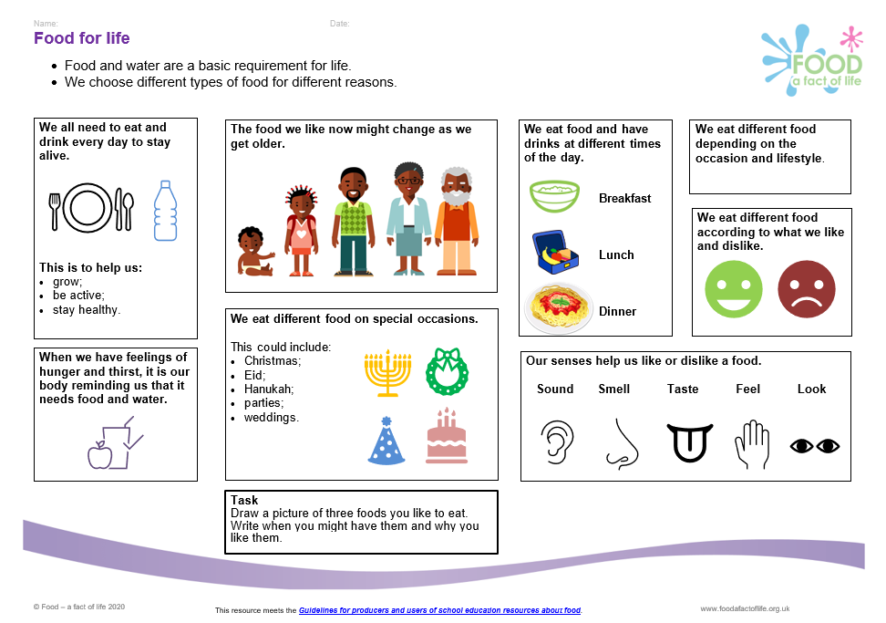
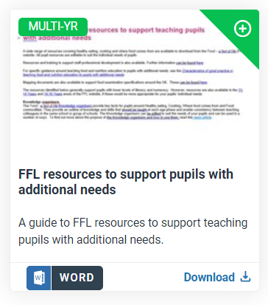
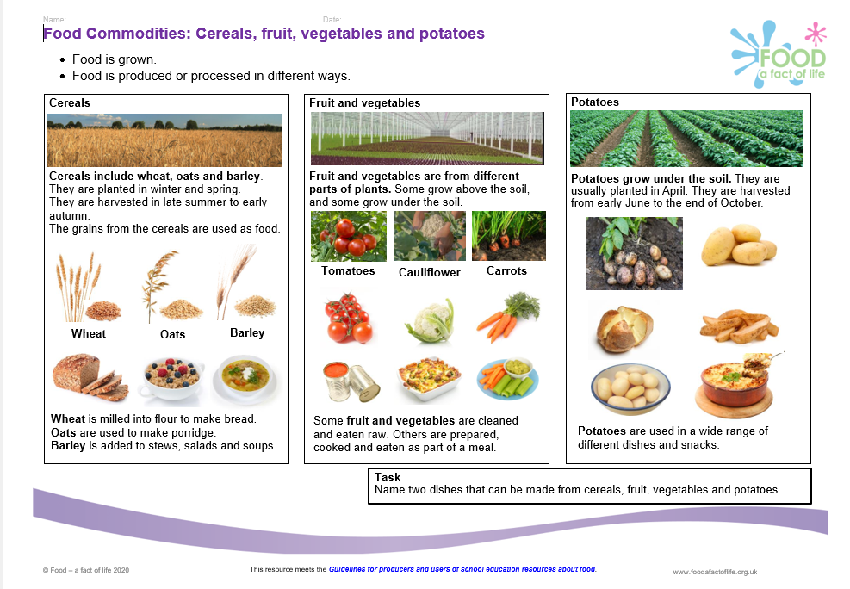
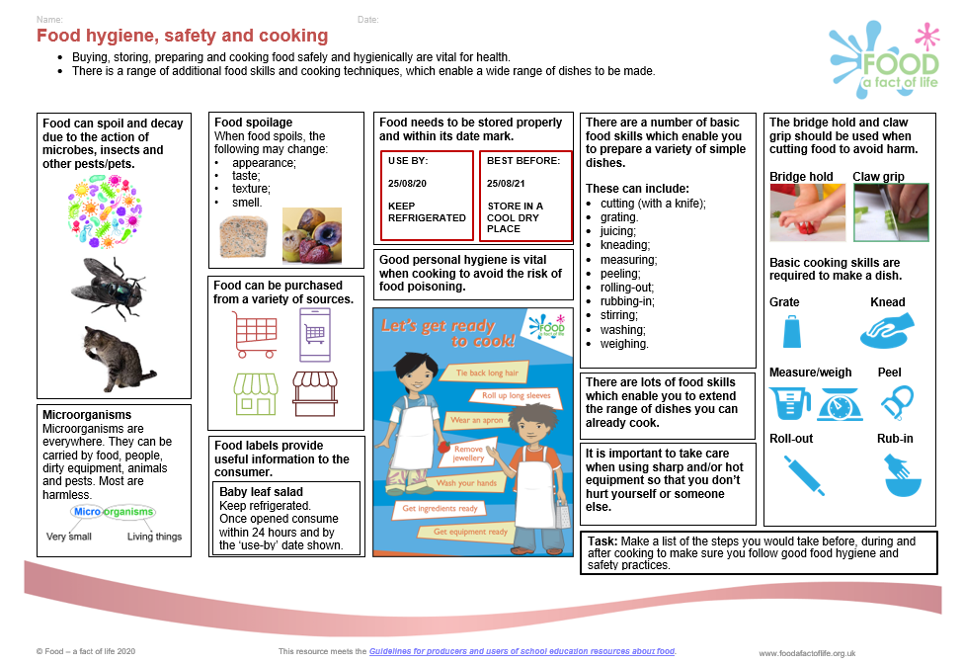
Other resources
Mapping document

Slide 9

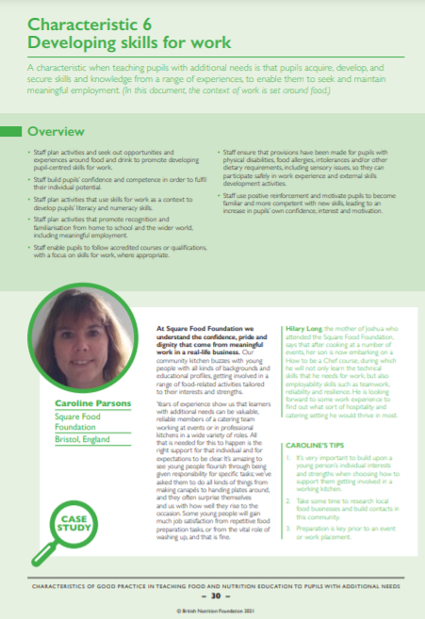
Characteristics of good practice in teaching food and nutrition education to pupils with additional needs
Defines the key characteristics of good practice that are specific to teaching food and nutrition to pupils with additional needs.
Exemplifies these characteristics of good practice in UK schools, both special and mainstream.
Guide and supporting resources
The British Nutrition Foundation would like to gratefully acknowledge the financial support provided by the Savoy Educational Trust for the production of this Guide.

Slide 10
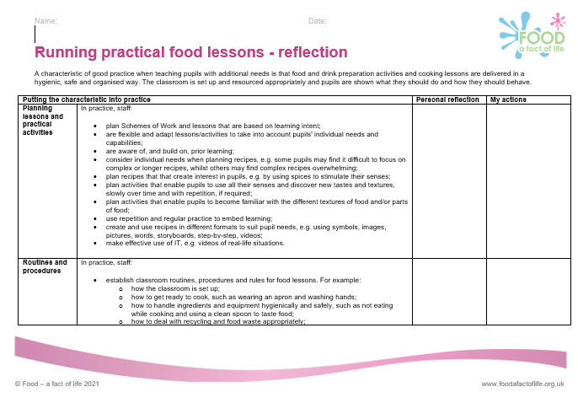
Support for your professional development
Reflection documents
Help develop reflective practice.
Ideal for staff at all career stages.
Provide an opportunity to reflect on personal practice and identify future actions.
There are also resources to support needs analysis and planning your own professional journey based on the Teaching food in primary/secondary schools: A framework of knowledge and skills.
Reflection documents

Slide 11
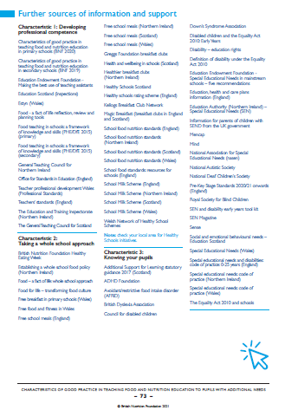
Sources of support and further information
Three pages of websites and useful information/ documents can be found at the end of the Characteristics of good practice in teaching food and nutrition to pupils with additional needs guide.

Slide 12
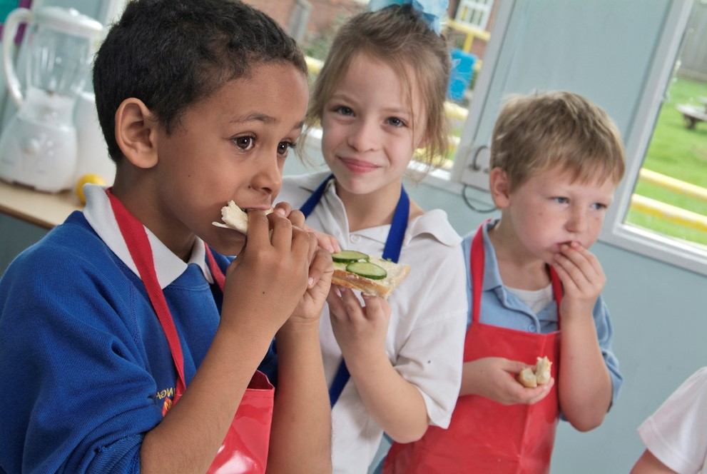
Future training events
Coming next…diary dates
Tue 16 Jan 2024 – 4pm Bringing seasonality to life, using blueberries!
Tue 27 Feb 2024 – 4pm Ask an expert
Tue 12 March 2024 – 4pm Engaging parents/carers & extra-curricular cooking
Tue 23 April 2024 – 4pm Cooking with heat in primary 2
Tue 14 May 2024 – 4pm Outside cooking!
Tue 4 June 2024 – 4pm Cook-a-long - global recipes
Remember that all webinars are recorded and the 22/23 recordings can be found here.
Also don’t forget our INSET package – seven topical videos ideal for you and your colleagues.

Slide 13
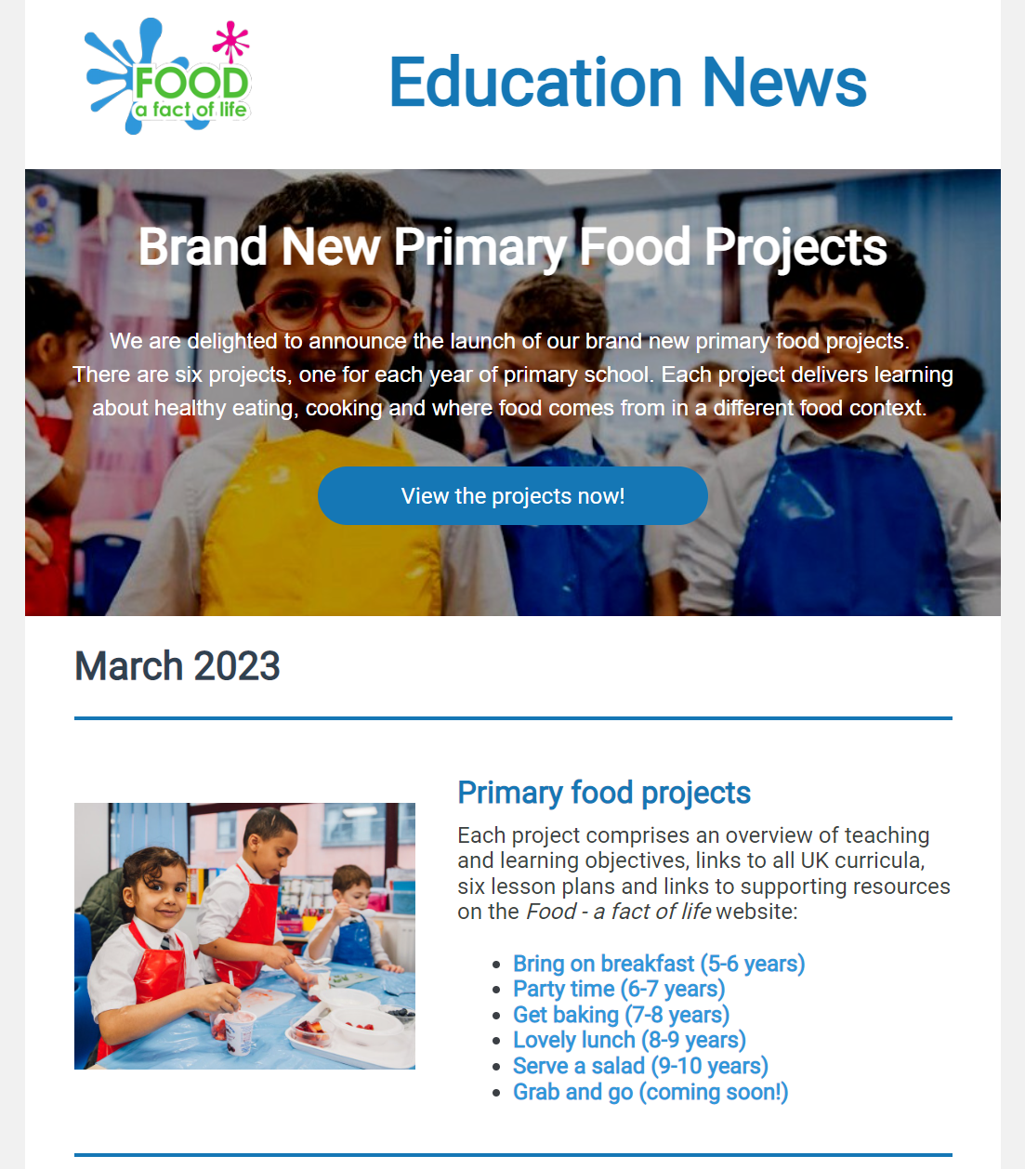
Keep up to date with our free resources and training
Education News (monthly email update)
Sign up on the homepage: www.foodafactoflife.org.uk
Follow us on Twitter @Foodafactoflife
https://twitter.com/foodafactoflife
Keep in touch: education@nutrition.org.uk
Do you know anyone who would find the TPFN programme useful?
They can view this introductory presentation and then register for free!

Slide 14
Thank you!

