Slide 1
Introduction to Nutrition

Slide 2

Introduction
Our bodies need a wide variety of different nutrients to function properly.
We need energy to keep us active and alert, but we also need water to keep us hydrated and many other nutrients to keep us healthy.
Consuming the right kind of foods and in the right amounts is important.

Slide 3

Contents
Click the links on the right to jump to each nutrition topic
Energy and energy balance
Macronutrients
Micronutrients
The Eatwell Guide
Hydration
Key words
Teacher’s guide and resources

Slide 4

Energy
Energy is essential for life, and is required to fuel many different body processes, growth and activities.
These include:
keeping the heart beating;
keeping the organs functioning;
maintenance of body temperature;
muscle contraction.

Slide 5

Energy
Different people need different amounts of dietary energy depending on their:
age;
gender;
body size;
level of activity;
genes.

Slide 6
Energy measurements
Energy intake is measured in joules (J) or kilojoules (kJ), but many people are more familiar with calories (kcal).
1 kilojoule (kJ) = 1,000 joules
1 megajoule (MJ) = 1,000,000 joules
1 kilocalorie (kcal) = 1,000 calories
To convert from one unit to another:
1 kcal = 4.184 kJ
Therefore, a 1000-kcal diet provides 4.184 MJ or 4184 kJ
1 MJ = 239 kcal

Slide 7
Energy
Carbohydrate (starch and sugars) provides 3.75 kcal (16 kJ) per gram (for the purposes of food labelling this is rounded up to 4 kcal (17kJ) per gram).
Protein provides 4kcal (17kJ) per gram.
Fat is the most energy dense nutrient, providing 9kcal (37kJ) per gram.
Energy intake can be estimated by applying these figures to the amount of carbohydrate, protein and fat we consume from food and drink.
Alcohol also provides energy at 7kcal (29kJ) per gram.

Slide 8

BMR and PAL
Basal metabolic rate (BMR) is the rate at which a person uses energy to maintain the basic functions of the body when it is at complete rest, such as:
breathing;
keeping warm;
keeping the heart beating.
In addition to their BMR, people also use energy for movement of all types, expressed as Physical Activity Level (PAL).
The amount of energy a person uses to perform daily tasks varies.

Slide 9

How much energy do we need?
Energy requirements vary from person to person, depending on the Basal Metabolic Rate (BMR) and Physical Activity Level (PAL).
Total energy expenditure =
BMR x PAL

Slide 10
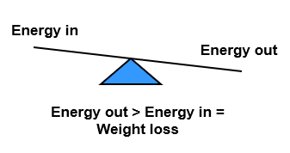
Energy balance
To maintain body weight it is necessary to balance energy intake (from food and drink) with energy expenditure (from activity).
This is called energy balance.
When energy intake is higher than energy output, over time this will lead to weight gain (positive energy balance).
When energy intake is lower than energy output, over time this will lead to weight loss (negative energy balance).
Energy balance can be maintained by regulating energy intake through the diet and adjusting physical activity levels.

Slide 11

Energy balance
In the UK and many other developed countries, overweight and obesity rates in adults and children have been increasing over the years.
According to Statistics on Healthy Survey for England, published in 2019, 60% of adult women and 68% of adult men are overweight or obese.
It is important to lead an active lifestyle and make healthier food choices.

Slide 12
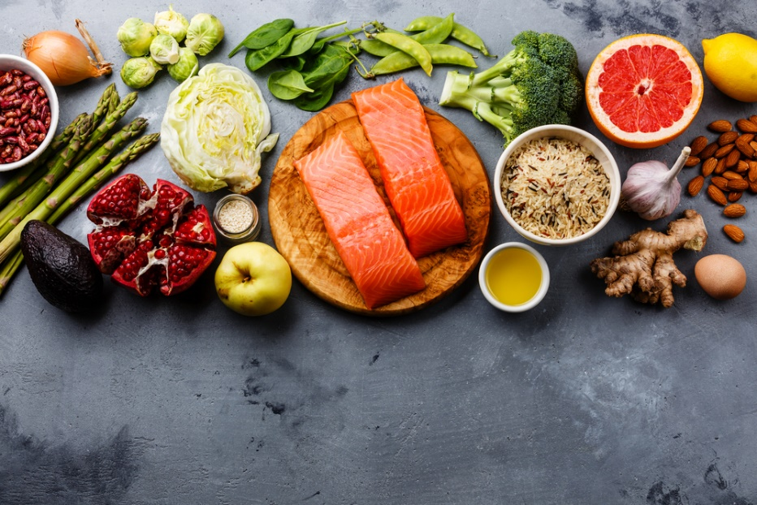
Nutrients
Food is eaten and digested in the body to allow the absorption of energy and nutrients.
There are two different types of nutrients:
macronutrients;
micronutrients.
There are three macronutrients that are essential for health:
carbohydrate;
protein;
fat.
Macronutrients are measured in grams (g).

Slide 13
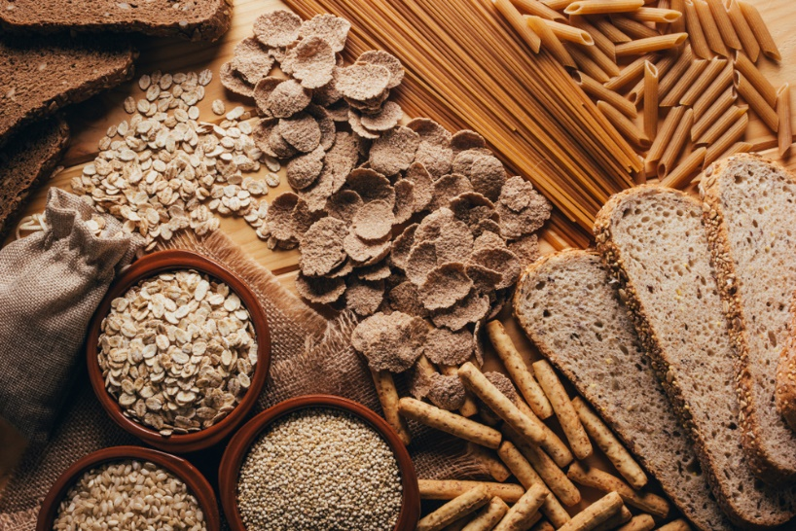
Carbohydrate
The two types of carbohydrate that provide dietary energy are starch and sugars. Dietary fibre is also a type of carbohydrate which is not digested by the human body to provide energy.
Starchy carbohydrate is an important source of energy.
1 gram of carbohydrate provides 4kcal (17kJ).

Slide 14
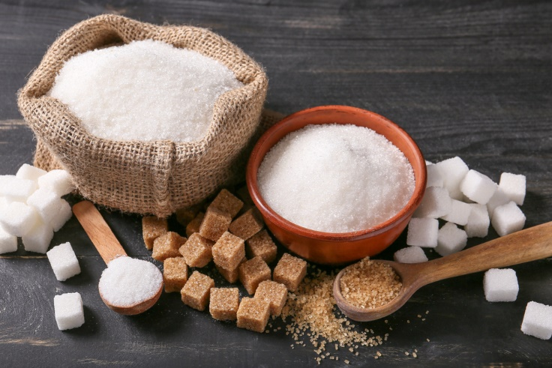
Structure of carbohydrate
All types of carbohydrate are compounds of carbon, hydrogen and oxygen.
They can be classified in many different ways. One common way is according to their structure.
Sugars
Sugars come from a variety of foods. Some are within the cellular structure of the food, e.g. in fruit or vegetables.
Other sugars are not bound into the cellular structure of the food, e.g. in milk or honey.

Slide 15

Free sugars
Free sugars include all sugars added to foods plus sugars naturally present in honey, syrups and unsweetened fruit juice.
The term does not include lactose (the sugar in milk) when naturally present in milk and dairy products and the sugars contained within the cellular structure of foods (e.g. fruit and vegetables).
The recommendations state that less than 5% of total energy intake should come from free sugars.

Slide 16
Starchy carbohydrate
Starch is found in a variety of foods. It is made up of many sugar molecules.
Examples of starchy foods include:
potatoes;
bread;
rice;
pasta.
Cereal and cereal products are the main source of carbohydrate for adults in the UK.

Slide 17
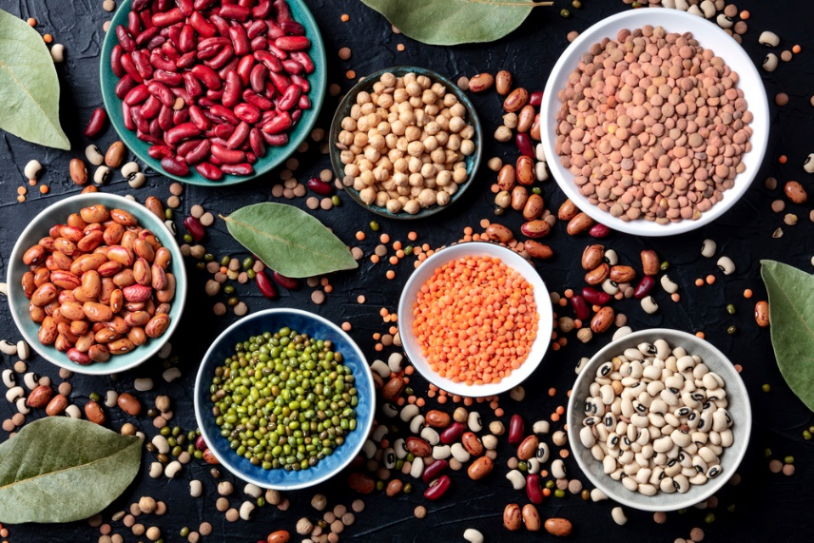
Protein
Protein is essential for growth and repair and keeping cells healthy.
Protein also provides energy:
1 gram of protein provides 4 kcal (17 kJ).

Slide 18
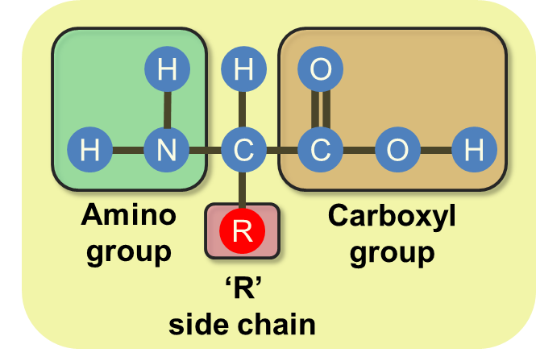
Structure of protein
Protein is made up of building blocks called amino acids. Different foods contain different amounts and different combinations of amino acids.
Protein from animal sources (e.g. meat, fish, eggs and dairy products) contains the full range of essential amino acids needed by the body.
Protein from plant sources (e.g. pulses and cereals) typically contain fewer essential amino acids.

Slide 19
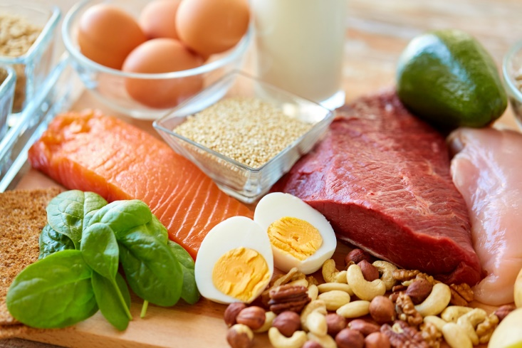
Sources of protein
Animal:
meat;
fish;
eggs;
milk;
cheese.
Plant:
nuts;
seeds;
pulses, e.g., beans, lentils;
mycoprotein;
soya products.

Slide 20
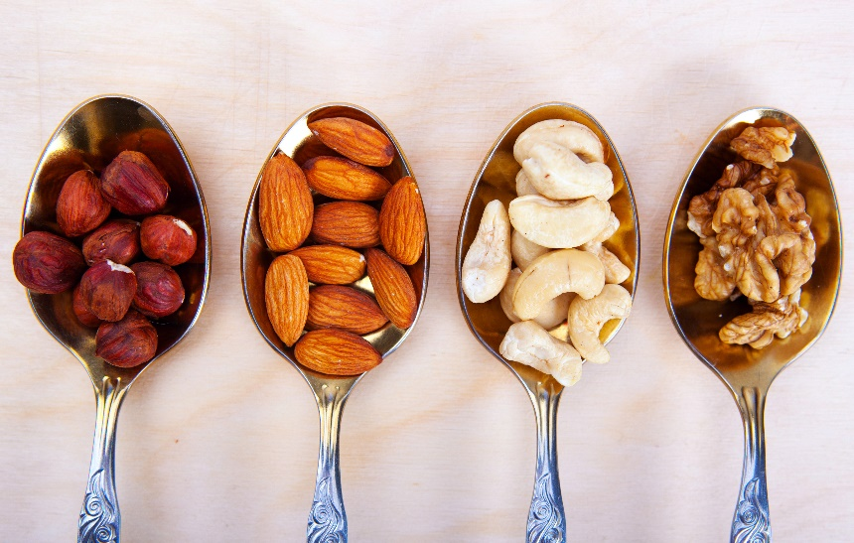
Fat
Fat provides fat-soluble vitamins A, D, E and K, and is necessary for their absorption. It is also important for essential fatty acids the body cannot make.
Fat provides a concentrated source of energy:
1 gram of fat provides 9 kcal (37 kJ) of energy.
Foods that contain a lot of fat provide a lot of energy (calories).

Slide 21
Structure of fat
Fat is made up of different types of fatty acids and glycerol.
The structure of the fatty acids determines:
their effect on our health;
their characteristics, e.g. melting point.
Depending on their chemical structure, fatty acids are usually classified as:
saturated;
monounsaturated;
polyunsaturated.

Slide 22

Micronutrients
Micronutrients are nutrients that the body needs in smaller amounts.
There are two types of micronutrients:
vitamins;
minerals.
Vitamins and minerals are needed in much smaller amounts than macronutrients. Their amounts are measured in milligrams (mg) and micrograms (μg).
(1mg = 0.001g)
(1μg = 0.001mg).

Slide 23
Vitamins
There are two groups of vitamins:
fat-soluble vitamins:
can be stored in the body (vitamins A, D, E and K).
water-soluble vitamins:
cannot be stored in the body and are therefore required daily, (e.g. B vitamins and vitamin C).

Slide 24
Fat soluble vitamins
Vitamin A
Vitamin A is needed for:
dim light vision;
healthy skin and eyes;
resistance to infection.
Vitamin A and D are often voluntarily added to reduced fat spreads.
Vitamin E and vitamin K are also fat soluble vitamins.
Vitamin D
Vitamin D is needed for the absorption of calcium from foods to keep bones and teeth healthy.
We get most of our vitamin D via the sun during the summer months, but we cannot do this in winter. Vitamin D is also provided by the diet from oily fish, meat, and eggs.
Due to low intakes in the UK population, it is recommended that everyone takes a daily vitamin D supplement between October and March.

Slide 25
Water soluble vitamins
The B vitamins
There are many different B vitamins and each has a specific function in the body.
B vitamins include:
vitamin B₁ (Thiamin);
vitamin B₂ (Riboflavin);
vitamin B₃ (Niacin);
vitamin B₆;
vitamin B₁₂;
folate/folic acid.

Slide 26

Thiamin (vitamin B₁)
Thiamin is required to release energy from carbohydrate.
It is also involved in the normal function of the nervous system.
Sources of Thiamin (vitamin B₁)
Nuts and seeds.
Meat (especially pork).
Beans and peas.
Fortified breakfast cereals.

Slide 27
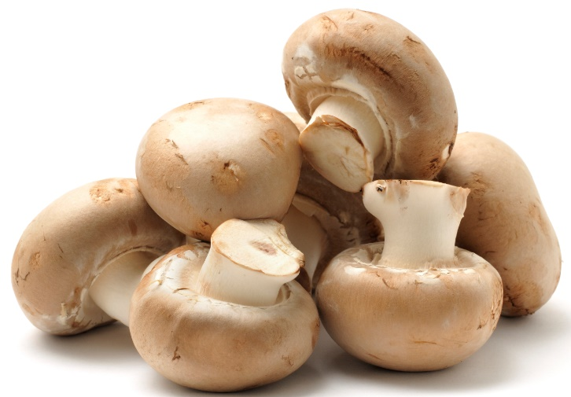
Riboflavin (vitamin B₂)
Riboflavin is required to release energy from protein, carbohydrate and fat.
It is also involved in the transport and use of iron in the body.
Sources of Riboflavin (vitamin B₂)
Milk.
Eggs.
Fortified breakfast cereals.
Mushrooms.

Slide 28
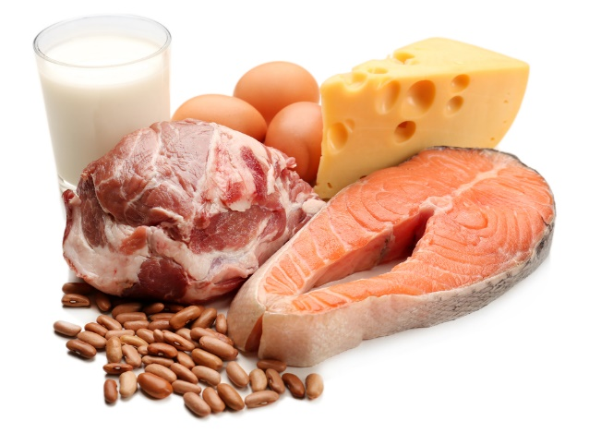
Niacin (Vitamin B₃)
Niacin is required for the release of energy from food.
Niacin is also required for the normal function of the skin, mucous membranes and nervous system.
Sources of Niacin
Meat.
Poultry
Shellfish
Wholegrains
Some nuts and seeds

Slide 29

Vitamin C (ascorbic acid)
Vitamin C is needed to make collagen. This is required for the structure and function of skin, cartilage and bones.
It is an important nutrient for healing cuts and wounds and can also help with the absorption of iron.
Sources of vitamin C
Fresh fruit, especially citrus fruits and berries.
Green vegetables.
Peppers.
Tomatoes.

Slide 30
Minerals
Minerals are inorganic substances required by the body in small amounts for a variety of different functions.
The body requires different amounts of each mineral.
People have different requirements, according to their:
age;
gender;
physiological state (e.g. pregnancy).

Slide 31
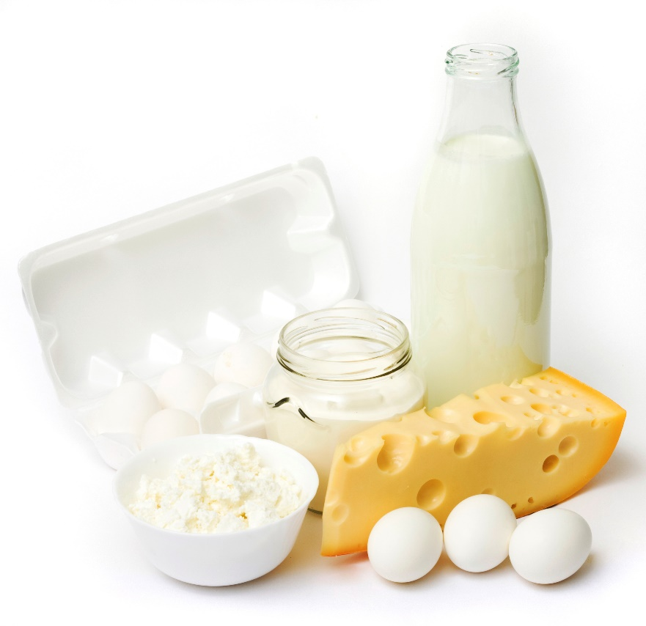
Calcium
The body contains more calcium than any other mineral. It is essential for a number of important functions such as the maintenance of bones and teeth, blood clotting and normal muscle function.
Milk, cheese and other dairy products provide about half of the calcium in the UK diet.

Slide 32

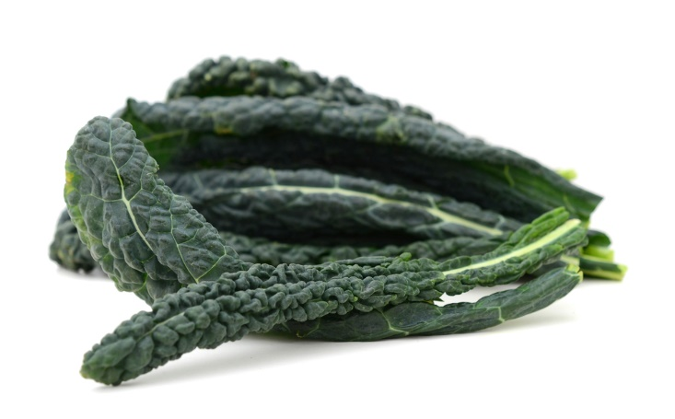
Iron
Iron is essential for the formation of haemoglobin in red blood cells. Red blood cells carry oxygen and transport it around the body.
Iron is also required for normal metabolism and removing waste substances from the body.
Did you know?
There are two types of iron; one from animal sources (e.g. liver and red meat) and the other from plant sources (e.g. pulses, dark green leafy vegetables).

Slide 33

Sodium
Sodium is found in all cells and body fluids. It is needed for regulating the amount of water and other substances in the body.
Sodium is a component of table salt, known as sodium chloride (NaCl).
Sodium intakes in the UK are considered to be too high. It is recommended that adults and children 11 years and over not to have more than 6g of salt per day. Young children should eat less.
High sodium intake is considered to be one of the risk factors for high blood pressure.

Slide 34
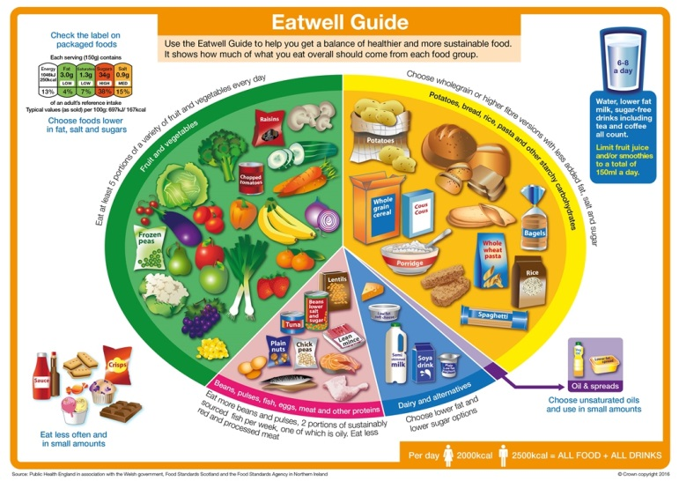
The Eatwell Guide
The Eatwell Guide is the UK’s healthy eating model.
It shows the proportions in which different groups of foods are needed in order to have a well-balanced and healthy diet.
Choose a variety of foods from each group to help get the wide range of nutrients the body needs.

Slide 35
The Eatwell Guide - continued
The Eatwell Guide applies to most people regardless of weight, dietary restrictions/preferences or ethnic origin.
It doesn’t apply to children under two years because they have different nutritional needs.
Children aged two to five years should gradually move to eating the same foods as the rest of their family, in the proportions shown on the Eatwell Guide.

Slide 36
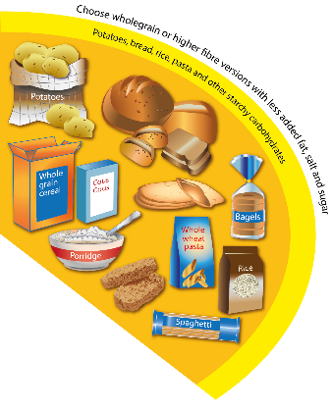
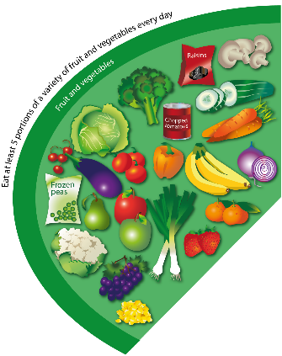

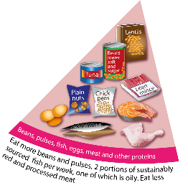
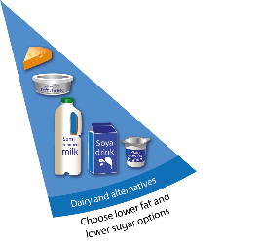
The food groups
Fruit and vegetables
Potatoes, bread, rice, pasta, and other starchy carbohydrates
Beans, pulses, fish, eggs, meat and other proteins
Oil and spreads
Dairy and alternatives

Slide 37
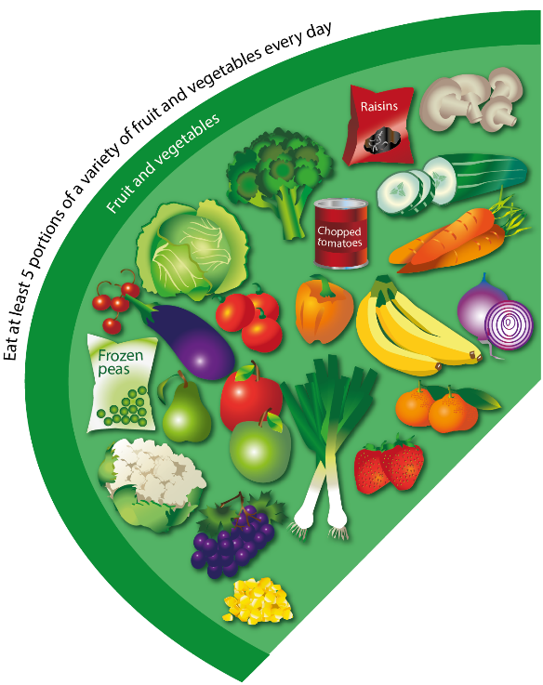
Fruit and vegetables
Fruit and vegetables should make up just over a third of the food we eat each day.
Aim to eat at least five portions of a variety of fruit and vegetables each day.
Choose from fresh, frozen, canned, dried or juiced.

Slide 38

Potatoes, bread, rice, pasta and other starchy carbohydrates
Starchy food should make up just over a third of the food we eat.
Choose higher-fibre, wholegrain varieties when you can by purchasing wholewheat pasta, brown rice, or simply leaving the skins on potatoes.
Wholegrain food contains more fibre than white or refined starchy food, and often more of other nutrients. Wholegrain food is digested more slowly, so it can help us feel full for longer.

Slide 39

Beans, pulses, fish, eggs, meat and other proteins
These foods are sources of protein, vitamins and minerals, so it is important to eat some foods from this group.
Beans, peas and lentils are good alternatives to meat because they’re naturally very low in fat, and they’re high in fibre, protein and vitamins and minerals. Other vegetable-based sources of protein include tofu, bean curd and mycoprotein.
Aim for at least two portions (2 x 140g) of fish a week, including a portion of oily fish.

Slide 40
Beans, pulses, fish, eggs, meat and other proteins - continued
Some types of meat are high in fat, particularly saturated fat.
When buying meat, remember that the type of cut or product you choose, and how you cook it, can make a big difference.
If you eat more than 90g of red or processed meat per day, try to cut down to no more than 70g per day.

Slide 41

Dairy and alternatives
Try to have some milk and dairy food (or dairy alternatives) such as cheese, yoghurt and fromage frais.
These are good sources of protein and vitamins, and they’re also an important source of calcium, which helps to keep our bones strong.
Some dairy food can be high in fat and saturated fat, but there are plenty of lower-fat options to choose from.

Slide 42

Oils and spreads
Although some fat in the diet is essential, generally we are eating too much saturated fat.
Unsaturated fats are healthier fats that are usually from plant sources and in liquid form as oil, for example vegetable oil, rapeseed oil and olive oil.
Swapping to unsaturated fats will help to reduce cholesterol in the blood.
Choosing lower fat spreads, as opposed to butter, is a good way to reduce your saturated fat intake.
Remember that all types of fat are high in energy and should be limited in the diet.

Slide 43
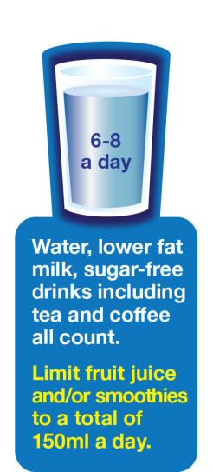
Hydration
Aim to drink 6-8 glasses of fluid every day.
Water, lower fat milk and sugar-free drinks including tea and coffee all count.
Fruit juice and smoothies also count towards your fluid consumption, although they are a source of free sugars and so you should limit consumption to no more than a combined total of 150ml per day.
Sugary drinks are one of the main contributors to excess sugar consumption amongst children and adults in the UK.
Swap sugary soft drinks for diet, sugar-free or no added sugar varieties to reduce your sugar intake in a simple step.

Slide 44
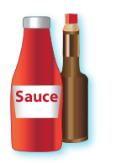






Foods high in fat, salt and sugars
This includes products such as chocolate, cakes, biscuits, full-sugar soft drinks, butter and ice-cream.
These foods are not needed in the diet. If they are included, have infrequently and in small amounts.
Food and drinks high in fat and sugar contain lots of energy, particularly when you have large servings.

Slide 45

Hydration
Our body is nearly two-thirds water, so drinking enough fluid to stay hydrated is important.
Water is essential for life, and it is important to get the right amount of fluid to be healthy.
The body loses water all the time, when we go to the toilet, from sweat and also evaporation from skin. If we do not consume enough water, we become dehydrated.

Slide 46

How much water do we need?
The amount of water and other fluids that we need to drink each day varies from person to person.
On average, we are recommended to drink 6 to 8 glasses of fluid a day to prevent dehydration, more when the weather is hot or when we are active.
Older adults may have a weaker sense of thirst. If necessary they should be helped and encouraged to drink regularly.
Children need plenty of fluid and they should be encouraged to drink regularly, especially if they are very active.
People who are very physically active should drink enough fluid to replace the water loss through sweating.

Slide 47

Sources of water
Water is also provided by food such as soups, yogurts, fruit and vegetables, as well as drinks such as milk and juice.
Water is a good choice because it hydrates without the provision of energy (calories).
It has been estimated that roughly 20% of water consumed is from food (e.g. soups, yogurt, fruit and vegetables), while 80% is from drinks (e.g. water, milk and fruit juice).

Slide 48

Healthy hydration
Water is a good choice because it hydrates without adding calories or potentially damaging teeth.
Milk is a useful source of essential nutrients such as protein, B vitamins and calcium, as well as being a source of water.
Fruit/vegetable juices and smoothies provide water plus some vitamins, minerals, fibre. However, they are also high in free sugars so it is recommended to not exceed 150ml per day.

Slide 49
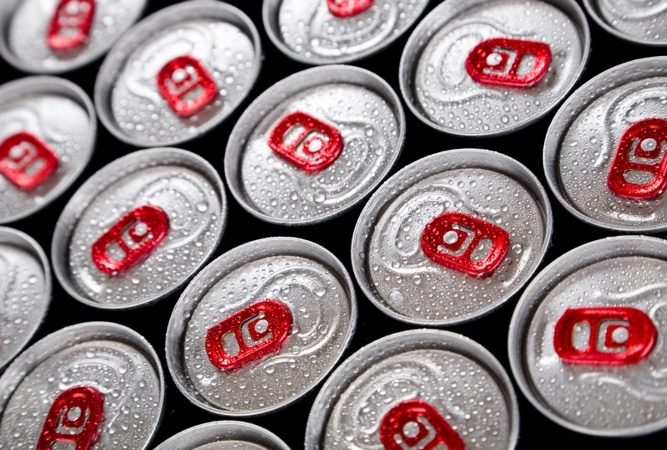
Drink less…
Tea and coffee contain caffeine which is harmless in small amounts. However, high intakes of these drinks should be avoided, especially for young children.
Sugary drinks add to children’s calorie intake and the sugar can potentially damage teeth if the drinks are consumed frequently.
Sports and energy drinks are high in sugars and contain caffeine and are therefore not suitable for young children.

Slide 50
Key words
Key word | Meaning
Amino acids | The units from which proteins are constructed. There are nine ‘essential’ or ‘indispensable’ amino acids, which can only be obtained through the diet.
Ascorbic acid (vitamin C) | A water-soluble vitamin required for collagen formation. It helps to protect cells from damage, aids the immune system and the nervous system to function normally and increases iron absorption. Found in fruits, especially citrus fruits and berries, green vegetables, peppers and tomatoes.
B vitamins | Water-soluble vitamins including thiamin (vitamin B1), riboflavin (vitamin B2) niacin, (vitamin B3), pantothenic acid (vitamin B5), vitamin B6, biotin (vitamin B7), folate (vitamin B9) and vitamin B12.
Basal metabolic rate | The amount of energy used over a period of time, when the body is at complete rest and in a fasting state.
Calories | A unit of energy in food. Can be measured in kilocalories (kcal) or kilojoules (kJ).
Carbohydrate | A component of food which includes sugars, fibres, and starches.

Slide 51
Key words
Key word | Meaning
Dehydration | A state in which the body has lost more fluids than it has taken in.
Eatwell Guide (the) | The UK’s healthy eating model, showing the types and proportions of foods that should be eaten to achieve a healthy, balanced diet.
Energy balance | The relationship between energy consumed (in food) and energy used (e.g., through exercise). Any sustained imbalance between energy intake and energy used will lead to gain or loss in weight.
Fats | Fats are composed of fatty acids and glycerol. Fats are an important part of a healthy, balanced diet. They provide essential fatty acids and carry the fat-soluble vitamins A, D, E and K. The functions of fats functions in food include shortening and enhancing mouthfeel.
Fibre | Carbohydrates found typically in plant foods that unlike other carbohydrates (sugars and most starches) are resistant to digestion.
Free sugars | Sugars that have been added to foods and drinks or are ‘released’ from fruits and vegetables when the structure is broken down (e.g., juice, purees, and pastes). Sugars present within whole fruits and vegetables and plain dairy foods are not free sugars.
Iron | A mineral element that is essential in the diet to make red blood cells that carry oxygen to the tissues. Iron also helps the immune system to function.

Slide 52
Key words
Key word | Meaning
Kilocalories (kcal) | A measurement of energy in food (commonly referred to as simply ‘calories’).
Kilojoules (kJ) | A metric measurement used for energy on food labels. Whilst it can be found on food labels, most people usually use calories (kcal).
Macronutrients | Nutrients the human body needs in larger amounts, and that provide calories, i.e., fats, proteins, and carbohydrates.
Micronutrients | Nutrient required by the body in tiny amounts for normal growth, development and maintenance of health; for example, vitamins, and minerals, e.g., vitamin C, iron, calcium.
Mineral | An inorganic micronutrient needed in the diet for normal growth, development and health. e.g., iron, calcium.
Niacin | A water-soluble vitamin also known as nicotinic acid. Essential for the release of energy from foods. Found in meat, poultry fish and shellfish, wholegrains (e.g., brown rice) and some nuts and seeds (e.g., peanuts and sesame seeds).
Physical activity level | A figure based on the amount of physical activity a person does in a day. Used in calculations of energy requirements.
Protein | A component of food that is made up of amino acids. There are many diverse types of protein with a range of functions, including enzymes that catalyse reactions and structural proteins that make up the tissues in our body.
Riboflavin | A water-soluble vitamin involved in energy release from foods, reduction in tiredness and contributing to normal nerve function. Found in milk, eggs, fortified breakfast cereals, and mushrooms.

Slide 53
Key words
Key word | Meaning
Sodium | A mineral element that regulates body water content and nerve function. Often added as salt (sodium chloride) during processing. Currently intakes of sodium are too high, and most people need to reduce their intake substantially.
Starch | A polysaccharide made up of many glucose units and the principal storage carbohydrate in plants. The main source of carbohydrate in most diets. Starch can have straight chains (amylose) or branched chains (amylopectin).
Sugars | Mono or disaccharides such as glucose, sucrose, and lactose.
Thiamin | A water- soluble vitamin essential for energy release from food and helps the nervous system and heart function normally. Good sources include pork, fortified breakfast cereals, nuts and seeds, beans, and peas.
Vitamin A | A fat- soluble vitamin needed for normal vision, mucous membranes and normal skin maintenance. Found as carotenes in plants, e.g., carrots, tomatoes, apricots and mangoes, and retinol in foods from animal sources, e.g., milk, butter, cheese, and eggs.

Slide 54
Key words
Key word | Meaning
Vitamin D | A fat- soluble vitamin which helps the body absorb calcium and is essential for the formation of bones and teeth. Good sources include oily fish, eggs, fortified breakfast cereals and fortified fat spreads. In summer, the majority of people will get most of their vitamin D through the action of sunlight on the skin.
Vitamin E | A fat-soluble vitamin which helps protects cells from oxidation. Found in vegetable and seed oils, nuts, seeds, and avocados.
Vitamin K | A family of fat-soluble vitamins; phylloquinone (vitamin K1) from plant origins, particularly in green vegetables and some oils and menaquinones (vitamin K2 found in animal products such as meat, cheese and egg). Also made in the gut by bacteria. Vitamin K is required for normal blood clotting.
Vitamin | An organic micronutrient that is essential for the human body.

Slide 55
Teachers’ guide

Slide 56
Teaching about healthy eating:
Nutrition is a broad and complex topic, but you should cover:
The Eatwell Guide (the UK’s healthy eating model)
Energy balance (energy intake vs expenditure)
Nutrients, including macronutrients and micronutrients
Hydration
Refer to the Food – a fact of life website for more detailed resources on each individual topic.

Slide 57
The Eatwell Guide - summary
The Eatwell Guide is the UK healthy eating model.
Choose a variety of foods from each group to help get the wide range of nutrients the body needs.
It doesn’t apply to children under two years because they have different nutritional needs.
The Eatwell Guide is a key document to refer back to when teaching about any aspect of nutrition.

Slide 58
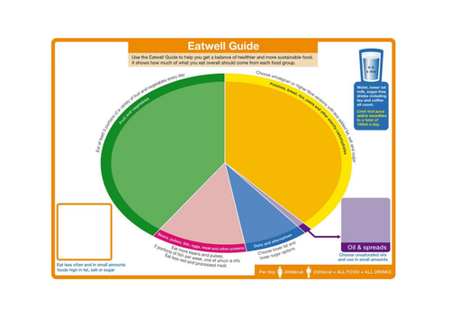
Teaching about the Eatwell Guide
It is important for pupils to understand that the Eatwell Guide shows the balance of foods that should be eaten in the overall diet, not the proportion to eat at every meal.
Pupils should be able to identify where basic foods fit on the guide.
Note that compound/composite foods may have components that fit into more than one group.
A blank Eatwell Guide is a useful resource to use in the classroom.
Some materials may reference the ‘Eatwell Plate’. This has been superseded by the Eatwell Guide.

Slide 59
Energy balance - summary
Energy intake is measured in joules (J) or kilojoules (kJ), but many people are more familiar with calories (kcal).
Carbohydrate provides 3.75 kcal (16 kJ) per gram (for labelling this is rounded up to 4 kcal (17kJ) per gram).
Protein provides 4kcal (17kJ) per gram.
Fat provides 9kcal (37kJ) per gram.
Alcohol also provides energy at 7kcal (29kJ) per gram.
When energy intake is higher than energy output, over time this will lead to weight gain (positive energy balance).
When energy intake is lower than energy output, over time this will lead to weight loss (negative energy balance).
Energy balance can be maintained by regulating energy intake through the diet and adjusting physical activity levels.

Slide 60
Teaching about energy balance
Pupils should understand the relationship between ‘calories (kcal)’ and ‘energy’ when talking about food.
Pupils should be able to relate the energy consumed from food with the energy expended through exercise and through other bodily processes.
It is useful to explain the concept of BMR and illustrate that the body does use up energy, even when at rest.
Explain that there are many different factors that change the amount of energy needed, such as age, sex, body size, activity and genes.

Slide 61
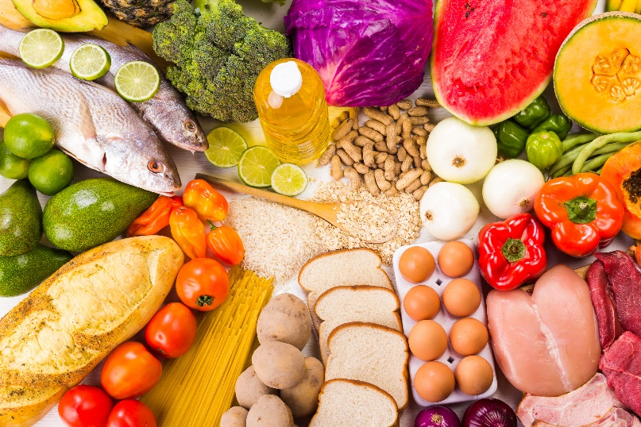
Nutrients - summary
There are three macronutrients that are essential for health:
carbohydrate;
protein;
fat.
Macronutrients are measured in grams (g).
There are two types of micronutrients:
vitamins;
minerals.
Vitamins and minerals are needed in much smaller amounts than macronutrients. Their amounts are measured in milligrams (mg) and micrograms (μg).

Slide 62

Teaching about nutrients
Pupils should understand the difference between macronutrients (that provide energy and are consumed in larger amounts) and micronutrients (that do not provide energy and are consumed in smaller amounts).
When teaching about nutrients, it can be helpful to use food examples and relate them to their place on the Eatwell Guide.
Stress that variety is important, in order to get the right balance of nutrients in the diet.

Slide 63

Hydration - summary
Our body is nearly two-thirds water, so drinking enough fluid to stay hydrated is important.
The body loses water all the time, when we go to the toilet, from sweat and also evaporation from skin.
The amount of water and other fluids that we need to drink each day varies from person to person.
On average, we are recommended to drink 6 to 8 glasses of fluid a day to prevent dehydration, more when the weather is hot or when we are active.
Children need plenty of fluid and they should be encouraged to drink regularly, especially if they are very active.

Slide 64
Teaching about hydration
Show the Eatwell Guide and note that hydration is mentioned in the guide.
It is useful to understand that the 6-8 drinks does include options other than water, however, water is usually the best choice for hydration.
Explain the detrimental effects of dehydration: fatigue, thirst, headaches, light-headedness
Note that fruit juice consumption should be limited, due to the risk of tooth decay.
Energy drinks are not good choices for children, due to the high caffeine content (and sugar content in some drinks).

Slide 65
Further supporting resources
Activities
Show the Eatwell Guide presentation and ask pupils to complete the accompanying worksheet.
You can also download a blank worksheet and food cards for use in the classroom.
To check knowledge pupils can take the Eatwell Guide quiz.
Show pupils the 8 tips for healthy eating presentation, and ask them complete the accompanying worksheet.
Other presentations that might be useful include:
5 A DAY presentation
Hydration presentation
Energy presentation
Nutrients presentation
We have many, many more resources available for teaching about healthy eating on the Food – a fact of life website!

Slide 66
Further supporting resources
Videos
What is the Eatwell Guide
Potatoes, bread rice, pasta and other starchy carbohydrates – The Eatwell Guide
Fruit and vegetables – the Eatwell Guide
Beans, pulses, fish, eggs, meat and other proteins – The Eatwell Guide
Dairy and alternatives – The Eatwell Guide
Hydration – The Eatwell Guide
Making better choices with the Eatwell Guide

Slide 67
Introduction to Nutrition
For further information, go to:
www.foodafactoflife.org.uk
This food science pack is one of a series of resources produced for the pHood Futures project, supported by the Royal Society of Chemistry.
This resource meets the Guidelines for producers and users of school education resources about food.

