Slide 1
Carbohydrates and their functional properties in food products

Slide 2
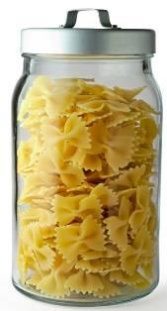
Carbohydrates in food
Many foods contain some carbohydrates, but the amounts of sugars, starch and fibre differ. Sugars are naturally present in foods such as milk, fruits, vegetables and honey. In the UK, sugar beet and sugar cane are the most common sources of sugar. Honey, treacle and golden syrup are also popular. Starch is present in foods such as potatoes, bread, rice and pasta.

Slide 3
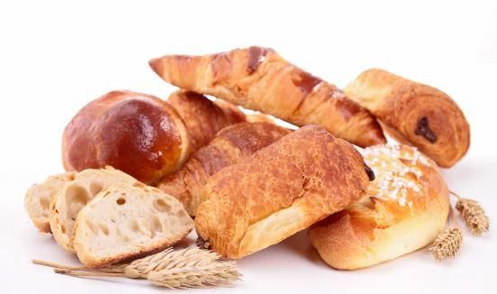
The structure of carbohydrates
All carbohydrates are compounds of the elements carbon, hydrogen and oxygen and have the general formula (CH₂O)_{n}.
e.g. glucose (CH₂O)₆ = C₆H₁₂O₆.
Another name for carbohydrates is ‘saccharides’.

Slide 4
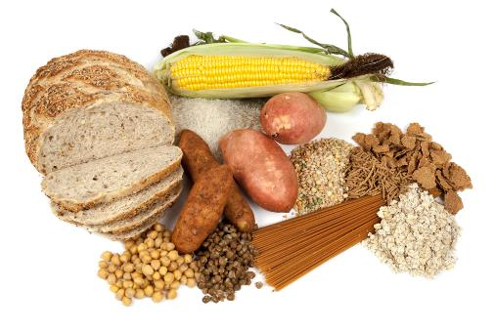
The structure of carbohydrates
Carbohydrates (saccharides) can be divided into three main groups:
monosaccharides;
disaccharides;
polysaccharides.

Slide 5
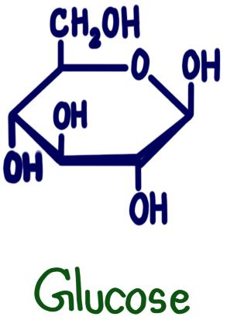
Monosaccharides
These are the simplest carbohydrate molecules.
The most commonly occurring monosaccharides in food are glucose, fructose and galactose.
The formula for glucose is C₆H₁₂O₆.

Slide 6
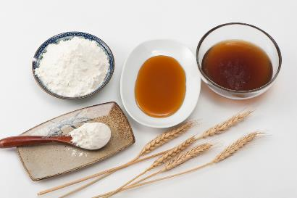
Disaccharides
These are formed when two monosaccharide molecules join together, with the elimination of one molecule of water.
They have the general formula C₁₂H₂₂O₁₁.
C₆H₁₂O₆ + C₆H₁₂O₆ = C₁₂H₂₂O₁₁ + H₂O
Glucose + Glucose = Maltose + Water
Examples of disaccharides are:
sucrose (glucose and fructose);
lactose (glucose and galactose);
maltose (2 molecules of glucose).

Slide 7
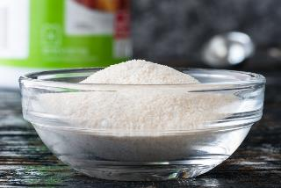
Polysaccharides
Polysaccharides are made up of many monosaccharide molecules joined together.
They have the general formula (C₆H₁₀O₅)_{n} where ‘n’ is a large number.
Examples of polysaccharides include:
starch;
glycogen;
cellulose;
pectin.
Pectin is used in jam making

Slide 8
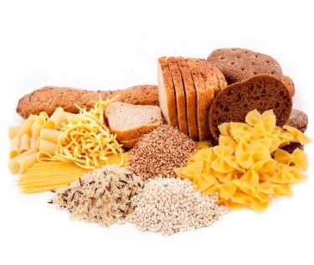
Fibre
Fibre is present in whole grains, fruits and vegetables, especially the outer covering of seeds.
It is a mixture of substances (mainly complex carbohydrates) which cannot be digested in the small intestine.
There are two types of fibre:
Soluble fibre - found in fruit, vegetables, pulses and oats.
Insoluble fibre - found in cereals such as bread and pasta.

Slide 9
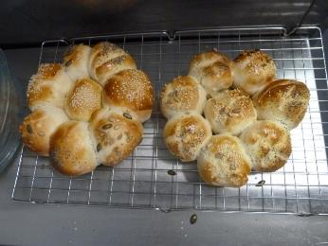
Carbohydrates and their functional properties in food products
Carbohydrates perform different functions in food products.
They can:
help to cause the colour change of bread, toast and bakery products;
contribute to the chewiness, colour and sweet flavour of caramel;
thicken products such as sauces and custards.

Slide 10
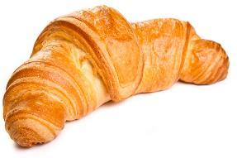
The Maillard reaction
Foods which are baked, grilled or roasted undergo colour, odour and flavour changes. This is primarily due to a group of reactions involving amino acids (from protein) and reducing sugars (e.g. glucose, fructose). These reactions contribute to the colour and flavour of many foods such as toast, bread and croissants. This group of reactions is collectively known as the Maillard reaction, after the Frenchman who discovered it. This reaction can also take place in foods with high protein content, such as meats.

Slide 11
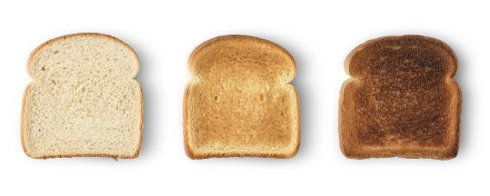
Dextrinisation
When foods containing starch are heated (without the presence of water) they can also produce brown compounds due to dextrinisation. Dextrinisation occurs when the heat breaks the large starch polysaccharides into smaller molecules known as dextrins. Many of these dextrins can also produce a brown colour. Toast is a good example to illustrate dextrinisation.

Slide 12
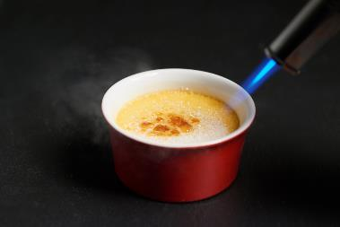
Caramelisation
When sucrose (table sugar) is heated above its melting point it undergoes physical and chemical changes to produce caramel. This happens more readily without water. However, syrups will caramelise with rapid heating. This process is used extensively in the production of confectionery. Overheating will cause the substance to become bitter and dark. Maillard, dextrinisation and caramelisation reactions are all examples of non-enzymic browning reactions.

Slide 13
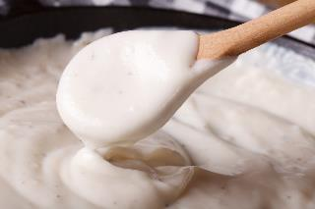
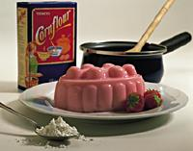
Gelatinisation
When starch is mixed with water and heated, the starch granules swell and eventually rupture, absorbing liquid, which thickens the mixture. On cooling, if enough starch is used, a gel forms. This process is used in the production of blancmange. Traditionally, English blancmange utilises cornflour as a source of starch, whilst French blancmange uses gelatine, which is a protein and gels by a different process.

Slide 14
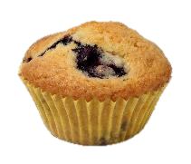
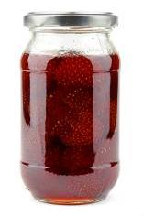
Other characteristics of carbohydrates
Flavouring:
Sugar, e.g. sucrose, may be used to flavour many products such as drinks, cakes, tomato sauce and confectionery. It supplies sweetness and mouthfeel.
Preservation:
High concentrations of sugar prevents the growth of microorganisms.
It is used extensively in the production of jam, marmalade and some canned fruit. Sugar is an important ingredient in determining the shelf-life of a product.
Gelling:
Some fruits, such as apples and blackcurrants, are rich sources of pectin. Pectin is used as a gelling agent in the production of jam.

Slide 15
Carbohydrates and their functional properties in food products
For further information, go to:
www.foodafactoflife.org.uk
This resource meets the Guidelines for producers and users of school education resources about food.

