Slide 1
Making scrambled egg

Slide 2
Making scrambled egg
Get ready to cook
Get the recipe ready
Get the ingredients ready
Get the equipment ready
Start cooking
Serve and enjoy
Wash and tidy-up

Slide 3
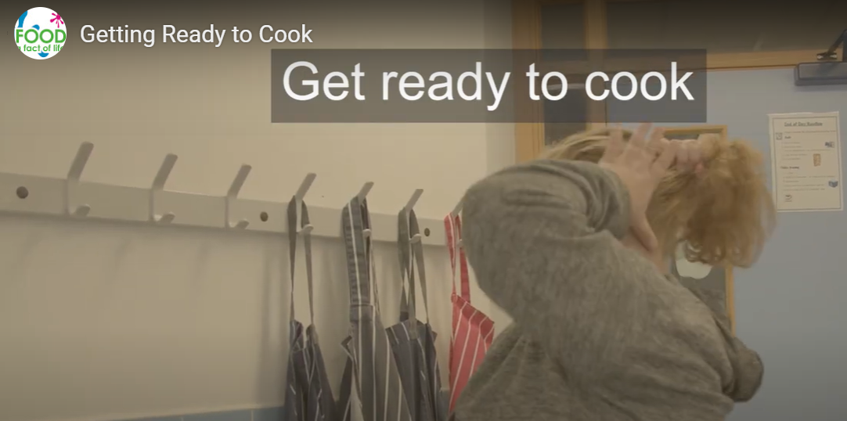
1. Get ready to cook
Click on the image to watch the video.

Slide 4
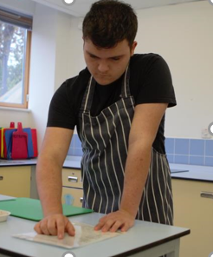
2. Get the recipe ready

Slide 5
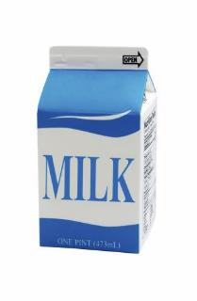
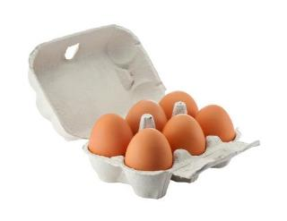
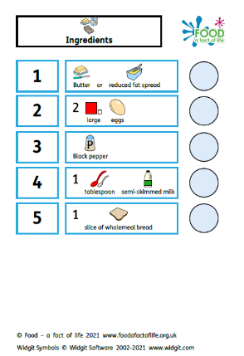
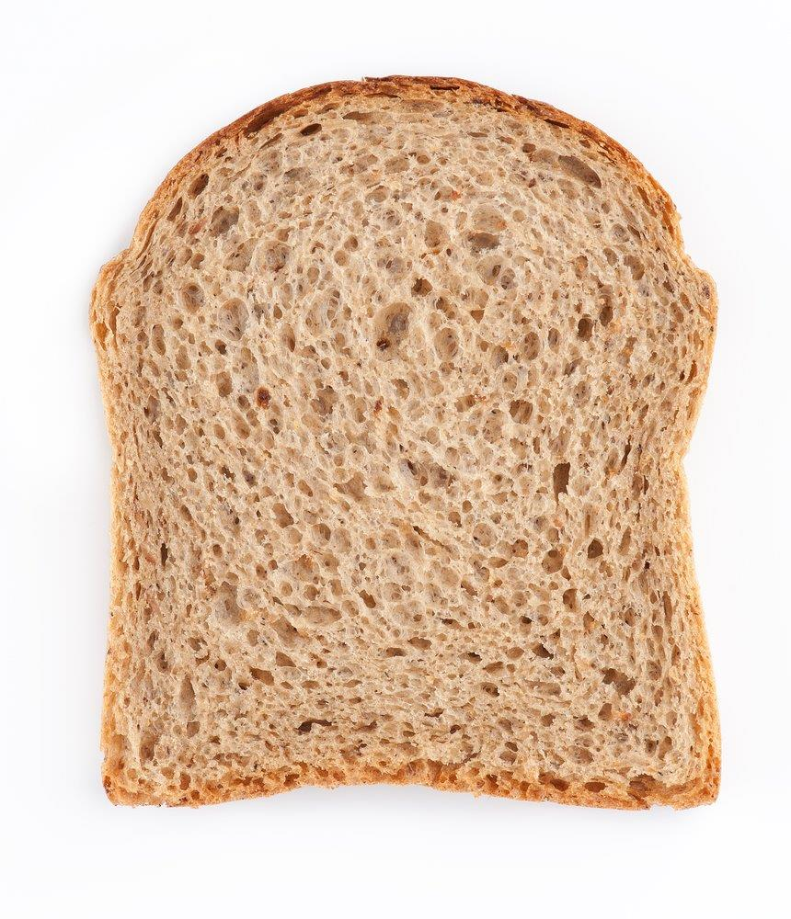
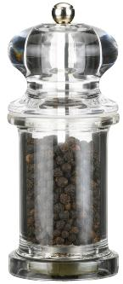
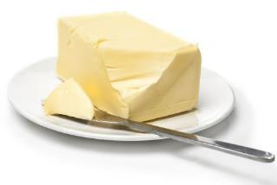
3. Get the ingredients ready

Slide 6
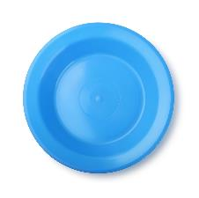
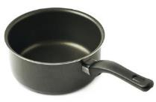
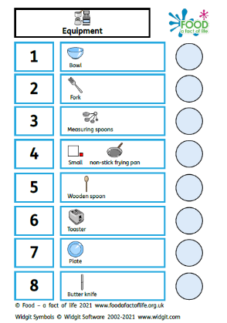
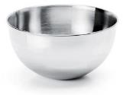




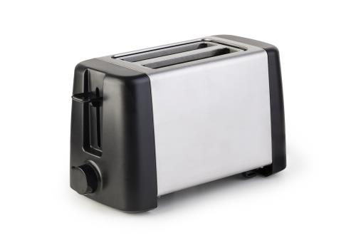
4. Get the equipment ready

Slide 7
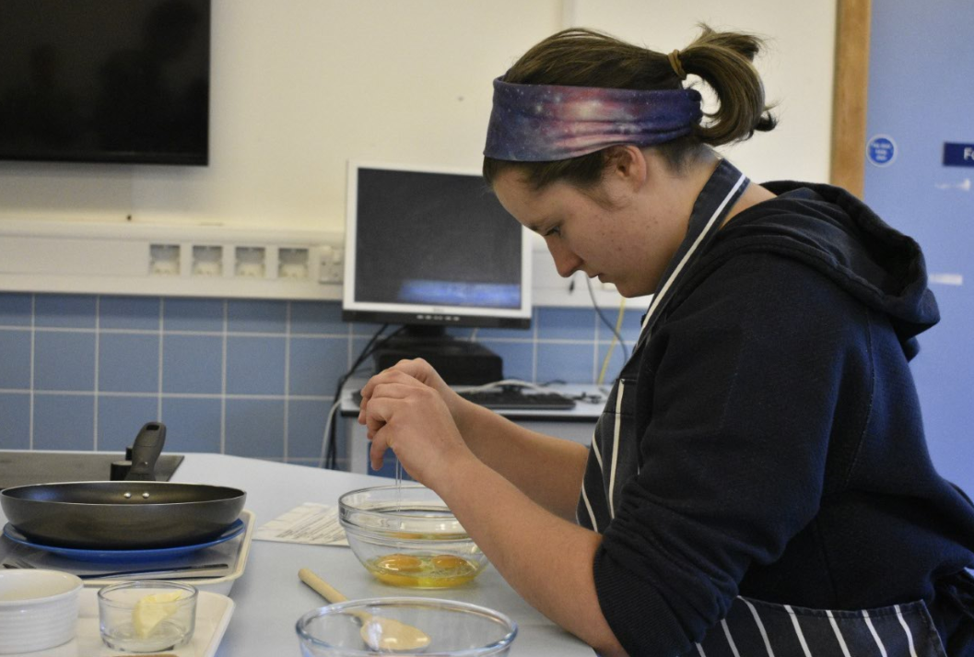
5. Start cooking
Crack the eggs

Slide 8
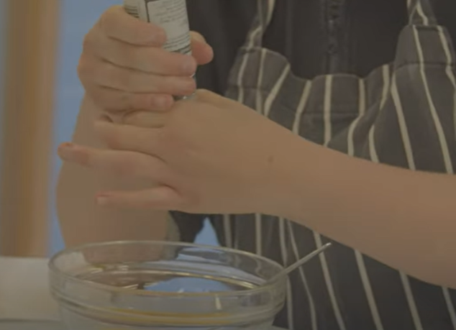
5. Cook
Season with black pepper

Slide 9
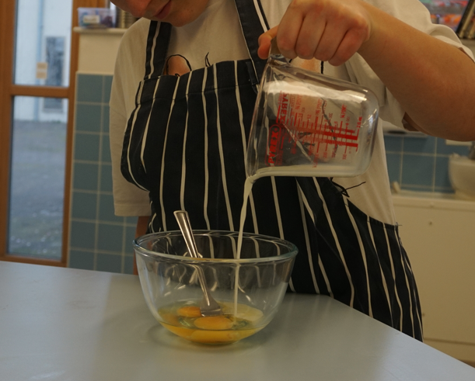
5. Cook
Add the milk

Slide 10
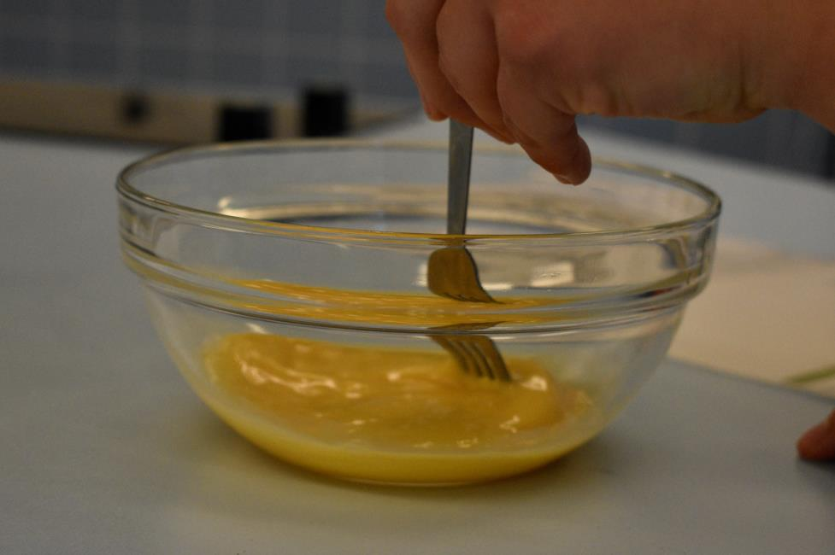
5. Cook
Mix the eggs and milk

Slide 11
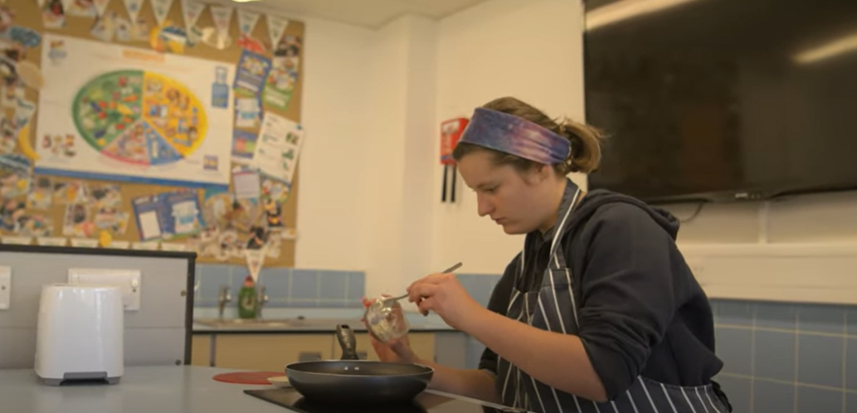
5. Cook
Melt the butter or spread

Slide 12
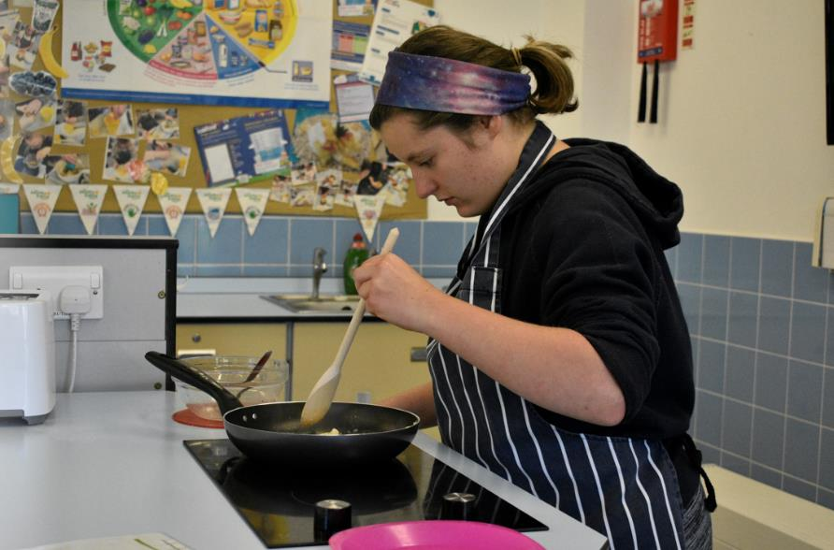
5. Cook
Cook the eggs

Slide 13
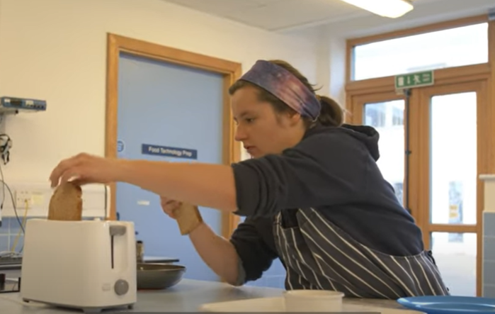
5. Cook
Toast the bread

Slide 14
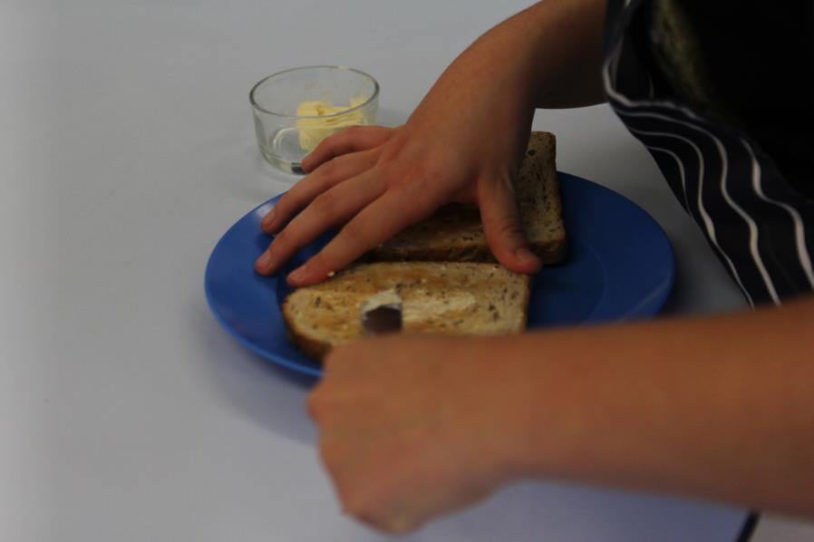
5. Cook
Spread the butter or spread

Slide 15
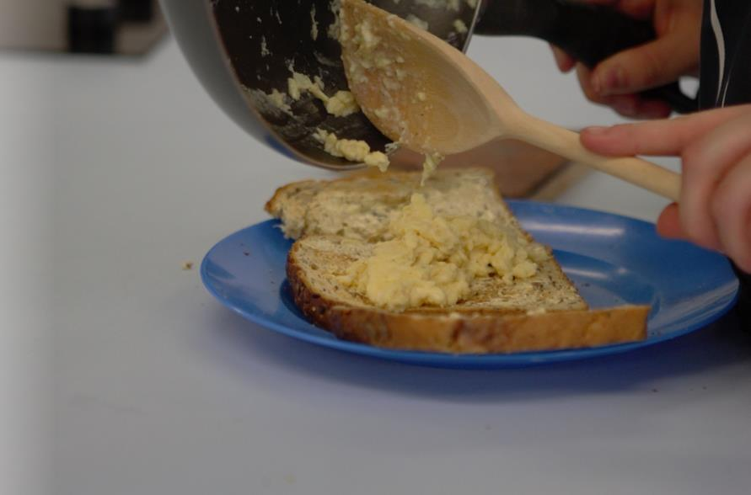
5. Cook
Add the cooked egg to the toast

Slide 16
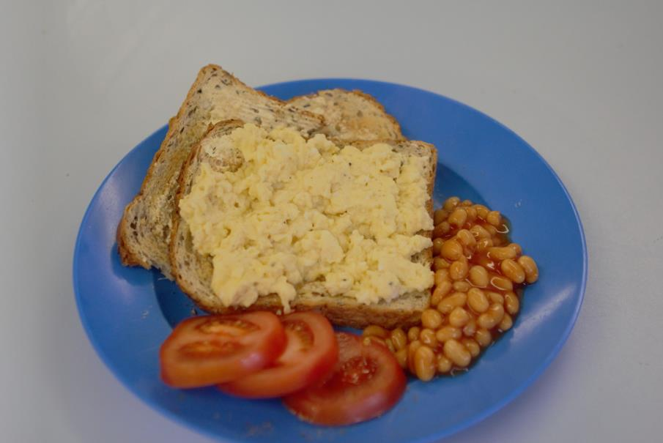
6. Serve and enjoy
Add baked beans and tomatoes

Slide 17
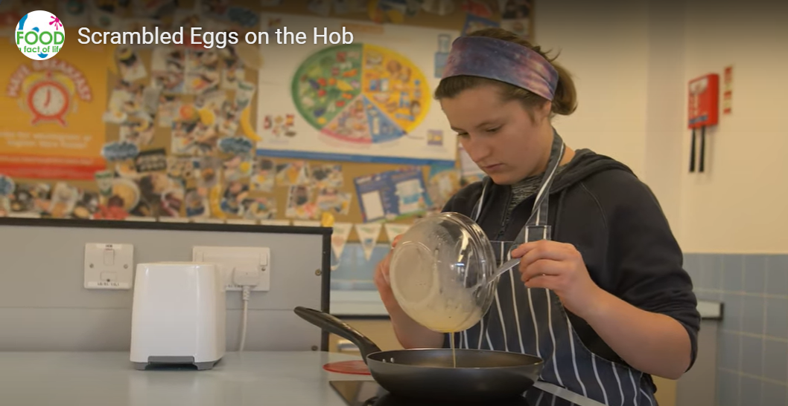
Now watch the video!
Click on the image to watch the video.

Slide 18
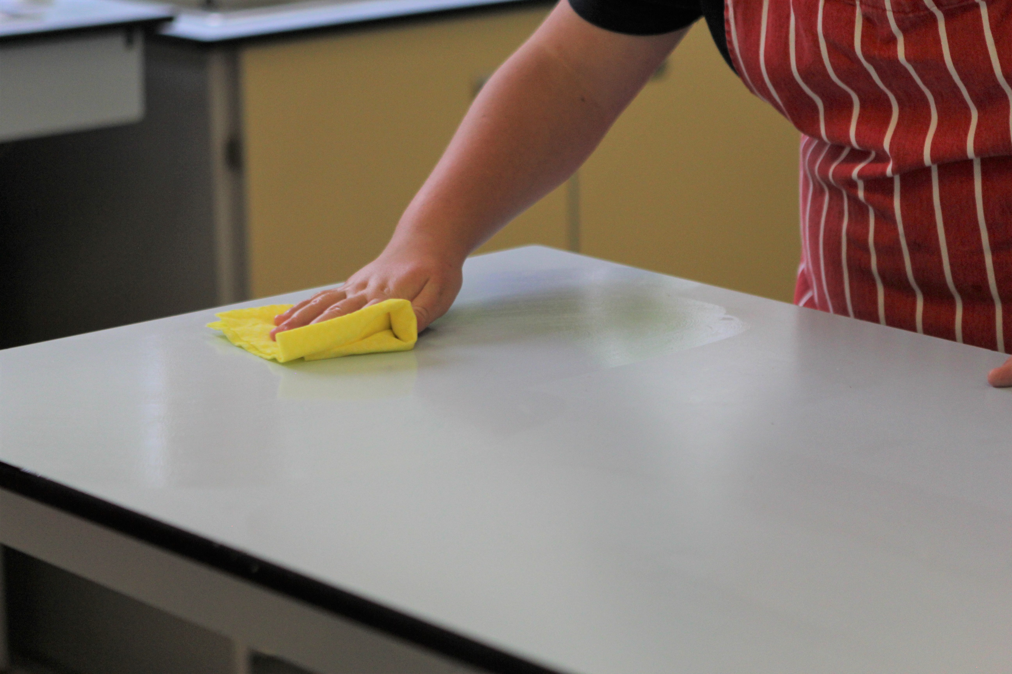
7. Wash and tidy up
Wipe the surfaces

Slide 19
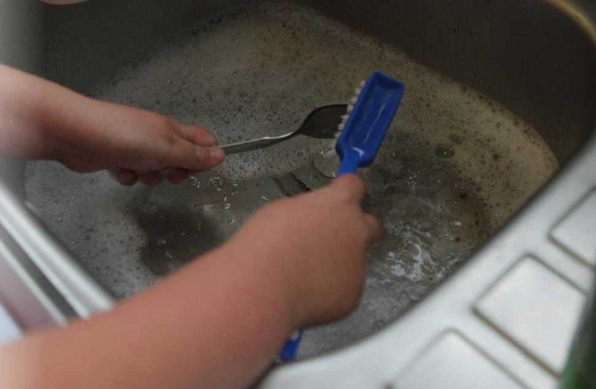
7. Wash and tidy up
Wash up

Slide 20
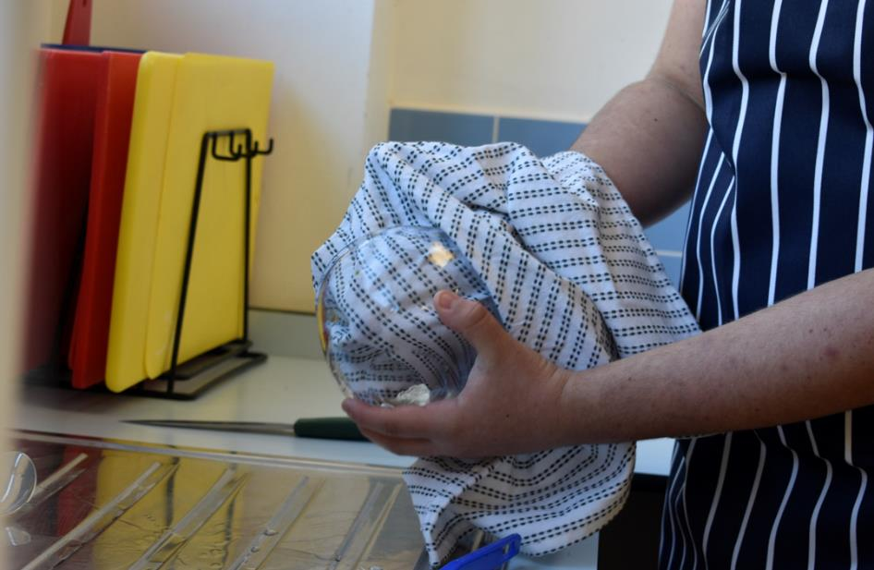
7. Wash and tidy up
Dry up

Slide 21
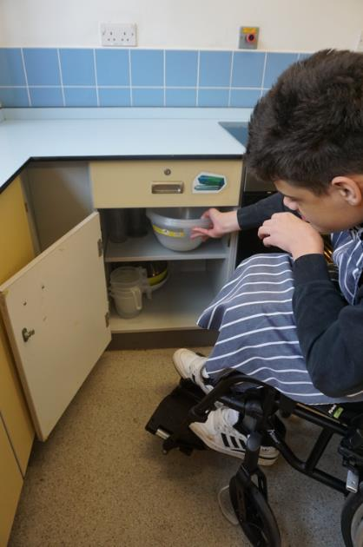
7. Wash and tidy up
Put away

Slide 22
8. Wash and tidy up
Put away

Slide 23
Making scrambled egg
Get ready to cook
Get the recipe ready
Get the ingredients ready
Get the equipment ready
Start cooking
Serve and enjoy
Wash and tidy-up

Slide 24
Making scrambled egg
For further information, go to:
www.foodafactoflife.org.uk
This resource meets the Guidelines for producers and users of school education resources about food.

