Slide 1
Food processing

Slide 2
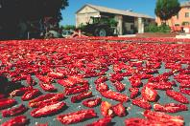

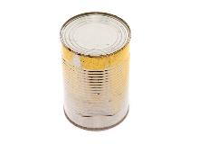
Food processing
Food processing is any deliberate change in a food that happens before it is available for us to eat.
Food processing is not new. It dates back to pre-historic times when food was sun-dried, preserved with salt and/or cooked.
Modern processing was developed over the centuries with canning and pasteurisation advancing the micro-biological safety of food.

Slide 3
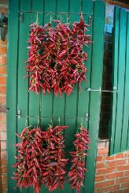
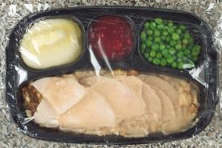
Food processing
Food processing can be very simple, e.g. preparing, freezing or drying food to preserve nutrients and freshness.
It can also be complex, e.g. formulating a frozen meal with the right balance of nutrients and ingredients.

Slide 4
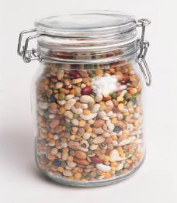
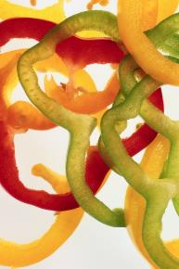
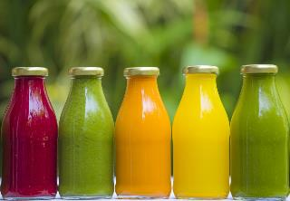
Food processing
Minimally processed foods are:
washed;
peeled;
sliced;
juiced;
frozen;
shredded;
dried.

Slide 5
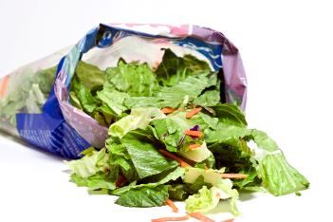
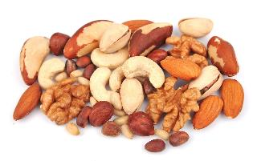
Food processing
Food that requires little processing or production includes:
washed and packaged fruit and vegetables;
shelled and ground nuts;
coffee beans.

Slide 6

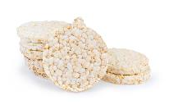
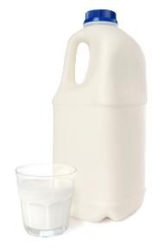
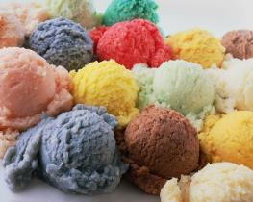
Food processing
More highly processed foods are:
baked;
fried;
smoked;
toasted;
puffed;
fermented;
pasteurised;
artificially flavoured;
artificially coloured.

Slide 7
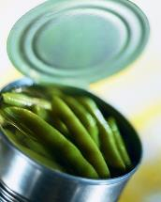
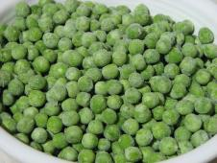
Food processing
Food is processed to help preserve and enhance nutrients and freshness of ingredients at their peak, for example:
canned tuna;
beans and tomatoes;
frozen fruit and vegetables;
pureed fruit.

Slide 8
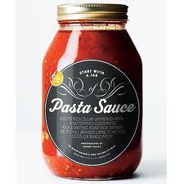
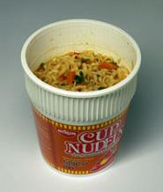
Food processing
Ingredients such as sweeteners, spices, oils, flavours, colours, and preservatives are also added to food to improve safety and taste and/or add visual appeal, for example:
instant noodles or rice;
jars of tomato sauce;
salad dressings and sauces.

Slide 9
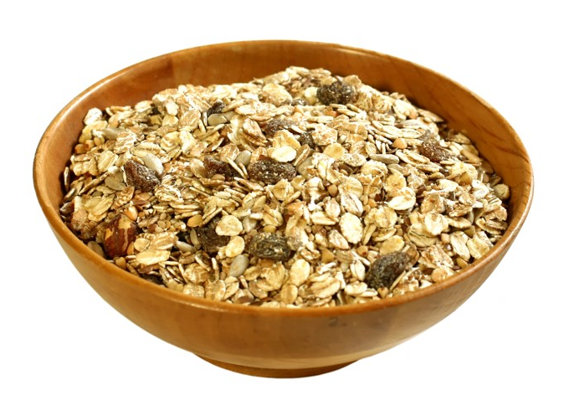
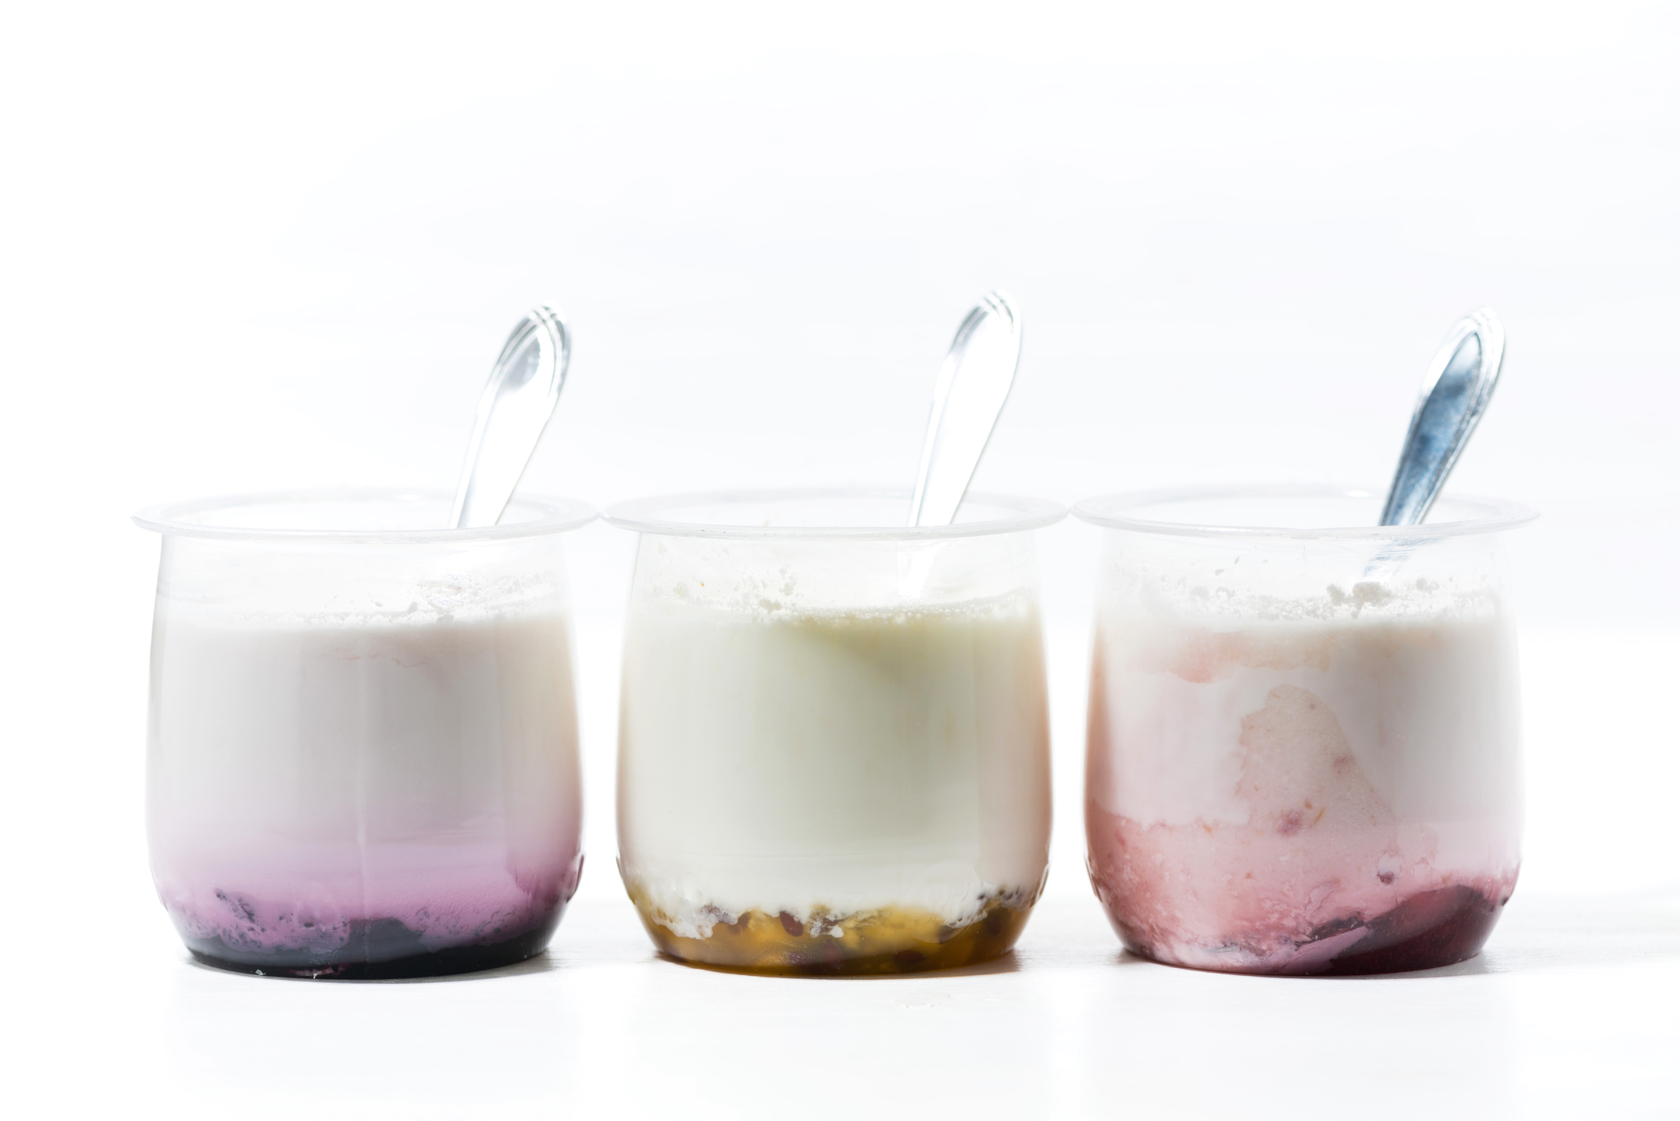
Food processing
Food can also be processed so that it is “ready-to-eat” and requires little or no preparation. For example:
breakfast cereal;
jam;
peanut butter;
ice cream;
yogurt;
biscuits;
ham;
cheese spreads.

Slide 10
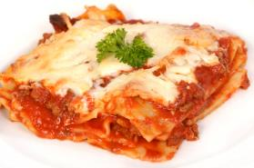
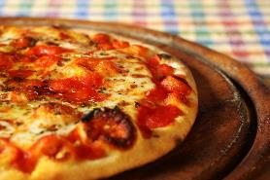
Food processing
Food processing enables food to be packaged, staying fresher for longer and saving time. For example:
prepared deli foods;
frozen meals;
ready meals;
pizza.

Slide 11
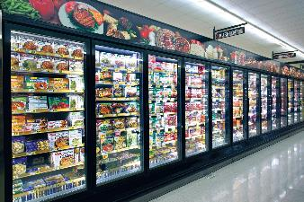
Food processing
Food is processed for a number of reasons:
to extend the shelf life;
to add variety;
convenience;
consumer’s health.

Slide 12

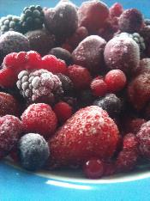
To extend the shelf life
Processing foods often makes them safer by killing existing bacteria and slowing bacterial growth. For example, heating foods helps remove harmful bacteria.
Examples of preserving food through food processing include:
fermenting;
salting;
canning;
pasteurising;
freezing;
drying.

Slide 13
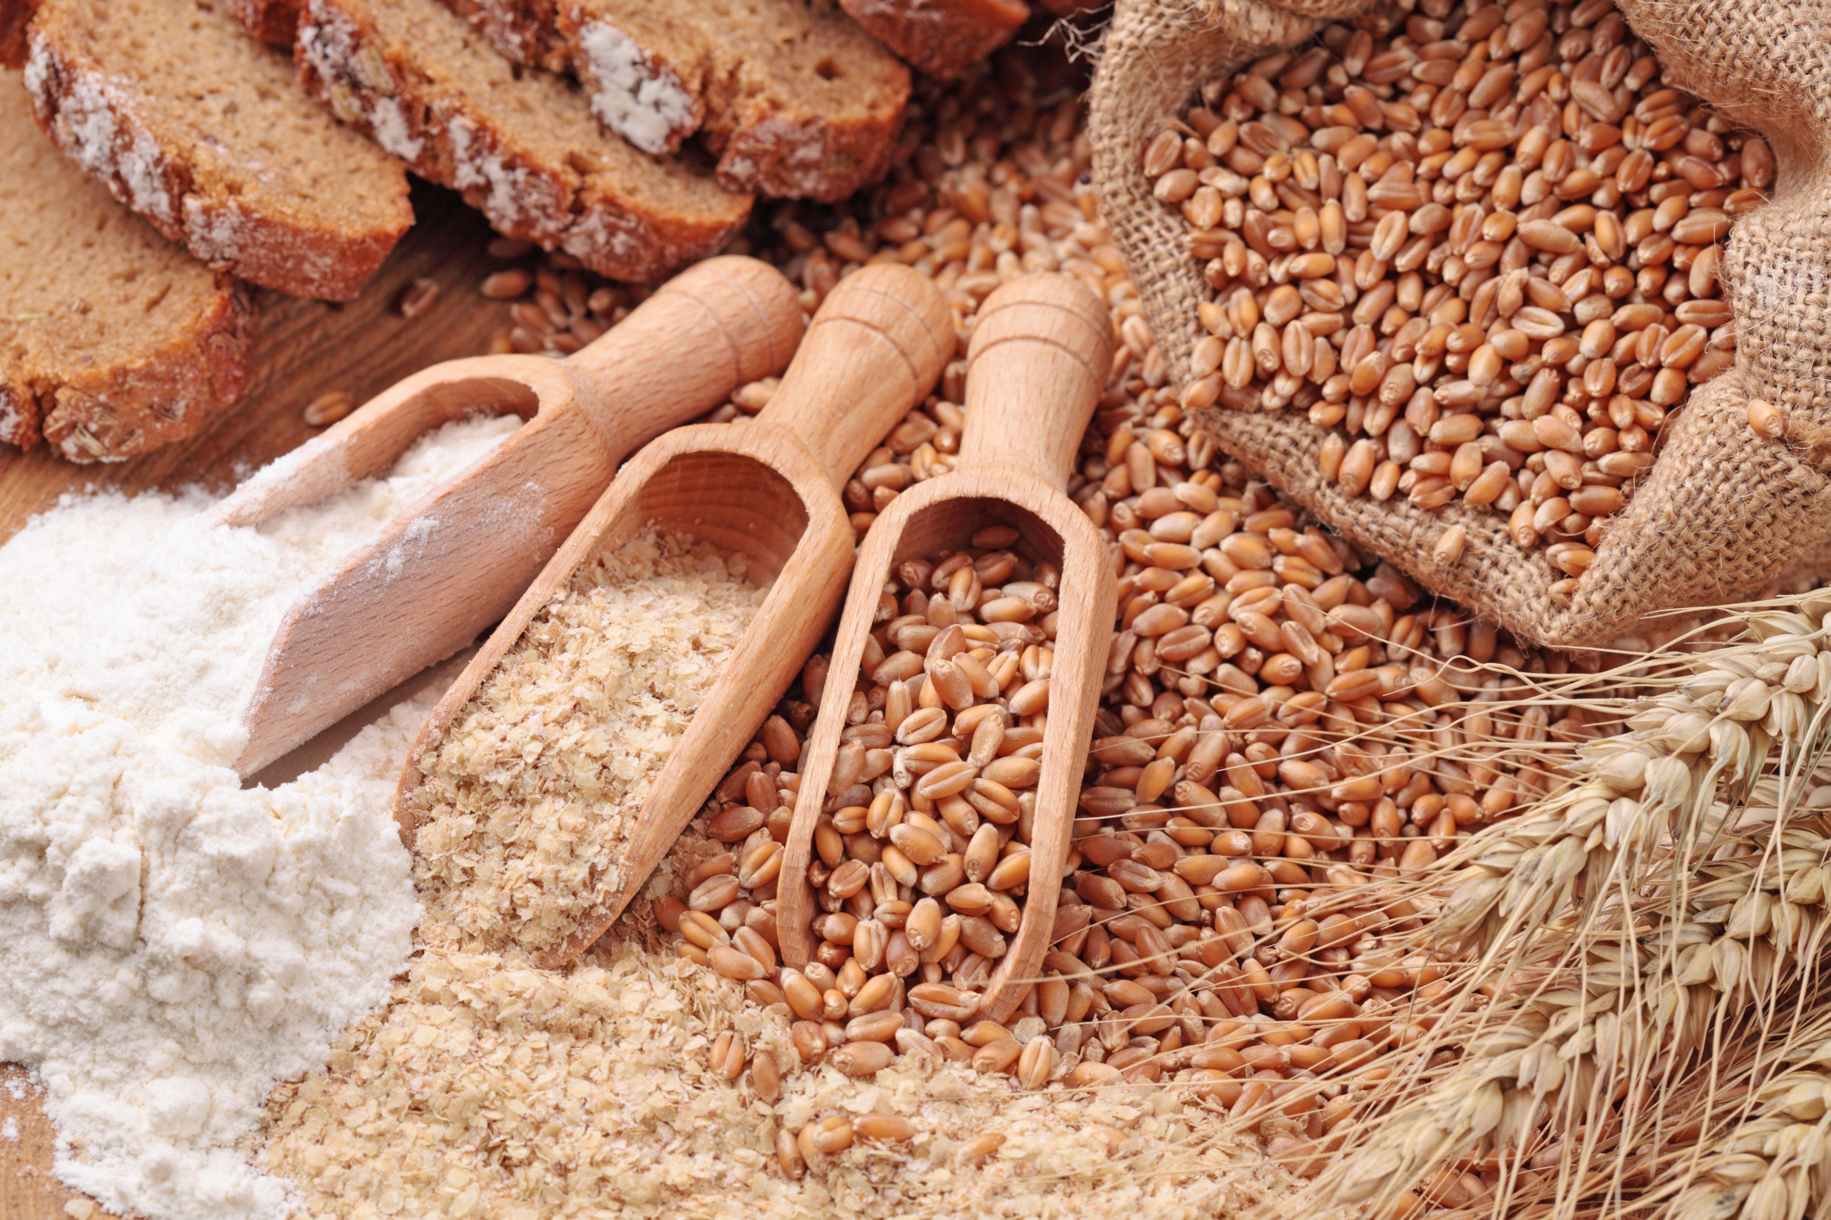
To add variety
Processing foods provides the consumer with a wider choice.
Processing food can modify the:
flavour;
texture;
smell;
colour;
shape.

Slide 14

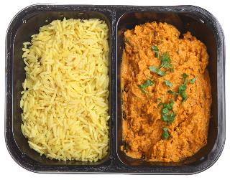

Convenience
Consumer demand and lifestyle choices has led to the development of a wide variety of convenience and fast food.

Slide 15
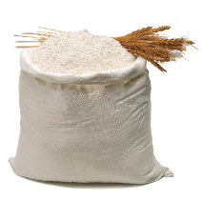
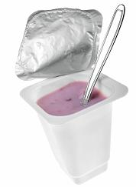
Consumer health
Health concerns within the population has led to an increased demand for healthier food choices, e.g. lower salt, fat and/or sugar.
Food products are also sometimes fortified to improve the nutritional profile. Nutrients may be added to products to:
replace nutrients lost during food processing;
add extra nutrients that would not normally be present, e.g. added fibre in yogurt;
produce a substitute product with similar nutritive value.

Slide 16
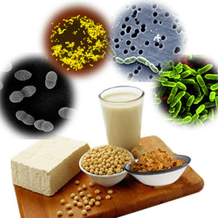
Functional food
Innovation in food processing has also led to the development of functional food.
A functional food provides benefits over and above their basic nutritional value. Examples include:
dairy products containing probiotic bacteria;
cholesterol lowering spreads, drinks and cereal bars;
Omega 3 eggs;
other functional foods or drinks fortified with a nutrient that would not usually be present to any great extent, e.g. folic acid fortified bread or breakfast cereals.

Slide 17
Food processing
For further information, go to:
www.foodafactoflife.org.uk
This resource meets the Guidelines for producers and users of school education resources about food.

