Slide 1
Food safety

Slide 2
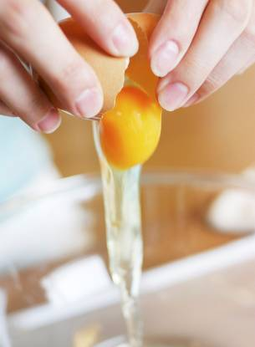
When cooking
It is important to ensure that good practice in food safety and hygiene is being followed to avoid accidents and any risk of food poisoning.

Slide 3
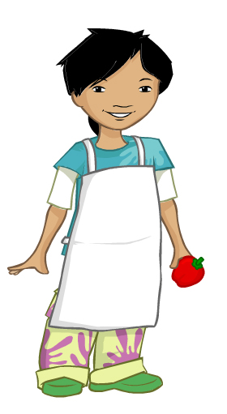
Personal hygiene
Tie back long hair.
Roll up long sleeves.
Wear an apron.
Remove jewellery.
Wash your hands.

Slide 4
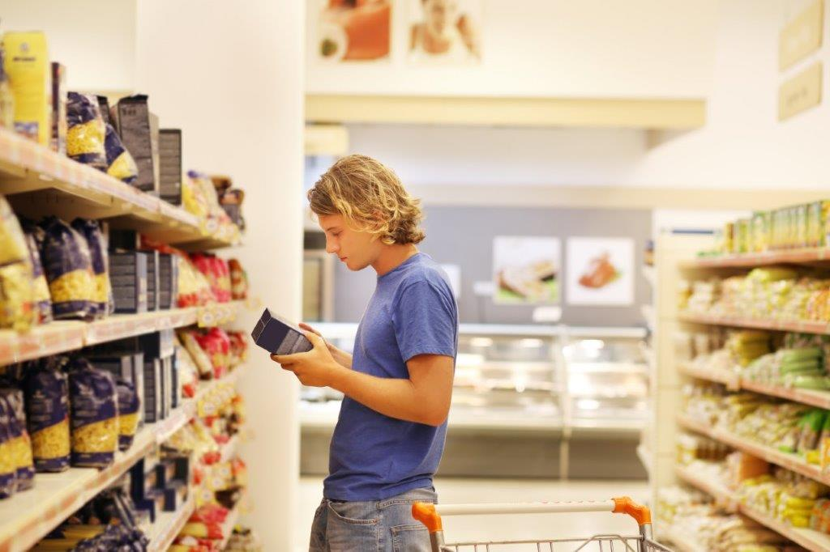
Storing foods
Read the labels – check the date marks and storage instructions.
Store foods in the right place and eat within the date mark.

Slide 5
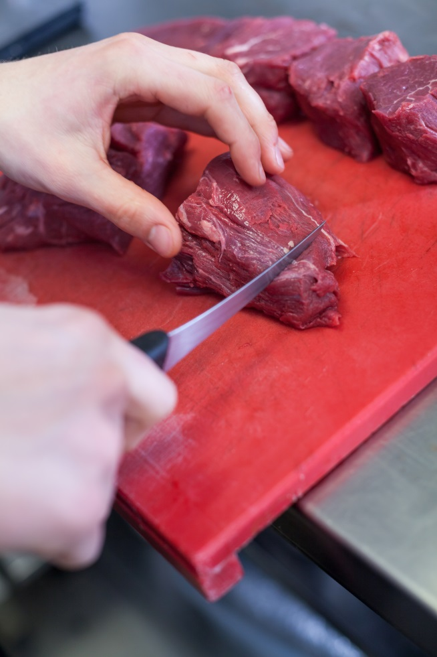
Avoiding cross-contamination
Do not use the same equipment for raw and cooked foods.
Keep raw and cooked foods separate, e.g. raw meat and bread.

Slide 6
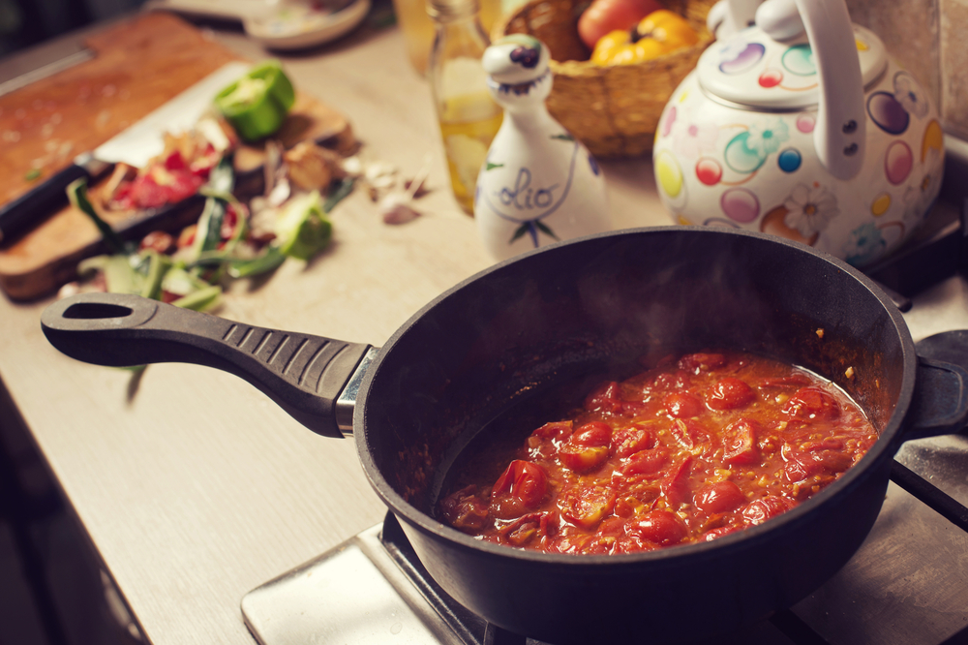
Heating and reheating safely
Check that food is properly cooked.
When reheating, make sure the food is piping hot.
Only reheat the food once.

Slide 7
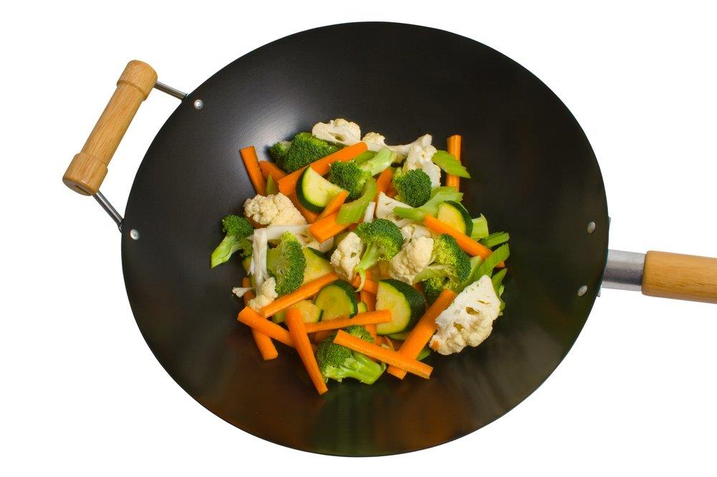
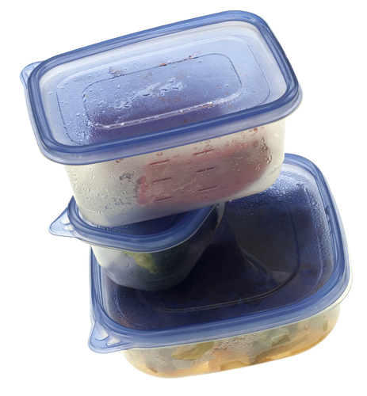
Storing cooked food
Cool down the food as quickly as possible.
Place food into a suitable container.
Label the food.

Slide 8
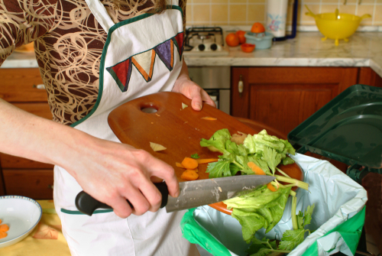
Waste
Make sure you have a bin nearby when you cook.
Collect food waste on newspaper or in a bowl on the table – place in the bin or compost after you have cooked.
Recycle used food packaging.

Slide 9
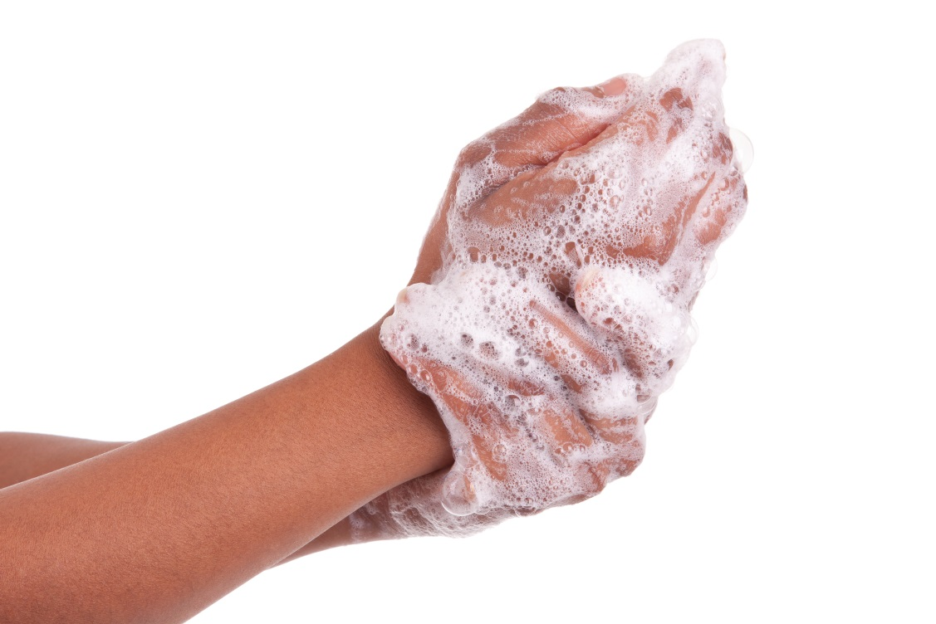
Cleaning and washing-up
Keep your cooking area clean and tidy throughout.
If you’ve got time to lean, you’ve got time to clean!
Wash up equipment in hot soapy water

Slide 10
Food safety
For further information, go to:
www.foodafactoflife.org.uk
This resource meets the Guidelines for producers and users of school education resources about food.

