Slide 1
Zero waste, full taste

Slide 2
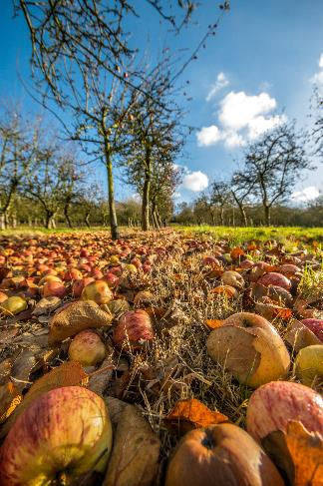
What is food waste?
About one third of all food is lost or wasted.
Food loss is food that is lost before it even makes it to stores.
Food waste is what we waste at home or in stores.
Finding ways to reduce food waste at home doesn’t only have environmental benefits but could also save money, because less food would need to be bought.

Slide 3
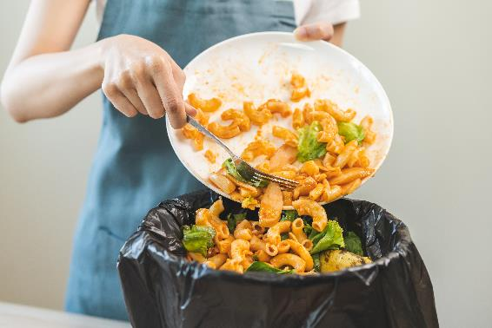
Food waste
Food waste in the UK generates approximately 25 million tonnes of greenhouse gas emissions annually, contributing to climate change.
The average household spends £470 on food that ends up in the bin every year
The UK produces the largest amount of food waste in Europe
WRAP estimates that 70% of food waste comes from households
Food waste statistics

Slide 4

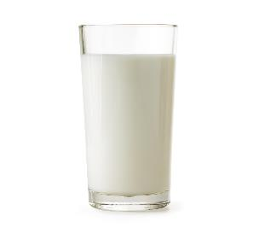
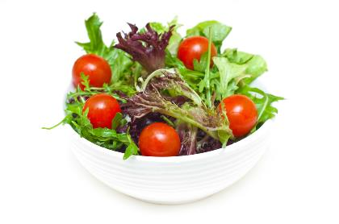
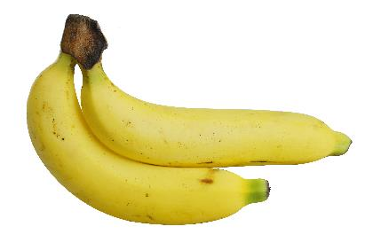
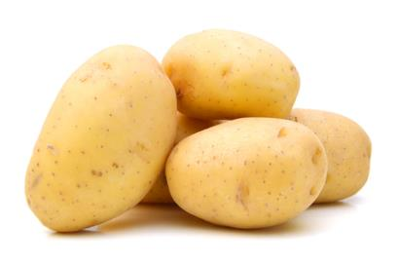
Top 5 wasted foods in the UK
1.
2.
4.
Milk can spoil if not stored correctly.
5.
Consumers do not understand best before dates and bread is thrown away while still edible.
Bread has been stored incorrectly and has gone hard.
Bread has been stored too long as has gone mouldy.
3.
Fruit and vegetables not stored correctly.
Large pack sizes encourage consumers to buy more than needed.
Consumers cook too large a portion, and leftovers get thrown away.
Food waste statistics

Slide 5
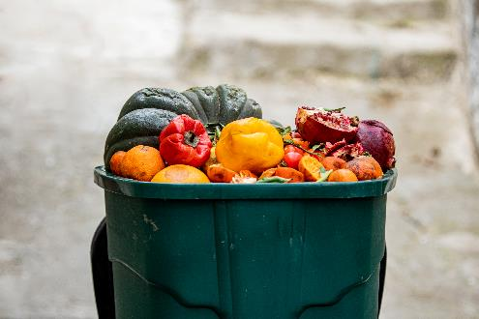
Reducing food waste
Reducing food waste is a priority for both the economy and environment. The Courtauld Commitment 2030 aims to reduce UK food waste by 50% by 2030.
When food waste goes to landfill, it rots and during the process methane gas is produced. Methane is a greenhouse gas and contributes to global warming.
Consumers should use food waste bins wherever possible to avoid excess food waste ending up in a landfill.
Ethically, it is challenging- despite the amount of food wasted there are an increasing number of people who are in food poverty and rely on food banks.

Slide 6
How can we reduce food waste?
Think before you shop: What do you actually need?
Stay in control of your shopping: Write a shopping list.
Storing food after shopping: Store food correctly so it stays freshers for longer.
Keep an eye on fresh food: Eat me first shelf in fridge.
Eat every edible morsel: Eat all edible parts, make your own stock.
Planning to stay ahead: Create a realistic meal plan for the week ahead.
Love food, hate waste

Slide 7
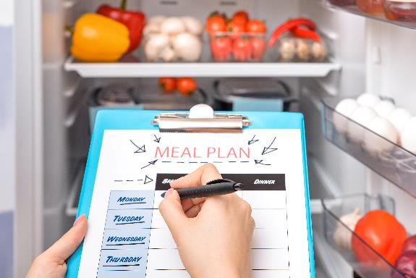
Meal planning
Meal planning can help to reduce food waste, prevent impulse buying and help budget weekly money.
Create a meal plan for the week ahead and then make a shopping list.
Check your fridge, freezer and cupboards before creating your meal plan. Is there any food which you can use up before purchasing more?
Consider the recipes you chose in your meal plan- could the leftovers be used to create a new dish?
Refer to the Eatwell Guide for recommendations to help ensure you are planning balanced meals across the week.

Slide 8
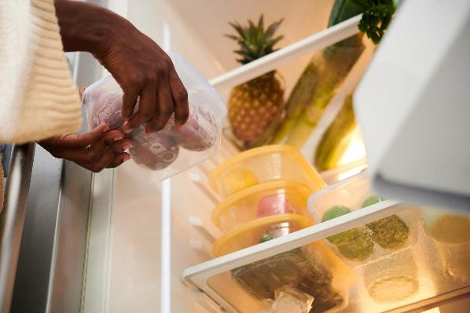
Transforming leftovers
To reduce food waste, we can use leftovers smartly. Leftover ingredients can be used to create an exciting range of dishes.
When using leftovers, it is important to consider food hygiene precautions:
Leftovers should be stored correctly, e.g. in the fridge below 5°C;
Unless frozen, they must be used withing 48 hours;
Rice dishes should be eaten within 24 hours;
Leftovers should only be reheated once.

Slide 9
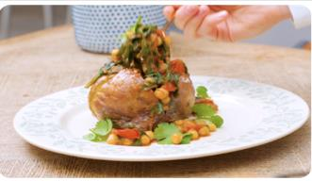
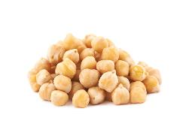
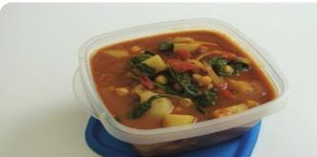
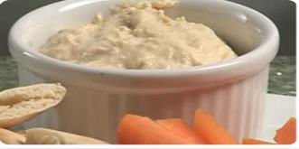
Top tips
Deliberately create leftovers - cook extra vegetables and make a soup for lunch later in the week.
Make double the quantity of your evening meal and take the rest for lunch the next day.
Don’t throw away stale bread - whizz in a food processer to make breadcrumbs and freeze.
Make extra pasta and make a salad for your lunchbox.
Freeze unused wraps, pitta and sliced bread.
If eggs are nearing their best-before-date date, separate and freeze
Freeze tubs of baking fat to prevent it going off before you next want to bake.
Spicy chickpea jacket potato
Leftover chickpeas
Spinach, potato and chickpea curry
Hummus

Slide 10
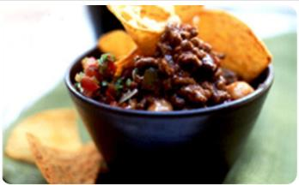
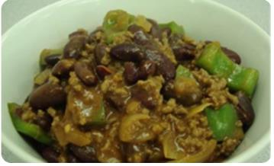
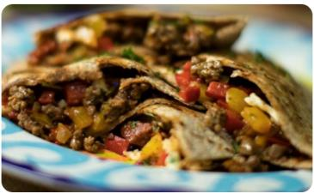
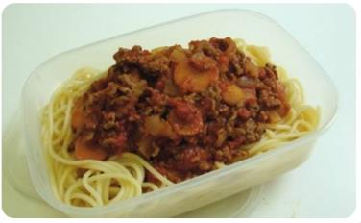
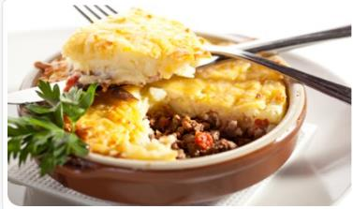
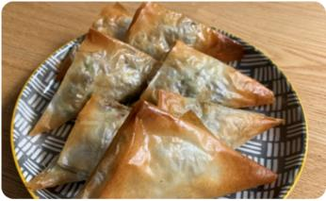
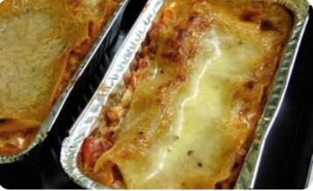
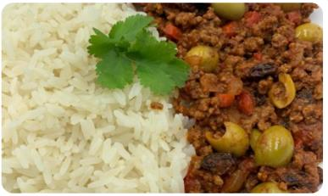
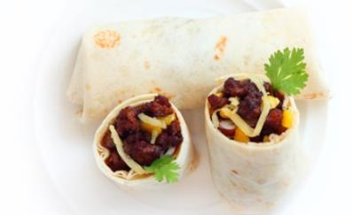
Bolognaise and beyond
Beef nachos
Chilli con carne
Beef quesadilla
Beef samosas
Spaghetti bolognaise
Cottage pie
Beef lasagne
Mexican beef burritos
Picadillo

Slide 11
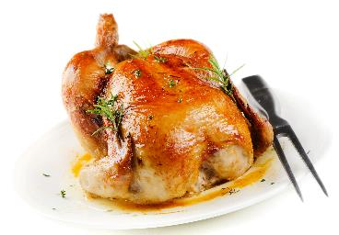
How can you transform these leftovers?
Roast Chicken

Slide 12
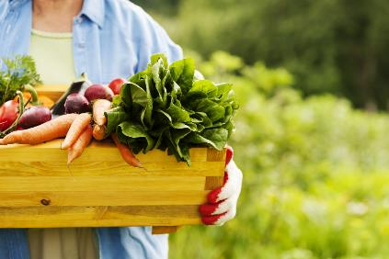
Task: Can you transform your leftovers?
You have been given a mystery box of ingredients.
The challenge is to create a meal using only the ingredients in your mystery box along with some kitchen basics, e.g. oil, spices, stock cubes.
The rules:
You must use 80% of the ingredients in the mystery box.
Where possible, make use of every edible part of the ingredient, e.g. stems or peels.
You can choose to add one or two ingredients of your choice, e.g. milk or eggs. But the focus is on minimising waste!
You must cook and serve your meal or dish within the time provided.

Slide 13
Zero waste, full taste
For further information, go to:
www.foodafactoflife.org.uk
This resource meets the Guidelines for producers and users of school education resources about food.

