Slide 1
Physical and chemical changes: Making and melting butter

Slide 2
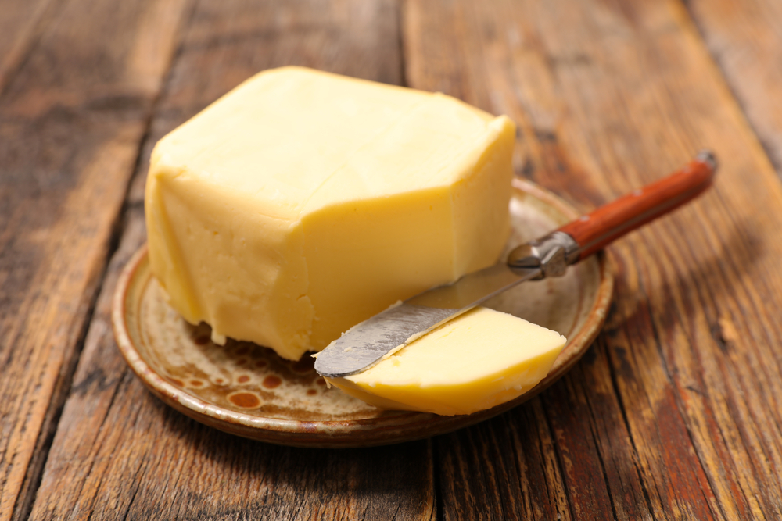
Starter
Where does the butter come from?
What nutrients are found in butter?
What is butter used for?

Slide 3

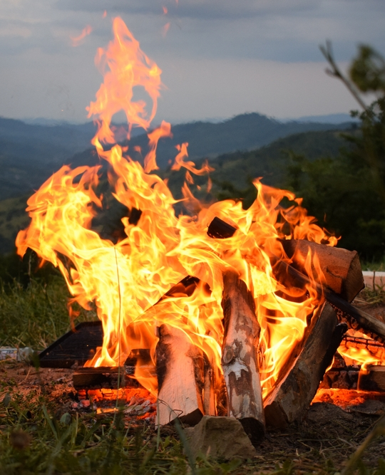
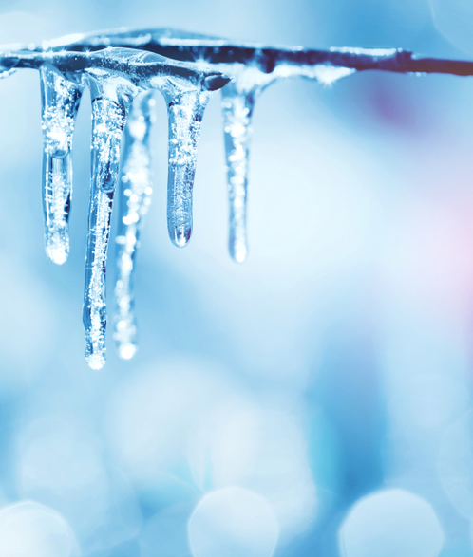
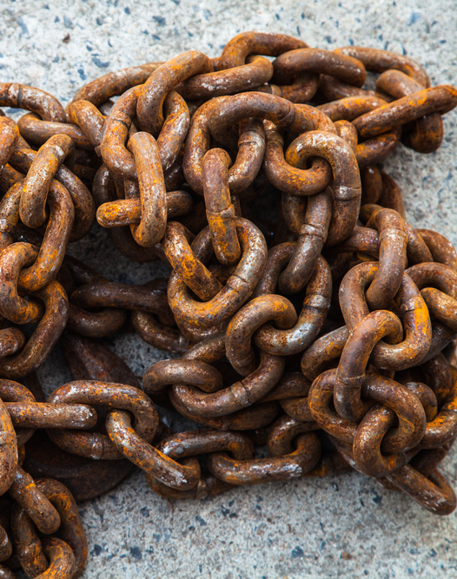
There are physical and chemical reactions
Have a look at the following reactions.
Consider: Can you get back what you started with? (Reversible) Or is it changed forever? (Irreversible)

Slide 4
There are physical and chemical reactions
Have a look at the following reactions.
Consider: Can you get back what you started with? (Reversible) Or is it changed forever? (Irreversible)
Reversible
Irreversible
Reversible
Irreversible

Slide 5
There are physical and chemical reactions
Physical Reaction
A reaction that is reversible (this means you can change it back).
Chemical reaction
A reaction that is irreversible (this means that you can’t change it back).
Examples of physical changes including boiling, melting, freezing.
Chemical changes include burning, cooking, rusting, and rotting.

Slide 6
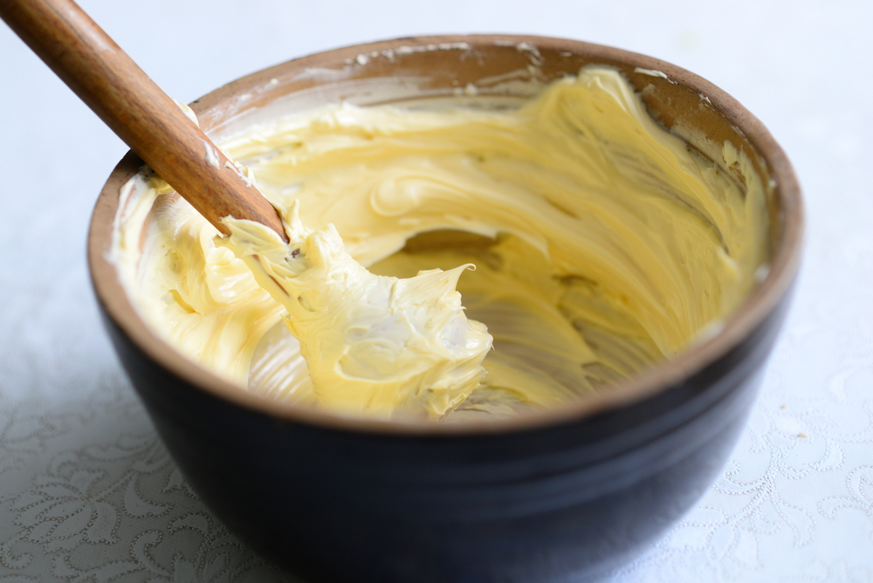
Butter: Melting and Making
Today we are going to look at melting butter and making butter.

Slide 7
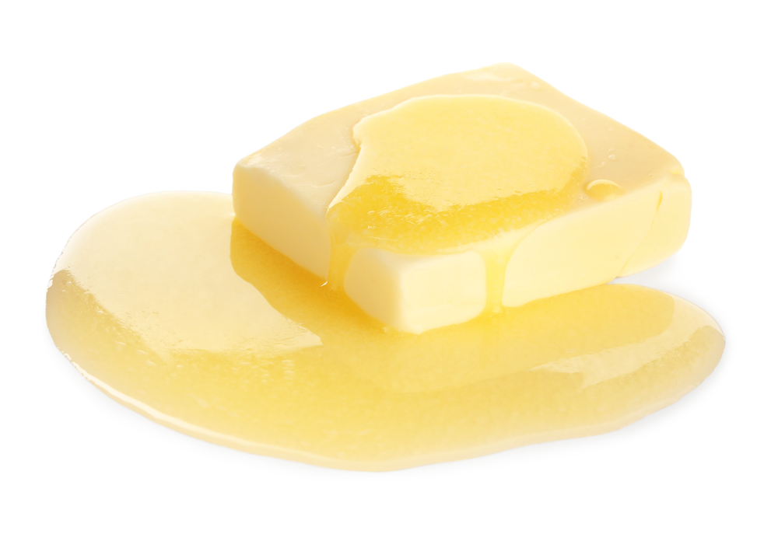
Butter: Melting demonstration
Was heating and melting the butter a chemical or physical change?
What if the butter starts to burn?
Explain your answers.

Slide 8
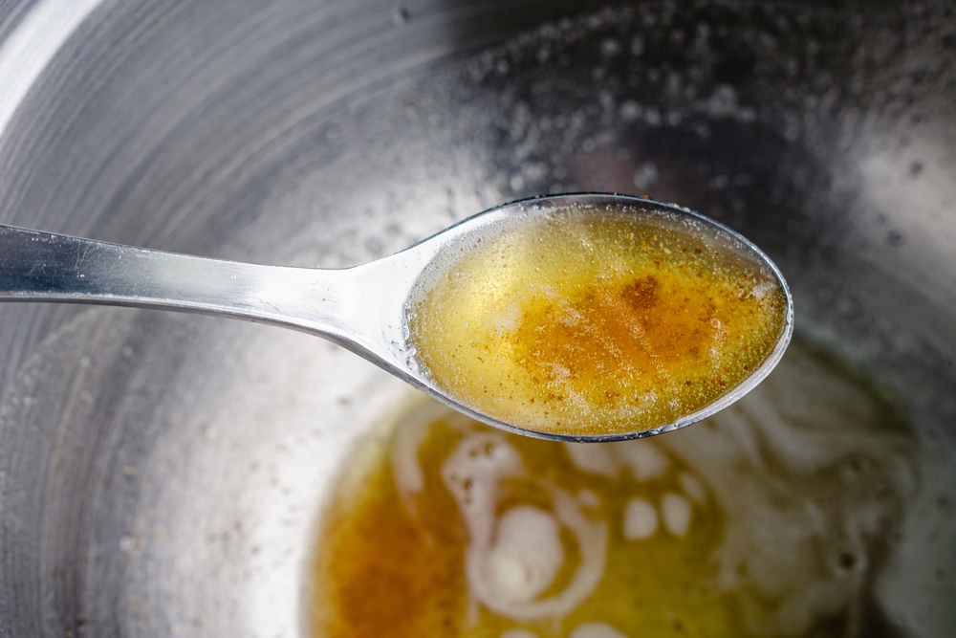
Butter: Melting and Making
If butter is melted to become a liquid, it is a reversible change because it can become solid again by freezing.
If the butter is continually heated until it burns, a chemical change happens which means it is an irreversible change.
Physical
Chemical

Slide 9
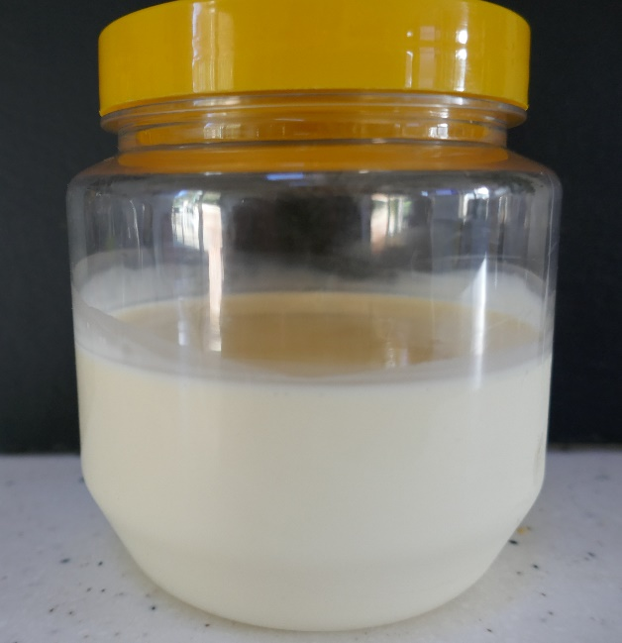
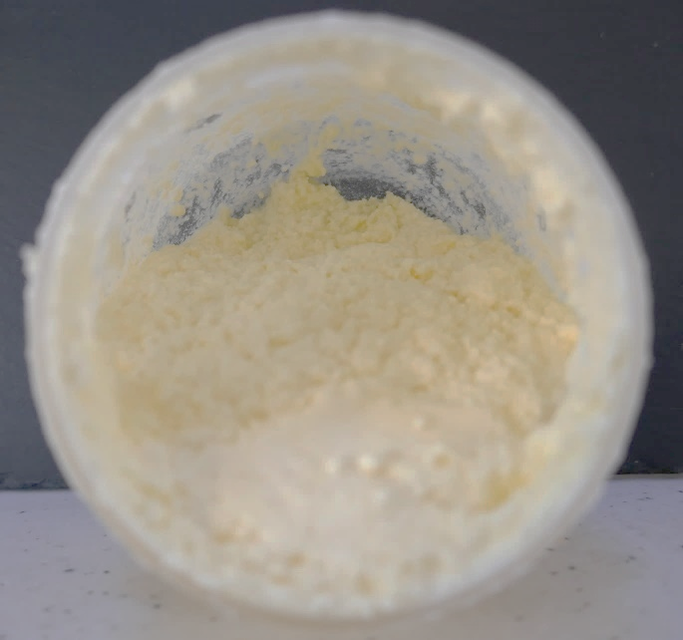
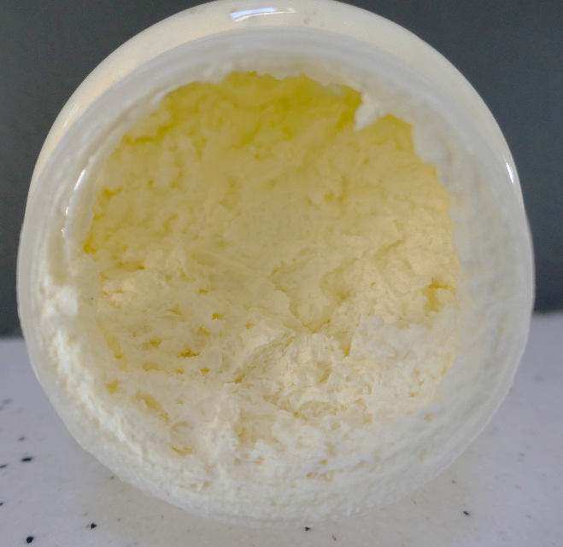
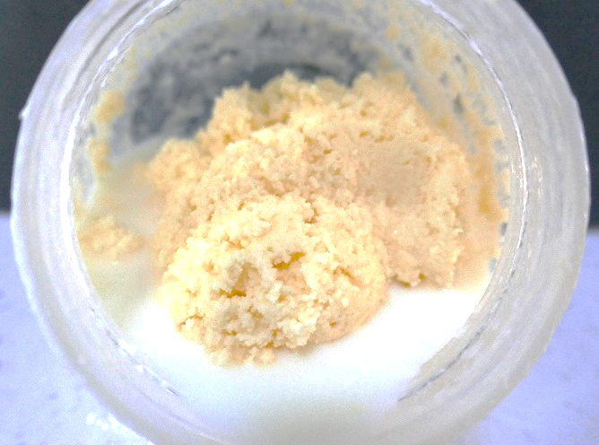
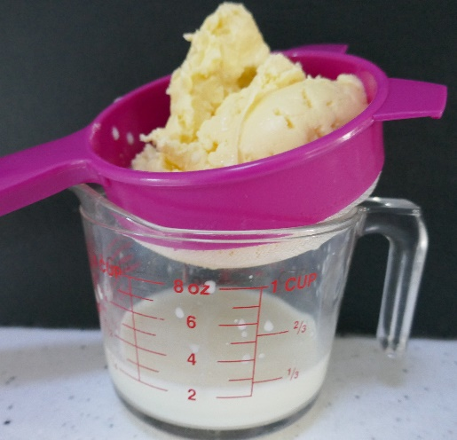
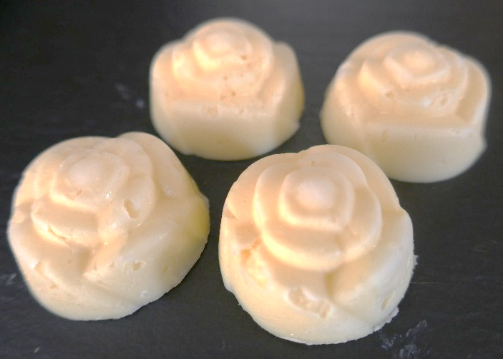
Practical: Making butter
Instructions
Weigh the empty container (a plastic screw top jar.
Pour in 125ml double cream, weigh the cream in the jar.
Screw on lid.
Shake until you hear the butter has split.
Drain.
Weigh the butter produced.
Press into moulds, chill.
Thecookeryteacher.com

Slide 10
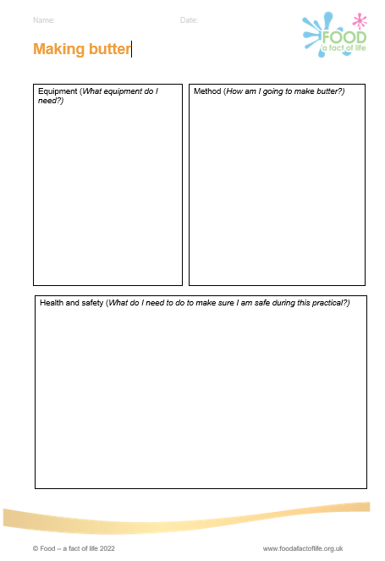
Practical
Complete the worksheet with the equipment you are going to need, the method to make butter and how you are going to stay safe.

Slide 11
Practical: Making butter
Was making the butter a chemical or physical change?
Explain your answer.

Slide 12
Physical and chemical changes
Physical change | Chemical change​
Can be reversed | Cannot be reversed
No new material formed | New material formed (that are different to starting materials)
Change in state | Often a colour change

Slide 13

Tweet about it
Summarise what you have covered today in 140 characters (that’s letters, numbers, punctuation AND spaces!)

Slide 14
Key words
Key word​ | Meaning​
Physical reaction | A reaction that is reversible (this means you can change it back)
Chemical reaction | A reaction that is irreversible (this means that you can’t change it back)

Slide 15
Teachers’ guide

Slide 16
Teaching about butter
Explain the difference between a chemical and physical reaction and give examples of each.
Ask 3 things that indicate a chemical reaction has happened.
Ask 3 things that indicate a physical reaction has happened
Plan and carry out a practical activity.
Consider safety within a practical activity.

Slide 17
What happens as butter is formed?
Creaminess is a sensory factor, an emulsion of lots of tiny fat globules suspended in a small amount of liquid.
Butter can be made by the simple process of whipping cream – but it’s a different route than that of churning.
Whipped cream is a foam – air bubbles trapped between fat molecules suspended in liquid. During whipping the fat molecules collide and thicken the foam.
If cream is overwhipped the fat membranes are damaged and the fats join together forming bigger fat blobs. These push out the air from the foam and the mixture deflates.
Butter curds appear firstly as ‘curdles’ and then if whipping continues as larger pieces of butter. Buttermilk is released as a watery fluid. This is irreversible.

Slide 18
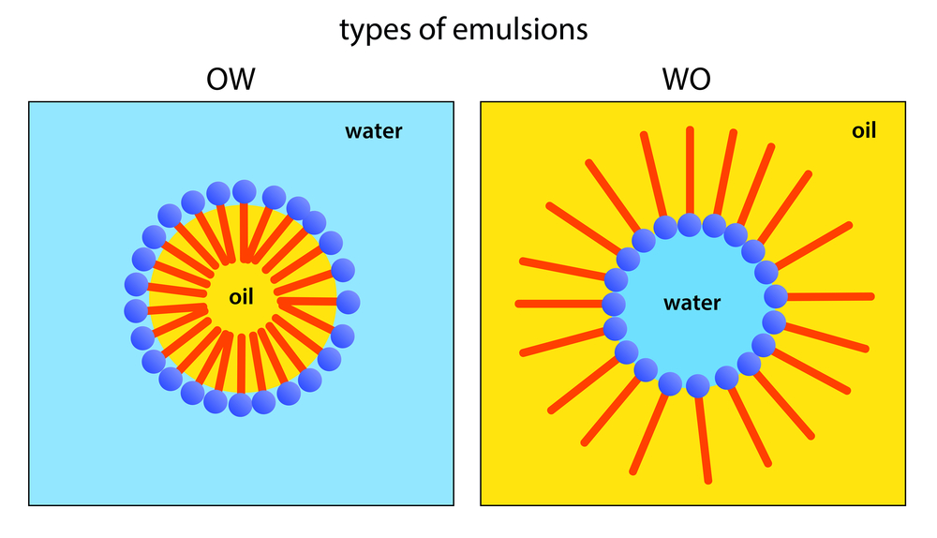
Emulsions in butter and milk
Butter
Milk
Water in oil (fat) emulsion
Oil in water emulsion

Slide 19
The science of making butter
Butter can be made in a food processor, using a hand mixer or in a jar. The key is agitation.
Cream that is agitated (whisked) incorporates air and becomes thicker.
Continued agitation causes the little globules of fat to collide, damaging their walls and allowing the hydrophobic (water-fearing) regions to clump together.

Slide 20
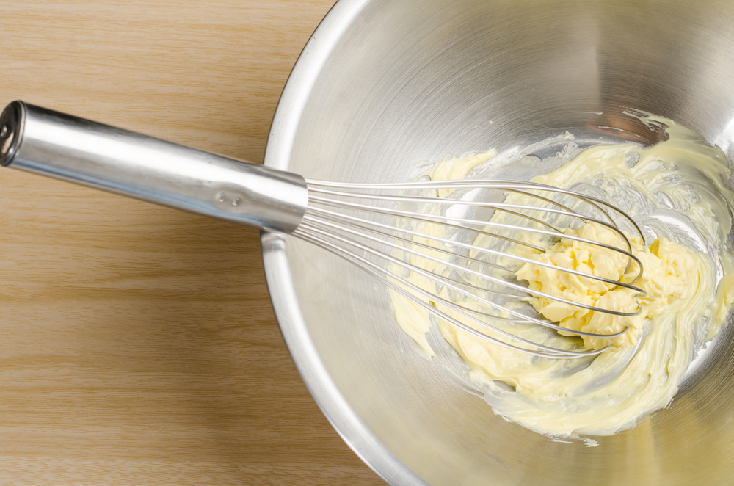
The science of making butter
Fatty triglycerides gather into a mass of butter, separating from the buttermilk (watery liquid).
Incorporated air is expelled, two phases remain - fat and buttermilk.
Butter is 82% fat.
It is a water in oil emulsion.

Slide 21
Physical and chemical changes: Making and melting butter
For further information, go to:
www.foodafactoflife.org.uk
This resource was produced for the pHood Futures project, supported by the Royal Society of Chemistry.
This resource meets the Guidelines for producers and users of school education resources about food.

