Slide 1
Factors affecting food choice

Slide 2

Factors affecting food choice
All around the world, people choose to eat different food for many different reasons, such as:
individual energy and nutrient needs;
diet and health;
religion and culture;
cost of food;
food availability.

Slide 3
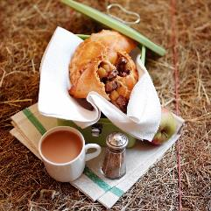
Factors affecting food choice
Different reasons for choosing food also include:
time of day and occasion;
food preferences;
social considerations;
environmental considerations;
advertising and other point of sale information.

Slide 4


Individual energy and nutrient needs
The amount of energy and nutrients needed differs between age groups and between males and females.
Energy needs also depend on activity levels.
Athletes, for example, have much higher energy requirements as they are more physically active.

Slide 5
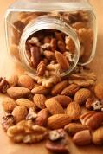
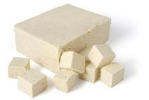
Diet and health
People may choose the food they eat based on their own or their family’s health concerns or for medical reasons.
This could include:
diabetes;
allergies, e.g. nuts;
intolerances, e.g. gluten (coeliac disease) or lactose;
vegetarian;
vegan;
weight loss or gain.
Where would you find information about potential allergens in food?
Why is this important?

Slide 6


Religion and culture
Food is an important part of observance for many different religious beliefs and cultures.
All over the world many people choose to eat or avoid certain foods according to their religious beliefs.

Slide 7
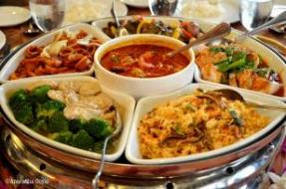
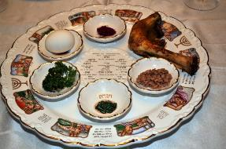
Religion and culture
Religions and beliefs which have particular food restrictions or celebrations involving food include:
Christianity;
Islam;
Hinduism;
Judaism;
Sikhism;
Buddhism;
Seventh-day Adventist Church;
Rastafari Movement.

Slide 8
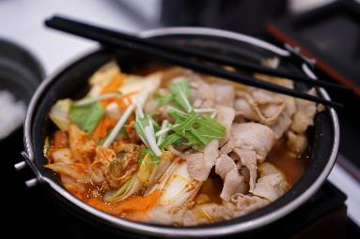
Cost of food
The cost of food and money available will influence people’s food choices.
If money is limited, people may choose to buy more basic items. Luxury items might then be used for special occasions.
Food prepared at home is often cheaper than eating out, buying take-away or ready prepared food.

Slide 9
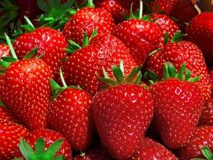
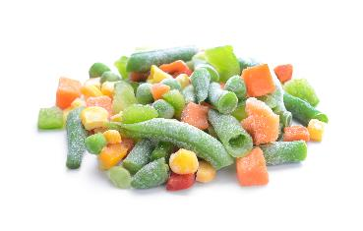
Food availability
Most foods are grown in a particular season of the year, e.g. strawberries are harvested in summer. These are called ‘seasonal foods’.
Buying foods when they are in season will often ensure the food price is lower.
Technology and the importation of food, however, has allowed food to be available all year round.
Frozen foods such as vegetables are a great alternative to fresh, if they are unavailable.

Slide 10
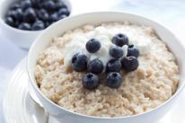

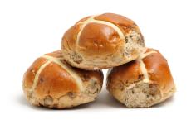
Time of day and occasion
The time of day will influence food choice – people may not eat the same for breakfast as they would for their main meal of the day.
The occasion will also impact on food choice – this could be a celebration such as a birthday or wedding or maybe a religious occasion such as Christmas or Passover.

Slide 11


Food preferences
Not everyone likes the same food.
The taste, odour, appearance, shape and colour of food can affect people in different ways.
Which senses do we use when making our food choices?

Slide 12
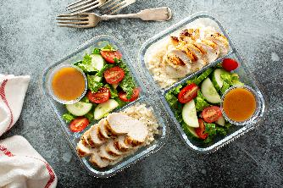
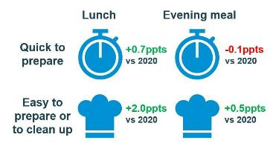
Social and economic considerations
Lack of competence and confidence in the kitchen – people may choose to buy ready-made, frozen or dried foods that are easy to prepare and cook and that require only basic cooking skills.
Lack of time – many people work long hours and either haven’t got the time or do not wish to spend time cooking at home. Both lunch and evening meal average cook times have been decreasing since 2021, averaging 8.6 mins for lunch and 27.1 mins for evening meal preparations in 2024
Source: AHDB

Slide 13
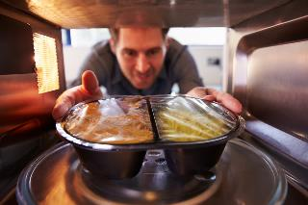

Social and economic considerations
Development of ready meals – because people lack time and have labour saving equipment (such as microwaves) the amount and range of convenience foods has grown.
Smaller households – an increasing number of people now live alone and this may well affect their food choices.
In 1960, 40% of households were 1-2 people and in 2016, this had risen to 63%.
By 2027, more than a third of the population will be over 60.
Source: ONS/Kantar Worldpanel Usage

Slide 14
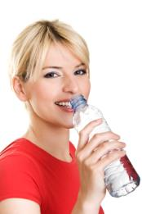
Social and economic considerations
Body image and peer pressure can both influence the food that people choose to buy, cook and eat.
A balanced diet, together with regular physical activity, can help to maintain a healthy weight. Eating the right balance of a wide range of foods provides most people with the energy and nutrients that they need to stay healthy.

Slide 15
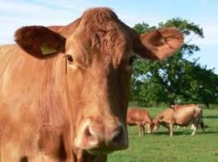
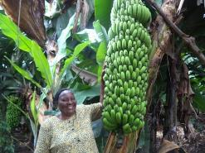
Environmental and ethical considerations
Human and animal welfare along with fair trading, scientific intervention in the food chain and the impact of food production on the environment can be of a high social concern for some people.
Some considerations when buying food might be:
fair trading – ensuring that farmers in less economically developed countries get a fair deal;

Slide 16
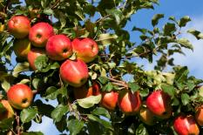

Environmental and ethical considerations
local foods – buying locally supports local business and farmers and some believe that food produced locally is more sustainable;
seasonal food – this can be fresher, tastier and more nutritious than out of season food;
genetically modified (GM) food – scientific intervention is used to change a plant, animal or micro-organism’s genes or to insert one gene from another organism;

Slide 17
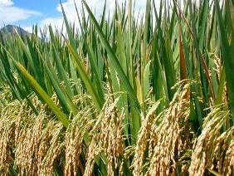
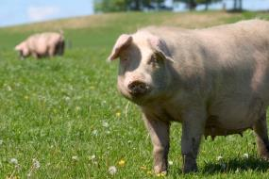
Environmental and ethical considerations
organic food – food sold as ‘organic’ must come from growers, processors and importers who are registered and approved by organic certification bodies, which are shown on the food label;
free range – animals are allowed to roam freely outside: this food may be more expensive.

Slide 18
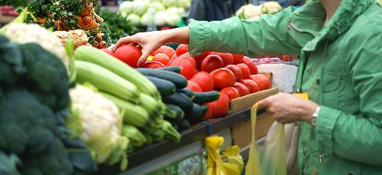
Food provenance
Food provenance means where ingredients and the foods made from them originally come from.
Many consumers want to know where their food originated.

Slide 19

Food provenance
Protected Geographical Indication (PGI)
Products which must be produced, processed or prepared within the geographical area and have a reputation, features or certain qualities attributable to that area.

Slide 20

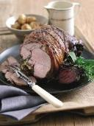
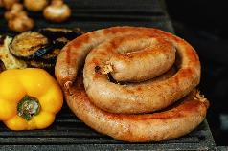
Food provenance
Protected Geographical Indication (PGI)
Two British products with PGI are:
Welsh lamb – Welsh lamb is derived from the sheep breeds of Wales and lambs are raised extensively on grassland.
Traditional Cumberland Sausage - is a spiral coil shaped seasoned pork sausage. Its most distinctive feature is that, unlike other sausages, it is not linked but long and coiled.

Slide 21

Food provenance
Traditional Speciality Guaranteed (TSG)
Products which are traditional or have customary names and have a set of features which distinguish them from other similar products.
These features must not be due to the geographical area the product is produced in nor entirely based on technical advances in the method of production.

Slide 22
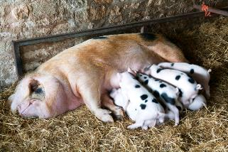
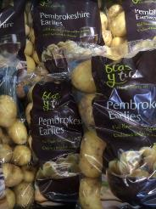
Food provenance
Traditional Speciality Guaranteed (TSG)
Two examples of British products with TSG are:
Gloucestershire Old Spots Pork - the first breed of any species in the world to be awarded TSG status.
Pembrokeshire earlies – Welsh potatoes that are harvested earlier than many other UK varieties, usually in the first week of May.

Slide 23

Food provenance
Protected Designation of Origin (PDO)
Products which are produced, processed and prepared within a particular geographical area and have a reputation, features or certain qualities attributable to that area.

Slide 24
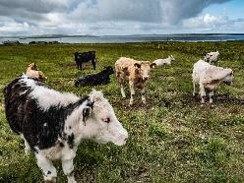
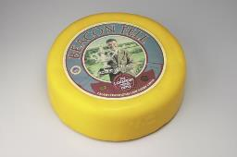
Food provenance
Protected Designation of Origin (PDO)
Two examples of British products with PDO are:
Orkney beef – a feature of Orkney Beef farming is the widespread use of Aberdeen Angus and Shorthorn cross breeding cows which give the beef its distinctive characteristics.
Beacon Fell Traditional Lancashire cheese - made exclusively in the Preston area from local milk which is pasteurised. Cylindrical shaped cheese made from the curd of two or three days. The cheese is lightly pressed for 2 days, waxed or buttered or cloth bound and is fully mature at 6 months.

Slide 25

Food assurance schemes
Red Tractor
Red Tractor assurance standards cover food safety, animal welfare, environmental protection and traceability. The Red Tractor logo tells the consumer that the food has been checked every step of the way and can be traced back to the farm source.
The Red Tractor logo appears on these products:
meat - beef, lamb, pork, chicken, turkey;
dairy - milk, cheese, cream;
cereals and flour;
fruit, vegetables and salads;
sugar.

Slide 26
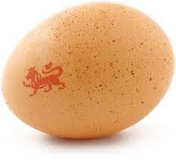
Food assurance schemes
The British Lion mark
A quality code of practice that ensures eggs have been produced to the highest standards of food safety.
The code covers the entire production chain and ensures strict food safety controls including the guarantee that all hens are vaccinated against Salmonella and a ‘passport’ system ensuring that all hens, eggs and feed are fully traceable.

Slide 27

Food assurance schemes
Marine Stewardship Council
The MSC is used to assess if a fishery is well managed and sustainable.
The Standard has three core principles:
sustainable fish stocks;
minimising environmental impact;
effective fisheries management.
The MSC logo can be used on fresh fish counters, packaged fish products and restaurant menus.

Slide 28
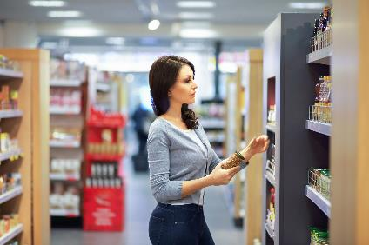
Advertising and other point of sale information
Advertisements encouraging people to choose certain foods often appear in the media.
Point of purchase information and product placement are strategies often used to provide information to consumers.

Slide 29

Other sources of information
There are many sources of information to help people when making food choices:
Department of Health;
NHS Choices;
British Nutrition Foundation – www.nutrition.org.uk
supermarkets, food manufacturers, charities and other groups;
the media, i.e. internet, newspapers, radio, magazines and television programmes.
It is important that advice is clear, consistent and correct. Look for the Information Standards logo.

Slide 30
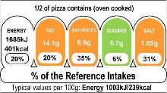
Other sources of information
Front and back of pack labels are also a good source of information to help make food choices.
Information required on the labels of pre-packed food and drink products:
name of food or drink;
list of ingredients (including additives and allergens);
weight or volume;
date mark.

Slide 31
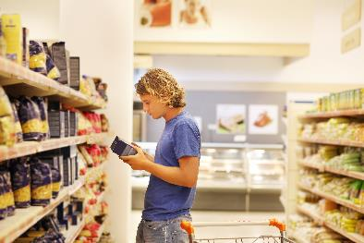
Other sources of information
Information required on the labels of pre-packed food and drink products also includes:
storage and preparation conditions;
name and address of the manufacturer, packer or seller;
country of origin and place of provenance;
nutrition information.

Slide 32
Factors affecting food choice
For further information, go to:
www.foodafactoflife.org.uk
This resource meets the Guidelines for producers and users of school education resources about food.

