Slide 1

Food skills, recipes and diversity Eastern Asian cuisines 6 April 2022
@foodafactoflife

Slide 2
Housekeeping and overview
Good food hygiene and safety practices - are you ready to cook?
Long hair tied up.
Jumpers removed/long sleeves rolled up.
Nail varnish and jewellery/watches removed.
Thoroughly washed and dried hands.
Clean apron on.
Turn off mobile phone (pop on vibrate)
You should have all your equipment and ingredients ready/handy
Get ready to cook!
Chat box – feel free to use to ask questions and share info/links and ideas
Camera on – we want to see your food skills
Help and direction (please don’t take as criticism!)
Feel free to ask questions and engage!
Feedback – it’s good to get your views!
Tweet or post on Facebook!
Enjoy!
@foodafactoflife

Slide 3
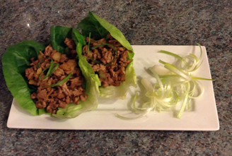
Welcome
As part of the British Nutrition Foundation’s work around a ‘modern, diverse food and nutrition education’ we asked students what was important to them about the recipes they cooked at school.
Students responded that they want dishes that are:
tasty, healthy, family/everyday recipes;
most significantly they want them to be dishes from around the world that are - modern, diverse and reflect different cultures.
Please say hello in the chat box!
The British Nutrition Foundation is grateful for the support from the All Saints Educational Trust for this work.

Slide 4
Session aims
During the session we will:
make two recipes from around the world that are new to Food – a fact of life;
use traditional ingredients and consider alternatives;
develop, acquire and secure practical food skills using recipes that are suitable and practical for schools and their budgets, promote healthier eating, reflect more global cuisine, and encourage dialogue around culture and inclusivity;
consider planning and implementing practical activities in the secondary classroom;
demonstrate good food hygiene and safety practices;
provide links to Food – a fact of life.

Slide 5
Programme
16.45 Registration
17.00 Welcome
Practical food skills, recipes and diversity – Eastern Asian cuisines
17.10 Katsu curry – activity and review
17.55 Pork yuk sung – activity and review
18.25 Review and next steps
18.30 Finish – Evaluation, certificate and voucher

Slide 6
Diversity and inclusion in Schemes of Work
Know your pupils!
Know and understand the local community, e.g. what are the challenges that young people are facing?
Understand what young people (and their families) want to make in food lessons. Not just cakes though!
Ensure recipes and practical activities build on knowledge and skill.
Incorporate different flavours, ingredients and culinary techniques and experiences to widen young people’s understanding of food and cultures around the world.
Encourage pupils to share their personal experiences around food culture, ingredients and recipes with the class or school community.
Consider healthy, sustainable diets – nutrition.org.uk
Did you know?
Some food and drink-related traditions are currently recognised by UNESCO and its Representative List of the Intangible Cultural Heritage of Humanity

Slide 7
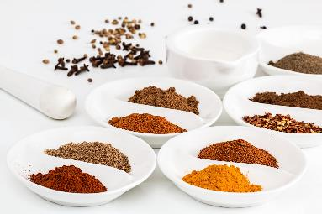
In the classroom
Consider the following:
time and budget available;
pupils - practical skills;
equipment available;
provision/availability of ingredients e.g. spices or herbs that may not be used often, vegetables that might not be readily available in your area;
involving the school/local community – there may be an ‘expert’ in a particular cuisine that could offer guidance and/or input to the lesson;
sharing the success of your pupils work through school social media, newsletters and special events such as open evening and options.

Slide 8
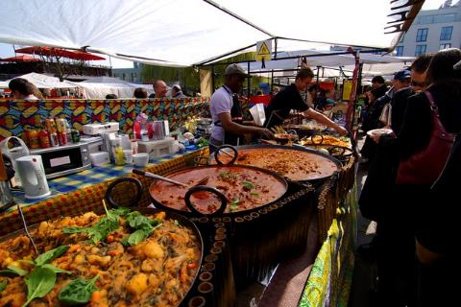
Generation Z and food culture
Globalisation has been changing the food we eat and the ways we eat those foods. But it is not new!
Food cultures are moving, and globalisation has made a wide range of cuisines more accessible.
Food culture is no longer tied down to where it originated from and can spread far and wide.
Trends:
Street food
Fusion food
Travel – trying a wider variety of cuisines
Notes:
Gen Z = born in 1997 or later - makes up a quarter of all the people going out to eat – high spending power. Organics/sustainability/plant based all feature.
A strong theme in Gen Z eating habits is authenticity and exploring exciting flavours from all over the world. Some of this may come from growing up in the same households as Gen X and Millennial foodies.
Gen Z brought up as 'digital natives' - they see and experience food around the globe – heritage and authenticity are key words.
Food trade has played a significant role in the history of globalisation, as it has allowed for cultural exchange for thousands of years. From the transporting of spices along the Silk Road, to the potatoes being imported from the Andes to Ireland in 1589 by Sir Walter Raleigh.
e.g. Italian coffee culture – worldwide verses local culture e.g. snakes, spiders

Slide 9
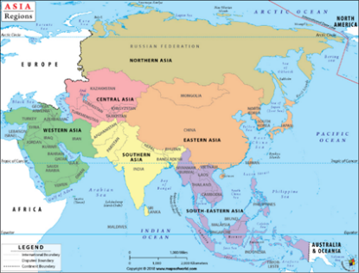
Eastern Asia cuisine
Asia can be divided into regions. These are North, Central, East, South, Southeast, and Western Asia.
East Asia includes China, Hong Kong, Japan, Macau, Mongolia, North Korea, South Korea, and Taiwan.
Being one of the most populated regions of the world East Asia has many regional cuisines.
The geography of East Asia is varied depending on the zone.
The inner continental area has a temperate climate;
Mongolia is covered by the arid Gobi Desert;
China ranges from tropical in south to subarctic in north;
Japan has many islands and coastlines.
These differences all have an influence on the cuisine of the area.

Slide 10
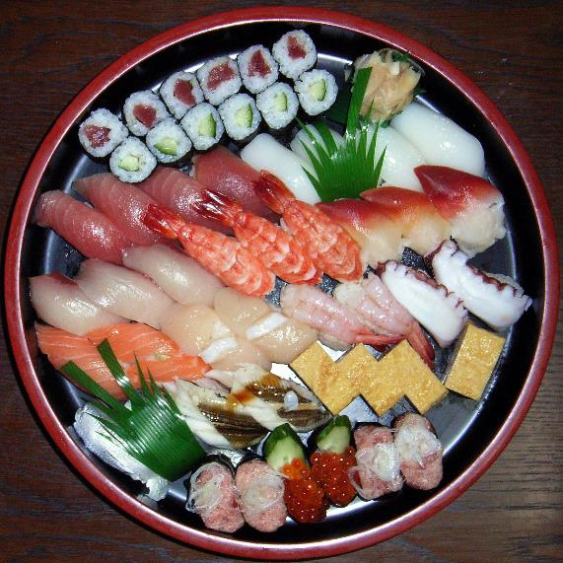
History
The countries of eastern and southeastern Asia have a culinary tradition that stretches back over thousands of years.
For example, rice was first cultivated in China in Neolithic times and still forms the basis of most East Asian cuisines.
There have been extensive inter-cultural exchanges in food culture in Eastern Asia. This has happened as a result of colonisation, wars of various scales, and, more recently, globalisation.
Notes:
The economic and cultural boundaries between countries are becoming less rigid and the gradual diffusion of different elements of national culture such as food and cuisine are some examples of this trend.

Slide 11
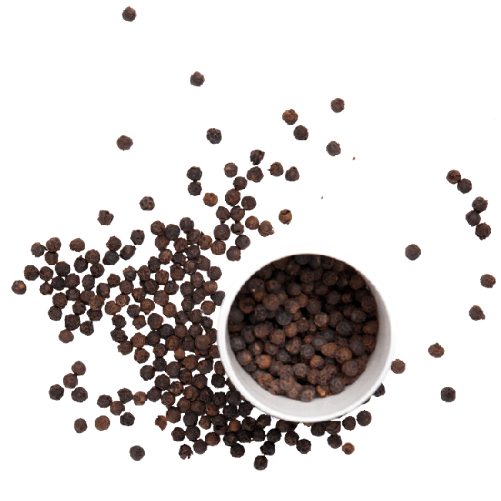
History
In 30 BC Rome, under Octavian, conquered the kingdom of Egypt.
For the next five centuries merchant ships crossed the Indian Ocean to transport pepper, ginger, cardamom, cinnamon, and other spices to Egypt’s ports on the Red Sea, eventually arriving at the central spice market in Rome.
Asian spices became an essential part of the aristocratic Roman diet, especially black pepper.
An example of the first wave of culinary globalisation.
Notes:
With the collapse of the Roman Empire, the volume of European trade in Asian spices dwindled, and prices of rare spices such as cinnamon, cloves, and nutmeg soared. Europeans never lost their taste for the flavours of Asia. The banquets of medieval European nobles were heavily spiced, not, as later generations claimed, in order to disguise food spoilage but because of the high status associated with consuming expensive Asian spices.

Slide 12
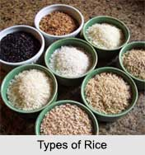
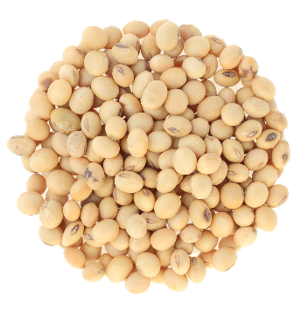
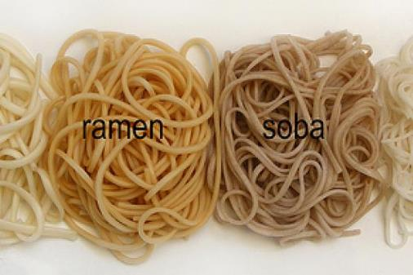
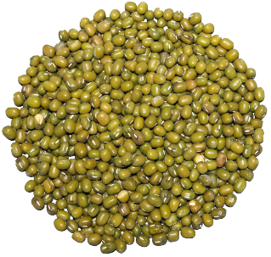
Staple food
Examples of staple foods include:
Rice - China accounts for approximately 25% of the world’s milled rice consumption and production
Noodles – popular in Eastern Asia daily diet
Mung beans
Soybeans
Burghul
Soybeans
Freekeh
Mung beans
Notes:
Virtually all of East and South East Asia is wholly dependent upon rice as a staple food
For geographic reasons, rice production is facilitated by the climate and irrigation. In Southern China and Vietnam three harvests a year are possible, whereas in Northern China, Korea, and Japan there is in one harvest. Therefore, rice through-
out history remained a more luxurious staple for commoners in these areas, relying on additional staple crops for nutritional survival. Grains like millet, sorghum, and wheat in the form of porridge and flour for noodles and dumplings were important
When milling, mixing, raising, and baking flour-dough were developed in Central Europe to make bread, Chinese ancestors discovered the possibility to also boil it in broth. From there, bǐng slowly developed into a thinner and longer shape, transforming into the noodle shapes used in East Asian cuisine today.

Slide 13
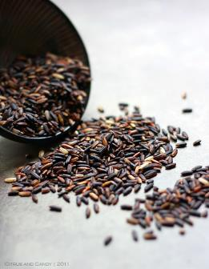
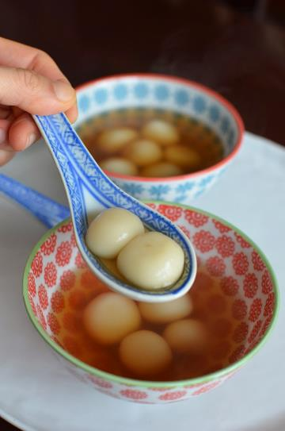
Rice
Glutinous rice is used is used in many recipes throughout Southeast and East Asia.
Also known as sticky rice, it is an umbrella term for various strains, which are processed and sold in hulled or whole-grain forms.
Available in white, maroon, purple and black colours it has different degrees of flavour and sticky texture when cooked.
Glutinous rice is traditionally steamed. A special bamboo-woven steamer is used in China.
It can also be ground to make glutinous rice flour.
Notes:
Glutinous rice is a variety of Oryza Sativa. Despite the term glutinous, this type of rice has no gluten and its sticky characteristic is due to the high content of amylopectin and low/no amylose. These molecules are responsible for leaving the rice loose or sticky according to their proportions.
Glutinous rice or glutinous rice flour are both used in many Chinese bakery products and in many varieties of dim sum. They produce a flexible, resilient dough, which can take on the flavors of whatever other ingredients are added to it. Cooking usually consists of steaming or boiling, sometimes followed by pan-frying or deep-frying.

Slide 14
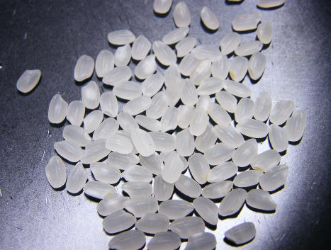
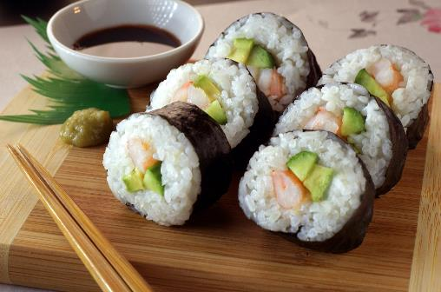
Rice - Japan
There are about 300 varieties of Japanese rice.
The most common variety is the Koshihikari rice (or koshi rice), a white, polished short grain which is used extensively.
The rice grain, which has a shiny sheen, is more sticky than other varieties as it has a higher starch content.
This makes it easier for the rice to be gently sculpted into sushi rolls and onigiri (Japanese rice parcels).
Koshihikari rice has a firm consistency with a naturally sweet and nutty flavour and aroma.

Slide 15
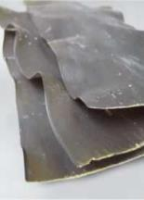
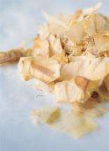
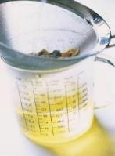
Umami
There are a large variety of seasonings and condiments are used in East Asian cuisine.
One of the dominant tastes in the cuisines is umami.
It is often achieved through the use and combination of ingredients such as soy sauce and fish sauce.
In Japan, umami is achieved by using dashi, the basic stock obtained from an infusion of kombu (kelp), shitake mushrooms, and katsuobushi (dried bonito – fish); and fermented soybeans, either in the form of soy sauce or miso.
Vegetarian dashi can be made by soaking 2-3 dried shiitake mushrooms in 600ml of water for 1 hour. Drain and use.
Kombu
Bonito flakes
Resources around umami
Notes:
Umami is not new - in 1908, Japanese chemist Ikeda Kikunae (1864–1936) first described its peculiarity among the tastes, which is derived from glutamic acid - a form of amino acid. Umami means "pleasant savory taste" in Japanese. People taste umami through taste receptors that typically respond to glutamates and nucleotides, which are widely present in meat broths and fermented products.
Traditionally, the people of the East Asian sub-region rely on sauces made from fermented grains and beans to add umami. The South East Asian sub-region developed numerous fermented fish sauces for the same reason.
The use of glutamate in cooking has a long history. Fermented fish sauces, which are rich in glutamate, were used widely in ancient Rome. Glutamate-rich fermented barley sauces were used in medieval Byzantine and Arab cuisine, and fermented fish sauces and soy sauces have histories going back to the third century in China.

Slide 16
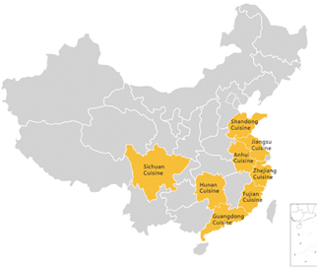
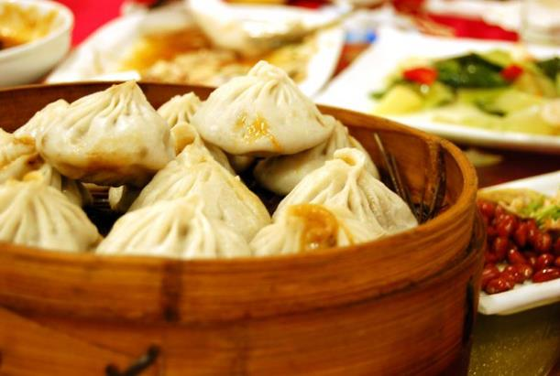
Chinese cuisine
Chinese cuisine is rich and diverse and varies in style and taste from region to region.
Distinctive styles from different regions contribute to the whole of Chinese cuisine.
There are eight specific culinary traditions that are recognised throughout Chinese society and around the world.
Of the various regional styles, Cantonese cuisine from Guangdong is the most widely recognised globally.
Notes:
Cantonese or Yue cuisine originates from Guangdong Province (SE China around Hong Kong), and it is the most widely served style of Chinese cuisine in the world. This is because most of the Chinese who immigrated and set up restaurants overseas were from Guangdong.
An authentic Cantonese chef's goal is to preserve the food's original flavour. Unlike other Chinese styles of cooking such as Sichuan style where the cook buries the food in a lot of spices and oil, a Cantonese chef aims to bring out or highlight the original flavor of the vegetable, meat, or fruit. So little spice or sugar is used generally.
Stir frying and steaming are the two most common cooking methods. Several sauces are important condiments in Guangdong cuisine. The most widely used sauces include hoisin sauce, oyster sauce, plum sauce, sweet and sour sauce, and soy sauce.
Spices used: Chives, coriander leaves, anise, black pepper, and slivers of ginger provide a mild tanginess that accentuates the flavor of the food – only small amounts are used.

Slide 17
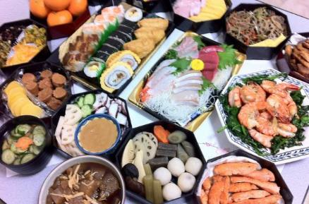
Japanese cuisine
Japan is divided into distinct geographic regions, each of which has developed its own unique culinary traditions.
The meal structure in Japan differs slightly from the multiple courses traditionally found in Western and European cuisine where each course is served separately.
The average homemade Japanese meal (or gohan) involves a single course with several dishes presented at once.
Notes:
Tofu is made of curdled soy milk, pressed into blocks in a process similar to making cheese. It is a good source of protein and a staple of Japanese cuisine. Tofu is an especially important ingredient in vegetarian Buddhist temple cuisine (shojin ryori).
Sushi and sashimi are two of the most popular food types in Japanese cuisine. Sushi usually refers to a dish of pressed vinegared rice with a piece of raw fish or shellfish, called a neta, on top. Sushi is generally eaten with soy sauce and wasabi. Similar to sushi but without the rice, sashimi is raw fish sliced into easy-to-eat pieces. Sashimi is typically eaten with soy sauce for flavoring.

Slide 18
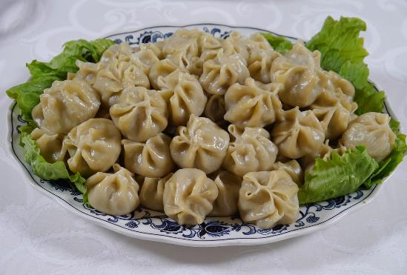
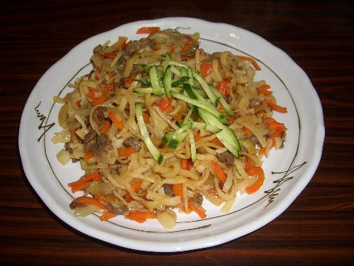
Mongolian cuisine
Mongolian cuisine is mainly derived from the traditions of ethnic Mongols. It is a blend of their nomadic diet and influences from northern China and Russia.
Mongolians have different eating habits depending on their geographical location due to the local products available.
In animal farming areas, ethnic Mongolians eat beef, mutton and dairy products as their staple food.
In cultivated land areas, the eating habits of ethnic Mongolians are similar to the Han people. They eat corn flour and millet as the staple food, and sometimes they eat rice, wheat, coarse rice, buckwheat flour, and sorghum.
Buuz
Tsuivan
Notes:
Horse, yak, beef, lamb, and even camel are all delicacies in Mongolia.
Mongolians drink a lot of milk tea (suutei tsai), wild fruit juice, and home-brewed alcoholic beverages.
Tsuivan is a Mongolian noodle dish usually made with mutton and various vegetables. Traditionally, the noodles are made by hand and steamed or fried with diced meat and vegetables.
Buuz, also known as steamed Mongolian dumplings, is the very popular. Street vendors and home cooks serve these dumplings which contain mutton, cumin and sometimes parsely.
Suutei tsai is one of the most common drinks in Mongolia. It is often drunk at meals and throughout the day. It is usually served to guests when they arrive at a Mongolian home, known as a yurt or ger. Upon arriving, guests are usually served suutei tsai with a hospitality bowl filled with snacks. It is made from green tea, water, milk and salt. Sometime toasted millet is also added.

Slide 19
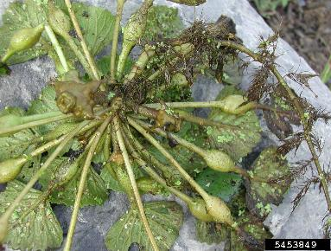
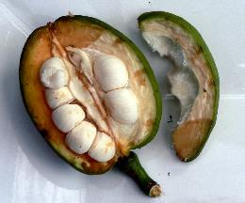
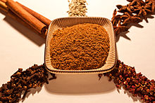
Ingredients
Water chestnuts - are aquatic tuber vegetables that grow in marshes, ponds, paddy fields and shallow lakes. They are native to Southeast Asia, Southern China, Taiwan, Australia, Africa and many islands in the Indian and Pacific oceans.
Soy sauce - soy sauce is a brown, salty liquid condiment made by fermenting soybeans or breaking them down with acid (hydrolysing). This releases sugars as well as umami elements and develops the brown colour for which soy sauce is known.
Hoisin sauce - most hoisin sauce recipes contain a combination of the following ingredients: fermented soybeans, five-spice powder, garlic, red chili peppers, and sugar.
Five-spice powder - is a common ingredient in Chinese and Taiwanese cuisine. It includes all five tastes (sweet, sour, bitter, salty, and umami) and uses five different spices - star anise, cloves, cinnamon, Sichuan peppercorns, and fennel seeds.
Check the list of ingredients for any potential allergens and consider alternatives. For more information on allergens.
Notes:
The 14 allergens are: celery, cereals containing gluten (such as barley and oats), crustaceans (such as prawns, crabs and lobsters), eggs, fish, lupin, milk, molluscs (such as mussels and oysters), mustard, peanuts, sesame, soybeans, sulphur dioxide and sulphites (at a concentration of more than ten parts per million) and tree nuts (such as almonds, hazelnuts, walnuts, brazil nuts, cashews, pecans, pistachios and macadamia nuts).
Soy sauce - as wheat flour is commonly used in the process, those sensitive to gluten need to look for gluten-free and wheat-free versions, such as some types of Japanese tamari, which is typically a vegan product.

Slide 20
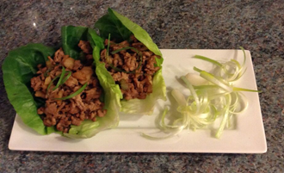
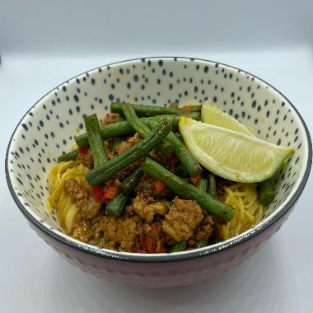
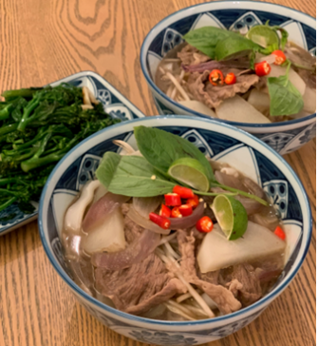
The recipes
Recipes that will be available on the Food – a fact of life website:
Asian forest greens noodles
Egg fried rice
Beef pho
Fragrant aubergines
Katsu curry
Kimchi tortilla
Pine nut salad
Pork yuk sung
Singapore noodles with prawns
Teriyaki grilled fish
Asian style hoisin pork

Slide 21
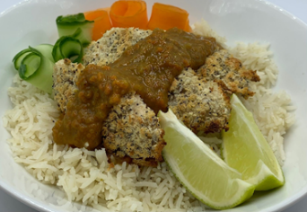
Katsu curry
Why are we doing this?
Learning in lesson: focus on skill/knowledge, not recipe.
Medium-high complexity recipe from a world cuisine that would work well in the secondary classroom.
Made and cooked within an hour, ideal for shorter lessons. Demonstrates a wide range of basic food skills.
Uses ingredients that are easy to source, mostly stored at ambient temperatures and traditional to Asian cuisines. May be a familiar recipe to students, so ideal for a ‘fakeaway’ style lesson.
Nutrition science: meat/alternatives in the diet
Food science: Heat transfer, denaturation
Maths: Weighing, measuring, dividing, time, temperature.
English: Reading and following a recipe, following written and verbal instructions.

Slide 22
Katsu curry
Ingredients
1 onion
1 carrot
1 garlic clove
5cm piece of ginger
1 reduced salt chicken stock cube
Spray oil
¼ x 5ml spoon turmeric
½ x 5ml spoon curry powder
1 x 15ml spoon plain flour
2 x 15ml spoons light soy sauce
1 x 5ml spoon honey
1 x 5ml spoon rice vinegar
½ x 5ml spoon garam masala
2 x 15ml spoon cornflour
Black pepper
100g fresh breadcrumbs
4 chicken mini fillets or 150g block firm tofu (or half and half)
To serve (optional)
½ Cucumber or 1 carrot
½ lime
Method
1. Line a baking tray with greaseproof paper. Preheat the oven to 220° or Gas mark 7.
2. Prepare the ingredients for the curry sauce:
Peel and finely chop the onion.
Peel and chop the carrot.
Peel and crush the garlic clove.
Peel and finely grate the fresh ginger.
Crumble the stock cube into a measuring jug, add 300ml boiling water and stir until dissolved.
3. Spray a large frying pan with oil, place over a medium heat and add the onion, carrot, garlic and ginger. Sauté for 3-4 minutes until soft and the onions begin to caramelise.
4. Stir in the turmeric and curry powder and cook for one minute.
5. Stir in the flour and cook for 1-2 minutes.
6. Gradually stir in the stock. Add the soy sauce and honey and simmer stirring occasionally for about
10 minutes.
7. Stir in the rice vinegar and garam masala. Keep warm.
8. Place the cornflour in a bowl and add 1 x 15ml spoons water. Season with black pepper and stir well.
Place the breadcrumbs in another bowl.
9. Dip the chicken (or tofu) into the flour mixture followed by the breadcrumbs. Turn each fillet over to make sure it is evenly coated.
10. Place the coated chicken fillets on the lined baking tray. Cook for 10-15 minutes until golden brown and cooked through.
11. Blitz the curry sauce using a tabletop or hand blender. Add a little extra water if needed. Taste to check seasoning.
12. Serve the katsu chicken or tofu with rice, topped with the curry sauce.
Garnish with cucumber or carrot ribbons and lime wedges.

Slide 23
Katsu curry - review
Skills and knowledge developed and demonstrated | Practicalities in the secondary classroom | Alternatives – ingredients, cooking methods …
Practical food skills: Weigh,
measure, peel, chop, crush, sauté, mix, stir, blitz, simmer, bake
Nutrition science: meat/
alternatives in the diet
Food science: Heat transfer, denaturation
Sensory science: Testing, tasting and evaluation.
Maths: Weighing, measuring, time, temperature.
English: Reading and following a recipe, following written and verbal instructions.
Ingredients (purchase, storage, providing)
Equipment
Storing, handling and cooking raw meat and hand washing
Safe use of oven
Extend: joint a chicken
Vegetarian - use vegetable stock cube and add tofu or meat substitute if required
Show the pupils fresh root ginger and how to prepare
Ready-made curry powder can be substituted with 2 x 15ml spoons ground coriander, 1 x 15ml spoon ground cumin, 2 x 5ml spoons ground turmeric and 1 x 5ml spoon of ground ginger.

Slide 24
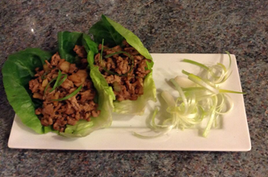
Pork yuk sung
Why are we doing this?
Learning in lesson: focus on skill/knowledge, not recipe.
A quick to prepare, medium complexity recipe.
Demonstrates a wide range of basic food skills but can be extended to allow for differentiation and inclusion.
Uses ingredients that are easy to source, inexpensive and mostly stored at ambient temperatures.
Nutrition science: Protein sources - meat/alternatives in the diet
Food science: Heat transfer, denaturation, Maillard reaction.
Maths: Weighing, measuring, time, temperature.
English: Reading and following a recipe, following written and verbal instructions.

Slide 25
Pork yuk sung
Ingredients
4 little gem lettuce leaves
1 ½ cm fresh ginger
1 garlic clove
2 spring onions
1 celery stick
½ x 220g can water chestnuts (optional)
Spray oil
250g pork mince
1 x 15ml spoon reduced salt light soy sauce
1 x 15ml spoon oyster sauce
Method
1. Prepare the vegetables:
wash the lettuce and dry being careful not to tear the leaves;
peel and very finely slice or grate the ginger;
peel and very finely chop the garlic;
slice the spring onions into fine rings;
finely dice the celery;
drain and chop water chestnuts, if using, into small pieces.
2. Spray a non-stick frying pan with spray oil. Add the garlic, ginger and spring onions.
3. Fry gently for 2-3 minutes, until the onions are soft but not browned.
4. Add the pork mince and cook until browned. Thoroughly wash and dry hands if touched raw meat.
5. Add the water chestnuts (if using) and celery to the pan and continue to cook over a medium heat for 5 minutes.
6. Add the soy sauce and oyster sauce to the pan and stir. Cook until the sauce is reduced and the mixture becomes dry.
7. If eating straight away, lay out a lettuce leaf and spoon the cooked mixture into the middle.

Slide 26
Pork yuk sung - review
Skills and knowledge developed and demonstrated | Practicalities in the secondary classroom | Alternatives – ingredients, cooking methods …
Practical food skills: Weigh, measure, peel, grate, chop, slice, dice, drain, fry
Nutrition science: protein sources - meat/alternatives in the diet
Food science: heat transfer, denaturation, Maillard reaction.
Sensory science: Testing, tasting and evaluation.
Maths: Weighing, measuring, time, temperature.
English: Reading and following a recipe, following written and verbal instructions.
Safe use of the hob and heat control
Storing, handling and cooking raw meat and hand washing
Use chicken mince or a plant-based mince instead of pork
Substitute water chestnuts for white turnips or celery
Soy or hoisin sauce can be used instead of oyster sauce
Try adding chopped shitake mushrooms. If using dried mushrooms, these should be soaked for 30 minutes to rehydrate.

Slide 27
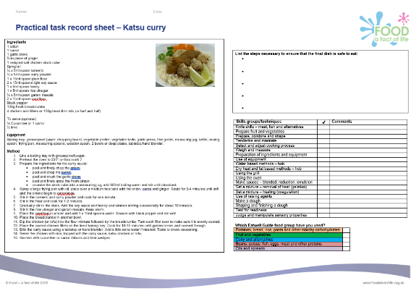
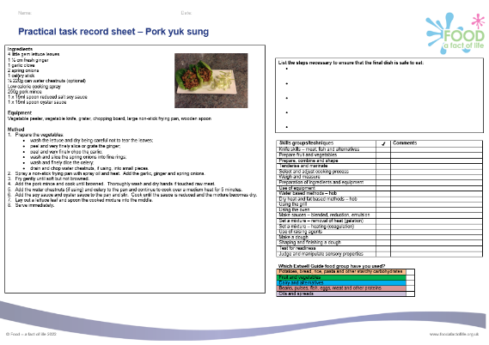
Practical task record sheets
Practical task record sheet – Katsu curry
Practical task record sheet – Pork yuk sung

Slide 28

Food – a fact of life: How can we help?
Food – fact of life website.
Tried and tested recipes.
Good practice guidance for primary and secondary schools, as well as supporting pupils with additional needs.
Resources to support pupils with additional needs
Whole school support
Guidelines for school education resources around food
My dashboard – store collections of recipes and resources in your own online area.
Personal and professional development (PPD) for teachers. PPD newsletter – sign up!
www.foodafactoflife.org.uk

Slide 29
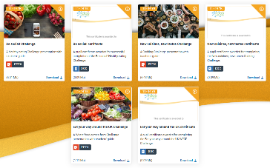
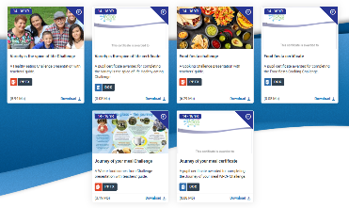
Challenge activities
The Challenges cover Healthy eating, Cooking and Where food comes from and provide a wide range of activities that teachers can select depending on their pupils’ needs, age and abilities, and the time available.
there are 12 Challenges developed to be used with nursery, primary or secondary pupils;
each Challenge presentation comprises:
slides to present the Challenge to the class, including images, information and questions/tasks to stimulate pupil discussion and planning;
a teachers' guide with opportunities for learning and a variety of pupil activities that can be completed individually or in groups.
11-14 years and 14-16 years

Slide 30
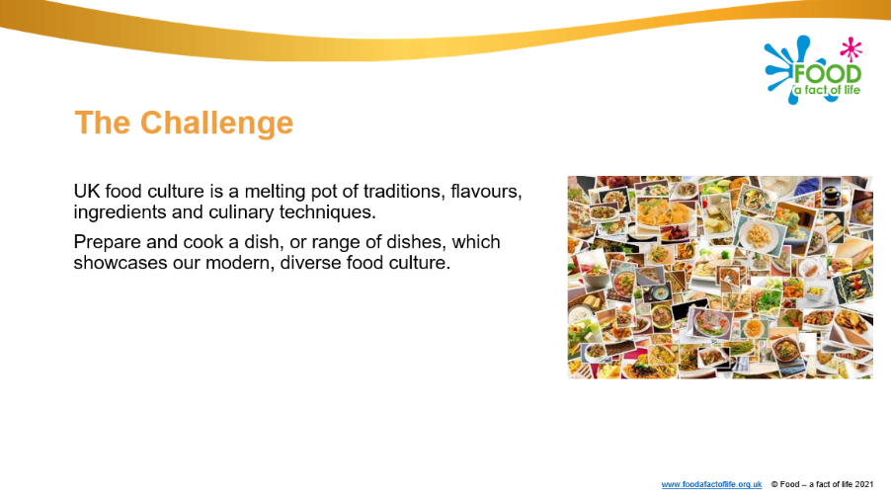
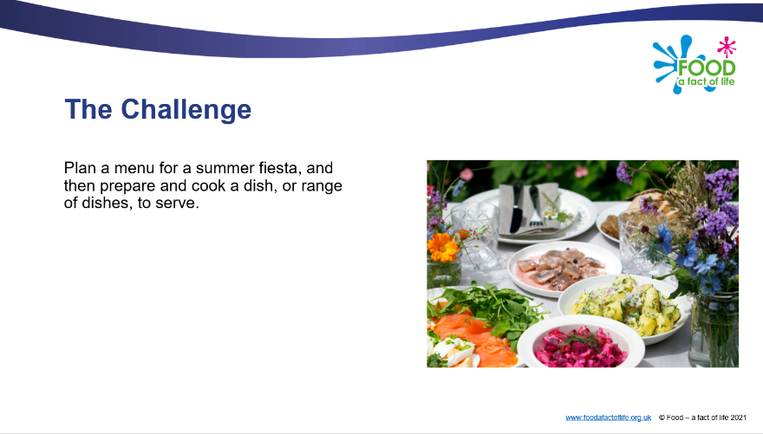
Diverse food culture Challenges
11-14 years and 14-16 years

Slide 31
Other FFL resources
Classroom resources and activities | Teaching and learning | Personal and professional development (PPD)
Bread activity pack Fibre activity pack Harvest activity pack Knowledge organisers 11-14 and 14-16 Nutritional analysis Quizzes 11-14 Quizzes 14-16 Remote learning resources Videos – cooking Videos – where food comes from | Good food hygiene and safety practices Planning sheets Resources and presentations Resources to support UK examination specifications Schemes of Work Teaching and learning videos Practical food skill progression and complexity rating | FFL training PPD toolkit Schemes of Work and lesson planning – advice and support Teacher knowledge and skills
Links to resources that focus on topics covered in today’s workshop can be found in your joining instructions.

Slide 32
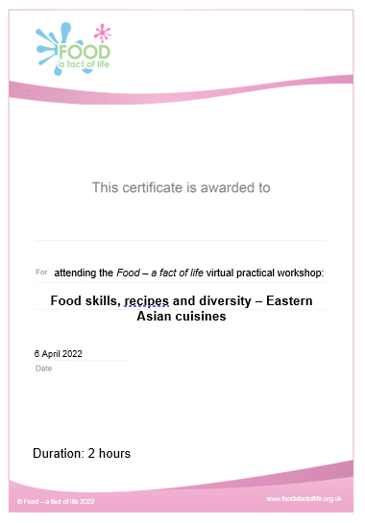
Last words ...
Review of training – ‘bright spots’?
Evaluation – a link will be sent to you. When completed …
Personalised certificate – will be emailed to you
Voucher – will be sent to you

Slide 33
Thank you for joining!
For further information, go to:
www.foodafactoflife.org.uk

