Slide 1
Pupils with additional needs: Key food skills, adaptations and considerations
25/05/2022

Slide 2
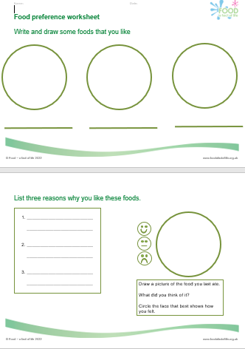
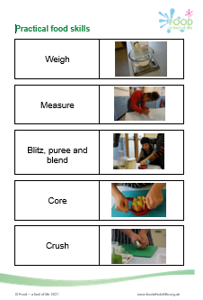
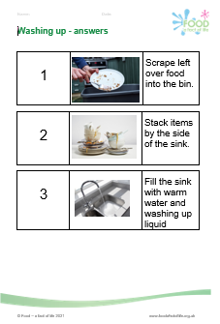
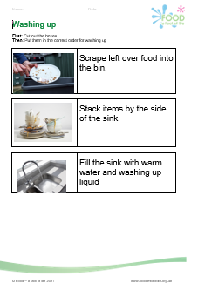

Food – a fact of life resources
The resources for pupils with additional needs cover nine key areas:
Food and drink for life
Variety (eat well)
Being active
Choice, preference and occasions
Cooking (including food hygiene and safety)
Serving and sharing
Food origins
Food is produced and processed
Shopping
Plus Developing skills for independent living*
*resources created with the support of the Sodexo Stop Hunger Foundation

Slide 3
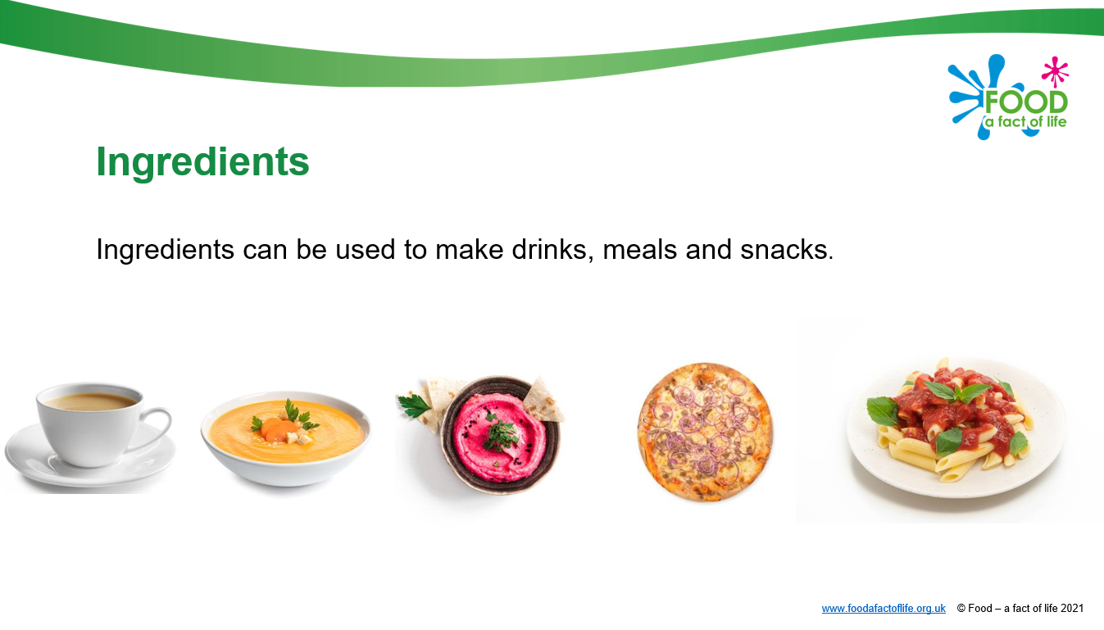
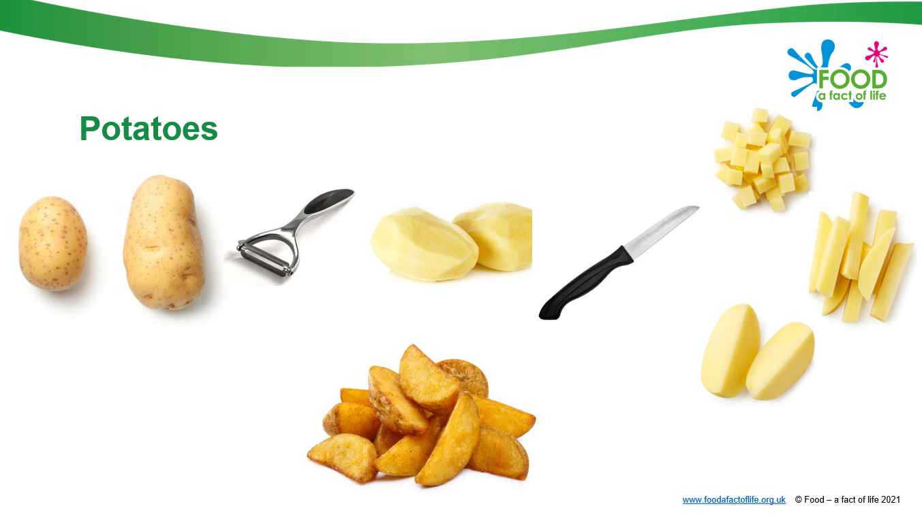
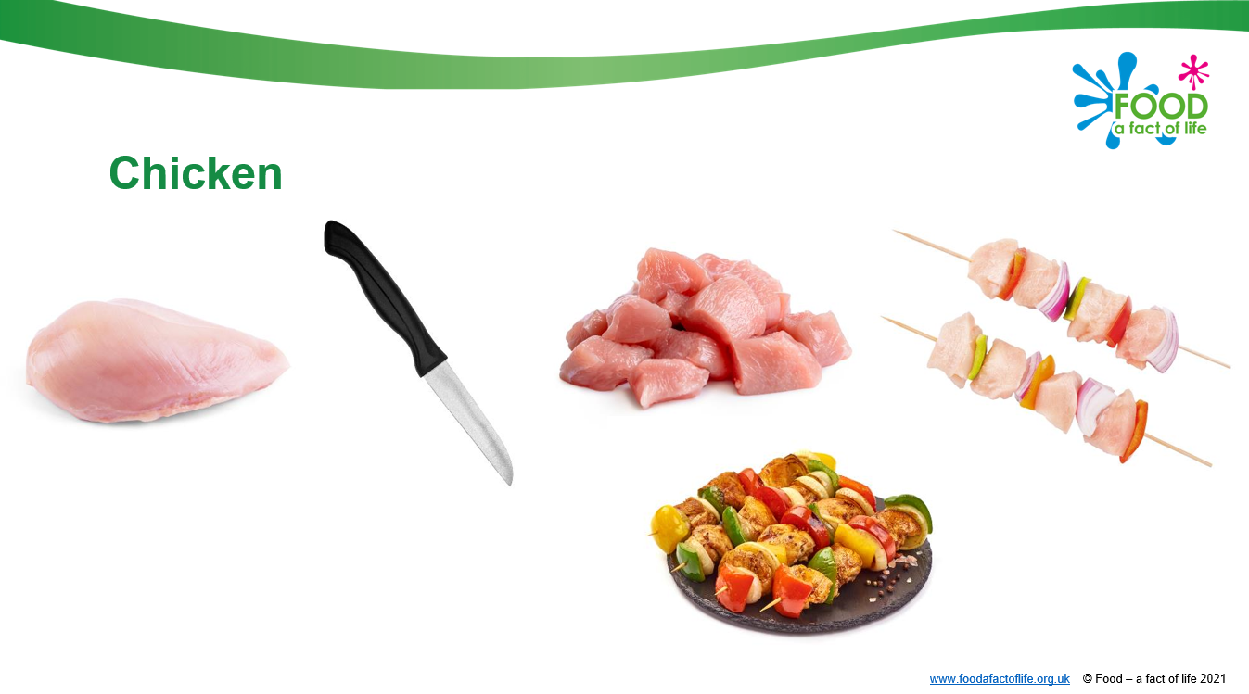

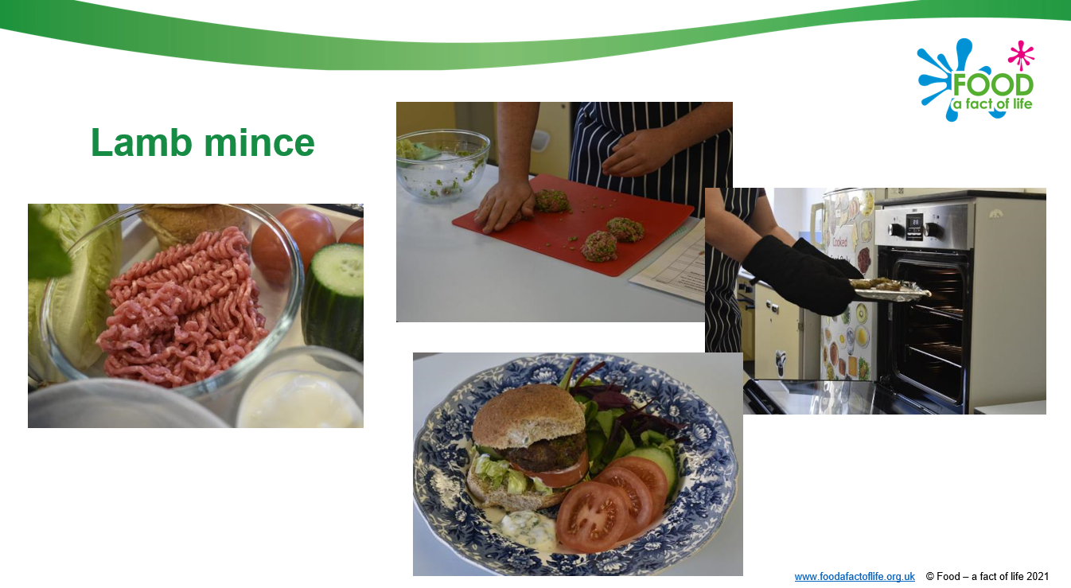
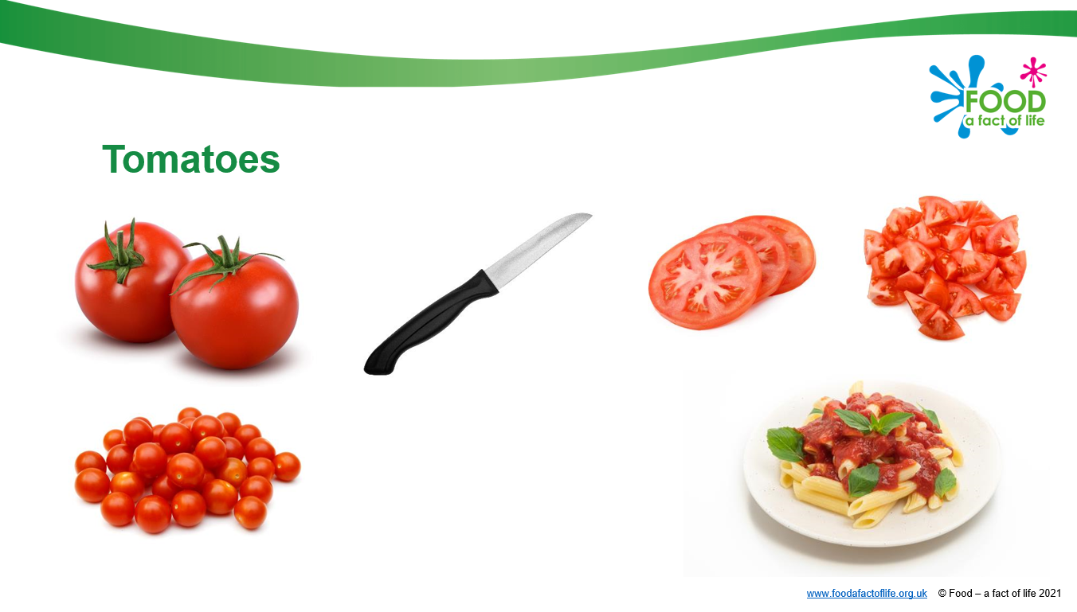
All resources are fully editable
Ingredients

Slide 4
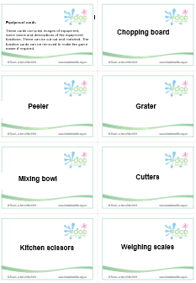
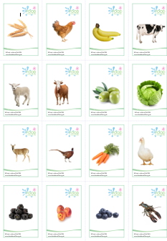
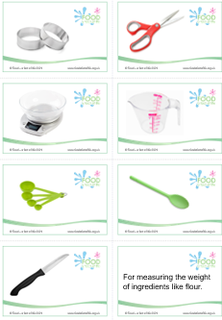
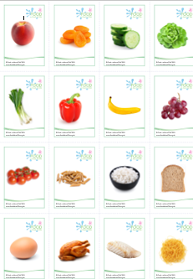
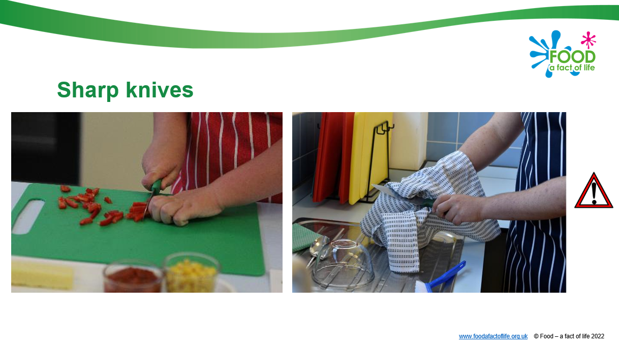
Equipment cards for recognition, matching and sorting
Presentation around kitchen hazards
Food cards
Grown reared or caught cards

Slide 5
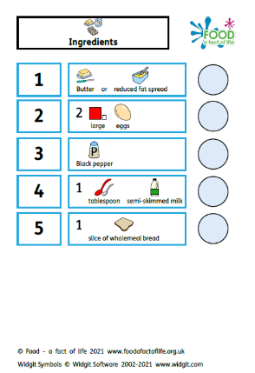
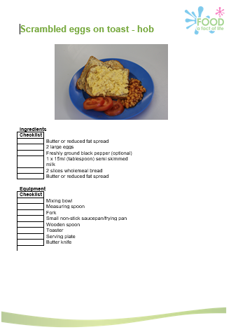
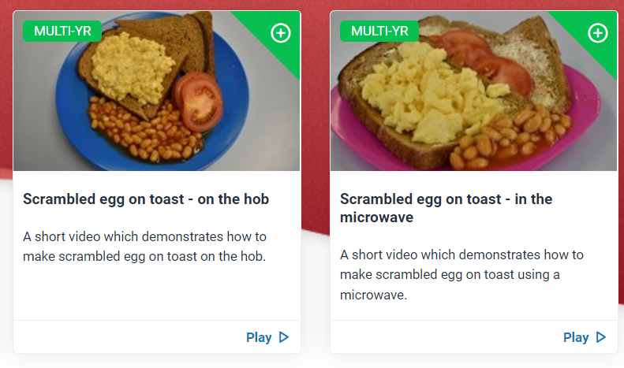
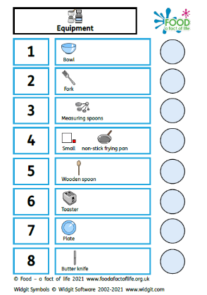
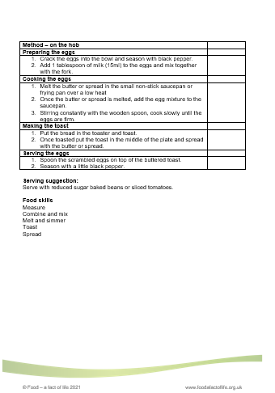
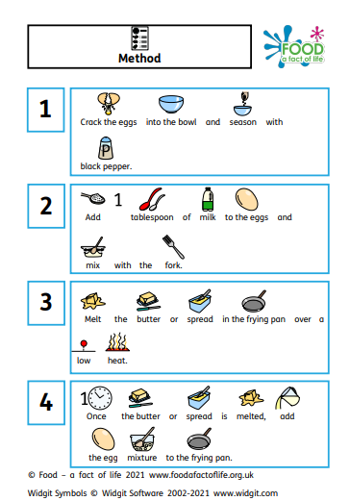
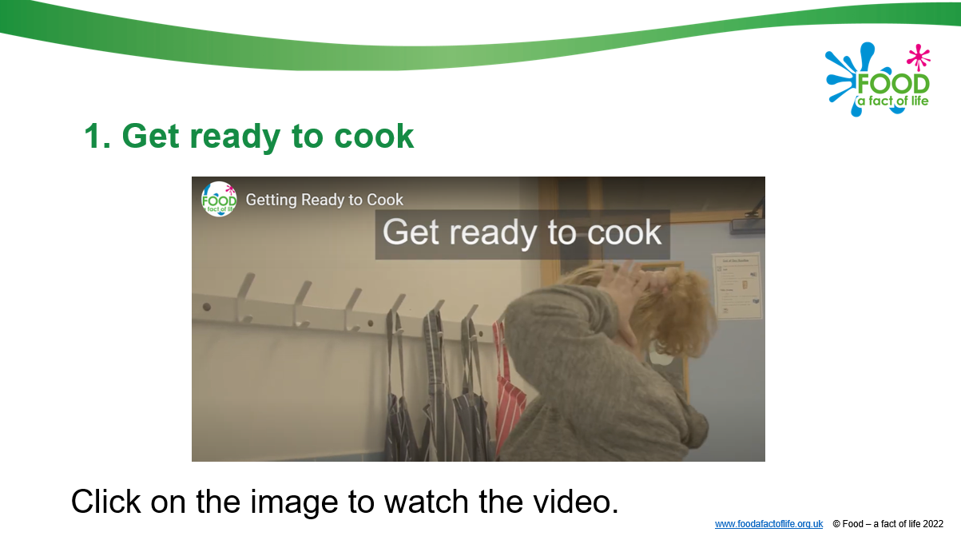

Slide 6
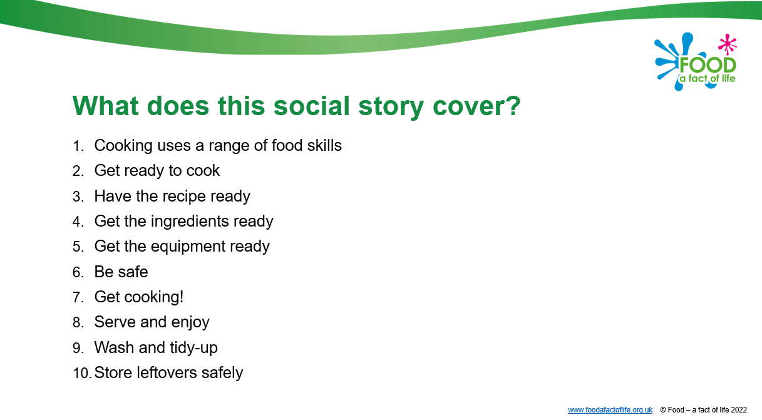
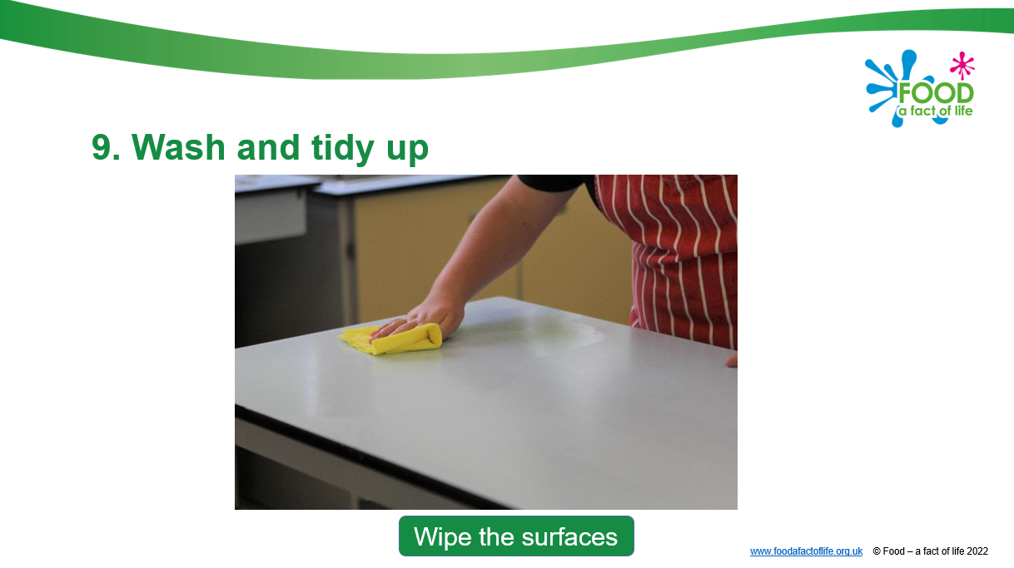
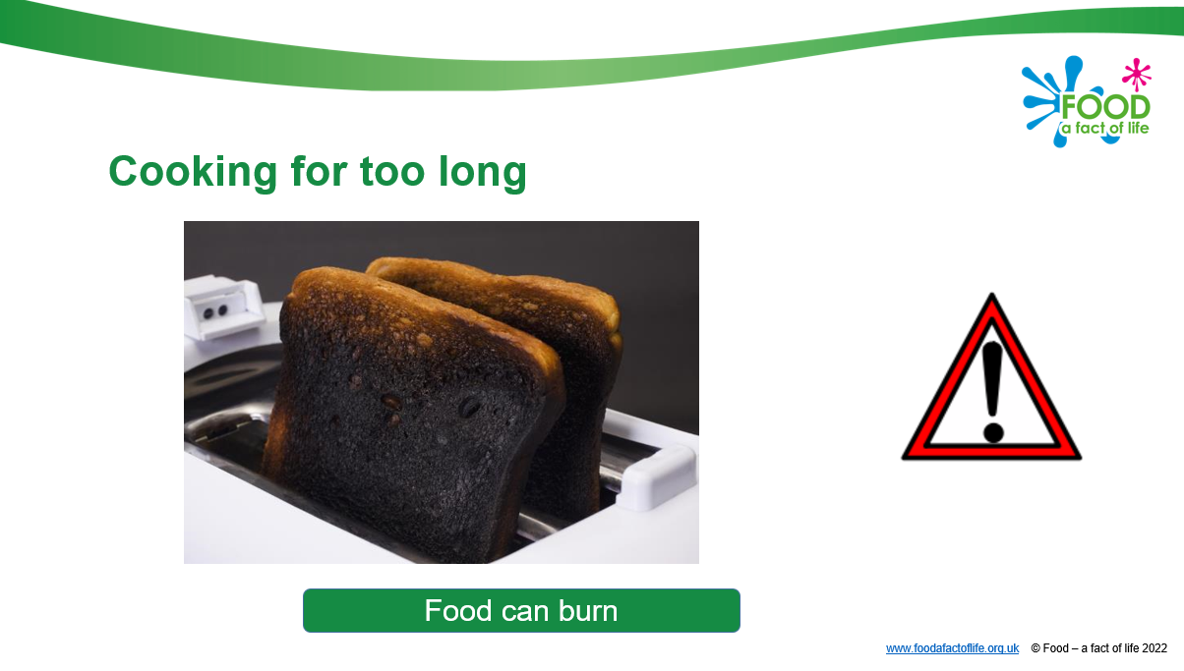
Developing skills for independent living
Planning what to cook
Going shopping
Cooking
Eating and sharing

Slide 7
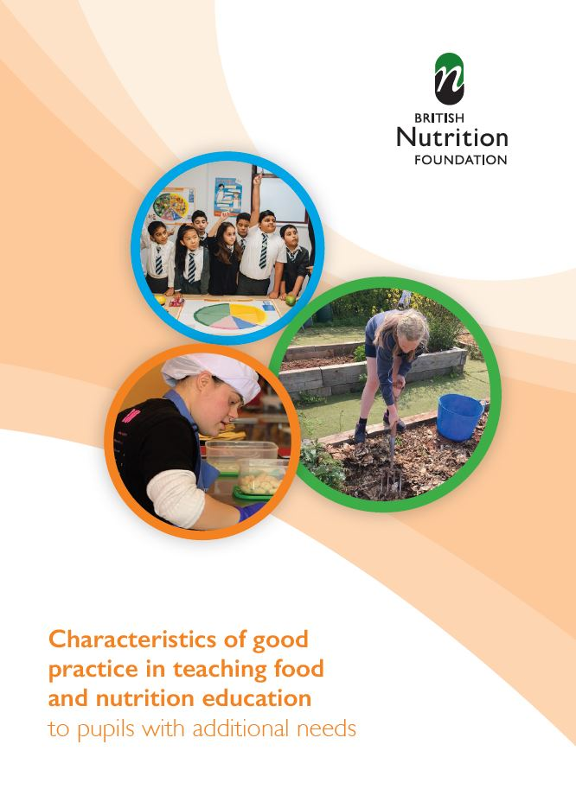
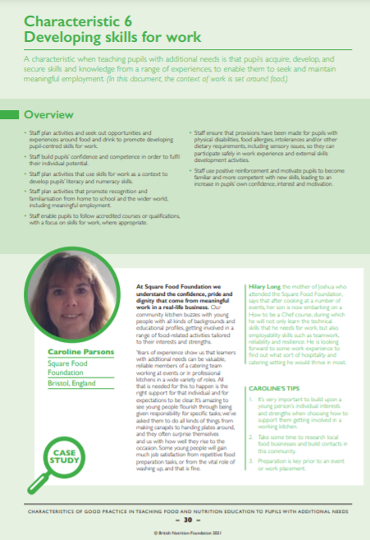
Characteristics of good practice in teaching food and nutrition education to pupils with additional needs
Defines the key characteristics of good practice that are specific to teaching food and nutrition to pupils with additional needs.
• Exemplifies these characteristics of good practice in UK schools, both special and mainstream.
Guide and supporting resources
The British Nutrition Foundation would like to gratefully acknowledge the financial support provided by the Savoy Educational Trust for the production of this Guide.

Slide 8
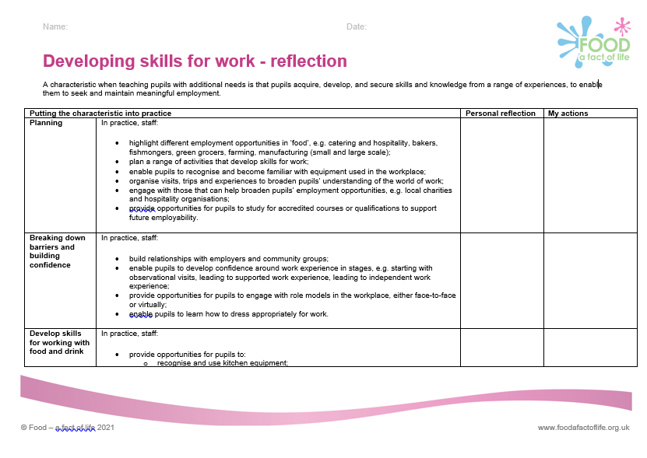
Support for your professional development
Reflection documents
Help develop reflective practice.
Ideal for staff at all career stages.
Provide an opportunity to reflect on personal practice and identify future actions.
There are also resources to support needs analysis and planning your own professional journey based on the Teaching food in primary/secondary schools: A framework of knowledge and skills.
Reflection documents

Slide 9
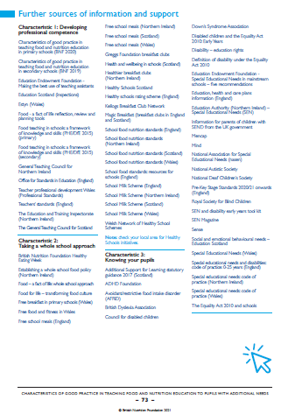
Sources of support and further information
Three pages of websites and useful information/ documents can be found at the end of the Characteristics of good practice in teaching food and nutrition to pupils with additional needs guide.

Slide 10
Further training
Webinars
Developing skills for independent living: Food and drink Thursday 9/06/22
Webinar recordings
Characteristics of good practice in teaching food and nutrition education to pupils with additional needs
Teaching pupils with additional needs
Careers in hospitality and catering for young people with additional needs
How to write in an accessible format for audiences with learning disabilities
Online
Characteristics of good practice in teaching food and nutrition education to pupils with additional needs
To find out more and to book, go to: https://www.foodafactoflife.org.uk/training/
More PPD information, support and newsletter sign-up: https://www.foodafactoflife.org.uk/professional-development/

Slide 11
Pupils with additional needs: Key skills, adaptations and considerations
For further information, go to:
www.foodafactoflife.org.uk
The British Nutrition Foundation gratefully acknowledges the support from the Sodexo Stop Hunger Foundation which has enabled us to develop and produce resources around Developing skills for independent living, as well as host training events for teachers.

